Slide 1
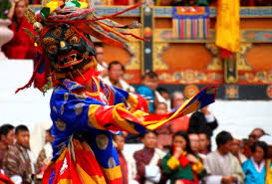
Beyond the Sky and the Earth:
A Journey into Bhutan
Jamie Zeppa
The connotations of the title tell us what….?

Slide 2
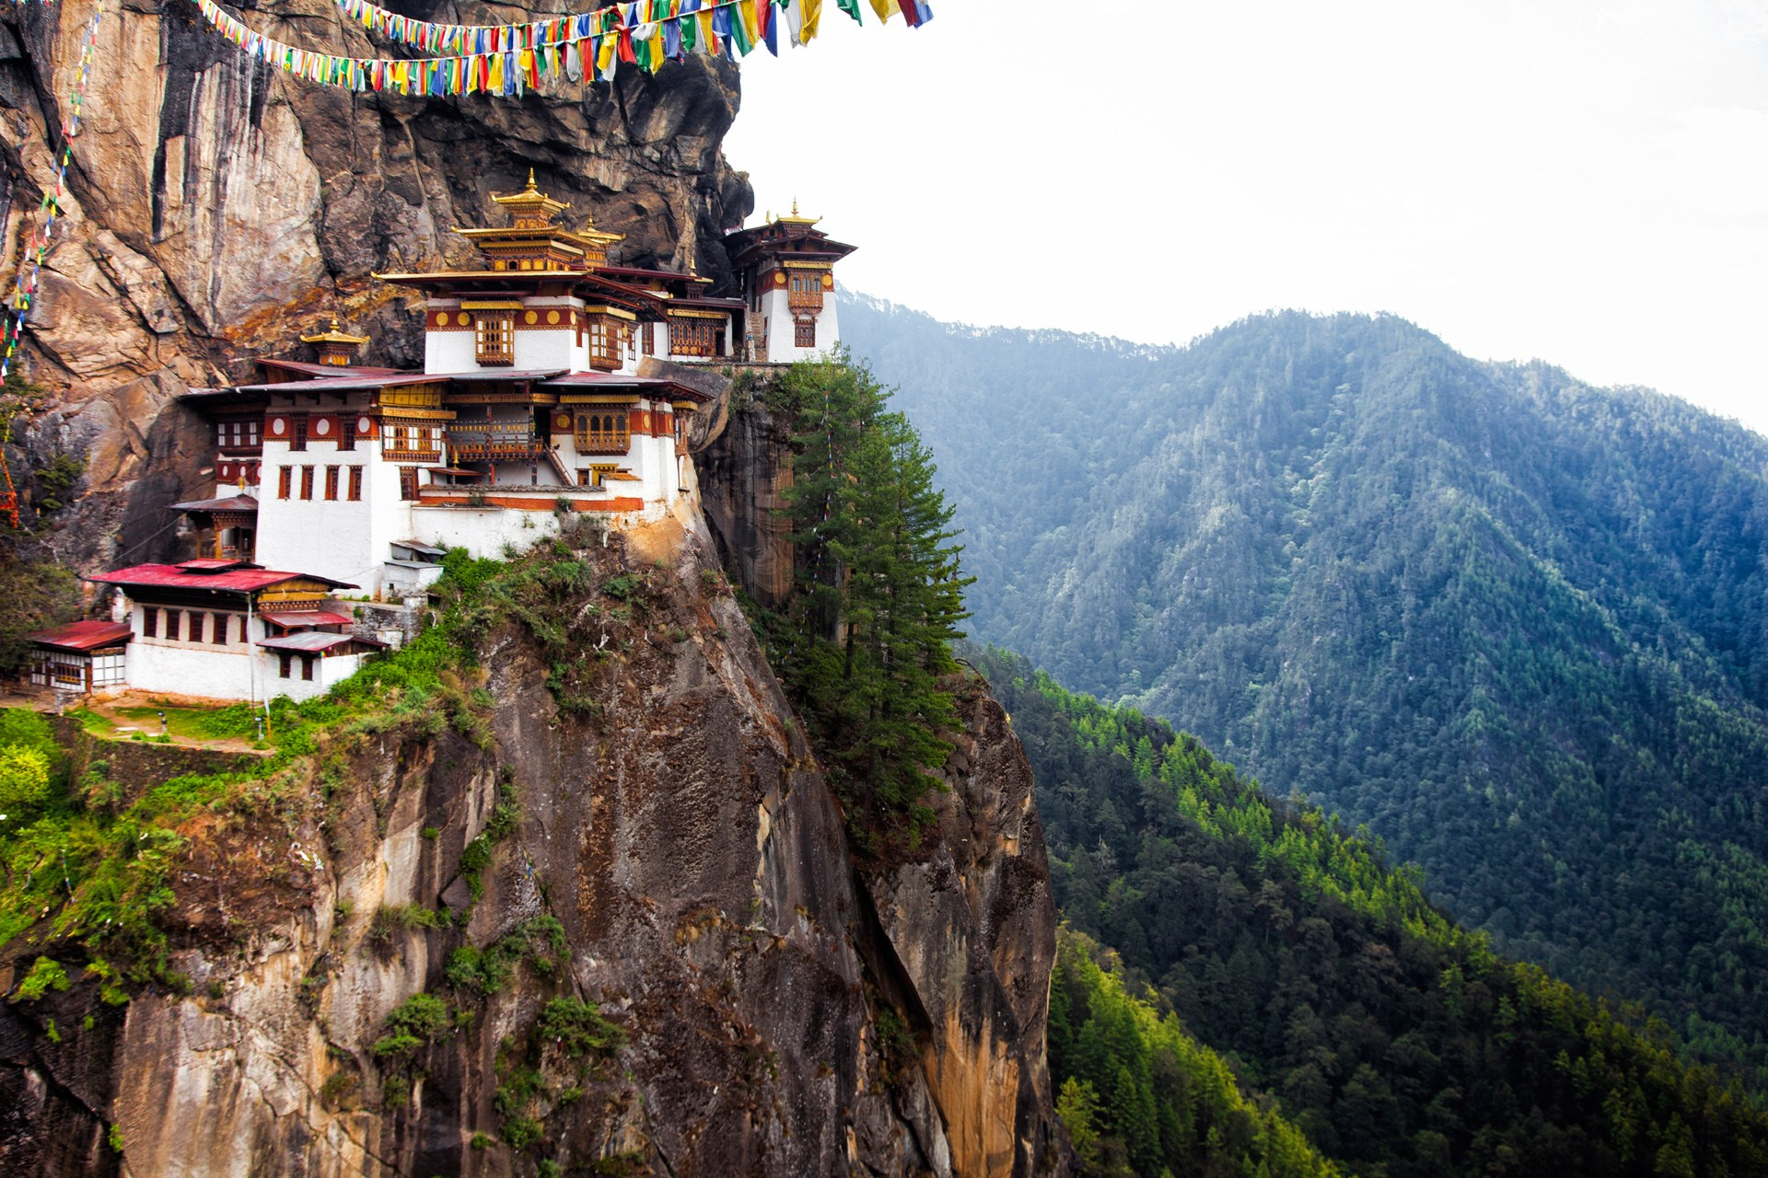
What do you know already know about Bhutan and its culture?
"I am thankful to you beyond the earth and sky"
Jamie Zeppa wrote Beyond the Sky and the Earth, as a memoir about her experience working as lecturer in eastern Bhutan.
The title of the book is derived from the expression of thankfulness in Bhutanese.
She narrates about the Himalayan topography of the isolated valleys, the Bhutanese people, history of Buddhism in the country, the religious affiliation of the people to the Bon religion of shamanistic beliefs, their social customs, etiquette, food habits, poor hygienic conditions, her love life and so forth. She explains about Buddha and his teachings. She also explains the experiences of fellow teachers from foreign countries with humorous epithets like “night hunting" (furtive entry into a girl's house in the night), "vomit-comet" (journey in a bus which stinks), "from scabies to rabies" (health conditions) and "Dysentery Danishes" (about the type of food they get). She gives vivid account of facts and events that happened during her teaching assignment

Slide 3
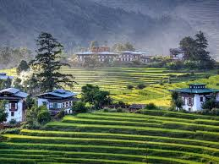
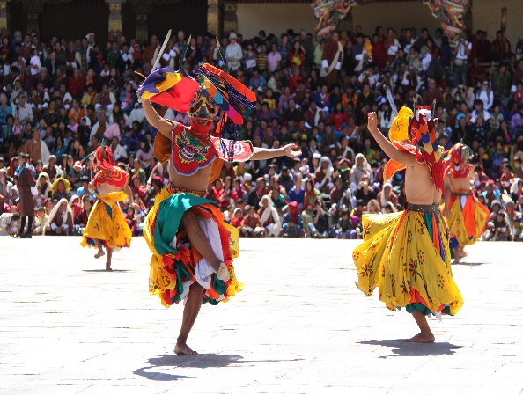
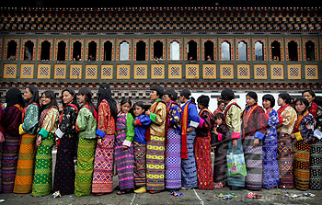
‘The land of the Thunder Dragon’
Researching Bhutan
Find out more about the following:
1.Location and geography
2.Historical timeline of key dates
3.Bhuantese people, e.g. religion, culture and cuisine
4.Important places and landmarks
5. ‘Gross National Happiness’

Slide 4
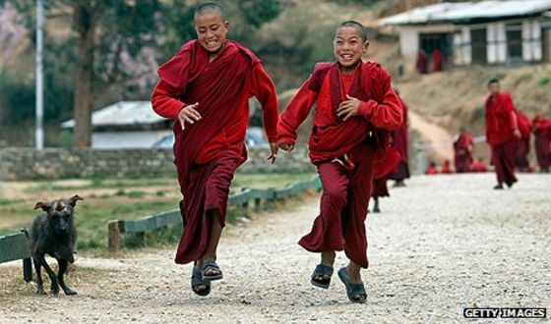
Zeppa employs a range of different devices to help create a vivid image of Bhutan. Some are listed below, as a class find other examples of devices and feedback!
Metaphors
‘ A giant child gathering earth in armfuls’- creates a image of make believe, its easier to imagine a ‘giant’ than the creation of Bhutan’s landscape. Both are unimaginable visions.
Exploring language
Personification
‘Mountains rise to meet the Moon.’ Nature working in harmony, personifying the moon as something extraordinary and to be admired. This can be linked to the context of Bhutan’s religion and culture. (AO3)
Alliteration
‘convulsion of crests’
Repetition
Use of present tense
What other devices can you find? What effect is created?

Slide 5
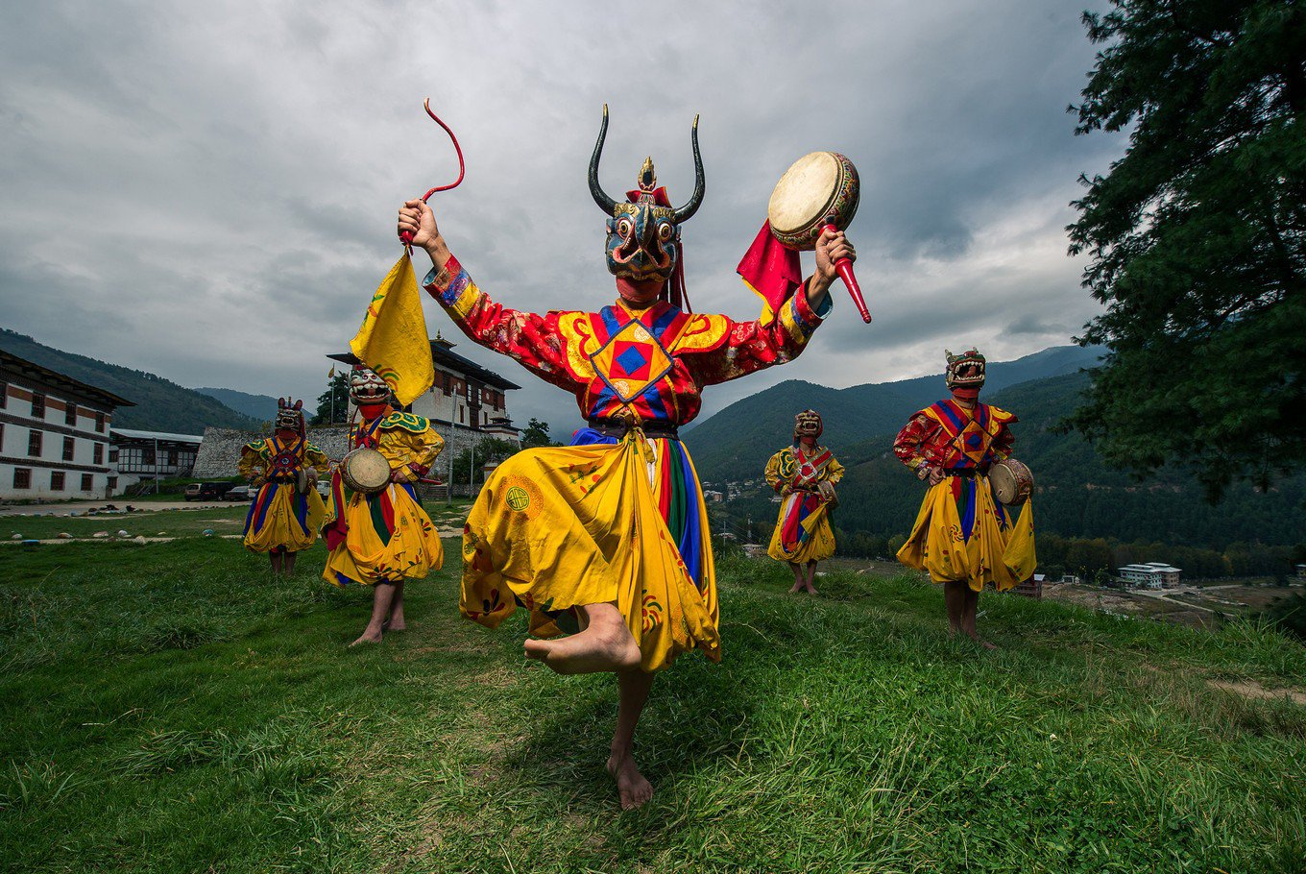
Key Quotes: Below is an example of a key quote in the text with contextualised and perceptive analysis. As a class or in pairs, go through the text and find other key quotes.
‘ Mountains all around, climbing up peaks, rolling into valleys, again and again. Bhutan is all mountains.’
The vivid description of landscape, through the use of the rule of three evokes a sense of wonder and illusions of grandeur. The verb ‘rolling’ portrays the hidden depths of the land- anything could happen. Bhutan is revered for its nature and it has a crucial role in customs and religion which further depicts the sense of wonder.
‘ I stay close to them, hoping to pick up some of their enthusiasm’
‘the Land of Longing and Silver Pines’
Explore lines and connections between writers IDEAS and PERSPECTIVES and how these are CONVEYED
AO3

Slide 6
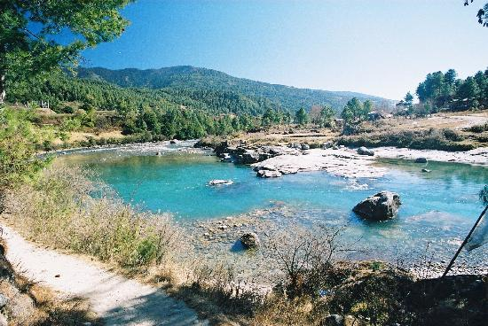
Textual Analysis (AO3)
Setting
The mountain scenery
How does Zeppa describe the mountainous landscape of Bhutan?
What impression do we get of this setting?
How does Zeppa create this impression?
Thimpu
In what ways does the author make Thimpu seem both strange and familiar?
What do you think the authors purpose is in describing Thimpu here?
Characters
The focus here is on the description of Bhutanese people. How are they portrayed by the author?
What impression does this leave the reader about life in Bhutan?
What qualities and characteristics does the author focus on?
Structure
The extract is organised into two very distinct sections. What is the content of each section focused on?
What features are used to create this?
Why does Zeppa structure the extract in this way?

Slide 7
Essay question
1. What impression does Jamie Zeppa create of Bhutan and how is this achieved?

