Slide 1
The Necklace
Pre 1914 short story.

Slide 2
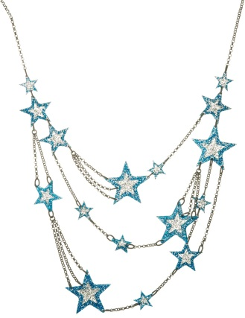
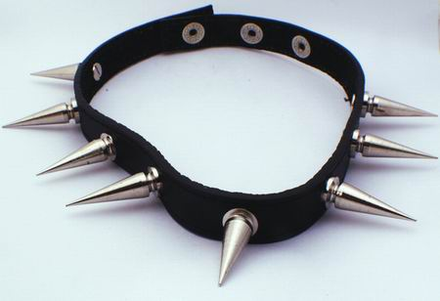
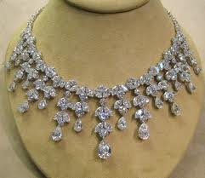
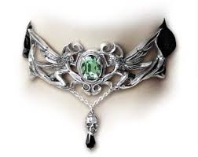
What type of people wear these necklaces?
Starter-individual
1
2
4
3

Slide 3
Context
LO: ALL will know about Belle Époque Paris.
MOST: Will be able to link social context with characters.
SOME: Will able to debate if Mathilde is justified in her dissatisfaction.

Slide 4
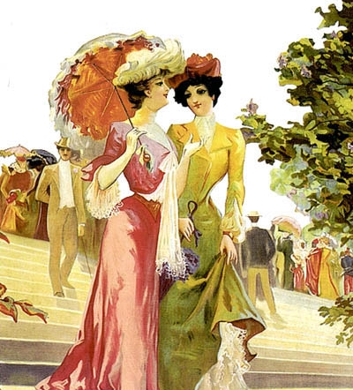
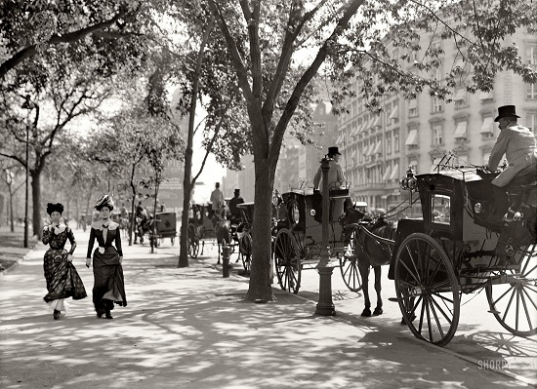
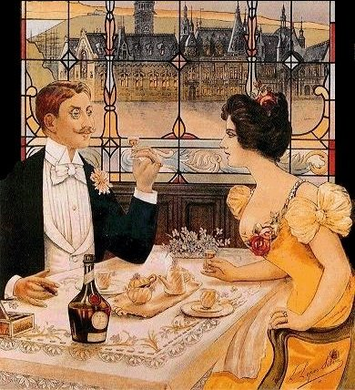
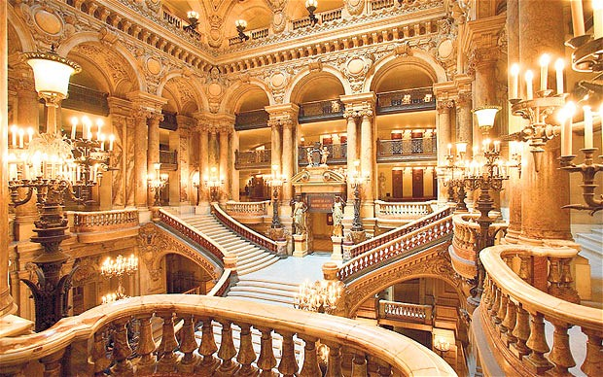
What words describe these scenes? What sort of life would people living during Belle Epoque live?
In pairs
Belle Époque Paris.

Slide 5
Belle Époque Paris.
Belle Epoque literally means "Beautiful Age". Name given in France to the period roughly 1871 to 1914
During this time standards of living and security for the upper and middle classes increased which is why they called it a Golden Age.
The quality of food increased, and people were able to buy more food because of new machines on farms.
More and more people had access to running water, gas and electricity. Basic Sanitation was improved, and children started to live for longer.
People were able to travel further away for holidays, and entertainment became more exciting.

Slide 6
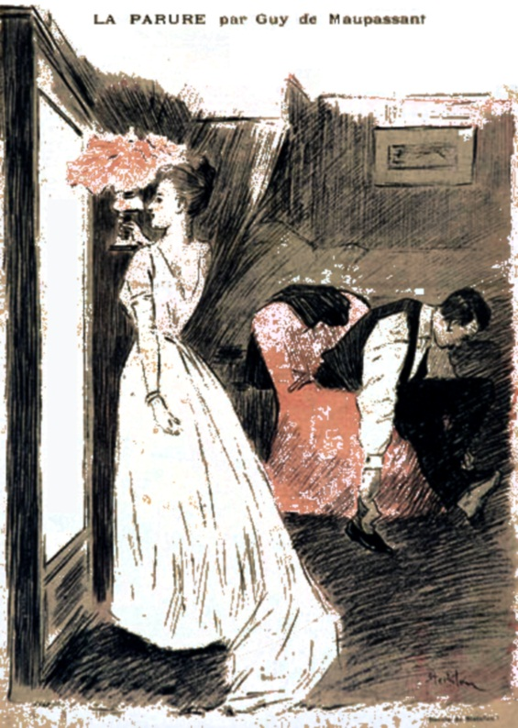
What do you think this woman would want from life?
Individual
This text is set in the late 19th Century
Notes:
Higher ability-would a modern woman feel the same way?

Slide 7
Label your picture with words from the text that you think describe Mathilde.
Individual
Notes:
Higher ability-would a modern woman feel the same way?

Slide 8
Do you feel Mathilde is right to be dissatisfied with her life?
Discussion-Groups

