Slide 1
Act 1, scene 3

Slide 2
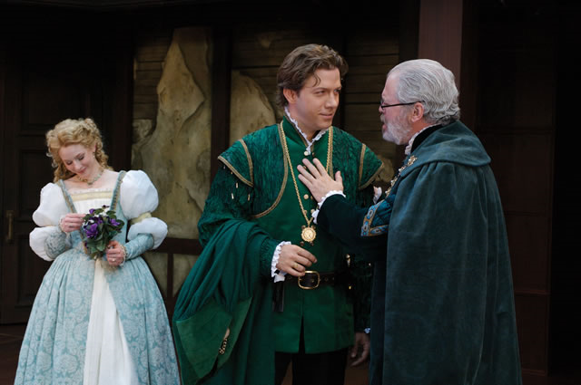
Act 1 scene 3 – key characters
Polonius – office not specified but King stresses his importance as his advisor. In the original story, he is not named but spies/eavesdrops on Amleth at Feng’s instruction.
Laertes – no equivalent in Shakespeare’s sources. Laertes is the name of Odysseus’s father in Homer’s The Odyssey. Like Hamlet, he is a student, but in Paris
Ophelia – described as ‘in love with Hamlet’ in one quarto. In the sources, she is a nameless young women who has been brought up with the hero and is used by Feng as temptation for him

Slide 3
Lines 1-52
Notice: Laertes’ brotherly advice about Ophelia’s relationship with Hamlet
To what extent is his advice sensible and realistic?
What picture of the brother/sister relationship do you derive from this section?
What does Ophelia’s response tell you about her?

Slide 4
Lines 53-86
Notice: There are several ways of seeing Polonius:
A doddery old man, a figure of fun
As a cunning, cynical politician
As a good father, concerned for his children’ welfare
What are your first impressions of Polonius?
To what extent is Polonius ‘true to his own self’?
Do you think Polonius believes in his own advice or are there signs of merely superficial morality?
How is the style of Polonius’ speech appropriate to his role in the court?

Slide 5
Lines 87- end of scene
Notice - the expected relationship of father to daughter is unquestioning obedience
- The language Polonius uses to talk to his daughter (e.g. his sarcasm)
How do you feel about the relationship between Ophelia and her father? Is there anything more behind her response of ‘I shall obey, my Lord.’
How does Polonius’s method of interrogation undermine Ophelia’s response? How does he shift the meaning of words? Explain his use of ‘tender’.

Slide 6
Summing up
Why are Ophelia’s brother and father so concerned about her relationship with Hamlet? Are they motivated by concern for her welfare or is it something else?

