Slide 1
Compare the depiction of love in La Belle Dame and His Last Duchess…
Friday, 02 February 2018

Slide 2
Remind yourself of the poems
As you read, start to think about SCASI features…
Focus particularly on the Character and the Style elements at first.

Slide 3
La Belle Dame Sans Merci
CHARACTER
Traveller, knight
In the story, a fairy -the Belle Dame
Semantic field of suffering and death
Imagery related to life ending used of the knight
Imagery related to wildness and passion used of the fairy..
STYLE
Ballad, typical of Medieval poetry
Conversation
Simple 4 line stanzas, ABCB rhyme scheme
Framed by opening and final stanza – purpose of slight change?

Slide 4
THE KNIGHT
Tells his story to an inquisitive observer
Key features of the character:
“alone and palely loitering”
“so haggard and woe begone”
“lily on your brow… on thy cheek a fading rose”.

Slide 5
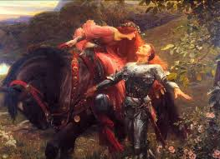
The Belle Dame
“full beautiful”
“… and her eyes were wild”
“ and made sweet moan” – a clearly erotic reference
“in language strange”
“wild wild eyes”

Slide 6
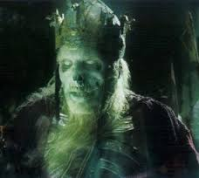
The vision
“pale kings and princes too”
“Death-pale”
“Starved lips”
“horrid warning gaped wide”

Slide 7
SETTING
An outdoor setting
“the sedge has withered from the lake” indicates death and a loss of natural beauty
“In the meads”
Transfer is made to “her elfin grot”. The poetic language helps to hide the idea of entrapment clear in the move to the fairy’s cave.
Gothic decay

Slide 8
Action
A meeting beside a dried lake
A story is told
In the story, we read of a meeting with a beautiful woman…
… enchantment
… entrapment
… waking in a state akin to death.

Slide 9
IDEAS:
Men are unable to resist the lure of women (in thrall)?
Women are temptresses who will emasculate their victims?
Death is the end of all happiness and is unavoidable –”and no birds sing”
Men can not resist the pull of lust, even when warned clearly about the potential dangers.
NB, told from the male point of view… can we trust his interpretation?

Slide 10
His Last Duchess- the same approach
Character
Based on a real character – Alfonso II d’Este
Total power – hinted at by his ability to dominate the poetic structure using enjambment and caesura
Proud of family lineage
“I gave commands”
Jealousy
Does not allow conversation
Proud of possessions
Style
A single block of text which reflects the power of the speaker and the marble blocks of Ferrara
Dramatic monologue – single speaker
Iambic Pentameter –many fractured lines
Heroic couplet form

Slide 11
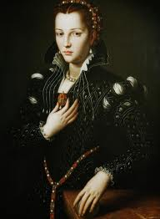
The Last Duchess
“… A wonder, now”
“spot of joy” prompted by courtesy –repeated.
“too soon made glad”
List of pleasures moves form personal gifts to utterly unsuitable elements – “white mule”
“who passed without/Much the same smile”?
“all smiles stopped together”
As if alive

Slide 12
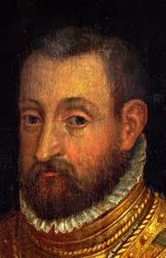
The Duke
Keeps the portrait behind a curtain
Rhetorical questions give sense of pomposity “how should I say?”
Addresses guest with confidence: “Sir, Twas all one!” consider the effect of the !
Sense of stream of consciousness, thinking aloud. Note the asides as he warms to his task
Pride: “I choose never to stoop”
A collector of fine art who can move from the former wife straight to a new bronze Neptune – another rpiece in his gallery
Greed? “no just pretence/of mine for dowry will be disallowed” – women as part of a financial arrangement

Slide 13
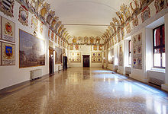
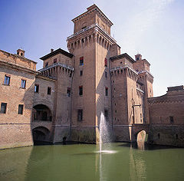
Setting
In a palace in Ferrara,
Claustrophobic – in front of a painting, a curtain having been drawn aside
Upstairs – at the end of the monologue, the pair will meet the “company below, then”

Slide 14
IDEAS
Male domination
Power
Ownership
Financial arrangements
Marriage as politics
Women as possessions
Jealousy

Slide 15
Comparison
HLD sees love as a business transaction whereas LBD sees men as helpless victims of lust and trickery
In HLD, men are in control, in LBD, women are in control
HLD presents an all powerful protagonist whereas the knight in LBD is weak and enfeebled because of love
Women depicted as powerless and powerful – are both seen as some form of temptress?
Setting of HLD is grand and soulless, setting of LBD is monochrome and desolate

