Slide 1
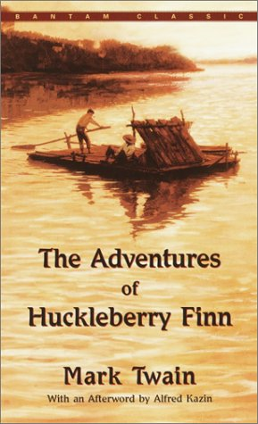
Huckleberry Finn Remote Learning Package
Week 4 May – 8 May

Slide 2
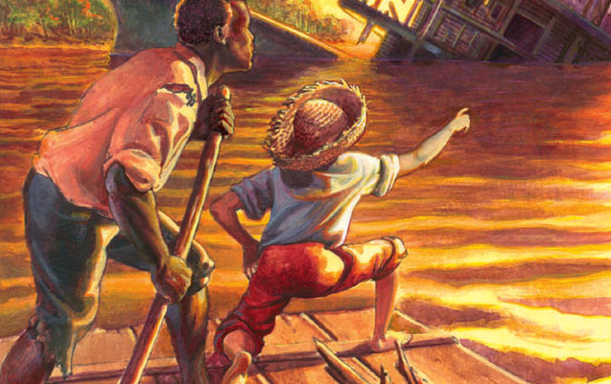
Tasks for the Week
Make sure last week’s tasks are sent to me. I will create an area for them all on FF which we can then refer to as we start revising for exams
Read up to Chapter 33
Answer the questions and prepare thoughts
on the points for discussion to be submitted in
Wednesday’s lesson.

Slide 3
Chapter 30 and 31Summary
The king, angry at Huck for trying to give them “the slip,” grabs him by the collar when they catch up with the raft. Afraid for his life, Huck tries to appease him with a story about the nice man who had held his hand on the way to the cemetery. Because he reminded him of his dead son, the man let him go, telling him to run for his life. Jim verifies Huck’s story, and finally the duke comes to Huck’s defence, reminding the king that he had not been concerned about Huck’s whereabouts when they had run from the scene.
The king and duke begin to argue and blame each other for hiding the money in the coffin. They both acknowledge the fact that they were tempted to keep the money for themselves, but neither one admits actually hiding it. Impatient and angry, the duke catches the king by the throat, forcing him to admit he had done it. That settles the argument and before long they are “thick as thieves” again. Later, when they are asleep, Huck tells Jim the whole story.
For fear of being recognized they do not dare stop at any of the towns along the river for several days. They are approaching the warm southern climate where Spanish moss hangs from the trees. The king and duke feel it is finally safe to “work the villages” again, but they have little success. Their usual jobs of “missionarying,” “doctoring,” and “mesmerizing” do not work out, and they are soon broke and desperate. They begin to talk in whispers for several hours at a time, and Huck and Jim feel uneasy. They decide to get rid of the two frauds when the next opportunity arises.

Slide 4
One morning they stop the raft in the village of Pikesville where the king wants to look around to make sure they have not heard of The Royal Nonesuch. Huck suspects that he wants to try something terrible like robbing a house. The king instructs the duke, Huck, and Jim to wait for him at the raft. If he does not come back by noon they will know it is all right to come into town. When the king doesn’t show up, Huck and the duke go into town to look for him. When the duke finds the king in a miserable state of drunkenness, he gets angry and they begin to argue. Huck sees his chance to slip away and head for the raft, but when he gets there, Jim is gone. Out on the road he meets a young boy who has seen a man fitting Jim’s description. He tells Huck that Jim is a runaway from a southern plantation who was sold by an old fellow for $40. He is now on the Phelps Plantation a few miles away.
Huck goes back to the raft to think. He cannot believe that the king could sell Jim back into slavery for “forty dirty dollars.” Desperately he tries to think of what he should do. The more he thinks the more his conscience bothers him. He begins to feel “wicked and low-down and ornery” for having stolen Jim, another person’s property. He tries to pray, but the words will not come. He finally decides to write a letter to Miss Watson, telling her that Jim is on the Phelps Plantation. When he finishes the letter his conscience is relieved, and he feels good and “all washed clean of sin.” He begins to think of all Jim has meant to him, however, and how good he has always been to him. He tears up the letter and decides that he will “go to hell” rather than allow Jim to be sold as a slave. He makes plans to “steal Jim out of slavery again.”

Slide 5
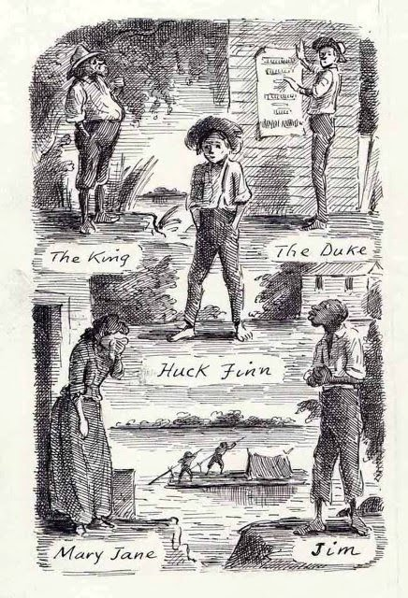
He hides his raft on a wooded island, and
after a good night’s sleep he takes the canoe
to shore where he accidentally meets the duke.
Surprised to see Huck, he asks about the raft,
and Huck tells him the raft and Jim have been
stolen. The duke begins to tell Huck that Jim is
on the Silas Phelps Plantation but changes his
mind and tells him he is 40 miles away instead.
He wants Huck out of town for the next three
days so Huck will not tell the townspeople
that he and the king are frauds.

Slide 6
Discussion and Analysis
In Chapter 30 the duke is seen in a better light than we have seen him so far in the novel. He jumps to Huck’s defence, reminding the king that he would not have done any different than Huck did in order to escape. “Did you inquire around for him (Huck) when you got loose?” The duke is able to identify with Huck as another human being running from an angry mob to save his own life. Until now the duke has been portrayed as a deceitful rogue symbolizing evil and demanding to be addressed as “your grace.”
In these climactic chapters Huck faces his ultimate moral decision to help Jim escape from slavery. It is the central crisis in Huck’s development. In three different incidents, he struggles with this choice.
The first time, in Chapter 8, Huck has just met Jim on Jackson’s Island. His easy decision not to tell that Jim is a runaway slave comes in the wake of his determination to leave Pap and his resolution never to go back to live with the Widow Douglas. It matters little to Huck that people would call him “a low-down Abolitionist . . . that don’t make no difference . . . I ain’t a-going back there, anyways.” His recent abandonment of society and its laws helps him to make a moral decision on human terms rather than on societal ones.
The second time is in Chapter 16 when Huck and Jim are nearing Cairo where they plan to take a steamboat up the Ohio River to the free states. In this incident the intensity of his decision has deepened. As he struggles with his conscience about allowing a slave, worth $800, to go free, the irony is clear—it never occurs to him that society might be wrong, and that he could be right. He simply realizes it is impossible for him to turn Jim in.

Slide 7
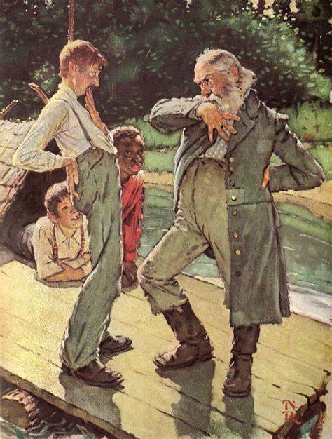
Although his second decision centres around the economic worth of slaves, Huck’s ultimate moral choice focuses on religion. “There was the Sunday school, you could ‘a’ gone to it . . . they’d ‘a’ learnt you there that people that acts as I’d been acting . . . goes to everlasting fire.” He tries to pray, but he “can’t pray a lie.” Ironically, when he writes the letter to Miss Watson telling her where Jim is, he is relieved to know he is no longer lost and going to hell. But he cannot leave it at that. His mind instinctively drifts to Jim’s friendship and the good times they have had on the raft. Jim is undoubtedly the most devoted friend
he has ever had. Huck’s ultimate moral decision in the novel
is, ironically, to “go to hell” for freeing Jim. He does not
justify his choice. He simply makes the decision to take up
wickedness again. Twain’s bitter satire in this passage is
a harsh invective against a society that would live by such
false standards.

Slide 8
Chapter 32 and 33 Summary
Huck arrives at the Phelps Plantation, noticing that things are rather “still and Sunday-like.” Everyone seems to be out in the fields, and Huck paints a rather bleak picture of the depressing surroundings. As he approaches the kitchen, he hears the hum of a spinning wheel. He walks up to the house, trying to decide what to say but finally leaving it to Providence. He has aroused fifteen of the sleeping dogs that quickly surround him with their barking and howling. With her rolling pin raised, a servant steps out and silences them. Hearing the commotion, Mrs. Phelps runs out to greet Huck with her spinning stick still in her hand and her children hanging around her skirts. Thinking he is Tom Sawyer, her nephew, she welcomes him with open arms.
Perplexed by her display of affection, he tries to guess who she thinks he is. She questions him about his family, but not knowing who his family is, he cannot answer and finally decides that this might be one of those times when he should risk telling the truth. It isn’t until Mr. Phelps comes home, and she introduces Huck as Tom Sawyer, that he breathes easy again. They have been expecting Tom to arrive on the steamboat for the past few days and are relieved and happy that he is finally here. Comfortable with his new identity, Huck can easily invent believable stories about Tom Sawyer’s family.

Slide 9
The noise of the steamboat on the river, however, suddenly reminds him Tom could be arriving any minute. He must ward off Tom’s appearance until he can explain the misunderstanding to him. He tells Tom’s aunt and uncle that he needs to go into town to pick up his baggage. Convincing them to let him go alone, he heads for town in the wagon and meets Tom Sawyer along the way. Tom thinks he is seeing a ghost, but Huck tells him that he was not murdered. Huck explains the case of mistaken identity at the Phelps Plantation to Tom. Coming up with a plan, Tom assures him all will be well. He puts his trunks in the wagon and tells him he will follow later. Huck also confides in Tom about his intent to steal Jim. To his surprise, Tom agrees to help him. Shocked that Tom would do such a thing, Huck’s high opinion of him falls considerably.
In a little while Aunt Sally and Uncle Silas Phelps see a stranger coming up the driveway. The stranger is Tom Sawyer. They quickly set another plate for dinner to welcome him. He pretends to be on the wrong plantation, but they invite him to stay for dinner just the same. During the course of the conversation the so-called stranger suddenly reaches over and kisses Aunt Sally on the mouth. Shocked and insulted she calls him an “owdacious puppy.” He apologizes and tells her he thought she would like it. He finally ends the practical joke by identifying himself as Sid Sawyer, Tom’s brother. They laugh at his joke, showering him with hugs and kisses.

Slide 10
During supper one of the children begs to see the show in town that night. His dad tells him the show has been cancelled because the runaway slave informed on the actors. Huck knows immediately that it was Jim who was trying to expose the king and the duke. That night he and Tom sneak out to try to warn the pair about the danger they are in, but it is too late. They have been tarred and feathered and are being driven out of town. Huck feels responsible somehow even though he was not to blame. He denounces his conscience that “takes up more room than all the rest of a person’s insides” but is of no value to him. Tom Sawyer agrees.

Slide 11
Discussion and Analysis
Twain’s depressing description of the Phelps Plantation is set in contrast to previous descriptions of the peace and tranquillity of life on the river. It is a “one-horse cotton plantation” with “sickly grass patches” and a yard that is “bare and smooth.” Even the sound of the spinning wheel makes Huck feel lonesome. Huck’s depiction of the plantation, symbolic of loneliness and death, reflects his mood after the loss of Jim and their idyllic life on the raft. Here, as in earlier chapters, the theme of freedom on the river stands in opposition to the constraints of life on the shore. Jim has, after all, been sold back into slavery again, and in Huck’s view, life on the shore carries with it a dismal outlook.
The appearance of Tom Sawyer lightens the tone of these chapters. We see Tom merely as a light-hearted practical joker whose morality is aligned with the society he is a part of. Huck respects his opinion, however, and holds him up as his ideal. He is astonished when Tom agrees to help him steal Jim, and because of this, his estimation of Tom is lowered. Ironically, Huck still believes his natural morality is wrong and Tom’s morality, based on the mores of society, is right. What he is not aware of is that Tom knows Jim has already been given his freedom by Miss Watson. This will not be divulged until the end of the novel. Tom is, therefore, only playing the game of stealing Jim out of slavery.

Slide 12
Thus far in the novel Jim has been patiently bearing the inconveniences the king and duke have caused him and Huck on the raft. The “rapscallions” go too far, however, when they sell him as a slave. The king and duke underestimate Jim’s intentions to get even. Although the duke mentions his suspicions to Huck, it is doubtful that he credits Jim with the ability to be instrumental in having them tarred and feathered and run out of town. Jim’s action in this episode reflects a deep sense of justice.
When Huck watches the king and duke being run out of town it makes him “sick to see it.” His feeling is reminiscent of his reaction to the Grangerford and Shepherdson feud in Chapter 18. During their last battle when most of the men are killed, Huck is repulsed as he watches the carnage from the tree. “It made me so sick I most fell out of the tree.” In spite of all the king and duke have done to him, Huck’s humanity is again revealed when he not only sympathises with the pair, but tries to warn them of trouble ahead.

Slide 13
Tasks for the Week
Emmy and Jon: we start to see Jim emerge as the ‘hero’ of the novel in this chapter. How so? What do we learn about him?
Sonny/ Cerys: Compile a list of quotes from the 4 chapters on racism/slavery.
Nick/Katie: Compile a list of quotes from the fours chapters on Huck’s character development.
Amelia/Annie: Research Propp’s Character Theory and try to classify the characters in Huck Finn according to this theory.
Tom/Natasha: Research Todorov’s Narrative Theory and explain how this relates to Huch Finn
Sophie: Explore the dramatic irony inherent in these chapters
Izza:Consider the continued use of stereotypes in these chapters.
Grace/Maddie: Look at the contrast between Huck and Tom in these chapters. What is Twain trying to do with this use of juxtaposition.

