Slide 1
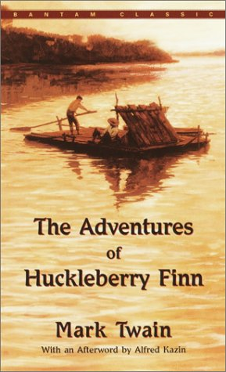
Huckleberry Finn Remote Learning Package
Week 11 May – 15 May

Slide 2
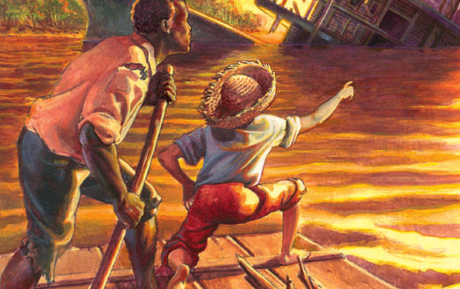
Tasks for the Week
Make sure last week’s tasks are sent to me. I have created an area for them all on FF which we can refer to as we start revising for exams
Read up to Chapter 37
Answer the questions and prepare thoughts
on the points for discussion to be submitted in
Wednesday’s lesson.

Slide 3
Chapter 34 and 35 Summary
Tom uncovers the secret of Jim’s whereabouts on the Phelps Plantation by observing one of the slaves bringing watermelon, along with other food, to a nearby hut. Since he would not be feeding watermelon to dogs, it follows that someone must be in the hut. The door to the hut is locked, and Uncle Silas holds the key. Sure that the prisoner must be Jim, Huck and Tom begin immediately to make plans to rescue him. Huck’s plan is easy. He suggests they steal the key out of Uncle Silas’s pants pocket, release Jim, and take off down the river on Huck’s raft. Tom criticizes the plan for being “mild as goosemilk.” Knowing they will do it Tom’s way no matter what Huck proposes, he gives in to Tom’s elaborate plans.
Huck is still wondering why a respectable, kind, and intelligent boy like Tom would stoop so low as to steal Jim out of slavery. He tries to stop him, but Tom says he knows what he is doing.
After dark they examine the hut and plan the rescue. Huck suggests several simple and practical methods such as having Jim climb out of a high window or sawing a hole in the cabin the way he had done when he escaped from Pap. Tom, however, holds out for some complicated method that would take twice as long. They finally decide to spend a week digging him out.
When they arrive at the house, Huck simply pulls the latchstring and walks in through the door. This is not romantic enough for Tom, however, who enters by climbing the lightning rods. He finally makes it after three tries and several painful falls.

Slide 4
In the morning they go down to the slave cabins to befriend the dogs so that they will not bark at them while they are digging Jim out. They meet the man who brings food to Jim. He naively invites them to come and see his prisoner. Jim, surprised and happy to see them, blurts out the boys’ names. The man asks Huck and Tom whether Jim knows them, but they flatly deny it. They convince him that the witches are causing him to hear things. When they get a chance they whisper the plan of escape to Jim. He squeezes their hands in gratitude and promises to pretend they are strangers from now on.
Tom, disgusted that the plan of escape is too easy, is constantly trying to “invent all the difficulties.” He wishes for a watchman to drug, or a dog to give a sleeping mixture to. Though one could easily slip the chain off the bedpost, Tom wants to saw the leg off Jim’s bed to remove the chain. He goes so far as to consider amputating Jim’s leg to get the chain off.
Instead of picks and shovels, Tom insists on digging him out with case knives because he has read about this in books. He also insists that the escape should take thirty-seven years. They need to hurry though, for when Mr. Phelps hears Jim is not from New Orleans, he will probably advertise him. They decide to “let on” or pretend that they had been at it for thirty-seven years. Huck tries to bring Tom back to practical reality, but Tom accuses him of never “having read any books at all.”

Slide 5
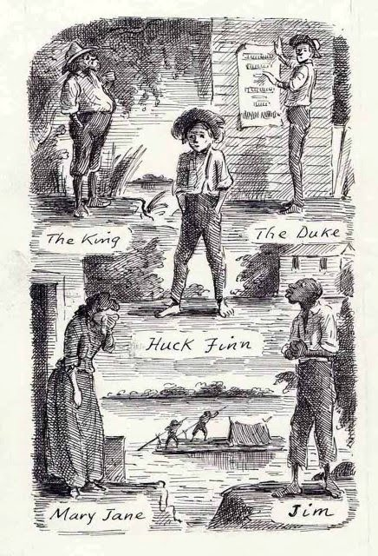
Huck borrows a bedsheet from the clothesline for a rope ladder that will be put in a pie and smuggled in for the escape. He also takes a white shirt so Jim can keep a journal on it. He takes three case knives, and Tom suggests making a saw out of one of them. When Huck gingerly suggests borrowing a saw from the smokehouse, Tom is discouraged and gives up on Huck, afraid he will never be able to teach him anything about the way it should really be done. Huck finally obeys his order to get the knives.

Slide 6
Discussion and Analysis
Huck’s practical, down-to-earth solutions to problems are set in juxtaposition to Tom’s romantic, unrealistic solutions in the plan to free Jim. Twain is satirizing the romantic notions inherent in the adventurous and courageous escapes that were made popular through the romance literature of his day. The contrasting personalities of Huck and Tom and their constant attempts to counter each other, lends much of the satiric humour to these chapters. On a deeper level the humour is lost, however, when we consider that Tom already knows Jim is free. He is simply playing the game for the sake of adventure. In the meantime he keeps Jim imprisoned with little regard for his suffering.
Huck admires Tom’s ability to solve the mystery of Jim’s hiding place. Tom’s observations about dogs and their dislike for watermelons clearly puts him on an intellectually superior level, and Huck is sure he would not trade Tom’s head for that of a “duke, nor mate of a steamboat, nor clown in a circus.” Huck knows his plan to free Jim cannot equal Tom’s, but he thinks about it just to be doing something. He is right. When he proposes his simple plan of stealing the key from Mr. Phelps’ pants pocket and unlocking Jim’s door, Tom does not go for it. Ironically, Huck’s plan is superior to Tom’s, because it is quick and efficient, and safe for Jim. Tom’s plan is more bookish and has more style, but, ironically, does not accomplish what Huck’s plan would. It is also a potentially dangerous plan. As Huck says, it could “get us all killed besides.”

Slide 7
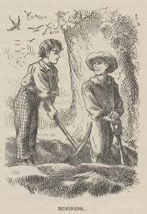
Chapter 36 and 37 Summary
Tom and Huck get right to work digging a tunnel into Jim’s cabin with their case knives. After several hours their hands are sore in spite of the fact that they have made little progress. Tom finally admits that his plan will not work, so they change to picks pretending they are case knives. Happy that Tom is finally becoming level-headed, Huck wholeheartedly agrees with the change of plan. They dig a sizable hole and decide to continue the next day. As usual Tom tries to climb up the lightning rod to the second floor. Dead tired and sore, he finally agrees to “let on” that the stairs are lightning rods after a bit of coaxing from Huck.
Between them the boys manage to pilfer a pewter spoon, a brass candlestick, six candles, and three tin plates. The next night when everyone is in bed they finally dig their way into Jim’s cabin in two and one-half hours. Happy to see them, Jim wants to cut the chain and clear out immediately, but Tom shows him that it would be highly “unregular.” He explains the plan to Jim, telling him that in case of danger the plan could be quickly altered. Tom assures Jim they will, indeed
see that he gets away. They talk about old times, and Jim informs them about the prayers Uncle Silas has with him
every day or two. Aunt Sally also stops by often to make sure he is comfortable. This gives Tom the idea of
smuggling things to Jim through his aunt and uncle’s pockets. Jim must then sneak them out. Despite Huck’s objections Tom
goes ahead with his plan.

Slide 8
Aunt Sally begins to notice that things are missing around the house. A big argument ensues between her and Uncle Silas. She rails at him for losing his shirt but finally concedes that the calf probably got the shirt off the line. She is sure the rats got the candles, but the pewter spoon is still a mystery. In the middle of her long diatribe on the need for Uncle Silas to stop up the rat holes, a servant announces a bedsheet is also missing. This is almost more than she can take. In the middle of it all, Uncle Silas reaches into his coat pocket and timidly pulls out the pewter spoon secretly put there by Tom. Eventually she orders all of them out of the house. Later, Tom conjures up a plan to confuse Aunt Sally about the count of the sheets and spoons by alternately taking one out and then sneaking it back so her count is inconsistent. She finally becomes thoroughly confused about the true number of her sheets and spoons.

Slide 9
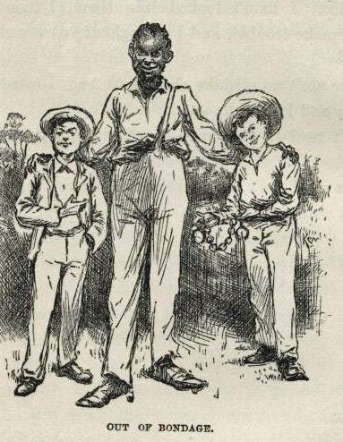
Tom and Huck decide to bake the rope ladder into a witch pie to satisfy the hunger of the witches who are constantly aggravating Nat, giving him no peace. Nat is, of course, grateful and cooperative. The boys take the rope ladder, made with a torn-up sheet, to the woods. They have enough rope for forty pies, however, so they finally throw most of the rope ladder away. They bring the witch pie to Jim’s cabin, and Nat turns his back to ward off the witches. Following directions explicitly, Jim quickly breaks open the pie, hides the
rope ladder inside his mattress, and throws out the
tin plates after scratching some marks on them.

Slide 10
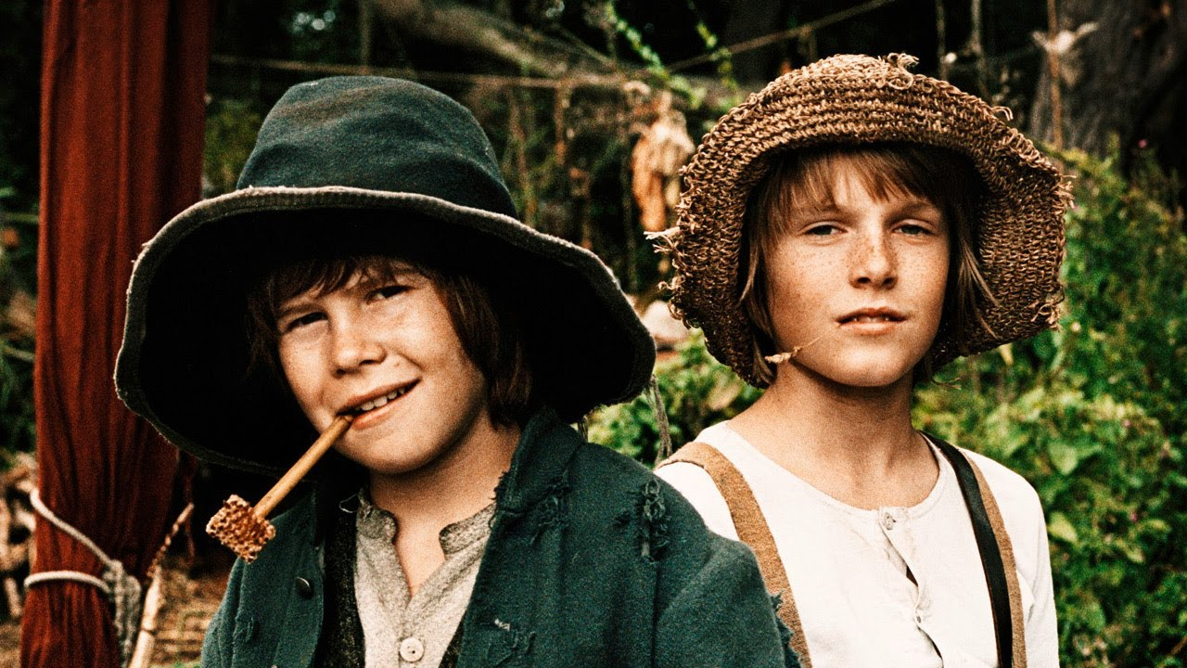
Discussion and Analysis
Twain’s ironic use of the word “moral” in this section of the novel is reminiscent of the earlier incident on the Walter Scott. When the gang of murderers on board contemplate killing Jim Turner, they decide “it ain’t good sense, it ain’t good morals.” Ironically, the Walter Scott would break up and kill him regardless. The moral thing to do would be to untie him and thereby save his life. In this section of the novel Tom’s statement is almost identical. “It ain’t right, and it ain’t moral.” In both cases the means to an end is all-important. In Tom’s case, the moral thing to do would be to free Jim as quickly as possible instead of prolonging his agony. Huck’s reply “I don’t care shucks for the morality of it, nohow,” shows that his morality is on human, practical terms where the end result is all-important. Besides, he does not care “what the authorities think” as long as it satisfies his own moral sensibilities.
The theme of superstition is brought out in Nat’s belief that
witches are haunting him. When the dogs appear in Jim’s cabin,
Tom leads him to believe he has seen witches. He exploits his
fear of witches in order to carry out his plan.

Slide 11
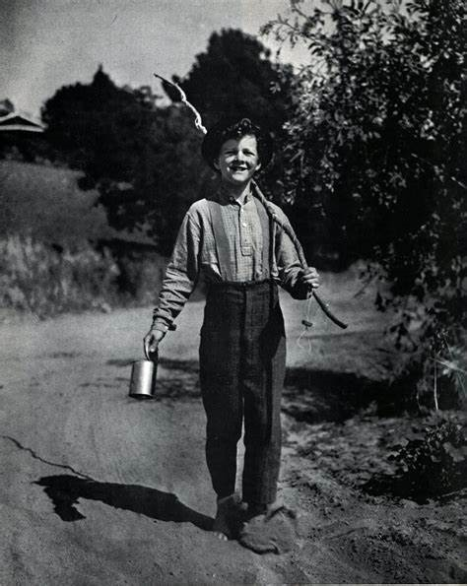
Twain is satirizing religious people like Uncle Silas and Aunt Sally who pray with Jim and make sure he has enough to eat but are waiting eagerly for the reward offered for his capture. If no one claims him they will, of course, sell him. It is doubly ironic that even Jim, being a product of society himself, does not see through this double standard. He simply comments that “both of them was kind as they could be.”
Tom explains his elaborate plan of escape to Jim all the way from smuggling the rope ladder pie into his cabin to tying things to Aunt Sally’s apron strings. Jim cannot see the sense in most of the plan, “but he allowed we was white folks and knowed better than him.” Jim is, of course, the sensible one who questions Tom’s preposterous plan, and, ironically, the “white folks” are obviously lacking in common sense.

Slide 12
Tasks for the Week
Emmy and Jon: Continue your examination of Jim and his role in the novel.
Sonny/ Cerys: Consider the relationship between religion and superstition. Link to previous chapters.
Nick/Katie: Examine the relationship between Huck and Tom..
Amelia/Annie: Develop your study on the theme of freedom.
Tom/Natasha: Research Todorov’s Narrative Theory and explain how this relates to Huch Finn
Sophie and Izza: Develop your understanding of satire in these chapters.
Grace/MaddieExplore Twain’s use of narrative technique and its effect.

