Slide 1
In this lesson, students will be mastering the following:
Mastery Content:
Mr Brocklehurst visits Lowood School with his daughters
His daughters wear fine clothes and have their hair in fancy styles
Mr Brocklehurst is a hypocrite
Learning Objective
To explore how Bronte presents Mr Brocklehurst as a hypocrite.
Mastery Content

Slide 2
Do Now: What is Mr Brocklehurst's position at Lowood? At Gateshead, Mr Brocklehurst tells Jane that she will go to _____ if she lies. Mr Brocklehurst tells Mrs Reed that Jane will not receive any __________ at Lowood. List one way the girls are treated badly at Lowood. Extension: Explain how Mr Brocklehurst’s Christian views differ to Helen Burns.
Recap Recall how Miss Temple fed the girls bread and cheese on the day that the porridge was burnt: this will have ramifications in the reading today.
Reading: Mr Brocklehurst Read the passage where Mr Brocklehurst admonished Miss Temple for the state of the girls’ stockings and for giving them bread and cheese. There are some check for understanding questions to allow you to assess students’ comprehension of the passage.
Starve their immortal souls Mr Brocklehurst’s words to Miss Temples are some of the most iconic in the novel. Explore quotation relating to Brocklehurst’s Christian faith. You may wish to recall and introduce Brocklehurst’s attitude to raising children if students are likely to have forgotten what he said. | Consider how you will direct the paired talk and writing task.
Hypocrite: vocabulary Introduce the word ‘hypocrite’ and discuss among students. This term will be particularly useful in the next passage. You may also want to relate the word to Mrs Reed, who gives a reason for disciplining Jane, but does not apply the same standards to John Reed.
Reading: Brocklehurst’s hypocrisy Read the passage where Brocklehurst admonishes Miss Temple for letting the girls have curly hair, and where he reminds them to appear meek and bland. This contrasts with his own daughters.
Brocklehurst’s hypocrisy Students discuss how Brontë presents Brocklehurst as a hypocrite, relating to the passage they have just read. Following this, student write their answer to the question, using evidence from the novel to support their answer. You may also want to discuss Brocklehurst’s statements from earlier in the novel where he talks about the sin of pride, when it is clear that he is a proud man, thinking he and his daughters are superior to the girls at Lowood. Alternatively, you could consider his emphasis on the ‘virtue’ of ‘consistency’ – the irony being that he is not consistent; he treats his family differently to the girls at Lowood. | Consider how you wish to scaffold or model writing for this task. Especially consider how you will get students to think about Brontë at work in this extract: you may (or may not) wish to draw attention to the writer’s craft.
Student response There is an example of a student paragraph to this question. Students can examine this and use it to edit and adjust their own response. Note that it explicitly writes about Brontë as the writer, so this could help students to begin to write about the writer’s craft if a model is needed.
Fortnightly Quiz Ask students to complete fortnightly quiz
Lesson Guide

Slide 3
Tuesday, 14 June 2022
Hypocrite
Do Now:
Mr Brocklehurst’s is the supervisor at Lowood.
At Gateshead, Mr Brocklehurst tells Jane that she will go to hell if she lies.
Mr Brocklehurst tells Mrs Reed that Jane will not receive any luxuries at Lowood.
The girls are given very little food to eat at Lowood.
Do Now:
What is Mr Brocklehurst's position at Lowood?
At Gateshead, Mr Brocklehurst tells Jane that she will go to _____ if she lies.
Mr Brocklehurst tells Mrs Reed that Jane will not receive any __________ at Lowood.
List one way the girls are treated badly at Lowood.
Do Now
Extension: Mr Brocklehurst believes in a vengeful God who punishes disobedience. In contrast, Helen Burns believes in a kind and forgiving God.
Extension: Explain how Mr Brocklehurst’s Christian views differ to Helen Burns.

Slide 4
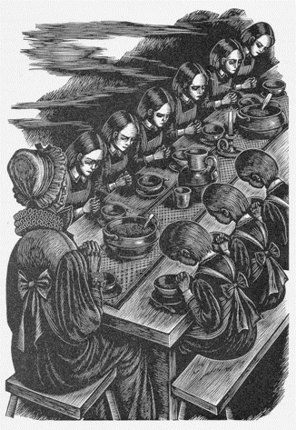
Life at Lowood School is harsh, and the girls living there are not treated well.
You may remember that the girls were served burnt porridge on Jane’s first morning at Lowood. None of the girls could eat it.
Miss Temple decided to give the girls some bread and cheese to replace the burnt porridge.
We will find out what Mr Brocklehurst thinks of Miss Temple’s kindness today!
Jane Eyre

Slide 5
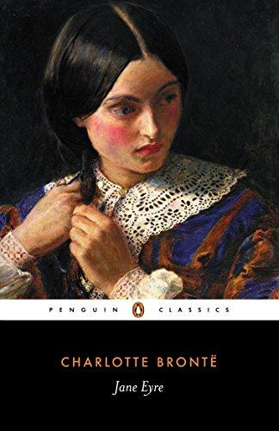
Jane is now living in Lowood, in the North of England.
We have already seen how the cold, harsh weather affects life at Lowood: the water freezes overnight so the girls are unable to wash their hands!
Let’s read about the rest of Jane’s first winter at Lowood.
Jane Eyre
Let’s read.
Read from, ‘My first quarter at Lowood seemed an age’ (page 71)
Read to, ‘propped up with the monitors’ high stools.’(page 73)

Slide 6
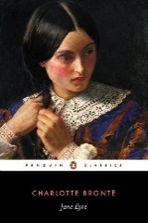
I have not yet alluded to the visits of Mr. Brocklehurst; and indeed that gentleman was from home during the greater part of the first month after my arrival; perhaps prolonging his stay with his friend the archdeacon: his absence was a relief to me. I need not say that I had my own reasons for dreading his coming: but come he did at last.
One afternoon (I had then been three weeks at Lowood), as I was sitting with a slate in my hand, puzzling over a sum in long division, my eyes, raised in abstraction to the window, caught sight of a figure just passing: I recognised almost instinctively that gaunt outline; and when, two minutes after, all the school,
teachers included, rose en masse, it was not necessary for me to look up in order to ascertain whose entrance they thus greeted. A long stride measured the schoolroom, and presently beside Miss Temple, who herself had risen, stood the same black column which had frowned on me so ominously from the hearthrug of Gateshead. I now glanced sideways at this piece of architecture. Yes, I was right: it was Mr. Brocklehurst, buttoned up in a surtout, and looking longer, narrower, and more rigid than ever.
alluded – referred
en masse – all together
ascertain – work out
surtout – coat
Jane Eyre
p.73

Slide 7
I had my own reasons for being dismayed at this apparition; too well I remembered the perfidious hints given by Mrs. Reed about my disposition, &c.; the promise pledged by Mr. Brocklehurst to apprise Miss Temple and the teachers of my vicious nature. All along I had been dreading the fulfilment of this promise,—I had been looking out daily for the “Coming Man,” whose information respecting my past life and conversation was to brand me as a bad child for ever: now there he was. He stood at Miss Temple’s side; he was speaking low in her ear: I did not doubt he was making disclosures of my villainy; and I watched her eye with painful anxiety, expecting every moment to see its dark orb turn on me a glance of repugnance and contempt. I listened too; and as I happened to be seated quite at the top of the room, I caught most of what he said: its import relieved me from immediate apprehension.
“I suppose, Miss Temple, the thread I bought at Lowton will do; it struck me that it would be just of the quality for the calico chemises, and I sorted the needles to match.
apparition – appearance
perfidious – dishonest
apprise – inform
orb – sphere
repugnance – disgust
calico chemises – cotton shirts
Jane Eyre
p.73-4

Slide 8
You may tell Miss Smith that I forgot to make a memorandum of the darning needles, but she shall have some papers sent in next week; and she is not, on any account, to give out more than one at a time to each pupil: if they have more, they are apt to be careless and lose them. And, O ma’am! I wish the woollen stockings were better looked to!—when I was here last, I went into the kitchen-garden and examined the clothes drying on the line; there was a quantity of black hose in a very bad state of repair: from the size of the holes in them I was sure they had not been well mended from time to time.”
He paused.
“Your directions shall be attended to, sir,” said Miss Temple.
“And, ma’am,” he continued, “the laundress tells me some of the girls have two clean tuckers in the
week: it is too much; the rules limit them to one.”
“I think I can explain that circumstance, sir. Agnes and Catherine Johnstone were invited to take tea with some friends at Lowton last Thursday, and I gave them leave to put on clean tuckers for the occasion.”
Mr. Brocklehurst nodded.
memorandum – list
hose – tights
tuckers – vests
Jane Eyre
p.74

Slide 9
“Well, for once it may pass; but please not to let the circumstance occur too often. And there is another thing which surprised me; I find, in settling
accounts with the housekeeper, that a lunch, consisting of bread and cheese, has twice been served out to the girls during the past fortnight. How is this? I looked over the regulations, and I find no such meal as lunch mentioned. Who introduced this innovation? and by what authority?”
“I must be responsible for the circumstance, sir,” replied Miss Temple: “the breakfast was so ill prepared that the pupils could not possibly eat it; and I dared not allow them to remain fasting till dinner-time.”
innovation – new idea
Jane Eyre
p.74

Slide 10
“Madam, allow me an instant. You are aware that my plan in bringing up these girls is, not to accustom them to habits of luxury and indulgence, but to render them hardy, patient, self-denying. Should any little accidental disappointment of the appetite occur, such as the spoiling of a meal, the under or the over dressing of a dish, the incident ought not to be neutralised by replacing with something more delicate the comfort lost, thus pampering the body and obviating the aim of this institution; it ought to be improved to the spiritual edification of the pupils, by encouraging them to evince fortitude under temporary privation. A brief address on those occasions would not be mistimed, wherein a judicious instructor would take the opportunity of referring to the sufferings of the primitive Christians; to the torments of martyrs; to the exhortations of our blessed Lord Himself, calling upon His disciples to take up their cross and follow Him; to His warnings that man shall not live by bread alone, but by every word that proceedeth out of the mouth of God; to His divine consolations, “If ye suffer hunger or thirst for My sake, happy are ye.”
accustom them – let them get used to
nicer than what they were meant to have
obviating – cancelling
evince fortitude – show self-control
exhortations – teachings
Jane Eyre
p.74-75

Slide 11
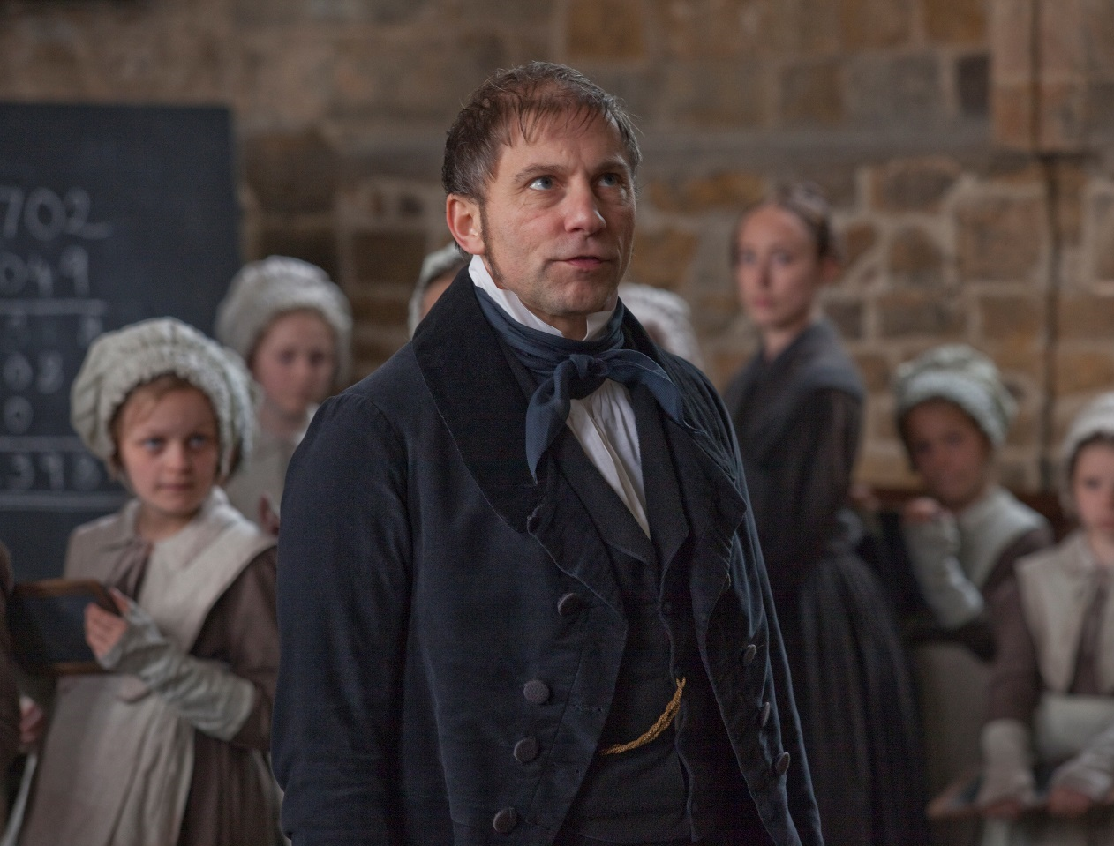
Oh, madam, when you put bread and cheese, instead of burnt porridge, into these children’s mouths, you may indeed feed their vile bodies, but you little think how you starve their immortal souls!”
Jane Eyre
p.75

Slide 12
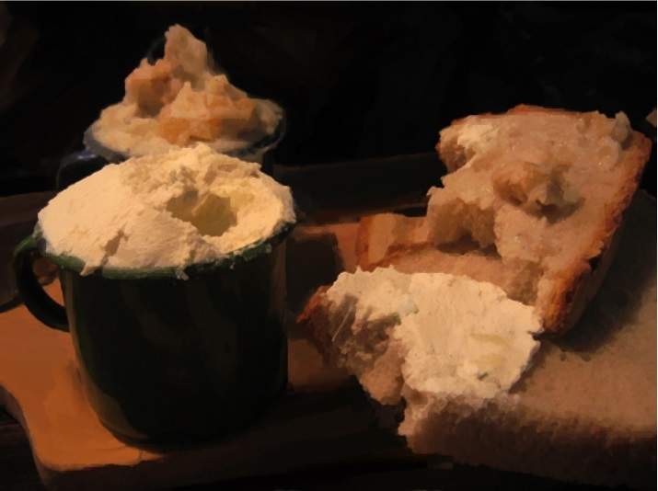
Discuss the answers to these questions in pairs:
How do the girls react when Mr Brocklehurst enters the schoolroom?
How does Mr Brocklehurst react when he finds out that Miss Temple fed the girls a breakfast of cheese and bread?
‘My plan in bringing up these girls is, not to accustom them to habits of luxury and indulgence, but to render them hardy, patient, self-denying.’ What does Mr Brocklehurst mean when he says this?
Jane Eyre

Slide 13
Discuss the answers to these questions in pairs:
All of the girls stand to attention when Mr Brocklehurst enters the room.
Mr Brocklehurst says that Miss Temple was wrong to give the girls bread and cheese. They should have been taught to be hardy and tough, and just go hungry.
‘My plan in bringing up these girls is, not to accustom them to habits of luxury and indulgence, but to render them hardy, patient, self-denying.’
Mr Brocklehurst tells Miss Temple that the girls should not be taught to expect nice things. He does not want the girls to think that they deserve anything good. They are only worthy of small, poor things.
Jane Eyre

Slide 14
This is a famous quotation from ‘Jane Eyre’:
“Oh, madam, when you put bread and cheese, instead of burnt porridge, into these children's mouths, you may indeed feed their vile bodies, but you little think how you starve their immortal souls!"
Mr Brocklehurst
In pairs, write down what you think Mr Brocklehurst means by this.
Mr Brocklehurst

Slide 15
“Oh, madam, when you put bread and cheese, instead of burnt porridge, into these children's mouths, you may indeed feed their vile bodies, but you little think how you starve their immortal souls!"
Mr Brocklehurst says that Miss Temple spoilt the girls when she gave them bread and cheese.
The girls were no longer hungry – their bodies were fed.
But as poor girls, they should be taught to be grateful for anything they receive. Mr Brocklehurst thinks that the girls should not feel like they are entitled to nice things because they are just poor orphan girls. He thinks that this will make their souls weak.
Mr Brocklehurst
What is your opinion of what Mr Brocklehurst says?
Mr Brocklehurst

Slide 16
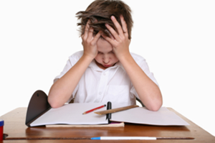
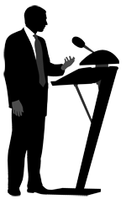
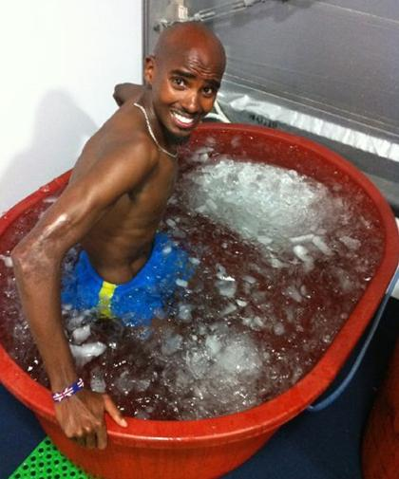
In ‘Jane Eyre’, a number of the characters can be described as hypocrites. A hypocrite is someone who says one thing, but does the opposite at another time.
Which of these situations would show that someone is a hypocrite?
A teacher tells his class that they should treat everyone equally. The next lesson, Sam and Tamara forget to bring in their homework. Only Tamara gets a detention because the teacher likes Sam more.
A teacher tells his class that they should treat everyone equally. The next lesson, Sam and Tamara forget to bring in their homework. Only Tamara gets a detention because the teacher likes Sam more.
Hypocrite
A politician makes a big speech saying that university should be free for everyone. Six months later, he makes an announcement saying that university tuition fees will be rising by 300%.
A politician makes a big speech saying that university should be free for everyone. Six months later, he makes an announcement saying that university tuition fees will be rising by 300%.
An athletics coach tells her athletes they must have an ice bath when they finish playing because it helps their muscles to recover. When the coach gets home, she has a hot bath.

Slide 17
We are going to see how a character in ‘Jane Eyre’ is a hypocrite.
Let’s continue reading.
Read from, ‘Mr. Brocklehurst again paused…’ (page 75)
Read to, ‘…enchanted my attention.’ (page 77)
Jane Eyre

Slide 18
Mr. Brocklehurst again paused—perhaps overcome by his feelings. Miss Temple had looked down when he first began to speak to her; but she now gazed straight before her, and her face, naturally pale as marble, appeared to be assuming also the coldness and fixity of that material; especially her mouth, closed as if it would have required a sculptor’s chisel to open it, and her brow settled gradually into petrified severity.
Meantime, Mr. Brocklehurst, standing on the hearth with his hands behind his back, majestically surveyed the whole school. Suddenly his eye gave a blink, as if it had met something that either dazzled or shocked its pupil; turning, he said in more rapid accents than he had hitherto used—
“Miss Temple, Miss Temple, what—what is that girl with curled hair? Red hair, ma’am, curled—curled all over?” And extending his cane he pointed to the awful object, his hand shaking as he did so.
It is Julia Severn,” replied Miss Temple, very quietly.
petrified severity – frozen
Seriousness
hitherto used – used up to now
Jane Eyre
p.75

Slide 19
“Julia Severn, ma’am! And why has she, or any other, curled hair? Why, in defiance of every precept and principle of this house, does she conform to the world so openly—here in an evangelical, charitable establishment—as to wear her hair one mass of curls?”
“Julia’s hair curls naturally,” returned Miss Temple, still more quietly.
“Naturally! Yes, but we are not to conform to nature; I wish these girls to be the children of Grace: and why that abundance? I have again and again intimated that I desire the hair to be arranged closely, modestly, plainly.
Miss Temple, that girl’s hair must be cut off entirely; I will send a barber to-morrow: and I see others who have far too much of the excrescence—that tall girl, tell her to turn round. Tell all the first form to rise up and direct their faces to the wall.”
Miss Temple passed her handkerchief over her lips, as if to smooth away the involuntary smile that curled them; she gave the order, however, and when the first class could take in what was required of them, they obeyed.
evangelical – Christian
abundance – large quantity
excrescence – growth
Jane Eyre
p.76

Slide 20
Leaning a little back on my bench, I could see the looks and grimaces with which they commented on this manoeuvre: it was a pity Mr. Brocklehurst could not see them too; he would perhaps have felt that, whatever he might do with the outside of the cup and platter, the inside was further beyond his interference than he imagined.
He scrutinised the reverse of these living medals some five minutes, then pronounced sentence. These words fell like the knell of doom—
“All those top-knots must be cut off.”
Miss Temple seemed to remonstrate.
“Madam,” he pursued, “I have a Master to serve whose kingdom is not of this world: my mission is to mortify in these girls the lusts of the flesh; to teach them to clothe themselves with shame-facedness and sobriety, not with braided hair and costly apparel; and each of the young persons before us has a string of hair twisted in plaits which vanity itself might have woven; these, I repeat, must be cut off; think of the time wasted, of—”
manoeuvre – move
scrutinised – examined
knell – bell
remonstrate – argue
mortify – kill
lusts – desires
sobriety – simple things
apparel – clothing
Jane Eyre
p.76

Slide 21
Mr. Brocklehurst was here interrupted: three other visitors, ladies, now entered the room. They ought to have come a little sooner to have heard his lecture on dress, for they were splendidly attired in velvet, silk, and furs. The two younger of the trio (fine girls of sixteen and seventeen) had grey beaver hats, then in fashion, shaded with ostrich plumes, and from under the brim of this graceful head-dress fell a profusion of light tresses, elaborately curled; the elder lady was enveloped in a costly velvet shawl, trimmed with ermine, and she wore a false front of French curls. These ladies were deferentially received by Miss Temple, as Mrs. and the Misses Brocklehurst, and conducted to seats of honour at the top of the room. It seems they had come in the carriage with their reverend relative, and had been conducting a rummaging scrutiny of the room upstairs, while he transacted business with the housekeeper, questioned the laundress, and lectured the superintendent. They now proceeded to address divers remarks and reproofs to Miss Smith, who was charged with the care of the linen and the inspection of the dormitories: but I had no time to listen to what they said; other matters called off and enchanted my attention.
attired – clothed
plumes – feathers
profusion – large amount
tresses – hair
deferentially – respectfully
conducted – taken
Jane Eyre
p.76-77

Slide 22
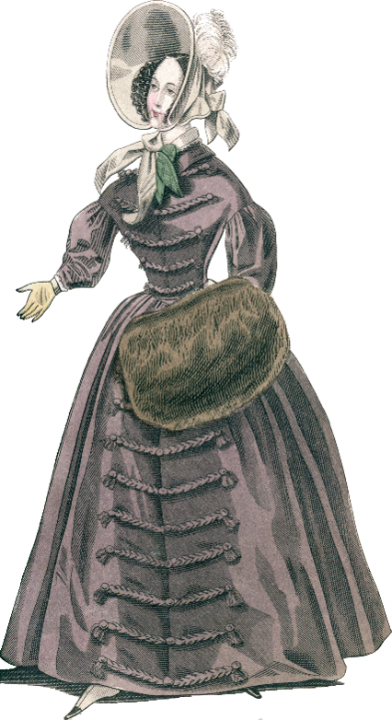
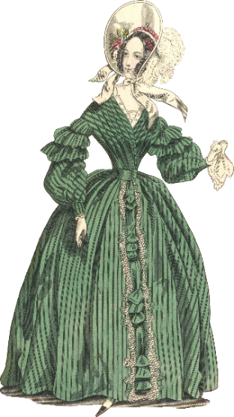
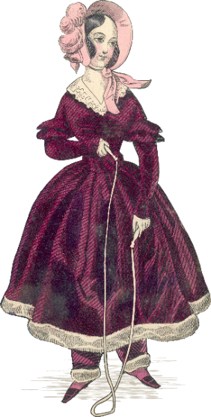
They ought to have come a little sooner to have heard his lecture on dress, for they were splendidly attired in velvet, silk, and furs. The two younger of the trio (fine girls of sixteen and seventeen) had grey beaver hats, then in fashion, shaded with ostrich plumes, and from under the brim of this graceful head-dress fell a profusion of light tresses, elaborately curled
Discuss in pairs:
How does this passage show that Mr Brocklehurst is a hypocrite?
Hypocrite
Mr Brocklehurst’s daughters
Mrs Brocklehurst

Slide 23
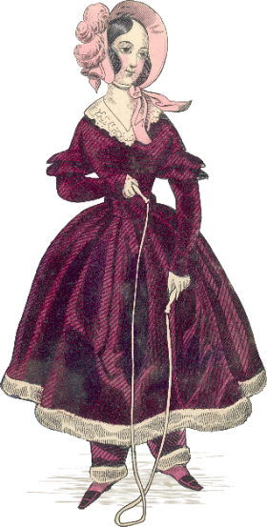
Write a paragraph on this question:
How does Charlotte Brontë present Mr Brocklehurst as a hypocrite in ‘Jane Eyre’?
These questions will help you to structure your paragraph:
What standards does he set for the girls at the school?
How is this different to how he treats his own daughters?
Does it matter that the girls at Lowood are poor?
How does the author – Charlotte Brontë – want us to feel about Mr Brocklehurst?
Hypocrite

Slide 24
Let’s look at a student’s answer.
As you read, think about what the student has done well, and what they could do to improve their answer.
Student response

Slide 25
Student response

Slide 26
Clear understanding of the plot
Student response
Good discussion of Brontë’s writing craft
Strong comment on Brontë’s intention and effect on reader
Good analysis of hypocrisy linked to historical context

Slide 27
Look back at your paragraph.
Is there anything you would like to imitate from this response?
Student response

Slide 28
Quiz time!
Circle the correct answers for quiz 4.
Fortnightly quiz

Slide 29
Quiz answers
e
b c d
a d
b
c d
d
b c e
b c d
c d
b
Answers

Slide 30
Love this lesson?
Have suggestions for improvements?
Does something need fixing?
Feedback
Please let us know!
Fill in this feedback form so that we can keep improving.

