Slide 1
Icon guide
Students should complete this task on their own.
Students should complete this task in pairs. Pair talk would work well with this activity.
This task may be completed in small groups.
This task should be modelled by the teacher. A model is provided, but teachers may want to complete an addition class model ’live’ with the group.
The answers to this task should be written. Teachers may decide that some tasks without this icon should also be written down – this is down to a teacher’s discretion.
This icon is a reminder that students will sit a fortnightly mastery quiz at the end of this lesson.

Slide 2
In this lesson, students will be mastering the following:
Mastery Content:
Bessie feels bad for the way she has treated Jane and attempts to raise her spirits with small gestures of kindness
Jane cannot imagine living a life with poor people: she would rather live with her rich aunt and be miserable than live in the supposed squalor of poverty
Mr Lloyd is an outsider to Gateshead Hall, and is the only character that is entirely kind to Jane
Learning Objective:
To learn how Bessie and Mr Lloyd treat Jane kindly.
Mastery Content

Slide 3
Do Now: List 3 words to describe Jane’s temperament. The bible influenced Victorians in the way they disciplined children. True or False? Why does Jane think Mrs Reed a tyrant? Why does the adult Jane think she should forgive Mrs Reed? Extension: Is Jane a good child? Explain your reasons.
Recap: Bessie Use Bessie’s character to help recap the events of the previous lessons – why Bessie was mean to Jane, how her behaviour has changed, and why her behaviour has changed.
Reading: Chapter 3 Read from, ‘Next day…’ p.25 Read to, ‘…untasted tart.’ p.26 You may wish to omit reading the passages marked by asterisks.
Check for understanding Bessie starts giving Jane little treats as she pities her and regrets how she acted towards Jane. Students discuss the quotation and Bessie’s behaviour, and how Jane’s life is not one of complete misery.
Reading: Chapter 3 Read from, ‘Bessie had now…’ p.26 Read to, ‘… at Gateshead Hall.’ p.28
Check for understanding Discuss these questions in pairs: What reason does Bessie give to Mr Lloyd for Jane crying? Why is Jane’s ‘self-esteem wounded’ by this reason from Bessie? Why can’t Bessie stay in the nursery with Jane and Mr Lloyd?
Reading: Chapter 3 Read from, ‘“The fall did not make you ill”’ (page 28) Read to, ‘“Would you like to go to school?”’ (page 30)
Mr Lloyd Students read quotations and discuss in pairs: How does Mr Lloyd treat Jane?
Mr Lloyd and Bessie How do Mr Lloyd and Bessie treat Jane in comparison to the other characters in the novel? Extension: Mr Lloyd is an outsider and not a resident of Gateshead. Why is this important? | Lloyd is the only person that has shown Jane any compassion or kindness. It is significant that he is not a resident of Gateshead Hall – it takes a complete outsider to recognise how badly Jane is being treated. Perhaps his suggestion of sending Jane to school is his best attempt at intervening in the cruel way Mrs Reed treats Jane.
Mastery assessment plenary Students complete quiz.
Lesson Guide

Slide 4
Tuesday, 14 June 2022
Bessie and Mr Lloyd
Do Now:
Stubborn, vulnerable, rebellious
The bible influenced Victorians in the way they disciplined children. TRUE
Jane thinks Mrs Reed a tyrant because she treats her unfairly and cruelly punishes her.
Jane thinks that she should forgive Mrs Reed because ‘she knew not what she did’ and thought that she was justly punishing Jane.
Do Now:
List 3 words to describe Jane’s temperament.
The bible influenced Victorians in the way they disciplined children. True or False?
Why does Jane think Mrs Reed a tyrant?
Why does the adult Jane think she should forgive Mrs Reed?
Do Now
Extension: During the Victorian era, Jane would not considered to be good because she is not obedient and respectful. However, Jane rebels because she is treated unfairly and unkindly.
Extension: Is Jane a good child? Explain your reasons.

Slide 5
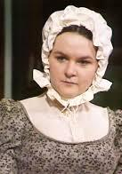
Bessie
Last lesson, we read the start of chapter 3 (page 23). Bessie showed a softer side towards Jane.
Jane described Bessie’s behaviour towards her as ‘Wonderful civility this!’
Jane said that Bessie spoke ‘rather softly’.
Bessie said to another servant that ‘Missis [Reed] was rather too hard’ on Jane’.
Recap
Bessie
Discuss these questions in pairs:
Why was Bessie being kind?
Was Bessie’s behaviour towards Jane before the red-room incident fair?

Slide 6
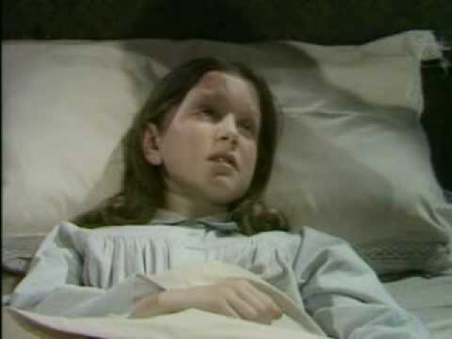
Jane wakes up in the nursery. She is being looked after by Bessie and Mr Lloyd, the apothecary. An apothecary was a person who made and sold medicines.
An apothecary was less qualified than a physician (doctor). Mrs Reed only sent for a physician when she or her children were sick.
Jane Eyre
Chapter 3
Read from, ‘Next day…’ p.25
Read to, ‘…untasted tart.’ p.26

Slide 7
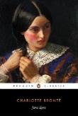
Next day, by noon, I was up and dressed, and sat wrapped in a shawl by the nursery hearth. I felt physically weak and broken down: but my worse ailment was an unutterable wretchedness of mind: a wretchedness which kept drawing from me silent tears; no sooner had I wiped one salt drop from my cheek than another followed. Yet, I thought, I ought to have been happy, for none of the Reeds were there, they were all gone out in the carriage with their mama. Abbot, too, was sewing in another room, and Bessie, as she moved hither and thither, putting away toys and arranging drawers, addressed to me every now and then a word of unwonted kindness. This state of things should have been to me a paradise of peace, accustomed as I was to a life of ceaseless reprimand and thankless fagging; but, in fact, my racked nerves were now in such a state that no calm could soothe, and no pleasure excite them agreeably.
hearth – the floor at the bottom of the fireplace
ailment – illness
wretchedness – feeling of being ill/sick/unhappy
unwonted – not usual
fagging – boring tasks
Jane Eyre
p. 25

Slide 8
Bessie had been down into the kitchen, and she brought up with her a tart on a certain brightly painted china plate, whose bird of paradise, nestling in a wreath of convolvuli and rosebuds, had been wont to stir in me a most enthusiastic sense of admiration; and which plate I had often petitioned to be allowed to take in my hand in order to examine it more closely, but had always hitherto been deemed unworthy of such a privilege. This precious vessel was now placed on my knee, and I was cordially invited to eat the circlet of delicate pastry upon it. Vain favour! coming, like most other favours long deferred and often wished for, too late! I could not eat the tart; and the plumage of the bird, the tints of the flowers, seemed strangely faded: I put both plate and tart away. Bessie asked if I would have a book: the word book acted as a transient stimulus, and I begged her to fetch Gulliver’s Travels from the library. This book I had again and again perused with delight.
convolvuli – a wild plant with triangular leaves
petitioned – to make a formal request
hitherto – until now
vessel – container
cordially – pleasantly
deferred – put off
plumage – feathers covering a bird’s body
transient stimulus – short distraction
Jane Eyre
p. 25

Slide 9
* I considered it a narrative of facts, and discovered in it a vein of interest deeper than what I found in fairy tales: for as to the elves, having sought them in vain among foxglove leaves and bells, under mushrooms and beneath the ground-ivy mantling old wall-nooks, I had at length made up my mind to the sad truth, that they were all gone out of England to some savage country where the woods were wilder and thicker, and the population more scant; whereas, Lilliput and Brobdignag being, in my creed, solid parts of the earth’s surface, I doubted not that I might one day, by taking a long voyage, see with my own eyes the little fields, houses, and trees, the diminutive people, the tiny cows, sheep, and birds of the one realm; and the corn-fields forest-high, the mighty mastiffs, the monster cats, the tower-like men and women, of the other. **
Lilliput and Brobdignag – fictional places from ‘Gulliver’s Travels’
Jane Eyre
p. 26

Slide 10
Yet, when this cherished volume was now placed in my hand—when I turned over its leaves, and sought in its marvellous pictures the charm I had, till now, never failed to find—all was eerie and dreary; the giants were gaunt goblins, the pigmies malevolent and fearful imps, Gulliver a most desolate wanderer in most dread and dangerous regions. I closed the book, which I dared no longer peruse, and put it on the table, beside the untasted tart.
leaves – pages
malevolent – desire to harm
peruse – read
Jane Eyre
p. 26

Slide 11
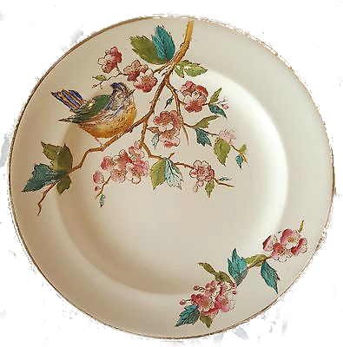
Jane is given a pastry tart to eat by Bessie. It is served on a beautiful china plate that Jane has often asked to see and admire.
Jane says:
‘Vain favour! coming, like most other favours long deferred and often wished for, too late!’
Jane Eyre
In pairs, discuss what the ‘favour’ Jane is given, and why it comes ‘too late’.

Slide 12
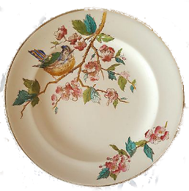
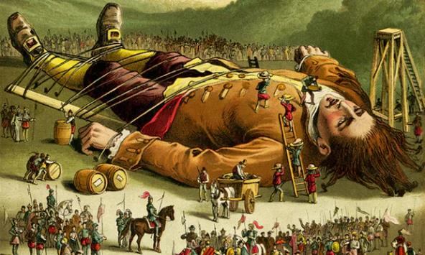
‘Vain favour! coming, like most other favours long deferred and often wished for, too late!’
Jane is finally allowed to see the plate that she admires, and is even given a pastry to eat. This would be a treat for Jane, and shows how Bessie is trying to be nice to Jane after what happened in the red-room.
However, Jane no longer wishes to see the plate. It was offered too long after the time Jane wanted to see it. The trauma of the red-room and the way she was treated by Bessie and Mrs Reed means that Jane does not find pleasure in things she used to enjoy.
Jane Eyre
‘Gulliver’s Travels’

Slide 13
A ballad is a song or poem that tells a story.
Bessie is about to sing a ballad to Jane about a ‘poor orphan child’.
Let’s read.
Chapter 3
Read from, ‘Bessie had now…’ (page 26)
Read to, ‘… at Gateshead Hall.’ (page 28)
Jane Eyre
♪
Bessie

Slide 14
Bessie had now finished dusting and tidying the room, and having washed her hands, she opened a certain little drawer, full of splendid shreds of silk and satin, and began making a new bonnet for Georgiana’s doll. Meantime she sang: her song was—
“In the days when we went gipsying,
A long time ago.”
I had often heard the song before, and always with lively delight; for Bessie had a sweet voice,—at least, I thought so. But now, though her voice was still sweet, I found in its melody an indescribable sadness. Sometimes, preoccupied with her work, she sang the refrain very low, very lingeringly; “A long time ago” came out like the saddest cadence of a funeral hymn. She passed into another ballad, this time a really doleful one.
shreds – small pieces
lingeringly – slow to end
cadence – the rise and fall of the voice
ballad – song or poem that tells a story
Jane Eyre
p. 26

Slide 15
“My feet they are sore, and my limbs they are weary;
Long is the way, and the mountains are wild;
Soon will the twilight close moonless and dreary
Over the path of the poor orphan child.
Why did they send me so far and so lonely,
Up where the moors spread and grey rocks are piled?
Men are hard-hearted, and kind angels only
Watch o’er the steps of a poor orphan child.
Yet distant and soft the night breeze is blowing,
Clouds there are none, and clear stars beam mild,
God, in His mercy, protection is showing,
Comfort and hope to the poor orphan child.
Ev’n should I fall o’er the broken bridge passing,
Or stray in the marshes, by false lights beguiled,
Still will my Father, with promise and blessing,
Take to His bosom the poor orphan child.
There is a thought that for strength should avail me,
Though both of shelter and kindred despoiled;
Heaven is a home, and a rest will not fail me;
God is a friend to the poor orphan child.”
weary – tired
beguiled – to trick someone into doing something
Take to His bosom – love and protect
Jane Eyre
p. 27

Slide 16
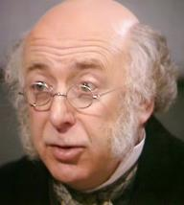
“Come, Miss Jane, don’t cry,” said Bessie as she finished. She might as well have said to the fire, “don’t burn!” but how could she divine the morbid suffering to which I was a prey? In the course of the morning Mr. Lloyd came again.
“What, already up!” said he, as he entered the nursery. “Well, nurse, how is she?”
Bessie answered that I was doing very well.
“Then she ought to look more cheerful. Come here, Miss Jane: your name is Jane, is it not?”
“Yes, sir, Jane Eyre.”
“Well, you have been crying, Miss Jane Eyre; can you tell me what about? Have you any pain?”
“No, sir.”
“Oh! I daresay she is crying because she could not go out with Missis in the carriage,” interposed Bessie.
“Surely not! why, she is too old for such pettishness.”
I thought so too; and my self-esteem being wounded by the false charge, I answered promptly, “I never cried for such a thing in my life: I hate going out in the carriage. I cry because I am miserable.”
“Oh fie, Miss!” said Bessie.
divine – find out by guessing
Missis – Mrs Reed
pettishness - caring and making a fuss about unimportant things
fie – an expression of disgust
Mr Lloyd
Jane Eyre
p.27-8

Slide 17
The good apothecary appeared a little puzzled. I was standing before him; he fixed his eyes on me very steadily: his eyes were small and grey; not very bright, but I dare say I should think them shrewd now: he had a hard-featured yet good-natured looking face. Having considered me at leisure, he said—
“What made you ill yesterday?”
“She had a fall,” said Bessie, again putting in her word.
“Fall! why, that is like a baby again! Can’t she manage to walk at her age? She must be eight or nine years old.”
“I was knocked down,” was the blunt explanation, jerked out of me by another pang of mortified pride; “but that did not make me ill,” I added; while Mr. Lloyd helped himself to a pinch of snuff.
As he was returning the box to his waistcoat pocket, a loud bell rang for the servants’ dinner; he knew what it was. “That’s for you, nurse,” said he; “you can go down; I’ll give Miss Jane a lecture till you come back.”
Bessie would rather have stayed, but she was obliged to go, because punctuality at meals was rigidly enforced at Gateshead Hall.
shrewd – clever at understanding
mortified – ashamed or embarrassed
snuff – powdered tobacco
Jane Eyre
p. 28

Slide 18
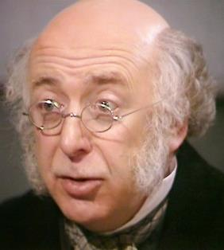
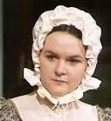
Mr Lloyd
Bessie
Quick check
Discuss the answers to these questions in pairs.
Jane Eyre
What reason does Bessie give to Mr Lloyd for Jane crying?
Why is Jane’s ‘self-esteem wounded’ by this reason from Bessie?
Why can’t Bessie stay in the nursery with Jane and Mr Lloyd?

Slide 19
Mr Lloyd
Bessie
Quick check
Jane Eyre
Bessie says that Jane is crying because she could not go out with Mrs Reed and the others in the carriage.
Jane’s self-esteem is wounded by this because it is not true: she doesn’t care that she isn’t out with her aunt. Jane feels that she is too old to be accused of such silly things.
Bessie leaves the nursery because she needs to be on time for dinner.

Slide 20
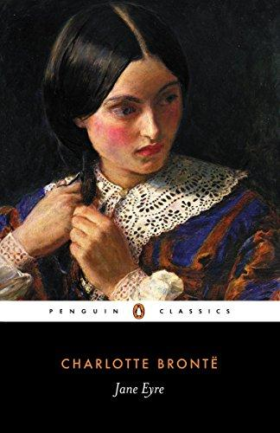
Let’s continue reading.
Chapter 3
Read from, ‘“The fall did not make you ill”’ (page 28)
Read to, ‘“Would you like to go to school?”’ (page 30)
Jane Eyre

Slide 21
“The fall did not make you ill; what did, then?” pursued Mr. Lloyd when Bessie was gone.
“I was shut up in a room where there is a ghost till after dark.”
I saw Mr. Lloyd smile and frown at the same time.
“Ghost! What, you are a baby after all! You are afraid of ghosts?”
“Of Mr. Reed’s ghost I am: he died in that room, and was laid out there. Neither Bessie nor any one else will go into it at night, if they can help it; and it was cruel to shut me up alone without a candle,—so cruel that I think I shall never forget it.”
“Nonsense! And is it that makes you so miserable? Are you afraid now in daylight?”
“No: but night will come again before long: and besides,—I am unhappy,—very unhappy, for other things.”
“What other things? Can you tell me some of them?”
pursued – continued
Jane Eyre
p. 28

Slide 22
How much I wished to reply fully to this question! How difficult it was to frame any answer! Children can feel, but they cannot analyse their feelings; and if the analysis is partially effected in thought, they know not how to express the result of the process in words. Fearful, however, of losing this first and only opportunity of relieving my grief by imparting it, I, after a disturbed pause, contrived to frame a meagre, though, as far as it went, true response.
“For one thing, I have no father or mother, brothers or sisters.”
“You have a kind aunt and cousins.”
Again I paused; then bunglingly enounced—
“But John Reed knocked me down, and my aunt shut me up in the red-room.”
Mr. Lloyd a second time produced his snuff-
“Don’t you think Gateshead Hall a very beautiful house?” asked he. “Are you not very thankful to have such a fine place to live at?”
“It is not my house, sir; and Abbot says I have less right to be here than a servant.”
“Pooh! you can’t be silly enough to wish to leave such a splendid place?”
frame – to put into words
impart – to communicate
bunglingly enounced – said clumsily
Pooh! – Rubbish!
Jane Eyre
p. 29

Slide 23
“If I had anywhere else to go, I should be glad to leave it; but I can never get away from Gateshead till I am a woman.”
“Perhaps you may—who knows? Have you any relations besides Mrs. Reed?”
“I think not, sir.”
“None belonging to your father?”
“I don’t know. I asked Aunt Reed once, and she said possibly I might have some poor, low relations called Eyre, but she knew nothing about them.”
“If you had such, would you like to go to them?”
I reflected. Poverty looks grim to grown people; still more so to children: they have not much idea of industrious, working, respectable poverty; they think of the word only as connected with ragged clothes, scanty food, fireless grates, rude manners, and debasing vices: poverty for me was synonymous with degradation.
“No; I should not like to belong to poor people,” was my reply.
“Not even if they were kind to you?”
industrious – hard working
scanty – little, poor
grates – fireplaces
debasing vices –evil ways
Jane Eyre
p. 29

Slide 24
I shook my head: I could not see how poor people had the means of being kind; and then to learn to speak like them, to adopt their manners, to be uneducated, to grow up like one of the poor women I saw sometimes nursing their children or washing their clothes at the cottage doors of the village of Gateshead: no, I was not heroic enough to purchase liberty at the price of caste.
“But are your relatives so very poor? Are they working people?”
“I cannot tell; Aunt Reed says if I have any, they must be a beggarly set: I should not like to go a begging.”
“Would you like to go to school?”
liberty – freedom
caste – social class
Jane Eyre
p. 30

Slide 25
Mr Lloyd talks to Jane about why she is so unhappy.
“The fall did not make you ill; what did, then?” pursued Mr. Lloyd when Bessie was gone.
“Perhaps you may—who knows? Have you any relations besides Mrs. Reed?”
“And is it that makes you so miserable?”
Jane Eyre
“Are you not very thankful to have such a fine place to live at?”
“Would you like to go to school?”
Mr Lloyd
Discuss this question in your pairs:
How does Mr Lloyd treat Jane?

Slide 26
Write a paragraph to answer this question:
How do Mr Lloyd and Bessie treat Jane in comparison to the other characters in the novel?
Extension: Mr Lloyd is an outsider and not a resident of Gateshead. Why is this important?
Mr Lloyd
Mr Lloyd
Bessie

Slide 27
How does Mr Lloyd treat Jane in a kind way? (2)
Mr Lloyd suggests that Jane should be grateful to Mrs Reed for letting her stay at Gateshead.
Mr Lloyd asks Jane why she is so unhappy and listens to her.
Mr Lloyd tells Jane to stay with her father’s family who are poor.
Mr Lloyd thinks that Jane is a baby because she believes in ghosts.
Mr Lloyd asks Jane if she would like to go to school.
Mastery

Slide 28
How does Mr Lloyd treat Jane in a kind way? (2)
Mr Lloyd suggests that Jane should be grateful to Mrs Reed for letting her stay at Gateshead.
Mr Lloyd asks Jane why she is so unhappy and listens to her.
Mr Lloyd tells Jane to stay with her father’s family who are poor.
Mr Lloyd thinks that Jane is a baby because she believes in ghosts.
Mr Lloyd asks Jane if she would like to go to school.
Mastery

Slide 29
Love this lesson?
Have suggestions for improvements?
Does something need fixing?
Feedback
Please let us know!
Fill in this feedback form so that we can keep improving.

