Slide 1
Assessment objectives
AO1 – the way you write and respond to texts
Articulate informed, personal and creative responses to literary texts, using associated concepts and terminology, and coherent, accurate written expression
A02 – how you analyse the impact of language, form and structure
Analyse ways in which meanings are shaped in literary texts
AO5 – your ability to interpret texts in multiple ways
Explore literary texts informed by different interpretations

Slide 2
The question is divided into two parts.
The first part will ask you to consider an extract from the play and analyse it closely, considering its relation to the play as a whole.
The second part will ask you a more general question about the play, such as: ‘In the world of Hamlet, trust is a rare commodity.’ How far and in what ways do you agree with this view of the play?

Slide 3
ASSESSMENT – 75 MINUTES, CLOSED BOOK
Part 1- close analysis of extract from play /15
AO2 (75%) Detailed discussion of effects of language, form and structure/ effective analytical methods/ use of quotations
AO1 (25%) Detailed understanding of the text/ coherent argument/ use of critical concepts and terminology
Part 2 – critical argument based on an interpretation /15
AO1 (50%) Detailed understanding of the text/ coherent argument/ use of critical concepts and terminology
AO5 (50%) Exploration of different interpretations/ critical reception and views over time

Slide 4
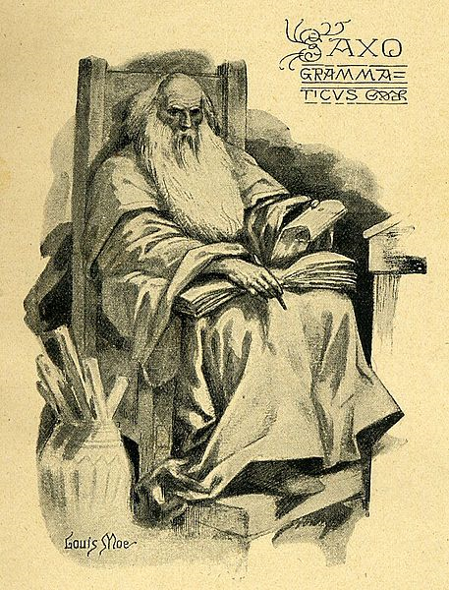
A story of revenge… Saxo Grammaticus
Based on a twelfth century revenge story about an early Prince of Denmark, Amleth.
Published in Latin in 1514 but Shakespeare probably read 1570 French translation of the story by Francois de Belleforest
Other influences: Roman dramatist, Seneca, Thomas Kyd’s The Spanish Tragedy, and a play, now lost, known as Ur-Hamlet

Slide 5
Amleth’s father is the King of Denmark. He defeats the King of Norway in a duel, but is murdered by Feng, his own brother. Feng quickly marries the queen, Gerutha, Amleth’s mother. In pursuit of revenge, Amleth feigns madness (in Danish, amleth meant simpleton or idiot). But his language is such a mix of insanity and cleverness that he is tested in several ways by Feng.
Amleth is sent away to England but returns, battling successfully with several members of Feng’s court, before seeking out Feng and killing him. He makes a public speech to defend and justify what he has done; the people are delighted, feeling Amleth has freed them from Feng’s tyranny. Amleth is declared King and has a long successful reign, ending only when is killed in battle.
ONGOING QUESTIONS: WHAT ADDITIONS/ CHANGES DOES SHAKESPEARE MAKE TO THE ORIGINAL SOURCE STORY AND WHY?

Slide 6
The title
‘The Tragedy of Hamlet, Prince of Denmark’
Now known simply as ‘Hamlet’ – what are the implications?

Slide 7
Who’s there?
What kind of atmosphere does this first line create?

Slide 8
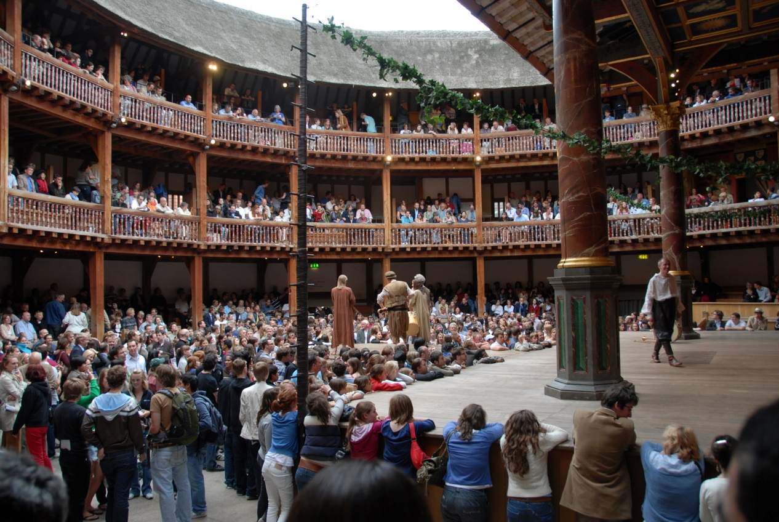
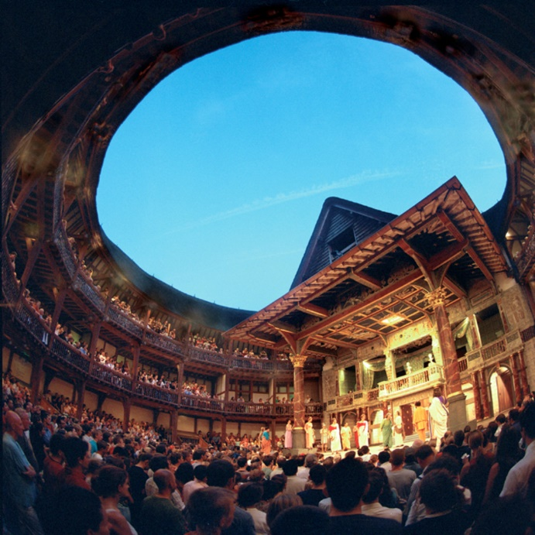
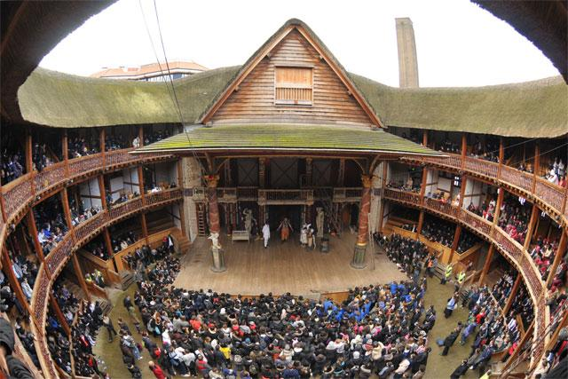
The Globe Theatre, London

Slide 9
Drama activity – two volunteers please!
Focusing on gaps in metre… how do they contribute to atmosphere?

Slide 10
Reminder – iambic pentameter
Heartbeat rhythm
Closest to natural rhythms of English speech
Christopher Marlowe, Shakespeare’s contemporary, credited with its invention
10 syllable line, every other syllable emphasised.
. / . / . / . / . /
I’M HERE TO SEE A MAN ABOUT A DOG

Slide 11
When we begin… ‘in medias res’ … in the middle of things…
Hamlet’s father, the King of Denmark has died
Within a couple of months, his uncle, Claudius has assumed the throne and married Hamlet’s mother, Gertrude
Hamlet has returned from the University of Wittenberg where he has been studying
Meanwhile, in Norway, Fortinbras, a young prince is preparing to attack Denmark in revenge for the fact Hamlet’s father (also called Hamlet – old Hamlet!) killed his father in a duel.

Slide 12
First questions….
What’s the scene about? What are the characters actually saying? What does this section add to the play as a whole?

Slide 13
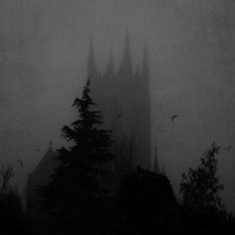
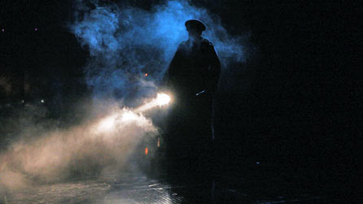
Act 1, scene 1 – reminders as we read
Barnardo, Marcellus, Francisco are soldiers on sentry duty
Horatio is a good friend of Hamlet’s and a fellow scholar
The king/ Old Hamlet is Hamlet’s dead father
Hamlet referred to first as ‘young Hamlet’
Fortinbras of Norway is the old King that Hamlet’s father killed; ‘young Fortinbras’ is his son
We are given at outsider’s perspective of the court – why might this be?

Slide 14
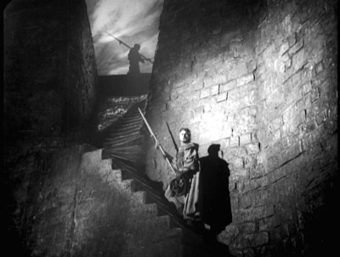
Summing up – make notes
Key quotes from the scene?
Most important techniques used here?
Themes and ideas?
As an opening, what kind of expectations does this scene create?

Slide 15
‘In the opening scene, the soldiers do something fundamental to the play: they ask questions...Questions are only asked when people are uncertain. This is the world of Hamlet.’ (Richard Gill, Mastering Shakespeare, p235)
What uncertainties and questions are apparent at the end of the first scene?

