Slide 1
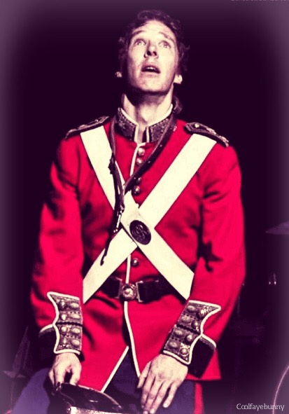
AO3 – Interpretation
Benedict Cumberbatch on the 2015 National Theatre production (Lyndsey Turner, director):
About ‘intergenerational trauma’
Suggested the ghost who urges to Hamlet to the act of murder is traumatised by war and is laying a burden on a generation that has not experienced war directly
The death of the younger generation symbolises this suffering but their deaths are also necessary to purify the ‘corrupt’ kingdom of Denmark
Suggest Hamlet’s role is to disrupt the court and all it symbolises
QUESTION: How did the clothing choices in this production emphasise this?

Slide 2
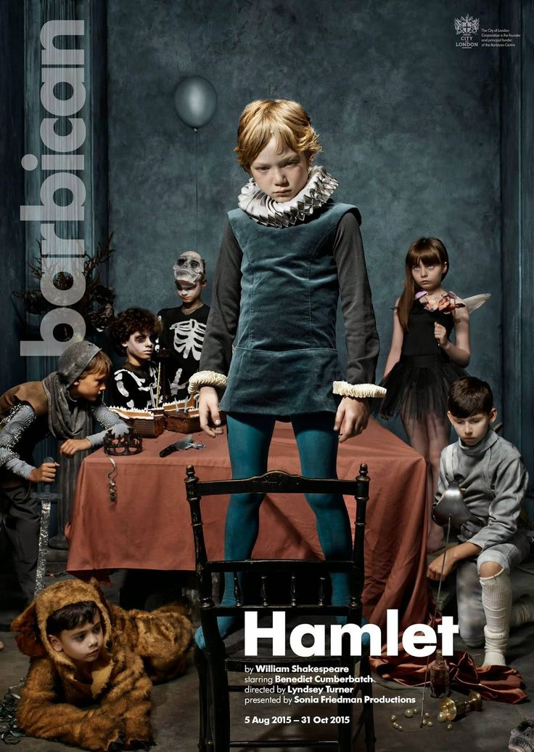
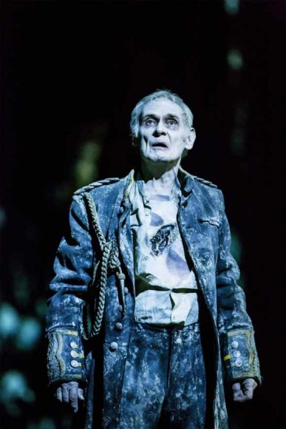
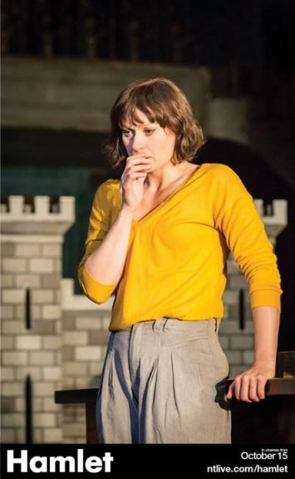
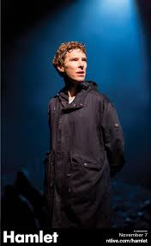
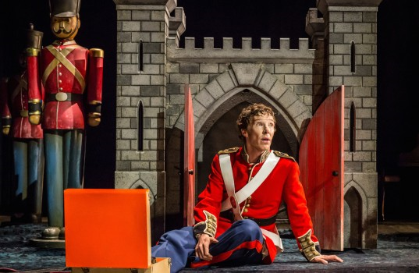
“This is a Hamlet for a world on the edge: a warning from history, and a plea for new ideas from a new generation”
Variety

Slide 3
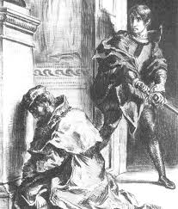
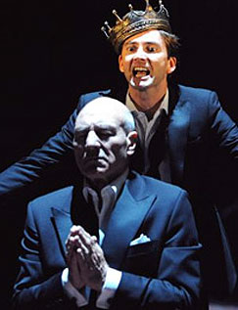
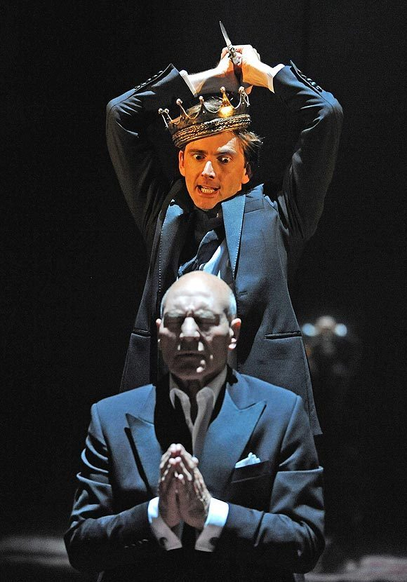
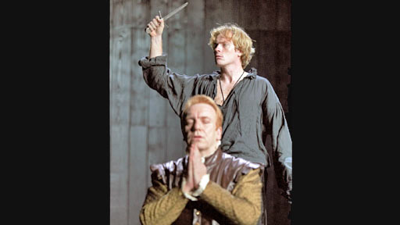
Act 3, scene 4 – Claudius’s guilt and Hamlet’s delay

Slide 4
3.3, LINES 1-27 – Techniques (AO2)
Irony
Metaphor of the body politic
Imagery of feeding/ cannibalism/ parasites
Enjambment
Lexical patterns associated with connection

Slide 5
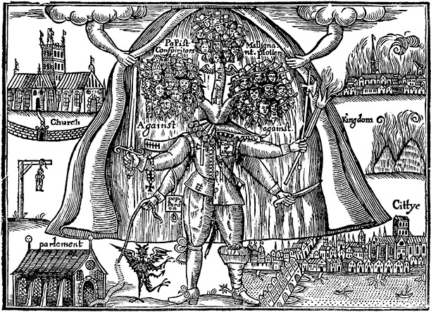
The body politic in Shakespeare
The power of the King lies ultimately in the people.
Together, they form the body politic, with King as the head and the people as the hands, feet, and other necessary organs.
The King has the power to lead, but not without the people to support him.
Shakespeare sees this relationship is symbiotic, with the king's death as a sign of possible disease in the body politic. The process of succession can introduce infectious elements, which can threaten the health of the state.
The body politic, with the King as the head, remains a powerful metaphor, which resonated with Shakespeare's Elizabethan times.

Slide 6
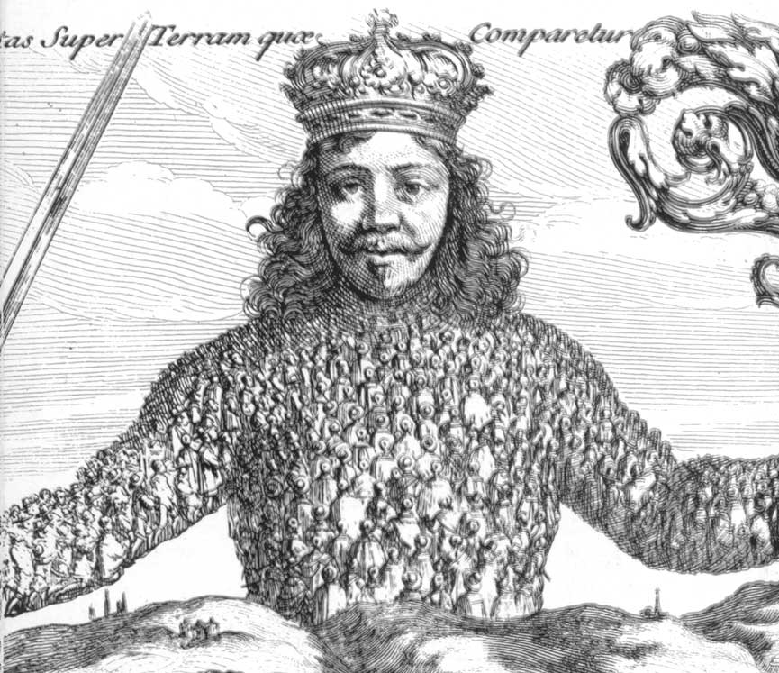
Frontpiece of
Thomas Hobbes ‘Leviathan’ 1651
‘Social contract theory’ of Ethics
All citizens are bound by laws because the laws are of the consent of the governed – BUT the King doesn’t rule by Divine Right but by the full and rightful consent of the governed majority.
Shakespeare’s work (predates this of course!) is full of references to the body politic.
Citizens are often seen as assets to be exploited in the body politic.

Slide 7
Questions to consider about the ‘body politic’
If the head of the body politic is a corrupt individual, what are the implications?
To what extent should the needs of the whole outweigh the needs of the individual?
Is the compromise of individual liberty necessary if the ‘body’ is to function well as a whole?
How do these ideas link to ‘Hamlet’?

Slide 8
Claudius
Note:
The word ‘offence’ is used four times
The use of the word ‘rank’ – foul smelling
The order in which he places the reasons for killing his brother
The recurrence of plosive ‘b’ and ‘d’, and consonance with the use of sharp ‘c’
Monosyllabic words and their effect on rhythm

Slide 9
Questions – Claudius
How genuine is Claudius’s regret/repentance?
What ‘offence’ does Claudius think he has committed?
How do the words ‘rank’ and ‘smell’ link to Hamlet’s preoccupation with ‘things rank and gross and nature’?
What state of mind is Claudius in here? How do the punctuation, pauses, line division, metre and use of rhetorical questions display his mood?
Is Claudius remorseful? Self-pitying?
What similarities can you find here between Claudius and Hamlet?

Slide 10
Hamlet
Falls in to three sections (as is common with Hamlet)
Now is my chance to kill him
But he is praying so I would send him to heaven
I’ll wait until I can send him to hell
Note:
Irony is that Claudius isn’t praying; he is unable to!
Echoes of earlier performance by players of Pyrrhus
Use of rhetorical questions

Slide 11
Questions - Hamlet
Do we take Hamlet’s reasoning at face value here or do you think he is really reluctant to actually kill Claudius? If so, what might be the reason? Consider:
The opening (‘Now might I do it..’)
The very real belief (of Claudius too) in hell and damnation
What the audience would remember and believe at this point?
How could this be considered a turning point in the play?
Why doesn’t Hamlet use this opportunity to kill Claudius?
Are Hamlet’s reasons for not taking action merely a form of self-deception?
Is Hamlet’s delay his fatal flaw (hamartia) and the reason for his downfall? Or is something else to blame?

Slide 12
Linguistic analysis (A01/A02)
AIM: Approach a text using stylistic methods, focusing on:
Lexis (word choices)
Grammar
Sound patterns
Graphological features (punctuation, lineation, layout)

Slide 13
INTRO: Reading the text and first interpretation
Read Act 3, scene 4
Make a note of your first thoughts, then put to one side

Slide 14
STAGE 1: an initial focus on words
Nouns, verbs, adjectives and most adverbs can all be described as open class (or content) words
Prepositions, conjunctions, determiners, pronouns are all closed class (or function) words
TASK: Organise the section of the text you have been given (Claudius or Hamlet) into the table, allowing you to see which types of words feature in (or perhaps dominate) different sections

Slide 15
Sentence or line | Nouns | Main verbs | Adverbs | Adjectives | Prepositions, conjunctions, determiners, pronouns
36 | offence heaven | smells is |  |  | my it To
37 | curse | Hath |  | Eldest primal | it upon’t the
38 | brother murder | pray | not |  | a I
39 | inclination will | be |  | Sharp | though
40 | guilt intent | defeats |  | Stronger Strong | my my
41 | man business |  |  | double bound | and a to

Slide 16
Stage 2: closer look at word classes
NOUNS
Can you recognise any lexical groupings?
Concrete or abstract nouns?
Any unusual words which stand out from the rest?
Particular use of monosyllabic or polysyllabic words?
VERBS
Tense
Concrete/abstract
Active/passive
The mood of the verb: declarative (declares something to be the case); interrogative (asks a question); imperative (expresses commands, advises, prohibits); conditional or modal (expresses possibility or necessity e.g. we must go)
ADJECTIVES AND ADVERBS
The number and type of adverbs and adjectives
How the adverbs and adjectives are used
OTHER WORDS
Is there anything to note about these words?

Slide 17
Stage 3: Repetition
Is there repetition in the text? What is foregrounded/suggested/implied by it? Try to consider repetition of:
Lexis
Sounds (alliteration, assonance, rhyme)
Images
Grammatical structures

Slide 18
Stage 4: pulling it all together
After completing a detailed linguistic textual analysis, step back and consider the insights you have gained.
What strikes you as particularly interesting or meaningful?
How could you use these insights to develop your interpretation of the text?
Look back at your initial thoughts on the scene – have your ideas moved on? Changed? Been clarified?

