Slide 1
In this lesson, students will be mastering the following:
Mastery Content:
Jane enjoys the springtime at Lowood School
Disease sweeps through the school and lots of girls fall ill; of these, many die
Brontë juxtaposes the joy and elation of spring with the tragedy of death at Lowood School
Jane’s childhood is tragic, but not entirely so
Learning Objective:
To explore how Jane reacts to more suffering at Lowood.
Mastery Content

Slide 2
Do Now: Disease affected both rich and poor people. True or False? Why did disease spread quickly in the Victorian era? In the Victorian era, bacteria had not been discovered. True or False? What did Charlotte Brontë and all of her siblings die of? Extension: Which characters have a positive influence on Jane at Lowood? Explain how they positively influence Jane.
Reading Before reading, explain the the season has changed from winter to spring. Read from, ‘But the privations…’ (page 90) Read to, ‘…is another question.’ (page 91) The quotations and image following the reading can be used to assess students’ comprehension of the preceding passage. In any case, the selected quotations all illustrate how life at Lowood become more tolerable and less severe. Reinforce this with students.
Reading Read from, ‘That forest dell…’ (page 91) Read to, ‘…our mutual intercourse.’ (page 93) Make link to Do Now: hygiene was poor in Victorian era, and people did not know that disease was spread by bacteria. Brontë here suggests that the disease comes from the bad water at Lowood, which we now know is not true. She is accurate in saying that the girls’ starvation does not help their health, through. The images after reading will allow you to assess students’ comprehension of the previous passage. Note that the wrong images show built up areas, and people contracting illnesses through dirty water – this is not what happens in ‘Jane Eyre’.
Jane’s childhood There are two statements on Jane’s childhood. Students work in pairs to debate these statements using evidence from the novel to support their viewpoint. Following this, students can write down their own opinion on the statements. | Consider how you will allocate the viewpoints. They are deliberately polarising. There is enough support and information presented throughout this lesson (and previous lessons) to allow either viewpoint to devise a sustained argument. You may also wish to open this activity into a larger group debate: if so, consider how you will allocate roles and manage the class in this context.
Fortnightly Quiz Ask students to complete fortnightly quiz
Lesson Guide

Slide 3
Tuesday, 14 June 2022
More suffering for Jane
Do Now:
Disease affected both rich and poor people. True.
Many places were unhygienic and overcrowded. Because of this, diseases spread quickly.
In the Victorian era, bacteria had not been discovered. True.
Charlotte Brontë and all of her siblings died of tuberculosis. In the Victorian era, this disease was known as consumption.
Do Now:
Disease affected both rich and poor people. True or False?
Why did disease spread quickly in the Victorian era?
In the Victorian era, bacteria had not been discovered. True or False?
What did Charlotte Brontë and all of her siblings die of?
Do Now
Extension: Through meeting Helen Burns and Miss Temple, Jane has become more mature and thoughtful at Lowood School.
Extension: Which characters have a positive influence on Jane at Lowood? Explain how they positively influence Jane.

Slide 4
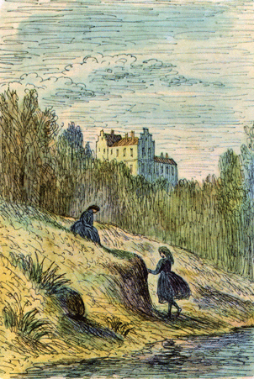
So far, we have read about winter at Lowood School.
In today’s lesson, Jane will describe her life at Lowood School in the spring.
‘Spring drew on – she was indeed already come; the frosts of winter had ceased.’
Jane Eyre

Slide 5
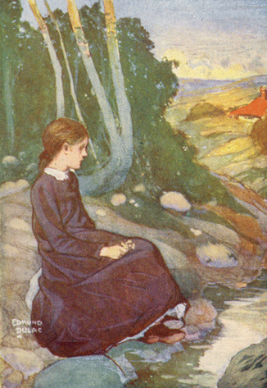
Let’s find out what happens to Jane next at Lowood School.
Read from, ‘But the privations…’ (page 90)
Read to, ‘…is another question.’ (page 91)
Jane Eyre

Slide 6
But the privations, or rather hardships, of Lowood lessened. Spring drew on – she was indeed already come; the frosts of winter had ceased; its snows were melted, its cutting winds ameliorated. My wretched feet, flayed and swollen to lameness by the sharp air of January, began to heal and subside under the gentler breathings of April; the nights and mornings no longer by their Canadian temperature froze the very blood in our veins; we could now endure the play-hour passed in the garden; sometimes on a sunny day it began even to be pleasant and genial, and a greenness grew over those brown beds, which, freshing daily, suggested the thought that Hope traversed them at night, and left each morning brighter traces of her steps. Flowers peeped out amongst the leaves: snowdrops, crocuses, purple auriculas, and golden-eyed pansies. On Thursday afternoons (half-holidays) we now took walks, and found still sweeter flowers opening by the wayside under the hedges.
ameliorated – improved
wretched – tormented
flayed – beaten
genial – friendly
freshing – newly made
traversed – crossed
Jane Eyre
p.90

Slide 7
I discovered, too, that a great pleasure, an enjoyment which the horizon only bounded, lay all outside the high and spike-guarded walls of our garden: this pleasure consisted in prospect of noble summits girdling a great hill-hollow, rich in verdure and shadow; in a bright beck, full of dark stones and sparkling eddies. How different had this scene looked when I viewed it laid out beneath the iron sky of winter, stiffened in frost, shrouded with snow! – when mists as chill as death wandered to the impulse of east winds along those purple peaks, and rolled down ‘ing’ and holm till they blended with the frozen fog of the beck! That beck itself was then a torrent, turbid and curbless; it tore asunder the wood, and sent a raving sound through the air, often thickened with wild rain or whirling sleet; and for the forest on its banks, that showed only ranks of skeletons.
April advanced to May – a bright serene May it was; days of blue sky, placid sunshine, and soft western or southern gales filled up its duration.
verdure – greenery
beck – stream
eddies – whirlpools
ing – meadow
holm – flood plain
torrent – violent stream
turbid – muddy
curbless – no restraint
asunder – apart
placid – gentle
Jane Eyre
p.90-91

Slide 8
And now vegetation matured with vigour; Lowood shook loose its tresses; it became all green, all flowery; its greater elm, ash, and oak skeletons were restored to majestic life; woodland plants sprang up profusely in its recesses; unnumbered varieties of moss filled its hollows, and it made a strange ground-sunshine out of the wealth of its wild primrose plants: I have seen their pale gold gleam in overshadowed spots like scatterings of the sweetest lustre. All this I enjoyed often and fully, free, unwatched, and almost alone: for this unwonted liberty and pleasure there was a cause, to which it now becomes my task to advert.
Have I not described a pleasant site for a dwelling, when I speak of it as bosomed in hill and wood, and rising from the verge of a stream? Assuredly, pleasant enough, but whether healthy or not is another question.
vegetation– plants
vigour – force
profusely – plentifully
unwonted liberty-
unusual freedom
dwelling – home
Jane Eyre
p.91

Slide 9
Which quotation best describes this image?
A. My wretched feet, flayed and swollen to lameness by the sharp air of January, began to heal
B. we could now endure the play-hour passed in the garden
Jane Eyre
C. I discovered, too, that a great pleasure lay all outside the high and spike-guarded walls of our garden: this pleasure consisted in a bright beck, full of dark stones and sparkling eddies.
D. On Thursday afternoons (half-holidays) we now took walks, and found still sweeter flowers opening by the wayside under the hedges.

Slide 10
All this I enjoyed often and fully, free, unwatched, and almost alone: for this unwonted liberty and pleasure there was a cause.
Jane was able to enjoy the countryside around Lowood School by herself a lot. There was a reason for this.
Let’s find out why Jane was able to spend so much time outside by herself.
Read from, ‘That forest dell…’ (page 91)
Read to, ‘…our mutual intercourse.’ (page 93)
Jane Eyre

Slide 11
That forest dell, where Lowood lay, was the cradle of fog and fog-bred pestilence; which, quickening with the quickening spring, crept into the Orphan Asylum, breathed typhus through its crowded schoolroom and dormitory, and, ere May arrived, transformed the seminary into a hospital.
Semi-starvation and neglected colds had predisposed most of the pupils to receive infection: forty-five out of the eighty girls lay ill at one time. Classes were broken up, rules relaxed. The few who continued well were allowed almost unlimited licence; because the medical attendant insisted on the necessity of frequent exercise to keep them in health: and had it been otherwise, no one had leisure to watch or restrain them. Miss Temple’s whole attention was absorbed by the patients: she lived in the sick-room, never quitting it except to snatch a few hours’ rest at night.
typhus – an infectious disease
predisposed – made them more vulnerable
licence – freedom
Jane Eyre
‘fog-bred pestilence’ – This refers to the ancient concept of ‘miasma’ (an unhealthy smell) believed to be the source of plague: toxic fumes and effluvia (harmful smells) were believed to rise as contaminants from the bowels of the earth. The existence of bacteria was not known yet. Therefore the marshy air of Lowood (literally ‘low wood’) carries the disease the marsh releases. Brontë attributed physical health to high ground.
p.91

Slide 12
The teachers were fully occupied with packing up and making other necessary preparations for the departure of those girls who were fortunate enough to have friends and relations able and willing to remove them from the seat of contagion. Many, already smitten, went home only to die: some died at the school, and were buried quietly and quickly, the nature of the malady forbidding delay.
While disease had thus become an inhabitant of Lowood, and death its frequent visitor; while there was gloom and fear within its walls; while its rooms and passages steamed with hospital smells, the drug and the pastille striving vainly to overcome the effluvia of mortality, that bright May shone unclouded over the bold hills and beautiful woodland out of doors. Its garden, too, glowed with flowers: hollyhocks had sprung up tall as trees, lilies had opened, tulips and roses were in bloom; the borders of the little beds were gay with pink thrift and crimson double daisies; the sweetbriars gave out, morning and evening, their scent of spice and apples; and these fragrant treasures were all useless for most of the inmates of Lowood, except to furnish now and then a handful of herbs and blossoms to put in a coffin.
contagion – infection
smitten – stricken
malady – illness
pastille – aromatic paste
effluvia – harmful smell
mortality – death
Jane Eyre
p.91-92

Slide 13
But I, and the rest who continued well, enjoyed fully the beauties of the scene, and season: they let us ramble in the wood, like gipsies, from morning till night; we did what we liked, went where we liked: we lived better too. Mr Brocklehurst and his family never came near Lowood now: household matters were not scrutinised into; the cross housekeeper was gone, driven away by the fear of infection; her successor, who had been matron at the Lowton Dispensary, unused to the ways of her new abode, provided with comparative liberality. Besides, there were fewer to feed: the sick could eat little; our breakfast-basins were better filled: when there was no time to prepare a regular dinner, which often happened, she would give us a large piece of cold pie, or a thick slice of bread and cheese, and this we carried away with us to the wood, were we each chose the spot we liked best, and dined sumptuously.
My favourite seat was a smooth and broad stone, rising white and dry from the very middle of the beck, and only to be got at by wading through the water; a feat I accomplished barefoot.
ramble – stroll
abode – home
liberality – kindness
sumptuously – extravagantly
Jane Eyre
p.92

Slide 14
The stone was just broad enough to accommodate, comfortably, another girl and me, at that time my chosen comrade – one Mary Ann Wilson; a shrewd, observant personage, whose society I took pleasure in, partly because she was witty and original, and partly because she had a manner which set me at my ease. Some years older than I, she knew more of the world, and could tell me many things I liked to hear: with her my curiosity found gratification: to my faults also she gave ample indulgence, never imposing curb or rein on anything I said. She had a turn for narrative, I for analysis; she liked to inform, I to question; so we got on swimmingly together, deriving much entertainment, if not much improvement, from our mutual intercourse.
comrade – friend
shrewd – smart
personage – person
gratification – satisfaction, pleasure
Jane Eyre
p.92-93

Slide 15
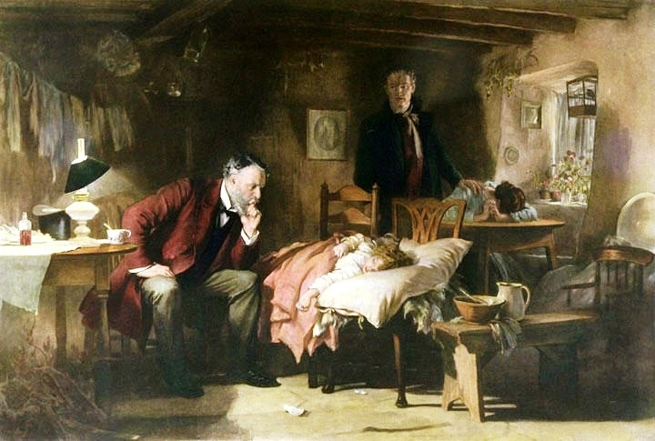
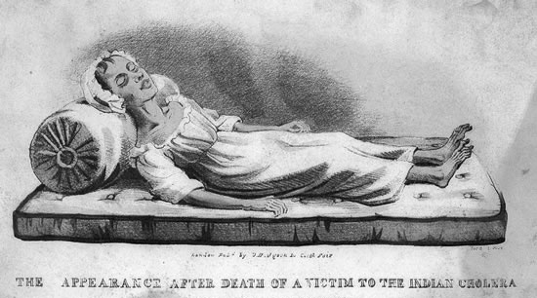
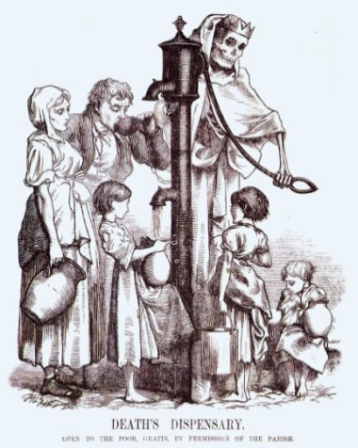
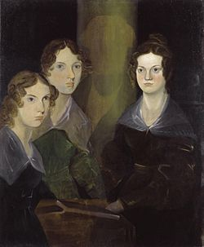
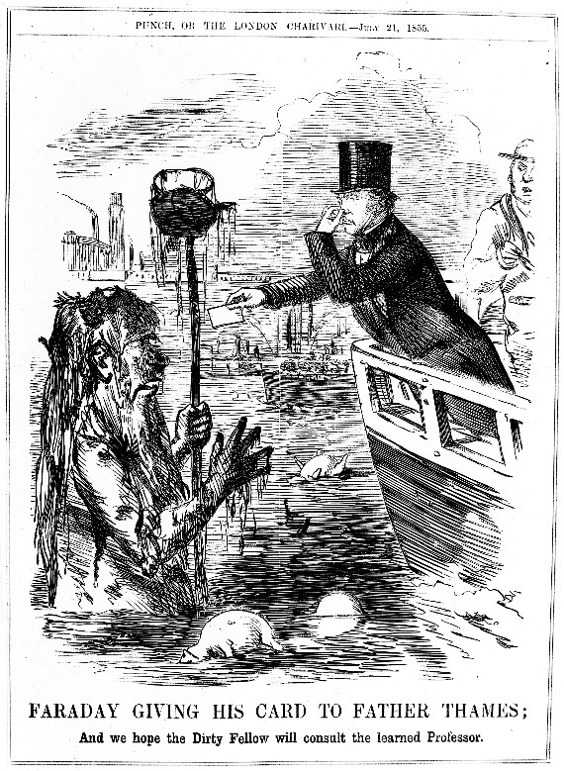
Which image(s) best illustrate the passage we have just read?
A
B
Jane Eyre
C
D
E

Slide 16
Which image(s) best illustrate the passage we have just read?
A
B
Jane Eyre
You could have chosen either of these images.
Image A shows how doctors were trying to treat the girls at Lowood from their sicknesses.
Image B shows that many girls died from typhus at Lowood School.

Slide 17
A. Charlotte Brontë shows Jane’s childhood experiences as entirely miserable. Any happiness she might be able to feel is cancelled out by a new tragedy in her life.
B. Even though Jane has a difficult childhood, Brontë shows a reader that there is always a reason for Jane to remain optimistic about the future. She always has at least one positive influence in her life.
Childhood
You are going to debate these two statements in pairs.
One person will agree with statement A.
The other person will agree with statement B.

Slide 18
A. Charlotte Brontë shows Jane’s childhood experiences as entirely miserable. Any happiness she might be able to feel is cancelled out by a new tragedy in her life.
B. Even though Jane has a difficult childhood, Brontë shows a reader that there is always a reason for Jane to remain optimistic about the future. She always has at least one positive influence in her life.
Childhood
Which statement do you agree with?
Write down your answer with reasons. You should use evidence from the novel to support your opinion.

Slide 19
Quiz time!
Circle the correct answers for quiz 5.
Fortnightly quiz

Slide 20
Quiz answers
a e
e
b
a d e
a b
a d
b c
b
b d e
b d
Answers

Slide 21
Love this lesson?
Have suggestions for improvements?
Does something need fixing?
Feedback
Please let us know!
Fill in this feedback form so that we can keep improving.

