Slide 1
How do these five quotes contribute towards our understanding of Hamlet’s feelings about death?
O, that this too solid flesh would melt/ Or that the Everlasting had not fix'd/ His canon 'gainst self-slaughter! (1.2)
‘the funeral baked meats/ Did coldly furnish the marriage table. (1.2)
‘the dread of something after death/ (the undiscovered country…) (3.1)
‘Nothing but to show you how a king may go progress through a beggar.’ (4.3)
‘I see the imminent death of twenty thousand men/ That for a fantasy and a trick of fame/ Go to their graves like beds.’ (4.4)

Slide 2
Act 5, scene 1

Slide 3
Aims
To explore the opening of the graveyard scene, considering the use of dark humour and representations of death in the play
To analyse Ophelia’s funeral and compare Hamlet and Laertes’s responses to her death

Slide 4
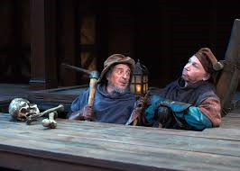
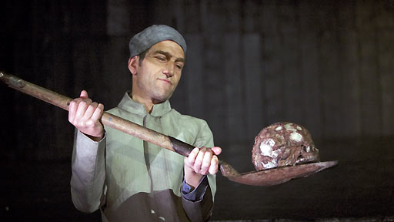
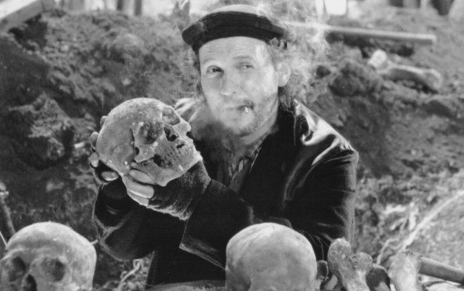
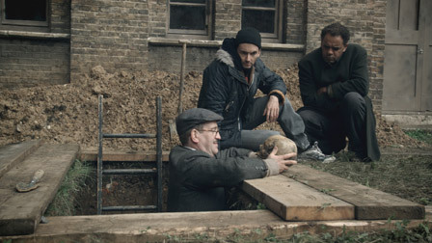
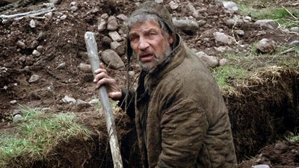
Role of gravediggers… why are they included by Shakespeare? I thought this was supposed to be a tragedy?

Slide 5
Summarise each bullet point into a simple idea
The gravediggers are designated as “clowns” in the stage directions and prompts, and it is important to note that in Shakespeare’s time the word clown referred to a rustic or peasant, and did not mean that the person in question was funny or wore a costume.
The gravediggers represent a humorous type commonly found in Shakespeare’s plays: the clever commoner who gets the better of his social superior through wit. At the Globe Theatre, this type of character may have particularly appealed to the “groundlings,” the members of the audience who could not afford seats and thus stood on the ground. Though they are usually figures of merriment, in this scene the gravediggers assume a rather macabre tone, since their jests and jibes are all made in a cemetery, among bones of the dead.
Their conversation about Ophelia, however, furthers an important theme in the play: the question of the moral legitimacy of suicide under theological law. By giving this serious subject a darkly comic interpretation, Shakespeare essentially makes a grotesque parody of Hamlet’s earlier “To be, or not to be” soliloquy (III.i), indicating the collapse of every lasting value in the play into uncertainty and absurdity.

Slide 6
5.1 Lines 1-60 – AS WE READ, UNDERLINE:
Quotes that highlight the absurdity of human existence
Quotes that suggest even the ‘common’ people of Denmark have recognised the corruption and hypocrisy of Denmark
Quotes that suggest a recognition of truth/reality
Quotes that comment on society (Elizabethan)
Quotes that suggest death is the only certainty

Slide 7
5.1 Lines 1-60 – key quotes
‘if the water come to him and drown him he drowns not himself
‘if this had not been a gentlewoman…’
‘great folk should have countenance in this world to drown themselves more than their even-Christian’
‘There is no ancient gentlemen but gardeners, ditchers and grave-makers. They hold up Adam’s profession.’
‘the gallows is built stronger than the Church’
On gravemakers: ‘The houses he makes last til domesday’

Slide 8
How do we define this type of humour?
Gallows humour/ dark humour is any humour that treats serious matters, such as death, war, disease, crime, etc., in a light, silly or satirical fashion
Absurd (in literature) focuses on the experiences of characters in situations where they cannot find any inherent purpose in life, most often represented by ultimately meaningless actions and events that call into question the certainty of existential concepts such as truth or value. Common elements in absurdist fiction include satire, dark humour, incongruity, the abasement of reason, and controversy regarding the philosophical condition of being "nothing”.

Slide 9
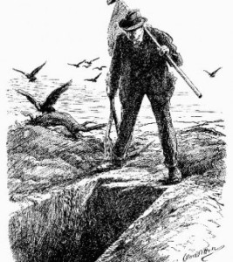
Why is it included here?
Dramatic contrast with soberness of previous scene and Gertrude’s romanticised depiction of Ophelia’s death
Central concerns/themes of the play are shown from a different perspective – the ordinary people of Denmark (the audience?)
Setting of graveyard contrasts the elaborate court and Claudius’s rhetorical flourishes; which is more ‘real’?

Slide 10
5.1 61-205
What evidence do we get that Hamlet has changed?
What evidence do we get that he is still the same?
How does the gravedigger’s view of death contrast with that of Hamlet’s?
How does Hamlet express disgust for the physical corruption/ decay of the body that happens we die?
What does Hamlet begin to realise about death (and life) at this point in the play?

Slide 11
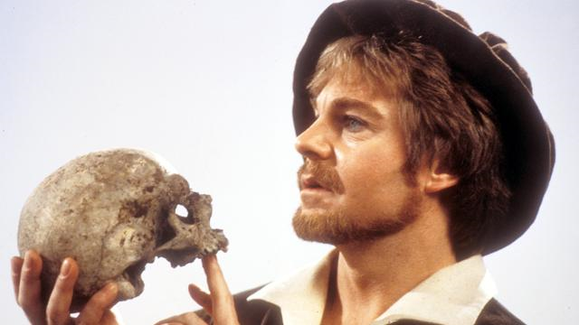
Why do you think this has become such an iconic image?

Slide 12
Death obsessed? (AO5: critical opinions)
G. Wilson Knight notes: "Death is over the whole play. Polonius and Ophelia die during the action, and Ophelia is buried before our eyes. Hamlet arranges the deaths of Rosencrantz and Guildenstern. The plot is set in motion by the murder of Hamlet's father, and the play opens with the apparition of the Ghost."
A.C. Bradley points out that, in his very first long speech of the play, "Oh that this too solid flesh…" Hamlet seems on the verge of total despair, kept from suicide by the simple fact of spiritual awe. He is in the strange position of both wishing for death and fearing it intensely, and this double pressure gives the play much of its drama.

Slide 13
Hamlet and death…key points
Fascinated by physicality of the body; we are flesh and bone in the end (so subject to/slave to physical desires as much, if note more, than spiritual ones)
Hamlet values intellect, thought, spirituality but is arguably disgusted with the physical realities of life
Recognises our intellect (however mighty) is connected to an unruly and decomposing machine
Hamlet fascinated by Yorick because he wonders how Yorick’s skull can really be Yorick’s skull? Does a piece of dead earth, a skull, really have a connection to a person/ a personality?

Slide 14
How do these five quotes contribute towards our understanding of Hamlet’s feelings about death?
O, that this too solid flesh would melt/ Or that the Everlasting had not fix'd/ His canon 'gainst self-slaughter! (1.2)
‘the funeral baked meats/ Did coldly furnish the marriage table. (1.2)
‘the dread of something after death/ (the undiscovered country…) (3.1)
‘Nothing but to show you how a king may go progress through a beggar.’ (4.3)
‘I see the imminent death of twenty thousand men/ That for a fantasy and a trick of fame/ Go to their graves like beds.’ (4.4)

Slide 15
Extract question – timed!
35 minutes – with text
Remember:
Brief overview of scene
Work through extract chronologically OR with one point per paragraph
Quotation – shorter the better
Critical terminology
ANALYSIS OF EFFECTS OF LANGUAGE, STRUCTURE, FORM
Shakespeare suggests…
Nominalisation/ literal language
How does language contribute towards our understanding of character, idea and plot?

Slide 16
5.1 206-end
How does the placement of Ophelia’s funeral after the graveyard sequence serve to highlight the absurdity/futility of ‘society’ in the play?
Why does Hamlet say, ‘This is I,/Hamlet the Dane.’?
How should the audience respond to the fight between Laertes and Hamlet?
Whose feelings for Ophelia seem more genuine and why?

Slide 17
The importance of this scene…AO5 CRITIC (Nicholas Marsh)
This scene has two elements which are present in the rest of the play as a whole:
Society operates by compromising between public/moral laws and the brute facts of power, greed and lust. As a result, society is tainted and can only produce a mixture of good and evil, or the pretence of good covering evil. The play is full of moral compromises.
The complications of society (including people’s attitudes interpretations of each other’s motives, subterfuges etc) are shown to be futile and irrelevant to the eventual outcome.
QUESTION: Where do we see these ideas in this scene and elsewhere in the play?
Notes:
Moral compromises: Claudius trying to pray but failing; Gertrude doesn’t want to think about her infidelity until Ham forces it on her; Fortinbras is bought off by being offered safe passage to attack somebody else; Claudius sees Ham’s mourning is excessive; Laertes persuaded to revenge through poison and trickery
Futility: none of Claudius’ plots work; hiding and eavesdropping cause further disguise and then the death of Polonius; All the advice other characters give to each other/ all Hamlet’s thinking has ZERO effect!! R and G easily fooled and sent to their deaths; the final plot goes horribly wrong and everyone dies.

Slide 18
Final question!
So, you are Hamlet – what are you going to do now? How are you going to resolve events, but also your own mind?
Talk me through it…

