Slide 1
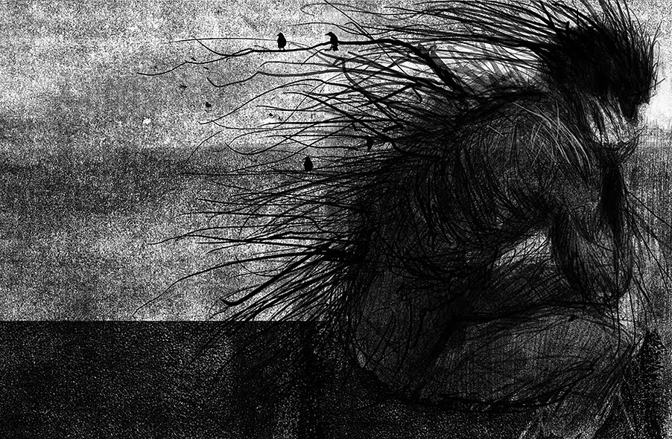
Today’s title is ‘The Monster showed up just after midnight.’
Register Task
Once you have written the date and title, choose five adjectives to describe this illustration and write them in your book.
Notes:
Take ideas from pupils and push them to develop their answers.

Slide 2
Context
A Monster Calls is a novel written by an author called Patrick Ness which was published in 2011.
The idea for the book was actually someone else’s, an author called Siobahn Dowd. Tragically, having started writing, Dowd passed away before she could write the rest.
Patrick Ness was asked to complete the book.
The Carnegie Medal is a prestigious literary award that annually recognises an outstanding new book for children or young adults, and the Greenaway Medal is a British literary award that annually recognises distinguished illustration in a book for children.
In 2012, A Monster Calls became the first book to win both awards.
The story is set in present-day England, and is about a young boy named Conor who is battling with a difficult truth, a truth that he must eventually come to terms with.
Notes:
Following this slide, read the Author’s note from Patrick Ness with the class. It sets up the story nicely.

Slide 3
This term you will…
Read the novel of A Monster Calls
Learn the rules of using dialogue in your writing
Improve your vocabulary
Develop your persuasive writing
Engage in a variety of reading/analytical activities
Finish by completing a writing assessment: your own story!

Slide 4
With the person next to you, make a list of as many answers to the following question as you can think of…
What makes a successful story opening?
Notes:
Partners to share answers with class. After this activity, read the first chapter (A Monster Calls, Page 15 -23)

Slide 5
“The monster showed up just after midnight. As
they do.” (Page 15)
What makes this an effective opening line?
Notes:
Class discussion on why the line is effective. Opportunity for Talk for learning e.g. Think, pounce, bounce

Slide 6
The monster: First impressions
As Conor watched, the uppermost branches of the tree gathered themselves into a great and terrible face, shimmering into a mouth and a nose and even eyes, peering back at him. Other branches twisted around one another, always creaking, always groaning, until they formed two long arms and a second leg to set down beside the main trunk. The rest of the tree gathered itself into a spine and then a torso, the thin, needle-like leaves weaving together to make a green, furry skin that moved and breathed as if there were muscles and lungs underneath. (Page 19-20)
Ness uses a large variety of verbs in this passage to create a clear picture in the readers’ minds. In your books, and on your own, make a list of all the verbs you can find and write next to them whether they are describing ‘Conor’ or the ‘Monster’.

Slide 7
Verbs to describe
As Conor watched, the uppermost branches of the tree gathered themselves into a great and terrible face, shimmering into a mouth and a nose and even eyes, peering back at him. Other branches twisted around one another, always creaking, always groaning, until they formed two long arms and a second leg to set down beside the main trunk. The rest of the tree gathered itself into a spine and then a torso, the thin, needle-like leaves weaving together to make a green, furry skin that moved and breathed as if there were muscles and lungs underneath. (Page 19-20)
Who is the more active character?
Conor – watched
The Monster – gathered, shimmering, peering, twisted, creaking, groaning, formed, set, gathered, weaving, make, moved, breathed, were.
In this extract, Conor is the passive character as he is just watching what is happening. The monster is the active character, and Ness uses specific verbs to give us a vivid description of the Monster from Conor’s garden.
Why do you think Ness has chosen to make Conor so passive in this section?
Notes:
Idea of activity is to focus on specific language and how much detail Ness goes into. This links to vocab starter in Lesson 2.
Take verbal answers to last question. Guide them to understanding that it is showing Conor’s lack of interest in the monster, but don’t go into too much detail why (more scared of nightmare monster)

Slide 8
Final Task
Using no more than half a page in your exercise book, draw your own impression of the Monster. You MUST annotate your drawing with at least FIVE short quotes, including page numbers, that describe what the monster looks like e.g. ‘Other branches twisted around one another’ (P.20) or ‘giant hands’ (P.20)
Notes:
Example on next slide. I didn’t actually draw it.

Slide 9
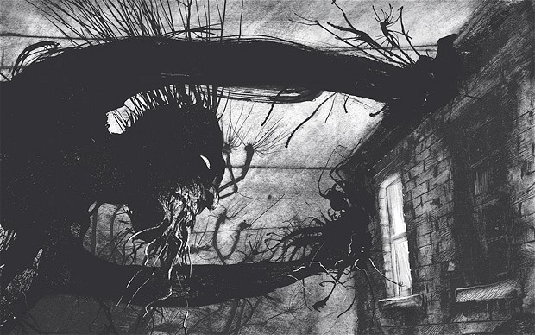
Other branches twisted around one another’ (P.20)
‘giant hands’ (P.20)
Notes:
Example on the board for any pupils struggling. If time, as pupils to show class their drawings and explain which quotes they chose.

Slide 10
Register Task
Once you have written the date and title, I want you to write as many alternatives as you can for the word ‘said’
Lesson Two
Today’s title is ‘I wish you didn’t have to be quite so good.’

Slide 11
The word ‘said’ is boring. You can use much better words in your own work to describe what someone says. Look at the following words. Pick FIVE that you could use in a future writing activity. If you want to challenge yourself, pick EIGHT.
acknowledged
admitted
agreed
answered
argued
asked
barked
begged
bellowed
blustered
bragged
complained
confessed
cried
demanded
denied
giggled
hinted
hissed
howled
interrupted
laughed
lied
mumbled
muttered
nagged
pleaded
promised
questioned
remembered
replied
requested
roared
sang
screamed
screeched
shouted
sighed
snarled
sobbed
threatened
warned
whimpered
whined
whispered
wondered
yelled

Slide 12
We are now going to read the next three chapters of the book, starting from page 24.
The chapters are called Breakfast, School and Life Writing.
Notes:
The writing activity is to write a script following the chapter Life Writing. There is 20 pages of reading this lesson which will take up quite a bit of time so here are some discussion questions if you have time in between chapters:
Breakfast –
‘First Paragraph, What do we learn about Conor’s mum?’
‘How does the writer show us that Conor is used to being on his own’
‘What is wrong with Conor’s mum? Is it obvious? How do we know? (Yew Tree)
‘How does Conor feel about his Grandma coming to stay?’
‘I wish you didn’t have to be quite so good … What does Conor’s mum mean by this?’ (Links to the title)
School –
‘Why did everyone freeze when Lily told Ms Kwan what the boys had said?
Why did Conor lie?’

Slide 13
The Little Talk?
In your books, answer the following questions. You will have an opportunity to share your answers, so keep them to yourself for now.
What was the little talk?
How did you feel about Conor’s behaviour towards Lily at first?
How do you feel after you found at the reason why he acted the way he did?
Notes:
Ask pupils to share answers with class before moving on, as it is important that these topics are discussed before next task. Difficult questions to answer in detail as pupils will need to empathise with characters.

Slide 14
Writing Task
Conor clearly has issues with Lily, and with what has gone on in their past. Based on your understanding of the last chapter, write a short script showing the conversation between Conor and Lily that you think they need to have to make thinks right between them.
Instructions for a script:
You write the name of the character followed by a colon to the left of the page, followed by their dialogue. As the dialogue continues don’t write directly underneath the name so it’s easy to see who’s speaking at all times (see below).
Stage directions are written in italics, but you can use brackets in your books if it easier (Think about how Our Day Out looked!)
Example
(Conor walks over to Lily, and spins her round to face him.)
Conor: Hey! Are you serious? How can you not know why things are the way they are?
Lily: Conor, I really don’t know. All I want to do is help you. I want to help look after you.
(Conor’s head goes down, as if he is about to cry, but he fights back the tears and stares at Lily.)
Conor: I don’t need looking after. I can look after myself. Just stop getting involved in things that don’t concern you!
Notes:
Pupils to write short script between Conor and Lily. Introduction to dialogue which will be developed throughout scheme.
This will see whether they have understood the relationship between the two characters, and if they can predict what may happen.
Plenary – Ask for volunteers to read their work out
If time, pupils can pick a partner and act out their scene for the class.

Slide 15
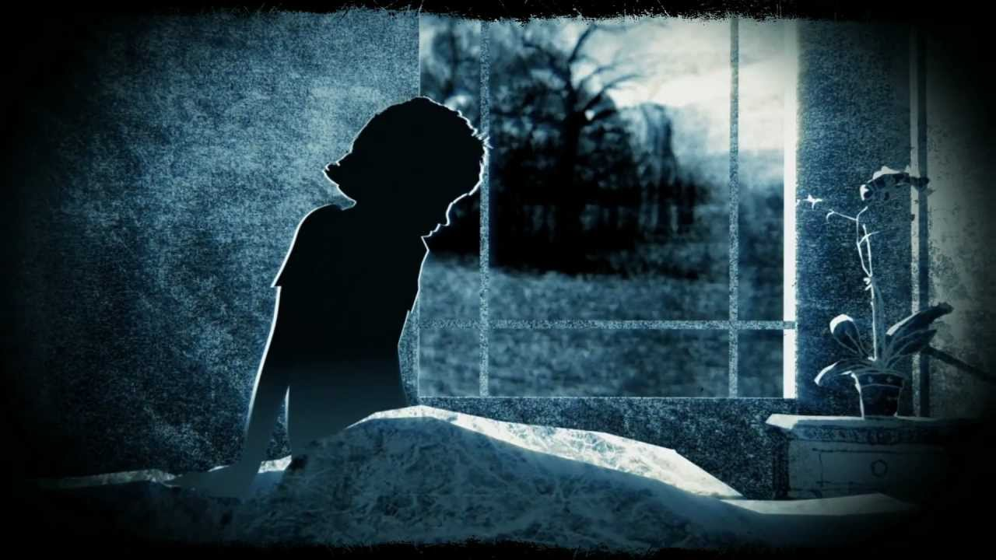
Lesson Three
Today’s title is ‘You look like a tree.’

Slide 16
Think of the word ‘monster’. Mindmap everything you think of when you think of a monster.
Monster
What is it that makes you think these things? Stories from your childhood? Games? Films? Books?

Slide 17
Today we are going to read the chapter called Three Stories (Page 45)
Whilst we read, I want you to focus on how Conor behaves towards the Monster.

Slide 18
PEE
This term, we are going to develop our analytical skills, using PEE
P – Point: what is your lead in sentence answering the paragraph
E – Use a quote (3-7 words) or paraphrase to support your point
E – Explain: develop your answer in 3-4 sentences explaining the EFFECT of the technique or point you are making.
Notes:
See CAMI Analysis Worksheet. Print out in colour and glue into books. Go through it with pupils to help them understand the requirements of each section. The example paragraph is in answer to the task on the next slide, which the pupils should try to answer.

Slide 19
How does Conor behave towards the Yew Tree Monster? What does this say about his state of mind?

Slide 20
Self Assessment
Read over your paragraph.
Underline and annotate your work to show how you’ve used PEE to structure your answer.

Slide 21
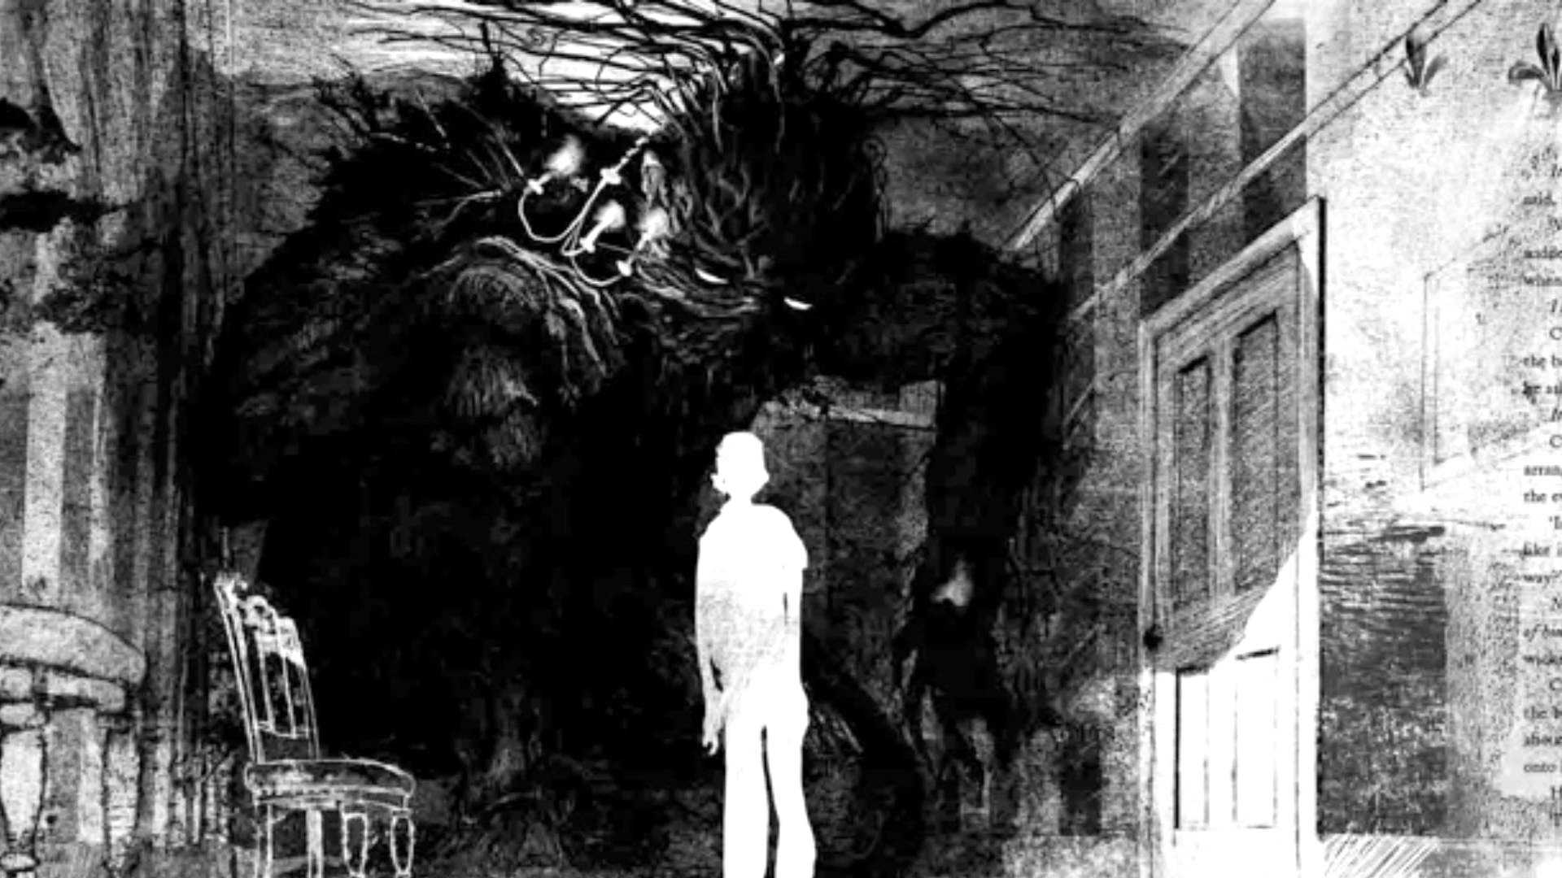
Register Task
Look at today’s title. Knowing what you do now about the story, who do you think says this quote and why? Answer in your exercise book underneath your date and title.
Today’s title is ‘I’m never going to live with you.’

Slide 22
Today we will read two chapters…
They are called Grandma (P.55) and The Wildness of Stories (P.63)
As we read the two chapters, think about the following questions:
Are there any examples of repetition?
What is Grandma’s role in the story?
Is she a typical Grandma?
What is the role of the tree?
Notes:
Questions for Discussion following each chapter if needed:
Grandma –
‘How He Was Holding Up – why the capital letters?’,
‘Repetition of anger rising in his stomach – When/what does/makes this happen?’,
‘Why was Grandma angry?’ ‘Comment on the relationship between Conor and his Grandma.’
The Wildness of Stories –
‘Repetition of 12:07 – mean anything? –
What examples of repetition have there been so far? Are they significant?’,
‘Why was Conor initially angry? What does the tree say to him to stop him being angry? Is it here to help or hurt?’

Slide 23
Character Study
Characters in stories also have particular traits. A trait is a distinguishing quality or characteristic that usually belongs to one or more characters.
When you write your own story, you will need to decide what traits you want your characters to have.
Can anyone think of any famous characters from books or films, and what their traits might be?
In every story, book, film or play, you have a variety of characters. Four types of characters are:
Protagonist – The main character in the story. He or she (or they) is faced with a conflict that must be resolved.
Antagonist – The antagonist is the character(s) (or situation) that represents the opposition against which the protagonist must contend. In other words, the antagonist is an obstacle that the protagonist must overcome.
Supporting – serve to complement the major characters and help move the plot event forward.
Symbolic – a symbolic character is any major or minor character whose very existence represents some major idea or aspect of society.
Task – Copy the grid and completing profiles for the characters we’ve met so far. Decide on what type of character they are, what character traits they have and finally, find evidence from the chapters we’ve read to justify your decisions (make sure you include page numbers!)
Notes:
Before going through this slide, give out the Worksheet Character Study. This sheet should be glued in as it will be useful for the assessment to have the characters traits in their books.
Read through the character types and their definitions. The order of the next activity is up to you depending on the class. You can do it step by step, and go through the character types on the worksheet before moving on to traits, or, go through character types and traits straight away and then get the class to do both on the worksheet for the characters from the book at the same time.
Some examples for Character traits – (Class discussion – try to develop their vocab using the traits on the back of the worksheet, and press the pupils to develop their answers with explanations and justifications for their answers.)
Harry Potter – brave, courageous
Mr Briggs – angry, ignorant
Scrooge – selfish, grumpy
James Bond – charming, skilful
Katniss Everdeen (Hunger Games) – loyal, daring

Slide 24
Name | Adjective to describe the character | Evidence from the book
Conor | Helpful | ‘Then he got a load of sheets going in the washer that he’d hang out on the line when he got back from school.’
Conor
Conor’s Mum
Conor’s Mum

Slide 25
Final task - Predictions
The monster has told Conor that it will tell him THREE stories.
What do you think they will be about, and what do you think the significance of the stories will be?

Slide 26
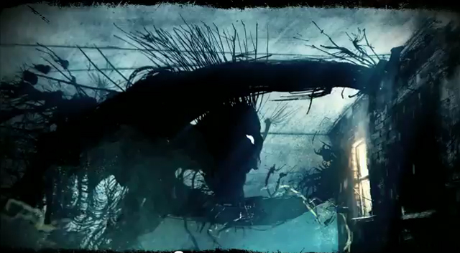
Register Task
Having encountered the tree monster several times now, do you think that it is real, or Conor’s imagination, and, do you think it is in the story to help or harm Conor?
Think about the types of things it says, the type of things it does, and the way it is presented in the actual book.
Today’s title is ‘Sometimes people need to lie to themselves most of all.’

Slide 27
Before we begin today’s reading, you will learn about ‘symbolism’. Write the below definition into your book.
Symbolism in literature is -
A figure of speech where an object, person, or situation has another meaning other than its literal meaning.
The actions of a character, word, action, or event that have a deeper meaning in the context of the whole story.
Some examples you may have heard of are –
1. The use of hearts to symbolise love
2. The use of an Eagle to symbolise freedom (think of America!)
3. The use of the colour white to symbolise peace or surrender
4. The use of the dove to symbolise peace
5. The use of the colour red to symbolise love or passion (it can also symbolise danger)
6. The use of the colour green to symbolise envy or jealousy
7. The use of the snake to symbolise evil (think of the bible)
8. The colour black is used to symbolise death or evil.

Slide 28
Real examples
In the movie The Wizard of Oz, the storm symbolizes high emotions and occurred when those emotions were present
In the movie trilogy Star Wars, Luke was dressed in light colors and Darth Vader was dressed in black, showing good vs evil
In Dr. Seuss’s How the Grinch Stole Christmas!, the Grinch steals the symbols of Christmas, like trees, presents and food, to find out in the end Christmas was more than those things.
Harry Potter’s scar is like a badge of honour because he survived a battle. It also stands for emotional sensitivity, since it hurts when someone directs hate towards him.
Think about The Lord of the Rings. What do you think the main symbol is and what does it represent?
Notes:
This slide is here to build on the symbolism if the class needs more detail. Hopefully some of them have seen/read The Lord of the Rings and will answer that the ring is the main symbol. The clue is in the title for those who haven’t.

Slide 29
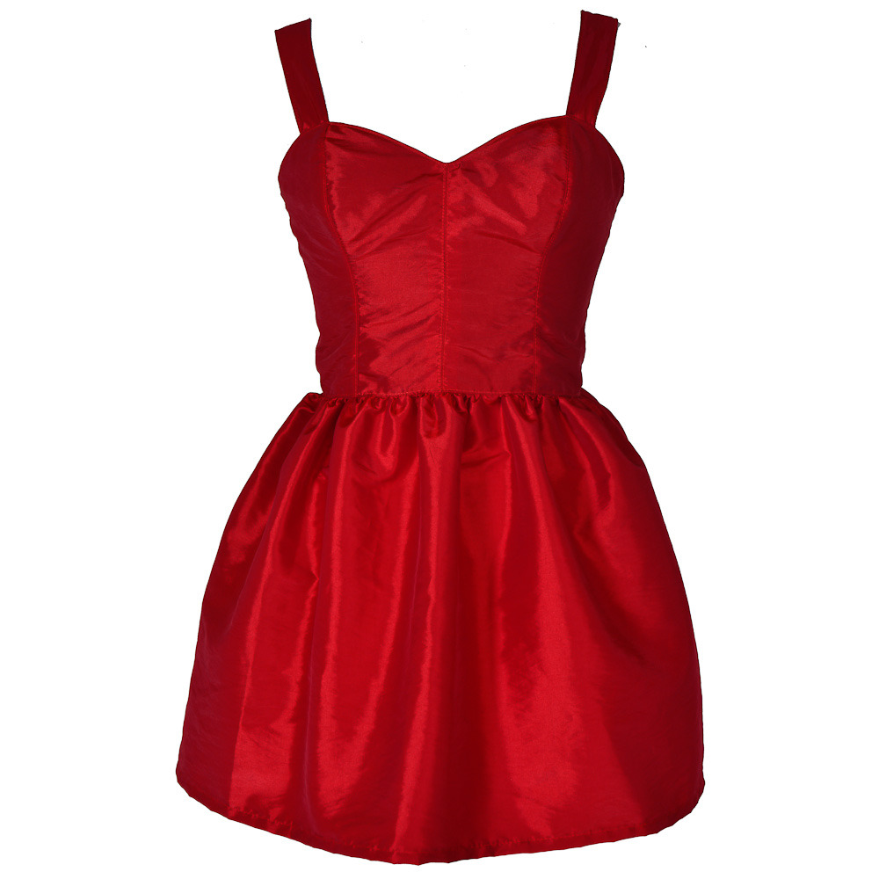
Example
So, if a character was wearing a red dress – what could that symbolise?
That the character is…..?
Because the colour red connotes …..

Slide 30
We are now going to read the next two chapters, which will us the whole of the First Tale (P.70)
As we read, see if you can pick out any examples of symbolism, i.e. any links between the tale and what is actually going on in Conor’s life.
Notes:
The First Tale –
‘What clues can you find that Conor is becoming more and more interested in the story?’
‘Halfway – What similarities are there between the Queen Regent and Grandma (Wanting to take over, trying to be young, bonding with the boy’
The Rest of the First Tale –
‘What is the point/relevance of the First Tale?
Do you think Conor understand this?
Do you think he wants to?’

Slide 31
You are now going to complete four different types of tasks that will test your understanding of the First Tale.
Search and Locate Questions
a) What rumours surrounded the King’s illness? (P.72)
b) What was the Queen’s plan for retaining power? (P.74)
c) Who saved the Queen from the flames? (P.79)
d) Where did the monster take the Queen? (P.79)
e) Who murdered the farmer’s daughter? (P.81)
Infer and deduce questions
f) ‘Sometimes people need to lie to themselves most of all’ (page 81). Do you think the monster is just referring to the First Tale when he makes this statement?
g) ‘It is not her you need saving from.’ Speculate about what the monster believes Conor actually needs saving from.
Summary question
h) Retell the First Tale in 3 chapters. The first must contain exactly 75 words, the second exactly 50 words and the final chapter must contain exactly 25 words.
Be as specific as you can, and stay within the word count
Additional Questions (Symbolism)
i) Which character in the book could The King be a symbol for? Explain your answer
j) Which character in the book could the Queen Regent be a symbol for? Explain your answer
Notes:
Student to complete all ten questions across the four disciplines.

Slide 32
Final Task - Symbolism
What is symbolic about a tree or a plant? Does it symbolise life maybe? Or growth? Perhaps, but there is something more to a Yew tree in particular that we should know about.
Watch this clip and listen out for the significant use of the Yew tree.
https://www.youtube.com/watch?v=S0WnRssz80w

Slide 33
So, we now know that the leaves off a Yew Tree are used to create a medicine called Taxol, a medicine that is used in the treatment of Cancer. Let’s look back at part of the opening question of today’s lesson.
Answer these questions in your book.
Is the Yew Tree Monster here to help or harm Conor? Why has Patrick Ness chosen a Yew Tree specifically? How can we link this to symbolism?
Notes:
This should be the first time the pupils are made aware of the fact that the Yew tree is used in cancer treatment. They should no be able to justify Ness’ choice of a Yew Tree in the story, and realise that in its own way, the tree monster is there to help Conor, whether he wants it or not.

Slide 34
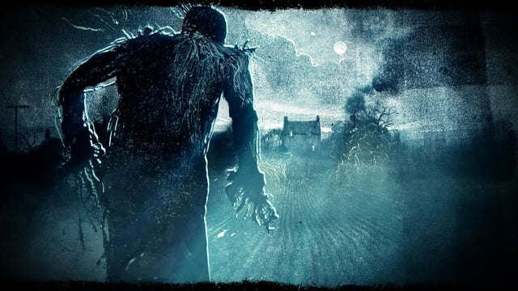
Register Task
Is there good & bad in everyone?
Explain your answer.
Today’s title is ‘He blamed Lily, because who else was there?’
Notes:
Take answers from pupils on the Register Task question

Slide 35
Before we read, or practise using dialogue, we need to know the rules of how to use it effectively.
Copy the following in to your books –
The Five Rules of Dialogue
1. New Speaker = New Line. When the speaker changes, skip to the next line, and indent.
2. P before Q. Punctuation marks always come before quotation marks.
3. ‘Speech’ within “speech”. Two marks for speech; one mark for speech within speech.
4. Break it up. Use action in between dialogue to add interest and to indicate who is speaking.
5. Sophisticated, not unnecessary. Dialogue that does not contribute to the plot in some way or that does not develop the characters should be edited out.

Slide 36
1. New Speaker = New Line. When the speaker changes, skip to the next line, and indent.
Example:
“Little pig, little pig, let me in!” cried the angry wolf, as he tried to blow the house down. “Not by the hair of my chinny, chin, chin.”

Slide 37
2. P before Q. Punctuation marks always come before quotation marks.
Examples:
WRONG “The giant tortoise is coming this way”, he whispered while grabbing my hand. “Come with me. I think I know where we can hide”.
CORRECT “The giant tortoise is coming this way,” he whispered while grabbing my hand. “Come with me. I think I know where we can hide.”

Slide 38
3. ‘Speech’ within “speech”. Two marks for speech; one mark for speech within speech.
Example:
Kara was beaming with excitement when I met her at the coop. Before I could even sit down, she quickly cried, “I can’t believe it. He actually said, ‘I love you.’ We were about to hang up, and he said, ‘I love you.’ Can you believe it?”

Slide 39
4. Break it up. Use action in between dialogue to add interest and to indicate who is speaking.
Example
“The giant tortoise is coming this way,” he whispered while grabbing my hand. “Come with me. I think I know where we can hide.”

Slide 40
5. Sophisticated, not unnecessary. Dialogue that does not contribute to the plot in some way or that does not develop the characters should be edited out.
No example needed for this one. To put it simply, if the dialogue isn’t going to add anything to your story, then you shouldn’t include it. Don’t just add people talking for the sake of it.

Slide 41
Today we are going to read two chapters, the first is called Understanding (p.86) and Little Talk (P.96).
As we read, focus on how dialogue is set out in the book.
Notes:
Understanding –
‘Is Conor fair to Lily here?
‘Do you think this is what he wants?’
‘Why does he blame Lily?
‘What does he blame her for?’
‘What is it that Conor doesn’t want/deserve? Why?’
Little Talk –
‘Is Conor’s attitude towards his Grandma fair?’
‘What does Conor mean when he says “…Because you could tell me you know.’
‘How would you describe Conor’s mum’s behaviour? Is it normal?’
‘What does Conor keep expecting from the tree?
‘What is the inner conflict he is having?’

Slide 42
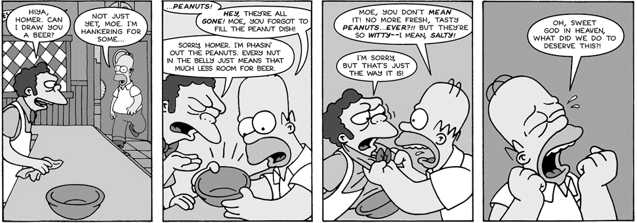
Dialogue Task
This is a comic strip featuring a conversation between Homer and Moe from the Simpsons. The only information we have is what the characters say. We know their emotions because of the pictures, but in a novel, there are very rarely pictures, which means that it is down to your description to let the reader know that information.
Your task is to turn this comic strip into a written narrative, by writing the speech out into dialogue using the five rules that we have looked at today.
*Challenge* Look back in your books to when we found alternatives to the word ‘said’. This word is banned from your work! Try to use a better range of vocabulary in your work.
Notes:
Give out worksheet The Simpsons Dialogue. Each sheet has two comic strips on.

Slide 43
Example
Having worked a long shift, Moe was delighted to see his friend Homer walk in to the bar.
“Hiya Homer, can I draw you a beer?” asked Moe as he welcomed Homer to his seat.
“Not just yet Moe,” Homer replied, “I’m hankering for some…” but before Homer could finish his sentence, he suddenly looked startled and disorientated.
Use this start if you need to and do the same for rest of the comic strip. Use as much detail as you can to make it entertaining. DO NOT use the word ‘said’!
Notes:
Finish this lesson by asking for volunteers to read out their work. Or, get the pupils to list the verbs that they used, and challenge them to use different ones next time to further extend their vocabulary.

Slide 44
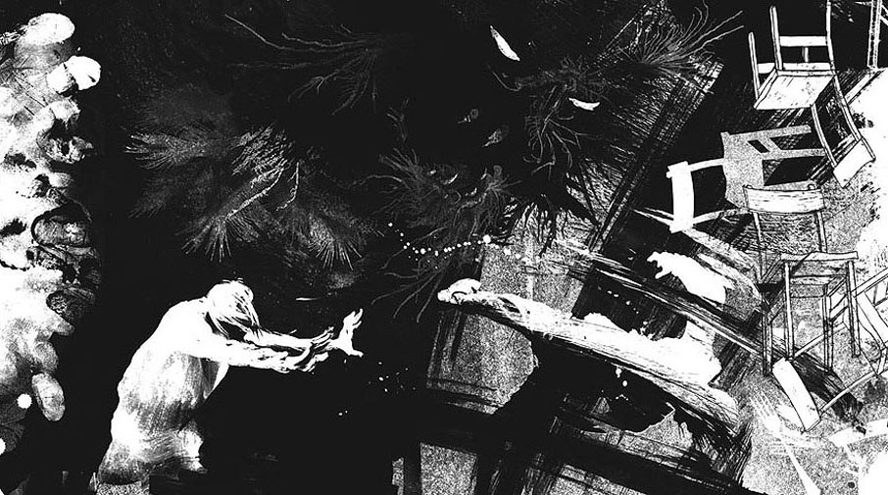
Register Task
Let’s see what we remember from last lesson.
What is the effect of using dialogue in stories? Answer in you exercise book underneath your date and title.
Today’s title is ‘I don’t want to live with Grandma
Notes:
Take answers from pupils on the Register Task question

Slide 45
What is a character flaw?
In fiction, a character flaw is a limitation, imperfection, problem, phobia, or deficiency present in a character who may be otherwise very functional.
The flaw can be a problem that directly affects the character's actions and abilities, such as a violent temper.
Alternatively, it can be a simple foible or personality defect, which affects the character's motives and social interactions, but little else.
Notes:
Explanation of character flaws in stories. The next two slides have examples, and then actual examples in fictional characters
Can ask pupils for answers to the question at the top before progressing through the bullet points

Slide 46
It takes a strong individual to identify their own faults. Have a look at these examples and see if any of them could describe you.
Enviousness -You are not truly happy for others success, and you work too hard to “keep up” with others on a material level.
Defensiveness - Defensiveness toward being corrected or criticized. Don’t respond well to feedback.
Aloofness - If you come off as cold/distant, you will not be trusted or influential. Acting as if you don’t care.
Volatility - Overly emotional people are attention hogs, and focus on themselves, not on the reality around them.
Eccentricity - Eccentrics are funny in the moment, but when building a team may lack the ability to tone down their eccentricity to build rapport. Deeper relationships are absent.
Entitlement - You believe you deserve everything you want.
Unreliable Character - You are unpredictable, and not trusted or confided in. You can’t be trusted in social situations or with responsibility
Making Destructive Comments - Needless sarcasm and cutting remarks wear down any rapport you may have built up with people.
Notes:
Opportunity for class discussion, or pupils could write down one that applies to them.

Slide 47
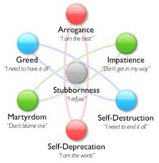
Title: Character Flaws Continued Did you have a think or ask anyone about your flaws? Write down what you’ve found out… (Discuss in2mins)
Wednesday 9th October

Slide 48
Examples of Tragic Flaws from Famous Literature?
The hero Achilles' tragic flaw is his pride. He thinks he is completely invincible, but he has a weak spot-his ankle.
In Macbeth, Macbeth's tragic flaw is his own ambition. He plots with his wife to murder the king, and his guilt haunts him.
In The Hunger Games, you could say that Katniss’ tragic flaw is her protectiveness of those she loves. She does not consider her own fate when she is thinking of protecting Prim or, in the end, Peeta.
Harry Potter's worst flaws, as stated by Rowling, are "anger and occasional arrogance“
Rocky Balboa thinks of himself as a loser who cannot go the distance in the boxing ring.
Peter Griffin is extremely impulsive and causes many problems for his family and friends.
Anakin Skywalker's anger and fear of losing his wife Padme eventually consumes him, leading to his transformation into Darth Vader
Notes:
There are seven examples but choose which are appropriate for your class e.g. you will know whether or not characters like Peter Griffin from Family Guy are worth mentioning or not

Slide 49
Major and Minor flaws
A minor character flaw is an imperfection which serves to distinguish the character in the mind of the reader, making them memorable and individual, but otherwise does not affect the story in any way.
Examples of this could include a noticeable scar, a thick accent or a habit such as cracking their knuckles.
A major character flaw is a much more noticeable and important hindrance which actually impairs the individual, whether physically, mentally or morally.
Sometimes major flaws are not actually negative per se (such as devout religious beliefs or a rigid code of honour), but are classified as such in that they often serve to hinder or restrict the character in some way.
Examples of this type of flaw could include blindness, amnesia or greed.
Notes:
This slide will link to the activity following the reading. Pupils can write down their own definitions of Major and Minor flaws, or copy the appropriate bullet points.

Slide 50
Today we are going to read three chapters.
These chapters are called Grandma’s House (P.103), Champ (P.111) and Americans don’t get much holiday (P.117).
During today’s reading, focus on Conor, and try to identify whether or not Conor has any flaws in his character.
Notes:
Grandma’s house –
‘What clues are there that Conor’s mum is getting worse?’
‘Who was Conor whispering to?
What manner did he do it in and why? (hopeful)’
Champ –
‘What is Conor’s attitude towards his father? Is it fair?
DO you like Conor as a main character? What are his pros and cons?’
Americans don’t get much holiday –
‘Why has Liam come to visit?’
‘What is it that no one wants to say?’
‘What is happening to Conor *reference to nightmare?’
‘Theme of control and Conor’s lack of it’
‘Who does Conor think the story is going to be about?’

Slide 51
Task 1
Create a bullet point list of Conor’s flaws. Think about his:
Limitations
Imperfections
Problems
Phobias
*Challenge* Write next to these flaws whether you think they are major flaws or minor flaws.
Notes:
Take answers from pupils and create a bullet list on the board. Pupils should add answers that they don’t have to their own list

Slide 52
Unlike minor flaws, major flaws are almost invariably important to either the character's, or the story's development.
For heroes, their major flaw usually must be overcome (either temporarily or permanently) at some point in the story, often at the climax, by their own determination or skill.
For villains, their major flaw is usually the cause of their eventual downfall.
For the protagonist, the most visible flaw generally serves a more vital interest as it defines his or her core problem. It is the protagonist's reluctant (and usually unconscious) journey to address this problem that forms the spine of the story.
Task 2
Think of any book/film/game that has a hero. Explain how they overcome their major flaw by the end of the story and explain what the resolution is.
Think of any book/film/game that has a villain. Explain how their major flaw results in their downfall at the end of the story.
As discussed in previous lessons, we know that Conor is our protagonist. What is his core problem? What has happened so far in the book that suggests that Conor reluctant to address his problem? What do you think the resolution of the book will be?
Notes:
The choice of book/film/game may not seem very literary, but it is to test whether or not they are understanding the premise of major flaws, and so for these two questions, you just need them to access something to show they have processed the information.
Finish the lesson by having the pupils share their answers for Question Three, either in pairs or with the class depending on time.

Slide 53
Register Task
Do you think Conor is a likable character? Does the main character in a book need to be likable?
Answer in your book underneath your date and title
Today’s title is ‘You dare to question me, boy?’

Slide 54
Continuing from last lesson, why do you think that authors make their characters flawed?
Think about your favourite book or film, and think about your favourite character in that book or film. Do they have a flaw? Write the character’s name in your book and briefly explain what their flaw is.
Share your character and their flaw with the person next to you? Do they agree?
In most cases, the character you are thinking of will have at least one flaw. The reason for this is that no one is perfect, and so characters who are flawless are boring, predictable and unrealistic. It is the characters with fears, baggage, issues, problems, bad habits and flaws who are interesting, and it is the character’s journey to overcome those flaws that makes a story!
Notes:
Title Question - Possible answers that you want from pupils – makes them vulnerable, accessible, unpredictable, interesting, complex etc
Second task – Time permitting, you can ask pupils for their characters and their flaws to ensure they have understood the concept.

Slide 55
Today we will read the Second Tale (P.125)
Like the previous tale, look for links between the tale and what is going on in Conor’s life.
Notes:
Complete reading of The Second Tale and The Rest of the Second Tale

Slide 56
You are now going to complete four different types of tasks that will test your understanding of the Second Tale.
Search and Locate Questions
a) When is the Second Tale set?
b) What does ‘apothecary’ mean?
c) Name two herbs collected by the Apothecary.
d) How many daughters did the parson have?
e) What does the parson refuse to give the Apothecary?
Infer and deduce questions
f) ‘She sometimes goes back to the hospital…the nurses let her sleep in a chair’ (page 117). What does this information about Grandma tell you about the sort of person she is?
g) Do the first two tales have anything in common? Why do you think the monster is telling them to Conor?
Summary question
h) Explain what Conor specifically dislikes about living with Grandma.
Use evidence from the last few chapters to explain your answer. Include page numbers!
Additional Questions (Grandma)
i) How do you think Grandma will react when she returns home? What do you think will be the consequences of Conor’s actions?
j) Is wrecking Grandma’s home a way of causing someone else as much pain as Conor is feeling himself? Is taking away things that are precious to others understandable in the circumstances or merely selfish?
Notes:
Student to complete all ten questions across the four disciplines.

Slide 57
Final Task
Think of as many reasons as you can to explain Conor’s anger. Think about everything that has happened so far that may have irritated, frustrated, scared or hurt him. Complete a mindmap like this: this:
Reasons for Conor’s anger
Notes:
Take answers from pupils and get them to add to their own mindmaps

Slide 58
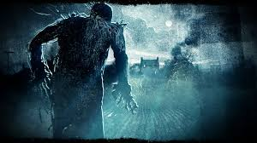
Register Task
What does this word make you think of?
Invisible
Today’s title is ‘What would possibly be the point?’
Notes:
Take answers from pupils after register

Slide 59
Today we are going to read three chapters. They are called Destruction (P.139), Invisible (P.146) and Yew Trees (P.153).
We will complete the reading in two stages.
Firstly…Destruction!
Notes:
Read Destruction. Pupils will complete CAMI paragraph on next slide based on the Grandma and her behaviour in this chapter

Slide 60
In Destruction, there are some incredibly tense and powerful moments between Conor and his Grandma. Using the chapter, explain the behaviour of Conor’s Grandma using the CAMI structure that we looked at earlier in the term. Look back at the worksheet for guidance on how to answer using CAMI. You will have 15 minutes to complete your answer.
C - Reveal insight into the character (character development)
A - Move the action on (action)
M - Show how effectively the author uses language, structure and form (methods)
I - Remind an audience of the key ideas and themes of the story (ideas)
When you have finished, look back over your answer and ensure that you have covered each section. Look back at your target from your last attempt at a CAMI paragraph and make sure that you have met it!
Notes:
Go through requirements for CAMI paragraph again to remind pupils OR ask them for requirements of each section to see what they remember
Give out worksheet Grandma CAMI Worksheet to pupils who need it. More able students may be confident enough to complete an answer on their own.
Worksheet has questions for each section that if pupils complete, their answers will create their paragraph.

Slide 61
We will now complete the next two chapters.
Notes:
Invisible –
‘What is interesting about the word relief?
Why is it important but strangely used?’
‘What does Conor want to happen? (think about the title of the chapter?’
Yew Trees –
‘Belief is half of healing – Why is this a key part of the story?
What has Conor possibly started to accept? (That the monster is trying to help)

Slide 62
Final Tasks – Quote Hunt
From the chapter Invisible, find five quotes that show that Conor feels invisible. Write the quote and the page number.
From the chapter Yew Trees, find five quotes that show that Conor’s mum’s disease is getting worse. Write the quote and the page number.
What does Conor find out in this chapter that we already know? (Think about the name of the chapter!) What do you think went through his mind when he heard this?
Notes:
Time permitting following the reading, pupils can complete this task in pairs. Ask for answers to Q3 and ensure all pupils understand the significance that Conor has just found out that the Yew Tree is used as a cancer treatment, which possibly changes his opinion of the tree monster. (Spoiler – Rather than realising that the tree is there to help him process his mother’s disease and impending death, Conor think that it will save his mum, as it is a cure. It all adds to the tragedy of the story)

Slide 63
Register Task
Which persuasive terms can you remember?
D
A
F
O
R
E
S
T
Write them in your book!
Lesson Ten
Today’s title is ‘You still do not know why you called me, do you?’
Notes:
D – Direct Address
A- Alliteration
F – Facts/Figures
O- Opinions
R – Repetition/Rhetorical Questions
E – Emotive Language
S – Statistics/Superlatives
T – Rule of Three

Slide 64
The three chapters we are going to read today cover many of the story’s themes:
Reality vs the Supernatural
Family
Isolation
Suffering
Following today’s reading, you will complete a persuasive speech, discussing whether or not you agree with a statement on one of these themes. Make sure you are following the story, and the behaviour of the different characters.
The three chapters we are going to read are called Could it be (P.158), No tale (P.164) and I No Longer See You (P.170).
Notes:
Could it be –
‘It really had been an incredibly warm October, like the summer was still fighting to stick around – Analogy for his mother’,
‘What would happen at 12:07?
What has changed in Conor’s attitude?’
No tale –
‘What do we now know that the monster knows (Conor’s nightmare’),
‘What do you think the nightmare is about?’
I no longer see you –
‘What do you think has happened here?
Why do people bully people? For what? Why has Harry given up?’

Slide 65
On the next slide, you will see the options you have to write your speech about.
Choose carefully. You need to pick one that you know you are going to be able to write in detail about
You are going to write a speech about ONE statement, explain why you agree or disagree with it, using a variety of features in order to persuade your audience to think and feel the same as you. You will have 15 minutes to complete you first draft.

Slide 66
Write a persuasive speech stating whether you agree or disagree with ONE of these statement. Write your chosen statement in to your book.
When Conor's dad says that his house is too small for Conor to come live with him, what he really means is that his life (or maybe his heart) is too small. He's only got room for one family, both literally and metaphorically. (Family)
Conor subconsciously summons the monster because he needs somebody to be honest with him, just like he needs to be honest with himself. (Reality vs the Supernatural)
Conor's wrecking of his grandma's house might be a way of causing someone else as much pain as he's feeling, of taking away something as precious to them as his mom is to him. It's not healthy, but it sure is therapeutic. (Suffering)
When Harry says he'll do the most hurtful thing to Conor he can, he stops bullying him and ignores him. Conor thinks being ignored is worse than being bullied. (Isolation)
Notes:
Have the pupils write which statement they are going to write about in their exercise books.
Worksheet Persuasive Speech can be used here so the pupils have the information in front of them. Also has tree on with AFOREST features (Thanks Jen!)
This is only a 15 minute task as pupils will complete a second draft, so they can’t go into lots and lots of detail, but they should be writing concisely and effectively to get their point across.

Slide 67
Mark Scheme (out of 50)
Using the below mark scheme, look though your speech and mark your work. Give yourself the appropriate marks for each item, and add up your mark out of 50.
Your speech includes:
Direct Address (use of you) (3 marks)
Alliteration (3 marks)
A Fact (3 marks)
An Opinion (3 marks)
A Rhetorical Question (3 marks)
Repetition (3 marks)
An example of emotive language (3 marks)
A statistic (3 marks)
A superlative (the extreme of something e.g. quickest, biggest, slowest) (3 marks)
Power of Three (3 marks)
Perfect use of capital letters (10 marks)
Perfect use of punctuation in all sentences (10 marks)
Notes:
Depending on your class, have them peer assess or self assess their work. Peer assessment for first draft is preferable, then self assess for the second

Slide 68
Now you know the mark scheme, you have 10 minutes to complete a 2nd draft. Try and get 50 marks!
Your speech includes:
Direct Address (use of you) (3 marks)
Alliteration (3 marks)
A Fact (3 marks)
An Opinion (3 marks)
A Rhetorical Question (3 marks)
Repetition (3 marks)
An example of emotive language (3 marks)
A statistic (3 marks)
A superlative (the extreme of something e.g. quickest, biggest, slowest) (3 marks)
Power of Three (3 marks)
Perfect use of capital letters (10 marks)
Perfect use of punctuation in all sentences (10 marks)
Notes:
Pupils to make their own work once completed, hopefully with improved results.

Slide 69
Plenary
Complete this paragraph with your results.
On my first draft I got……marks.
On my second draft I got……marks.
*To improve my work, I…………………………………
Explain what you changed to improve you work.

Slide 70
Register Task
Why do people bully?
Lesson Two
Today’s title is ‘There was once an invisible man.’
Notes:
Take student answers, link to Harry, Anton and Sully.

Slide 71
We will now read the chapter ‘The Third Tale’ P.175

Slide 72
Quick Prediction…
‘Then the monster leapt forward to make Harry see?’ … What do you think is going to happen?
Write your answer down in ONE full sentence.
We will then read the next chapter, ‘Punishment’.

Slide 73
Testing your inference and understanding
‘Never invisible again’. Why does the monster keep repeating this while Harry is being attacked?’
At this point, do you think that the monster is real or in Conor’s imagination? Create a table of arguments for and against…
Did Conor want to get expelled? How do we know? Use evidence from the chapter in your answer.
‘What purpose could that possible serve?’ Who says this and why is it significant?’
‘But there are harder things than being invisible’ – what point is the monster making to Conor?’
Notes:
Good exercise to take ideas from pupils to test their understanding. Questions allow for a variety of opinions so try to get a couple of answers from students for each one.

Slide 74
Plenary
You have answered this question before but now that we’re further into the story, has your opinion changed or not.
Is the Monster here to help or harm Conor? Explain your answer and be ready to share with the class.

Slide 75
Register Task
In your opinion, does Conor have any friends? If so, who, and if not, why?
Lesson Ten
Today’s title is ‘I wish I had 100 years.’

Slide 76
We are going to read the chapter called ‘A Note’
Quick activities
Find three quotes that suggest that Conor’s mum’s condition is getting worse.
–‘The rest of the world that wasn’t waiting – Waiting for what?’
The note from Lily is a rare moment in the story so far where someone has a legitimate connection with Conor.
‘Lily…….’ Finish off what you think Conor may have said to Lily…
We will now read 100 Years

Slide 77
Activity
Conor has felt a range of emotions throughout these two chapters.
Choose five moments and create a timeline from the start of ‘The Note’ to the end of ‘100 Years’.
For each moment, complete the following: What happened? What emotion Conor is feeling? A quote that shows this emotion. The Page number. See the example below. You may need to turn your book sideways.
1. Conor would wake up through the night following his nightmare. This shows Conor was scared and worried. On Page 189, it says that following his nightmare, Conor ‘would wake up shouting three or four times a night’.
2.
3.
Notes:
Have pupils share answers as a plenary to what emotions they found across the two chapters.
Extra plenary if time – Order from A-E which emotions they feel are the strongest. Share and justify.

Slide 78
Register Task
At the end of the last chapter, Conor demanded to go his house, the one ‘with the yew tree’. What do you think he will do when gets there?
Today’s title is ‘I just want it to be over.’

Slide 79
‘What’s the use of you?’
A catalyst in a story is something that happens to make something else happen. You may have heard the same word used in your Science experiments.
What is the catalyst in this chapter that leads to the Fourth Tale being told? What is it that happens, that the story has been leading to, that means that the fourth tale can now be told?
Notes:
Read the chapter ‘What’s the use of you?’
The catalyst for the Fourth Tale is although he still doesn’t say it yet, it is Conor admitting to himself that he has known all along that his mother wouldn’t survive.
You can have the pupils write their answers down or just answer verbally depending on time.

Slide 80
The Fourth Tale
Definition of tension in writing –
- mental or emotional strain.
"a mind which is affected by stress or tension cannot think as clearly“
Building tension in stories is key to keeping your reader engaged. They need to believe that something is going to happen, good or bad. During ‘The Fourth Tale’, Patrick Ness uses many techniques to build the tension for the reader.
In your exercise books, write the numbers 1-10 in your margin. Pick 10 quotes from across the two chapters that you feel are important to building the tension. Then, complete the tension graph with how tense you think each quote makes the Fourth Tale.
Notes:
Print off Tension Graph Worksheet. Pupils to choose 10 quotes (write in exercise book) that build tension and then decide how tense each one makes the chapter on a scale of 1-10 on the worksheet.

Slide 81
Plenary
Which quote did you think made the tale the most tense? Why?
‘He welcomed it with relief, because it was at last, the punishment he deserved.’ In what way has Conor been punished? Why does he think he deserves to be punished?
Notes:
Two plenary questions.

Slide 82
Register Task
What do you think the significance of 12:07 is?
Today’s title is ‘Why do you always come at 12:07?’
Notes:
Take answers from pupils after register

Slide 83
Today we are going to read the final three chapters.
They are called ‘Life After Death’, ‘Something in Common’ and ‘The Truth’.
Notes:
Read the final three chapters.
Possible suggestion for the final chapter – have the students close their eyes and just listen to the teacher read. May help them picture the final scene of the book.

Slide 84
A Monster Calls Summary Questions
What is the significance of 12:07?
Why do you think Patrick Ness chose not to let the reader be there when Conor’s mum died? Think about what the story was about…
Would the impact of A Monster Calls have been lessened if Ness had ever used the word "cancer?" Why or why not?
Why do none of the adults ever come right out and say to Conor that his mom is going to die? What do you think they're trying to accomplish? Do you think they're making the right call? Why or why not?
Why does it bother Conor that he gets special treatment at school because of his mum's illness? Is he bothered more by the negative attention (the bullying) or the positive (his teacher handling him with kid gloves)?
Do you think Conor handles his mother's illness well? Why or why not?
How does the monster help (or hurt) Conor come to terms with his mother's cancer? Do you think Conor ever might have been able to face his grief without the monster's help?
Notes:
Pupils to answer all questions to consolidate understanding. Potential for answers to be shared with class.

Slide 85
Exit Slip Questions…
What was your favourite part of the book?
What was your least favourite part of the book?
Would you recommend this book to others? Why?
What was your opinion of Conor? Did it change at all as you read further?
Did the ending satisfy you? Why or why not?
Notes:
Pupils to answer in exercise books. Can ask pupils for answers to conclude reading.

