Slide 1
Chapters 5-9

Slide 2
Re-cap
‘what a strange nature is knowledge! It clings to the mind, when it has seized on it, like Lichen on the rock.’
What negative things has the creature learnt about society by the end of Chapter 4?

Slide 3
AO3 – USEFUL CONTEXTUAL INFORMATION ON KNOWLEDGE
EPISTEMOLOGY (introduced in 1800s)
OTHER FORMS OF KNOWLEDGE
EMPIRICISM
JEAN JACQUES ROUSSEAU
JOHN LOCKE
Using the handout, what connections can you make between the contextual information and the creature’s journey thus far?

Slide 4
The inter-texts
Research the 4 texts that influence the creature:
Volney’s The Ruins of Empire
Goethe’s The Sorrows of Werther
Plutarch’s Lives
Milton’s Paradise Lost
Question: What is the significance of the texts the creature learns from? How does he react to them and why might Shelley have chosen them?

Slide 5
Re-cap – De Lacey family
De Lacey family - similarity and difference to the Frankenstein family, as well as what each family member might represent?
Look at again at Safie’s story in Chapter 6. Aspects of her story that strike you as significant?

Slide 6
Chapter 7
How does Shelley convey the importance of the books?
Find evidence in the chapter of both nature and nurture shaping the creature’s personality and values.
How does Shelley show the creature’s otherness (difference) in this chapter?
What does the creature want?
What is the significance and effect of the creature’s dialogue with de Lacey?

Slide 7
Chapter 8
The creature is still hopeful at the beginning of the chapter. Should he be?
How does Shelley convey the monstrous nature of the creature in this chapter?
What is significant about the burning of the cottage?
How are the descriptions of nature symbolic in this and the previous chapter?
Why does the creature kill William and incriminate Justine?

Slide 8
Chapter 9 - outside or inside?
Chapter 9 (last of volume 2) signifies the end of creature’s narrative and Victor’s response.
Arguably we have travelled through the centre of the narrative and out to the other side.

Slide 9
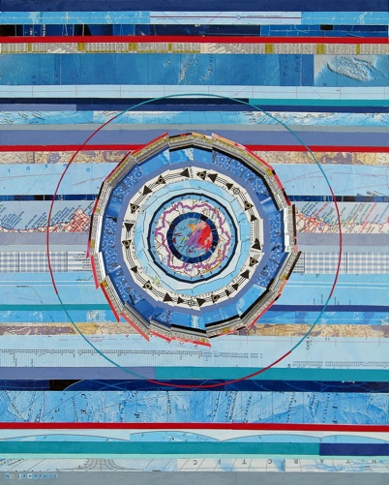
Concentric narration
‘liminal’ narrative; bringing the outsiders inside/ to the central position (links to Rom/ Goth)
Dramatizing the failure of human communication?
‘structural relay race’
‘reality on the outside, horror at the core’ (Swingle, 1993)

Slide 10
Passing back the baton
The narrative ‘baton’ has been passed back to Victor: how will he respond?
Ultimately, we know he will fail… what’s Shelley suggesting about communication then?

Slide 11
Creature’s request and Victor’s response
Engages with necessity of companionship; he has realised men and women aren’t in ‘fixed spheres’; co-operation doesn’t work. He is seeking an ‘interchange of sympathies’ (p147)
This is counteracted with the rage of Victor: ‘you shall never make me base in my own eyes’
Argument between them highlights a fundamental lack of understanding on Victor’s part; irony of Victor’s assertion of him as a ‘fiend’

Slide 12
Ethical questions
Exile makes a monster?
Lack of value makes a monster?
‘If I cannot inspire love, I will inspire fear.’
Should Victor go ahead with creation? Why do you think he agrees?

