Slide 1
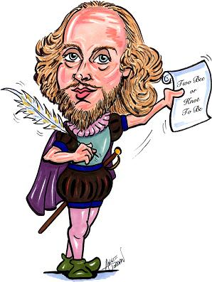
Sonnet 116

Slide 2
Shakespeare’s Sonnet 116
…today we will
Know the conventions of a typical sonnet
Be able to analyse the themes and language used by Shakespeare in sonnet 116
Understand how Shakespeare explores the theme of love in this sonnet

Slide 3
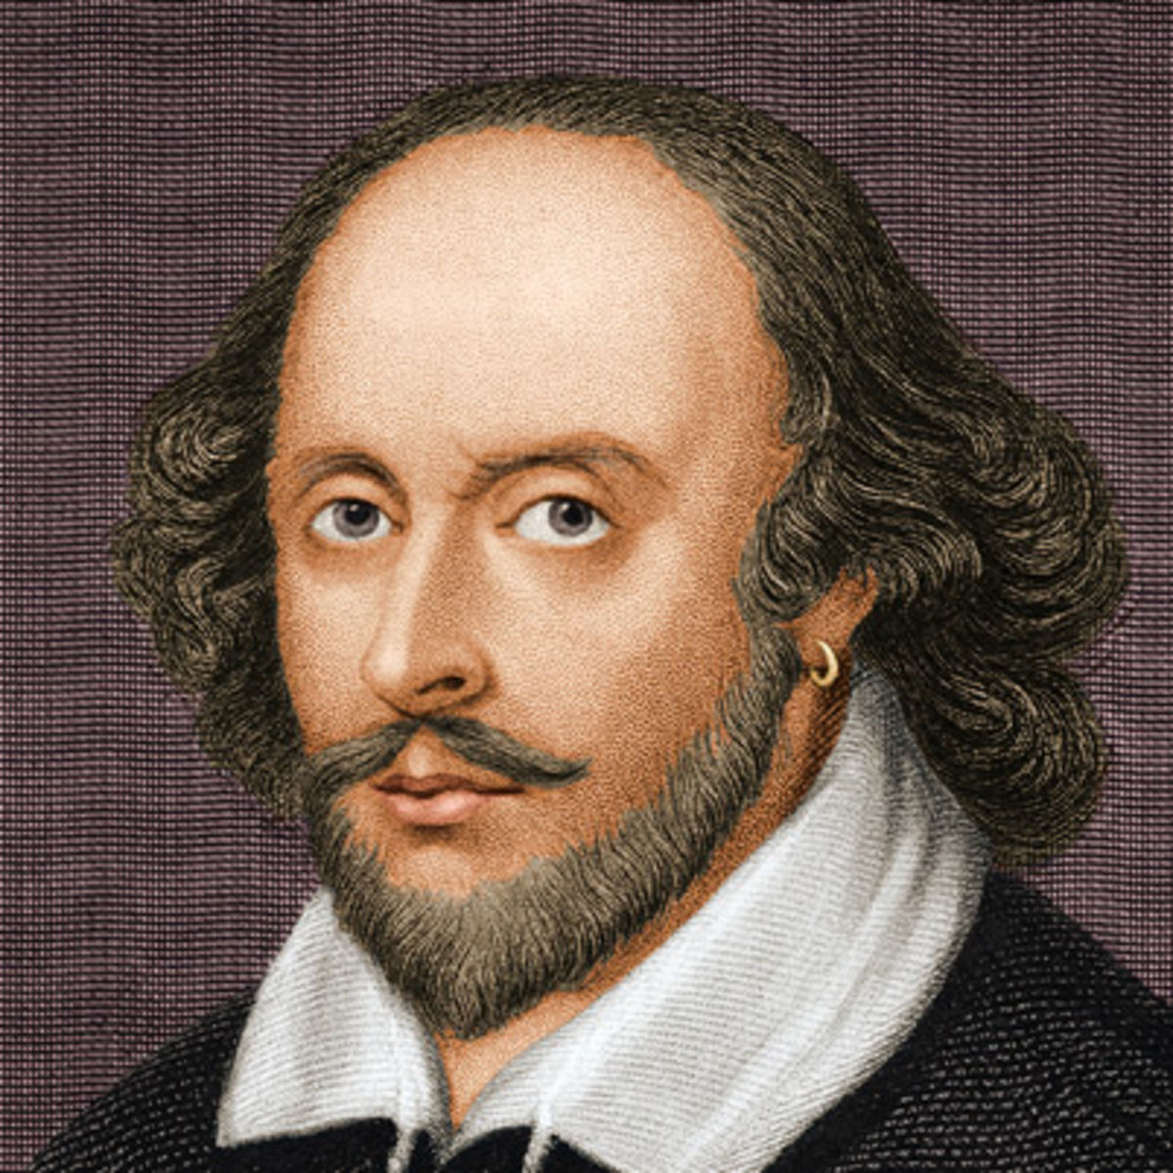
What do you know about Shakespeare?
READ THE SONNET AND TRY TO FIGURE OUT WHAT IT’S ABOUT – WRITE THIS DOWN IN YOUR OWN WORDS, NO MORE THAN TWO SENTENCES

Slide 4
List the ideal characteristics of a loving relationship
In this poem, Shakespeare gives us his idea of the characteristics of a really lasting love between two people.

Slide 5
Create a mind map to show how Shakespeare explores a number of themes in Sonnet 116.
Love
Morality
Sonnet 116
Beauty
Time (9,11)

Slide 6
Imagery
Look at the imagery used by Shakespeare in this poem. What words and phrases are used to describe love?
What do many of these words have in common? Why has Shakespeare used this imagery to describe love?

Slide 7
Let me not declare any reasons why two
True-minded people should not be married. Love is not love
Which changes when it finds a change in circumstances,
Or bends from its firm stand even when a lover is unfaithful:
Oh no! it is a lighthouse
That sees storms but it never shaken;
Love is the guiding north star to every lost ship,
Whose value cannot be calculated, although its altitude can be measured.
Love is not at the mercy of Time, though physical beauty
Comes within the compass of his sickle.
Love does not alter with hours and weeks,
But, rather, it endures until the last day of life.
If I am proved wrong about these thoughts on love
Then I recant all that I have written, and no man has ever [truly] loved.

Slide 8
An Introduction
Sonnet 116 was first published in 1609 and is one of the most famous sonnets in the world.
It is about everlasting love and is widely known for its idealistic vision of a loving relationship.
The poem begins by stating that no one can stand in the way of true love.
Shakespeare says that love is constant and unchanging through any difficulties.
In line six, love is compared to the north star and Shakespeare says that love will not fade but will last forever. The words ‘love will alters not with his brief hours and weeks, but bears it out even to the edge of the doom’, mean that love is timeless.
In the final two lines, Shakespeare says that if there is no such thing as true love, that he has never written a word and nobody has ever experienced it. However, because the poem exists, Shakespeare is saying so does true love.

Slide 9
Point,Evidence,Explain
Look at how Shakespeare uses language in the poem. Make three good points about the poem, select three quotations to back up your points and then explain the quotations in detail.
Point | Evidence | Explain
The poet believes that love never changes | ‘It is an ever fixed mark’ | The poet is saying that love never fades and the word ‘ever’ suggests it is an eternal force.
Death cannot defeat love

Slide 10
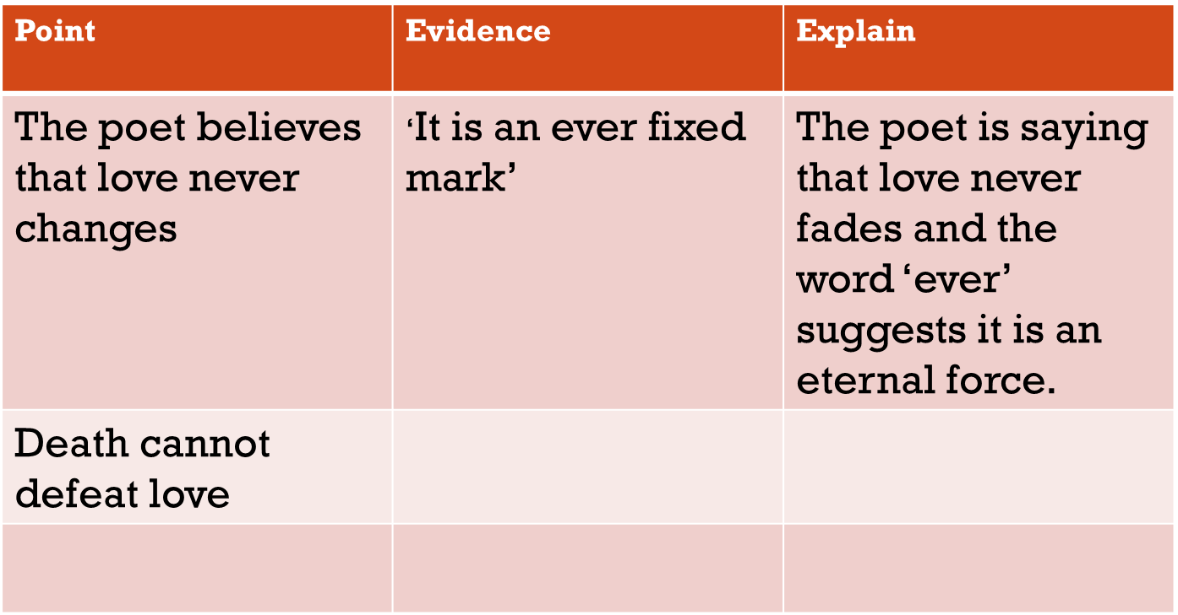

Slide 11
Point,Evidence,Explain
Use the information from the table to write three points about how Shakespeare uses language in the poem. Add a quote and explanation for each point.
POINT
The poem is about true love…
In line five Shakespeare says…
This suggests that…
evidence
explain

Slide 12
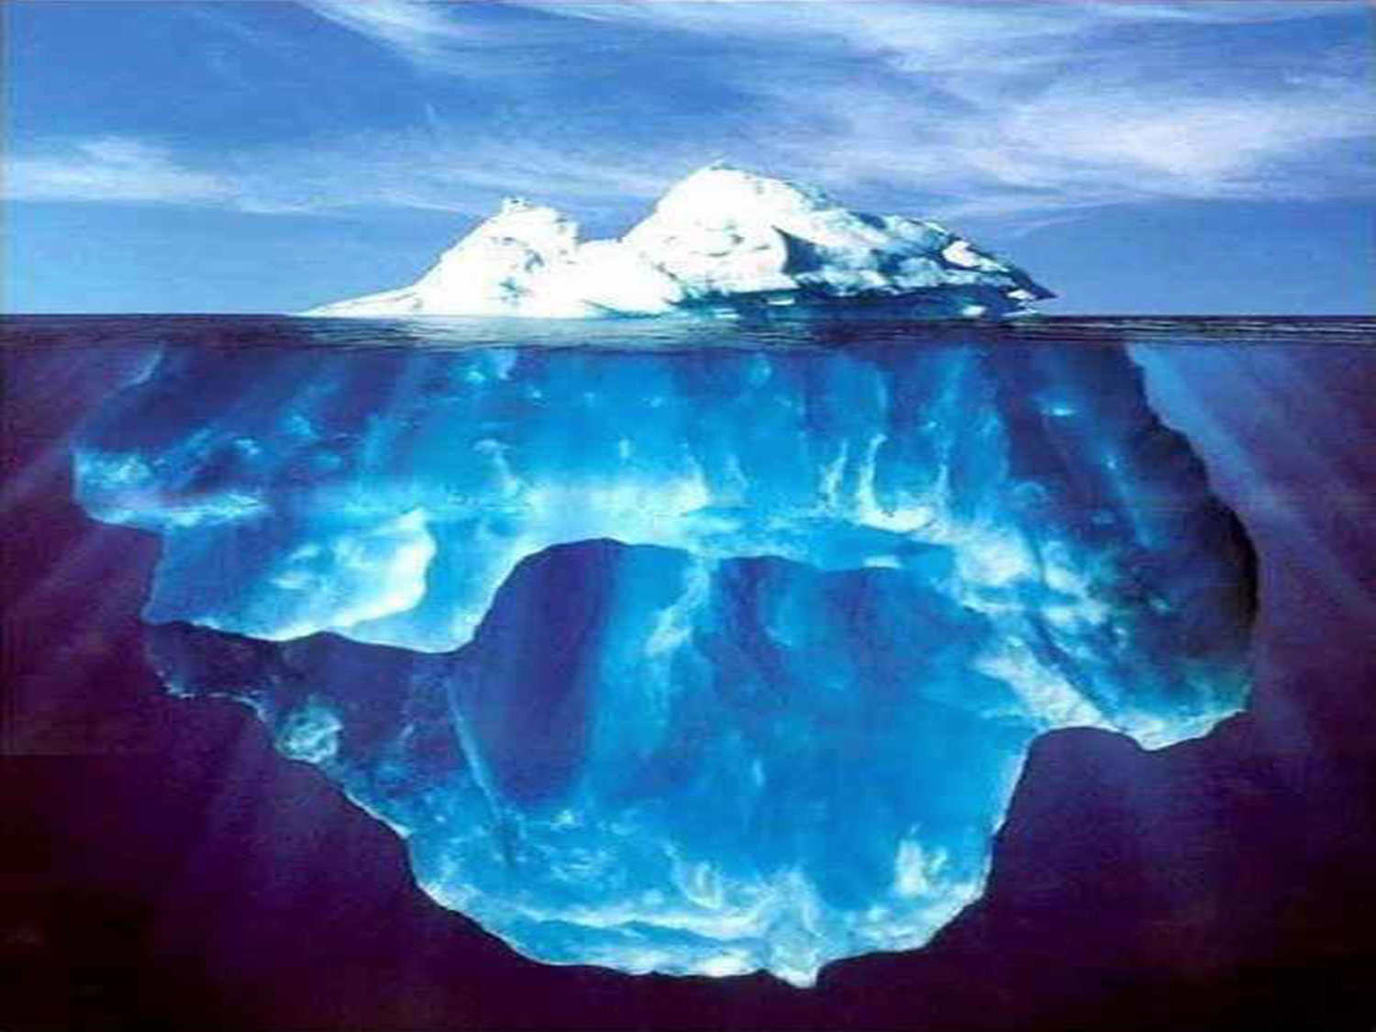
Topic sentence:
F
The writer/author/poet/name of uses….
E
Evidence: Quotation
D
Explanation:
This means…
C
This makes us think of…
C-B
Therefore we understand that…
B
This links to the writer’s message that…
LINK TO QUESTION
A-A*
KEY WORDS IN QUESTION AND SYNONYMS:
QUOTES – 3-5 MOST INTERESTING WORDS/IMAGES/TECHNICAL ASPECTS OF TEXT:

