Slide 1
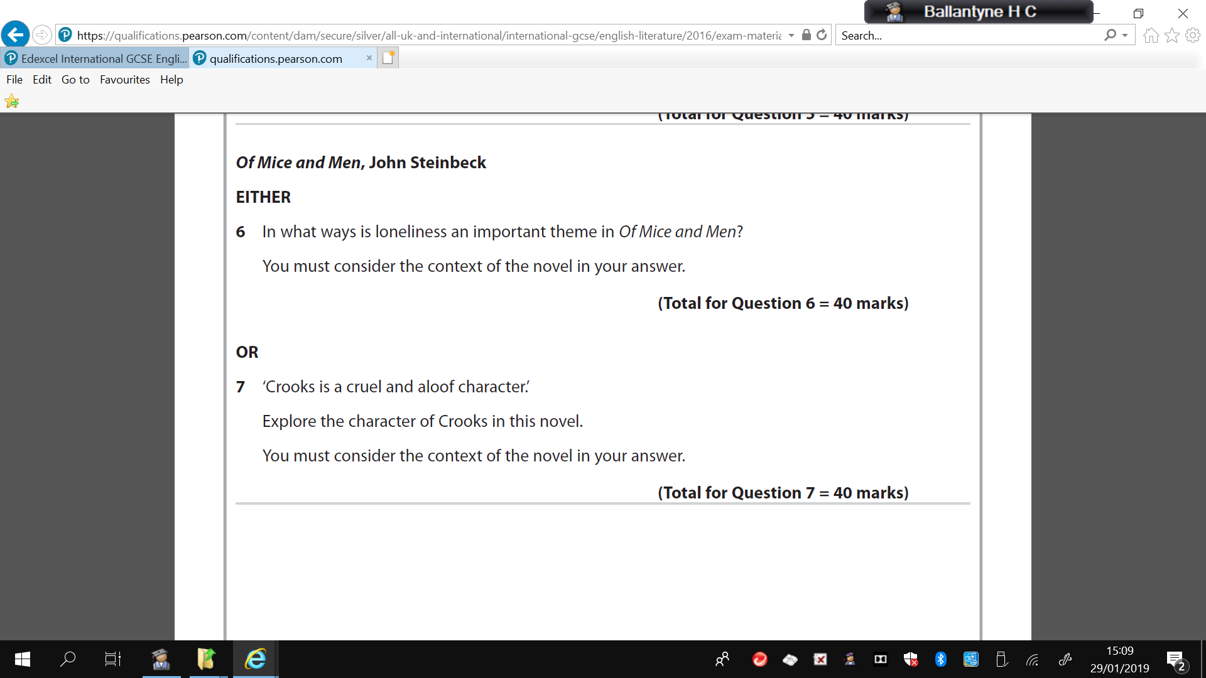
June 2018

Slide 2
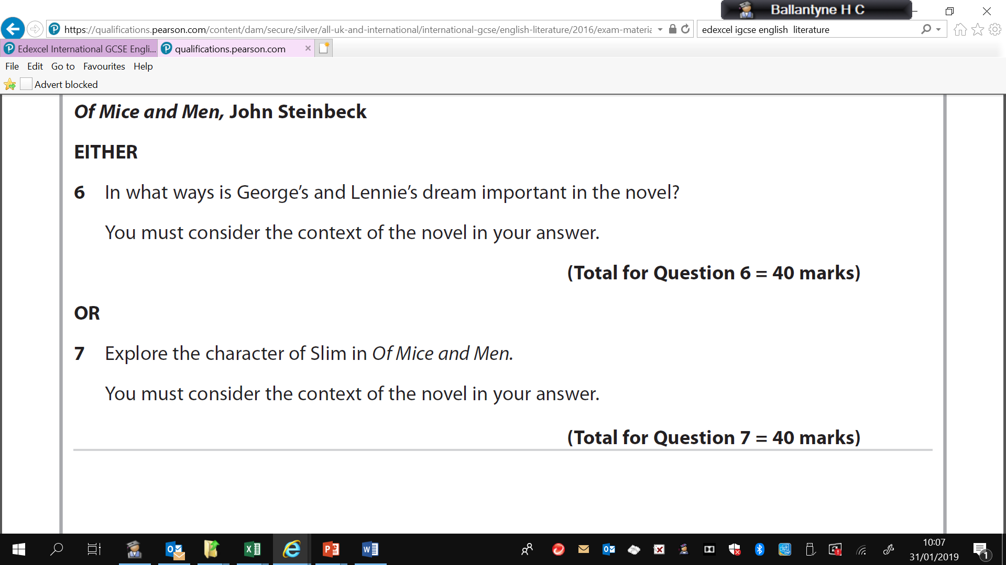
June ‘R’ 2018

Slide 3
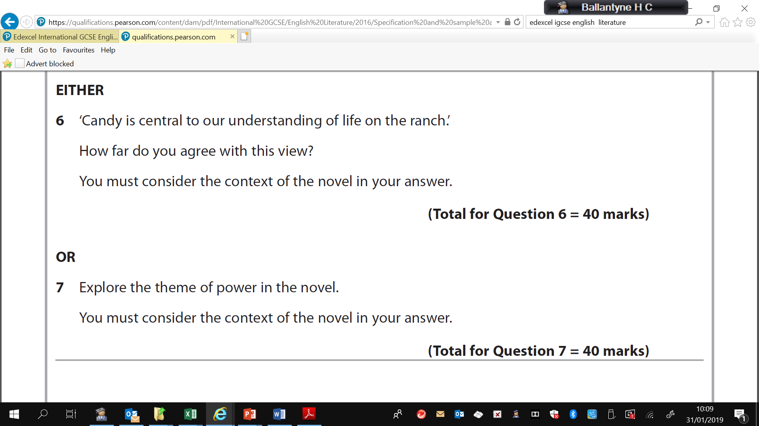
SAM

Slide 4
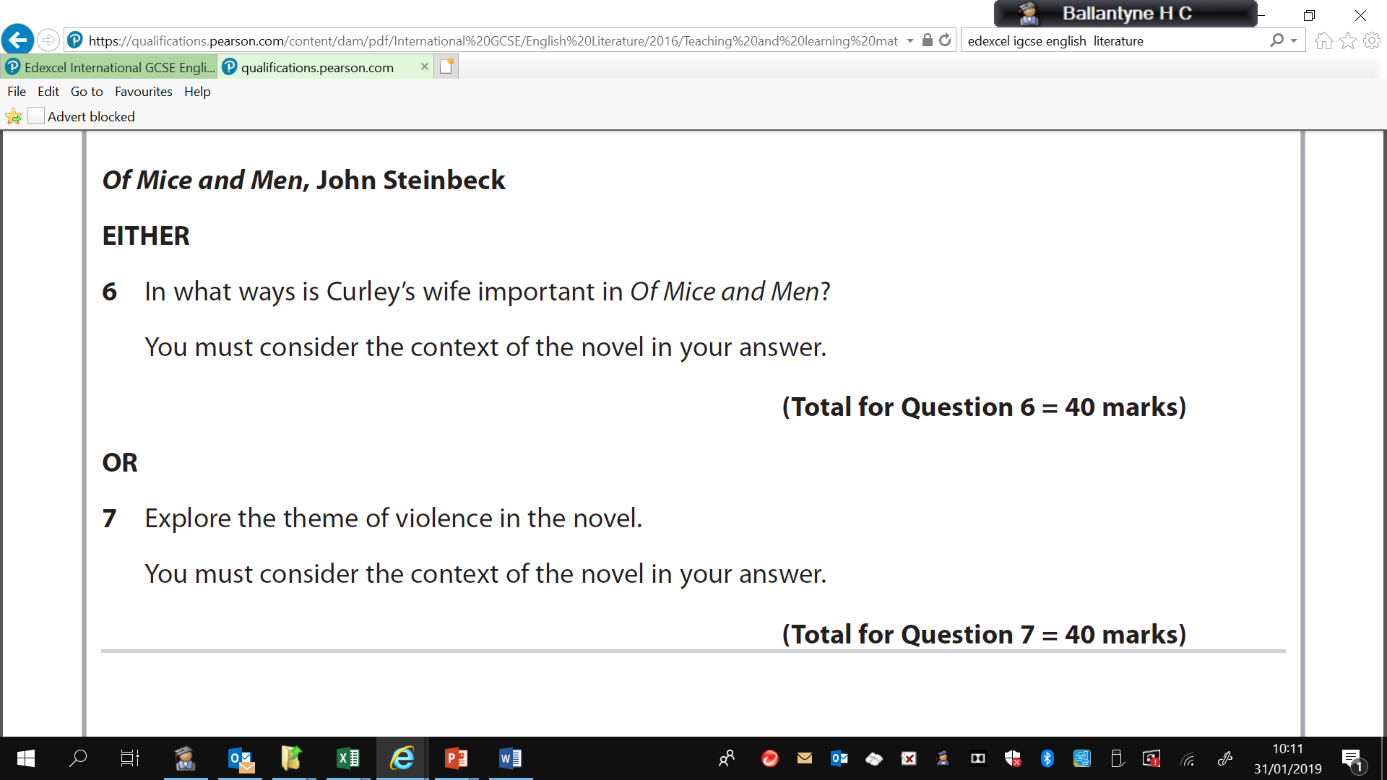
SPECIMEN PAPER

Slide 5
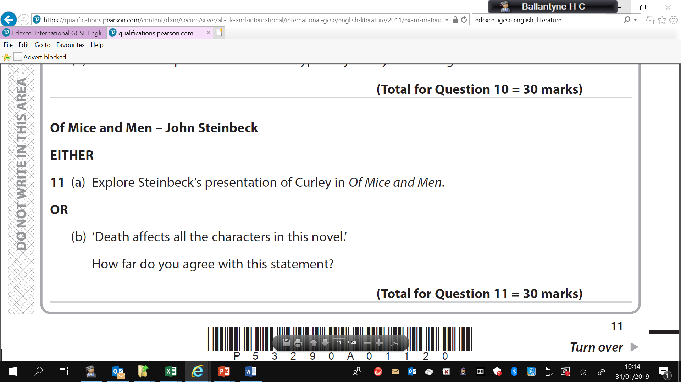
OLD SPEC QS JUNE 2018

Slide 6
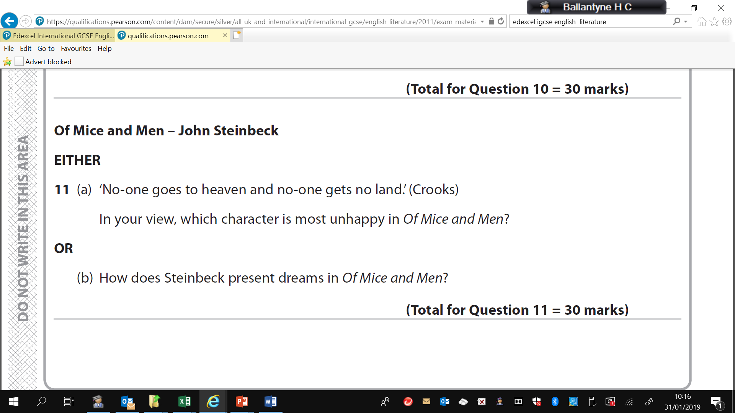
OLD SPEC QS JUNE ‘R’ 2018

Slide 7
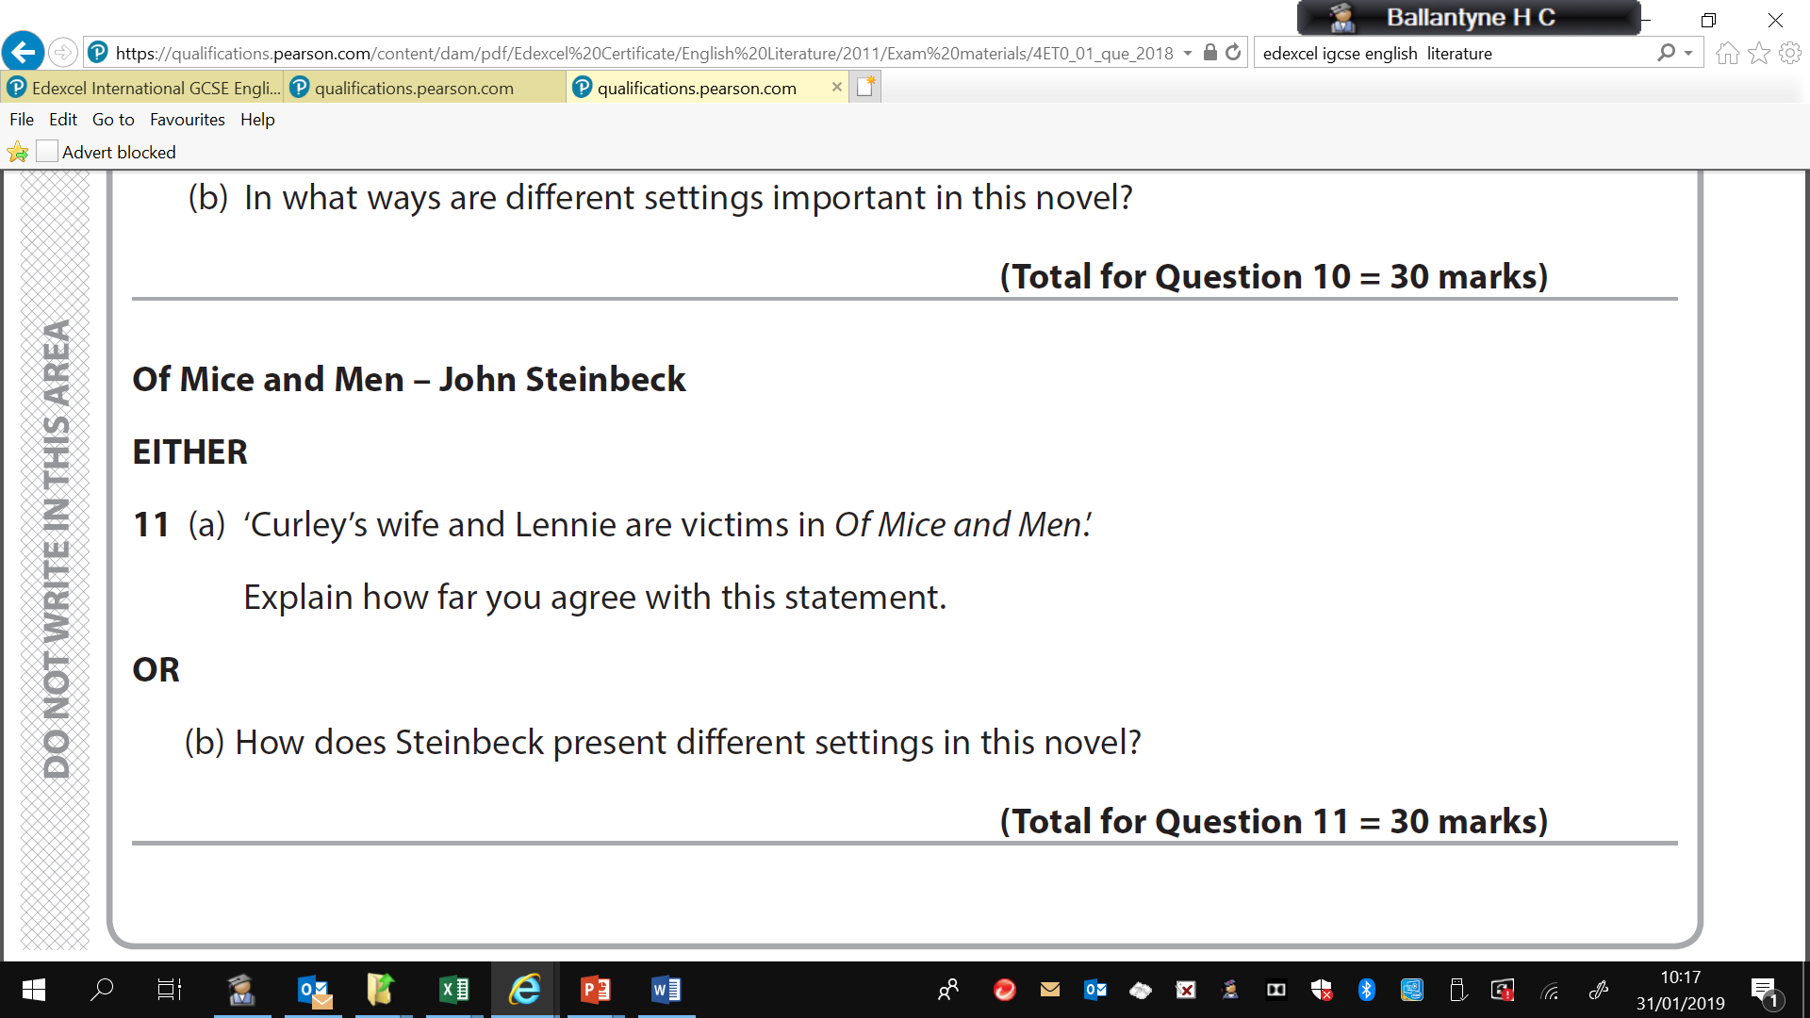
OLD SPEC QS JANUARY 2018

Slide 8
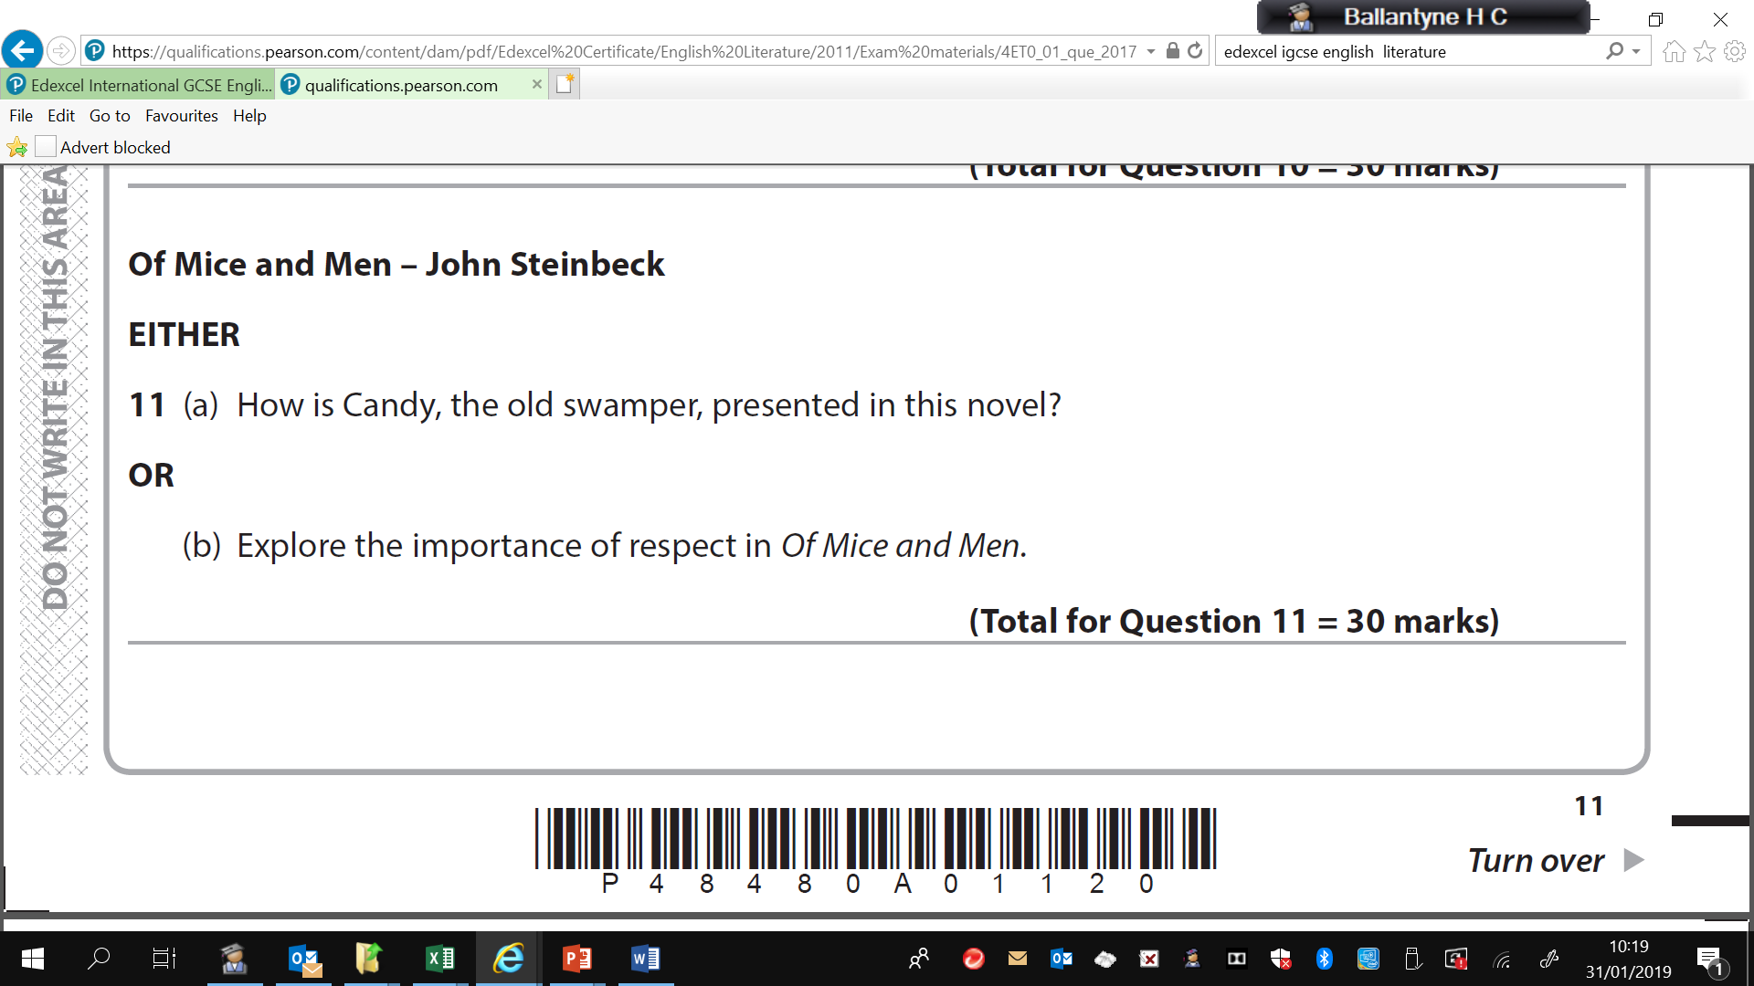
OLD SPEC QS JUNE 2017

Slide 9
OLD SPEC QS JUNE ‘R’ 2017

