Slide 1
In this lesson, students will be mastering the following:
Mastery Content:
Jane openly defies Mrs Reed in a passionate outburst
Jane says she will never call Mrs Reed ‘aunt’ again
Jane prepares to go to school
Learning Objective
To evaluate how Jane has been treated at Gateshead Hall.
Mastery Content

Slide 2
Do Now Mr Brocklehurst was inspired by a real person in Charlotte Brontë’s life. True or False? List 3 ways that Jane is treated unfairly at Gateshead. Why is Mrs Reed sending Jane to Lowood School? Why would being a passionate child be a bad thing in the Victorian era? Extension: Mrs Reed lies to Mr Brocklehurst, making him think that Jane is a liar. Why do you think she does this?
Reading Read the passage. Jane argues with Mrs Reed for the final time. Jane defies Mrs Reed, and shows that she is feisty and determined. This would be absolutely shocking for a contemporary reader, seeing such a young and small girl openly defy her benefactress and elder. Students answer comprehension questions in pairs.
Reading Continue reading Jane’s elation and relief after she opens up on Mrs Reed. Students answer the following questions. Why does Jane feel victorious after telling Mrs Reed how she really feels? What is this feeling of victory replaced with? Why? | Decide if you want this task to be a paired discussion or written task.
Summarising the events of Gateshead Hall Use the illustrations and the guidelines to write a summary of Jane’s life at Gateshead Hall. The colour-coded sentence stems should help students write a brief and accurate summary of what has happened to Jane so far at Gateshead Hall. NOTE: These summary sentences will be useful for students when they come to write analytical paragraphs about ‘Jane Eyre’. One of the features of a successful analytical paragraph is placing an extract in context within the novel; these summary sentences can help students to do this succinctly and accurately. | There is a model for the first illustration. You may wish to compose the second illustrations as a class or in pairs before asking students to complete the rest of the summary independently.
Fortnightly Quiz Ask students to complete fortnightly quiz
Lesson Guide

Slide 3
Tuesday, 14 June 2022
Gateshead Hall
Do Now:
Mr Brocklehurst was inspired by a real person in Charlotte Brontë’s life. False
Mrs Reed doesn’t excludes Jane from playing with the other children; Jane is bullied by John Reed; Jane is cruelly punished by being locked in the Red Room.
Mrs Reed thinks that Jane is too passionate and needs to learn how to behave at Lowood.
In the Victorian era children were expected to be meek and obedient, which is the opposite of the passionate and rebellious Jane.
Do Now:
Mr Brocklehurst was inspired by a real person in Charlotte Brontë’s life. True or False?
List 3 ways that Jane is treated unfairly at Gateshead.
Why is Mrs Reed sending Jane to Lowood School?
Why would being a passionate child be a bad thing in the Victorian era?
Do Now
Extension: This final act might be one of Mrs Reed’s cruellest deeds, as she is trying to ensure that Jane has a miserable future ahead of her. Jane will not be able to start afresh at Lowood School.
Extension: Mrs Reed lies to Mr Brocklehurst, making him think that Jane is a liar. Why do you think she does this?

Slide 4
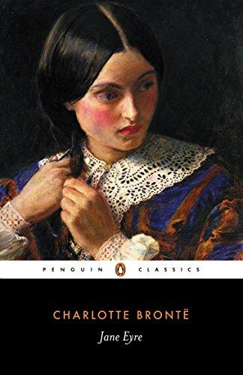
We already know that Jane is a passionate child.
She can finally take no more of the way she has been treated by Mrs Reed.
Let’s find out what happens next between Jane and Mrs Reed.
Let’s read.
Read from, ‘Mrs. Reed and I were left alone’ (page 43)
Read to, ‘… she abruptly quitted the apartment.’ (page 45)
Jane Eyre

Slide 5
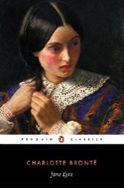
Mrs. Reed and I were left alone: some minutes passed in silence; she was sewing, I was watching her. Mrs. Reed might be at that time some six or seven and thirty; she was a woman of robust frame, square-shouldered and strong-limbed, not tall, and, though stout, not obese: she had a somewhat large face, the
under jaw being much developed and very solid; her brow was low, her chin large and prominent, mouth and nose sufficiently regular; under her light eyebrows glimmered an eye devoid of ruth; her skin was dark and opaque, her hair nearly flaxen; her constitution was sound as a bell—illness never came near her; she was an exact, clever manager; her household and tenantry were thoroughly under her control; her children only at times defied her authority and laughed it to scorn; she dressed well, and had a presence and port calculated to set off handsome attire.
Sitting on a low stool, a few yards from her arm-chair, I examined her figure; I perused her features. In my hand I held the tract containing the sudden death of the Liar, to which narrative my attention had been pointed as to an appropriate warning.
robust – solid
ruth – pity
flaxen – blonde
constitution – health
tenantry - employees
attire – clothing
tract – religious booklet, the book Brocklehust gave Jane
Jane Eyre
p.43

Slide 6
What had just passed; what Mrs. Reed had said concerning me to Mr. Brocklehurst; the whole tenor of their conversation, was recent, raw, and stinging in my mind; I had felt every word as acutely as I had heard it plainly, and a passion of resentment fomented now within me.
Mrs. Reed looked up from her work; her eye settled on mine, her fingers at the same time suspended their nimble movements.
“Go out of the room; return to the nursery,” was her mandate. My look or something else must have struck her as offensive, for she spoke with extreme though suppressed irritation. I got up, I went to the door; I came back again; I walked to the window, across the room, then close up to her.
Speak I must: I had been trodden on severely, and must turn: but how? What strength had I to dart retaliation at my antagonist? I gathered my energies and launched them in this blunt sentence—
“I am not deceitful: if I were, I should say I loved you; but I declare I do not love you: I dislike you the worst of anybody in the world except John Reed; and this book about the liar, you may give to your girl, Georgiana, for it is she who tells lies, and not I.”
tenor – tone
acutely – strongly
fomented – grew
suspended – stopped
mandate – instruction
retaliation – counter-attack
antagonist – enemy
Jane Eyre
p.43-44

Slide 7
Mrs. Reed’s hands still lay on her work inactive: her eye of ice continued to dwell freezingly on mine.
“What more have you to say?” she asked, rather in the tone in which a person might address an opponent of adult age than such as is ordinarily used to a child.
That eye of hers, that voice stirred every antipathy I had. Shaking from head to foot, thrilled with ungovernable excitement, I continued—
“I am glad you are no relation of mine: I will never call you aunt again as long as I live. I will never come to see you when I am grown up; and if any one asks me how I liked you, and how you treated me, I will say the very thought of you makes me sick, and that you treated me with miserable cruelty.”
“How dare you affirm that, Jane Eyre?”
“How dare I, Mrs. Reed? How dare I? Because it is the truth. You think I have no feelings, and that I can do without one bit of love or kindness; but I cannot live so: and you have no pity.
antipathy – hatred
ungovernable – uncontrollable
affirm – say
Jane Eyre
p.44

Slide 8
I shall remember how you thrust me back—roughly and violently thrust me back—into the red-room, and locked me up there, to my dying day; though I was in agony; though I cried out, while suffocating with distress, ‘Have mercy! Have mercy, Aunt Reed!’ And that punishment you made me suffer because your wicked boy struck me—knocked me down for nothing. I will tell anybody who asks me questions, this exact tale. People think you a good woman, but you are bad, hard-hearted. You are deceitful!”
Ere I had finished this reply, my soul began to expand, to exult, with the strangest sense of freedom, of triumph, I ever felt. It seemed as if an invisible bond had burst, and that I had struggled out into unhoped-for liberty. Not without cause was this sentiment: Mrs. Reed looked frightened; her work had slipped from her knee; she was lifting up her hands, rocking herself to and fro, and even twisting her face as if she would cry.
“Jane, you are under a mistake: what is the matter with you? Why do you tremble so violently? Would you like to drink some water?”
“No, Mrs. Reed.”
“Is there anything else you wish for, Jane? I assure you, I desire to be your friend.”
ere – before
exult – delight
sentiment – feeling
Jane Eyre
p.44-45

Slide 9
“Not you. You told Mr. Brocklehurst I had a bad character, a deceitful disposition; and I’ll let everybody at Lowood know what you are, and what you have done.”
“Jane, you don’t understand these things: children must be corrected for their faults.”
“Deceit is not my fault!” I cried out in a savage, high voice.
“But you are passionate, Jane, that you must allow: and now return to the nursery—there’s a dear—and lie down a little.”
“I am not your dear; I cannot lie down: send me to school soon, Mrs. Reed, for I hate to live here.”
“I will indeed send her to school soon,” murmured Mrs. Reed sotto voce; and gathering up her work, she abruptly quitted the apartment.
disposition – personality
sotto voce – quiet voice
Jane Eyre
p.45

Slide 10
Quick Check
Discuss the answers to these questions in pairs.
What does Mrs Reed order Jane to do?
What is Jane’s reaction to this?
What does Jane say to Mrs Reed in her passionate outburst?
Quick Check

Slide 11
Quick Check
Discuss the answers to these questions in pairs.
Mrs Reed orders Jane to get out of the room and return to the nursery.
Jane does not obey Mrs Reed and proceeds to express her anger at Mrs Reed.
Jane tells Mrs Reed that she will never call her ‘aunt’ again. The thought of Mrs Reed and her cruelty makes her feel sick.
Quick Check

Slide 12
Let’s find out what happens after Jane’s passionate outburst.
Let’s read.
Read from, ‘I was left there alone’ (page 45)
Read to, ‘Even for me life had its gleams of sunshine.’ (page 48)
Jane Eyre

Slide 13
I was left there alone—winner of the field. It was the hardest battle I had fought, and the first victory I had gained: I stood awhile on the rug, where Mr. Brocklehurst had stood, and I enjoyed my conqueror’s solitude. First, I smiled to myself and felt elate; but this fierce pleasure subsided in me as fast as did the accelerated throb of my pulses.
A child cannot quarrel with its elders, as I had done; cannot give its furious feelings uncontrolled play, as I had given mine, without experiencing afterwards the pang of remorse and the chill of reaction. A ridge of lighted heath, alive, glancing, devouring, would have been a meet emblem of my mind when I accused and menaced Mrs. Reed: the same ridge, black and blasted after the flames are dead, would have represented as meetly my subsequent condition, when half-an-hour’s silence and reflection had shown me the madness of my conduct, and the dreariness of my hated and hating position.
subsided – went down
pang – feeling
heath - bushes
emblem – symbol
meetly – accurately
Jane Eyre
p.45

Slide 14
Something of vengeance I had tasted for the first time; as aromatic wine it seemed, on swallowing, warm and racy: its after-flavour, metallic and corroding, gave me a sensation as if I had been poisoned. Willingly would I now have gone and asked Mrs. Reed’s pardon; but I knew, partly from experience and partly from instinct, that was the way to make her repulse me with double scorn, thereby re-exciting every turbulent impulse of my nature.
I would fain exercise some better faculty than that of fierce speaking; fain find nourishment for some less fiendish feeling than that of sombre indignation. I took a book—some Arabian tales; I sat down and endeavoured to read. I could make no sense of the subject; my own thoughts swam always between me and the page I had usually found fascinating. I opened the glass-door in the breakfast-room: the shrubbery was quite still: the black frost reigned, unbroken by sun or breeze, through the grounds. I covered my head and arms with the skirt of my frock, and went out to walk in a part of the plantation which was quite sequestrated; but I found no pleasure in the silent trees, the falling fir-cones, the congealed relics of autumn, russet leaves, swept by past winds in heaps, and now stiffened together.
repulse – hate
fain – rather
sequestrated – separated
Jane Eyre
p.45-46

Slide 15
I leaned against a gate, and looked into an empty field where no sheep were feeding, where the short grass was nipped and blanched. It was a very grey day; a most opaque sky, “onding on snaw,” canopied all; thence flakes felt it intervals, which settled on the hard path and on the hoary lea without melting. I stood, a wretched child enough, whispering to myself over and over again, “What shall I do?—what shall I do?”
All at once I heard a clear voice call, “Miss Jane! where are you? Come to lunch!”
It was Bessie, I knew well enough; but I did not stir; her light step came tripping down the path.
Jane Eyre
p.46

Slide 16
“You naughty little thing!” she said. “Why don’t you come when you are called?”
Bessie’s presence, compared with the thoughts over which I had been brooding, seemed cheerful;
even though, as usual, she was somewhat cross. The fact is, after my conflict with and victory over Mrs. Reed, I was not disposed to care much for the nursemaid’s transitory anger; and I was disposed to bask in her youthful lightness of heart. I just put my two arms round her and said, “Come, Bessie! don’t scold.”
The action was more frank and fearless than any I was habituated to indulge in: somehow it pleased her.
“You are a strange child, Miss Jane,” she said, as she looked down at me; “a little roving, solitary thing: and you are going to school, I suppose?”
I nodded.
“And won’t you be sorry to leave poor Bessie?”
“What does Bessie care for me? She is always scolding me.”
“Because you’re such a queer, frightened, shy little thing. You should be bolder.”
“What! to get more knocks?”
“Nonsense! But you are rather put upon, that’s certain.
transitory – temporary
habituated – normal
put upon – misused
Jane Eyre
p.46-47

Slide 17
My mother said, when she came to see me last week, that she would not like a little one of her own to be in your place.—Now, come in, and I’ve some good news for you.”
“I don’t think you have, Bessie.”
“Child! what do you mean? What sorrowful eyes you fix on me! Well, but Missis and the young ladies and Master John are going out to tea this afternoon, and you shall have tea with me. I’ll ask cook to bake you a little cake, and then you shall help me to look over your drawers; for I am soon to pack your trunk. Missis intends you to leave Gateshead in a day or two, and you shall choose what toys you like to take with you.”
“Bessie, you must promise not to scold me any more till I go.”
“Well, I will; but mind you are a very good girl, and don’t be afraid of me. Don’t start when I chance to speak rather sharply; it’s so provoking.”
“I don’t think I shall ever be afraid of you again, Bessie, because I have got used to you, and I shall soon have another set of people to dread.”
“If you dread them they’ll dislike you.”
“As you do, Bessie?”
Jane Eyre
p.47

Slide 18
“I don’t dislike you, miss; I believe I am fonder of you than of all the others.”
“You don’t show it.”
“You little sharp thing! you’ve got quite a new way of talking. What makes you so venturesome and hardy?”
“Why, I shall soon be away from you, and besides”—I was going to say something about what had passed between me and Mrs. Reed, but on second thoughts I considered it better to remain silent on that head.
“And so you’re glad to leave me?”
“Not at all, Bessie; indeed, just now I’m rather sorry.”
“Just now! and rather! How coolly my little lady says it! I dare say now if I were to ask you for a kiss you wouldn’t give it me: you’d say you’d rather not.”
“I’ll kiss you and welcome: bend your head down.” Bessie stooped; we mutually embraced, and I followed her into the house quite comforted. That afternoon lapsed in peace and harmony; and in the evening Bessie told me some of her most enchanting stories, and sang me some of her sweetest songs. Even for me life had its gleams of sunshine.
venturesome – brave
Jane Eyre
p.47-48

Slide 19
It was the hardest battle I had fought, and the first victory I had gained: I stood awhile on the rug, where Mr. Brocklehurst had stood, and I enjoyed my conqueror’s solitude. First, I smiled to myself and felt elate; but this fierce pleasure subsided in me as fast as did the accelerated throb of my pulses.
Jane
Quick Check
Quick Check
Discuss the answer to these questions in pairs.
For the first time Jane is able to express the anger she has been bottling up inside against Mrs Reed. She feels the joy in her freedom to say how she really feels.
Afterwards Jane feels guilt and remorse because she knows that children should not speak to their elders in such a harsh way.
Quick Check
Discuss the answer to these questions in pairs.
Why does Jane feel victorious after telling Mrs Reed how she really feels?
What is this feeling of victory replaced with? Why?

Slide 20
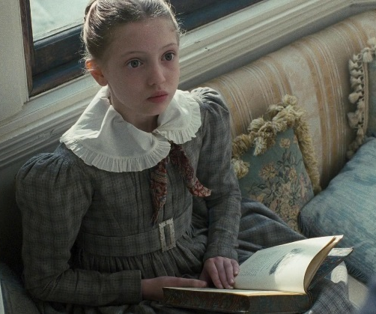
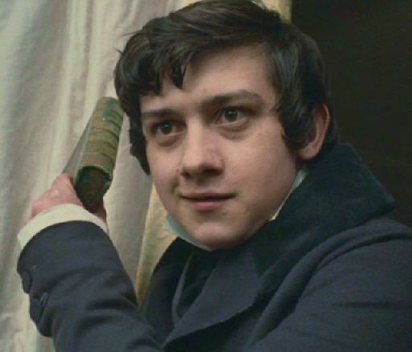
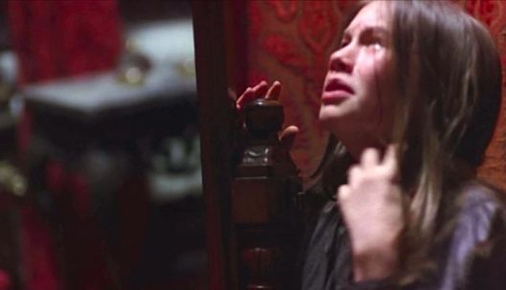
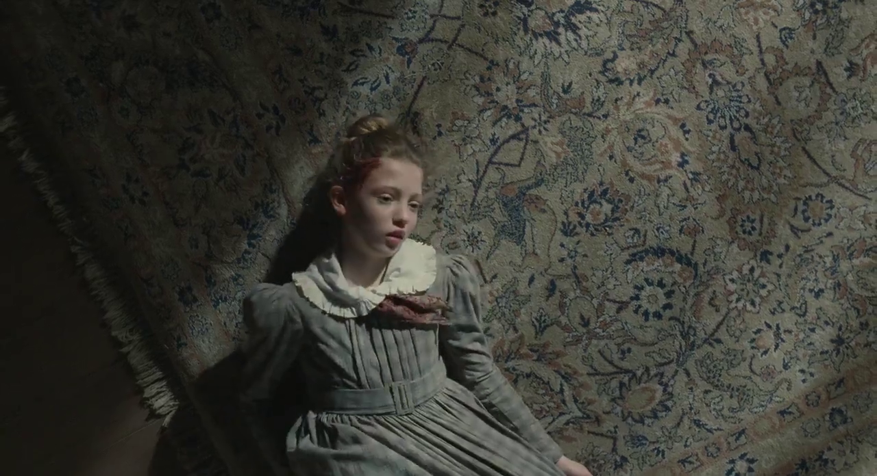
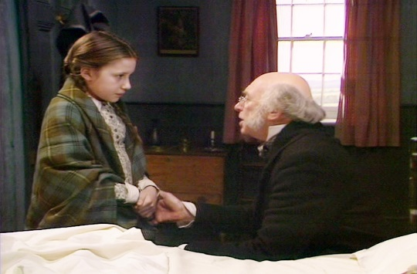
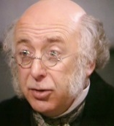
There have been a number of formative events for Jane. This means that there have been lots of events that she will remember for a long time, and will shape who she is as a person.
Jane Eyre

Slide 21
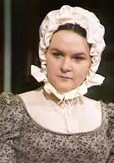
In pairs, use these images to discuss what has happened to Jane so far in the novel.
1.
4.
Jane Eyre
2.
5.
3.
6.

Slide 22
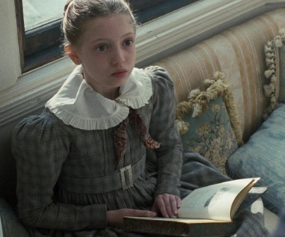
It is possible to summarise a long piece of writing in a few sentences.
Firstly, you should identify the key events and put them in chronological order.
We did this in the previous activity.
Jane Eyre
1.
4.
2.
5.
3.
6.

Slide 23
When you have the main events in the correct order, you can then summarise the events with brief, clear sentences.
To make your summary brief and clear, include these parts in your sentences:
The subject of each sentence should be clear. It is clear who the sentence is talking about.
When it happened explains how the events of the story are sequenced. It makes it clear when the events in the story happen.
Why it happened explain the reasons for the sequence of events in the novel.
Jane Eyre

Slide 24
The subject of each sentence should be clear. It is clear who the sentence is talking about.
When it happened explains how the events of the story are sequenced. It makes it clear when the events in the story happen.
Why it happened explain the reasons for the sequence of events in the novel.
Here’s an example of three brief sentences that explains the events for image 1. Notice how the each sentence only contains vital information.
Jane Eyre
At the start of the novel, Jane Eyre reads a book at Gateshead Hall. Her cousin, John Reed, enters and hits her round the head because he is a bully. After John makes her head bleed, Jane jumps up and attacks her cousin.
1.

Slide 25
On your own, use these images to write a summary of what has happened to Jane so far in the novel.
1.
4.
Jane Eyre
2.
5.
3.
6.

Slide 26
Take a look at your partner’s summary of events at Gateshead Hall.
Is their summary clear?
Is it brief?
Are there additional words or phrases (e.g. parts that tell where or adjectives) that are not vital? If there are, get rid of them!
Jane Eyre
The subject of each sentence should be clear. It is clear who the sentence is talking about.
When it happened explains how the events of the story are sequenced. It makes it clear when the events in the story happen.
Why it happened explain the reasons for the sequence of events in the novel.

Slide 27
Which statements are correct?(3)
Jane automatically feels guilty after her passionate outburst to Mrs Reed.
Bessie continues to be kind to Jane and tells her that she likes Jane better than the Reed children.
Mrs Reed tells Jane that she desires to be her friend.
Mrs Reed wants Jane to have a miserable time at Lowood.
Jane tells Mrs Reed that she has no pity.
Mastery

Slide 28
Which statements are correct?(3)
Jane automatically feels guilty after her passionate outburst to Mrs Reed.
Bessie continues to be kind to Jane and tells her that she likes Jane better than the Reed children.
Mrs Reed tells Jane that she desires to be her friend.
Mrs Reed wants Jane to have a miserable time at Lowood.
Jane tells Bessie all about her outburst to Mrs Reed.
Mastery

Slide 29
Love this lesson?
Have suggestions for improvements?
Does something need fixing?
Feedback
Please let us know!
Fill in this feedback form so that we can keep improving.

