Slide 1
Past Poetry Questions
Disclaimer Alert! You MUST revise ALL poems, especially common themes and links, it is a COMPARISON question don’t forget!
‘New’ Ones: Blessing, Search for My Tongue & Half Caste
Predictions: Blessing (life), Search for My Tongue (identity), Prayer Before Birth (childhood)

Slide 2
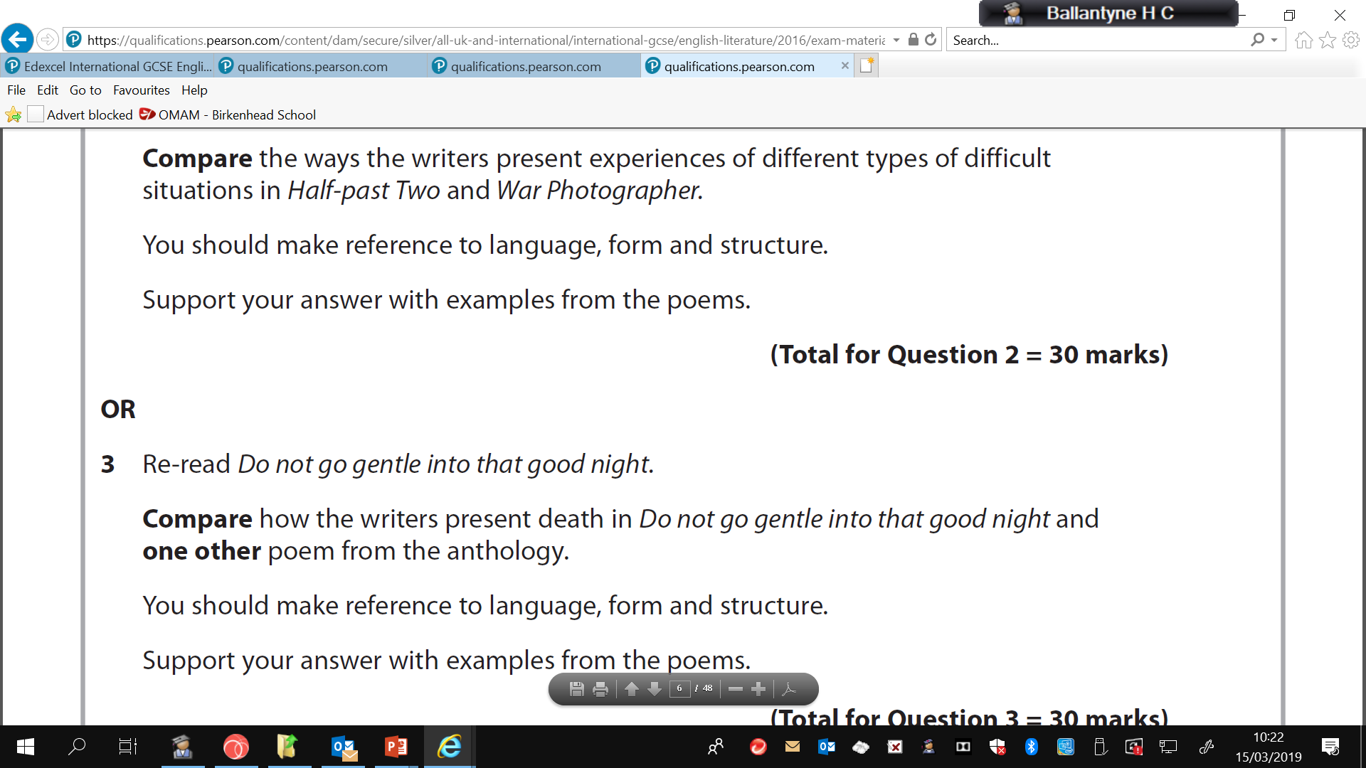
January 2019 R

Slide 3
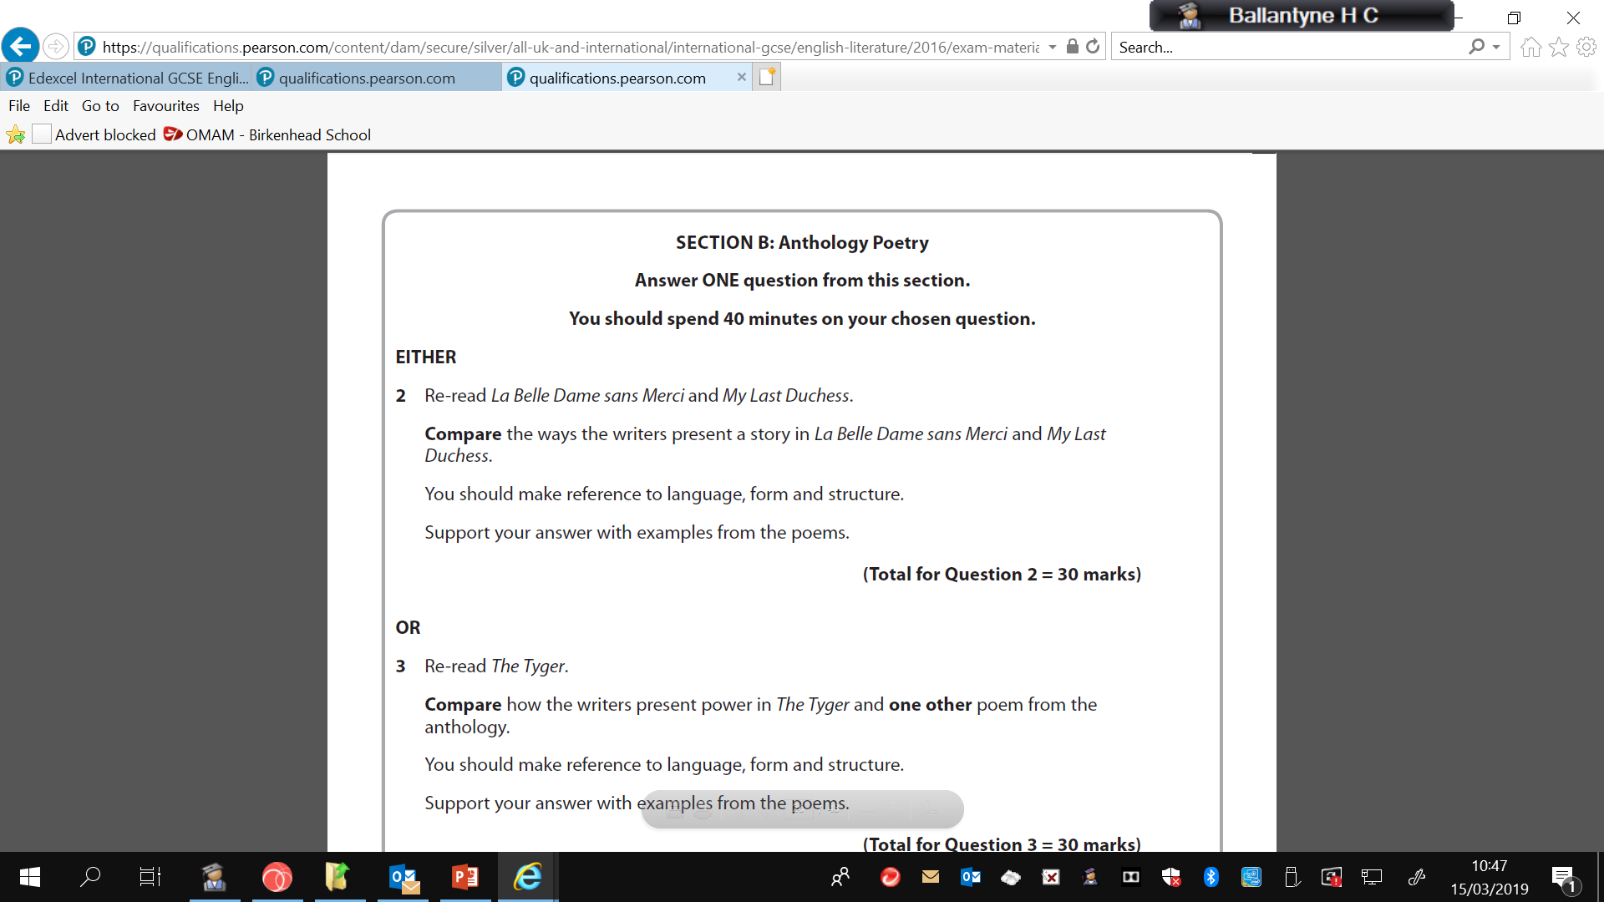
January 2019

Slide 4
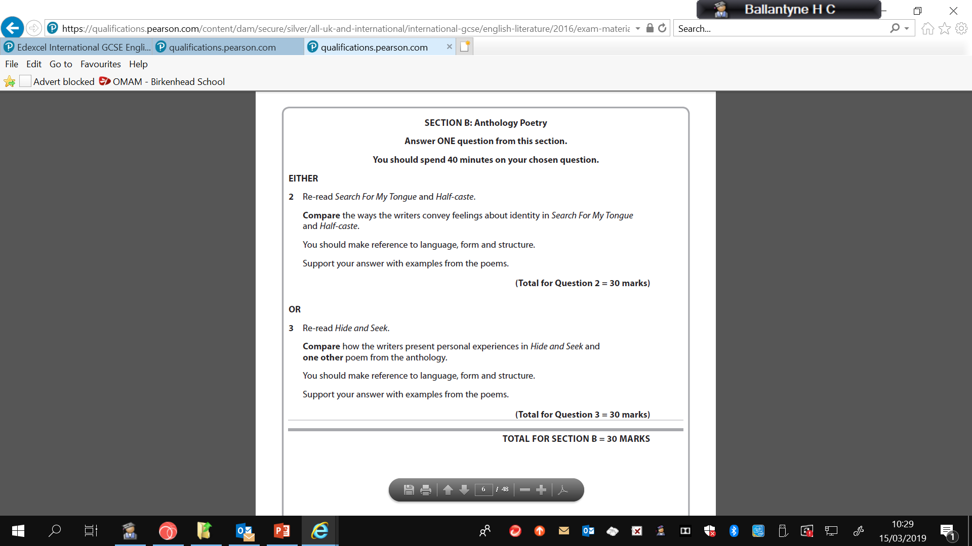
June 2018

Slide 5
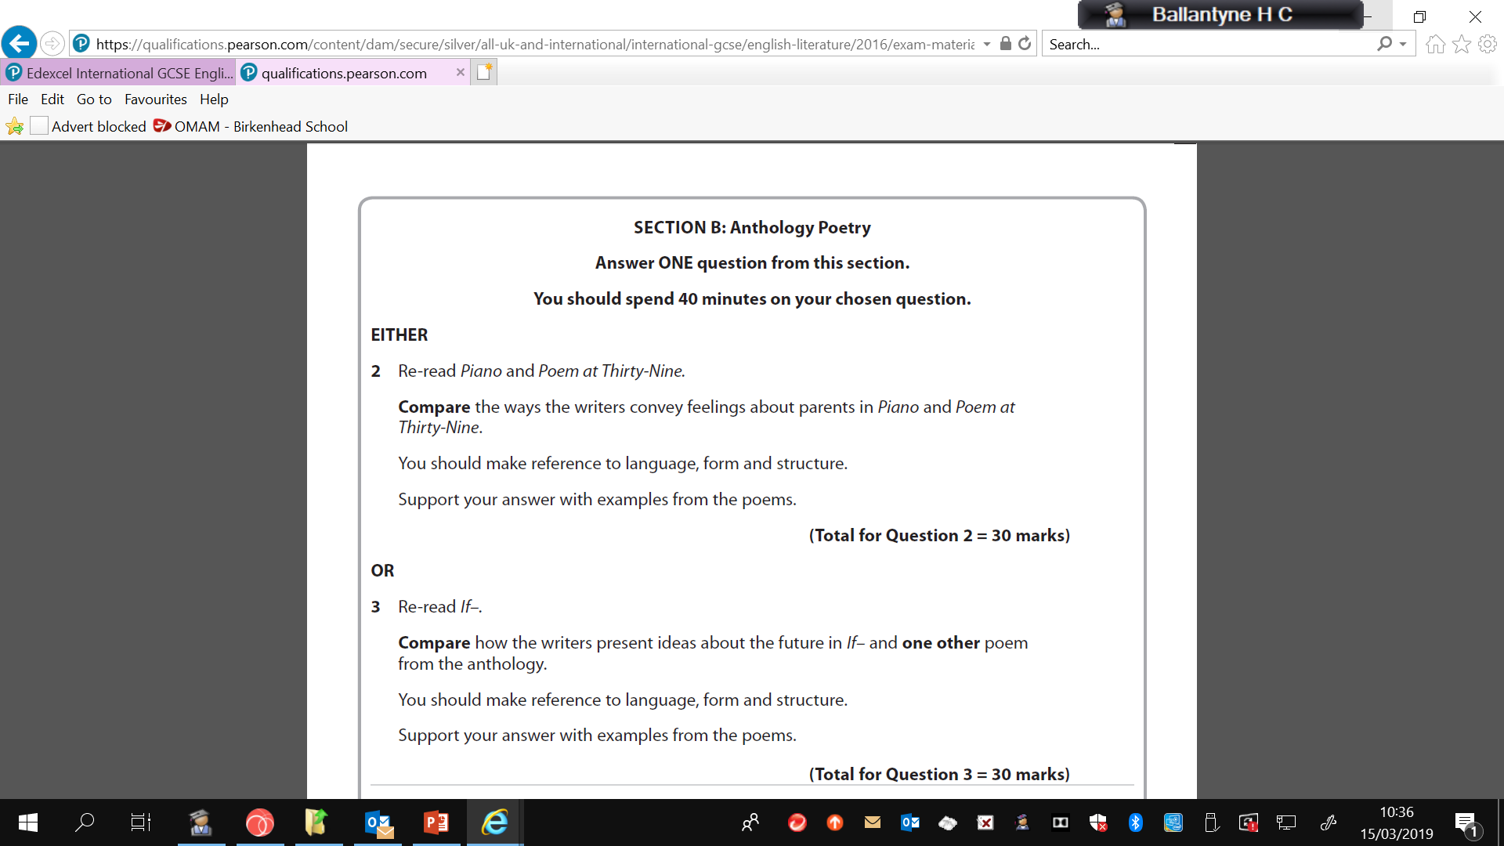
June R 2018

Slide 6
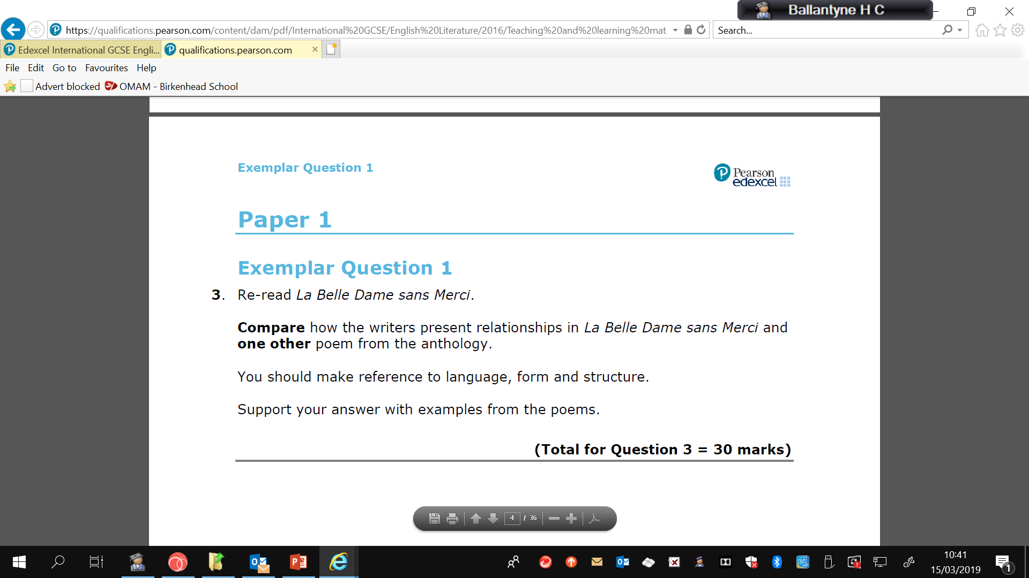
Exemplar

Slide 7
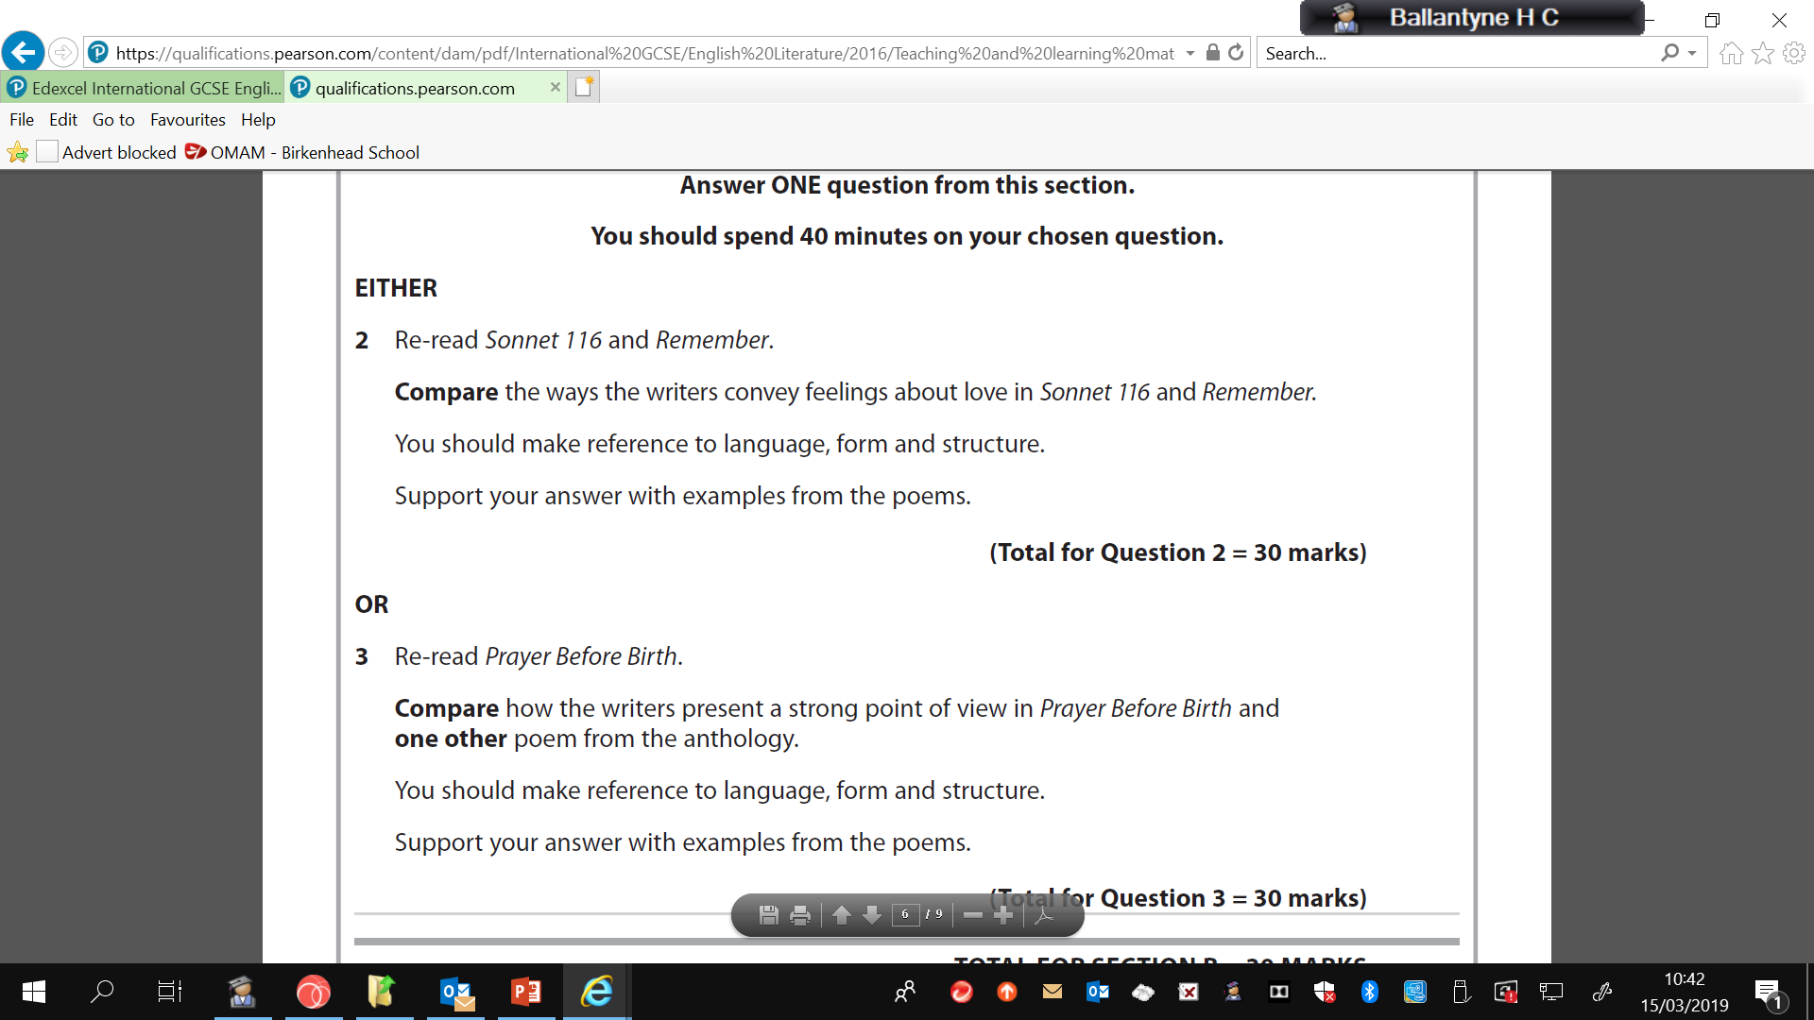
Exemplar

