Slide 1
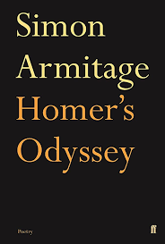
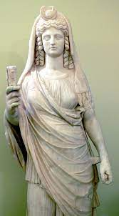
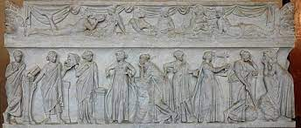
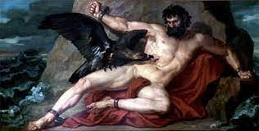
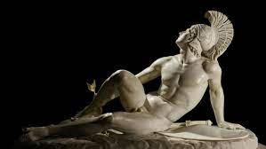
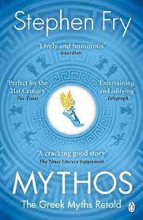
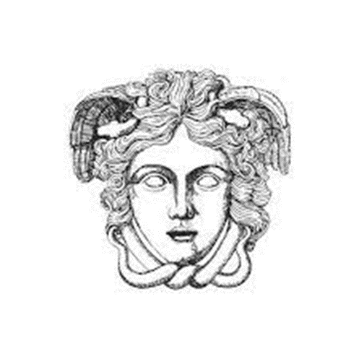
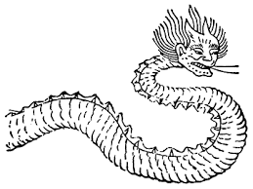
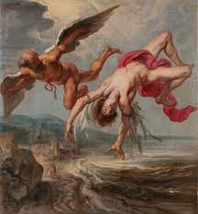
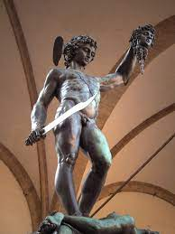
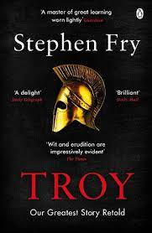
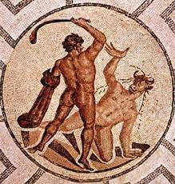
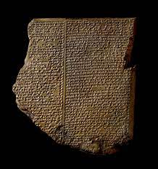
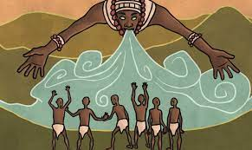
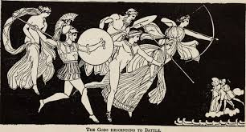
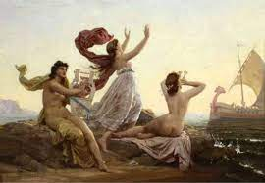
Year 7 English
Michaelmas Term
Ancient Origins

Slide 2
Week 1
Year 7 English
Michaelmas Term
Ancient Origins

Slide 3
Pre-teaching Quiz (R1):
Answer as many questions as you can.
It’s ok to say you don’t know – it helps me know what to teach you next.

Slide 4
This week’s Big Questions:
Y7 ANCIENT ORIGINS: WEEK 1
This Week’s Core Knowledge:
This Week’s terminology & vocabulary:
Myth/Mythology
Deity
Cosmogony
Pantheon
Polytheism
What is a myth?
Why are myths important?
How have different cultures tried to explain the world around them?
Why are Greek myths important to English Literature?
A myth is a traditional story involving gods and supernatural events that often explain event and ideas. From the Greek mythos meaning a story or tale.
Myths are important because they are the beginnings of Literature and English Literature, in particular, draws heavily on myths.
Different cultures have created different myths to explain the world around them.
Greek myths have formed the foundation of English Literature and appear in many different stories.
This Week’s discussion, writing and
reading foci:
You will:
Focus on oracy this week, considering mythic conventions and discussing references to the texts given, sharing your opinion on creation myths and the importance of stories.
Work on reducing information into 3 sentences.

Slide 5
Warm Up: List all of the stories you’ve ever come across for 30 seconds. You can include film, TV, YouTube, books, family stories, jokes…
Fun Task: Create a story from random words:
https://www.shortstoryideas.co.uk/random.htm

Slide 6
Now write down the following key points:
Stories
As human beings, we think, feel, dream and live in and through stories.
Stories help us to make sense of the world and the behaviour of others.
Stories are fundamental to being human – and that’s what we study in English.

Slide 7
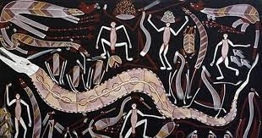
Creation Myths
How is the creation of the world described in each of the following stories?
Similarities and differences? Why might these exist?
You will be writing your own thesis statements, comparing the creation myths
New Key Term:
‘Cosmogony’ to describe a theory that explains the beginnings of the universe/world

Slide 8
New Term: ‘Thesis Statement’
‘A complex sentence that sums up your argument. We create thesis statements by using a controlling idea and a topic’
Modelled example:(I want my thesis statement to sum up difference between what Myths are, versus what the 'First Order' was for the Greeks)

Slide 9
New Term: ‘Thesis Statement’
‘A complex sentence that sums up your argument. We create thesis statements by using a controlling idea and a topic’
Modelled example:
Although myths are stories that explain how the world works, the First Order explains how the ancient Greeks thought the world was created.

Slide 10
Creation Myths 1. ‘The First Order’ Stephen Fry Mythos p.7
New Key Term:
‘Cosmogony’ to describe a theory that explains the beginnings of the universe/world
How is the creation of the world described in this story?
Can we think about similarities and differences with others that we are going to read and why might these exist?

Slide 11
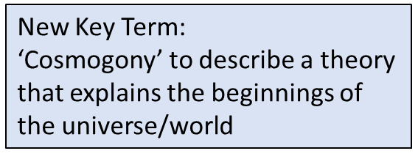
Creation Myths 2. ‘Yoruban Creation Myth’ p.8
How is the creation of the world described in this story?
Can we think about similarities and differences with others that we are going to read and why might these exist?

Slide 12
Creation Myths 3. ‘Persephone, Queen of the Underworld’ p.9
How is the creation of the world described in this story?
Can we think about similarities and differences with others that we are going to read and why might these exist?

Slide 13
Creation Myths 4. ‘Chinese Myth of Zhulong the Candle Dragon’ p.11
How is the creation of the world described in this story?
Can we think about similarities and differences with others that we are going to read and why might these exist?

Slide 14
Extension/Extra Resources:
3. The importance of myth
The significance of myth in human society and culture has been recognised since ancient times. There are a number of ways to understand myths:
Myths create culture: we can read myths as explanations for how the world was created and as moral tales that tell us how we should – and should not – behave. In this way, myths help to create cultures and societies, giving people an identity and a set of rules to follow, as well as explaining the world around them and where they came from.
Different societies create different myths: not only do myths help to create cultures, but different cultures will also create different myths. The Greeks, for example, created gods and goddesses who looked like them, just as the Han Chinese created gods who looked like them. Not only does culture define myths but myths can come to define cultures.
Myths are allegorical: We can read myths as allegories, where for example the Minotaur represents an older religion that worshipped a bull-headed god but which was defeated by the civilised Greeks represented by Theseus. We can also see myths as explaining our minds – so the minotaur can be seen as the shadow self or dark part of ourselves that Theseus, the rational ego, must find and conquer. Part of the reason why myths are still so popular is because they can be interpreted in many different ways.
Myths are foundational in English literature: Myths are used by many different writers through English Literature. As you go study and explore novels, poems and plays, you’ll see that images and ideas from ancient myths crop up again and again. Theseus for example is a character in A Midsummer Night’s Dream; Carol Ann Duffy has written a series of poems told from different viewpoints in Classical mythology. Further, we use common phrases that are taken straight from myths – following a thread is from the story of the Minotaur, flying too close to the sun is from the story of Icarus.
Myths and Epic introduce us to key literary concepts: Aristotle’s Poetics will be important here for foundational ideas such as exposition and resolution, as well as hamartia and hubris in heroes; Homeric epithets introduce us to metaphor.

Slide 15
Creation Myths
New Term: ‘Thesis Statement’
‘A complex sentence that sums up your argument. We create thesis statements by using a controlling idea and a topic’
Now write your own thesis statements, comparing the creation myths
‘Although ancient Han Chinese people believed that…, Yoruban stories tell us that…’
‘Although myths are different, they also…’
EXTENSION: Use the word ‘COSMOGONY’
Ted Talk: Gottschall – we are storytelling humans https://youtu.be/s4kXLK1dWc0

Slide 16
Prometheus is also believed to have given man the gift of writing.
Why would writing be such a powerful gift?
What connections can we make between fire and writing?
Why would Zeus – or any omnipotent god – want to stop mankind from being able to write?
What changes when we can write things down?
‘The Story of Prometheus ’ By James Baldwin p.12
Key point:
the myth of Prometheus giving fire (and writing) to man has inspired writers throughout millennia and we will come across this myth again and again

Slide 17
New Term: ‘Thesis Statement’
‘A complex sentence that sums up your argument'
Let’s practice writing thesis statements:
Since/Because/As
Since stories are fundamental to being human, studying stories in English allows us to explore how human beings understand themselves and the world around them.
Subordinating clause
Comma (pivot point)
Subordinating conjunction
Main
clause
TITLE & QUESTION:
Why is it important to learn through stories?

Slide 18
‘The Story of Prometheus ’ By James Baldwin p.12
Let’s practice summarising:
What are the main events in this myth?
Reduce to 5, then 3
Now write into sentences using these stems:
First…
Then…
Finally…

Slide 19
Which 5 Events did you pick out?
1.Introduction to the Brothers
2. Prometheus Brings Fire to Humans
3. Prometheus defies Jupiter
4. The Beneficial Effects of Fire
5. Prometheus' Punishment

Slide 20
And now to 3?
Prometheus Brings Fire to Humanity
2. Prometheus' Punishment
3. Humanity's Transformation

Slide 21
What is a myth?
Ten Characteristics of a Myth
1. A myth is a story that is, or was, considered a true explanation of the natural world and how it came to be.
2. Characters are often non-human and are typically gods, goddesses, supernatural beings or mystical “first people.”
3. Setting is typically ancient, or prior to the time when actual records were kept. Myths are typically set in a world very similar to our own, but with supernatural monsters or areas.
4. The plot of a myth may take place between a supernatural world and our present-day world. Myths do this to highlight the basic human behaviours that are essential in any setting.
5. Myths possess events that bend or break natural laws. This is often done to magnify the “super-naturalness” of the mythical world.
6. Promotes “Social Action”—myths try to tell people how to act and live. Core values such as individualism, family and community are often instilled in mythical heroes.
7. Myths have sense of mystery, or the unknown.
8. Dualities (or complete opposites such as night/day, good/evil) often play important roles in the plot of a myth.
9. Myths often have an emphasis on language… Mythical heroes are often sophisticated storytellers.
10. Myths are often metaphoric—that is, myths are created to comment or analyze a real-world event. Real world questions that myths often attempt to answer are:
Why are we here?
Who are we?
Why are we living? What is our purpose?

Slide 22
Extension/Extra Resources:
4. Ted Talk: Gottschall – we are storytelling humans https://youtu.be/s4kXLK1dWc0
Human Beings: The Story-telling Animal
Jonathan Gottschall is an American literary scholar specializing in literature and evolution. Gottschall argues that humans are the storytelling animals. We thrill to an astonishing multitude of fictions on pages, on stages, and on screens: murder stories, sex stories, war stories, conspiracy stories, true stories and false. We are, as a species, addicted to story. But the addiction runs deeper than we think. We can walk away from our books and our screens, but not from story. We dream, fantasize, and socialize in stories. Story infiltrates every aspect of how we live and think. Did you know that fiction enhances our empathy? That it is better at changing our values and beliefs than non-fiction that is designed to persuade? Did you know that stories have brought on wars, inspired atrocities, and driven massive social change? Did you know that the stories in dreams, literature, and children's make-believe, all share the same universal structure? Did you know that we all boldly fictionalize the stories of our own lives?

Slide 23
Extension/Extra Resources:
5. Introduction to Classical Greece and Greek Mythology
(Resource 2 in Folder)
6. Who were the ancient Greek gods and heroes? - BBC contains a useful dramatization of the Medusa story:
https://www.bbc.co.uk/bitesize/topics/z87tn39/articles/zgt7mp3

Slide 24
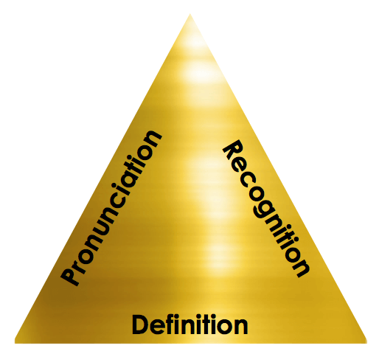
Myth/Mythology
Deity
Cosmogony
Pantheon
Polytheism
Vocabulary Learning
Pronunciation – how is the word is said. If you say it aloud and use it in a sentence, it will help you remember it.
Recognition – how is the word spelt? Being able to use phonics to decode new vocabulary and then to be able to reproduce the spelling makes a dig difference.
Definition – what does the word mean? It might sound obvious, but if you know the meaning of a word, you’re much more likely to remember it.

Slide 25
Vocabulary learning (link to David Didau N:\Word of the week - innovation (David Didau).mp4) 1. Say new word, display on screen 2. Say new word in a few different sentences 3. Pronunciation (1): Use phonetical spelling to show how to pronounce word 4. Recognition (2): Spell word, broken down into logical sections. 5. Definition (3): Use synonyms. 6. Etymology 7. Related Words

Slide 26
Myth/Mythology
Deity
Cosmogony
Pantheon
Polytheism
Vocabulary Learning
Myth/Mythology
Rate how well you know it:
Never seen it before
Seen it, heard it, unsure what it means
Understand and can sometimes use
Confidently understand and can explain

Slide 27
New Word:
Myth/Mythology
Spell It:
Say It!
“Mith”
My-th
Etymology:
Ancient Greek μῦθος (mûthos, “word, humour, companion, speech, account, rumour, fable”)
Understand it Definition: A story or tale
Word Class: Noun
Example: “Most societies have their own creation myths.”

Slide 28
Myth/Mythology
Deity
Cosmogony
Pantheon
Polytheism
Vocabulary Learning
Deity
Rate how well you know it:
Never seen it before
Seen it, heard it, unsure what it means
Understand and can sometimes use
Confidently understand and can explain

Slide 29
New Word:
Deity
Spell It:
Say It!
“Day-ity”
De-ity
Etymology: Middle English (denoting the divine nature of God): from Old French deite, from ecclesiastical Latin deitas (translating Greek theotēs ), from deus ‘god’.
Understand it Definition: A god or goddess
Word Class: Noun
Example: Ares and Aphrodite were the ancient Greek deities of war and love.

Slide 30
Myth/Mythology
Deity
Cosmogony
Pantheon
Polytheism
Vocabulary Learning
Cosmogony
Rate how well you know it:
Never seen it before
Seen it, heard it, unsure what it means
Understand and can sometimes use
Confidently understand and can explain

Slide 31
New Word:
Cosmogony
Spell It:
Say It!
“Cos-mogo-nee”
Cos-mog-on-y
Etymology: From Ancient Greek κοσμογονία (kosmogonía), from κόσμος (kósmos, “world”) + γόνος (gónos, “creation”)
Understand it Definition: 1. : a theory of the origin of the universe. 2. : the creation or origin of the world or universe.
Word Class: Noun
Example: "in their cosmogony, the world was thought to be a square, flat surface"

Slide 32
Myth/Mythology
Deity
Cosmogony
Pantheon
Polytheism
Vocabulary Learning
Pantheon
Rate how well you know it:
Never seen it before
Seen it, heard it, unsure what it means
Understand and can sometimes use
Confidently understand and can explain

Slide 33
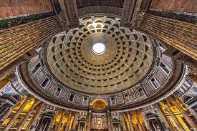
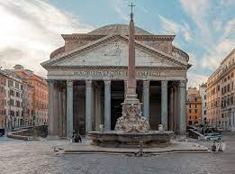
New Word:
Pantheon
Spell It:
Say It!
Pan-the-on
“Panth-e-on”
Etymology: Old English pantheon (referring especially to the Pantheon, a large circular temple in Rome): via Latin from Greek pantheion, from pan ‘all’ + theion ‘holy’ (from theos ‘god’).
Understand it
Definition: 1.
a group of particularly respected, famous, or important people.
2.all the gods of a people or religion
Word Class: Noun
Example:"the deities of the Hindu pantheon"

Slide 34
Myth/Mythology
Deity
Cosmogony
Pantheon
Polytheism
Vocabulary Learning
Polytheism
Rate how well you know it:
Never seen it before
Seen it, heard it, unsure what it means
Understand and can sometimes use
Confidently understand and can explain

Slide 35
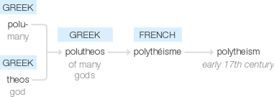
New Word:
Polytheism
Spell It:
Say It!
Poly-the-ism
“Polly-thee-ism”
Etymology: early 17th century: from French polythéisme, from Greek polutheos ‘of many gods’, from polu- ‘many’ + theos ‘god’.
Understand it
Definition: the belief in or worship of more than one god.
Word Class: Noun
Example: "the polytheism of the ancient Near East"

Slide 36
Week 2
Year 7 English
Michaelmas Term
Ancient Origins

Slide 37
This week’s Big Questions:
Y7 ANCIENT ORIGINS: WEEK 2
This Week’s Core Knowledge:
This Week’s terminology & vocabulary:
Protagonist
Cuneiform
Myth
Thesis
Hubris
What is an Epic?
How are heroes presented?
How are heroes presented in myths?
What happens in the Epic of Gilgamesh?
How were heroes presented in epic texts?
History’s oldest known fictional story is probably the “Epic of Gilgamesh,” a mythic poem that first appeared as early as the third millennium B.C.
The adventure-filled tale centres on a Sumerian king named Gilgamesh, described as being one-third man and two-thirds god.
Over the course of twelve clay tablets’ worth of text, he goes on a classic hero’s journey that sees him slay monsters, rub elbows with the gods and search for the key to immortality—all with predictably tragic results.
An epic hero had the following traits:
• Favoured by the gods
• A hero must be mortal
• Physically impressive
• Skilled at warfare
This Week’s discussion, writing and
reading foci:
You will focus on:
Summarising key texts using a Single Paragraph Outline.
Using thesis statements.
Vocabulary tasks during reading
Structured discussion

Slide 38
‘The Epic of Gilgamesh’ Introduction
Great Overview (13mins)
Crash Course World Mythology https://youtu.be/sWppk7-Mti4
Look at the timeline in your anthologies (p.6), we’re going back to the very earliest beginnings of literature (that we know so far!)
What is the Epic of Gilgamesh?
History’s oldest known fictional story is probably the “Epic of Gilgamesh,” a mythic poem that first appeared as early as the third millennium B.C. The adventure-filled tale centres on a Sumerian king named Gilgamesh, described as being one-third man and two-thirds god.
Over the course of twelve clay tablets’ worth of text, he goes on a classic hero’s journey that sees him slay monsters, rub elbows with the gods and search for the key to immortality—all with predictably tragic results.
The Epic of Gilgamesh started out as a series of Sumerian poems and tales dating back to 2100 B.C., but the most complete version was written around the 12th century B.C. by the Babylonians. The story was later lost to history after 600 B.C., and it wasn’t until the mid-19th century that archaeologists finally unearthed a copy near the Iraqi city of Mosul.
Since then, scholars have hailed the 4,000-year-old epic as a foundational text in world literature.

Slide 39
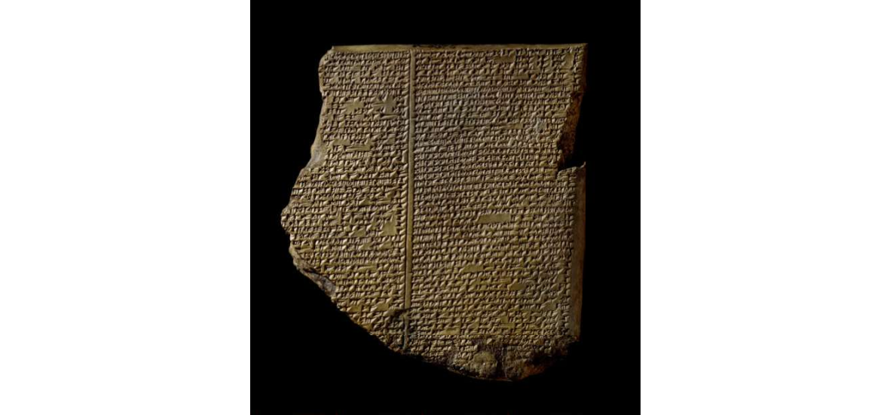
‘The Epic of Gilgamesh’ 2100-1200BCE
Tablet 1-2 p.14
Vocabulary in action
Choose the word that is not related in meaning to the other words in each set.
a) diminutive, b) immense, c) huge, d) enormous
a) dirty, b) cleanse, c) defile, d) corrupt
a) easy, b) tranquil, c) leisurely, d) arduous
a) ferocity, b) gentleness, c) savagery, d) viciousness
a) consult, b) ask, c) ignore, d) confer
a) bade, b) summoned, c) beckoned, d) dismissed
a) survive, b) resist, c) crumble, d) withstand

Slide 40
‘The Epic of Gilgamesh’ 2100-1200BCE
Tablets 3-4 p.15
Vocabulary in action
Choose the word that is not related in meaning to the other words in each set.
a) stature, b) height, c) size, d) immense
a) disdained, b) derided, c) chosen, d) scorned
a) begged, b) implored, c) appealed, d) seized
a) prevail, b) fail, c), collapse, d) flop
a) spiralling, b) increasing, c) soaring, d) plummeting
a) caress, b) buffet, c) stroke, d) embrace

Slide 41
‘The Epic of Gilgamesh’ 2100-1200BCE
Tablets 5-6 p.16
Vocabulary in action
Choose the word that is not related in meaning to the other words in each set.
a) sorrowful, b) jubilant, c) triumphant, d) exultant
a) scarcity, b) abundance, c) paucity, d) dearth
a) praise, b) esteem, c) tribute, d) contempt
a) contempt, b) appreciation, c) regard, d) approval
a) threatening, b) dread, c) encouraging, d) foreboding
a) emaciated, b) wilted, c) strengthened, d) withered
a) lament, b) rejoice, c) mourn, d) grieve

Slide 42
‘The Epic of Gilgamesh’ 2100-1200BCE
Tablets 7-9 p.16
Vocabulary in action
Choose the word that is not related in meaning to the other words in each set.
a) took, b) doled, c) grabbed, d) stole
a) dispersed, b) collected, c) mustered, d) gathered
a) shallow, b) weighty, c) overwhelming, d) profound
a) etched, b) scratched, c) cut, d) stroked
a) chains, b) structure, c) controls, d) rigging
a) climb, b) ascend, c) disembarking, d) rise
a) surrendered, b) routed, c) vanquished, d) overcame

Slide 43
‘The Epic of Gilgamesh’ 2100-1200BCE
Tablets 10-11 p.18
Vocabulary in action
Choose the word that is not related in meaning to the other words in each set.
a) dimensions, b) proportions, c) measurements, d) weight
a) restored, b) weary, c) rejuvenated, d) energized
a) sung, b) carved, c) chiselled, d) inscribed
a) clasp, b) hold, c) release, d) hug

Slide 44
‘The Epic of Gilgamesh’ 2100-1200BCE
Tablet 12 p.19

Slide 45
Summarising task:
Read the following thesis statement for the Epic of Gilgamesh:
‘Gilgamesh is presented as a hero who goes on a quest to discover the truth about himself and life.’
Now decide on 4 key events in the epic (you can do this as a whole class or paired task)
Use these sentence stems: At first… but then/after; Together, Gilgamesh and Enkidu…/After Enkidu dies…/In the end…’

Slide 46
Now write a concluding sentence answering the question:
‘How does Gilgamesh change?’
Now write this into a paragraph that might look like this:
Gilgamesh is presented as a hero who goes on a quest to discover the truth about himself and life. At first Gilgamesh is a cruel and despotic king, but after he meets Enkidu, his best friend, he becomes kinder. Gilgamesh and Enkidu together travel to the Cedar Forest and battle Humbaba. After Enkidu dies, Gilgamesh searches for the secret of immortality. In the end, he realises that no man can live forever and returns home to write down his adventures. Gilgamesh changes from being an evil king to being kind because of Enkidu. N

Slide 47
What makes an epic hero?
Today we think of a hero as somebody who does something dangerous to help somebody else. The heroes in Greek mythology were nothing like this: they were a pretty selfish bunch, and often behaved very badly. In other words, not exactly role models for the younger generation of today. But knowing their names and exploits is essential for understanding references in literature and even popular culture today. An epic hero was often of divine ancestry, is endowed with great courage and strength, celebrated for his bold exploits, and favoured by the gods.
Favoured by the gods – this might mean that he was descended from a god or goddess, or just that he was under a deity’s protection. For example, Achilles was the son of the sea goddess Thetis. Gilgamesh was made two thirds god and one third man.
2. A hero must be mortal – they had to risk death. Although some heroes (particularly Heracles) become immortal, they have to die first. Although his mother is a goddess, Achilles’ father was a mortal man; although Thetis makes him invulnerable, his heel was unprotected, allowing him to be killed by Paris.
3. Physically impressive – they must be beautiful and imposing; being tall and strong was pretty important.
4. Skilled at warfare – Achilles was the ultimate warrior but Odysseus is also capable of super human feats e.g. no one else can string his bow. Skill at war included both tactical intelligence and ability in single combat.
For Homer, a hero was only as impressive as his epithets. The more labels of descriptions the better. Odysseus is describes as “man of many schemes,” “much enduring,” “loved of Zeus,” “of the steadfast heart,” “crafty,” “cunning” and so on.

Slide 48
How is Gilgamesh presented as a hero?
This is the story of a man who knew all that could be known. He saw the hidden things from the time before the Flood. He built the walls of Uruk. Climb those walls. Examine their foundations; marvel at their brickwork. No other city can rival strong-walled Uruk. Within the city is a temple, and within the temple is a cedar box. Open the box. Take out the tablets and read the story of Gilgamesh. Gilgamesh, the wild bull, perfect in strength, surpassing all others.
Gilgamesh, the hero – immense and terrible. Who other than Gilgamesh can say: “I am king without equal”? Gilgamesh was his name before birth. The great goddess Aruru designed his body. Two thirds god she made him, and one third man. Shamash the Sun gave him beauty. Adad the Storm gave him courage. Gilgamesh, strongest of all! Long was his journey, and arduous his labours. Weary, he returned to city of Uruk and inscribed this story.
Gilgamesh was unmatched in strength and power. Arrogant, he believed everything belonged to him. He ripped sons from their fathers and demanded their daughters be made to serve him. His tyranny and savagery grew. The women and the old ones complained to the gods, “Shouldn’t Gilgamesh be our shepherd, the protector of our people?” They called to Aruru: “You made this king of ours. Now make us another who is strong enough to withstand him.” The goddess Aruru heard the cries of the people of Uruk, and out of clay she fashioned a wild man named Enkidu.

Slide 49
Key points:
Gilgamesh has many of the common attributes of a hero (favoured by gods, mortal, physically impressive, skilled at warfare)
Gilgamesh is also flawed at the beginning – he is not a perfect king or ruler until he meets Enkidu, suffers the grief of Enkidu’s death and is denied immortality.

Slide 50
Hero Myths
‘Theseus and the Minotaur’ p.20

Slide 51
Hero Myths
‘Perseus the Gorgon Slayer’ p.24-5

Slide 52
Now let’s practice summarising skills using kernel sentences and w-questions:
e.g. Theseus kills the Minotaur
where- in the labyrinth in Crete;
why – to free the people of Athens;
when – after Ariadne shows him how to find his way back
= Theseus kills the minotaur in the labyrinth in Crete in order to free his people from their obligation, but only after Ariadne shows him how to find his way back
Now do your own for Perseus the Gorgon Slayer:
Where, why, when and =

Slide 53
How far do the protagonists in these stories meet the criteria for epic heroes?
Why? Why Not?
Favoured by Gods?
Mortal?
Physically impressive?
Skilled at warfare?

Slide 54
Seven Basic Plots?

Slide 55
Although protagonists in these stories don't always meet the criteria for being an epic hero (COMMA),

Slide 56
Myth/Mythology
Deity
Cosmogony
Pantheon
Polytheism
Vocabulary Learning
Pronunciation – how is the word is said. If you say it aloud and use it in a sentence, it will help you remember it.
Recognition – how is the word spelt? Being able to use phonics to decode new vocabulary and then to be able to reproduce the spelling makes a dig difference.
Definition – what does the word mean? It might sound obvious, but if you know the meaning of a word, you’re much more likely to remember it.

Slide 57
Vocabulary learning (link to David Didau N:\Word of the week - innovation (David Didau).mp4) 1. Say new word, display on screen 2. Say new word in a few different sentences 3. Pronunciation (1): Use phonetical spelling to show how to pronounce word 4. Recognition (2): Spell word, broken down into logical sections. 5. Definition (3): Use synonyms. 6. Etymology 7. Related Words

Slide 58
Protagonist
Cuneiform
Myth
Thesis
Hubris
Vocabulary Learning
Hubris
Rate how well you know it:
Never seen it before
Seen it, heard it, unsure what it means
Understand and can sometimes use
Confidently understand and can explain

Slide 59
New Word:
Hubris
Spell It:
Say It!
Hub-ris
“H-you-bris”
Etymology:
Understand it
Definition: (in Greek tragedy) excessive pride towards or defiance of the gods, leading to nemesis.
Word Class: Noun
Example: "He was punished for his hubris"
from Ancient Greek ὕβρις (húbris) 'pride, insolence, outrage

Slide 60
Protagonist
Cuneiform
Myth
Thesis
Hubris
Vocabulary Learning
Cuneiform
Rate how well you know it:
Never seen it before
Seen it, heard it, unsure what it means
Understand and can sometimes use
Confidently understand and can explain

Slide 61
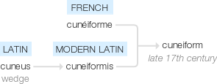
New Word:
Cuneiform
Spell It:
Say It!
Cune-if-orm
“K-you-niform”
Etymology: Late 17th century: from French cunéiforme or modern Latin cuneiformis, from Latin cuneus ‘wedge’.
Understand it
Definition: denoting or relating to the wedge-shaped characters used in the ancient writing systems of Mesopotamia, Persia, and Ugarit, surviving mainly on clay tablets
Word Class: Noun/adjective
Example: "a Mesopotamian script pre-dating cuneiform“/"a cuneiform inscription"

Slide 62
Protagonist
Cuneiform
Myth
Thesis
Hubris
Vocabulary Learning
Thesis
Rate how well you know it:
Never seen it before
Seen it, heard it, unsure what it means
Understand and can sometimes use
Confidently understand and can explain

Slide 63
New Word:
Thesis
Spell It:
Say It!
via late Latin from Greek, literally ‘placing, a proposition’, from the root of tithenai ‘to place’.
The-sis
“Thee-sis”
Understand it
Definition: denoting or relating to the wedge-shaped characters used in the ancient writing systems of Mesopotamia, Persia, and Ugarit, surviving mainly on clay tablets
Word Class: Noun/adjective
Example: "a Mesopotamian script pre-dating cuneiform“/"a cuneiform inscription"

Slide 64
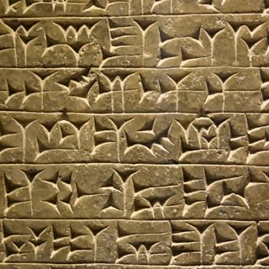
BBC ‘In Our Time’ Epic of Gilgamesh
Melvyn Bragg and guests discuss the Gilgamesh Epic, often described as the earliest surviving great work of literature, with origins in Mesopotamia in the 3rd millennium BC. Epic of Gilgamesh
Extension/Extra Resources:
Useful background information:
https://www.bbc.co.uk/sounds/play/b08wn9m0
Things That Made the Modern Economy
(Cuneiform) First few minutes are the most useful
Cuneiform is a system of writing first developed by the ancient Sumerians of Mesopotamia c. 3500-3000 BCE. It is considered the most significant among the many cultural contributions of the Sumerians and the greatest among those of the Sumerian city of Uruk which advanced the writing of cuneiform c. 3200 BCE. The name comes from the Latin word cuneus for 'wedge' owing to the wedge-shaped style of writing. In cuneiform, a carefully cut writing implement known as a stylus is pressed into soft clay to produce wedge-like impressions that represent word-signs (pictographs) and, later, phonograms or `word-concepts' (closer to a modern-day understanding of a `word').
All the great Mesopotamian civilizations used cuneiform until it was abandoned in favour of the alphabetic script at some point after 100 BCE. When the ancient cuneiform tablets of Mesopotamia were discovered and deciphered in the late 19th century CE, they would literally transform human understanding of history. Prior to their discovery, the Bible was considered the oldest
and most authoritative book in the world.
The brilliant scholar and translator George Smith (l.1840-1876 CE) changed the understanding of history with his translation of The Epic of Gilgamesh in 1872 CE. This translation allowed other cuneiform tablets to be interpreted and opened the ancient world of Mesopotamia to modern historians.
Greek myths:
Useful summary and discussion of the concept of heroes in Ancient Greek myth and culture. https://mythopedia.com/topics/greek-heroes
In Our Time: Greek Myths
https://www.bbc.co.uk/programmes/b0093z1k

Slide 65
Week 3
Year 7 English
Michaelmas Term
Ancient Origins

Slide 66
This week’s Big Questions:
Y7 ANCIENT ORIGINS: WEEK 3
This Week’s terminology & vocabulary:
This Week’s Core Knowledge:
Protagonist
Epic
Epithet
Appositive
Metaphor
Vehicle
Tenor
Ground
An epic poem is a long, narrative poem that usually follows the exploits of a hero/group of heroes as they face challenges and obstacles.
Achilles meets all of the criteria for an ancient Hero: he is blessed by the gods (such as Athene), he is physically impressive, he is skilled at warfare and although he is very hard to kill, he is not actually immortal.
An epithet is a common phrase used to describe a character, place or thing, often used in epic poetry eg the wine dark sea, swift footed Achilles.
A metaphor is a figure of speech where two things are compared – usually an abstract idea (eg love) with a concrete object (eg a red rose).
The tenor refers to the subject of the metaphor.
The vehicle is the thing being compared and the ground is the link between the subject (the tenor) and the comparison (the vehicle).
What is Epic and why is it important?
What is Epic Poetry?
How is Achilles presented compared to other heroes?
What is an epithet?
What is metaphor, tenor, vehicle and ground?
This Week’s discussion, writing and
reading foci:
You will be able to:
correctly identify elements of a range of metaphors.
correctly identify appositives and Homeric epithets.
write clear thesis statements answering the question ‘How far is Achilles presented as a hero?’
use slow writing to imitate writers’ techniques.

Slide 67
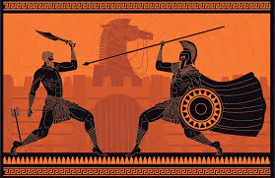
‘The Iliad’
p.28-31
Vocabulary in action
Choose the word that is not related in meaning to the other words in each set.
a) face, b) meet, c) evade, d) confront
a) ponderous, b) swift, c) weighty, d) hefty
a) clamour, b) peacefulness, c) silence, d) calm
a) dirty, b) cleanse, c) defile, d) corrupt
a) strong, b) vulnerable, c) weak, d) defenceless
a) dodge, b) capture, c) elude, d) escape
a) destruction, b) disaster, c) havoc, d) protection
a) whetted, b) dull, c) blunt, d) rounded
a) disobey, b) flout, c) punish, d) disregard
a) promise, b) exult, c) rejoice, d) celebrate
a) defender, b) guardian, c) protector, d) scourge
a) act, b) abstain, c) proceed, d) perform

Slide 68
Vocabulary in action task.
Key Term: ‘Epithet’
Definition: An epithet is an adjective or adjectival phrase that is used to define a distinctive quality of a person or thing.
In Homer, the poet uses set epithets (formulas) for referring to characters and setting which are always the same: e.g. fleet-footed Achilles, bolt-hurling Zeus, wine-dark sea.
We use the term epithet rather than adjective because epithets express an essential quality or characteristic, rather than a trait that only lasts for a particular moment.
Task:
Find the epithets applied to Achilles in this extract (line 9 fleet-footed Achilles, line 24 Achilles the great runner which is an adjectival phrase as it modifies the noun ‘Achilles’).
Epithets are also applied to famous people in history e.g. Alexander the Great, or in comic books e.g. Batman = the Dark Knight, Superman = man of steel
Now write your own epithets for famous people (this could be your teacher, a celebrity, a sportsperson e.g. sharp-eyed Mrs Woozley; kind-hearted Marcus Rashford; swift diving Tom Daly etc.)
More info here: https://study.com/academy/lesson/character-epithets-in-the-iliad.html

Slide 69
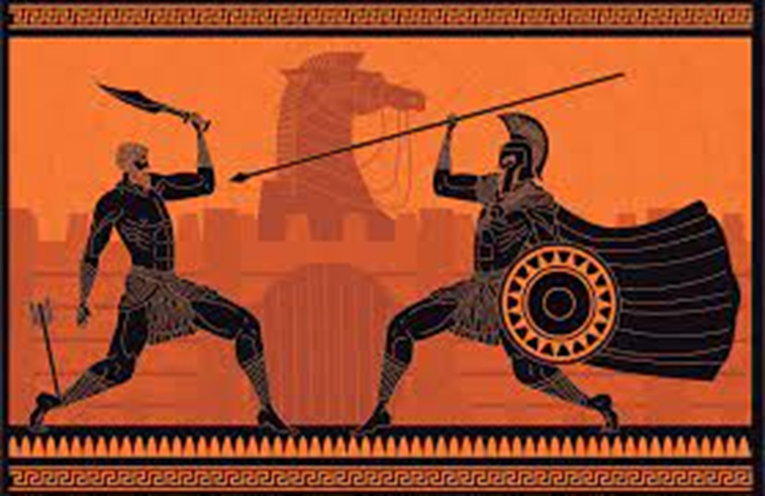
Now let’s have a quick recap from last week…
What makes an epic hero? (slide 44)
…now let’s read Extract 2 from the Iliad, p.29 ‘Desolation Before Troy’
Task:
Identify the epithets (x5) used to describe Achilles and Hector (l.11swift Achilles; l18 splendid Hector.
Now list as many of the key features of a hero that you can remember.
Structured discussion
What is your impression of Achilles?
Does Achilles loyalty to his friend Patroclus justify the way he treats Hector?
To what extent do Achilles and Hector conform to your idea of a hero?
How is Achilles similar to Gilgamesh?
What is your opinion of the gods’ involvement with events?

Slide 70
Mini Assessment:
To what extent is Achilles a hero?
Discuss your first response to the question in pairs, brainstorm some ideas.
2. Now write your own THESIS STATEMENT that sums up what your MAIN point is (use appropriate adjectives):
3. Now expand your sentences using
a) w-questions (when/why/where) and then
b) subordinating conjunctions.
4. Now self and peer assess your sentences; share with the class.

Slide 71
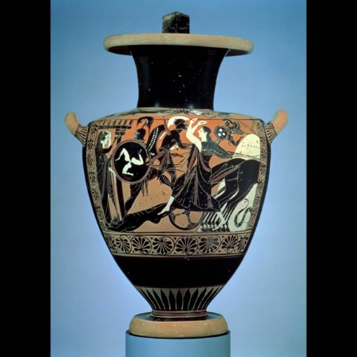
Task: Sentence unscramble (in workbook)
Unscramble the sentences:
with long its shadow and cast his twirled shaft he.
dust he fell now the aside into.
gave it back to Pallas Athena Hector Achilles and plucked it out, but unperceived by.
talk I’ll of have no pacts unforgiven with, forever Hector, as you you are.
Key Term: Appositives
The epitaphs given to the heroes and gods in Homer’s epics are often appositives – noun phrases that give extra description and can substitute for the character’s name.
In the extracts Achilles is referred to as ‘the great runner’. He also sometimes called ‘Best of the Greeks’ and ‘Prince of Phthia’.
P.31 Task: Add an appositive to the sentences below:
Patroclus, ____________, was killed by Hector.
Thetis, ___________, comforted her grieving son.
Achilles, _____________, killed Hector.
Hector, _______________, was dragged around the walls of Troy.
Priam, _______________, mourned for his son.

Slide 72
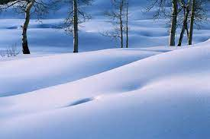
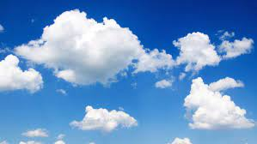
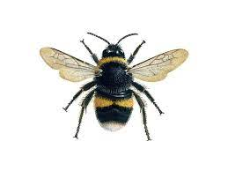
Key terms: metaphor, vehicle, ground, tenor.
Metaphor = a figure of speech that describes something by saying that it is something else. It is not actually true but it gives the reader a clearer idea of what it is like.
Tenor = the subject of the metaphor and its intended meaning
Vehicle = the source of the comparison or substitution being made
Ground = the relationship between the tenor and the vehicle
Example 2:
‘I wandered lonely as a cloud’:
Tenor = Wordsworth’s wanderings
Vehicle = a cloud
Ground = just as the cloud is far above the earth, alone and isolated, so Wordsworth feels far above everyday life, alone and isolated.
Example 1:
‘The blanket of snow’:
Tenor = the snow
Vehicle = a blanket
Ground = the snow looks thick and is covering everything, like a big white blanket.
Now explore the following:
‘Hope is the thing with feathers’
‘Fame is a bee’.
Find one of your own!

Slide 73
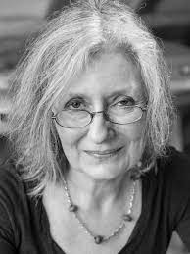
‘Achilles’
By Elizabeth Cook
p.32-33
Cook uses similes in her writing and we can analyse them using the same premise of tenor/vehicle/ground
Let’s look at following worked example:
‘Slamming into the ground like a huge tree’
Tenor = Achilles body falling to the ground
Vehicle = a huge tree
Ground = Achilles’ body is huge as a tree, but also has the same
connotations of majesty and beauty of a tree that has been cut down in its prime.
Now you do the same with:
‘fierce as a dog’

Slide 74
Challenge: have a go at unpicking this extended metaphor from the same extract:
The sound is the sound that would happen if every fish in a silver shoal had its own fine note. An intricacy of sound, a close-stitched cloth. Each fish a needle darting over and under, over and under, till the cloth is tight. Each needle a note, taking its place in the vast canopy of sound that spreads itself out over their heads. This pliant, seam-free cloth of shot skill which encloses them unfurls, interposing itself between them and the sky.
Cook is a poet and as a writer, she uses long extended and complex metaphors.
To analyse the metaphor used here, you will need to break it down in to the different stages:
Every fish in a shoal was a note of music
The sound is so dense it’s like a closely woven cloth
Each fish is now like a needle, weaving the cloth.
Each needle is a note creating the sound
The sound stretches over the men on the beach like a piece of fabric
Here Cook uses multiple vehicles to describe the same thing – the otherworldly sound of Thetis’ grieving.

Slide 75
Now practise writing your own metaphors:
Divide your page into three columns
2. In Column 1 write down 10 – 20 abstract nouns e.g. love, justice, hate, peace (things we can feel but can’t hold) (i.e. the tenor).
3. In Column 2 write down a list of common, everyday objects that you can touch. (i.e. the vehicle)
4. Now pick one abstract noun and one every day object and in column 3 write down the links between them e.g. Love is a daisy – daisies need watering, just like love needs attention, daisies are beautiful like love, daisies grow where you least expect them.
5. Now turn these into metaphors e.g. Love is a daisy, growing unexpectedly in a dark corner.
E.g.:
‘Fear is the cheapest room in the house’ becomes:
[Emotion] is the [comparative] room in the house
‘Love is the best room in the house’ or ‘Anxiety is the neatest room in the house’ or ‘Sadness is the emptiest room in the house’.
Extension: Follow Cook’s example and build a layer of comparisons in your metaphors.

Slide 76
Formative Assessment: Slow Writing Activity
Slow writing is where students are given very precise instructions – sentence by sentence – for your creative writing, helping you to concentrate on quality rather than quantity.
Try this:
A sentence with a simile, starting with ‘They’.
A complex sentence that starts ‘When…’
Three word sentence
A short line of dialogue
A sentence that starts with the word ‘Now…’
Bringing it all together:
You can now try to bring everything together that we have covered this week in the following slow writing activity:
Moments after you were felled – slamming into the ground like a huge tree – there was chaos. They did not want to let you go, these Trojans who had got you so suddenly. So undeservedly. But Odysseus and Ajax arrived, wielding their broad swords.
A sentence in the second person (using ‘you’)
Start with an appositive.
A sentence with a simile in the middle
A sentence that starts with ‘but’
A two word sentence.

Slide 77
Extension/Extra Resources:
Natalie Haynes does a brilliant summation of the Iliad here: https://www.bbc.co.uk/sounds/play/m000d7p2
In Our Time on The Iliad: https://www.bbc.co.uk/programmes/b0bh5x1y

Slide 78
Myth/Mythology
Deity
Cosmogony
Pantheon
Polytheism
Vocabulary Learning
Pronunciation – how is the word is said. If you say it aloud and use it in a sentence, it will help you remember it.
Recognition – how is the word spelt? Being able to use phonics to decode new vocabulary and then to be able to reproduce the spelling makes a dig difference.
Definition – what does the word mean? It might sound obvious, but if you know the meaning of a word, you’re much more likely to remember it.

Slide 79
Vocabulary learning (link to David Didau N:\Word of the week - innovation (David Didau).mp4) 1. Say new word, display on screen 2. Say new word in a few different sentences 3. Pronunciation (1): Use phonetical spelling to show how to pronounce word 4. Recognition (2): Spell word, broken down into logical sections. 5. Definition (3): Use synonyms. 6. Etymology 7. Related Words

Slide 80
Epic
Epithet
Appositive
Metaphor
Vehicle
Tenor
Ground
Vocabulary Learning
Epic
Rate how well you know it:
Never seen it before
Seen it, heard it, unsure what it means
Understand and can sometimes use
Confidently understand and can explain

Slide 81
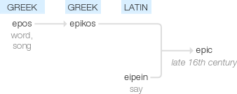
New Word:
Epic
Spell It:
Say It!
Etymology: late 16th century (as an adjective): via Latin from Greek epikos, from epos ‘word, song’, related to eipein ‘say’.
E-pic
“eh-pick”
Understand it
Definition: a long poem, typically one derived from ancient oral tradition, narrating the deeds and adventures of heroic or legendary figures or the past history of a nation.
Word Class: Noun/adjective
Example: "the business of getting hospital treatment soon became an epic“ / heroic or grand in scale or character.
"his epic journey around the world"

Slide 82
Epic
Epithet
Appositive
Metaphor
Vehicle
Tenor
Ground
Vocabulary Learning
Epithet
Rate how well you know it:
Never seen it before
Seen it, heard it, unsure what it means
Understand and can sometimes use
Confidently understand and can explain

Slide 83
New Word:
Epithet
Spell It:
Say It!
Etymology: Late 16th century: from French épithète, or via Latin from Greek epitheton, neuter of epithetos ‘attributed’, from epitithenai ‘add’, from epi ‘upon’ + tithenai ‘to place’.
Epi-thet
“epp-e-thet”
Understand it
Definition: an adjective or adjectival phrase that is used to define a distinctive quality of a person or thing.
Word Class: adjective
Example: The epithet “Curly” is used to describe the big football player with the curly hair.

Slide 84
Epic
Epithet
Appositive
Metaphor
Vehicle
Tenor
Ground
Vocabulary Learning
Appositive
Rate how well you know it:
Never seen it before
Seen it, heard it, unsure what it means
Understand and can sometimes use
Confidently understand and can explain

Slide 85
New Word:
Appositive
Spell It:
Say It!
Etymology: late 17th century: from late Latin appositivus ‘subsidiary’.
Ap-po-sit-ive
“a-positive”
Understand it
Definition: Appositives are nouns or noun phrases that follow or come before a noun, and give more information about it. (e.g. The puppy, a golden retriever, is my newest pet._
Word Class: Noun
Example: Insert an appositive beside the noun.

Slide 86
Epic
Epithet
Appositive
Metaphor
Vehicle
Tenor
Ground
Vocabulary Learning
Metaphor
Rate how well you know it:
Never seen it before
Seen it, heard it, unsure what it means
Understand and can sometimes use
Confidently understand and can explain

Slide 87
New Word:
Metaphor
Spell It:
Say It!
Etymology: Late 15th century: from French métaphore, via Latin from Greek metaphora, from metapherein ‘to transfer’.
Me-tap-hor
“met-a-for”
Understand it:
Definition: a figure of speech in which a word or phrase is applied to an object or action to which it is not literally applicable.
Word Class: Noun
Example: ‘Explore the metaphor used by the poet on line 3’

Slide 88
Epic
Epithet
Appositive
Metaphor
Vehicle
Tenor
Ground
Vocabulary Learning
Vehicle
Rate how well you know it:
Never seen it before
Seen it, heard it, unsure what it means
Understand and can sometimes use
Confidently understand and can explain

Slide 89
New Word:
Vehicle
Spell It:
Say It!
Ve-hic-le
“vee-hickle”
Etymology: drawn from the Latin root vehere (to carry), denotes a means of embodiment, transmission, dilution, expression, or transportation.
Understand it:
Definition: In a metaphor, the vehicle is the image or idea that represents the subject
Word Class: Noun
Example: The part of the metaphor used to compare is called the vehicle

Slide 90
Epic
Epithet
Appositive
Metaphor
Vehicle
Tenor
Ground
Vocabulary Learning
Tenor
Rate how well you know it:
Never seen it before
Seen it, heard it, unsure what it means
Understand and can sometimes use
Confidently understand and can explain

Slide 91
New Word:
Tenor
Spell It:
Say It!
Ten-or
“ten-or”
Etymology: Modern French teneur), from Latin tenorem (nominative tenor) "a course," originally "continuance, uninterrupted course, a holding on," from tenere "to hold
Understand it:
Definition: The tenor is the thing being described.
Word Class: Noun
Example: The tenor is the thing being described.

Slide 92
Epic
Epithet
Appositive
Metaphor
Vehicle
Tenor
Ground
Vocabulary Learning
Ground
Rate how well you know it:
Never seen it before
Seen it, heard it, unsure what it means
Understand and can sometimes use
Confidently understand and can explain

Slide 93
New Word:
Ground
Spell It:
Say It!
Gr-ound
“gr-ound”
Etymology: Old English grund "bottom; foundation; surface of the earth," also "abyss, Hell," and "bottom of the sea"
Understand it:
Definition: The “ground” is the thing or things that the vehicle and tenor have in common. In other words, the ground in what enables the metaphor to work—to make sense.
Word Class: Noun
Example: The “ground” is the thing or things that the vehicle and tenor have in common

Slide 94
Classical Epic: introduction to Homer, The Iliad and The Odyssey Introduction to Homer and key characters, explore the presentation of Achilles, creative writing imitation of Elizabeth Cook. Introduction to Homeric epithets and appositives.
WEEK 3

Slide 95
First assessment To what extent is Achilles a hero? (thesis statements) Slow Writing activity Knowledge recall quiz
WEEK 4

Slide 96
What is the Odyssey and why is it important?
WEEK 5

Slide 97
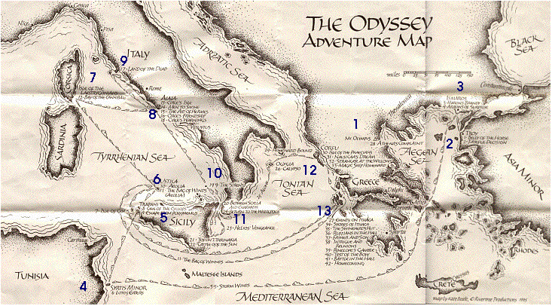
1. Mount Olympus
2. Troy
3. Cicones
4. Lotus-Eaters
5. Cyclops
6. Aeolia's Island
7. Laestrygonians
8. Circe's Kingdom
9. Land of the Dead
10. The Sirens
11. Scylla and Charybdis
12. Calypso’s cave
13. Ithaka

Slide 98
Simon Armitage’s The Odyssey Odysseus’ character: strengths and weaknesses
WEEK 6

Slide 99
Simon Armitage’s The Odyssey Homeward bound: a satisfying resolution?
WEEK 7

Slide 100
Is Odysseus Admirable? Summative Assessment of learning
WEEK 8

Slide 101
Modern Reinterpretations of Myth How have modern writers responded to classical myths? Explore Atwood and Duffy. Creative response.
WEEK 9

