Slide 1
In this lesson, students will be mastering the following:
Mastery Content:
Mr Brocklehurst labels Jane a liar in front of the whole school
Jane is made to stand on a stool in front of the whole school with a board with ‘liar’ written on it hanging from her neck
Jane feels completely humiliated
Helen Burns offers Jane support
Learning Objective
To explore how Mr Brocklehurst humiliates Jane.
Mastery Content

Slide 2
Do Now: What does Mrs Reed tell Mr Brocklehurst before Jane leaves Gateshead? How were children meant to behave in the Victorian era? Who has received a harsh punishment at Lowood? What were they punished for? Extension: What makes Mr Brocklehurst and hypocrite?
Recap Recap Mr Brocklehurst’s visit to the school. Jane is trying to avoid him. Her luck is about to run out!
Reading Read from, ‘Hitherto, …’ (page 77) Read to, ‘“…the remainder of the day.”’ (page 79) Students use the image to describe what has happened in the passage they have just read.
Jane’s humiliation There are three key quotations here that relate to important information from previous chapters. Students can discuss and answer the questions on these quotations. They can also elicit Jane’s humiliation and Brocklehurst’s terrifying sentence on Jane. | There is a separate optional resource for this, if required. There are model answers too, but consider how you wish to use these. You may want to model the first answer together as a class before asking students to complete the remainder of the questions independently. If you do want students to refer back to previous chapters, consider providing them with relevant page numbers to speed up the time spent looking for information.
Jane’s humiliation Students write a paragraph on their own answering question 5
Mastery assessment plenary Students complete quiz.
Lesson Guide

Slide 3
Tuesday, 14 June 2022
Jane the liar
Do Now:
What does Mrs Reed tell Mr Brocklehurst before Jane leaves Gateshead?
How does Mr Brocklehurst expect the girls to behave at Lowood school?
Who has received a harsh punishment at Lowood?
What were they punished for?
Do Now:
Mrs Reed tell Mr Brocklehurst that Jane is a liar.
Mr Brocklehurst expects the girls to be meek, quiet and obedient.
Helen Burns has received a harsh punishment at Lowood.
Helen was punished for having dirty hands.
Do Now
Extension: Mr Brocklehurst is a hypocrite because he tells Mrs Reed that pride is a sin, but he thinks that his daughters are much better than the girls at Lowood School.
Extension: What makes Mr Brocklehurst a hypocrite?

Slide 4
So far, Jane has been able to hide from Mr Brocklehurst. But her luck is about to run out as he is visiting Lowood with his family.
The next scene is one of the most famous parts of Jane’s childhood.
Let’s find out what happens!
Jane Eyre
Let’s read.
Read from, ‘Hitherto, …’ (page 77)
Read to the end of the chapter (page 80)

Slide 5
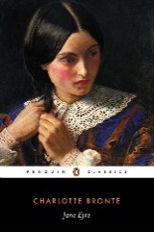
Hitherto, while gathering up the discourse of Mr. Brocklehurst and Miss Temple, I had not, at the same time, neglected precautions to secure my personal safety; which I thought would be effected, if I could only elude observation. To this end, I had sat well back on the form, and while seeming to be busy with my sum, had held my slate in such a manner as to conceal my face: I might have escaped notice, had not my treacherous slate somehow happened to slip from my hand, and falling with an obtrusive crash, directly drawn every eye upon me; I knew it was all over now, and, as I stooped to pick up the two fragments of slate, I rallied my forces for the worst. It came.
“A careless girl!” said Mr. Brocklehurst, and immediately after—“It is the new pupil, I perceive.” And before I could draw breath, “I must not forget I have a word to say respecting her.” Then aloud: how loud it seemed to me! “Let the child who broke her slate come forward!”
Hitherto – until now
discourse – conversation
elude – avoid
slate – thin stone for writing in chalk on
perceive – see
accord – will
Jane Eyre
p.77-78

Slide 6
Of my own accord I could not have stirred; I was paralysed: but the two great girls who sit on each side of me, set me on my legs and pushed me towards the dread judge, and then Miss Temple gently assisted me to his very feet, and I caught her whispered counsel—
“Don’t be afraid, Jane, I saw it was an accident; you shall not be punished.”
The kind whisper went to my heart like a dagger.
“Another minute, and she will despise me for a hypocrite,” thought I; and an impulse of fury against Reed, Brocklehurst, and Co. bounded in my pulses at the conviction. I was no Helen Burns.
“Fetch that stool,” said Mr. Brocklehurst, pointing to a very high one from which a monitor had just risen: it was brought.
“Place the child upon it.”
And I was placed there, by whom I don’t know: I was in no condition to note particulars; I was only aware that they had hoisted me up to the height of Mr. Brocklehurst’s nose, that he was within a yard of me, and that a spread of shot orange and purple silk pelisses and a cloud of silvery plumage extended and waved below me.
Mr. Brocklehurst hemmed.
counsel – advice
despise – hate
hypocrite – liar
conviction – label
particulars – details
Jane Eyre
p.78

Slide 7
“Ladies,” said he, turning to his family, “Miss Temple, teachers, and children, you all see this girl?”
Of course they did; for I felt their eyes directed like burning-glasses against my scorched skin.
“You see she is yet young; you observe she possesses the ordinary form of childhood; God has graciously given her the shape that He has given to all of us; no signal deformity points her out as a marked character. Who would think that the Evil One had already found a servant and agent in her? Yet such, I grieve to say, is the case.”
A pause—in which I began to steady the palsy of my nerves, and to feel that the Rubicon was passed; and that the trial, no longer to be shirked, must be firmly sustained.
“My dear children,” pursued the black marble clergyman, with pathos, “this is a sad, a melancholy occasion; for it becomes my duty to warn you, that this girl, who might be one of God’s own lambs, is a little castaway: not a member of the true flock, but evidently an interloper and an alien. You must be on your guard against her; you must shun her example; if necessary, avoid her company, exclude her from your sports, and shut her out from your converse.
palsy – trembling
shirked – avoided
sustained – accepted
interloper – unwanted
converse – conversation
Jane Eyre
p.78-79

Slide 8
Teachers, you must watch her: keep your eyes on her movements, weigh well her words, scrutinise her actions, punish her body to save her soul: if, indeed, such salvation be possible, for (my tongue falters while I tell it) this girl, this child, the native of a Christian land, worse than many a little heathen who says its prayers to Brahma and kneels before Juggernaut—this girl is—a liar!”
Now came a pause of ten minutes, during which I, by this time in perfect possession of my wits, observed all the female Brocklehursts produce their pocket-handkerchiefs and apply them to their optics, while the elderly lady swayed herself to and fro, and the two younger ones whispered, “How shocking!” Mr. Brocklehurst resumed.
scrutinise – pay attention to
optics – eyes, glasses
Jane Eyre
p.79

Slide 9
“This I learned from her benefactress; from the pious and charitable lady who adopted her in her orphan state, reared her as her own daughter, and whose kindness, whose generosity the unhappy girl repaid by an ingratitude so bad, so dreadful, that at last her excellent patroness was obliged to separate her from her own young ones, fearful lest her vicious example should contaminate their purity: she has sent her here to be healed, even as the Jews of old sent their diseased to the troubled pool of Bethesda; and, teachers, superintendent, I beg of you not to allow the waters to stagnate round her.”
With this sublime conclusion, Mr. Brocklehurst adjusted the top button of his surtout, muttered something to his family, who rose, bowed to Miss Temple, and then all the great people sailed in state from the room. Turning at the door, my judge said—
“Let her stand half-an-hour longer on that stool, and let no one speak to her during the remainder of the day.”
i.e. Mrs Reed
pious – holy
ingratitude – ungratefulness
stagnate – go mouldy
mounted – put on
pedestal – stand
infamy – fame for a bad reason
Jane Eyre
p.79

Slide 10
There was I, then, mounted aloft; I, who had said I could not bear the shame of standing on my natural feet in the middle of the room, was now exposed to general view on a pedestal of infamy. What my sensations were no language can describe; but just as they all rose, stifling my breath and constricting my throat, a girl came up and passed me: in passing, she lifted her eyes. What a strange light inspired them! What an extraordinary sensation that ray sent through me! How the new feeling bore me up! It was as if a martyr, a hero, had passed a slave or victim, and imparted strength in the transit. I mastered the rising hysteria, lifted up my head, and took a firm stand on the stool. Helen Burns asked some slight question about her work of Miss Smith, was chidden for the triviality of the inquiry, returned to her place, and smiled at me as she again went by. What a smile! I remember it now, and I know that it was the effluence of fine intellect, of true courage; it lit up her marked lineaments, her thin face, her sunken grey eye, like a reflection from the aspect of an angel.
mounted – put on
pedestal – stand
infamy – fame for a bad reason
imparted - gave
effluence – flow
lineaments – lines
Jane Eyre
p.79

Slide 11
Yet at that moment Helen Burns wore on her arm “the untidy badge;” scarcely an hour ago I had heard her condemned by Miss Scatcherd to a dinner of bread and water on the morrow because she had blotted an exercise in copying it out. Such is the imperfect nature of man! such spots are there on the disc of the clearest planet; and eyes like Miss Scatcherd’s can only see those minute defects, and are blind to the full brightness of the orb.
orb – sun
Jane Eyre
p.79-80

Slide 12
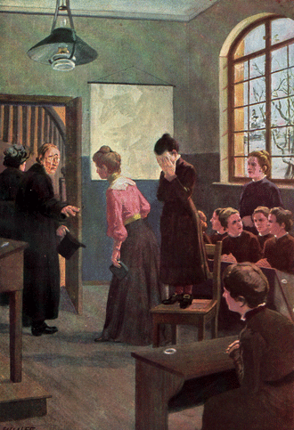
This image illustrates what has happened in the passage we have just read.
Jane Eyre
In pairs, summarise what has happened in five bullet points.

Slide 13
Jane dropped her chalkboard, which caught Mr Brocklehurst’s attention.
Mr Brocklehurst instructed Jane to stand on top of a high stool in front of everyone.
He told everyone that the devil had begun to show himself in Jane, and that Jane was a liar.
Mr Brocklehurst told Jane to stand on the stool for 30 minutes, and nobody was allowed to talk to her for the rest of the day.
Helen smiled at Jane to give her support.
Jane Eyre

Slide 14
Let’s look at some quotations from this passage. Discuss the quotations with a partner, then write down your answers to the questions.
Jane thought,
‘I was no Helen Burns.’
Liar
How did Helen Burns act when she was in a similar situation?
Why does Jane think she is unlike Helen?

Slide 15
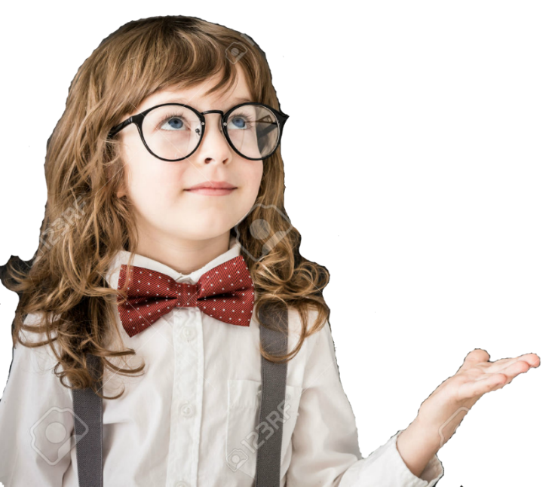
Helen received a similar punishment to Jane when she was told to stand on a chair in front of the whole school. She also received a much worse punishment when she was whipped in front of everyone. She did not complain or protest when she was given these punishments; she accepted them.
Jane told Helen that she would not be able to accept a punishment in the same way that Helen did. Helen told Jane that it would be her duty to accept it. Now, we see that Jane is going to have to accept her punishment quietly.
Liar

Slide 16
Brocklehurst said,
‘You must be on your guard against her; you must shun her example; if necessary, avoid her company, exclude her from your sports, and shut her out from your converse.’
Why does Brocklehurst tell the other girls to ‘shun’ and ‘exclude’ Jane?
Why would Jane find this humiliating to hear?
Liar

Slide 17
Brocklehurst wants the other girls to shun and exclude Jane because he thinks that she will be a bad example to them. He also wants to further punish Jane by isolating her from her friends. He wants to humiliate Jane further.
Jane would find this a particularly terrible punishment for a number of reasons. She looked forward to starting afresh at Lowood School where she could prove how good she was. Now, she is unable to do that. Everyone will think she is a liar. Also, one of the worst parts of Jane’s life at Lowood was how Mrs Reed didn’t allow Jane to play with anyone. She was very lonely. Just as Jane had begun to start making friends at Lowood School, Jane fears that everyone will turn their back on her and stop being her friend.
Liar

Slide 18
You are now going to complete this question on your own. Write a paragraph answering this question.
Brocklehurst said,
‘punish her body to save her soul.’
Liar
How does this statement relate to Brocklehurst’s attitude to childhood?
Brocklehurst believes that children are born evil, and they need to have the sin beaten out of them with strict discipline. He says that by punishing Jane in a severe way, he will make her good, and prevent her soul from going to hell.
Notes:
Complete this task on your own.

Slide 19
What feelings has Jane experienced in the passage we have read?
Hope, as Helen Burns gave her confidence to endure Mr Brocklehurst’s punishment.
Humiliation, as everyone at Lowood School thinks that she is a liar.
Shame, because she was embarrassed that everyone knows that she is a liar.
Relief, because Helen was also punished, which meant that everyone was looking at Helen for a while.
Acceptance, because she knows that she deserves to be punished for being a lying girl.
Mastery

Slide 20
What feelings has Jane experienced in the passage we have read?
Hope, as Helen Burns gave her confidence to endure Mr Brocklehurst’s punishment.
Humiliation, as everyone at Lowood School thinks that she is a liar.
Shame, because she was embarrassed that everyone knows that she is a liar.
Relief, because Helen was also punished, which meant that everyone was looking at Helen for a while.
Acceptance, because she knows that she deserves to be punished for being a lying girl.
Review

Slide 21
Love this lesson?
Have suggestions for improvements?
Does something need fixing?
Feedback
Please let us know!
Fill in this feedback form so that we can keep improving.

