Slide 1
5 minute warm up…
Why do you think the advice given in the poem has proved to be so timeless? Do you find it relevant today?

Slide 2
‘If’ by Rudyard Kipling
Today’s aims:
carry out a close reading of the poem
understand the wider context of the poem
understand the content, including unusual vocabulary in the text
Next Lesson:
analyse the way the poet has used language, including the use of literary devices and techniques
analyse the form and presentation of the poem
understand the theme(s) the author is writing about
be aware of thematic links between this poem and others in the anthology
prepare for writing about the text in your exam
access links to readings of the poem

Slide 3
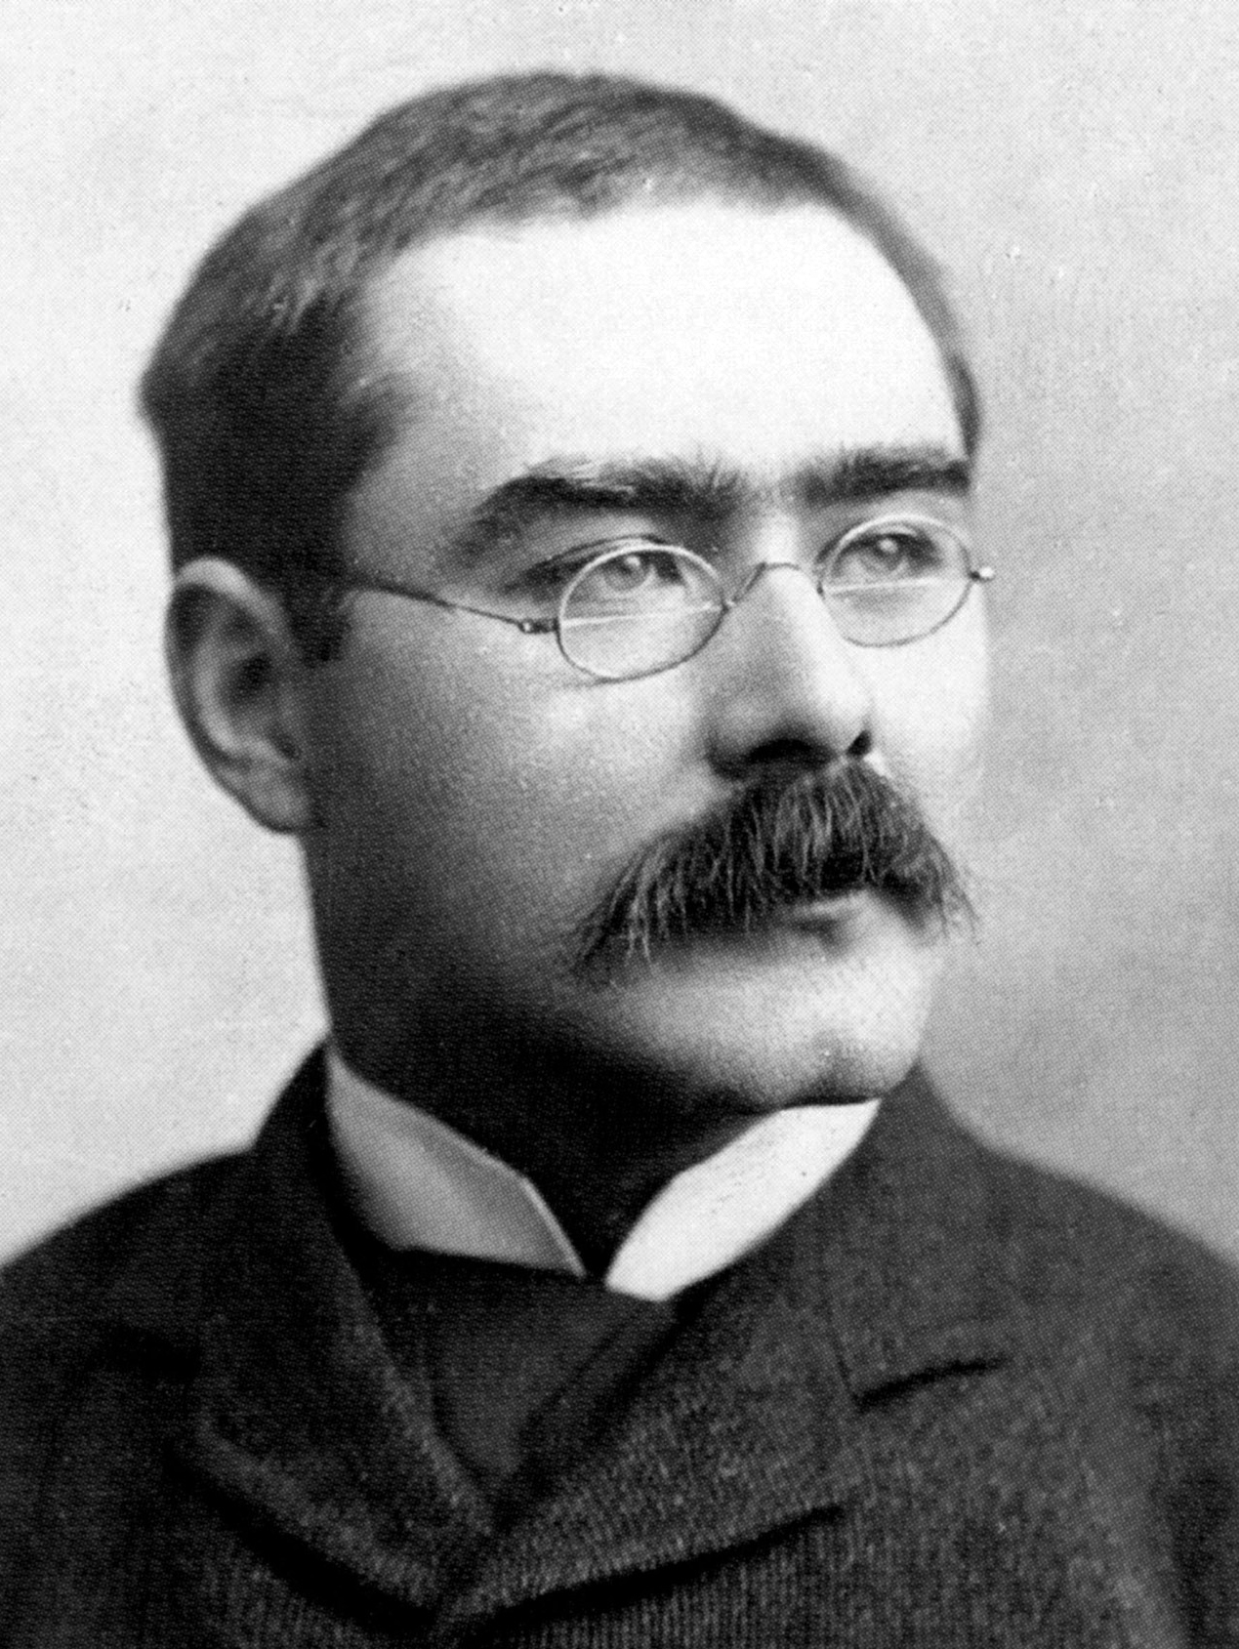
Rudyard Kipling
(1865-1936), writer, was born in India where he spent his early childhood before his family returned to England.
He is most famous for his prose writing. The Jungle Book has had lasting popularity, both as a story and in film adaptations.
Kipling travelled widely and wrote travel articles as well as poetry.
In 1907 he was the first English writer to be awarded the Nobel Prize for Literature and the youngest writer to receive it.
^{For further details see:}
http://nobelprize.org/nobel_prizes/literature/laureates/1907/kipli ng-bio.html
Kipling did not seek recognition, however, refusing the both position of Poet Laureate and a knighthood
.
“If” has been voted the nation’s favourite poem on a number of occasions and is widely quoted.
Lines 11–12 appear above the players’ entrance to the central court at Wimbledon.
The film if (1968) directed by Lindsay Anderson savagely satirizes English public school life. The title is based on that of the poem whose values are enshrined in English public school life. It is important to remember, however, that Andersen satirised the hypocrisy and sham behaviour that are also a feature of the British establishment rather than the values celebrated in the poem itself.

Slide 4
^{Content}
“If” consists of advice given by a father to his son on what it means to “be a Man”. Various attributes are listed including: self-belief, patience, truthfulness, kindness and modesty.
The advice is presented in a series of statements each beginning with the conditional word “if”.
Each statement contains a pair of opposites which build up into a strong guide as to how the father feels life should be lived.

Slide 5
Stanza 1
The main idea in this stanza is that one should be true to oneself and not over-react to the views of others, or adopt them without full consideration.
To achieve this, the boy needs to develop certain qualities.
The father advocates:
• level-headedness and keeping calm
• trusting in your own decisions
• understanding what makes others doubt or hesitate
• sensitivity to other people’s view / ideas
• patience
• truthfulness
• generosity
• modesty
• humility

Slide 6
Stanza 2
This stanza focuses on overcoming obstacles that can impede our progress through life. The father considers that:
dreams are important, but should not rule our lives
while it is necessary to think things through, we should not
be distracted by thought
success and failure are ‘impostors’ and so we should not be unduly influenced by them.
(Sometimes what looks like success – or disaster - may turn out not to be, and so neither should knock us off course.)

Slide 7
Stanza 3
There is a hint of recklessness at the beginning of the stanza; suggesting that taking chances is a vital part of life. It is important to learn how to manage risk, and to be stoical when we lose.
The father counsels his son that he should:
take risks, but being willing to start again if not successful
not complaining when he loses out, but remain stoical and self-contained
What is suggested by “breathe” in line 20?
persevere and strive, even when exhausted, and never give up
develop strength of will to survive and succeed
Why is “Will” capitalised?

Slide 8
Stanza 4
There are two pieces of advice in this final stanza: do not be corrupted by power, and use your time to the full.
The father advises his son:
not to be corrupted by political power
to be able to talk equally to kings and the common man
not to be over-influenced by what others say, whether they are friends or enemies
To live every second of of his life to the full.
Explain the metaphor used in lines 29-30.
What do you understand by “yours is the earth and everything that’s in it”?
What is even more important than this in line 32.
What does his father believe his son will gain if he follows his
advice?

Slide 9
Language and Style
By beginning each piece of advice with the word “if” Kipling uses the first part of the conditional tense construction.
The second part comes at the end of Stanza 4 in “Yours is” and “you’ll”. In both constructions there is the sense that ‘If you do this ... then that will happen’.
The situations mentioned are hypothetical and general, the attributes are ones to strive for, not ones that can be achieved overnight. The fact that the poem is one long conditional sentence indicates that it will take a long time, and considerable effort, for the son to become a man in the sense that the father is speaking of.
The father uses the second person pronoun, “you” throughout the poem. As “you” can be singular and plural the poem is both a personal address by a father to his son, and at the same time a general address to every reader. It has a universal appeal. Being addressed directly helps to maintain the reader’s attention as s/he is curious to discover where this advice is leading. If we can achieve what seems to be a long and impossible list, what will we achieve?
The many imperatives in the poem are not intrusive or strongly commanding; the tone is that of a father offering his son friendly and helpful advice.
Metaphor and personification, examples of which are mentioned above, strengthen the impact of the fatherly advice.

Slide 10
Structure and Form
The poem develops through a series of suggestions, using opposites to clarify the message.
It is divided into four 8-line stanzas with a regular metre or rhythm.
There is only one complete stop in the poem: the exclamation mark at the end.
The advice is continuous and cumulative.
This structure suggests that to become a man is an on-going process that is difficult and challenging.
From line 5 until the end, the rhyme scheme is a regular alternate one of ababcdcd. This maintains the momentum of the repeating structure. The first four lines all rhyme with each other, the first three all end in “you”, stressing the personal direction of the message.
The division into four stanzas allows the father to group his ideas into related sets of personal attributes. However there is some overlap; these personal qualities are not entirely separate entities. The conditional nature of this address.

Slide 11
Overview
“If” has continued to be widely anthologised from the time of its publication in 1909, and is often quoted today.
Why do you think the advice given in the poem has proved to be so timeless? Do you find it relevant today?

Slide 12
Exam-Style Question:
Re-read ‘If-’.
This lesson: Discuss how the idea of success is presented in ‘If-’
Tomorrow’s lesson:
(and one other poem in the anthology)
You should make reference to language, form and structure.
Support your answer with examples from the poems. (30 marks)

Slide 13
Comparisons?
“Prayer Before Birth” What qualities would an individual need to “be a man” in the world MacNeice depicts?
How useful would the advice advocated here be?
“Poem at Thirty-Nine” in which Alice Walker considers what she learnt from her father.
“Do not go gentle into that good night” where a son is instructing his father how to approach old age.

Slide 14
‘Prayer Before Birth’ by Louis Macneice

