Slide 1
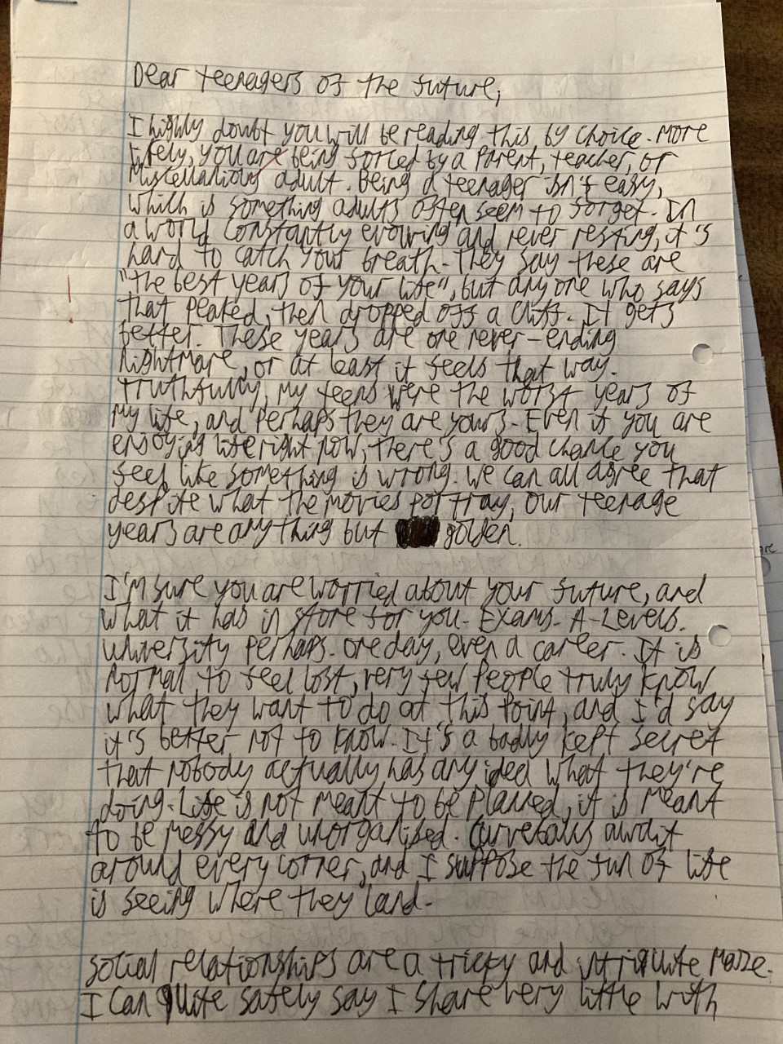
TRANSACTIONAL WRITING EXEMPLAR
LANGUAGE PAPER 1
45 MARKS/45 MINUTES
WRITE A LETTER TO TEENAGERS OF THE FUTURE
MY NOTES

Slide 2
