Slide 1
Evaluating the impact of context in ‘Frankenstein’

Slide 2
Assessment objective and our aim in relation to it…
AO3 Consistently developed and consistently detailed understanding of the significance and influence of the contexts in which literary texts are written and received
Significance and influence of contexts – how important/ how much influence does context have on the way we interpret the texts? Asking you to evaluate…
Written – Mary Shelley’s ‘contexts’
Received – Our ‘contexts’ right now

Slide 3
Assessment objective and our aim in relation to it…
AIM:
To explore some contextual material, focusing on the contexts in which literary texts are written
To evaluate the influence and significance of these contexts
AKA: HOW CAN WE USE WHAT WE KNOW TO HELP US UNDERSTAND/ INTERPRET/ ANALYSE THE TEXT?

Slide 4
Contextualising/ placing the text within the Gothic period…
TIME PERIOD | NOVELISTS | TYPICAL FEATURES | OTHER CONTEXTS
1700s/ 18TH century – Core Gothic - part of an artistic and philosophical shift away from scientific rationalism with its emphasis on reason, rather than feeling/emotion… | Horace Walpole, Ann Radcliffe, Matthew Lewis, William Beckford | Terror, excess, supernatural, imprisonment, Satanic bargaining, castles, forests, destruction, disruption, immorality, dread, irrational violence, women under threat, tyranny, patriarchal oppression, sexuality, corruption, medieval Catholicism, ghosts, demons | Early 1700s – Neo classicism re-invokes the style of Classical civilisation of Ancient Greece and Rome 1756-1763- England at war with France 1775-1784 – American War of Independence 1789-99- French Revolution 1793-94- Robespierre’s reign of terror in France
Late 1700s-early 1800s – Romantic-era Gothic – Cross-over texts – aspects of the Gothic used in ‘Romantic’ texts- a way of exploring accepted boundaries and social conventions… | Mary Shelley, Charles Maturin, James Hogg | The sublime, sensibility, prioritising of emotion over reason, tyranny, position of women, horror, terror, awe, vengeance, violence, justice, injustice, multiple narrators, boundaries and limits, dreams | Late 1700s-1800s – Industrial revolution Late 1700s-early 1800s – Romantic movement; Human institutions and restrictions seen as source of evil; emphasis on emotion over reason; imagination as powerful force; emphasis on the self and individual experience Mid 1700s onwards-Scientific experiments such as Galvanism, exploring the origins of life

Slide 5
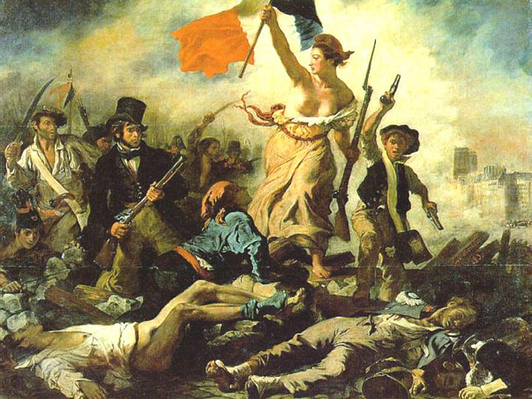
The Romantic movement: political
Originated 1789, year of French Revolution, optimistically seen as the beginnings of a new age of justice and equality for all
Politically inspired by American/ French revolutions
Background of social unrest and political activism
Optimism and idealism for future and a belief in the perfectibility of human race
Human institutions/ restrictions seen as source of evil
However, experience often caused disillusion about possibilities of reform through political movement.

Slide 6
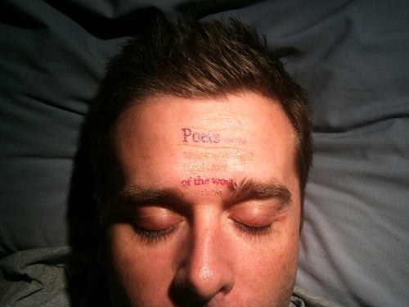
The Romantic movement: literary
Through their championing of social progressive causes and rejection of social morals, many Romantics felt isolated and alienated from society as a whole.
Attempts to transform the world through poetry – Shelley wrote ‘poets were the unacknowledged legislators of the world’ – furthered this inward turn
For the Romantics, imagination is seen as powerful; it can be used to escape the world and such creativity is seen as powerful/ Godlike
Emphasis is on assertion of self and individual experience.

Slide 7
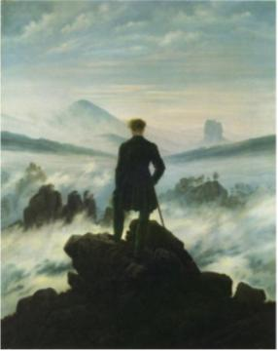
The Romantic movement: geographical
Romantics not only looked to their inner natures, but the natural world around them.
They reacted against 18th century admiration for ordered/cultivated and were more interested in the wild and untamed
Influenced by Edmund Burke and his concept of the sublime, with its association of terror, darkness, infinity and the incomprehensible
Mountains, ice, expansive and sterile regions like the Antarctic appealed.
Walking was also seen as an imaginative pursuit, particularly in these kind of untamed landscapes.

Slide 8
Overall, Romanticism now associated with…
Emotion over reason
Passion over logic
Spontaneity over restraint
Originality over tradition
Departs from Enlightenment thinking which suggested the world could, and should, be ruled by reason and logic.

Slide 9
What if you slept And what if In your sleep You dreamed And what if In your dream You went to heaven And there plucked a strange and beautiful flower And what if When you awoke You had that flower in you hand Ah, what then?”
Samuel Taylor Coleridge
“Come forth into the light of things, Let Nature be your teacher.”
“Fill your paper with the breathings of your heart.”
William Wordsworth
“A thing of beauty is a joy forever.”
John Keats

Slide 10
A deliberately intertextual work…
Frankenstein or The Modern Prometheus
Epigraph from Milton’s ‘Paradise Lost’:
‘Did I request thee, Maker, from my clay
To mould me man? Did I solicit thee
From darkness to promote me?’
3. Dedication to William Godwin ‘author of political justice, Caleb Williams&c’

