Slide 1
Shakespeare’s Comedies

Slide 2
What Makes a Comedy
Happy Ending
Often a marriage
Not based on a real person or historical event (like most of Shakespeare’s plays)
Can be uncomfortable and sometimes sad (melancholy)
Separation and reunion
Laugh with characters – like with Malvolio
People act with empathy and consideration, especially at the end
Dangers and tragedies are avoided

Slide 3
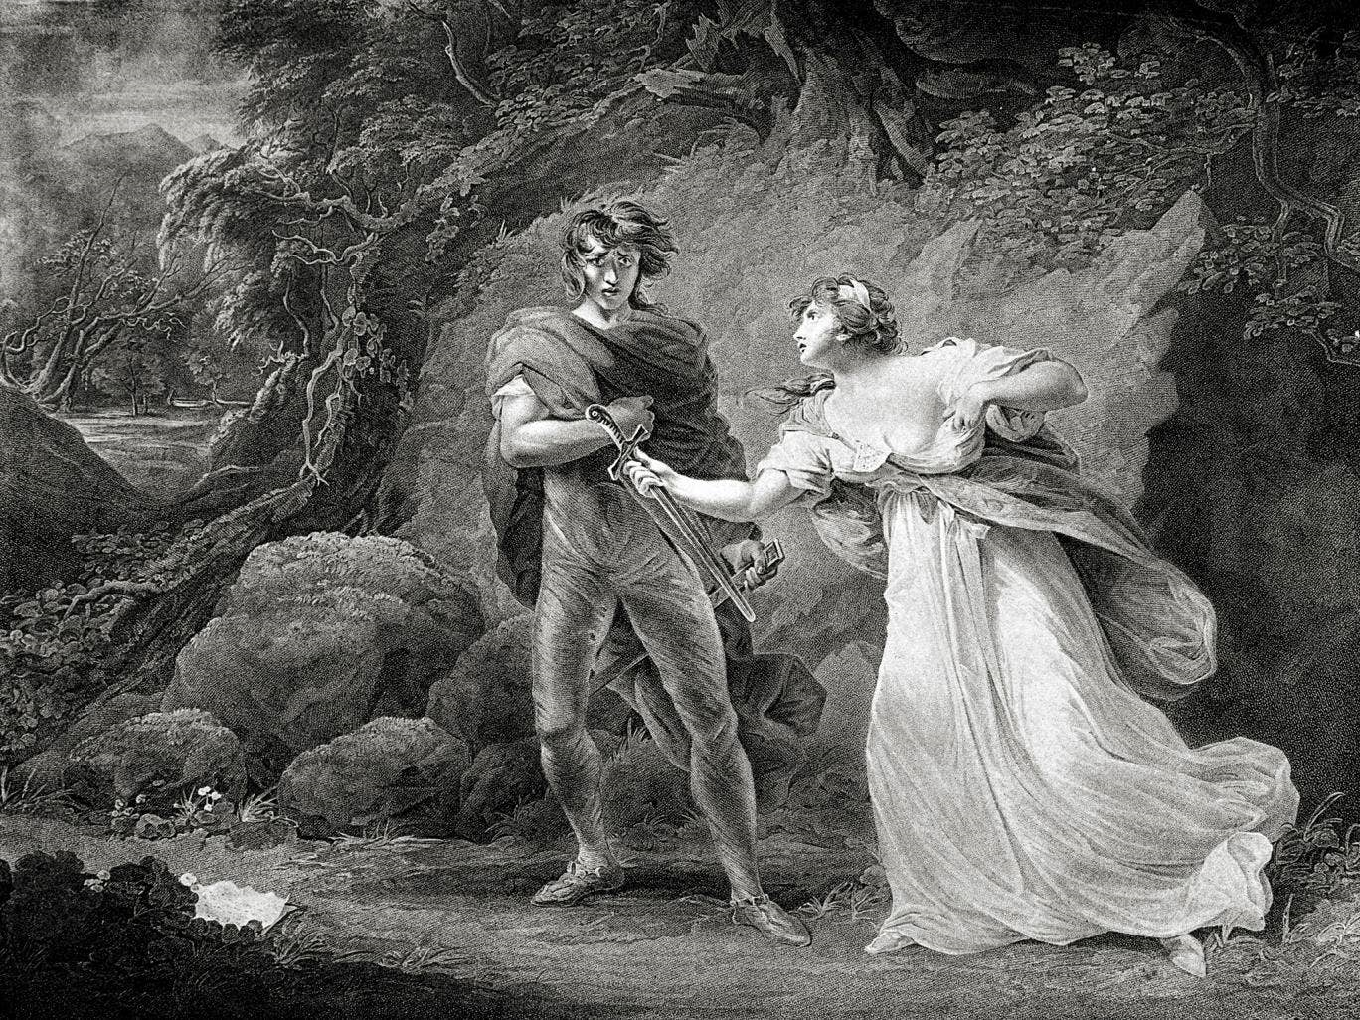
Why Forests?
This is a mysterious place
where societal rules don’t apply
Girls can wear trousers!
Mysterious events can
teach us life lessons
You can be more ‘yourself’
and say how you truly feel
There are often songs

Slide 4
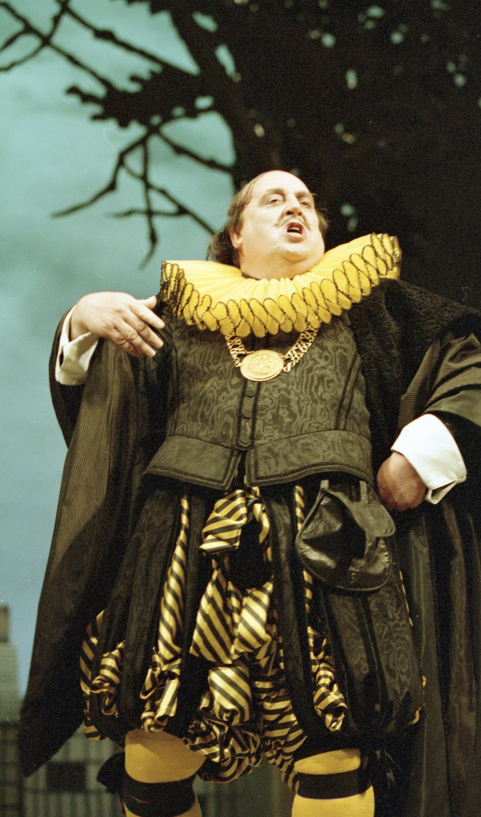
Stock Characters
Except Shakespeare’s characters are very ‘real’
Based on classic Roman and Greek Comedy:
- Hero
Girl next Door
Temptress (evil)
Father/Old Man
Slave
Soldier

Slide 5
The Great Chain of Being
God and the Angels
King or Queen
Knights
Noblemen
Business Men
Servants or Normal People
Poor
Animals
Plants

Slide 6
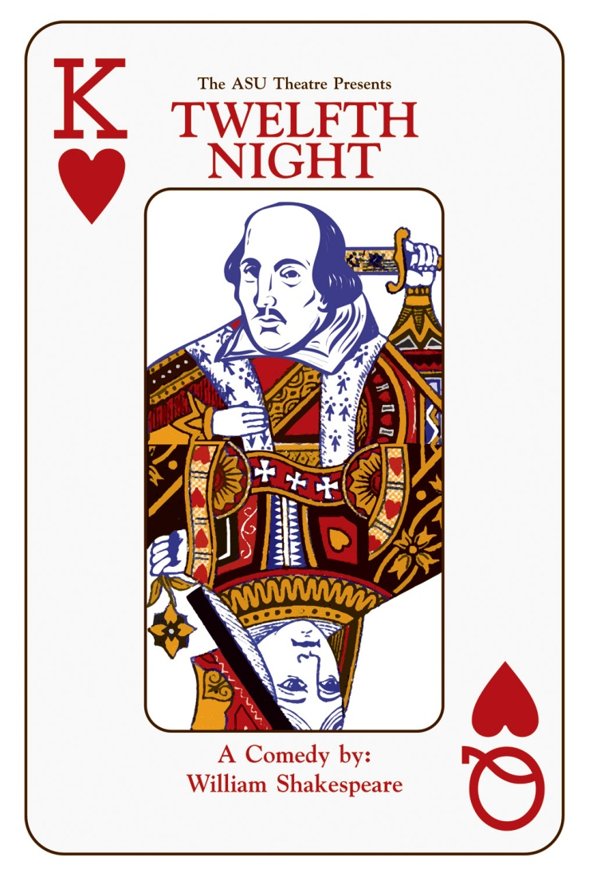
Social hierarchy: does your place in society affect how you speak?
Kings: You speak down to everyone, and everyone is respectful to you.
Queens: People look up to you, and are respectful. You can say what you like, except to a king.
Knaves/Jacks (aristocrats/noblemen): You can say whatever you like to servants, but must hold your tongue with royalty.
Ace, 2-10: You are servants and have low status. If spoken to by a member of the court, you must be respectful.
Joker: your status is low and even the servants treat you badly. However, you are liked and can say what you want, even to royalty.

Slide 7
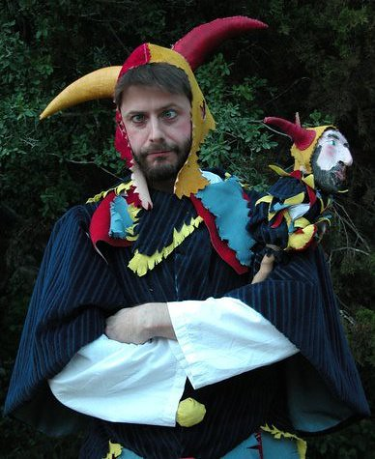
Comedic Elements
Forests
Twins
Dressing Up
Disguise and ‘appearance v Reality’
Mistaken Identity
Slapstick

Slide 8
Women in Comedies
Tragedies are about Men – comedies are about women
Sometimes women are in trouble and need help
Sometimes it’s about women trying to marry a man they love (unusual) like in Much Ado
Women need to step away from their ordinary lives in order to succeed
They often run away to the forest to escape from their lives
Women are often strong (morally) and they have more choice and they defy social norms, for a while
In Twelfth Night we have girls pretending to be boys
These acts of rebellion end, and women put their dresses back on and go back to society

Slide 9
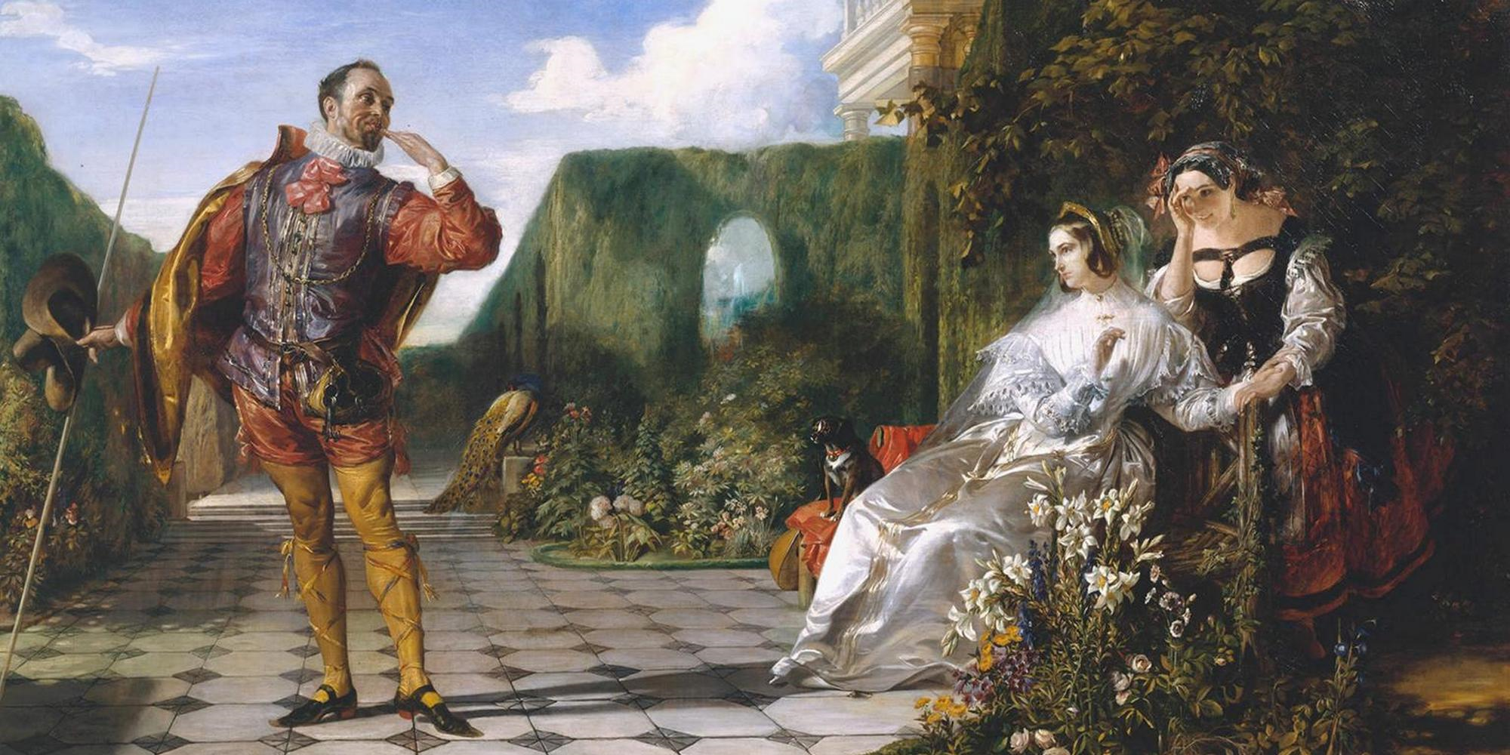
Love and Marriages
Marriages of equals not money. In tragedies this doesn’t work, in comedies it does
Women are often stronger and more intelligent than their men

Slide 10
Jokes!
In comedies men tell most of the jokes
There is often a ‘joker’ who is paid to tell jokes and they are often funny, and cutting – or sad like Feste in Twelfth Night
The jokes are often puns
They are often very naughty jokes and these are usually told by the servants

