Slide 1
In this lesson, students will be mastering the following:
Mastery Content:
Holmes respects Adler.
Holmes describes her as ‘the woman’ to show his regard for her.
Holmes is usually dismissive and disrespectful of women.
Topic sentences can be used to link an essay together.
Mastery Content

Slide 2
Do Now Three comprehension questions on the preceding reading and discussion lesson.
Irene Adler Recall what happened with Irene Adler using images to guide.
Sherlock’s attitude to women and Irene Adler Using worksheet to help, look at Sherlock’s attitudes to Irene Adler and women. Model example with students first. Students then write annotations and summary answer on Sherlock’s attitudes to women. Teacher to lead class model on Holmes's attitude to Irene Adler. Students then write annotations and summary answer on Sherlock’s attitudes to Irene Adler. The purpose of the resource and the annotation activity is to provide students with material to write about. If in doubt, spend less time on the annotations here and spend more time on writing the paragraphs and linking the paragraphs together. | Resource - Irene Adler
Writing about Irene Adler Students to answer question ‘Why does Sherlock Holmes refer to Irene Adler as ‘the woman’?’ independently. | Do students need further support to complete this task? Sentence starters? Key words?
Linking paragraphs Model how paragraphs can be linked together. Students adjust work to link paragraphs together. Check work. | At this point, the quality of students’ analytical paragraphs is of little consequence. For example, these can be adjusted and improved as a homework activity. Try to spend more time on the linking sentences between paragraphs.
Mastery assessment plenary Students complete quiz. If all correct, do extension by asking students to turn a wrong answer into a right one. If incorrect, address misconception and explain correct answer/get other student to explain correct answer. | How do you want to capture understanding? Mini whiteboards? Physical ‘tickets’? Hand signals? Cold calling?
Lesson Guide

Slide 3
Friday, 10 June 2022
Last lesson, we finished A Scandal in Bohemia.
What disguise does Holmes adopt during the plan?
What is Watson’s role in Holmes’s plan?
How does Holmes get in to Irene Adler’s house?
Holmes disguises himself as a clergyman.
Do Now
Watson’s has to throw a smoking flare into Irene’s house.
Holmes is invited in to recuperate (get better) after the ‘fight’.
Extension: How does Holmes feel about Irene Adler? How do you know?

Slide 4
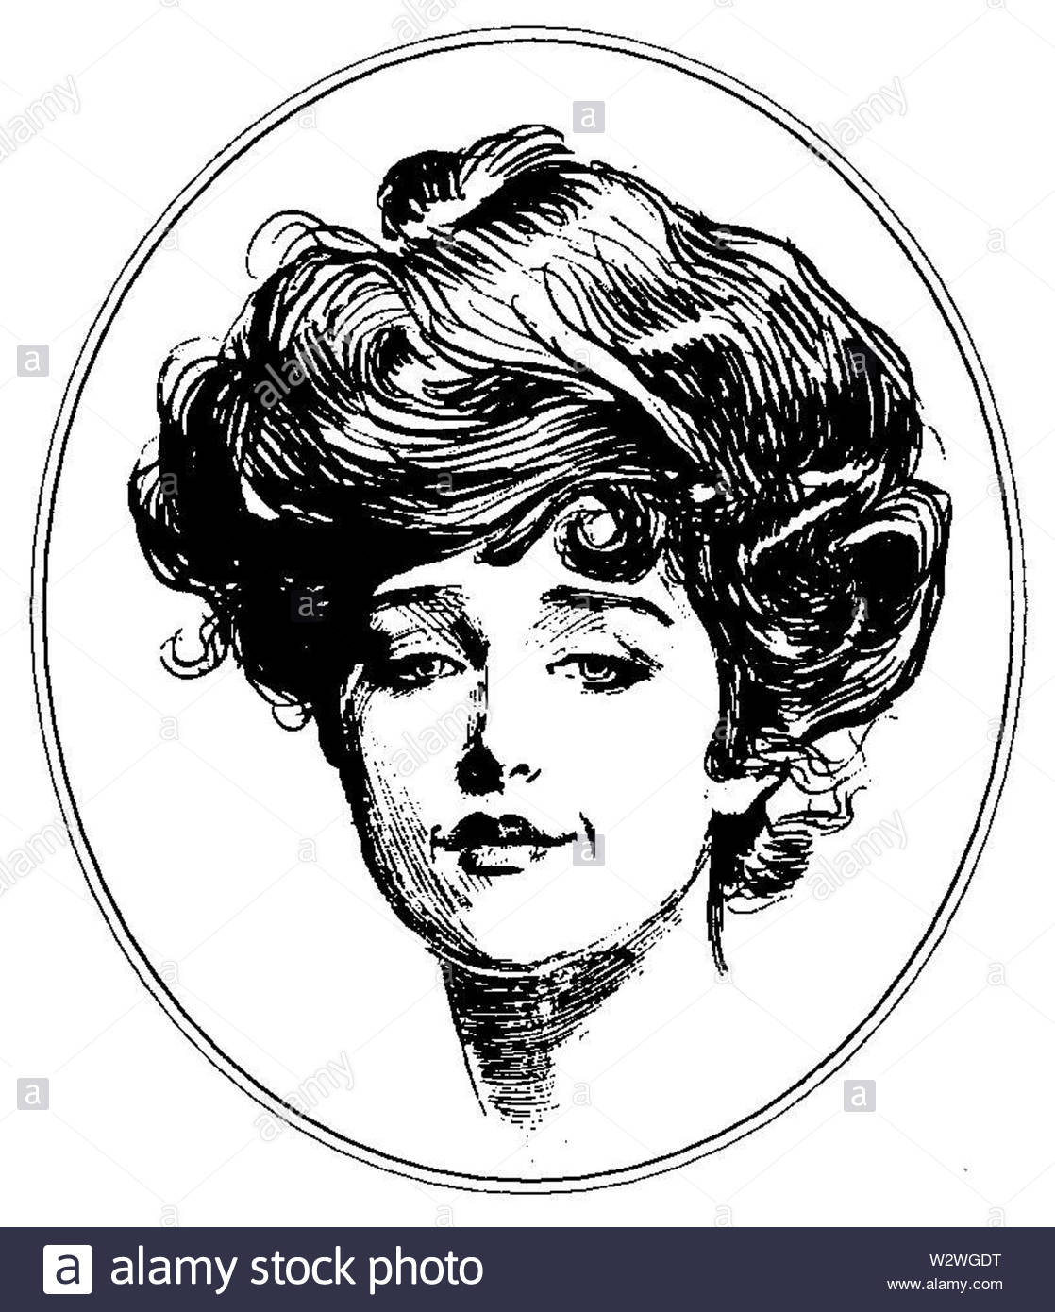
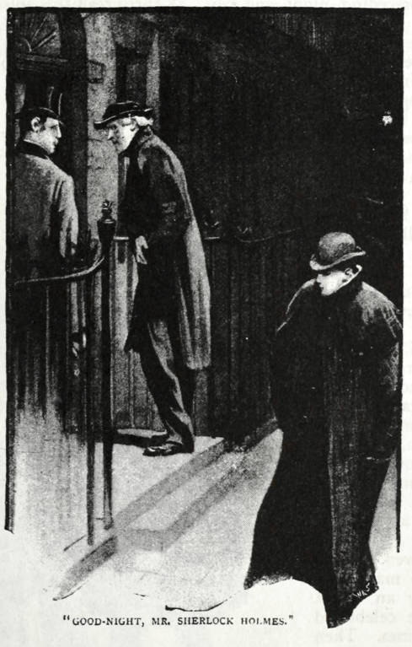
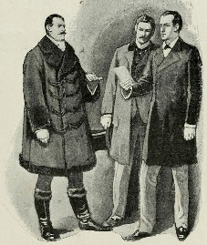
Last lesson we saw how Irene Adler outsmarted Sherlock Holmes.
Using the images below to guide you, explain how she manages this.
She works out that the clergyman was Sherlock Holmes.
She is warned that he might come to investigate her.
Irene Adler
She follows him back to Baker Street and says, “Good-night, Mister Sherlock Holmes.”
She leaves with the photograph before Holmes can get to her, leaving Holmes a teasing letter, explaining how she beat him.

Slide 5
Today we’re going to answer this question:
Why does Sherlock Holmes refer to Irene Adler as ‘the woman’?
We already know what Irene Adler has done to impress Holmes.
To answer this question, we need to do two more things:
Irene Adler
Find out Sherlock Holmes's original attitudes towards women.
Explore Sherlock Holmes’s respect for Irene Adler.
p.14

Slide 6
What do these quotations tell you about Sherlock Holmes’s original attitudes towards women?
Let’s annotate the first quotation together. Here, the King tells Holmes when Irene Adler will send the photograph (on the day the wedding is announced).
“Oh, then we have three days yet,” said Holmes with a yawn. “That is very fortunate”
Holmes seems not to care about what Adler will do. He does not think that she could be dangerous.
Annotations
Holmes's yawn suggests that he is unconcerned by a woman. He is totally relaxed and is even arrogant about his ability to beat Adler.
p.14

Slide 7
What do these quotations tell you about Sherlock Holmes’s original attitudes towards women?
Complete your annotations and summary.
Tick and fix your answers
He used to make merry over the cleverness of women, but I have not heard him do it of late.
Holmes didn’t think women were clever. He would make fun of their intelligence.
Annotations
“Women are naturally secretive, and they like to do their own secreting.”
Holmes makes generalisations about women, and thinks he understands them.
Holmes’s attitudes towards women – a summary
Holmes’s attitudes towards women – a summary
Holmes has an arrogant attitude towards women. He thinks he is better than them. Not only this, he thinks he understands what women are like and doesn’t respect the idea that woman are as intelligent as men.
p.14

Slide 8
Now look at the second table with your partner. How do these quotations show Sherlock Holmes’s respect for Irene Adler?
This quotation is taken from the start of the story. Here, Watson explains Holmes’s attitude towards Irene.
Annotate the first quotation in pairs.
Tick and fix your work.
“And yet there was but one woman to him”
To Holmes, Irene Adler is the only woman worth thinking about.
Annotations
It is clear to Watson that Holmes admires Irene Adler, and that this admiration is unusual for Holmes.
The word ‘yet’ suggests that although Holmes seems emotionless, he does have some feelings.
p.14

Slide 9
How do these quotations show Sherlock Holmes’s respect for Irene Adler?
Tick and fix your work.
Annotate the next two quotations independently.
“In his eyes she eclipses and predominates the whole of her sex.”
To Holmes, Irene Adler is better than any woman in the world.
Annotations
“‘From what I have seen of the lady, she seems, indeed, to be on a very different level to your Majesty,’” said Holmes coldly.”
Whilst the King is wealthier and more powerful than Irene, Holmes thinks Irene is superior to the King.
Holmes’s feelings towards Irene Adler – a summary
Holmes’s feelings towards Irene Adler – a summary
Holmes respects Irene both over any other woman, and over the wealth and power of the king.
p.14

Slide 10
Irene Adler
You are now going to answer this question. You have twenty minutes.
Why does Sherlock Holmes refer to Irene Adler as ‘the woman’?
Write two paragraphs or sections:
Write about Holmes's original attitudes towards women.
Look at how Holmes describes Adler.
Irene Adler
Extension: Explain what Irene Adler does to impress Holmes. (We looked at this last lesson). Page 15 of your booklet will help you.
p.14

Slide 11
Last year, we looked at writing good topic sentences.
You should remember that a good topic sentence does three important things:
It answers the question.
It says something accurate.
It focusses on one thing.
Linking paragraphs
This year, we are going to look at how to develop your topic sentences further.

Slide 12
You can make your writing better by linking your paragraphs together.
Here’s how you can do this:
Use the topic sentence of each paragraph to link to the previous paragraph.
Use the topic sentence to say how what you are about to say is different to the previous paragraph.
Linking paragraphs
Let’s look at an example

Slide 13
Irene Adler teases the great detective, Sherlock Holmes. After following him back to Baker Street, Adler has the tenacity to say, “Good-night, Mister Sherlock Holmes” as Holmes and Watson arrive home. This is an incredibly confident and brave thing to do. Once she is sure that Holmes had used a disguise to find out where the photograph was, Adler goes and taunts him by using a more convincing disguise. Holmes wasn’t able to deduce that the person in the coat was the person he wanted to fool – Irene Adler.
Linking paragraphs
It is this tenacity and bravery that makes Holmes respect Irene Adler so much. He admires the fact that Adler had the strength of character to …
This topic sentence links back to the previous paragraph.
It also begins to say what the next paragraph will be about.

Slide 14
Look back at the paragraphs you have written.
Edit the topic sentence to each paragraph to help them link together.
Use the topic sentence of each paragraph to link to the previous paragraph.
Use the topic sentence to say how what you are about to say is different to the previous paragraph.
Linking paragraphs

Slide 15
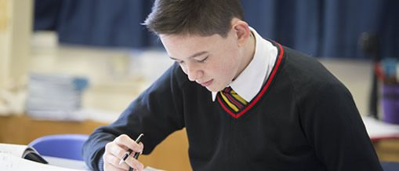
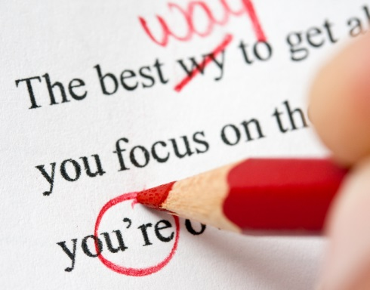
When you’ve finished, check your writing.
Check 1: Are there any run-on sentences?
Check 2: Have you used pronouns clearly and accurately?
Check 3: Have you used the topic sentence in each paragraph to link the paragraphs together?
Check 4: Have you checked your spellings?
Check your writing

Slide 16
Which statements are correct?
Sherlock Holmes has stopped making fun of women since meeting Irene Adler.
Sherlock Holmes was most impressed by Irene Adler’s beauty.
Sherlock Holmes thinks that Irene Adler is more impressive than the King of Bohemia.
Sherlock Holmes admits that he was in love with Irene Adler.
Sherlock hates Irene Adler so much that he can’t use her name. This is why he calls her ‘the woman’.
Mastery

Slide 17
Which statements are correct?
Sherlock Holmes has stopped making fun of women since meeting Irene Adler.
Sherlock Holmes was most impressed by Irene Adler’s beauty.
Sherlock Holmes thinks that Irene Adler is more impressive than the King of Bohemia.
Sherlock Holmes admits that he was in love with Irene Adler.
Sherlock hates Irene Adler so much that he can’t use her name. This is why he calls her ‘the woman’.
Review

Slide 18
Love this lesson?
Have suggestions for improvements?
Does something need fixing?
Feedback
Please let us know!
Fill in this feedback form so that we can keep improving.

