Slide 1
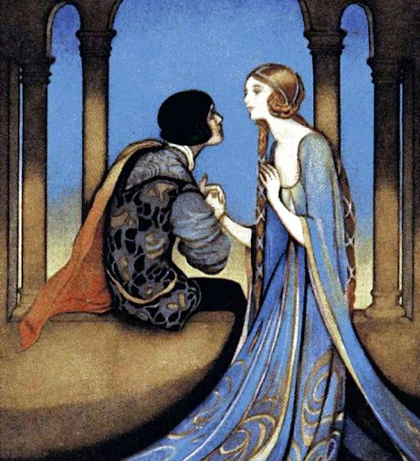
Year 10 Romeo and Juliet

Slide 2
Context
What does context mean for your exam?
AO3 is the understanding of ​the relationship between the ideas in the text and the contexts of the text. It is the way that Shakespeare may be commenting on/giving his views on life at the time the play was written/set. Context is assessed ​throughout the paper​.
The context may relate to ​various factors​:
➔ The relationship between the text and ​the context in which it was written​ and/or the context within which the text is set​.
➔ You may also consider​ literary contexts​ such as which ​genre​ the text is from - for example, The Strange Case of Dr Jekyll and Mr Hyde is a gothic text.
➔ You can also consider the contexts in which texts are engaged with by different audiences - for example An Inspector Calls was set in 1912 but was watched by audiences in 1945 who would have a different opinion about what takes place compared with an audience watching it now.
When thinking about context you can consider factors such as location, social structures and features, cultural contexts, and periods in time.
Acknowledgement of the universality of a literary text is an integral part of relating to it contextually.
Essay writing tip
It is important that the contextual information provided ​is directly relevant, ​rather than being ‘bolted-on’ to the end of a paragraph or essay. When writing your response you should include relevant context​ to ​illustrate and develop your interpretation​ of what is required by the task. Don’t ​just write everything you know about Shakespeare and Elizabethan England!
In your own words summarise what context is:
Underline or highlight the key information

Slide 3
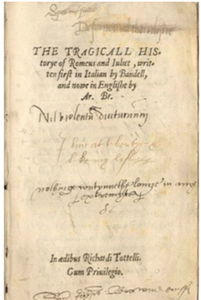
Background Information
Shakespeare is known as England’s most famous playwright; he lived from ​1564 – 1616​. ​His plays can be divided into Histories​ ​(e.g. Henry VI), ​Comedies​ ​(e.g. Midsummer’s Nights Dream), and ​Tragedies​ ​(e.g. Romeo and Juliet, Hamlet).
Shakespeare was writing during ​the Renaissance​ which was a period between the 14​th​ to 17​th​ centuries where there was an expansion of artistic expression. This expression freed itself from the​ restrictions​ of previous centuries. Romeo and Juliet is suspected to have been written at the beginning of Shakespeare’s career from around ​1597-1579​.
Plays were an incredibly ​popular and central medium of entertainment​ during the Elizabethan and Jacobean era.​ ​Shakespeare’s plays were the mass media of London for the day. The importance of ​entertainment​ of the plays must be understood when studying them; intense critical analysis is important, but should not detract from the big-picture view that these were first-and-foremost written to entertain​.
History of Romeo and Juliet
Who was the audience? Shakespeare was writing for what ​John Lennard ​calls a​ ​“cross-class” audience​, this is because members would have been from both the lower and middle classes. His plays often contain ‘lower-class’ humour i.e. bawdy and crude jokes to​ entertain​ alongside refined language.
The difference between classes is reflected in some of the characters. For example, the nurse is meant to ​represent the lower class ​which is clear from the ​sexual jokes​ that she makes when talking to Juliet.
However, Shakespeare also used more refined language which the literate audience members would have appreciated. For​ ​example, the ​sonnet structure​ may have been appreciated by the richer and more educated audience members.
Where did the inspiration come from?
While Shakespeare’s Romeo and Juliet may be the most famous story about ‘two star-cross’d lovers’ taking their lives, Shakespeare is not the first person to use this concept. Indeed, the story of Romeo and Juliet​ spans across cultures and stands the test of time​. There were many before Shakespeare the earliest written piece being in 1562.
Underline or highlight the key information

Slide 4
Genre
While Romeo and Juliet is known as one of the greatest love stories of all time, it is also very important to note that it is a ​tragedy​.
Tragedies have been used as a form of entertainment throughout history and tend to have certain common characteristics.
Aristotle​ ​outlined the key elements to a tragedy (it is important to note that Shakespeare had likely not read Aristotle’s works, though some people believe he had at least a general sense of the key ideas):
● Catharsis​ ​– a tricky term which can generally be understood as ​a purging of pity and fear among the audience through the action of the play​. ○ Negative emotions are purged by watching the tragic events of the play. For example, the end of the play when the lovers commit suicide Juliet says ​“O happy dagger, / This is thy sheath,” ​ and dies, this is a great ​source of catharsis ​for the audience.
● Hamartia​ ​– tragic error made by the character (something more than the simplistic ​‘fatal flaw”’​); a foolish decision made by a character which leads to disaster. ○ For example, Romeo’s ​hamartia​ is that he is​ “too rash” ​ which leads him to fall in love too quickly first with Rosaline and then with Juliet, which of course leads to the tragic end.
Senecan tragedy​ (a set of Ancient Roman tragedies) were ​bloody and sensationalist​ – elements of this violence can be seen in Romeo and Juliet, such as the fight in Act 1 and the bloody ending. s
QUIZ
What genre is Romeo and Juliet?
What is an example of Catharsis from the play?
What is an example of Hamartia from the play?
At what point can we see elements of a Senecan Tragedy in the play?

Slide 5
Setting
The play is set in ​Verona​, which is modern-day Italy. Shakespeare placed the setting of the play in both a ​temporally and a geographically distant place.​ This distance would give the audience a sense of safety from which they could experience catharsis ​(see below).
As the audience doesn’t have to worry that the issues of the play could infect their world, they can escape from their mundane rainy lives in England to hot and passionate Verona.
Why did Shakespeare set his plays in foreign lands?
Shakespeare was sometimes highly critical of the English monarchy, setting his plays in faraway places like Verona permitted him to critique society and the monarchy without being ​accused of treason.​ It also allowed him to ​explore subversive themes​ such as suicide, war and hostility in a safe space.
In addition, these settings added a sense of ​‘foreignness’​ to the play, meaning new ideas could be explored with greater ease. In Romeo and Juliet, the​ hot temperature​ of Verona is associated with increased passion so is an apt setting for this ​passionate tale.
Bullet point 3 easy to remember ideas about the setting that you will use in future essays:
Religion
Italy was known to the English for its ​Catholicism​. As England’s national religion at the time was Protestantism, due to Elizabeth I being the reigning monarch, the audience may have viewed this setting with mistrust. Catholicism was viewed negatively as it was known for its ​apparent corruption ​and its excess of passion​.
Anti-Catholicism​ was at its height in the Elizabethan era in England due to the war with Catholic Spain (Spanish Armada etc.). This means the ​Friar ​in the play would have been viewed with suspicion or at least been regarded as an untrustworthy character. ​In England, at the time, you could even get sent to prison for being a Catholic.
Underline or highlight the key information for religion.

Slide 6
Christianity
Religion was central to Elizabethan life and would have had a great bearing on the considerations of the morality of Romeo and Juliet’s affair.​ ​
It is easy to compare Elizabethan religious life with modern religious life, but this would be inaccurate.
➔ In the modern-day religion is often an “addition” to one’s life - religion is something ​one does​.
➔ In the Medieval to Early Modern Era, religion was the entirety of one’s life - religion was something ​one was​.
➔ Most could not conceive of a life without religion, unlike today.
It’s important to consider the ​audience’s religious stance ​when reflecting what effect the play would have on them.
The concept of ​sin​ also has its place in the play, with the idea of sin pervading Juliet’s refusal to obey her father (a contravention of the 10 Commandments). Moreover, the young couple epitomising the ​sin of hubris​ (one of the Seven Deadly Sins). The young couple can also be seen to embody pride, lust and perhaps greed.
​The tragic ending can be seen as a ​manifestation and re-assertion of traditional Christian Divine Justice​.
Challenge
Do you agree that Romeo and Juliet were sinful? Explain why/why not.
Astronomy
Astronomy​ ​taught the Elizabethans that the Earth was the centre of the universe and was surrounded by various spheres, this concept was also supported by religious teaching at the time.
➔ This creates another interpretation of Juliet’s​ allusions to the heavens and stars.​ When she talks about the universe it is possible she believes they are extensions of the central, Earthly power of which they are the centre.

Slide 7
Gender
The position of women
Women were seen as lesser than men, due to their increased propensity towards sin (in the Bible Eve is seen as the mother of sin) and the Aristotelean idea that ​women were deformed men​ and were thus lower on the​ Great Chain of Being​ (see challenge box above).
Objectification
In the Elizabethan era women were ​seen as property ​and were therefore ​objectified​. (seen as objects.) Women were not allowed to own any ​property​, in fact they were seen as property themselves.
➔ Females always ​belonged ​to the closest male relative, when they were born they belonged to their father and then when they were married they became the property of their husbands.
➔ This meant that the men could do whatever they wanted to their wives free of judgement or condemnation. ➔ Women weren’t just seen as property but also sexual objects ​there to satisfy the needs of their husbands who were their​ lords’​ and ​masters​.
The importance of marriage
Women were also seen as objects within marriage. Among richer families (e.g. the Montagues and the Capulets) the girls in the family were seen principally as a means of making links with other rich families.
Marriage was looked at as an end goal and purpose for all women. If a woman didn’t marry then she was thought of as a ​deviant​ (someone who does not follow social norms and values). An unmarried woman would not just be ignoring her natural calling but also have been diverting from the will of God.
➔ Lady Capulet tells Juliet that ​“ ​ I was your mother much upon these years” ​ meaning that she was already married with a baby at Juliet’s age.
CHALLENGE:
Ordered Great Chain of Being​:​ a belief system which underpinned Elizabethan society and taught that there was a ​hierarchical ordering of all creation​ (including all Heavenly bodies, human society, animals etc.). It essentially meant that​ ​one must adhere to one’s place in the ​Great Chain, ​breakage in the hierarchy would inevitably precipitate chaos.
However, the position of women had changed with the assumption of ​Queen Elizabeth I​ ​which defined (and, to an extent, introduced) the ​archetype of the strong female leader​.
It is possible that Shakespeare was inspired by Elizabeth I as a powerful woman to create a strong female character. Juliet is a strong character​ - she disobeys her father following her heart, is sexually liberated and takes autonomy of her own life.
Do you agree that Juliet is a strong female lead? What do you think Shakespeare is trying to suggest with this character?

Slide 8
Gender Norms
In marriage, women were expected to be ​passive​ and take on a domestic role. This contrasts to the men who were ​dominant and active and meant to make money.
Shakespeare’s exploration of Romeo and Juliet’s love affair challenges these ​gender norms​ as both characters are portrayed as active​. In addition to this, Romeo’s ​feminine tendencies​ subverts the typically masculine traits men were supposed to have.​ ​
It is clear to see that men had to be ​aggressive ​and were associated with ​violence ​as it was their role to protect their women, family and friends as well as their honour. It is possible that the feud between the Montagues and the Capulets is no longer about real fight or disagreement but one just based on ​male honour and pride​. Within the play the grudge is so​ “ancient”​ no one remembers what it is really about.
Love
Petrarchan lovers
Shakespeare draws heavily on the archetype of the ​Petrarchan Lover​:​ a man who falls in love with a woman but is either resisted or rejected. Simply put, ​Petrarchan love is unrequited. ​This rejection inevitably led the man to ​internal turmoil ​and ​self-imposed solitude​.
Romeo is evidently a Petrarchan lover both in his pursuit of Rosaline and Juliet (at first; though when Juliet accepts him, the love becomes reciprocated and therefore no longer Petrarchan).
Loving marriage was increasingly seen as the best way to achieve a ​moral life​. This form of love represents a movement away from the traditional fixation on chastity as the ideal of morality
Courtly Love
Courtly love​ incorporates ideas such as ​love at first sight ​and ​dying for one’s true love​. It was a Medieval ideal or, at least, an ideal which was imposed on the Middle Ages during the Renaissance.
➔ In Romeo and Juliet, courtly love is glorified and romanticised.
Courtly love also had many rules which a man was supposed to follow to show that he was really in love:
● The man cannot eat or sleep when he is in love and isolates himself ​ - while it can be argued that Romeo was not in love with Rosaline but instead infatuated with her, he still displays characteristics which were​ typical of a courtly lover. ○ In ​Act 1 Scene 1​ Benvolio says that “​So early walking did I see your son” ​ and Montague adds that​ “Away from light steals home my heavy son”, ​ they are observing that Romeo is staying up late and not sleeping. These​ are the signs of a man whose love has rejected him.
● The man forgets his old love when a new love comes along​ - the audience knows that Romeo must forget Rosaline as Juliet is his ​‘star-crossed’ lover​

Slide 9
● The man sends love letters or speaks in poetry when he is in love​ - In​ Act 1 Scene 5 when Romeo and Juliet meet for the first time their language becomes ​elevated ​both through ​imagery ​but also through the ​syntax ​used. ○ When the lovers meet for the first time they use the ​sonnet structure​ which is usually associated with romantic love. To the educated audience who would identify this it characterises their love as something special. ○ Also the language that Romeo uses also includes images which are out of this world. On the balcony scene Romeo calls Juliet a​ “bright angel!” ​ this ​heavenly metaphor​ suggests that he sees her as a ​pure and peaceful woman​. Her purity would also have been significant as a womans’ ​virginity ​was very important. In addition to this, the use of ​“bright” ​ indicates that she is ​illuminating him​ and perhaps to juxtapose the dark night. The ​exclamation mark​ indicates the excitement ​which Romeo feels seeing Juliet for the second time.
Types of love
It’s worth noting the different kinds of love and to what extent Romeo and Juliet’s affair embodies them. Their affair seems to incorporate both ​erotic love​ (​eros​; epitomised in their sexual encounters) and ​selfless, coupling love​ (​agape​; selfless love).
➔ Shakespeare’s time saw a move towards marriages formed from love rather than out of duty to one’s family. The play may be seen as the ​epitome​ of this ideal.
➔ These changing motivations for marriage meant a change in the way men went about obtaining a woman. This led to the notion of ​‘wooing’ ​a woman. Wooing is the process of impressing a woman so she wants to be with you.
What part of the play do we see the notion of ‘wooing’?
Fate
What we would call ​superstition​ was central to the lives of Elizabethans (witches, magic, fairies etc.). ​Fate​, itself a form of superstition, was ​a central concept in Elizabethan society​.​ Most believed that some greater force (be it God, the stars etc.) would or has already controlled their destiny.
Many sources of fate are recognised as being in Romeo and Juliet by John F. Andrews who writes that it is a play about “Fortune, Fate, and the Stars”. He also notes how ​Free Will (i.e. the antithesis of Fate) is central to their tragic ending

Slide 10
Violence
Explicit violence ​was a far more public affair in Elizabethan times than it is today so fights of the sort between the Montagues and Capulets would not have been unthinkable.
This was in part because the state employed violence so readily in dispatching criminals; ​hanging ​and ​burnings all formed a ​central part of entertainment ​in Elizabethan society.
However, the Elizabethan era was not an out-and-out barbarous era, violence was still treated with a ​paradoxical revulsion​ and attraction (as today).
➔ Suicide ​was both condemned as ​sinful ​(though see above for possible developments in this view), and yet – because of this condemnation, the society was incredibly fascinated in it which may have been a reason why Shakespeare included it in his plays.
➔ Just as people enjoy watching gruesome Horror films with explicit deaths today, despite a revulsion of violence, people in Elizabethan England were attracted by instances of violence in plays and in the public sphere. It is possible that the explicit forms of violence that occurred during Shakespeare’s era created a need within the society to see more.
➔ Romeo ​struggles​ with the concept of violence throughout the play unlike other characters who seem to go out looking for it.
➔ The concept of revenge through violence is debated by many characters, both male and female, who have different views on it.
➔ The Montague-Capulet feud appeals to an archetype of two warring families / countries / clans etc. This is a pertinent image for both an Elizabethan and a modern day audience. It is therefore worth considering how universal the ideas and messages of the play are.
Highlight or underline the key information about violence.

Slide 11
Context – end of reading quiz
What 4 factors can you consider when thinking about context?
Which period of time was Shakespeare writing in and what were the features of this time?
Which character represents the lower classes and how is this clear?
What genre is Romeo and Juliet?
What is Catharsis and how do we see it in the play?
What was the effect of setting the play in Verona?
What is the hot temperature of Verona associated with?
What would an English audience think about Catholicism at the time?

Slide 12
Context – end of reading quiz
How were religious values different to today?
How were women viewed during the Elizabethan Era?
How was marriage viewed during the Elizabethan Era?
How do Romeo and Juliet break gender norms?
What was a Petrarchan lover?
What did many Elizabethans believe about Fate?
What could the Montague - Capulet feud symbolise in wider society?
Extra notes:

Slide 13
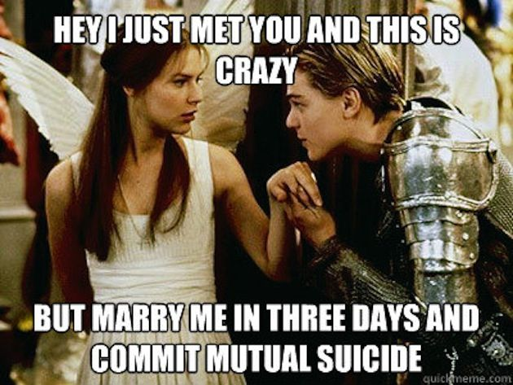
Overview
Act 1
Act 1 Scene 1:​ The action starts with a fight on the streets of Verona between the Montagues and Capulets. The fight breaks up and the Prince threatens the patriarchs of the families that if another fight like this breaks out they will pay with their “​lives ​ ”.
Act 1 Scene 2:​ After this, Paris, a young nobleman, asks Lord Capulet for Juliet's hand in marriage. Lord Capulet believes Juliet is too young but invites Paris to a feast that he is throwing, giving Paris an opportunity to ​“woo” ​ Juliet.
Act 1 Scene 3:​ The audience is then introduced to Lady Capulet, Juliet and her Nurse. They have a conversation about marriage and Juliet reflects that it is a fate that ​“I dream not of.''
Act 1 Scene 4: ​ The audience is then introduced to a ​lovesick ​Romeo who through the encouragement of Mercutio chooses to go to Capulet’s feast to distract himself from how much he misses Rosaline.
Act 1 Scene 5: ​The two lovers meet in this scene at Capulet’s feast and fall in love, but quickly find out that they belong to the opposing families.
***
Act 2
Act 2:​ Prologue
Act 2 Scene 1: ​Mercutio and Benvolio are looking for Romeo after the ​“feast”​.
Act 2 Scene 2:​ This is the iconic​ balcony scene​ where Romeo and Juliet confess their love for each other and plan to be married.
Act 2 Scene 3:​ Romeo meets with the Friar to ask if he will marry Romeo and Juliet. Despite the Friar’s reservations he agrees to marry the couple, hopeful about the peace it could bring to the families.
Act 2 Scene 4:​ The Nurse meets with Romeo, Romeo tells her that Juliet should meet him in Friar Laurence’s cell. They make plans to consummate the marriage.
Act 2 Scene 5: ​The Nurse tells Juliet about what she and Romeo had discussed.
Act 2 Scene 6: ​In this scene, Romeo and Juliet are secretly married by the Friar.
***

Slide 14
Act 3
Act 3 Scene 1​: Tybalt challenges Romeo to a fight but Romeo refuses. Mercutio steps in and is killed by Tybalt. Romeo is then filled with a ​murderous rage ​and kills Tybalt. The Price hears about this from Benvolio and then banishes Romeo.
Act 3 Scene 2:​ While Juliet waits at home for her new husband, the Nurse returns to tell Juliet the news about Romeo’s banishment. Juliet is distraught about it.
Act 3 Scene 3: ​The Friar tells Romeo about his ​banishment ​and Romeo is troubled and threatens to kill himself. The Nurse comes with news saying Juliet is in the same state. The Friar comes through with a plan to save the couple. He sends Romeo to ​Mantua​.
Act 3 Scene 4: ​In light of ​Tybalt’s death,​ Capulet decides (in hopes of making Juliet feel happier) that his daughter ​must ​marry Paris without asking her opinion.
Act 3 Scene 5: ​Juliet is told about her fate to marry Paris. She ​refuses ​to marry him which leads to her father ​threatening to disown​ her. Juliet goes to the Friar to help.
***
Act 4
Act 4 Scene 1: ​Paris goes to the Friar in preparation for the wedding; Juliet is also there but tries to ​ignore ​Paris’ advances. When Paris leaves Juliet starts to weep asking for advice from the Friar. He sets in motion a plan to rescue the lovers. He gives Juliet a ​potion ​that will make it look like she's dead and tells Friar John to go to Mantua to tell Romeo of the plan.
Act 4 Scene 2: ​Juliet comes back from the Friar’s cell revealing that she will marry Paris and so the wedding is moved up.
Act 4 Scene 3: ​Juliet soliloquises her fears about the plan but takes the potion. Act 4 Scene 4: ​The Capulets prepare for the wedding.
Act 4 Scene 5: ​The Nurse finds Juliet’s​ ‘dead body’ ​and the family begins to grieve as the wedding turns into a funeral.
***
Act 5
Act 5 Scene 1: ​Romeo hears news of Juliet’s death in Mantua and, unaware of the Friar’s plan, finds an apothecary who gives him a poison.
Act 5 Scene 2: ​Friar John tells Friar Laurence that he was unable to give Romeo the letter outlining the plan.
Act 5 Scene 3: ​Paris protects Juliet’s tomb, Romeo enters trying to find Juliet the two fight and Paris dies. Romeo sees Juliet, drinks the poison, dies, Juliet wakes up as Friar Laurence arrives, he then goes outside as he hears voices. Juliet then takes Romeo's dagger and stabs herself. The families of the lovers enter the scene and agree to make peace.

Slide 15
Create your own timeline for Romeo and Juliet
Please see the detailed
Romeo and Juliet: Overview of Text for a detailed summary of each scene and key quotations.

Slide 16
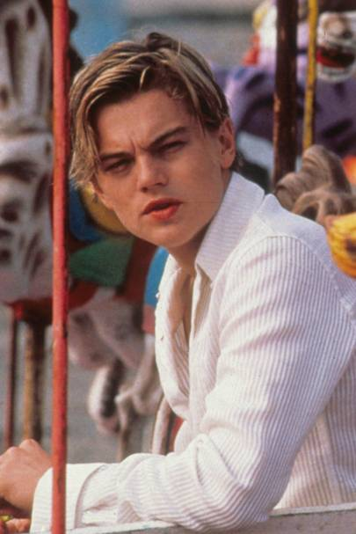
Characters
ROMEO
Romeo Montague
INTRODUCTION
Romeo Montague is the ​eponymous character​ of the play, who is initially portrayed as an ​archetypal Petrarchan lover.​
​He is the ​self-conscious sufferer​, driven by his ​unrequited love for Rosaline. This causes him to isolate himself from his family, relatives and friends, which is a common trope of Petrarchan poetry.
His meeting with ​Juliet Capulet ignites a major shift in both the trajectory of the play as well as Romeo’s narrative. Coming from opposing houses, the couple are deemed as “star-crossed lovers” ​ ,​ ​as their love is challenged by arbitrary fate. Their story allegorically questions whether tragedies are created by​ ​individual choices​ or by ​fate​.
In the play, Romeo’s development is an important cursor for the ​transition​ from comedy to tragedy. Romeo’s narrative echoes tropes of ​Aristotelian Tragedy​; the character’s​ hamartia (fatal flaw)​ ​is the inability to think rationally, choosing instead to make quick ​impulsive decisions​, which ultimately results in his downfall.
CHARACTER IN CONTEXT
● Petrarchan love - ​Shakespeare is also conversing with ​Petrarchan definitions​ ​of love. Petrarch was a poet in Italy, where the ​sonnet form​ originated. Petrarch’s poems often objectified women ​as Romeo does with Rosaline and Juliet. The poems also presented men as ​tormented lovers​, as Romeo is at the beginning of the play. Petrarch’s trope of unrequited and unattainable​ ​love is undermined by Romeo, this hints at Shakespeare’s own theories about love.
● Elizabethan Society -​ Romeo is presented, to an extent, as a ​dissident​ ​of the society that Shakespeare inhibited.​ ​Although the play is set in Verona, this city is a ​mere model​ ​of Elizabethan England ​as Italian society was seen through works of literature. The protagonist is​ ​unable to assimilate​ ​to the​ ​rules and customs​ of this society: Romeo breaks the law and returns from exile, and Romeo abandons expected behaviour of a man by denying Tybalt in a duel. It was​ ​common practice​ in England for men to duel one another - there was a growing fashion of​ ​Italian fencing,​ which features in the play (the fencing manoeuvres such as the “passado” and the “punto reverso”).
● Romeo’s purpose -​ Shakespeare is ​engaging with the idiosyncrasies​ of his time, with the portrayal of Romeo. However, it can be left up to debate whether the ​playwright’s purpose​ was​ ​didactic and confrontational​,​ or if it was simply to put forward a ​mirror reflection​ ​of his ​society.

Slide 17
KEY CHARACTERISTICS & CHARACTER DEVELOPMENT
● LOVING: ​Romeo encourages the audience to explore ​different types of love​ and question the effect love can have on a person​. Initially, he is preoccupied by the ​concept of love​, which is embodied by his infatuation with Rosaline. As Rosaline doesn’t physically appear anywhere in the play Shakespeare allows her to represent love as an idea, a thought, an abstract concept. This kind of love makes Romeos ​despondent​ and he seeks solace in ​isolation​. In contrast, Juliet, who is the personification​ of real and tangible love, causes Romeo to ​transcend boundaries​ and ​societal expectations​. Therefore, Romeo becomes the audience’s ​proxy​ for Shakespeare’s exploration of this ​universal theme​.
● FATEFUL: ​The protagonists are ultimately unable to defy the​ powers​ of ​fortune​ and​ fate​, however, they do signify a level of ​self-autonomy​ and an ​assertion​ of the ​individual self​. Therefore, Romeo’s​ trials and tribulations​ in the play stimulate a reading into the battle between the ​microcosmic individual​ and the ​macrocosmic higher powers​.
● RELIGIOUS: ​Romeo’s dialogue is imbued with ​religious allusions​, which echoes the religious society of Shakespeare’s time. The playwright investigates the role of religion as a moral epicentre​, and how love is intrinsically linked to a religious relationship, which is dictated by blind ​faith and devotion​.
● ISOLATED: ​The hero of this text indicates isolation in various scenes, which refer to Petrarchan suffering​, but also a ​detachment​ from the world and his individual “self”. Shakespeare attempts to question the ​nature of loneliness​, and to what extent it is self-inflicted. Predominantly, Romeo’s scenes are with other characters such as Juliet, Benvolio, Mercutio and Friar Lawrence, which shows the conflict between ​external companionship​, and ​internal solitude​.
● MASCULINE: ​Romeo navigates the realm of ​masculinity​ in the play. He is contrasted with hyper-masculine​ characters such as Mercutio, who is violent and uses ​misogynistic bawdy humour​ to make fun of love. Romeo’s refusal to accept Tybalt’s duel also ​subverts the characteristics of ​stereotypical masculinity​. Thus, Shakespeare presents characters who ​conform or confront​ the gender rules of their society in order to emphasise the constraints​ of gender.
● VIOLENT: ​This theme is antithetical ​to love. Violence is hindered by love, as Romeo refuses Tybalt due to his ​new maturity​ brought upon by his relationship with Juliet. After Juliet’s purported death, Romeo reverts to the typical masculine behaviour, by indulging in violent acts, such as ​threatening Balthasar​ ​and ​killing Paris​. Juliet is the ​antidote to the violence presented within the text. Romeo exclaims that her love makes him ​“effeminate” ​ , thus he is unable to duel Tybalt. This means that Juliet functions as the ​antithesis to violence.​ This is mainly to do with​ ​societal structures​ and ​gender constructs.​ Sword fighting was mainly associated with males who would ​take part in duels​ ​in the Elizabethan era. However, at the end of the play, Juliet is forced to take violent action against herself. It could mean that violence may be the only answer at times. Juliet’s choice to use violence ​ends the feud​, thus technically ending all of the violence of play. To this extent, Juliet is the ​cure to violence​.
Highlight or underline the key information on this page

Slide 18
Using the information on the previous pages create mind map of KEY info for the character of Romeo
Challenge tasks: include context, include independent research

Slide 19
RELATIONSHIPS BETWEEN OTHER CHARACTERS
Juliet |​ The two eponymous characters are immediately established as possessing the central relationship of the play; their relationship develops quickly​ which makes it incredibly passionate​. Juliet is extremely young in comparison to Romeo and so it is highly possible that this is her first real relationship. Their initial interaction is incredibly flirtatious, which juxtaposes​ the terrible and debilitating tension it goes on to cause, but is also evidently ​pure​ and passionate​. Their love for each other is potently strong, obviously demonstrated by how they both end up committing suicide as a result.
Rosaline |​ Although we never see Rosaline within the play, she plays an important role as she serves to show the audience the difference between lust and love. It is due to Rosaline that the audience is introduced to Romeo acting as a ​Petrarchan lover​.
Lord Montague | The Lord is Romeo’s father, and he clearly has a lot of love and respect for his son. He is a minor character in the plot and mainly serves to ​further the tension between the Montagues and Capulets - however, he is also the character who​ resolves this conflict at the end of the play as he learns about the fate of his son.
Lady Montague | Also a minor character, Lady Montague also has a lot of love and affection for her son; upon finding out about his death, she eventually dies from grief.
Mercutio​ | This is Romeo’s best friend, it is important to note that Mercutio is also a ​foil​ for Romeo. While Romeo is an ​emotional romantic​, Mercutio is a ​cynical​ man focused on the physical parts of love. It is clear that they deeply care for each other, at first when Romeo is heartbroken after Rosaline Mercutio makes jokes making his long ‘Queen Mab’ speech in attempts to make Romeo feel better. Later in Act 3 when Mercutio dies Romeo is overcome with a murderous rage. The reaction that the audience sees from Romeo illustrates the extent of love that Romeo had for Mercutio. The only other time that the audiences see a similar reaction from Romeo is when he finds out about Juliet’s ‘death’.
Tybalt | Tybalt is a Capulet, and has a fight with Romeo in the third act, which results in Romeo killing Tybalt in revenge for Mercutio’s death. He is Romeo’s main rival.
The Friar |​ The Friar acts as a father figure for Romeo.
Chart Romeo’s relationships, with 1 being the strongest and 0 being the weakest.
Challenge: justify your choices.

Slide 20
ROMEO QUOTE BANK
As you study the quotations, underline or highlight any key parts of the analysis. If you’re stuck with any of the terms consult the glossary at the end of the booklet. You can also email/ask your teacher.
These pages will help you write your essays!
Quote | Analysis
Montague:​ ​ “Shuts up his windows, locks fair daylight out,/And makes himself an artificial night:” (I.i.133-34) | Action of making ​“himself” ​ an ​“artificial night” ​ implies self-inflicted isolation​. The dichotomy​ ​set up between​ “daylight” ​ and​ “night”, reflects Romeo’s ​conflicting emotions​.
Romeo: ​“...Why then, O brawling love, O loving hate,/ O any thing of nothing first create!...” (I.i.165-77) | Use of ​oxymorons​ ​in this section highlights the ​ineffable quality​ of love: it is full of ​contradictions​ and does not make sense. This ​speech​ is ​13 lines​, which is arguably an ​imperfect sonnet​. This reflects the idea that Romeo’s experience with love is ​incomplete and flawed​. Irregular rhyming couplets​ ​in the section​ ​indicates​ ​the unpredictable nature​ of love. This section highlights Romeo’s role as the ​Petrarchan lover​, who suffers from unrequited love. In ​Baz Luhrmann’s​ directorial interpretation, the​ poetry is personified ​- it is made more visible,​ ​as​ ​Romeo is shown writing his dialogue. This emphasises Petrarchan self-conscious suffering​.
Romeo:​ “​O, she is rich in beauty, only poor/ That when she dies, with beauty dies her store”. (I.i.209-210) | Caesura ​interjects the line, much like how death interrupts her “beauty”. ​ The ​repetition​ of the ​verb​ “dies”, ​ emphasises the indomitable transience​ of her ​“beauty” ​ and ​“store” ​ , which are ​semantically linked​ to the body. Use of ​adjectives concerning wealth ​“rich”​ and ​“poor” ​ implies that women are commodities measured​ by their ​beauty and fertility.
Romeo​: “​Transparent heretics, be burnt for liars./One fairer than my love! The all-seeing sun/ Ne’er saw her match since first the world began”. (I.ii.93-95) | “heretics” ​ were individuals with ​unorthodox religious beliefs​, who were often burned to death in the Elizabethan era. Romeo’s infatuation is ​analogous​ to faith and religion: Rosaline is portrayed as the ​perfect being,​ like God, and Romeo as a devout follower. If his eyes should stray and become “heretics” ​ , Romeo demands​ biblical punishment​, conveyed by the action of being ​“burnt” ​ . The ​“sun” ​ and ​“light” ​ is a lexically cohesive motif​ associated with beauty and love.

Slide 21
Quote | Analysis
Romeo:​ “Some consequence yet hanging in the stars…But He hath the steerage of my course.” (I.iv.106-113) | Romeo:​ “Some consequence yet hanging in Shakespeare continues to ​form his image​ of Romeo as someone who is lacking control of his own life. ​“...the stars” ​ , indicate the heavens, and the idea that life on earth is dictated by ​that macrocosm.​ This, additionally,​ foreshadows fate’s interference​ in the text. In line 112, Shakespeare​ allegorically represents​ Romeo as a ship and God as the captain- ​“...He hath steerage of [Romeo’s] course” ​ . Thus, signifying lack of self-autonomy​ and the character’s ​passivity​ to higher power.
Romeo:​ “​O she doth teach the torches to burn bright!...As a rich jewel in an Ethiop’s ear-” (I.v.43-52) | Regular rhyming couplets​ add energy to the dialogue, reinforcing the excitement and intense emotions of Romeo. In addition, couplets heighten the feeling of love - they are two lines fit together as a ​singular unit/ anatomy​. Juliet is metaphorically portrayed as ​transcendental​ in this extract, as she​ “teaches the torches,” ​ is a ​“snowy dove” amongst​ “crows”, ​ and her beauty is ​“for earth too dear”. Shakespeare establishes the ​lexically cohesive conflict between ​light and dark​ in this extract. This alludes to the “artificial night” ​ in scene 1, which emphasises the weight of Juliet’s presence in the ​character’s narrative arc​. Shakespeare also portrays the​ objectification​ of Juliet, with the ​metaphor​ ​“As a rich jewel in an Ethiop’s ear-”.
Juliet:​ “Saints do not move, though grant for prayers’ sake/ Romeo: Then move not while my prayer’s effect I take.” (I.v.92-105) | First 14 lines of dialogue between the two protagonists form a Shakespearean sonnet​ ​- indicates romance and love. The ​call and response​ in the ​sonnet rhyme scheme​, finished by a rhyming couplet echoes the characters’ ​compatibility​; it also implies the ​reciprocation of love​. Romance is also expressed as a ​religious experience​, conveyed by the ​allegory​ of ​saints praying.
Romeo:​ “​But Soft, what light through yonder window breaks?/ It is the east and Juliet is the sun./ Arise fair sun, and kill the envious moon.” (II.ii.2-5 | Juliet being ​described metaphorically​ as the ​“fair sun”, illustrates Romeo’s growing ​obsession and infatuation​, as the sun is the source of all life; Juliet vitalises Romeo. Modern interpretation may allude to the ​helio-centric model​ of the solar system, thus Juliet becomes the centre of Romeo’s world. Antithesis constructed​ between the ​“sun” ​ and ​“moon” ​ . The “moon” ​ refers to Diana, the patroness of virgins, which Romeo wishes to ​“kill” , suggesting his carnal desires to have Juliet.

Slide 22
Quote | Analysis
Romeo​: “With love’s light wings did I o’erperch these walls,/ For stony limits cannot hold love out”. (II.ii.66-67) | Dichotomy​ between the ​abstract noun​ ​“love” ​ with ​concrete nouns​ such as​ “walls” ​ and​ “stony limits” ​ . Highlights that love​ transcends borders​, with the ​allegory of flying​ over the walls with ​“love’s light wings”. ​ Use of alliterative sounds​ ​“Love” “light” ​ ​“walls” “limits”, ​ draw attention to the word ​“love ​ ”, which is repeated twice. Demonstrates a ​form of enlightenment​ achieved through love, as Romeo figuratively ​overcomes physical boundaries​.
Romeo​: “Tybalt, the reason that I have to love thee/ Doth much excuse the appertaining rage/ To such a greeting.” ​ (III.i.59-61) | Shakespeare contrasts fighting with Romeo’s newfound love for Tybalt. This effectively ​detaches Romeo emotionally​ ​from his contemporary crowd​,​ highlighting his character development; the idea that love transcends ​societal conventions and expectations​.
“...O sweet Juliet,/ Thy beauty hath made me effeminate,/ And in my temper soften’d valour’s steel!”. ​ (III.i.109-111) | Analogy ​is with the hardness imparted to steel by the process of tempering; Romeo is presented as ​a blunt sword​, which symbolises his ​emasculation​. Swords are typically associated with violence and bravery. The inability to ​conform to violent behaviour​ is considered feminine. The quote shows how Juliet has caused Romeo to change. Alliterative ​“t” ​ ​ sounds heighten the tension.
“Romeo: Away to heaven, respective lenity, / And fire-ey’d fury be my conduct now!” ​ (III.i.119-120) | Fricatives ​of ​“fire-eye’d fury” ​ accentuate the ​harshness of the dialogue. Shakespeare​ juxtaposes​ ​“heaven” ​with ​descriptions of hell​, “fire-ey’d fury” ​ to emphasise the conflict between ​mercy and revenge​.
“Romeo: O, I am fortune’s fool.” ​ ​ (III.i.132) | Simple sentence​ underline’s Romeo’s ​subjugation​ to “fortune” ​ ; Romeo’s language ​prowess​ have been ​diminished to an ​unimpressive syntax​. Romeo makes himself the ​object​, ​“fortune’s fool” ​ , which communicates his ​passive stance​ on life and his ​​inability to accept responsibility​ for his actions. “Fortune” ​ , was perceived as a woman during the Elizabethan era, thus ​“fortune” may also refer to Juliet in this instance.
“For exile hath more terror in his look,/ Much more than death. Do not say ‘banishment’!” ​ (III.iii.13-14) | Shakespeare​ personifies​ ​“exile” ​ to accentuate Romeo’s fear. Half internal rhymes​ “more” ​ and ​“terror” ​ ​draws attention​ to these words to signify fear. Imperative ​“Do not say…” ​ shows Romeo’s violent reaction to his punishment.

Slide 23
Quote | Analysis
“Romeo: There is no world without Verona walls,/ But purgatory, torture, hell itself:”. ​ (III.iii.17-18) | Shakespeare shows Romeo’s ​hyperbolic manner of thought and over exaggerated view of the world as he says, ​“there is no world without Verona walls”. “...purgatory, torture, hell…” ​ is an ​auxesis​, as the words ascend in intensity. The religious semantic field illustrates how Romeo views the external world​ as ​biblical damnation. “Purgatory” ​ , quickly escalates into ​“torture” ​ then ​“hell” ​ which implies that banishment does not mean ​atonement​ but rather eternal punishment.
“Friar Lawrence: Thy tears are womanish, thy wild acts denote/ The unreasonable fury of a beast.” (III.iii.110-111) | “unreasonable fury of a beast” ​ ,​ ​is a ​metaphor ​used to describe ​Romeo’s irrational nature​. “Womanish” ​ conveys the ​patriarchal society​ in which the text is set and written, as Friar Lawrence exposes Romeo’s​ loss of self​, by describing him as ​“womanish” ​ , describing his actions as ​“wild” ​ , and drawing an analogy​ to a beast, implying a level of dehumanisation.
“I must be gone and live, or stay and die”. ​ (III.v.11) | Monosyllabic phrasing​ which is not for Romeo. This shows character development, as it signifies a ​new maturity and understanding​, unlike ​oxymoronic turmoil. Compound patterning​ of ​“gone and live” ​ , and ​“stay and die” ​ , ​emphasise the conflict​ that Romeo is faced with. Internal rhyme​ between ​first person pronoun​ ​“I” ​ and ​“die” ​ , foreshadows Romeo’s death.​ The self represented by ​“I” ​ is inextricably linked​ to death. Shown by the ​verb​ ​“die” ​ . Iambic pentameter​ effectively stresses the key words of the line,​ “must”, ​ ​“gone”, “live”, “stay” ​ and ​“die” ​ .
“Is it e’en so? Then I defy you, stars!” ​ (V.i.24) | Caesura​ ​“...so? Then I…” ​ indicates an assertion of agency and self-autonomy, in order to defy the will of the heavens, which is symbolised by the “stars”. Therefore, Shakespeare creates the ​conflict between the individual and fate​. Romeo’s belief that he can​ ​“defy the stars” ​ ​suggests a self-assured hubris.​ ​In Greek Mythology hubris is followed ​by nemesis,​ fate and destruction. This ​echoes the structure​ of the play as Romeo’s defiance against the stars, leads to his destruction. The use of ​broken syntax​ in the line​ elucidates his internal turmoil.
“By heaven, I will tear thee joint by joint,/ And strew this hungry churchyard with thy limbs./ The time and my intents are savage-wild,”. (V.iii.35-37) | The ​“graveyard” ​ is ​anthropomorphised​, as it is described as “hungry” ​ . “Intents” ​ being​ ​“savage-wild” ​ ,​ ​denotes Romeo’s ​detachment from his humanity,​ which results in isolation. Violent images of breaking down the human body, connotes a displacement​ of Romeo’s psyche.

Slide 24
Quote | Analysis
“Thou detestable maw, thou womb of death,/ Gorg’d with the dearest morsel of the earth,/ Thus I enforce thy rotten jaws to open,/ And in despite I’ll cram thee with more food.” ​ (V.iii.45-497) | Paradoxical image​ of the ​“womb of death” ​ , as ​“womb” ​ is associated with life. Therefore, this image acts as ​an inversion​- there is no life, only death. “I enforce…” ​ is a powerful command, that seems to be violating the body​ of the tomb. Semantic field of the dismembered body, ​“maw”, “womb”, “death” ​ , is a ​subversion of Petrarchan love poetry,​ which focuses on body parts of the object of desire.
“... O here/ will I set up my everlasting rest,/And shake the yoke of inauspicious stars/ From this world-wearied flesh…” (V.iii.109-112) | “...shake the yoke” ​ means to ​“resist the domination” ​ - Romeo once again attempts to ​defy fate​. The ​enjambment​ of this quotation hints at the speed of Romeo’s thought, which is arguably ​rash​ and ​irrational.​ It suggests the ​inevitability of ending​ this ​soliloquy,​ which finishes with Romeo’s death.
Memorising tips
Some techniques to help you learn quotations include:
Choose a few quotes, don’t try and learn them al. choose the ones that YOU can write about
circling key words in your quotation in different colours
writing quotations on sticky notes and posting them around the house
stressing certain syllables of the lines you want to learn - eg 'And the sheen of their spears was like stars on the sea'.
writing the text as a summarised textual reference if you can’t remember the full quotation
Understand the quotes fully- We are more likely to remember quotes if we understand them.
Stick quotes where you can see them
Reading a Quote Actively. Read your quote over and over again.
Copying and Repeating. Break the quote into smaller parts.
Trying Memory Hacks. Walk or run while saying the quote to yourself
Ask a friend or family member to quiz you on the quotes
Record yourself repeating the quotes and then play it back

Slide 25
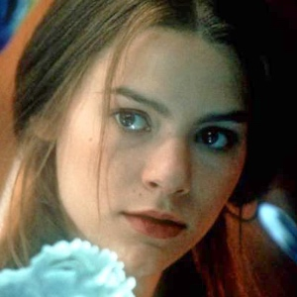
Characters
JULIET
Juliet Capulet
INTRODUCTION
Juliet is the ​female protagonist​ of the play. She makes up the ​“...pair of star-crossed lovers…” ​ the ​tragedy​ is centred around.
Although Juliet is only 13, Capulet ​arranges her marriage​ to Paris in the first scene she is mentioned. Thus, Shakespeare presents her as an ​object of desire whose only function is to be married. Although she is seen in such a ​reductive​ ​way, the character displays complexity and maturity​ which​ ​contrasts​ with her young age.
The protagonist can be perceived as ​an anomaly​ ​in the play, as she is the only character who attempts to reject the​ ​societal pressures​ she faces: she insists on marrying for love ​and ​takes action​ ​against her ​circumstances​. Juliet becomes the ​catalyst​ ​that causes the ​metamorphosis of Romeo​ from a ​Petrarchan lover​ ​to a ​Shakespearean lover​. Ultimately, the two lovers meet a​ tragic end,​ but Juliet’s action at the end of the play signifies the lengths to which the character is able to go in order to​ ​assert her freedom.
CHARACTER IN CONTEXT
The Nurse Juliet’s close relationship with her Nurse directly contrasts with how distant she is with her mother. This reflects how many upper-class mothers did not raise their own children. Instead, the Nurse carries out the​ ​role​ of the​ ​traditional mother​; ​she gives Juliet advice, looks after her and even elaborates that she breastfed Juliet. This can be seen in the quote, ​“For I had then laid wormwood to my dug,” ​ outlining how Juliet’s relationship with the Nurse is more ​naturally maternal​ ​than with Lady Capulet.
Sonnet form - Traditionally, the ​sonnet form​ was used by men to write about women. The women were usually portrayed as ​objects​ within the poems and therefore had​ no agency​. However, Shakespeare subverts​ the form as Juliet, a female character, speaks to Romeo in the sonnet form. Juliet’s ability to communicate with Romeo on an equal footing would have been unusual at the time which would have shown the audience that she wasn't a stereotypical Elizabethan woman. In this play, although still written by Shakespeare himself, Juliet participates in ​constructing​ ​the Sonnet form, for example, the first 14 lines of dialogue between Romeo and Juliet is a sonnet. Shakespeare thus allows a woman, who is seen as an object by the male characters within the play, to become the subject within this dynamic. Through giving his female character agency Shakespeare's use of the​ sonnet ​subverts the patriarchal dominance ​over the form. Through giving his female character a typically male voice Shakespeare has allowed female agency to take place within the play. (Shakespeare gives many of his female characters agency, can you think of other plays he has written where this is the case?

Slide 26
Feminist messages
Shakespeare conveys a dynamic between men and women within the play which could be considered feminist. Although Mercutio finishes Romeo’s rhymes with​ ​elaborate misogynistic lines​,​ ​Juliet completes his rhymes with ​wit and intelligence​, contrary to the sexist attitudes of the time. Therefore Juliet is an​ ​atypical portrayal​ ​of an Elizabethan woman, as she​ ​transcends​ ​the​ ​cultural and societal boundaries​ ​of her time. Refusing to b​e subjected or reduced to her circumstances, modern ​critics may even argue that Juliet is a​ ​proto-feminist character​,​ ​t​hat attempts to break down the patriarchy, and ​reclaim her own fate.
Religion
The theme of religion is ​explored ambivalently​ (meaning with mixed emotion)​ ​in the play: Juliet both ​upholds​ ​religion and subverts it​.
➔ Juliet’s presence in the play highlights how​ ​worshipping​ ​and ​idolising​ a person (i.e. Rosaline) can be detrimental as it leads to isolation for Romeo
.➔ Juliet describes Romeo as ​“the god of my idolatry” ​ . Her reference to ​“god” ​ implies she perpetuates love​ as a ​religious experience​. Whereas Shakespeare’s use of the ​noun “idolatry” ​ illuminates the dangers of such a love.
➔ Furthermore, Juliet preserves ​religious ideals​ as she makes it clear that she wants to be married before continuing her relationship with Romeo.
➔ However, she ultimately commits the most​ ​sacrilegious act​ ​by committing suicide which is considered a sin in the Bible. The Elizabethan audience, who was extremely religious, would have been shocked by this. Therefore, Juliet allows readings of both religious conformism​ ​and ​dissidence.
Gender Roles
The ​feminine​ ​and the​ ​masculine​ are contrasted greatly in the play. Most of the men have scenes set in ​the outdoors​ (such as the duel between Mercutio and Tybalt, Romeo hiding in the groves). However, Juliet’s scenes often ​take place indoors.​ This is displayed in many productions of the play, as it demonstrates the​ domesticity​ ​Juliet is ​subjected​ to. Thus setting and spaces become a physical representation​ of the masculine and the feminine. Despite being female, Juliet is a figure who can be considered equal to Romeo within the play. She is seen as being just as intelligent as she ​finishes Romeo’s rhymes​ which only Mercutio and Benvolio are seen doing; this can be seen in​ Act 1 Scene 5 ​when the lovers first meet. This indicates that Juliet is well educated, as she is able to keep up with men who would have been privileged with an education. Thus, Juliet can be seen as a​ ​revolutionary character​,​ ​who​ ​does not perpetuate​ ​the ​narrative archetype​ she has been written into. Unlike most women of her status, she ​rejects societal expectations​ and ​rules​ in order to pursue her love with Romeo.
Highlight or underline the key information on this page

Slide 27
Violence
Juliet is the ​antidote ​to the violence presented within the play. Romeo exclaims that her love makes him ​“effeminate” ​ , thus he is unable to duel Tybalt. This means that Juliet functions as the antithesis to violence.​ This is mainly to do with​ ​societal structures​ and ​gender constructs. Sword fighting​ ​was mainly associated with males, who would ​take part in duels​ ​in the Elizabethan era. However, at the end of the play, Juliet is forced to take violent action against herself. It could mean that violence may be the only answer at times. Juliet’s choice to use violence ends the feud,​ thus technically ending all of the violence of play. To this extent, Juliet is the ​cure to violence​ in the play
KEY CHARACTERISTICS & CHARACTER DEVELOPMENT
● Love - ​Juliet is the ​epitome​ of ​Shakespearean love.​ This form of love is not one of unrequited self-conscious suffering​, but rather a ​complete and romantic relationship. Juliet is the foil to ​“Rosaline”, ​ who symbolises the ​abstract concept​ of perfect love. This can be seen in how Juliet​ ​reciprocates​ love. The physical act of kissing when she meets Romeo means that the character embodies a ​physical, tangible, real love​. The dialogue between Romeo and Juliet, where they finish each other’s rhymes or complete the rhyme scheme of a ​Shakespearean sonnet,​ ​signifies their ​compatibility ​(look below to quote bank for a complete analysis). Thus, Juliet is the embodiment of a love that ​undermines the​ ​tradition​ of ​Petrarchan courtly love.​ ​Modern feminists​ ​would encourage a reading that Juliet is a ​sexually liberated,​ ​self-autonomous lover,​ ​who is ​not subservient​ to her male counterpart but is in fact his​ ​equal.
● Fate - ​Juliet is faced by the challenge of ​arbitrary fate:​ she is a Capulet and Romeo is a Montague, she has been arranged to marry Paris, and she is a woman who has very ​little freedom ​to make her own choices in life. Yet, Shakespeare has given Juliet ​agency​ within the play which allows her to confront and overcome these obstacles to be with her one true love, Romeo. She understands that Romeo is, ​“[her] only love sprung from [her] only hate”. ​ She encourages him to ​“deny thy father and refuse thy name” ​ showing how she rejects​ their ​circumstance.​ Juliet ignites the plot to avoid marrying Paris and instead persuades Friar Lawrence to help her marry Romeo. These acts show her as a strong woman who refuses to be ​confined ​by the​ boundaries​ ​of gender rules​. Ultimately, her suicide can be interpreted as a ​defiant act against fate​ ​and the society ​she inhabits. She makes an active choice to establish arguably a form of freedom from a fate that has destroyed her life- she takes charge of her own life. Juliet’s ​self-autonomous nature​ is antithetical to ​fate,​ which is the​ ​set of conditions​ she is placed within.
Highlight or underline the key information on this page
Create a quiz to test yourself on what you have read

Slide 28
● Isolation - ​In contrast to Romeo, Juliet is never alone; she is never left in isolation. This can be seen in how the Nurse constantly calls out for Juliet, or her scenes always have one other character present. To what extent this is intended is debatable, however, this does symbolise Juliet’s ​lack of freedom and privacy. ​Being alone does not always mean isolation, however, it can be an indication of feeling isolated. Isolation can be seen as an attempt at ​creating a place for oneself​,​ ​therefore a lack of this suggests that Juliet does not have the freedom to construct her own space. Her final act of taking action alone and detaching herself from her family and the Nurse connotes an ​emotional maturity and growth.
● Opposition - ​Juliet’s journey within the play is full of opposing forces;​ antithetical themes such as ​Hate and Love,​ ​Life and Death​, ​become inextricably linked.​ Juliet’s love stems out of hate, Romeo, and her relationship with Romeo leads to her death. Thematically Juliet is ​presented as liminal​, as she is caught between two states. The fact that she is in between ​adulthood ​and ​childhood ​is evidence for her liminality. Through this Shakespeare is able to develop a ​complex character​ ​which is four-dimensional and does not simply adhere to simple, superficial themes.
Relationships with other characters
Romeo | ​The two eponymous characters are immediately established as possessing the central relationship of the play; their relationship ​develops quickly​ which makes it incredibly ​passionate​. Juliet is extremely young in comparison to Romeo and so it is highly possible that this is her first real relationship. Their initial interaction is incredibly flirtatious, which juxtaposes the terrible and debilitating tension it goes on to cause, but is also evidently pure and passionate. Their love for each other is potently strong, obviously demonstrated by how they both end of committing suicide as a result.
Lord Capulet | ​Throughout the course of the play their​ father-daughter ​relationship changes drastically. The first time the audience meets Juliet’s father he acts as an ​overprotective ​father who is just trying to shield his daughter from the world. He calls her a​ “stranger in this world” ​ and tells Paris that he will only give Paris his ​blessing ​if Juliet chooses to be with him. This suggests that Lord Capulet is a ​progressive father​, not one that orders his family around even when the Elizabethan audience believed that he had the right to. However, this ​drastically ​changes after Tybalt’s death and Lord Capulet demands that Juliet must marry Paris, saying that if she refuses he will ​disown ​her. It is clear that their relationship is ​complicated ​but it is also clear that Lord Capulet greatly cares for his daughter and only reacts when he​ ​is challenged.
Lady Capulet | ​Their relationship is essentially​ non-existent​. The only time in which the audience sees an exchange between the mother and daughter is when Lady Capulet ​must ​talk to her daughter or is​ sent by her husband​ to talk to her. Lady Capulet and Juliet are also ​opposites ​of each other; everything that Lady Capulet wants, Juliet does not. While her mother was married and with a child at Juliet’s age, Juliet is not even​ “dream(ing)” ​ of it which suggests that Juliet is an independent woman. However, it could be argued that the way in which Juliet becomes ​infatuated with a man at a young age shows her to be ​more like her mother​ than previously thought. ​.

Slide 29
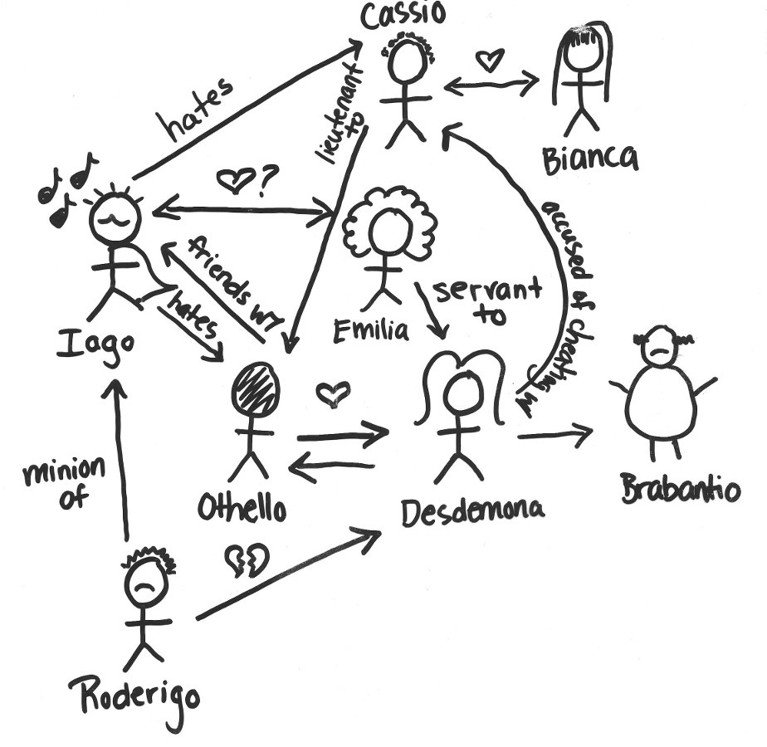
The Nurse |​ ​The Nurse is the ​maternal figure ​for Juliet within the play. Their ​strong bond ​is a result of the fact that she has been Juliet’s​ ‘wet nurse’ ​meaning that she has been with Juliet since Juliet was breastfeeding as a baby. Throughout the play, the Nurse remains supportive of Juliet, even helping to make plans for Romeo and Juliet’s ​marriage ceremony​. It can be argued that the Nurse is an accomplice to fate as without her the lovers may have never been able to have the relationship they had for as long as they did.
The Friar | ​The Friar is always a point of contact for advice for the lovers. However, it is through his plan that the lovers die which is quite ​ironic​. Like the Nurse, the Friar is a ​tool for fate​. The Friar is instrumental in Juliet’s life as she seeks him out for advice, he also comes up with the plan and gives her the potion which ​ignites the sequence of events.
Paris | ​They don’t really have a relationship, and what they do have is incredibly ​one-sided​ on Paris’ part. He represents the ​duty ​that is inevitably a part of a young Elizabethan’s woman’s life.
Tybalt | ​Tybalt is Juliet’s cousin who is dedicated to protecting their​ family honour
Create a character relationship map with Juliet in the centre. Use the example from Othello to help you.

Slide 30
Using the information on the previous pages create mind map of KEY info for the character of Juliet
Challenge tasks: include context, include independent research

Slide 31
JULIET QUOTE BANK
As you study the quotations, underline or highlight any key parts of the analysis. If you’re stuck with any of the terms consult the glossary at the end of the booklet. You can also email/ask your teacher.
These pages will help you write your essays!
REMEMBER THE TIPS FROM ROMEO’S QUOTATION BANK
Quote | Analysis
Capulet ​ : “My child is yet a stranger in the world,/ She hath not seen the change of fourteen years;” (I.ii.8-9) | Shakespeare emphasises how Juliet is stuck in a ​period between childhood and adulthood: ​Capulet describes her as a ​“stranger”, yet discusses her forthcoming marriage to Paris. This ​alludes​ to how Juliet is constantly caught between opposing forces. Juliet is only 13, which was still an ​uncommon age​ ​to get married​ ​in Shakespeare’s time
Nurse ​ : “...Thou wilt fall backwards when thou hast more wit,/ Wilt thou not, Jule?” (I.ii.43-44) | Shakespeare ​illustrates​ how ​patriarchal ​Verona is, as the Nurse and her husband had discussed Juliet reaching ​sexual maturity​ even when she was a child. This highlights how ​Juliet has always been seen as an object to be married off. The use of the ​rhetorical question​ is ​ironic,​ as Juliet is not being given a choice. It rather cements the​ inevitability ​of Juliet’s circumstance.
Lady Capulet ​ : “Speak briefly. Can you like of Paris, love?/ Juliet: I’ll look to like, if looking liking move./ But no more deep will I endart mine eye/ Than your consent gives strength to make it fly.” (I.iii.97-100) | Dialogue indicates her ​emotional maturity and headstrong nature- she rejects the ideals that​ ​society propagates​. ​Shakespeare uses half-rhyme​ to reply to Lady Capulet’s question, which​ ​illustrates Juliet’s dissidence.​ It also ​foreshadows​ ​her future rebellion against her family and society. Active verbs​ ​used with ​prominent first-person pronoun, ​“I’ll look to like…”, ​ conveys an ​assertion of agency.​ ​Juliet makes her own decision, thus ​opposing the forces of oppression-​ her family, and the patriarchy. This means Juliet is ​atypical for her time,​ ​where women were conditioned into subjugation and submission.

Slide 32
Quote | Analysis
Romeo ​ : “​O she doth teach the torches to burn bright!...As a rich jewel in an Ethiop’s ear-” (I.v.43-52) | Regular rhyming couplets​ heighten the feeling of love - they are two lines fit together as a ​singular unit/ anatomy​. This suggests Juliet is able to reciprocate Romeo’s feelings. Juliet is ​metaphorically portrayed as ​transcendental​ in this extract, as she ​“teaches the torches,” ​ is a ​“snowy dove” ​ amongst​ “crows” ​ , and her beauty is “for earth too dear” ​ . Furthermore​ “dove[s]” ​ generally have ​biblical connotations​ of good luck and crows have connotations of bad luck. Shakespeare establishes the ​lexically cohesive conflict​ between light and dark​ in this extract. This alludes to the ​“artificial night” ​ in Scene 1, which emphasises the weight of Juliet’s presence in the character’s narrative arc​. Shakespeare also portrays the objectification​ of Juliet, with the ​metaphor​ ​“As a rich jewel in an Ethiop’s ear-”.
Romeo ​ ​[To Juliet]: “If I profane with my unworthiest hand. This holy shrine, the gentle fine is this: My lips, two blushing pilgrims, ready stand To smooth that rough touch with a tender kiss.” (I.v.92-95) | Throughout this whole exchange, ​religious imagery ​and ​religious allusion ​are used which ​typifies ​Romeo and Juliet’s love as something ​sacred​. ​Pilgrims ​were religious travellers who went on a pilgrimage which is a religious​ journey to a place of spiritual importance​, for example, Christians in the Elizabethan time up until the present day still go to pilgrimages to Israel which is known as the Holy Land. Shakespeare uses an ​extended metaphor​ of pilgrims to suggest that Juliet’s body is the Holy land and that Romeo is the pilgrim trying to pursue Juliet
Juliet ​ :​ “Good pilgrim, you do wrong your hand too much, Which mannerly devotion shows in this; For saints have hands that pilgrims’ hands do touch, And palm to palm is holy palmers’ kiss.” (I.v.96-98) | Juliet is saying here that when Pilgrims travel to the Holy land all the pilgrims need to do is touch the statues of the saints and that is enough for them. It can be suggested that Juliet is trying to follow the courtly lover rules of a woman as she tries to play ​‘hard to get’ ​as it is what any self-respecting woman at the time would do
Juliet ​ :​ “My grave is like to be my wedding bed”. (I.v.134 | Shakespeare showcases a ​meta-theatrical foreshadowing ​of the play’s events. ​Freudian ideas​ of ​eros and thanatos​ can be identified in this quote;​ ​love and sex ​lead ​to death. Shakespeare​ allegorically ​links the ​“wedding bed” ​ , ​a symbol of intimacy, sex ​and ​love​, to a grave which is​ associated​ with ​death and​ decay. ​Demonstrates how ​oppositions are intertwined​ in the play.

Slide 33
Quote | Analysis
Juliet ​ : “​O Romeo, Romeo, wherefore art thou Romeo?/ Deny thy father and refuse thy name;” (II.ii.33-34) | Juliet reveals the ​futile ​and​ trivial nature ​of the feud that separates them by acknowledging that is only due to a name. This demonstrates her wisdom ​and shows a more​ spiritual and wise understanding​ of the cogs of Veronian society. “Deny” ​ , and ​“...refuse” ​ are ​imperatives,​ which suggests a ​conflict with fate:​ she wants Romeo to take action. When she asks Romeo to “refuse [his] name”, it indicates a ​youthful sense of idealism​ and naivety.​ This highlights two sides of her character, her​ wisdom and her youthfulness;​ she is ​intelligent but naive.
Juliet ​ : “​If they do see thee, they will murder thee.” (II.ii.70) | Shakespeare establishes Juliet’s character as a ​reasoned​ ​and realistic​ person. Her transition to ​simple one-liners ​emphasises her cautious thinking. The use of the ​dominant monosyllabic wording​ adds ​realism and steadfast nature​ to her character. “Murder” ​ is the only word that is​ not monosyllabic,​ indicating it’s importance in the line. The ​presence of violence ​drives this line and unlike love, it is not poetic, but real and definite like the​ simple syntax of the line.
Juliet ​ : “O swear not by the moon, th’inconstant moon.../ Do not swear at all/ Or if thou wilt, swear by thy gracious self” (II.ii.109-113) | Shakespeare presents Juliet as ​favouring actions ​as she rejects the ideas of traditional fake love ​and encourages Romeo to follow a love more spontaneous ​and ​unrehearsed. Juliet’s ​half-line imperative riposte ​“Do not swear…” ​ emphasises her decisive nature. Shakespeare’s ​monosyllabic phrases​ highlight how assertive she is; this is ​antithetical to Romeo’s lyrical language. The ​caesura ​in line 13, puts more weight in the ​imperative command of Juliet’s. This means she is ​not a passive participant ​in this event.
Juliet ​ : “​O, I have bought the mansion of love,/ But not possess’d it, and though I am sold/ Not yet enjoy’d...”. (III.ii.26-28) | The​ half-rhymes ​“​possess’d” ​ and​ “enjoy’d” ​ are placed in the internal lines​, which means that Juliet’s ​experience ​has been incomplete.​ By describing herself as​ “sold” ​ , the character is seen as objectifying herself. The ​mercantile lexicon​ is delivered by Juliet. The character informs audiences that she is ​self-aware of her commodification. ​She is the “mansion”, ​ a ​transactional object ​that can be ​“bought ​ ” and ​“sold”. Spondaic substitution,​ ​“O,I…” ​ puts stress on the ​first-person pronoun​ “I”, ​ and this is dominant in the section. This quote is one of the rare moments when Juliet is by herself; in this isolated soliloquy, she is able to ​assert her ​“self”​ ​ indicated by the prominent​ “I”.
Juliet ​ : “​Can heaven be so envious?” (III.ii.40) | Shakespeare in this ​rhetorical question​ conveys the ​dichotomy between ​fate ​and the ​individual. This shows how ​physical matters ​have no effect on love, but only spiritual alluded to by ​“heaven”. ​ Echoes the idea of how the macrocosm affects​ and ​impacts the microcosm.​ The heavens dictate the events on earth

Slide 34
Quote | Analysis
(III.ii.64-68) Juliet ​ : ​“​What storm is this that blows so contrary/ Is Romeo slaughter’d? and is Tybalt dead? My dearest cousin, and my dearer lord?/ Then, dreadful trumpet, sound the general doom…” | Syntactical patterning​ “​Is Romeo…”, “...is Tybalt” ​ , sets up the two characters as oppositions.The ​Low-frequency lexis ​used to refer to Romeo, indicates that ​Romeo is more significant ​to Juliet. The superlative​ ​“dearest cousin” ​ , is​ negated by the comparative “dearer lord”, ​ highlighting Romeo means more to Juliet. Shakespeare uses the​ apocalyptic images​ to ​describe the death of Tybalt of Romeo.​Their supposed deaths signal the end of her two worlds - the ​romantic ​and the​ familial.​The two characters referred to, allude to the ​dichotomy between familial and romantic love. Displays the ​internal conflict ​in Juliet’s mind; she will have to choose one.
Juliet ​ : ​“​Beautiful tyrant, fiend angelical!/ Dove-feather’d raven, wolvish-ravening lamb!/ Despised substance of divinest show!” (III.ii.75-77) | The ​sequential use of oxymorons​ for example ​“Beautiful tyrant”, “fiend angelical”, ​ conveys the conflict that plagues Juliet. ​Echoes Romeo’s Petrarchan suffering; ​in this instance Juliet laments thee opposing familial and romantic love. Revolutionary​ ​for the ​Elizabethan era-​ Juliet is a ​complex character like Romeo. She is able to use oxymorons attributed to Romeo, and is able to ​use language to invert Romeo’s imagery,​ ​“Dove-feather’d raven”. This shows her ​proficiency in language ​that ​educated men had.​ In order to purportedly hurt Romeo, she uses his language against him. Broken syntax evokes ​the violence of this turmoil- makes the dialogue more potent, and expresses her anger.
Juliet ​ : ​“O Fortune, Fortune, all men call thee fickle;/…Be fickle, Fortune:/ For then I hope thou wilt not keep him long…” (III.v.60-64) | Anthropomorphism ​of ​“Fortune”, ​ makes fate’s presence more real. Fricatives ​of “​Fortune” ​ with ​“fickle”, ​ draws attention ​to these words. The ​form of address​ “thou”, ​ shows that Juliet is on equal footing with ​“Fortune” ​ . This could be attributed to the fact that “Fortune” ​ was ​personified as a female​ during the Elizabethan era. Indicates a relationship between Juliet and “Fortuna”, who are both women.
Juliet ​ : “​Good father, I beseech you on my knees,/ Hear me with patience but to speak a word./ She kneels down.” (III.v.158-59) | Stage direction​ of ​“kneel[ing]” ​ makes this ​action religious​- like praying. The word ​“father” ​ , both literally ​means biological father,​ but also the religious holy ​“father”, ​ ​who is God. This indicates that Capulet is in ​charge and dominates ​the family, whilst Juliet must be ​subservient.
Capulet ​ : “​Hang thee, young baggage, disobedient wretch!” (III.v.160) | The ​asyndetic listing​ of ​pejorative epithets,​ “young baggage,” “disobedient wretch” creates ​ the effect of ​the torrent of insults. Ironic,​ as this is the only time the relationship resembles a normal family - whilst Capulet is chastising Juliet. ​Broken syntax​ emphasises Capulet’s fury.

Slide 35
Quote | Analysis
Juliet ​ : ​“...And what I spake, I spake it to my face.”/ Paris: Thy face is mine , and thou hast slander’d it.” (IV.i.22-36) | The use of​ ​stichomythia​ and ​riposte​ ​builds an intensity between Paris and Juliet, which is antithetical to Juliet’s interaction with Romeo. The ​clever evasion​ of Paris’ questions and comments from Juliet helps to show her maturity. It also conveys her highly moral nature as she doesn’t lie to Paris. The use of stichomythia also ​indicates her quick minded nature and wit. Paris views Juliet as a possession, ​“Thy face is mine” ​ shows marriage for men meant ownership​ of their wives.
Juliet: ​ “I pray thee leave me to myself tonight.../To move the heavens to smile upon my state,/ Which, well thou knowest, is cross and full of sin.” (IV.iii.2-5) | This shows her ​final detachment ​from the ​two maternal figures​ of her life. It indicates that she asserts her​ ​independence and growth​ ​into a new level of emotional maturity. Use of ​dramatic irony​,​ “thou knowest” ​ , exposes how Juliet is attempting to make the nurse feel guilty. Maidens ​had to sleep with Nurses as ​a symbol of​ ​preserving their virginity​. This alludes to​ ​patriarchal pursuit ​of ​controlling female sexuality.
Juliet ​ :​ ​ “...O happy dagger,/ Taking Romeo’s dagger/ This is thy sheath;/ Stabs herself/ there rust, and let me die.” (V.iii.169-170) | Uses​ ​inverted metaphors;​ the ​dagger is personified​ as ​“happy”, whereas her body becomes its ​“sheath”. This shows the idea that ​love and death​ are ​inextricably linked. Shakespeare ​lexically cohesively ​phrases Juliet’s dialogue with monosyllables,​ which highlights her affirmative and assertive quality. In Roman tradition,​ ​stabbing was the most​ ​honourable and noble form of suicide.​ ​Thus, Shakespeare presents Juliet as​ ​a tragic hero​. Tragedies are often​ linked with​ the ​conflict ​between ​individual action ​and ​arbitrary fate. This is her ​only act of violence,​ ​but is also the ​play’s final act of violence. ​Juliet’s action, thus ​exerts a change in society. Shakespeare therefore is promoting the idea that ​action is necessary to bring about a new order.
Memorising tips
Some techniques to help you learn quotations include:
Choose a few quotes, don’t try and learn them al. choose the ones that YOU can write about
circling key words in your quotation in different colours
writing quotations on sticky notes and posting them around the house
stressing certain syllables of the lines you want to learn - eg 'And the sheen of their spears was like stars on the sea'.
writing the text as a summarised textual reference if you can’t remember the full quotation
Understand the quotes fully- We are more likely to remember quotes if we understand them.
Stick quotes where you can see them
Reading a Quote Actively. Read your quote over and over again.
Copying and Repeating. Break the quote into smaller parts.
Trying Memory Hacks. Walk or run while saying the quote to yourself
Ask a friend or family member to quiz you on the quotes
Record yourself repeating the quotes and then play it back

Slide 36
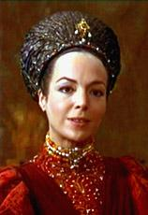
Characters
LADY CAPULET
LADY CAPULET
INTRODUCTION
Lady Capulet is Juliet’s mother, however she acts in an ​unconventional​ way. Instead of having a close, maternal relationship with her daughter their relationship is ​tense​ and ​formal​. Perhaps their strained relationship serves to ​highlight the differences between the two female characters.
Lady Capulet wishes for Juliet to marry Paris, and conforms heavily to the ongoing conflict between the two families.
CHARACTER IN CONTEXT
● Traditional Elizabethan woman:​ in wealthier families, the mother was not expected to care for or have a large role in raising their children; instead, families would employ a nurse to look after their sons and daughters. This is reflected in the character of Lady Capulet, who appears to act ​coldly​ towards her daughter. It was also usual for Elizabethan women to marry and give birth young - it is revealed that Lady Capulet herself was only fourteen when she gave birth to Juliet. This is why she tries to pressure Juliet into marrying Paris so young.
KEY CHARACTERISTICS
● Self-Centred - ​instead of listening to Juliet's concerns for marrying Paris, Lady Capulet focuses on how their marriage will help the family’s image.
● Unloving -​ Lady Capulet appears to neglect her daughter’s feelings and refuses to love her in a maternal sense.
● Materialistic - ​Lady Capulet is concerned with the material gain she will obtain once Juliet has married Paris. She values her status over Juliet's happiness. She only forgives her daughter when Juliet's decides to marry Paris to appease her and her father.
RELATIONSHIPS
Juliet | ​Their relationship is essentially​ non-existent​. The only time in which the audience sees an exchange between the mother and daughter is when Lady Capulet ​must ​talk to her daughter or is​ sent by her husband​ to talk to her. Lady Capulet and Juliet are also ​opposites ​of each other; everything that Lady Capulet wants, Juliet does not. While her mother was married and with a child at Juliet’s age, Juliet is not even​ “dream(ing)” ​ of it which suggests that Juliet is an independent woman. However, it could be argued that the way in which Juliet becomes infatuated ​with a man at a young age shows her to be ​more like her mother​ than previously thought. Lord Capulet​ | It appears that Lady Capulet is fearful of her husband, demonstrated when she refuses to tell him that Juliet does not wish to marry Paris. She fears his reaction.

Slide 37
LADY CAPULET QUOTE BANK
As you study the quotations, underline or highlight any key parts of the analysis. If you’re stuck with any of the terms consult the glossary at the end of the booklet. You can also email/ask your teacher.
These pages will help you write your essays!
REMEMBER THE TIPS FROM ROMEO’S QUOTATION BANK
Quote | Analysis
“Here comes your father; tell him so yourself, And see how he will take it at your hands.” (A3S5) | Here, it could be interpreted that Lady Capulet fears Lord Capulet, so encourages her daughter to tell him herself that she no longer wishes to marry Paris. This portrays her as a weak character who cares more for herself than her daughter, further demonstrating the distanced relationship between Juliet and her mother. This distance is suggested through the ​repeated​ use of the ​pronoun​ ​“your”.
"Talk not to me, for I'll not speak a word, Do as thou wilt, for I have done with thee." (A3S5) | Again, the major separation between mother and daughter is heavily implied here. It shows the unemotional address that Lady Capulet utilises when conversing with her daughter - but again, this may be seen as common practice to a contemporary audience.
“We will have vengeance for it." (A3S5) | This comes after the Capulets find out about Tybalt’s death - Lady Capulet is an unforgiving character who desires revenge.
”Nurse, come back again.” ​ (A1S3) | This implies how she is unable to look after her own daughter, relying on staff to do this for her. This may show how she is an incapable character, but also demonstrates her as a stereotypical (wealthy) Elizabethan woman
Create a character map.

Slide 38
Characters
LORD CAPULET
Lord Capulet
INTRODUCTION
Lord Capulet is arguably a ​product of his time because he displays the characteristics of a typical ​patriarch​. In this way, an Elizabethan audience may view Lord Capulet as a ​good father​ as he only tries to protect Juliet by arranging a marriage for her.
It’s important you consider Lord Capulet from the views of a ​contemporary​ vs a ​modern day audience.
➔ This sort of possessive behaviour would not have been shocking to Shakespeare’s Elizabethan audience as women were merely seen as property to their fathers.
➔ Yet, to Shakespeare’s ​modern​ ​audience, Lord Capulet’s possessive and abusive behaviour would perhaps stir up a sense of​ ​injustice​. His patriarchal attitudes and foul treatment towards Juliet would be viewed with outrage as ​gender equality​ has become increasingly important in most parts of the world. Therefore, some individuals would view Capulet as a terrible father, but both sides could be argued. He could be seen as a good father as he attempts to protect her by arranging a marriage which he deems suitable and beneficial for Juliet. However, the way he treats Juliet in trying to get her to do what he wants would be cringeworthy for a modern audience.
CHARACTER IN CONTEXT
● Family honour - ​During the Elizabethan era ​family honour​ was extremely important to many individuals which Shakespeare portrays through the Montague versus Capulet feud. Each family member stays loyal to each other by fighting against members of the other family and protecting their own. It is possible that Shakespeare employs Romeo and Juliet’s suicide to reveal to the audience the possible dangers of allowing family honour to consume an individual. Yet it is only through Romeo and Juliet’s death that Lord Capulet decides to settle the feud between both families, thus their death was essential to the change of Lord Capulet’s views.
● The treatment of women​ ​– ​As aforementioned, Capulet is extremely abusive and oppresses Juliet throughout the whole play. Yet this wouldn’t have been surprising to an Elizabethan audience as men were expected to follow the rules of patriarchy to prevent women from threatening the rigid social order in society. to tell him that Juliet does not wish to marry Paris. She fears his reaction.
KEY CHARACTERISTICS & CHARACTER DEVELOPMENT
● PATRIARCHAL ​– From the very outset of the play, it becomes clear that Lord Capulet is a ​product of his time​. It isn't surprising that he oppresses Juliet and disregards her views as women were meant to be ruled by men. An Elizabethan daughter was nothing other than the ​property of her father​, until she got married and became the property of her husband, and thus she was expected to abide by his every command.

Slide 39
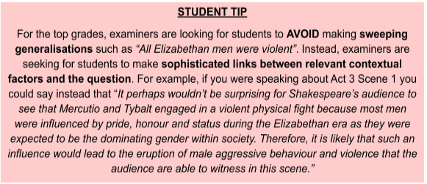
CONFLICTED ​– Throughout the play, the audience may be conflicted as to whether or not they view Lord Capulet as a ​good or a bad father​. As the play progresses he becomes increasingly controlling and abusive. This is because,​ ​at the beginning of the play, although Lord Capulet may come across as overly possessive of Juliet, yet as the play progresses and Juliet continues to disobey her father, he becomes ​increasingly abusive​ and cruel towards her, even wishing ​death​ upon her, which enforces the impression that he is a bad father. Yet, at the ending of the play, Capulet is distraught at his daughter’s death and even reconciles with the Montague family, ending the family feud despite cursing them throughout the whole play. Therefore, Lord Capulet is portrayed by Shakespeare as a character that is ​complex ​as his actions, especially toward Juliet, ​fluctuate ​as the play continues.
ABUSIVE​ – At the start of the play, the audience are able to witness Lord Capulet’s possessiveness over Juliet, yet it does not come across as abusive until the play progresses. Lord Capulet becomes ​increasingly abusive​ towards Juliet as she continuously disobeys his orders and pursues a passionate romance with Romeo, refusing to marry Paris. Arguably, Lord Capulet is most abusive in ​Act 3 Scene 5 ​where he wishes death upon his own daughter, and states that he will never again acknowledge her, poor Juliet!
RELATIONSHIPS BETWEEN OTHER CHARACTERS
Juliet​ | Lord Capulet and Juliet share a ​volatile​ bond. There is certainly a correlation between Juliet’s continuous disobedience and Lord Capulet’s rising manipulation. At the beginning of the play, Lord Capulet can be seen as a ​protective father​ who wishes to shield his child from the dangers of the world. Yet, as the play progresses, Lord Capulet becomes increasingly controlling and abusive towards Juliet as she continues to disobey him, and thus, their relationship disintegrates. Lord Capulet only conveys his love for Juliet when he realises that she has committed suicide.
Lord Montague ​| Lord Capulet and Lord Montague share a chaotic​ ​bond, which is due to the feud between both families. At the beginning of the play, both Capulet and Montague ​despise each other, whereby their shared hatred becomes ​increasingly potent​ as the play progresses. Yet, at the ​dramatic climax of the play​ when Romeo and Juliet commit suicide, both fathers realise the damage that the family feud had really caused. Thus, at the end of the play, both Capulet and Montague share their grief and sympathise with each other, agreeing to put a halt to their disagreements and therefore their relationship becomes one that is surprisingly understanding​ and ​peaceful​.

Slide 40
LORD CAPULET QUOTE BANK
As you study the quotations, underline or highlight any key parts of the analysis. If you’re stuck with any of the terms consult the glossary at the end of the booklet. You can also email/ask your teacher.
These pages will help you write your essays!
REMEMBER THE TIPS FROM ROMEO’S QUOTATION BANK
Quote | Analysis
“O brother Montague, give me thy hand.” Act 5 Scene 3 | At the ​dramatic climax​ of the play where both the Montagues and Capulets become to know of Romeo and Juliet’s death, the feud between both families seems to be settled which was first ​foreshadowed​ in the prologue.
“My child is yet a stranger in the world.” Act 2 Scene 1 | The ​personal pronoun​ ​“my” ​ emphasises Lord Capulet’s possessiveness over Juliet. Furthermore, the fact that he doesn’t mention Juliet’s name but rather calls him his ​“child” ​ further reinforces the impression of possessiveness; one could argue that Lord Capulet merely views his daughter as his own property and possession as this is what was expected of him living in a ​patriarchal society​. On the other hand, his ​possessive language​ ​could be employed by Shakespeare as an expression of Capulet’s love and concern for his child. Thus, this quote may not be just an expression of his possessiveness and authority, but rather it could alternatively show the audience how Capulet actually cares for his child and is willing to protect him from the dangers of the ​“world” ​ .
“Disobedient wretch!” Act 3 Scene 1 | This ​epithet​ created through the ​adjective​ ​“Disobedient” ​ used to describe Juliet illuminates how cruelly Juliet is treated by her father and further reinforces the impression that he views Juliet as mere property.
“Hang, beg, starve, die in the streets, for by my soul I’ll ne’er acknowledge thee” Act 3 Scene 5 | The ​asyndetic listing​ here emphasises the idea that Capulet is becoming increasingly erratic and distraught as Juliet continues to disobey him. The harsh terms “​hang” “beg”, “starve” ​ , and ​“die” ​ agglomerate to create a ​semantic field of death​ ​which further reinforces the impression that Capulet is a bad father and is concerned more by ​reputation​ and ​honour than he is concerned for his own daughter’s life. Particularly, the term “hang” ​ would have perhaps shocked the Elizabethan audience because a hanging only usually occurred in the case where a crime had been committed. In this way, it is as if Lord Capulet views Juliet as a criminal for going against his orders, which again reinforces the impression that Juliet is trapped by the patriarchal, abusive views of her father.

Slide 41
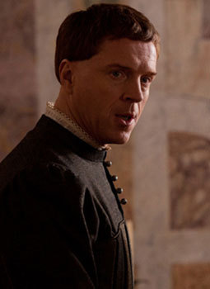
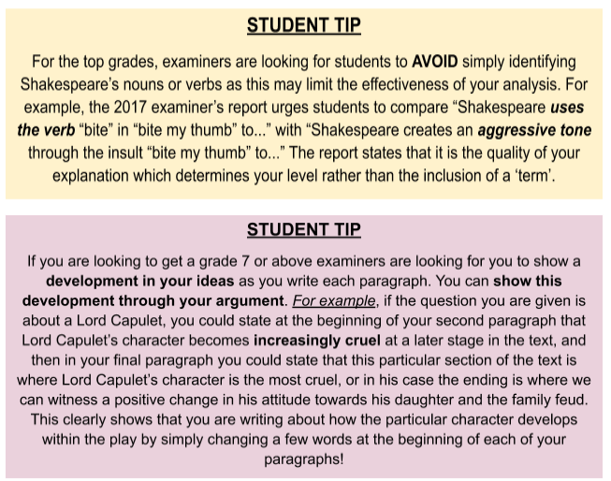
Create a character map.

Slide 42
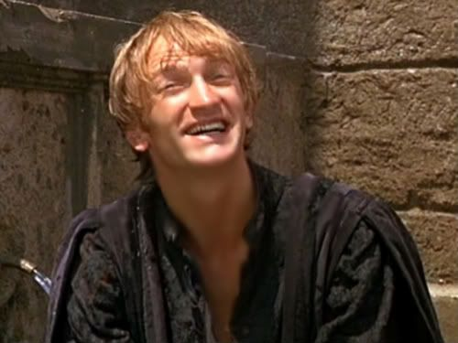
Characters - MERCUTIO
INTRODUCTION
Mercutio’s character not only encapsulates the​ ​comedic relief​ ​in Romeo and Juliet, but Shakespeare also employs him to ​contrast the views of many of the other characters. The ​critic​ Stephen Greenblatt describes Mercutio as a ​“force within the play that functions to deflate the possibility of romantic love and the power of tragic fate” ​ . From this perspective, Shakespeare has perhaps implemented the character of Mercutio to provide a ​realistic​ yet harsh view of love to his audience as his opinions harshly ​juxtapose​ the potent, tender love that Romeo and Juliet share.
However, although Mercutio provides Shakespeare’s audience with a rough view of love that is not controlled by fate but rather sexual impulsion, it is clear that Mercutio’s views do not completely dampen the potent theme of love within the play. Romeo and Juliet continue to pursue their romance, and it can be argued that they die together due to fate despite Mercutio’s suggestion that fate is of no importance.
CHARACTER IN CONTEXT
● Family Honour - ​During the Elizabethan era ​family honour​ was extremely important to many individuals. Shakespeare portrays this through the Montague versus Capulet feud, whereby each family stays loyal to each other by fighting against members of the other family and protecting their own. Yet, Mercutio disregards the idea of ‘family honour’ as he blames the feud between both families for his tragic death; thus, Mercutio’s death and final words ​(“A plague o’ both your houses. They have made worms’ meat of me.”) perhaps reveal to Shakespeare’s audience the possible ​dangers​ of allowing family honour to consume an individual. Through Mercutio’s death, he shows that an obsession with family honour can tragically lead to impulsive murder.
● Courtly love - ​Mercutio is well known for his explicit speeches about ​sexual desire​ and his emotionless views of love. Therefore, he completely contradicts the Elizabethan idea of courtly love, which was meant to be ​true, pure and full of restraint​. ​Instead, he clearly suggests that love is based off of sex and nothing more.
● Religion - ​R​religion was ​central​ to Elizabethan life, yet it seems as if Mercutio’s crude and sexual views on love contradict Catholic and Protestant religious teachings. This means his explicit views almost come across as ​blasphemous​.
KEY CHARACTERISTICS & CHARACTER DEVELOPMENT
● VIOLENT​ – From the outset, Shakespeare presents Mercutio as violent as he exerts an aggressive tone​ throughout many of his speeches. This can be witnessed through examining the way in which Mercutio speaks about love in a rough​ ​way (look at his quote bank on the last page) and mocks Romeo for being ​“effeminate” ​ for not wanting to battle with Tybalt in ​Act 3 Scene 1​. It is through Mercutio’s aggressive view of love and act of physical violence against Tybalt​ ​that the audience are reminded that despite the large emphasis on love and romance, Romeo and Juliet​ ​ is set in an era that was ​dominated by males​, and thus the plot was destined to be plagued by male aggressive behaviour due to their fixation with ​pride, respect and status​.

Slide 43
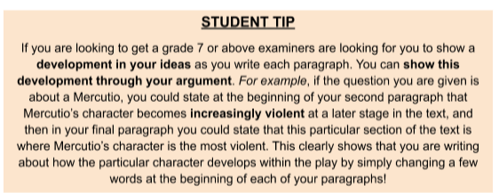
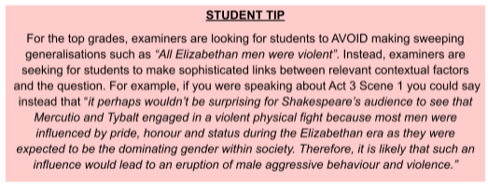
● CYNICAL ​– Mercutio’s views become increasingly cynical​ as the play progresses. He views love as something that is purely based on sexual desire and mocks Romeo for the way that he fantasises about true love.
● UNCONVENTIONAL​ – Throughout the play, Mercutio consistently goes against the conventions formed by not only the Elizabethan era, but also by the other characters in the play. For example, despite the fact that most of the other characters believe in ​fate and ​true love​, Mercutio goes against these ideas by broadcasting his own views on love and suggesting before death that it was the family feud that had led to his death and not fate.
RELATIONSHIPS BETWEEN OTHER CHARACTERS
The Nurse​ | Although Mercutio and the Nurse do not share a ​direct relationship​, it is interesting to note the ​similarities​ in their views on love (refer to the Nurse’s character profile and jot down any similarities between her and Mercutio’s views in regard to love and relationships).
Romeo​ | Romeo and Mercutio share a ​strong bond​, and thus it is the breaking of this bond that acts as a ​catalyst​ for Romeo’s violent behaviour. It is after Mercutio’s death that Romeo kills Tybalt which leads to Romeo’s banishment.
Tybalt​ | Mercutio and Tybalt share a brief but chaotic relationship that is extremely significant to Shakespeare’s plot. Their main encounter is in Act 3 Scene 1 where Mercutio and Tybalt sword fight, leading to Mercutio’s death. Their relationship is significant as their dislike for each other stems from the fact that Mercutio is associated with Romeo, a Montague. Whilst Tybalt is a Capulet and thus, they cannot be civil with each other. Through this, Shakespeare reveals how tragically futile this family feud is as it leads to the death of not only Mercutio, but the feud causes a plethora of deaths throughout the whole play which is why Mercutio curses both families before he falls to his demise.

Slide 44
MERCUTIO QUOTE BANK
As you study the quotations, underline or highlight any key parts of the analysis. If you’re stuck with any of the terms consult the glossary at the end of the booklet. You can also email/ask your teacher.
These pages will help you write your essays!
REMEMBER THE TIPS FROM ROMEO’S QUOTATION BANK
Quote | Analysis
“A plague o’ both your houses. They have made worms’ meat of me.” Act 3 Scene 1 | The first sentence is repeated twice within Act 3 Scene 1. Thus, the repetition​ of this phrase enforces the impression that Mercutio, unlike the majority of characters within the play, completely disregards fate. Rather, he instils his opinion that it was the pointless feud between the two families that had caused his death. Mercutio describes his death in ​euphemistic​ terms (​a euphemism being ​ a mild or indirect word or expression substituted for one considered to be too harsh or blunt when referring to something unpleasant ​ ) as he does not actually say that Tybalt had murdered him but rather suggests that he had made a ​“worms’ meat”
“If love be rough with you, be rough with love. Prick love for pricking, and you beat love down” Act 1 Scene 3 | The ​plosive lexis​ (​lexis being a fancy word for ‘group of words’ in this case the words “be”, “prick”, “pricking” and “beat” agglomerate to create a succession of harsh sounds ​ ) reinforces the impression of Mercutio’s harsh, and raw perception of love because this almost suggests that he views love making as a violent action. The ​violent verbs​ ​“prick” ​ and ​“pricking” ​ create ​phallic imagery​, which shows Shakespeare’s audience how he views love as purely sexual, whilst this also depicts the dominance that men were supposed to have over women within an Elizabethan relationship. The ​symmetry of the sentence structure​ here, as both sentences are split in half by the implementation of a comma, contrasts Mercutio’s opinion of love. This is because the ​symmetry​ makes it seem as if love is very complete and perfect, which is not what Mercutio believes. Yet, his harsh opinions completely contrast Romeo and Juliet’s pure and tender expression of love
“I conjure thee by Rosaline's bright eyes, By her high forehead and her scarlet lip, By her fine foot, straight leg, and quivering thigh” Act 2 Scene 1 | Mercutio’s ​listing​ of Rosaline’s body parts alludes to the popular poetic ‘blazon’ technique​. This listing of body parts reinforces the impression of Mercutio’s sexual and primitive view of love as he again creates ​sexual imagery​ through his speech.

Slide 45
“O Romeo, that she were, O, that she were An open-arse, thou a poperin pear!” Act 2 Scene 1 | Again, the ​plosive lexis​ ​created through the mentioning of ​“poperin pear!” ​ reinforces the impression that Mercutio views love in a harsh and rough way. To build upon this, the mention of ​“poperin pear!” ​ creates more sexual imagery​ (not surprising from Mercutio) as this was a fruit that was often at the time compared to a woman's genitalia. Thus, Mercutio believes that love is based on sexual desire and not true affection.
“O calm, dishonourable, vile submission!” Act 3 Scene 1 | ​The ​tricolon​ here creates a ​lexicon of fragility​ (lexicon being another fancy word for saying ‘group of words’) which emphasises Romeo’s effeminate inability to fight, whilst exaggerating Mercutio’s male aggressive behaviour.
Create a character map.

Slide 46
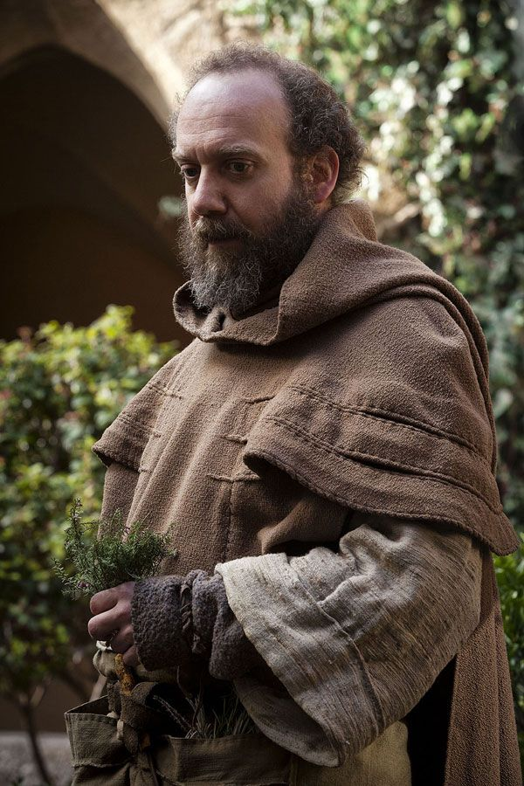
Characters - FRIAR LAWRENCE
FRIAR LAWRENCE
INTRODUCTION
The Friar ​enables​ and ​facilitates​ most of the action within the play; he marries Romeo and Juliet, and also helps Juliet devise the plan to ‘reunite’ with Romeo after she is instructed to marry Paris.
CHARACTER IN CONTEXT
● Religion -​ Although many of the characters use religious imagery, the Friar is the only character who​ presents religion​ in the play. Thus religion is portrayed as a rational and peaceful presence. Arguably though, Friar causes the death of the young lovers by helping Juliet stage her suicide - which could be an interpretation on the ​dangers of religion​ if not kept in check. Alternatively, it could suggest the polluting of religion which occurs when conflict (such as from the two families) arises.
KEY CHARACTERISTICS
● POLITICAL / SCHEMING - ​He intentionally marries Romeo and Juliet with the intention of ending the ​civil tension​ which was occurring between the Montagues and Capulets. This demonstrates that whilst he is neutral in stance within the conflict between the two families, he has an ​agenda​ of his own. This means when he helps Romeo and Juliet it isn’t solely with the intention of helping two young lovers be united, instead he also wants to bring the two families back together.
● TRUSTED - ​Both the characters Romeo and Juliet frequently ​seek guidance​ throughout the play. This suggests that the Friar is a ​neutral figure​ between the two families and therefore can offer ​rational​ and ​unbiased​ help. However, the Friar does have an agenda - ending the civil strife in Verona. This means that though unintentional, his wish to end the conflict leads to the young lovers death. In this respect, he is to be trusted but is not wholly neutral.
● WISE - ​When Romeo reveals to the Friar that he wants to pursue Juliet instead of Rosaline, the Friar questions this sudden change. He is also shown to be a figure the two principal characters always turn to for ​wisdom​. This may demonstrate his age or prowess in the realm of religion and the Church aggressive behaviour due to their fixation with ​pride, respect and status​.
RELATIONSHIPS
Romeo |​ The Friar acts as a ​father figure​ for Romeo. The Friar uses Romeo’s relationship with Juliet to try and end the conflict occurring between the two families.
Juliet |​ The Friar helps Juliet come up with the plan to reunite with Romeo by pretending to commit suicide - however that backfires, and because of this, he unintentionally kills Juliet.

Slide 47
FRIAR LAWRENCE QUOTE BANK
As you study the quotations, underline or highlight any key parts of the analysis. If you’re stuck with any of the terms consult the glossary at the end of the booklet. You can also email/ask your teacher.
These pages will help you write your essays!
REMEMBER THE TIPS FROM ROMEO’S QUOTATION BANK
Quote | Analysis
“Within the infant rind of this small flower/ Poison hath residence, and medicine power” (A2S3) | By referencing ​nature​, the Friar is revealing to the audience that there are positive and negative sides to everything, because plants can be used for both healing and poisonous purposes. This can be likened to the situation between the Capulets and Montagues; within opposition, Romeo and Juliet are still able to fall in love. It foreshadows the ending of the play
“For this alliance may so happy prove, // To turn your households’ rancor to pure love.” (A2S4) | This quote displays the Friar’s good intentions, however in the end of the play he is proved wrong, as it is in fact the death of the two lovers which unites the Montagues and Capulets, instead of their marriage.
“For by your leaves, you shall not stay alone, Til Holy Church incorporate two in one.” (A2S4) | A major theme of the novels is the imagery and reference to pairings​, and naturally Romeo and Juliet’s relationship is the central pairing of the play. The phrase​ “incorporate two in one” reflects this ​semantic field​ of pairings, and suggests that the Friar is a ​key motivator​ in their relationship.

Slide 48
Paris
Juliet’s family expect her to marry Paris in order to gain status and wealth.
In the first act, Paris asks Lord Capulet if he can be her husband and the father of her children, but Lord Capulet tells him to wait until Juliet is older.
However, later in the play, when Lord Capulet wants Juliet to marry Paris, she refuses and ends up getting beaten by her father. Paris sees her body as she is ‘laid to rest’ - he claims he still loves her. In the end, he dies in a duel with Romeo, and Paris is dragged to lay to rest beside Juliet’s body.
Paris is a figure who demonstrates the power a woman’s father and partner has over her in the Elizabethan era. If a member of the aristocracy, the father’s role is to find a wealthy suitor for his daughter, and Paris is this suitor. He is also a powerful complication in the pair’s relationship.
Lord & Lady Montague
Whilst they are minor characters in the play, these two do a lot to produce conflict between the Capulets, their rival family in Verona. It is revealed at the end of the play that Lady Montague dies out of grief for her dead son: ​“grief of my own son’s exile hath stopp’d her breath”. Lord Montague is also shown to be a very caring father -​ ​ "Could we but learn from whence his sorrows grow" ​ . This juxtaposes the Capulets’ attitude towards their daughter, who are more distanced and neglectful.
Benvolio
He is Lord and Lady Montague’s cousin, and therefore Romeo’s cousin. He and Romeo are incredibly close, and he serves as a very loyal character; throughout the play he is trying to diffuse conflict. For example, in the first scene of the play, he says: ​“I do but keep the peace: put up thy sword // or manage it to part these men with me” ​ . This shows that he doesn’t like to participate in the tension between the two families. He is also critical of fighting later in the play, when in act three he says: ​“An I were so apt to quarrel as thou art, any man // should Buy the fee-simple of my life for an hour and a quarter” ​ , comparing his lack of participation in conflict to Romeo. He speaks with possession regarding Romeo - “Romeo! My cousin Romeo!” - which shows he’s proud of his cousin.
Tybalt
He is Juliet’s cousin, who engages in the physical conflict between the two families. He seems to enjoy fighting, and this comes to destroy him in the end as he dies during a physical altercation with Mercutio, a Montague. He kills Mercutio, and Romeo kills him in revenge. At this point, it is revealed that Tybalt is Juliet’s first cousin - Lady Capulet cries ​“Tybalt, my cousin, O my brother’s child!”.
Tybalt hates the Montagues intensely - he exclaims in the first scene ​“What, drawn, and talk of peace! I hate the word, // As I hate hell, all Montagues, and thee ​ ”. This is his main role in the play - to provoke conflict which moves the narrative of the play onwards. He specifically hates Romeo - stating in the third act: ​“Romeo, the hate I bear thee can afford // No better term than this,—thou art a villain.”

Slide 49
THE NURSE
The Nurse's key function within the play is to act as a go-between for Romeo and Juliet, and is the only other character besides Friar Laurence to know of their wedding. The Nurse, despite being a servant in the Capulet household, has a role equivalent to that of Juliet's mother and regards Juliet as her own daughter. Juliet's frustration at having to rely upon the Nurse as her messenger is used to comic effect in Act II, Scene 5, when Juliet is forced to listen to the Nurse's ailments while trying to coax from her the news of her wedding plans. The Nurse, like Mercutio, loves to talk at length. She often repeats herself, and her bawdy references to the sexual aspect of love set the idealistic love of Romeo and Juliet apart from the love described by other characters in the play. The Nurse doesn't share Juliet's idea of love; for her, love is a temporary and physical relationship, so she can't understand the intense and spiritual love Romeo and Juliet share. When the Nurse brings Juliet news of Romeo's wedding arrangements, she focuses on the pleasures of Juliet's wedding night, "I am the drudge, and toil in your delight, / But you shall bear the burden soon at night" (II.5.75-76).
This clash in outlook manifests itself when she advises Juliet to forget the banished Romeo and marry Paris, betraying Juliet's trust by advocating a false marriage:
I think it best you married with the County.
O, he's a lovely gentleman.
Romeo's a dishclout to him.
(III.5.218-220)
Juliet can't believe that the Nurse offers such a course of action after she praised Romeo and helped bring the couple together. The Nurse is ultimately subject to the whims of society. Her social position places her in the serving class — she is not empowered to create change around her. Her maternal instinct toward Juliet buoys her to aid Juliet in marrying Romeo; however, when Capulet becomes enraged, the Nurse retreats quickly into submission and urges Juliet to forget Romeo.
Your summary
Write your own summary of each character. Use sophisticated phrasing and vocabulary from your reading. Challenge: consider, writer’s intention, context and quotations. Continue on paper if necessary.
ROMEO

Slide 50
JULIET

Slide 51
Lady Capulet
Lord Capulet
Mercutio
Friar Lawrence

Slide 52
The Nurse
Tybalt
Benvolio
Paris

Slide 53
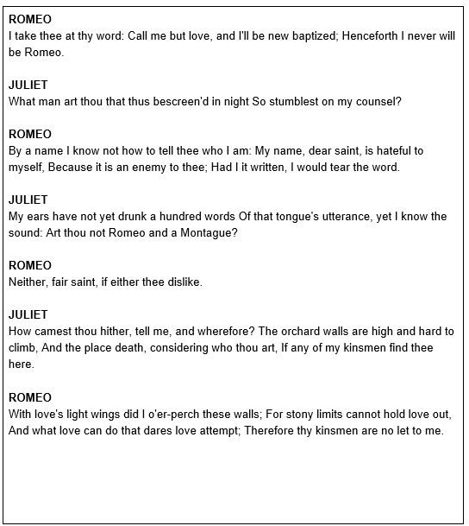
Romeo mock question
Annotate and plan your response first. Your essay can be handwritten or typed and then it can be emailed to your teacher or shared via google classroom for feedback.

Slide 54
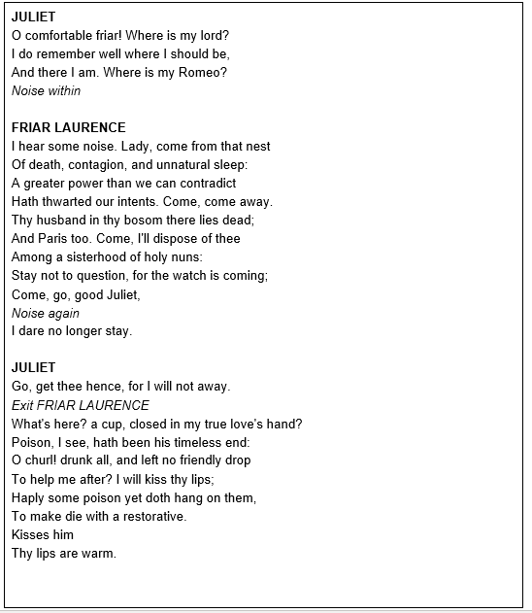
Juliet mock question
Annotate and plan your response first. Your essay can be handwritten or typed and then it can be emailed to your teacher or shared via google classroom for feedback.

Slide 55
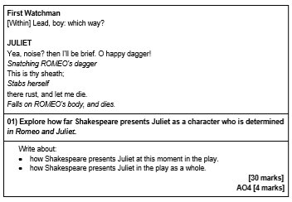
Juliet mock question
Annotate and plan your response first. Your essay can be handwritten or typed and then it can be emailed to your teacher or shared via google classroom for feedback.

Slide 56
Friar Lawrence mock question
FRIAR LAURENCE Be plain, good son, and homely in thy drift; Riddling confession finds but riddling shrift. ROMEO Then plainly know my heart's dear love is set On the fair daughter of rich Capulet: As mine on hers, so hers is set on mine; And all combined, save what thou must combine By holy marriage: when and where and how We met, we woo'd and made exchange of vow, I'll tell thee as we pass; but this I pray, That thou consent to marry us to-day. FRIAR LAURENCE Holy Saint Francis, what a change is here! Is Rosaline, whom thou didst love so dear, So soon forsaken? young men's love then lies Not truly in their hearts, but in their eyes. Jesu Maria, what a deal of brine Hath wash'd thy sallow cheeks for Rosaline! How much salt water thrown away in waste, To season love, that of it doth not taste! The sun not yet thy sighs from heaven clears, Thy old groans ring yet in my ancient ears; Lo, here upon thy cheek the stain doth sit Of an old tear that is not wash'd off yet: If e'er thou wast thyself and these woes thine, Thou and these woes were all for Rosaline: And art thou changed? pronounce this sentence then, Women may fall, when there's no strength in men.
Annotate and plan your response first. Your essay can be handwritten or typed and then it can be emailed to your teacher or shared via google classroom for feedback.

Slide 57
Friar Lawrence mock question
ROMEO Thou chid'st me oft for loving Rosaline. FRIAR LAURENCE For doting, not for loving, pupil mine.
01) Explore how far Shakespeare presents Friar Lawrence as an advisor to Romeo in Romeo and Juliet.
Write about: how Shakespeare presents Friar Lawrence at this moment in the play. how Shakespeare presents Friar Lawrence in the play as a whole. [30 marks] AO4 [4 marks]
Annotate and plan your response first. Your essay can be handwritten or typed and then it can be emailed to your teacher or shared via google classroom for feedback.

Slide 58
Benvolio mock question
A public place. Enter MERCUTIO, BENVOLIO, Page, and Servants BENVOLIO I pray thee, good Mercutio, let's retire: The day is hot, the Capulets abroad, And, if we meet, we shall not scape a brawl; For now, these hot days, is the mad blood stirring. MERCUTIO Thou art like one of those fellows that when he enters the confines of a tavern claps me his sword upon the table and says 'God send me no need of thee!' and, by the operation of the second cup, draws it on the drawer, when indeed there is no need. BENVOLIO Am I like such a fellow? MERCUTIO Come, come, thou art as hot a Jack in thy mood as any in Italy, and as soon moved to be moody, and as soon moody to be moved. BENVOLIO And what to?
01) Explore how far Shakespeare presents Benvolio as a peacemaker in Romeo and Juliet.
Write about: How Shakespeare presents Benvolio at this moment in the play. How Shakespeare presents Benvolio in the play as a whole. [30 marks] AO4 [4 marks]
Annotate and plan your response first. Your essay can be handwritten or typed and then it can be emailed to your teacher or shared via google classroom for feedback.

Slide 59
Lord Capulet mock question
CAPULET How now, how now, chop-logic! What is this? 'Proud,' and 'I thank you,' and 'I thank you not;' And yet 'not proud,' mistress minion, you, Thank me no thankings, nor, proud me no prouds, But fettle your fine joints 'gainst Thursday next, To go with Paris to Saint Peter's Church, Or I will drag thee on a hurdle thither. Out, you green-sickness carrion! out, you baggage! You tallow-face! LADY CAPULET Fie, fie! what, are you mad? JULIET Good father, I beseech you on my knees, Hear me with patience but to speak a word. CAPULET Hang thee, young baggage! disobedient wretch! I tell thee what: get thee to church o' Thursday, Or never after look me in the face: Speak not, reply not, do not answer me; My fingers itch. Wife, we scarce thought us blest That God had lent us but this only child; But now I see this one is one too much, And that we have a curse in having her: Out on her, hilding!
01) Explore how far Shakespeare presents Lord Capulet as protective in Romeo and Juliet.
Write about: how Shakespeare presents Lord Capulet at this moment in the play. how Shakespeare presents Lord Capulet in the play as a whole. [30 marks] AO4 [4 marks]
Annotate and plan your response first. Your essay can be handwritten or typed and then it can be emailed to your teacher or shared via google classroom for feedback.

Slide 60
The Nurse mock question
A room in Capulet's house. Enter LADY CAPULET and Nurse LADY CAPULET Nurse, where's my daughter? call her forth to me. NURSE Now, by my maidenhead, at twelve year old, I bade her come. What, lamb! what, ladybird! God forbid! Where's this girl? What, Juliet! Enter JULIET JULIET How now! who calls? NURSE Your mother. JULIET Madam, I am here. What is your will? LADY CAPULET This is the matter:--Nurse, give leave awhile, We must talk in secret:--nurse, come back again; I have remember'd me, thou's hear our counsel. Thou know'st my daughter's of a pretty age. NURSE Faith, I can tell her age unto an hour. LADY CAPULET She's not fourteen.
Annotate and plan your response first. Your essay can be handwritten or typed and then it can be emailed to your teacher or shared via google classroom for feedback.

Slide 61
The Nurse mock question
NURSE I'll lay fourteen of my teeth,-- And yet, to my teeth be it spoken, I have but four-- She is not fourteen. How long is it now To Lammas-tide? LADY CAPULET A fortnight and odd days.
01) Explore how far Shakespeare presents the Nurse as a successful mother figure to Juliet in Romeo and Juliet.
Write about: How the Nurse is presented at this moment in the play. How the Nurse is presented in the play as a whole. [30 marks] AO4 [4 marks]
Annotate and plan your response first. Your essay can be handwritten or typed and then it can be emailed to your teacher or shared via google classroom for feedback.

Slide 62
Mercutio mock question
MERCUTIO You are a lover; borrow Cupid's wings, And soar with them above a common bound. ROMEO I am too sore enpierced with his shaft To soar with his light feathers, and so bound, I cannot bound a pitch above dull woe: Under love's heavy burden do I sink. MERCUTIO And, to sink in it, should you burden love; Too great oppression for a tender thing. ROMEO Is love a tender thing? it is too rough, Too rude, too boisterous, and it pricks like thorn. MERCUTIO If love be rough with you, be rough with love; Prick love for pricking, and you beat love down. Give me a case to put my visage in: A visor for a visor! what care I What curious eye doth quote deformities? Here are the beetle brows shall blush for me.
01) Explore how Shakespeare uses Mercutio to explore different perceptions on love in Romeo and Juliet.
Write about: How Mercutio is presented at this moment in the play. How Mercutio is presented in the play as a whole. [30 marks] AO4 [4 marks]
Annotate and plan your response first. Your essay can be handwritten or typed and then it can be emailed to your teacher or shared via google classroom for feedback.

Slide 63
Romeo & Mercutio mock question
Read the following extract from Act 3 Scene 1 of Romeo and Juliet and then answer the question that follows.
At this point in the play, Romeo, Mercutio and Benvolio have encountered the Capulet’s in a public area.
ROMEO I do protest, I never injured thee But love thee better than thou canst devise, Till thou shalt know the reason of my love: And so, good Capulet,--which name I tender As dearly as my own,--be satisfied. MERCUTIO O calm, dishonourable, vile submission! Alla stoccata carries it away. Draws Tybalt, you rat-catcher, will you walk? TYBALT What wouldst thou have with me? MERCUTIO Good king of cats, nothing but one of your nine lives; that I mean to make bold withal, and as you shall use me hereafter, drybeat the rest of the eight. Will you pluck your sword out of his pitcher by the ears? make haste, lest mine be about your ears ere it be out. TYBALT I am for you. Drawing ROMEO Gentle Mercutio, put thy rapier up. MERCUTIO Come, sir, your passado. They fight
01) Explore how far Shakespeare presents Romeo’s relationship with Mercutio as toxic in Romeo and Juliet.
Write about: how Shakespeare presents Romeo’s relationship with Mercutio at this moment in the play. how Shakespeare presents Romeo’s relationship with Mercutio in the play as a whole. [30 marks] AO4 [4 marks]
Annotate and plan your response first. Your essay can be handwritten or typed and then it can be emailed to your teacher or shared via google classroom for feedback.

Slide 64
Romeo & Juliet mock question
Read the following extract from Act 1 Scene 5 of Romeo and Juliet and then answer the question that follows.
At this point in the play, Romeo and Juliet have encountered for the very first time.
ROMEO [To JULIET] If I profane with my unworthiest hand This holy shrine, the gentle fine is this: My lips, two blushing pilgrims, ready stand To smooth that rough touch with a tender kiss. JULIET Good pilgrim, you do wrong your hand too much, Which mannerly devotion shows in this; For saints have hands that pilgrims' hands do touch, And palm to palm is holy palmers' kiss. ROMEO Have not saints lips, and holy palmers too? JULIET Ay, pilgrim, lips that they must use in prayer. ROMEO O, then, dear saint, let lips do what hands do; They pray, grant thou, lest faith turn to despair. JULIET Saints do not move, though grant for prayers' sake. ROMEO Then move not, while my prayer's effect I take. Thus from my lips, by yours, my sin is purged. JULIET Then have my lips the sin that they have took. ROMEO Sin from thy lips? O trespass sweetly urged! Give me my sin again.
01) Explore how far Shakespeare presents Romeo’s relationship with Juliet as impulsive in Romeo and Juliet.
Write about: how Shakespeare presents Romeo’s relationship with Juliet at this moment in the play. how Shakespeare presents Romeo’s relationship with Juliet in the play as a whole. [30 marks] AO4 [4 marks]
Annotate and plan your response first. Your essay can be handwritten or typed and then it can be emailed to your teacher or shared via google classroom for feedback.

Slide 65
Romeo & Friar Laurence mock question
Read the following extract from Act 2 Scene 3 of Romeo and Juliet and then answer the question that follows.
At this point in the play, Romeo has just left Juliet and makes his way to the Friar’s cell.
ROMEO Thou chid'st me oft for loving Rosaline. FRIAR LAURENCE For doting, not for loving, pupil mine. ROMEO And bad'st me bury love. FRIAR LAURENCE Not in a grave, To lay one in, another out to have. ROMEO I pray thee, chide not; she whom I love now Doth grace for grace and love for love allow; The other did not so. FRIAR LAURENCE O, she knew well Thy love did read by rote and could not spell. But come, young waverer, come, go with me, In one respect I'll thy assistant be; For this alliance may so happy prove, To turn your households' rancour to pure love. ROMEO O, let us hence; I stand on sudden haste. FRIAR LAURENCE Wisely and slow; they stumble that run fast. Exeunt
01) Explore how far Shakespeare presents Romeo’s relationship with the Friar as beneficial in Romeo and Juliet.
Write about: how Shakespeare presents Romeo’s relationship with the Friar at this moment in the play. how Shakespeare presents Romeo’s relationship with the Friar in the play as a whole. [30 marks] AO4 [4 marks]
Annotate and plan your response first. Your essay can be handwritten or typed and then it can be emailed to your teacher or shared via google classroom for feedback.

Slide 66
The Capulet & Montague households mock question
Read the following extract from Act 1 of Romeo and Juliet and then answer the question that follows.
At this point in the play, Shakespeare introduces his audience to the story of Romeo and Juliet.
PROLOGUE Two households, both alike in dignity, In fair Verona, where we lay our scene, From ancient grudge break to new mutiny, Where civil blood makes civil hands unclean. From forth the fatal loins of these two foes A pair of star-cross'd lovers take their life; Whose misadventured piteous overthrows Do with their death bury their parents' strife. The fearful passage of their death-mark'd love, And the continuance of their parents' rage, Which, but their children's end, nought could remove, Is now the two hours' traffic of our stage; The which if you with patient ears attend, What here shall miss, our toil shall strive to mend.
01) Explore how far Shakespeare presents the relationship between the Capulet household and the Montague household as harmful in Romeo and Juliet.
Write about: How Shakespeare presents the relationship between Capulets and Montagues at this moment in the play. How Shakespeare presents the relationship between Capulets and Montagues in the play as a whole. [30 marks] AO4 [4 marks]
Annotate and plan your response first. Your essay can be handwritten or typed and then it can be emailed to your teacher or shared via google classroom for feedback.

Slide 67
Romeo & Rosaline mock question
Read the following extract from Act 1 scene 1 of Romeo and Juliet and then answer the question that follows.
At this point in the play, Romeo speaks of Rosaline to Benvolio.
ROMEO Alas, that love, whose view is muffled still, Should, without eyes, see pathways to his will! Where shall we dine? O me! What fray was here? Yet tell me not, for I have heard it all. Here's much to do with hate, but more with love. Why, then, O brawling love! O loving hate! O any thing, of nothing first create! O heavy lightness! serious vanity! Mis-shapen chaos of well-seeming forms! Feather of lead, bright smoke, cold fire, sick health! Still-waking sleep, that is not what it is! This love feel I, that feel no love in this. Dost thou not laugh? BENVOLIO No, coz, I rather weep. ROMEO Good heart, at what? BENVOLIO At thy good heart's oppression.
01) Explore how far Shakespeare uses Romeo’s relationship with Rosaline to explore unrequited love in Romeo and Juliet.
Write about: how Shakespeare presents Romeo and Rosaline’s relationship at this moment in the play. how Shakespeare presents Romeo and Rosaline’s relationship in the play as a whole. [30 marks] AO4 [4 marks]
Annotate and plan your response first. Your essay can be handwritten or typed and then it can be emailed to your teacher or shared via google classroom for feedback.

Slide 68
Juliet & Lord Capulet mock question
Read the following extract from Act 3 Scene 5 of Romeo and Juliet and then answer the question that follows.
At this point in the play, Juliet has just told her father that she refuses to marry Paris.
CAPULET How now, how now, chop-logic! What is this? 'Proud,' and 'I thank you,' and 'I thank you not;' And yet 'not proud,' mistress minion, you, Thank me no thankings, nor, proud me no prouds, But fettle your fine joints 'gainst Thursday next, To go with Paris to Saint Peter's Church, Or I will drag thee on a hurdle thither. Out, you green-sickness carrion! out, you baggage! You tallow-face! LADY CAPULET Fie, fie! what, are you mad? JULIET Good father, I beseech you on my knees, Hear me with patience but to speak a word. CAPULET Hang thee, young baggage! disobedient wretch! I tell thee what: get thee to church o' Thursday, Or never after look me in the face: Speak not, reply not, do not answer me; My fingers itch. Wife, we scarce thought us blest That God had lent us but this only child; But now I see this one is one too much, And that we have a curse in having her: Out on her, hilding!
01) Explore how Shakespeare uses Juliet’s relationship with Lord Capulet to explore patriarchy in Romeo and Juliet.
Write about: How Juliet’s relationship with Lord Capulet is presented at this moment in the play. How Juliet’s relationship with Lord Capulet is presented in the play as a whole. [30 marks] AO4 [4 marks]
Annotate and plan your response first. Your essay can be handwritten or typed and then it can be emailed to your teacher or shared via google classroom for feedback.

Slide 69
Juliet & The Nurse mock question
Read the following extract from Act 2 Scene 5 of Romeo and Juliet and then answer the question that follows.
At this point in the play, the Nurse has just visited Romeo and is now conversing with Juliet.
Nurse O God's lady dear! Are you so hot? marry, come up, I trow; Is this the poultice for my aching bones? Henceforward do your messages yourself. JULIET Here's such a coil! come, what says Romeo? Nurse Have you got leave to go to shrift to-day? JULIET I have. Nurse Then hie you hence to Friar Laurence' cell; There stays a husband to make you a wife: Now comes the wanton blood up in your cheeks, They'll be in scarlet straight at any news. Hie you to church; I must another way, To fetch a ladder, by the which your love Must climb a bird's nest soon when it is dark: I am the drudge and toil in your delight, But you shall bear the burden soon at night. Go; I'll to dinner: hie you to the cell. JULIET Hie to high fortune! Honest nurse, farewell. Exeunt
01) Explore how far Shakespeare presents the Nurse’s relationship with Juliet as devoted in Romeo and Juliet.
Write about: How the Nurse’s relationship with Juliet is presented at this moment in the play. How the Nurse’s relationship with Juliet is presented in the play as a whole. [30 marks] AO4 [4 marks]
Annotate and plan your response first. Your essay can be handwritten or typed and then it can be emailed to your teacher or shared via google classroom for feedback.

Slide 70
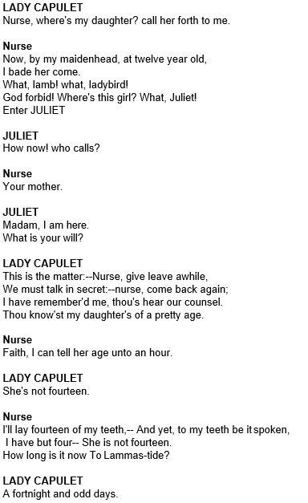
Juliet & Lady Capulet mock question
At this point in the play, Lady Capulet calls the Nurse in order to speak with her daughter.
Read the following extract from Act 1 Scene 3 of Romeo and Juliet and then answer the question that follows.
01) Explore how Shakespeare uses the relationship between Juliet and Lady Capulet to explore parenthood in Romeo and Juliet.
Write about:
How Juliet’s relationship with Lady Capulet is presented at this moment in the play.
How Juliet’s relationship with Lady Capulet is presented in the play as a whole.
[30 marks] AO4 [4 marks]
Annotate and plan your response first. Your essay can be handwritten or typed and then it can be emailed to your teacher or shared via google classroom for feedback.

Slide 71
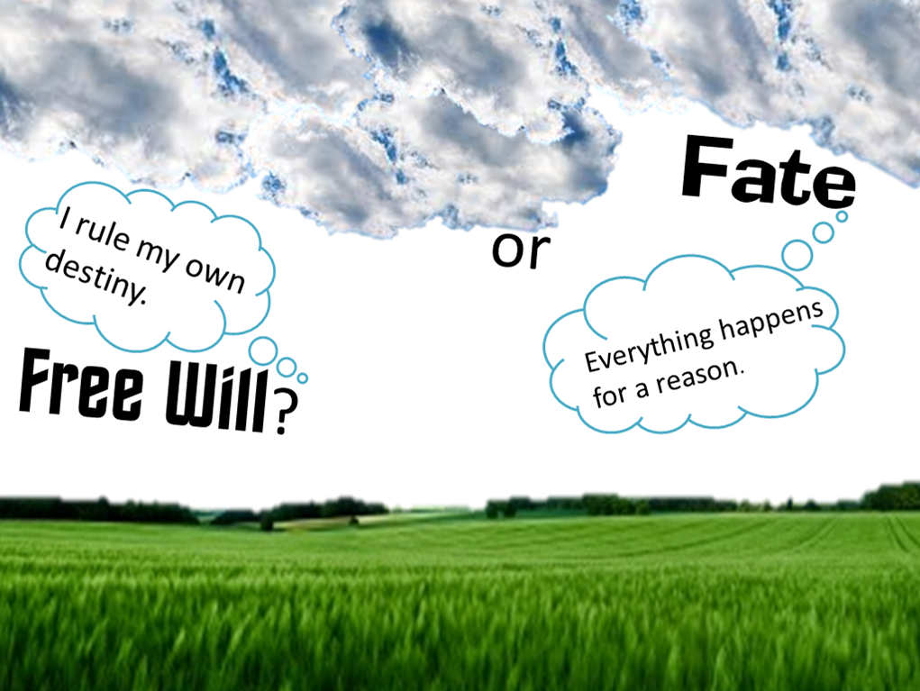
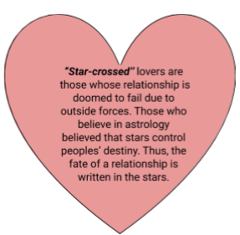
THEMES
FATE AND FREEWILL
Fate and Freewill
Fate is the concept that there are forces outside of human control which predetermine ​what happens in our lives, there’s nothing we can do to change what is happening to us now or what will happen to us in the future. Freewill is the exact ​antithesis (opposite) of this as it claims that there are no outside forces and all the actions we take are just a result of us exercising our own ​choices​. We therefore have the ability to change what happens to us in the future based on the choices we decide to make in the present.
Prologue
The ​prologue ​identifies a theme of fate as it tells the audience what is going to happen before it happens, this is a ​dramatic tool ​used to ​create tension​. Through telling the audience exactly what is going to happen at the beginning of the play, it is evident that the characters are unable to escape their impending doom. ​Thus, it is evident that fate is in control​. Shakespeare even tells the audience how long the story will be, referencing the ​“two hours’ traffic of our stage”. ​ This reference to the length of the play further increases the tension as the audience are in constant anticipation of the two protagonists.
The tension and anticipation is resolved when the prophecy is finally fulfilled. Here the emotions of the audience climax which result in ​catharsis​ (relieving of emotion).
Superstition
The ​Elizabethan era ​was a very ​superstitious time, many believed in concepts such as destiny and many believed that their lives were written in the stars. Through referring to the lovers as​“star-crossed” Shakespeare shows how even the planets have an opposition to this relationship. It could also show the audience that their love is different from others and how it has a spiritual connection.
The prologue is performed by the chorus (a group of people.) How would this strengthen the idea that the protagonists are not in control?

Slide 72
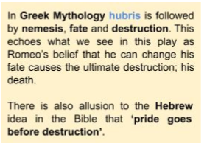
Act 1 Scene 4
Shakespeare uses ​Act 1 Scene 4 ​to expand on the idea of ​fate being a large factor in the events that take place within the play.
Between lines 106 and 113, Romeo uses a ​multitude of worrying abstract noun phrases such as ​“mind misgives” to build up anticipation to the dreadful events that take place later in the play. His talk of a consequence ​“hanging in the stars” ​echoes the ideas of two 'star-crossed” lovers ​ and reminds the audience of how the loves are in a way, doomed.
In this scene the Friar discusses the ​duality ​within flowers and other elements of nature, perhaps suggesting a coexistence between good and evil. By bringing in the ​natural imagery ​of the ​“baleful weeds” ​ and the ​“precious-juiced flowers” ​ , Shakespeare creates almost a sense of certainty in this coexistence.
This ​natural imagery further ties in with the themes of fate as the Friar discusses the natural and definite cycle of birth and death​.​He describes the​“burying grave that is [a mother's] womb” ​ , which ​foreshadows ​the death that comes up later in the play.
When Juliet thinks that Romeo is dead, instead of regarding the possible things on Earth that could have killed him she asks if “heaven [could] be so envious”. This shows that she could only think of the spiritual world as having the ability to intervene in their relationship. Once more Shakespeare is reminding the audience of fate, and how much of a role the spiritual world plays in this play.
Romeo’s belief that he can ​“defy the stars” shows his self-assured ​hubris ​(excessive pride) and belief that he is bigger than fate, destiny and the stars​. This allows his character to be defiant and arrogant.
Romeo’s death is further foreshadowed when Juliet compares Romeo’s love to ​“lightning”. Lightning has connotations of destruction and intensity which almost foreshadows the destruction ​that the love between Romeo and Juliet creates. Alternatively, it suggests the power and overwhelming and quick nature of their love.
Shakespeare then says that love ​“doth cease to be” , indicating that love has to have an end. Here, Shakespeare fills this scene with the foreshadowing that the love between Romeo and Juliet will ​“cease to be”.
Freewill
Ideas of fate and destiny can be perceived as contradictory to the religious beliefs ​of the time. While many people were superstitious and believed in fate, many people were religious and believed that God gave humans free will to do as they please.
➔ Shakespeare uses this tension between the two beliefs to introduce a ​philosophical argument on ​freewill vs. predestination​: does anyone really have a choice in their life or is everything predetermined? Arguments for each side are explored through the play.

Slide 73
Although there is a great level of destiny involved in Romeo and Juliet love story, the two lovers also make conscious decisions which contribute to their tragic ending.
● In Act 2 scene 6 ​the Friar says “ ​these violent delights have violent ends” ​ which foreshadows the tragic ending of the lovers' story. It could be argued that this warning by the Friar ​foreshadows ​the end of the play and proves that fate is very much at work. However, Romeo and Juliet were giving multiple warnings like this one but still decided to follow their desires. It could therefore be argued as not being fate but as a result of teenagers following their own ​desires. Perhaps the power of Romeo and Juliet’s love is so powerful that forces like free will cannot even affect it. The Elizabethan audience was incredibly superstitious and would have been receptive to this belief, the concept of fate would have increased the ​tension ​and intrigue of the tragedy.
Shakespeare’s use of the sonnet form
The ​sonnet form is used throughout the play. Sonnets are poetry of love and Shakespeare’s use of the form adds to the romance of the two lovers’ growing romance. The form could also be used by Shakespeare because it has a very regular rhyme scheme and rhythm​. The regularity of the form adds to the theme of fate as through it the audience is able to anticipate the inevitable rhythmic timing.
By using this sonnet form in the prologue, which already introduces the element of foreshadowing​, Shakespeare could be reinforcing the idea that everything in the world is planned and predestined ​and that nothing we do is ever spontaneous because it is already written in the stars somewhere. This revelation can have one of two effects on the audience:
● The revelation could be ​comforting to the reader, filling them with a sense of hope that if things are meant to happen they will.
○ For example, in the love story of Romeo and Juliet despite so many things being in the way of their love (Romeo was ​infatuated ​with Rosaline, they come from feuding families, Juliet was about to be betrothed to Paris etc), they still wanted to be together. Here, love conquers all.
● The revelation could be unsettling to the audience as ​predestination ​would also mean that no one really has control of what they do and so free will as a concept doesn't really exist. The very concept of fate and destiny means that you could not change the course you are already on.
○ Romeo exclaims “I defy you stars” ​ , this phrase in itself is ​paradoxical ​as the stars by definition are​inevitable​. However, it reveals a lot about Romeo's character, as even though it is impossible to defy the stars Romeo is persistent.
Highlight or underline the key information on this page

Slide 74
“Romeo and Juliet were responsible for their own deaths” Explain why a student may agree with this statement and then explain why they may disagree.
Explain the effect of Shakespeare’s use of the sonnet form

Slide 75
QUIZ
FATE AND FREEWILL
Answer the questions below. These can be checked by somebody else in your household or self-assessed. (the answers are at the back.)
CHALLENGE – create your own quiz with answers and ask somebody to test you.
What is fate?
What is freewill?
What is the effect of the quotation ​“two hours’ traffic of our stage”?
What is catharsis?
Why does Shakespeare refer to the lovers as ‘star-crossed’? (2 effects)
What does the friar use in Act 1 Scene 4 to symbolise good vs evil?
When Juliet thinks that Romeo is dead, instead of regarding the possible things on Earth that could have killed him she asks if “heaven [could] be so envious”, what is the effect of this?
What does Juliet compare Romeo to that foreshadows his death?
How does the use of sonnet form add to theme of Fate?

Slide 76
THEMES GENDER ROLES
Gender is an important theme within Romeo and Juliet as it contributes to the characters and their development. However, it can still be a source of conflict as the characters do not always adhere to the roles which they are traditionally supposed to fulfil. It is important to note that even though the play is set in a patriarchal society which was oppressive to women, men also had their own social rules that they had to follow.
Masculinity and violence
The concept of masculinity is a key theme in Romeo Juliet as it dictates the way in which the male characters behave towards each other and the female characters.
From the beginning of the play we know there is a feud between the Montagues and Capulets however the audience doesn’t know the cause of this. Instead, all they are told in the prologue is that it is an “ancient grudge”. No one knows what the feud is about and so it has been manipulated into something based on male pride, with no side willing to back down to create peace.
Masculinity and male pride is often associated with destructive behaviour, as shown in Act 1 Scene 1. The fact Shakespeare positions this scene as the opening one is a structural tactic to show how male conflict and violence pervades the play. It also presents to the audience the calibre of the feud and the lengths that men will go to defend their pride.
An argument begins between men from each household. As neither side are prepared to lose face and back down a fight starts.
➔ Abraham asks “Do you bite your thumb at
me, sir ?” The simple question leads into a fight.
➔ This fight is escalated by the “fiery Tybalt” who exclaims he “hates” the word peace, “Hell” and the “Montagues”. In essence, the men would rather fight than be perceived as cowards.
Hegemonic masculinity
In the first scene, the character of Sampson is a tool by Shakespeare to express the traditional beliefs of masculinity. Sampson believes in what some call hegemonic masculinity which is the idea that male dominance is established through the submission of women as well as the excursion of their aggression.
● Sampson (a Capulet) argues that “women, being the weaker vessels, are ever thrust to the wall: therefore I will push Montague’s men from the wall, and thrust his maids to the wall”.

Slide 77
This belief encapsulates what it was to be a man in Elizabethan times. It is filled with violence ​and ​aggression ​as well as the ​submission of women ​and ​sexual imagery.
Sampson states that he will ​“push Montague’s men from the wall” and then take their women and ​“thrust his maids to the wall”, ​ this​ crude language ​is suggestive of rape. The men feel as though they have the right to do this because women are the ​“weaker vessels”. ​ This phrase is Biblical allusion from​ 1Peter3:7​ which tells men to​‘ honour their wives’​ because they are the​ “weaker vessels”.
Shakespeare uses this ironically as he has flipped the verse upside down. While the Bible uses women’s supposed weakness as a reason for men to be kind Sampson uses it as a reason to take advantage. This is interesting to note as it tells the audience a lot about the character of Sampson as well as the way the idea of masculinity has evolved. Similar to the way that no one knows what the​ “ancient grudge” is about and so it has been degraded to just male pride, the concept of masculinity which was once about honour is compromised and is just a ​show of violence and aggression​.
This is also supported by the ​crude language ​by Sampson as he talks about his ​“naked weapon” being out. This has a double meaning as it can ​literally ​be about his weapon as they are about to engage in a fight. However it could be meant ​figuratively ​as a ​sexual Innuendo of a phallic image (here his penis is a weapon which can be used against women). The fact that he talks of it as a weapon expresses again reinforces the male domination​ over women.
How is violence and gender shown in act 1 scene 1?

Slide 78
Romeo’s masculinity
It is important to know that throughout the ​arc of the play the audience never gets to see Romeo’s natural disposition. The audience only sees him when he is suffering from being lovesick over his infatuation with Rosaline or when he is madly in love with Juliet. In some ways, Romeo has ​no identity free of emotional attachments and could therefore be considered an ​effeminate character​.
Act 1 Scene 1
Through ​Act 1 Scene 1 Shakespeare presents the typical traits of masculinity (strength, power and aggression) through the male characters within the fight. This hypermasculinity is exemplified by the behaviour and language used by Tybalt and Sampson. This masculinity is immediately ​juxtaposed ​by Shakespeare’s portrayal of Romeo. Shakespeare feminises Romeo and therefore ​subverts the masculinity​ created in the opening scene.
➔ He is described as ​having “tears” and “​adding to clouds more clouds with his deep sighs”. The image created is not one of a ​hegemonic man but instead ​of a wounded soul, a ​courtly lover suffering from unrequited love ​from Rosaline.
Instead of engaging with a battle as his family did in the opening scene, Romeo takes an early morning walk ​“ ​ underneath the grove of sycamore”.
➔ While this image was not that of a traditional Elizabethan male, the ​image ​is not foreign to the audience as Romeo is acting like a Petrarchan lover.
The development of Romeo’s masculinity Romeo ​struggles with his masculinity throughout the play. External factors (such as the influence of other characters) are portrayed as being the cause of this struggle.
Relationships with women Shakespeare shows how affected Romeo is by his love for women. When Romeo starts crying the Friar tells him to “ ​Hold thy desperate hand. Art thou a man? Thy form cries out thou art. Thy tears are womanish.”.​ This statement encapsulates the societal attitudes of the time. The fact that an important figurehead such as the Friar said this shows how widespread these beliefs of masculinity were, a modern-day audience may call this toxic masculinity​.
Romeo admits that his love for Juliet has made him soft.
O sweet​ Juliet,/Thy beauty hath made me effeminate,/And in my temper softened valor's steel! (Act III Scene i)

Slide 79
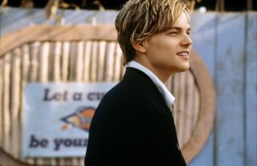
Romeo blames his femininity on Juliet. The ​metaphor ​comparing his “valour”​ to ​“steel” suggests that he feels as though his bravery should be strong and moving but Juliet has “softened” ​ it. The exclamation mark at the end expresses his emotions and also his conviction in the statement, he believes it to be fact and so leaps to the other end of the spectrum seeking to avenge his ​“friend”
Masculine Throughout the play, Romeo's character develops as he transforms from a Petrarchan lover to someone who allows“ rage to guide(his)actions” ​ after his​“friend” ​ Mercutio is killed by the Capulet Tybalt.
➔ Here it is murder and revenge (both masculine acts) which has caused Romeo to re find his masculinity.
Romeo becomes consumed with a ​murderous ​“rage” which leads to him and Tybalt fighting and Tybalt’s death. Romeo says before they fight that Mercutio is waiting in heaven “​above our heads staying for thine (Tybalt) to keep him company.''
It is interesting to note that before Mercutio’s death he puts a ​curse ​on the families saying “A plague o' both your houses!”. It is possible that this curse is responsible for Romeo’s transformation​. However, an alternative explanation could be that the death caused Romeo to recalculate what was important to him, stating ​“Thy (Juliet) beauty hath made me effeminate And in my temper softened valor’s steel!” ​ .
After this experience, Romeo’s anger is quenched and he maintains his previous demeanour. Shakespeare may be trying to tell the audience that ​anger, violence and aggression​ are just a part of what it meant to be a man.
What do you think?
Would you describe Romeo and a masculine or feminine character?
Explain why. Consider what Shakespeare may be trying to suggest.

Slide 80
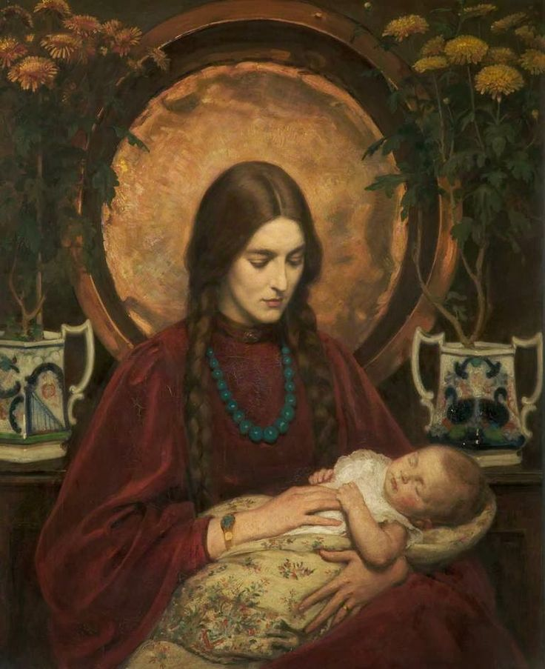
The role of women
While the male characters struggle to navigate what it is to be a man within the confines of Elizabethan’s societal expectations surrounding masculinity, the women are also restricted by their role as women within society.
Marriage During the Elizabethan period marriage was often used by important families as a way of making new alliances and spreading their power and influence. Daughters were often married off by their fathers who decided on a suitable man for them to marry. This sort of arrangement is how the audience is first introduced to Juliet.
Act 1 Scene 2 shows Paris asking Lord Capulet for Juliet’s hand in marriage. However, at this point in the play Lord Capulet doesn’t act like a normal Elizabethan father, instead he wants his daughter to be older before she marries and also wants Juliet to marry someone she loves.
➔ He says​“ ​ But woo her, gentle Paris, get her heart My will to her consent is but a part.” This implies that Juliet has a choice in who she marries and that if she doesn’t like Paris then she won’t have to marry him.
However, this perceived choice in future partner is short lived. After Tybalt's death Lord Capulet changes his mind and agrees to let Paris marry Juliet. He asks his wife to tell Juliet, saying “​Have you delivered to her our decree?”. ​ The word ​“decree” ​ has connotations with ​law ​and ​royalty​. Here it is evident that Lord Capulet believes he is a king in his own home and so everything he says goes.
Lord Capulet’s true​ authoritarian demeanour​ is revealed when Juliet refuses to marry Paris saying “I will not marry yet”. This created an explosive response from Lord Capulet. He calls his daughter “​Unworthy as she is, that we have wrought So worthy a gentle man to be her bride” ​saying that if she does not do as she is told he “will drag thee on a hurdle thither. Out, you green sickness, carrion! Out, you baggage!”. ​ The ​listing ​of insults used encapsulates her father’s lack of respect for his daughter. The use of ​punctuation breaks up Lord Capulet’s speech and suggests how emotional and outraged he was at this attempt of insolence.
Mother
A woman’s role within the play was to become a wife and mother. In ​Act 1 Lady Capulet talks about how she fears her daughter, who is only 14, will die unmarried. She says her daughter should start to ​“think of marriage now” because girls ​“Younger than (Juliet) Here in Verona” ​ have gotten married. Juliet's mother even comments that she was Juliet’s ​“mother much upon these years” which means that Lady Capulet was already wedded with a child by the time she was Juliet’s age.

Slide 81
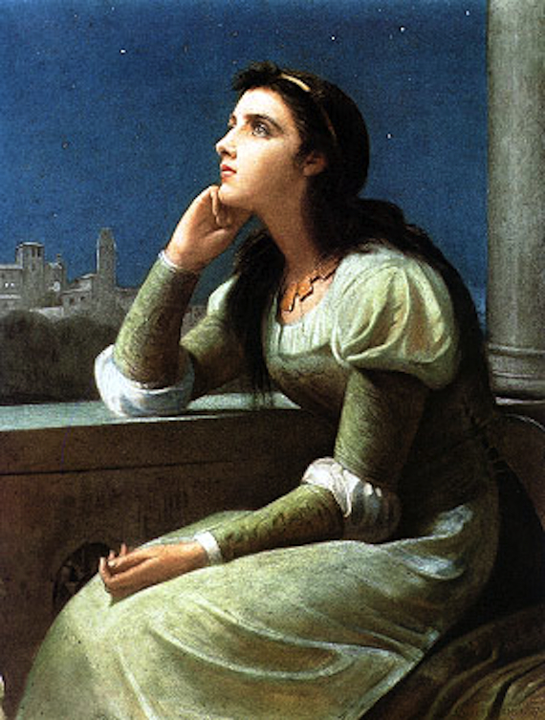
Sexual objects
Women are not just seen as wives and mothers within the play but they are also perceived by men as ​sexual objects​.
In ​Act 2 Scene 1 Mercutio ​subverts the convention of romantic poetry when describing Rosaline’s body. He ​lists her body parts ​saying; “​ I conjure thee by Rosaline's bright eyes,/By her high forehead and her scarlet lip, /By her fine foot, straight leg, and quivering thigh,”. ​Here, Mercutio is ​sexualising Rosaline’s body and seeing her purely as an object for sexual gratification. Moreover, the Friar notes​“Young men’s love lies not truly in their hearts, but in their eyes”
Sexual subservience
However, sexualisation isn’t just limited to the men within the play. Juliet’s nurse makes many sexual jokes and makes fun of women’s ​sexual subservience​.
➔ She tells a story and quotes her husband who jokes about a baby who fell and says that ​“Thou wilt fall backward when thou comest to age”. This is a sexual joke in which they are making fun of a woman’s sexual subordination.
◆ The fact that the nurse retells this joke could mean that she agreed with it. This would mean that women in the play now believe what they have been taught to believe, they accept their subordination.
➔ She also talks about how Juliet will “rest but little” when Romeo visits. This is filled with ​dramatic irony as the audience know that Juliet will soon be dead (resting in peace), which fills the beginning of the scene with new tension.
◆ The fast transition from these jokes to her sorrow at finding a ‘dead’ Juliet shows once more the fast pace and action that has rushed the course of the play.
Juliet’s freedom
Despite Juliet being constrained by the patriarchal society she lives in, Shakespeare gives her power within the play. She is given some freedom and independent choices and as a result stands up to male figures​. ​There are very few works of Shakespeare in which women are one of the leads so it is possible that Shakespeare used Juliet as an opportunity to ​challenge gender conventions of the time. She dares to defy men, and in some way is ​liberated​ by her defiance.
Courtship
Juliet ​claims her agency by ​actively pursuing her relationship with Romeo​. ​ Normally in courtship the male would actively pursue a passive female for her hand in marriage. However, Juliet plays an ​active role in their relationship instead of a passive one. She does not wait around for Romeo to find her but instead uses the Nurse and Friar to help facilitate their relationship and marriage.
She also ​breaks conventions through proposing to Romeo. She demands that he shows his devotion to her saying ​“If that thy bent of love be honorable, Thy purpose marriage, send me word tomorrow”. ​ This ​assertive sentence identifies Juliet as a girl who knows what she wants and is not afraid of the consequences of her desires.

Slide 82
Sexuality
Another way in which Juliet reclaims her agency is through ​embracing her sexuality ​which is something that women were not supposed to do at the time. Instead, they were meant to be conservative; for example, in the rules of ​courtly love the woman is supposed to refuse the man’s advancements.
The fact that Juliet does not refuse Romeo’s advances and instead encourages them would have seemed like odd behaviour to an Elizabethan audience.
➔ She says “ ​ I have bought the mansion of a love, But not possessed it, and though I am sold, Not yet enjoyed.” ​ This means that Juliet has fallen in love with Romeo so she now belongs to him. However, she points out that she has not been “possessed” ​ by him. The ​verb ​is ​sexual innuendo​, illustrating to the audience that Juliet desires to be with Romeo sexually.
Death
When considering what kind of message Shakespeare is giving the audience through Juliet’s death there are different possibilities. There isn’t a right answer here and it’s something you will grapple with and change your mind over the more you read the play.
➔ Juliet’s decides to make her own choices throughout the play. The consequences of these actions are her death. What kind of message is this sending women in the audience?
◆ Through death Juliet can no longer defy the men who have power over her, she has been silenced forever.
➔ Juliet ​affirms her freedom by choosing to die. She did not get murdered but instead took back her ​autonomy ​by committing suicide. She finally found freedom in the afterlife instead of spending her life being constrained by her marriage to Paris.
➔ If Juliet has committed suicide because of a man is she really liberated? Instead she died because she was so ​“possessed” ​by a man she could not live without him.
Are there other readings of her death you can think of? Was Shakespeare trying to send a message to his audience or was the story purely for entertainment?

Slide 83
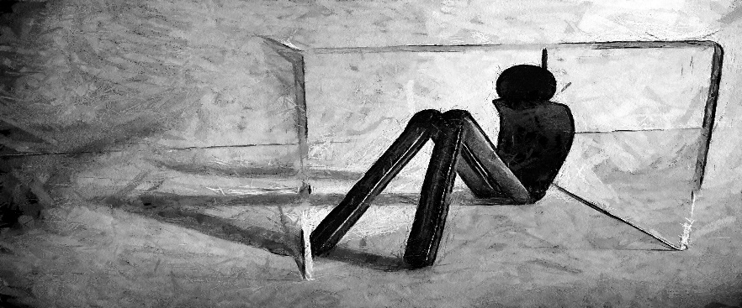
THEMES ISOLATION
Although many of the scenes in Romeo and Juliet portray the interaction of characters, there are many in which the characters are in ​physical isolation​. This isolation is used by the characters to help ​process their thoughts and emotions​.
It’s important to consider how a character would look to an audience on stage alone. They would suddenly seem very ​vulnerable​. It is often these moments that the audience finds out the ​inner feelings​ of the character (perhaps through a soliloquy) which makes them more ​relatable​. The separation and isolation of the characters isn’t only physical, it is also ​reflected in the language they use​.
Juliet
Separation is symbolised by the ​contrast between day and night​. She notes that much of their relationship occurs during the night, the darkness hiding their forbidden love.
➔ She describes how ​blind love ​“best agrees with night”.
➔ Her description of night being ​“love-performing” highlights the ​secrecy ​of their love and emphasises how separate it is from the rest of the world.
➔ Juliet says that by letting day in, the window must let life out”, which shows the separation that daylight brings to the couple.
With daylight holding connotations of ​realisation ​and truth​, this could be Shakespeare suggesting that it is the reality of the world they live in, a world that is full of societal expectations and ​family feuds​, that is holding them apart.
As Juliet asks the Nurse and Lady Capulet to ​“let [her] now be left alone”, we see her ​final detachment ​from the two ​maternal figures of her life as she asserts her independence and growth into a new level of emotional maturity. We see once more her lack of dependence on the people she previously relied on as she reached out to call the Nurse but then decided that she “must act alone”.
Romeo
At the beginning of the play Romeo spends much of his time alone as he ​despairs over his unrequited love for Rosaline.
He is also portrayed by Shakespeare as being separate from the other male characters in the play. He tries to avoid getting caught up in the male fighting which takes place and in doing so separates himself from the ​hypermasculine persona​ the male characters exhibit. As Romeo gets ready to kill himself to be with Juliet he acknowledges that his intents are “savage-wild”​, showing his ​detachment from his humanity​, isolating himself from everything that previously made him Romeo.

Slide 84
QUIZ
ISOLATION
Answer the questions below. These can be checked by somebody else in your household or self-assessed. (the answers are at the back.)
CHALLENGE – create your own quiz with answers and ask somebody to test you.
How is physical isolation used by the characters in the play?
How would a character look (when isolated) on stage?
What is used to symbolise separation?
What does Juliet’s description of night being “love-performing” highlight?
How is Romeo separate from the other male characters?
When Romeo gets ready to kill himself and says “savage-wild”, what does it show?
Further notes:

Slide 85
THEMES LOVE
Romeo and Juliet is widely regarded as one of the​ greatest love stories ever told​. Shakespeare tells the story of two young people who are so in love that they would rather die than live without each other.
The​ theme of love​ is interwoven into every scene in the play, the different forms of love are also explored by Shakespeare. He contrasts the purity of first love with the passionate and uncontrollable force of the emotion. He uses existing conventions, as well as his own elaborate language and imagery, to present love as:
● Unrequited
● Elevated and holy
● Physical
● Linked with violence and death
Unrequited Love
Unrequited love is portrayed through Romeo’s infatuation with Rosaline; instead of bringing him joy he becomes depressed as his love is one sided and she doesn’t feel the same way.
In Act 1 Scene 1, Romeo uses a range of ​oxymorons ​to express his emotions about love. ​“O brawling love, O loving hate”. The ​verb ​“​brawl” is used as an ​adjective ​here and has connotations ​of fighting (which emphasises the conflict within the play). The​ oxymoron ​between “​brawling​ ” and “​love” ​represents the ​contrast ​between Romeo and Juliet’s love with the quarrelling and violence of the family feud. It also ​foreshadows ​the amount of violence that will occur throughout the course of the play between the families, and links with the important theme of the coexistence of love and hate.
The unending ​list ​of Romeo’s ​oxymorons from ​“feather of lead,” “​bright smoke,” “cold fire,” to ​“​sick health,” suggests Romeo’s inability to comprehend what is in front of him and his overall confusion on love. In addition to this, it strongly alludes to Romeo’s immature and inexperienced character, and his tendency to make rushed decisions.
This is reinforced when Juliet says in Act 2 Scene 2 ​“​too rash, too unadvis’d, too sudden, too like the lightning”, ​ the ​asyndetic ​listing builds to the ​simile ​which encapsulates Romeo’s character as someone who is reckless and impulsive.
1. Highlight all the quotations
2. List all the techniques/methods on this page:

Slide 86
Religion and love
The​ pure and chaste religious imagery​ when Romeo and Juliet meet is contrasted to ​Act 5 Scene 3​ where the imagery becomes sexualised. In many cultures sex is a way of ​consummating​ a marriage and thus completes the unification of a couple. Here the couple are ​unified in death​ and the sexual imagery is ​symbolic of the consummation of their unity in the afterlife​.
➔ Romeo drinks to his death from a round vial which in Elizabethan times was an ​allusion to female sexuality​.
➔ This combines with the action of Juliet killing herself with a dagger, a ​phallic symbol ​which could also be seen as representing a​ re-consummation of the marriage.
This highlights how they had a love that was transcendental and able to connect them across three levels; ​physically, mentally and spiritually. ​The fact that the two lovers die together also cements their eternal devotion for each other.
Physical Love
This concept of love being both ​emotional and physical​ is exemplified in various places throughout the play.
In Act 1 Scene 4​, Mercutio says that if ​“love be rough with you, be rough with love” ​ . This alludes to the ​sexual nature of love which is physical and not pure. This also suggests that love can also be “rough” ​ emotionally which is evident in the way that Romeo is suffering from unrequited love​.
In ​Act 2 Scene 1 Mercutio ​subverts the convention of romantic poetry when describing Rosaline’s body. He ​lists ​her body parts saying; “ ​ I conjure thee by Rosaline's bright eyes,/By her high forehead and her scarlet lip, /By her fine foot, straight leg, and quivering thigh”. ​ Here, Mercutio is reducing what was previously a love-filled romance for Rosaline to nothing but a sexual description​ of her body.
The Friar shows his lack of emotional understanding in this scene as he says that​“Young men’s love lies not truly in their hearts, but in their eyes” ​ , essentially disregarding the idea that love can be something from the heart. This could be seen as Shakespeare shining light on the superficial nature of love, perhaps cloaking the whole play in ​irony ​and showing a fresh view of love, which contradicts the more romantically idealised conventions of the time. This idea is further explored as the Friar says that Romeo was only ​“doting” ​for Rosaline. This sexual form of love is not just focused on by the men. The Nurse checks out Romeo’s body and comments that his​ ​ “leg excels all men’s ​ ” . The Nurse’s sexualised view of Romeo contrasts with the emotional attachment Juliet feels towards him. Perhaps Shakespeare is stressing how Romeo and Juliet’s love ​transcends the conventional ideas​ of love that we see from Lady Capulet, the Nurse and Mercutio.

Slide 87
Oxymorons
Shakespeare’s use of ​oxymorons ​are interesting as Juliet describes the good parts of Romeo in relation to physical attributes and external beauty. This could be seen as Shakespeare commenting on the ​superficial ​nature of all love or perhaps Juliet is still in the same sex-orientated state of mind that she had adopted earlier.
Alternatively, the oxymorons express the ​dichotomy ​of love, while it is pure and “​beautiful ​ ” it can also be the exact opposite.
Furthermore, by saying that she has ​“bought the mansion of a love / But not posses’d it” we see Juliet liken the consummation of her marriage to the possession of a mansion. This could be a reference to the ​objectification ​of women, and how instead of it being based on mutual affection it is instead more of a ​business transaction​, the emotional for the physical.
Love linked with violence and death
Within Romeo and Juliet Shakespeare manages to fuse together many​ powerful emotions​. The passionate love of Romeo and Juliet is ​unsettled by the violence ​and conflict that takes place in the play. However, while some might think that the ​conflict corrupts​ their love it actually ​fuels ​it and makes it more ​powerful​. The ​amalgamation ​of love and the violence is what characterises the ​drama as a tragedy.
Love is also linked with violence and death in many other ways within the play.
➔ In Act 1 Scene 1, Sampson and Gregory describe acts of violence and rape with the use of a ​“naked weapon” ​ . ​ The word “​naked” ​ fills the description with both sexual ideas of intimacy but also highlights an idea of truth. The ​juxtaposition ​of this with ​“weapon” ​ which has ​connotations of violence​ again highlights how there is an ​overlap​ between love and hate.
◆ It is said along with desires to ​“thrust [Montague’s] maids to the wall” ​ and to rape the women. Rape can be seen as violence infiltrating what is supposed to be an act of love and intimacy.
➔ The use of the ​sonnet form​ ​which was conventionally used to depict love is used by Shakespeare to describe death and feud. He uses ​blood-filled imagery ​of ​“civil blood makes civil hands unclean” ​which ​highlights ​how this play is contained within ideas of love but is just as much to do with hate and fighting.
➔ The marriage of Romeo and Juliet is described as ​“violent delights” ​ by Friar Lawrence. This use of ​oxymoron​ emphasises the difference between the two ideas but also highlights a connection between them. The use of the ​adjective​ ​“violent” ​ echoes the fighting that has gone on within the novel. However, the use of the ​verb​ ​“delights” ​ , rather than love also puts emphasis on how the violence occurs within the indulgence rather than the relationship
➔ The almost ​prophetic words​ of Juliet that her ​“grave is like to be [her] wedding bed” again highlights an intersection between violence and death with love. The image of a wedding bed is interesting as it suggests consummation of a marriage and finality which has links to death which is also final.

Slide 88
COMPLETE THE MINDMAP WITH NOTES
Religion and Love
Unrequited Love
LOVE
Physical Love
Violence and death

Slide 89
QUIZ
LOVE
Answer the questions below. These can be checked by somebody else in your household or self-assessed. (the answers are at the back.)
CHALLENGE – create your own quiz with answers and ask somebody to test you.
In what 4 ways does Shakespeare present love?
How is unrequited love portrayed?
Romeo and Juliet die together, what does this show?
When The Friar says “Young men’s love lies not truly in their hearts, but in their eyes” what is he suggesting about love and what could Shakespeare be trying to show?
Fill in the gaps: The _________ love of Romeo and Juliet is ______ by the ________ and _______ that takes place in the play.
CHALENGE: How does Shakespeare use oxymorons in Act 1 scene 1 to present love? You must use and analyse evidence.

Slide 90
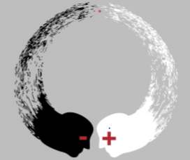
THEMES Opposition
Shakespeare ​uses ​oppositions in Romeo and Juliet to make the audience question conflict and opposition in their own lives and society. Shakespeare is able to bring polarising concepts together which allow the audience to analyse how they interact. By doing this, Shakespeare is able to highlight obvious differences as well as the more implicit similarities.
Shakespeare often uses ​juxtapositions ​and oxymoronic ​language to present these contrasting and contradicting ideas in the play. He also creates characters which have contrasting or similar personalities​.
Capulets and Montagues
The play is ​based on a conflict ​between these two opposing families. This instantly grounds the play as a story based on opposing forces ​and their ​destructive powers​.
It is important to note that the Montagues and Capulets have an “ancient grudge” ​ against each other, which suggests that they are very different people. However, the​ reality ​is that the families are ​more similar than they are different​. They’re both ​noble families with characters who have similar attributes such as Mercutio, a Montague, and Tybalt, a Capulet.
While Romeo and Juliet is a love story and a tragedy it also is a​ moral story as it fulfils a​ didactic purpose. At the end of the play the two families realise the error of their ways and ​make peace with each other​. Lord Capulet says ​“ ​O brother Montague, give me thy hand” ​. Through the tragic ending in the play, Shakespeare illustrates the ​dangers of opposition and conflict in life​.
Mercutio and Tybalt
Tybalt and Mercutio are similar characters as their ​inclination towards violence make them catalysts ​for the plot. In ​Act 3 Scene 1 ​we can see both men starting fights which ultimately lead to their deaths:
➔ In this scene Tybalt is looking to fight Romeo. He calls him a “​villain ​ ” to try and ​entice him to fight​. Despite this Romeo refuses to fight Tybalt. Mercutio does not understand why Romeo is refusing to fight. In the Elizabethan era it would have been typical to challenge someone to a duel if they disrespect you. Mercutio decides to step in and puts forward the challenge by saying to Tybalt: “​O calm dishonourable, vile submission!... Tybalt, you rat catcher, will you walk?”. ​ This decision ultimately results in his death.
◆ Both of these characters contrast with Romeo who does not want to join in the violence. Their masculinity is contrasted with Romeo’s feminine traits.
Didactic means when something is intended to teach a moral lesson

Slide 91
Whilst Tybalt and Mercutio are very similar, they also ​juxtapose ​each other; Tybalt is a very serious character who introduces the ​reality ​of the situation to the audience whereas Mercutio adds ​comedic relief.
➔ An example of Mercutio’s comedy is found in ​Act 1 Scene 4 when Romeo is still depressed over Rosaline. Mercutio says his Queen Mab speech which includes moments of comedy as he talks about Queen Mab (a fairy who visits people in their dreams) “Tickling a parson’s nose as he lies asleep”.
➔ This ​juxtaposes ​Tybalt who never has a moment of humour. Even at the party in Act 1 Scene 5 Tybalt is angry that Romeo has gate crashed the feast saying that Romeo is a “​villain”. Lord Capulet has to make him calm down.
Love and Hate
Shakespeare ​juxtaposes love and hate throughout the play. He even​ subverts ​incredibly romantic scenes with moments filled with hate and conflict. The opposition of love and hate within the play ​creates tension​. Act 1 Scene 5 This is the iconic scene where the two lovers meet for the first time. Here the lovers speak in a ​sonnet form and their language is filled with​ religious imagery​. This exchange is completely ​fuelled by ​romance ​which leads to a ​climax​: their kiss. Juliet tells Romeo: ​“You kiss by th' book.”.
However, just before this exchange, there is a conflict between Tybalt and Lord Capulet. Tybalt is enraged ​by Romeo and his friends gate-crashing the “​feast ​ ”. Tybalt believes that Romeo is a “​villain” and should be thrown out of the party. However, Lord Capulet doesn’t want to spoil the celebrations and demands that Romeo ​“shall be endured”.
➔ This is one of the few times that the audience is able to see ​in house conflict​. In this instance it occurs between the​patriarch​of the family and one of his relatives. While Tybalt tries to ​persist ​in the end he says ​“I will withdraw” which emphasises Lord Capulet’s authority.
What is Shakespeare trying to achieve by placing these contrasting exchanges, one filled with anger and one filled with love, next to each other?

Slide 92
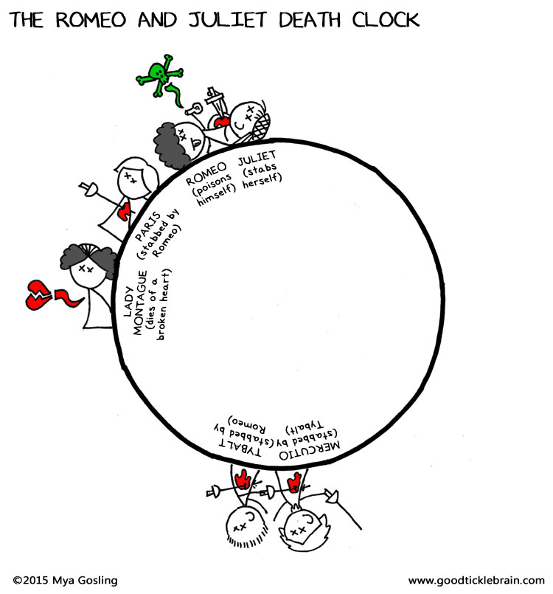
Act 2 Scene 6 and Act 3 Scene 1
Another instance in which love and hate are put together is after the two lovers get married.
➔ The Friar conducts the ceremony saying “Come, come with me, and we will make short work.” ​Friar Lawrence basically says here that they have to go quickly and make the ceremony fast.
➔ This scene is immediately ​juxtaposed by the ​climax ​of the play ​Act 3 scene 1 where Mercutio and Tybalt die. Shakespeare manages to put together the ​epitome of love which is marriage ​and the epitome of hate which is murder to illustrate to the audience the ​simplicity ​as well as the complexity ​of life in presenting the two most powerful emotions alongside each other.
Life and Death
Shakespeare shows the ​duality between life and death within the play. A key theme within any tragedy is death, it is used by Shakespeare to ​release tension and ​purge emotions​. It was the usual practise in Shakespearean tragedies to have a series of deaths in the final scene. Romeo and Juliet is no different as the final scene encompasses the deaths of Paris, Romeo and Juliet.
Death
In Romeo's final speech before he commits suicide he ​contrasts the sadness of death with a feeling of elation saying “How oft when men are at the point of death/ Have they been merry ,which their keepers call A lightning before death!” ​ . ➔ Here Romeo is saying here that some men describe happiness before they die, he shows the audience that he is experiencing a similar kind of high which he compares to ​“lightning” ​. (This ​metaphor is also used by Juliet to describe their love which is​“too like lightning” ).
Life
The theme of life is shown in a ​subtle way within the play. There aren’t any births, instead there are ​new beginnings​ which can be seen as ​symbolic of new life​.
➔ The love between Romeo and Juliet is symbolic of this new life. They cannot remember a life before they had met each other, and they cannot imagine a life without each other.
➔ Equally, they ​forge a new life together ​as a married couple.

Slide 93
QUIZ
Opposition
Answer the questions below. These can be checked by somebody else in your household or self-assessed. (the answers are at the back.)
CHALLENGE – create your own quiz with answers and ask somebody to test you.
What two methods does Shakespeare often use to present contrasting and contradicting ideas?
What does Didactic mean?
Through the tragic ending in the play, what does Shakespeare illustrate?
How are Tybalt and Mercutio similar?
How are Tybalt and Mercutio different?
What does the opposition of love and hate within the play ​create?
Opinion: Why do you think Shakespeare uses so many opposites throughout the play?

Slide 94
THEMES - Violence and Conflict
Romeo and Juliet is a tragedy and so includes a substantial amount of​conflict​. Shakespeare uses the possibility of conflict as a way of ​building tension ​within the play, then the violence which ensues releases the tension.
Shakespeare shows ​two ​different types of conflict:
● External ​which is shown through the ​dispute and fighting between the Montagues and the Capulets.
● Internal conflict which is the mental struggle characters may feel towards their feelings and what is happening to them.
Household Conflict
While the main conflict in the play is between the two opposing households, the Capulets and Montagues, there is still conflict inside each of the households as they come to terms with their own conflicts. Shakespeare may have done this to explore the complexities ​and ​intricacies ​that are apart of the​ human existence.
Capulets
Act 1 Scene 5 The first time the reader sees conflict in the Capulet household is in ​Act 1 Scene 5 ​during the ​“old accustom'd feast” between Tybalt and Lord Capulet.
● When Tybalt sees Romeo Montague at the “feast” he states that the ​“villain is a guest” and that he shall not ​“endure him”.
● Tybalt is a ​hot-headed ​and ​loyal ​Capulet who believes it is his duty to protect his family from the Montagues.
● However, Lord Capulet becomes angry at this remark claiming he “shall be endured”​. He then asks, ​“Am I the master here, or you?”. ​The ​rhetorical question reaffirms Lord Capulets' authority while at the same time discrediting any authority that Tybalt believed he had.
Lord Capulet’s language in this section (lines 74- 91) is extremely ​patronising ​to Tybalt. For example, he calls Tybalt a “saucy boy” ​which is ​belittling ​to Tybalt as he is a grown man. The term “saucy” means someone who is silly and likes to cause trouble. Tybalt inevitably ​says ​“I will withdraw” as he succumbed to what Capulet wants, realising that Lord Capulet has the true power in the household.
Act 3 Scene 5
There is further conflict in the Capulet household when Juliet ​disobeys ​her father and ​refuses to marry Paris​. Due to this disobedience Lord Capulet becomes aggressive and violent.

Slide 95
➔ Lord Capulet explodes in her face saying ​“Hang thee, young baggage! Disobedient wretch!”
➔ He goes on to say that his “fingers itch” ​ meaning that he feels a need to slap her. Here we see how ​violence ​is apart of their way of life. The ​verb “itch” shows the audience that his body is telling her to punish her but he is using self control to stop himself.
➔ The violent imagery used in the ​list ​“hang, beg, starve, die in the streets'' creates a vivid image ​in the reader's mind. The words used also illustrate the level of​disregard​that Lord Capulet has for Juliet if she does not do as he says his own daughter becomes nothing better than trash.
Juliet is ​disowned ​by her father which would have been the ​expected reaction ​from her father. Through these examples, it is clear that conflict arises in the Capulet household when someone threatens Lord Capulet's authority.
Juliet is ​disowned ​by her father which would have been the ​expected reaction ​from her father. Through these examples, it is clear that conflict arises in the Capulet household when someone threatens Lord Capulet's authority.
External Conflict
The play is all about the conflict between the ​“Two households”, the Montagues and the Capulets, who are ​“both alike in dignity”. The ​prologue ​sets the scene of the conflict, it tells us that their “ancient grudge” ​ makes ​“civil ​ ​hands unclean” ​ .
Shakespeare makes it very obvious to the reader that the tragic fate which awaits the lovers would not be there if not for the “mutiny ​ ” between their parents.
The importance of conflict is affirmed in​ Act 1 Scene 1 ​which starts with violence between the Montague and Capulet servants. Shakespeare starts the play​in media res ​to immerse the audience in the action and the fast-moving​ pace earlier on in the storyline.
It starts from a small insult“ ​ Do you bite your thumb at us, sir?” ​ and the resulting arguing builds dramatic tension. ​This tension is laced with humour as the servants try to catch each other in ​technicalities in language​.
➔ For example, the men act as though they want to start a fight but also keep the pretence of civility by using ​“sir”​.
➔ However, the ​quick transition between ​comedy ​in ​lines 1-38 of the first scene to violence ​and danger demonstrates the rapid pace that later dictates the play and its sequence of events.
The Prince’s speech
The Prince is used as a way to explain the effects of the Montague and Capulet conflict on the people of Verona. He explains that the families have ​“Have thrice disturbed the quiet of our streets” ​ which shows that conflict and violence have become a​ regular occurrence in the city. He explains that the violence they bring has “​made Verona’s ancient citizens, Cast by their grave-beseeming ornaments, To wield old partisans in hands as old”.

Slide 96
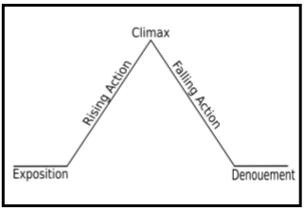
The Prince then presents the extent of the ​conflict​when he declares that if they start another fight on the streets of Verona again their ​“lives shall pay the forfeit of the peace”. ​ This means that if there is conflict again then they will die. The speech is therefore​foreshadowing​later events in the play as the audience know that members of the family will die which of course means that there will be more conflict to come.
Violence - Act 3 Scene 1
Violence can be seen as a manifestation of conflict​. One of the biggest accumulations of conflict in Romeo and Juliet occurs halfway through the play in ​Act 3 Scene 1 ​where fighting between Mercutio, Romeo and Tybalt results in the deaths of Mercutio and Tybalt.
➔ Just before this scene in ​Act 2 Scene 6 ​Romeo and Juliet have just had their marriage ceremony in which Friar ​foreshadows ​that their ​“violent delights have violent ends”. Act 3 Scene 1 juxtaposes ​the previous scene which perfectly encapsulates the story of Romeo and Juliet, while there is a lot of love and desire, there is also a lot of violence and bloodshed.
Shakespeare opens Act 3 ​with Benvolio’s discussion of ​“mad blood stirring” which creates tension ​and ​pace​. The ​personification ​of blood as “mad” ​ could imply the fact that the families are about to ​clash​, and so ​‘familial blood’ ​will take over.
Romeo and Juliet follows a clear structure in which the ​climax​ occurs right in the middle of the storyline which is the ​traditional structure ​for stories following ​Freytag’s Pyramid (the structure of a play or tragedy developed in Gustav Freytag in 1863). By putting this scene right in the ​middle​, Shakespeare provides catharsis for the audience as the tension which has been building throughout the first half is quelled through fighting.
Mercutio’s last words before his death are ​"A plague o' both your houses!". This is not only foreshadows ​events which come later in the play but the scene also acts like a​catalyst​for the events that come.
After Mercutio’s death, Romeo becomes filled with a murderous rage ​and kills Tybalt. Due to his actions Romeo is banished from Verona: the Prince says ​“Immediately wed o exile him hence”. This banishment sets in motion the tragic ending of Romeo and Juliet as they try to be together.
Internal Conflict
Aside from the obvious external conflict which manifests itself through violence within the play, characters also suffer from ​internal conflict​.

Slide 97
Juliet
Juliet suffers a lot of internal conflict as she struggles between her love for Romeo and her loyalty to her family. Due to the conflict between the houses she is forced to choose her family or to follow her heart and pursue a relationship with the son of her enemy.
Balcony scene - Juliet’s soliloquy After the party, Juliet goes to her balcony trying to ​rationalise ​her feelings and even find ways to overcome the problem. In Juliet’s balcony ​soliloquy ​the audience is able to see how desperate she is to have a way in which Romeo could not be a Montague. This desperation is what leads Juliet to go to the Friar after Romeo’s banishment for the potion which leads to the ​tragic ending.
Line number | Quote | Analysis
(I.v.34-36) | “Deny thy father and refuse thy name Or, if thou wilt not, be but sworn my love, And I’ll no longer be a Capulet.” | Juliet is saying that Romeo should no longer be a Montague or if he truly loves her, she will stop being a Capulet. However, this is, of course, impossible and just wishful thinking.
(I.v.40-41) | “What’s Montague? It is nor hand, nor foot, Nor arm, nor face, nor any other part” | Juliet then becomes more desperate​, trying to figure out what is so special about a name. By ​listing​ parts of the body, Juliet tries to show the audience how meaningless the name is. Maybe she is trying to get the audience to sympathise with her position
(I.v.38-46) | “That which we call a rose By any other word would smell as sweet. So Romeo would, were he not Romeo called, Retain that dear perfection which he owes” | Finally, Juliet uses the ​metaphor of a rose to illustrate to the audience again that a name truly means nothing. A rose is a symbol ​of romance which is known for its smell and beauty, however, a rose has thorns. It is possible that Shakespeare uses this image to exhibit the​ duality of love, ​that while it can be soft and beautiful, it can also be harsh.
Act 3 Scene 2
After Juliet finds out that Romeo has killed her cousin Tybalt she is conflicted and doesn’t know what to think. The man she fell in love with and married is a murderer. The ​sequential use of oxymorons ​“serpent heart” and ​“beautiful tyrant” ​ between lines 73 and 77 help to portray this conflict between seeing Romeo as the gentle man she loves, and him as a murderer.
Ending
As the Prince says in the end ​“Never was there a story of more woe than Juliet and her Romeo”. Shakespeare illustrates to the audience that conflict will lead to pain and ​“woe”.

Slide 98
Create your own mind map for violence and conflict

Slide 99
QUIZ
Violence and Conflict
Create your own q & a quiz using the reading. You can then test yourself and ask members of your household to test you.

Slide 100
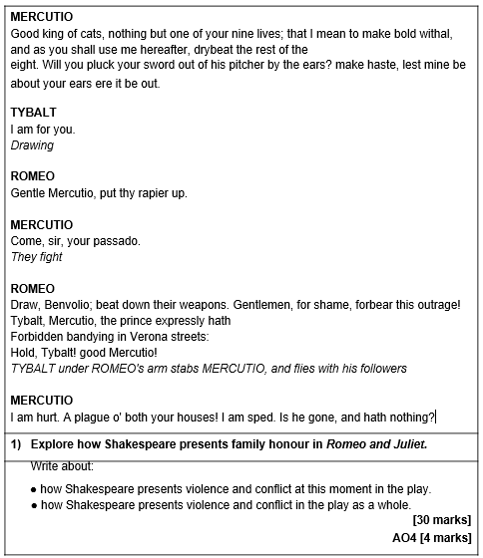
Violence & Conflict mock question
Read the following extract from Act 3 Scene 1 of Romeo and Juliet and then answer the question that follows.
At this point in the play, Romeo, Mercutio and Benvolio have encountered the Capulet’s in a public area
Annotate and plan your response first. Your essay can be handwritten or typed and then it can be emailed to your teacher or shared via google classroom for feedback.

Slide 101
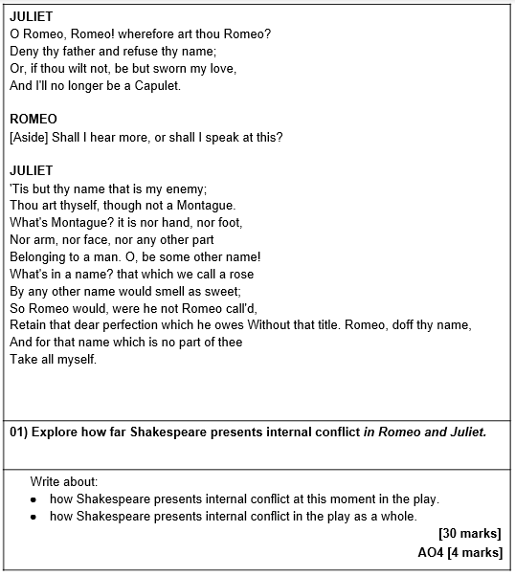
Internal Conflict mock question
Read the following extract from Act 2 Scene 2 of Romeo and Juliet and then answer the question that follows.
At this point in the play, Juliet has just called out for Romeo, not knowing that he was beneath her in hiding.
Annotate and plan your response first. Your essay can be handwritten or typed and then it can be emailed to your teacher or shared via google classroom for feedback.

Slide 102
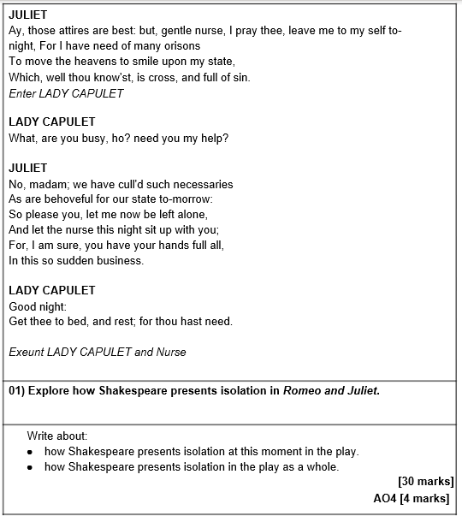
Isolation mock question
Read the following extract from Act 4 Scene 3 of Romeo and Juliet and then answer the question that follows.
At this point in the play, Juliet has just agreed to marry Paris the following day.
Annotate and plan your response first. Your essay can be handwritten or typed and then it can be emailed to your teacher or shared via google classroom for feedback.

Slide 103
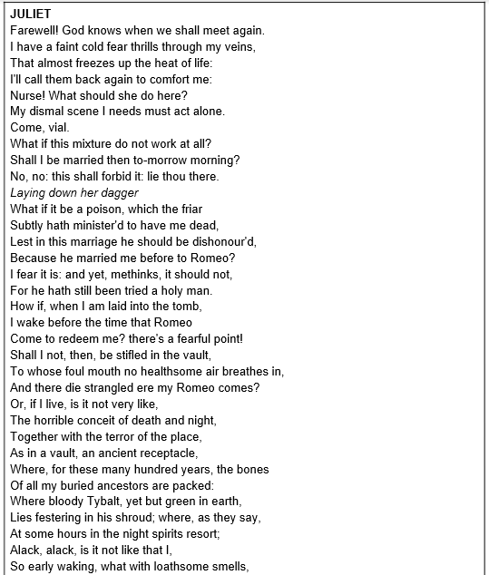
Love mock question
Read the following speech from Act 4 Scene 3 of Romeo and Juliet and then answer the question that follows.
At this point in the play, Juliet has just asked her mother and the Nurse to leave her alone.
Annotate and plan your response first. Your essay can be handwritten or typed and then it can be emailed to your teacher or shared via google classroom for feedback.

Slide 104
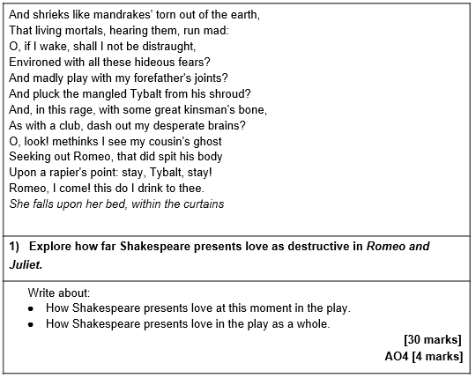
Love mock question
Read the following speech from Act 4 Scene 3 of Romeo and Juliet and then answer the question that follows.
At this point in the play, Juliet has just asked her mother and the Nurse to leave her alone.
Annotate and plan your response first. Your essay can be handwritten or typed and then it can be emailed to your teacher or shared via google classroom for feedback.

Slide 105
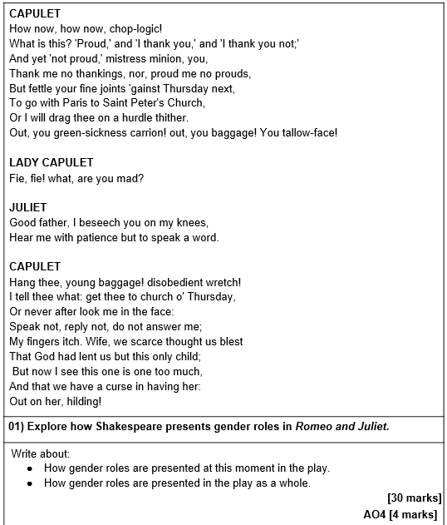
Gender Roles question
Read the following extract from Act 3 Scene 5 of Romeo and Juliet and then answer the question that follows.
At this point in the play, Juliet has just told her father that she refuses to marry Paris.
Annotate and plan your response first. Your essay can be handwritten or typed and then it can be emailed to your teacher or shared via google classroom for feedback.

Slide 106
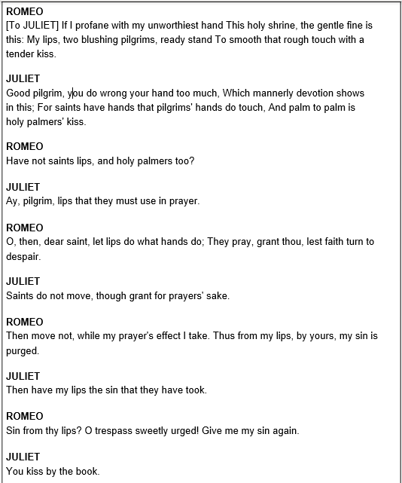
Religion question
Read the following extract from Act 1 Scene 5 of Romeo and Juliet and then answer the question that follows.
At this point in the play, Romeo has just found Juliet at the ball.
Annotate and plan your response first. Your essay can be handwritten or typed and then it can be emailed to your teacher or shared via google classroom for feedback.

Slide 107
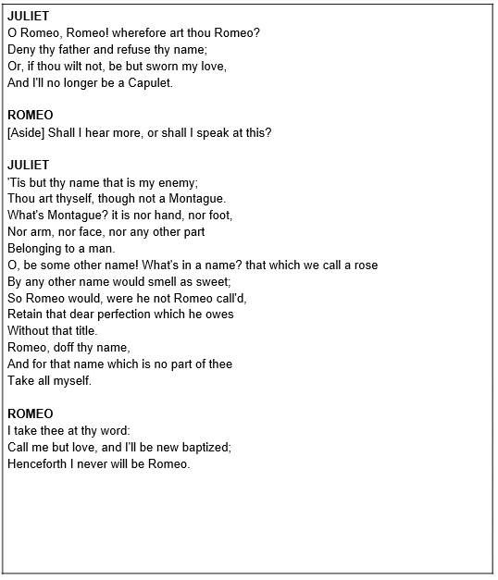
Family Honour question
Read the following extract from Act 2 Scene 2 of Romeo and Juliet and then answer the question that follows.
At this point in the play, Juliet has just called out for Romeo, not knowing he was beneath her in hiding.
Annotate and plan your response first. Your essay can be handwritten or typed and then it can be emailed to your teacher or shared via google classroom for feedback.

Slide 108
Shakespeare – Glossary of key terms
Techniques - Language
Allegory​ - A story, character, place, or event is used to convey a hidden meaning, typically moral or political, about real-world events or issues (e.g. Duncan’s death is an allegory for the risks of killing your king).
Allusion​ - An indirect reference to another event, person or work which the writer assumes the reader is familiar with.
Archetype​ - The first real example or prototype of something; an ideal model or the perfect image of something.
Bathos ​- An anti-climax which is abrupt; usually humour that comes from an odd and sudden change in tone.
Biblical ​- Language that relates to the bible and thus has religious connotations.
Blazon​ - A poem in which the speaker describes a woman’s physique by focusing on and listing various individual parts of a woman’s body.
Caricature​ - An imitation where particular notable characteristics are exaggerated to a comic or grotesque effect.
Colloquialism ​- An informal word or phrase used in normal or familiar conversation.
Comic relief ​- Relief from tension caused by the introduction of a comedic element.
Connotation​ - An impression, idea, or feeling associated with a word or phase beyond its literal meaning.
Dichotomy​ - A division or contrast between two opposed things.
Double entendre​ - Words or phrases that have a double meaning and is deliberately ambiguous, especially when one of the meanings is risqué. (For example: In Elizabethan England, the use of the word “die” referred to both death and orgasm).
Dysphemism ​- The substitution of a more offensive term for one considered less so.
Epithet ​- A word or phrase applied to a person to describe an actual or credited quality. (For example: “star crossed lovers” = Romeo and Juliet).
Epitome​ - A perfect example of a specific quality.
Epizeuxis​ - The repetition of words in succession within the same sentence.
Euphemism​ - The substitution of a harmless term for one that is considered as offensively risqué or explicit.
Extended metaphor​ - A metaphor that continues over many sentences and could even extend throughout the entire play.
Foreshadowing​ - A device in which an author suggests certain plot developments that might come later in the play.
Grotesque​ - Ugly and distorted, physically or figuratively, in a way that is comic or repulsive.
Hyperbole ​- An extravagant exaggeration of fact, used either for serious or comic effect.
Ideology​ - A system of beliefs and ideals, typically forming a framework for a political policy or a religion.
Imagery ​- Use of language which is visually descriptive or symbolic.

Slide 109
Shakespeare – Glossary of key terms
Techniques - Language
Irony ​- The use of words where the meaning is contrary to what is expected to actually occur.
Juxtaposition ​- A literary technique that places two opposing words, phrases or events side by side, often for the main purpose of comparing or contrasting them. (For example - “Here is much to do with hate, but more to do with love.”).
Manifestation​ - A physical expression or realisation of an abstract idea through a character, object, place, or event.
Motif ​- An element that reoccurs, such as a word, phrase, idea, image, action, character or symbol that appears throughout the play for emphasis.
Oxymoron​ - A form of paradox that combines a pair of contrasting terms into a single, sometimes unique expression. (For example - When Juliet says “O happy dagger”).
Parable​ - A story used to teach a moral or spiritual lesson, typically told in the Bible by Jesus.
Pathetic Fallacy​ - When human emotions or characteristics are given to objects, nature or the weather.
Personification​ - Giving something non-human a human trait, capability, or personality.
Pun​ - A play on words which suggests multiple meanings.
Satire​ - The use of humour, irony or exaggeration to ridicule and criticize an individual’s stupidity.
Semantic Field​ - When a writer employs multiple words which are similar and thus group together under one sub-heading.
Sibilance​ - The repetition of ‘s’ sounds close together.
Simile​ - Comparing something to something else in a nonliteral way, in order to convey a particular idea or quality of the original thing.
Symbolism​ - Using one object or character to expose a broader idea running throughout the play.
Trope ​- A particular type of character, event, or setting that is used frequently in stories (e.g. ‘The Damsel In Distress’ is a trope).
Zoomorphism ​- Imagery representing animal forms.
Techniques - Structure
Anaphora​ - Repeating a sequence of words at the beginning of adjacent clauses.
Antithesis​ - Parallel structure that uses opposites to create emphasis. (For example: “It was the best of times, it was the worst of times”).
Aside ​- A part of an actor’s lines that are not meant to be heard by other characters on stage and intended only for the audience; a short digression.
Blank verse​ - Unrhymed poetry written in iambic pentameter. Couplet​ - A rhymed pair of lines.
Cyclical ​- When the same sequence of events repeats throughout a story.

Slide 110
Shakespeare – Glossary of key terms
Techniques - Structure
Dramatic Irony​ - When a character shows that they are oblivious of the reality of which the audience is aware. (In Romeo and Juliet the audience can infer that Romeo and Juliet’s romance is doomed from the start as Shakespeare mentions in the prologue that “a pair of star-crossed lovers take their life”, thus the audience are aware from the beginning that the pair will commit suicide. Yet, throughout the play, Romeo and Juliet are unaware that they are going to commit suicide until the last act).
Dramatic monologue​ - A passage of speech in which one person is speaking to an audience or “thinking out loud”.
Epistrophe ​- When the same word (or group of words) is employed at the end of successive sentences with the aim of emphasising it.
Exposition​ - Information provided through stage directions, narration, dialogue, or description, used to introduce the audience to crucial background information.
Heroic couplet​ - The last two lines of a Shakespearean Sonnet - a couplet of rhyming iambic pentameter.
Iambic pentameter ​- A sentence (10 syllables in total) which is composed of two syllables: the first unstressed; the second stressed.
In Media Res ​- Starting in the middle of the action.
Microcosm​ - Using a place, group of people, or event in the small-scale to represent something much larger (e.g. the battle at the start of Macbeth is a microcosm for the whole play).
Paradox ​- A statement that seems to contradict itself but is still true.
Parallelism​ - Using components that are similar in grammar, structure, or meaning within a sentence or multiple sentences, or throughout the text as a whole (e.g. “He came, he saw, he conquered”).
Refrain​ - A word, phrase, or sentence that is repeated throughout a text.
Soliloquy​ - A dramatic device whereby a character stands alone on stage and addresses the audience, giving voice to their deepest thoughts and feelings.
Sonnet form ​- A highly stylized form of poetry, with 14 lines written in iambic pentameter. (For example - Romeo and Juliet’s first real encounter in the balcony scene).
Stichomythia​ - A dialogue between two characters who speak one after the other. ​For example:
ROMEO: _____
JULIET: _____
ROMEO: ____
JULIET: ____

Slide 111
Shakespeare – Glossary of key terms
Describing character development/change
Anagnorisis ​- A moment in a play when a character makes a critical discovery, such as the tragic hero’s sudden awareness of a real situation usually as a result of their downfall.
Antagonist​ - A character who actively opposes or is hostile to another character, particularly the protagonist.
Catharsis ​- The process of letting go of or providing liberation from, strong or suppressed emotions.
Conscience ​- A moral sense of right and wrong that guides a character’s behaviour.
Foil​ - A character with qualities that are in contrast with another character. (For example, Rosaline and Juliet, or Macbeth and Banquo).
Hamartia ​- A character’s tragic flaw.
Hubris​ - An exaggerated self-pride or self-confidence which often leads to a fatal retaliation.
Peripeteia​ - A sudden turn of events or an unexpected reversal.
Protagonist​ - The leading character in the play.
Tragic hero​ - A character who is usually depicted as perfect and honourable yet has one ‘fatal flaw’ or hamartia.
Context & Concepts
Autonomy​ - The right and ability to be able to govern yourself, including your actions and decisions.
Convention ​- The traditional way of doing things.
Courtly love​ - An idealised form of love written about in medieval literature, where a knight devotes himself to a noblewoman. However, this type of love is polite and not expected to be passionate.
Dehumanise ​- Denying someone their humanity, including their emotions and independent thought.
Divine Order/Great Chain of Being​ - The belief in Medieval Christianity that all life and matter on Earth was organised into a hierarchy by God.
Facade ​- A front or mask that is put up to disguise something or someone’s true character.
Fate ​- The development of events outside an individuals’ control, it is sometimes said to be determined by a supernatural power.
Globe Theatre​ - A theatre in London associated with William Shakespeare where all of Shakespeare’s plays were performed. It was built in 1599 by Shakespeare’s playing company and has been rebuilt and reconstructed since.
Heathen ​- Someone who isn’t a Christian, particularly someone who is pagan or lacks moral principles.
Infallible ​- Never failing, incapable of making mistakes.
Melodrama ​- A dramatic piece that includes exaggerated characters and exciting events.

Slide 112
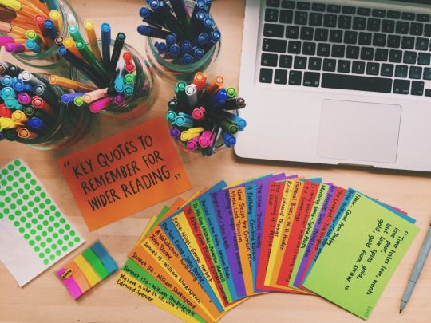
Shakespeare – Glossary of key terms
Context & Concepts
Misogyny ​- Hatred, contempt, or prejudice towards women for no reason other than their gender.
Morality ​- Principles, either personal or social, concerning the difference between right and wrong, going beyond legality and often religion.
Mythology ​- A collection of stories, especially belonging to a particular religion or culture such as the Ancient Greeks, that teach moral lessons or explain aspects of our world.
Nihilism ​- Believing life is pointless and meaningless.
Patriarchy ​- A system of society whereby men have ultimate authority which they use to oppress women who are largely excluded from the male dominated society.
Prejudice ​- Having a negative view or opinion of someone that is not based on experience or logic.
Remorse ​- The feeling of intense regret and guilt for doing a bad deed.
Repent ​- To feel or/and express great regret for sinning or committing a crime, particularly in a religious context.
Stereotype ​- A view or preconception of a person or thing that is fixed and oversimplified, held by most of a population.
The Renaissance​ - A period of time from the 14th to 17th century where artists, writers, and philosophers revisited the works of the Ancient Greeks and Romans.
Toxic Masculinity ​- The concept that traditional male gender roles restrict emotion in men while encouraging negative, often violent traits.
Tragedy ​- A branch of drama that usually depicts the downfall and the reversal of fortune of a good person; suffering usually awaits many of the characters, especially the tragic hero.
Vice ​- A behaviour or trait that is immoral.
Virtue ​- A behaviour or trait that is moral.
You can use the glossary to create quizzes and flashcards. You can then ask a member of your household to quiz/test you on the key terms. Some of these terms are particularly challenging, try to use them in your essays ☺ you’re teacher will help you to use them if you happen to use them incorrectly.
Studying With Flashcards
When studying with flashcards, make a small checkmark in the corner of the cards you answer correctly. When you have made two or three marks on a card, you know you can put it in a separate pile. Keep going through your main pile until all cards have two or three marks. Then, shuffle them and put them away for your next review session (or keep practicing!).

Slide 113
Context – end of reading quiz
What 4 factors can you consider when thinking about context?
location, social structures and features, cultural contexts, and periods in time.
Which period of time was Shakespeare writing in and what were the features of this time?
Shakespeare was writing during ​the Renaissance​ which was a period between the 14​th​ to 17​th​ centuries where there was an expansion of artistic expression
Which character represents the lower classes and how is this clear?
the nurse is meant to ​represent the lower class ​which is clear from the ​sexual jokes​ that she makes when talking to Juliet.
What genre is Romeo and Juliet?
A tragedy
What is Catharsis and how do we see it in the play?
a purging of pity and fear among the audience through the action of the play​. For example, the end of the play when the lovers commit suicide Juliet says ​“O happy dagger, / This is thy sheath,” ​ and dies, this is a great ​source of catharsis ​for the audience.
What was the effect of setting the play in Verona?
Can have any of the following: give the audience the safety to experience catharsis, permitted Shakespeare to critique society and the monarchy without being accused of treason, It is easier to explore new ideas, Verona is associated with increased passion.
What is the hot temperature of Verona associated with?
the​ hot temperature​ of Verona is associated with increased passion so is an apt setting for this ​passionate tale.
What would an English audience think about Catholicism at the time?
Catholicism was viewed negatively as it was known for its ​apparent corruption ​and its excess of passion​.

Slide 114
Context – end of reading quiz
How were religious values different to today?
How were women viewed during the Elizabethan Era?
Women were seen as lesser than men/sinful/In the Elizabethan era women were ​seen as property ​and were therefore ​objectified​/they were seen as property themselves.
How was marriage viewed during the Elizabethan Era?
Marriage was looked at as an end goal and purpose for all women.
How do Romeo and Juliet break gender norms?
Shakespeare’s exploration of Romeo and Juliet’s love affair challenges these ​gender norms​ as both characters are portrayed as active​. In addition to this, Romeo’s ​feminine tendencies​ subverts the typically masculine traits men were supposed to have.​ ​
What was a Petrarchan lover?
a man who falls in love with a woman but is either resisted or rejected.
What did many Elizabethans believe about Fate?
Most believed that some greater force (be it God, the stars etc.) would or has already controlled their destiny.
What could the Montague - Capulet feud symbolise in wider society?
The Montague-Capulet feud appeals to an archetype of two warring families / countries / clans etc.
Extra notes:

Slide 115
QUIZ - ANSWERS
FATE AND FREEWILL
Answer the questions below. These can be checked by somebody else in your household or self-assessed. (the answers are at the back.)
CHALLENGE – create your own quiz with answers and ask somebody to test you.
What is fate?
Fate is the concept that there are forces outside of human control which predetermine ​what happens in our lives.
What is freewill?
Freewill is the exact ​antithesis (opposite) of this as it claims that there are no outside forces and all the actions we take are just a result of us exercising our own ​choices​.
What is the effect of the quotation ​“two hours’ traffic of our stage”?
This reference to the length of the play further increases the tension as the audience are in constant anticipation of the two protagonists.
What is catharsis?
relieving of emotion).
Why does Shakespeare refer to the lovers as ‘star-crossed’? (2 effects)
Through referring to the lovers as​“star-crossed” Shakespeare shows how even the planets have an opposition to this relationship. It could also show the audience that their love is different from others and how it has a spiritual connection
What does the friar use in Act 1 Scene 4 to symbolise good vs evil?
Flowers (can include weeds)
When Juliet thinks that Romeo is dead, instead of regarding the possible things on Earth that could have killed him she asks if “heaven [could] be so envious”, what is the effect of this?
This shows that she could only think of the spiritual world as having the ability to intervene in their
What does Juliet compare Romeo to that foreshadows his death?
Lightning
How does the use of sonnet form add to theme of Fate?
The regularity of the form adds to the theme of fate as through it the audience is able to anticipate the inevitable rhythmic timing.

Slide 116
QUIZ
ISOLATION
Answer the questions below. These can be checked by somebody else in your household or self-assessed. (the answers are at the back.)
CHALLENGE – create your own quiz with answers and ask somebody to test you.
How is physical isolation used by the characters in the play?
isolation is used by the characters to help ​process their thoughts and emotions​.
How would a character look (when isolated) on stage?
They would suddenly seem very ​vulnerable​.
What is used to symbolise separation?
Separation is symbolised by the ​contrast between day and night​.
What does Juliet’s description of night being “love-performing” highlight?
the ​secrecy ​of their love and emphasises how separate it is from the rest of the world.
How is Romeo separate from the other male characters?
He tries to avoid getting caught up in the male fighting which takes place and in doing so separates himself from the ​hypermasculine persona​ the male characters exhibit.
When Romeo gets ready to kill himself and says “savage-wild”, what does it show?
This shows his ​detachment from his humanity​, isolating himself from everything that previously made him Romeo.

Slide 117
QUIZ
LOVE
Answer the questions below. These can be checked by somebody else in your household or self-assessed. (the answers are at the back.)
CHALLENGE – create your own quiz with answers and ask somebody to test you.
In what 4 ways does Shakespeare present love?
Unrequited, Elevated and holy Physical Linked with violence and death
How is unrequited love portrayed?
Through Romeo and Rosaline
Romeo and Juliet die together, what does this show?
It cements their eternal devotion for each other.
When The Friar says “Young men’s love lies not truly in their hearts, but in their eyes” what is he suggesting about love and what could Shakespeare be trying to show?
He is disregarding the idea that love can be something from the heart. This could be seen as Shakespeare shining light on the superficial nature of love, perhaps cloaking the whole play in ​irony ​and showing a fresh view of love, which contradicts the more romantically idealised conventions of the time.
Fill in the gaps: The _________ love of Romeo and Juliet is ______ by the ________ and _______ that takes place in the play.
The passionate love of Romeo and Juliet is ​unsettled by the violence ​and conflict that takes place in the play.
How does Shakespeare use oxymorons in Act 1 scene 1 to present love? You must use and analyse evidence.

Slide 118
QUIZ
Opposition
Answer the questions below. These can be checked by somebody else in your household or self-assessed. (the answers are at the back.)
CHALLENGE – create your own quiz with answers and ask somebody to test you.
What two methods does Shakespeare often use to present contrasting and contradicting ideas?
Shakespeare often uses ​juxtapositions ​and oxymoronic ​language to present these contrasting and contradicting ideas in the play.
What does Didactic mean?
Didactic means when something is intended to teach a moral lesson
Through the tragic ending in the play, what does Shakespeare illustrate?
Through the tragic ending in the play, Shakespeare illustrates the ​dangers of opposition and conflict in life​.
How are Tybalt and Mercutio similar?
Their ​inclination towards violence make them catalysts ​for the plot. In ​Act 3 Scene 1 ​we can see both men starting fights which ultimately lead to their deaths:
How are Tybalt and Mercutio different?
Tybalt is a very serious character who introduces the ​reality ​of the situation to the audience whereas Mercutio adds ​comedic relief.
What does the opposition of love and hate within the play ​create?
Tension

