Slide 1
Walton’s letters

Slide 2
Aims
Explore and analyse the characterisation of Walton
Evaluate the effect of Shelley’s chosen form – epistolary and frame narrative

Slide 3
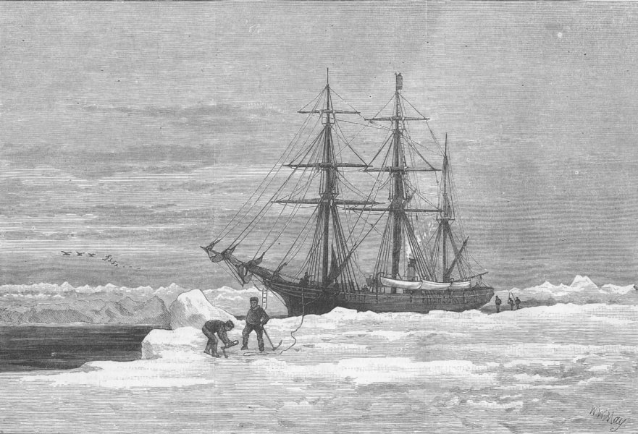
Who is Walton?
A single Londoner from an affluent background, travelling to the North Pole
Novel set in 1700s – the first successful Polar expedition didn’t happen until 1831 - an ambitious undertaking!
The ‘frame’ that holds the narratives of Frankenstein and the creature together

Slide 4
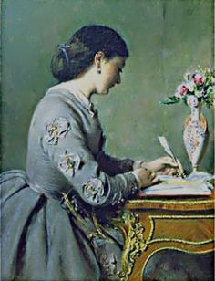
Who is Mrs Saville?
Walton’s married sister
A woman
The listener – we never read her response
The reader – like us – we listen to the story
MS – same initials as?

Slide 5
Key terms
Frame narrative: The result of inserting one or more small stories within the body of a larger story that encompasses the smaller ones. Often this term is used interchangeably with both the literary technique and the larger story itself that contains the smaller ones, which are called pericopes, "framed narratives" or "embedded narratives”.
Epistolary: Taking the form of a letter, or actually consisting of a letter written to another. For instance, several books in the New Testament written by Saint Paul are epistolary--they were originally letters written to newly founded Christian churches. Sometimes, novelists will write an epistolary novel, in which the story is unveiled as a series of letters between the characters.

Slide 6
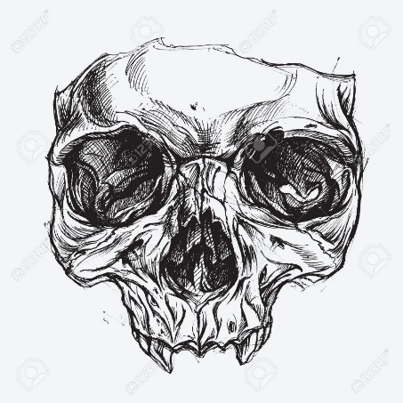
The Gothic connection…
Use of letters a common form in Gothic literature – allows slow revelations, multiple perspectives, questions about reliability, subjective and emotional responses …
Also common in travel narratives, which give a strong sense of place…
Quick question – other Gothic texts where you have encountered this use of form?

Slide 7
Letter 1 – the gist!
I have arrived in St Petersburg and am well
Driven by dreams of wonderful discover and hope of bringing benefits to humanity
Enthusiastic/ fulfilling childhood dreams
Initially hoped to be a poet, but failed at this
Inherited money, returned to dream of expedition
I deserve to succeed but feelings are changeable; often depressed and lonely
QUESTION: HOW DOES SHELLEY USE LANGUAGE TO ESTABLISH WALTON’S CHARACTER?

Slide 8
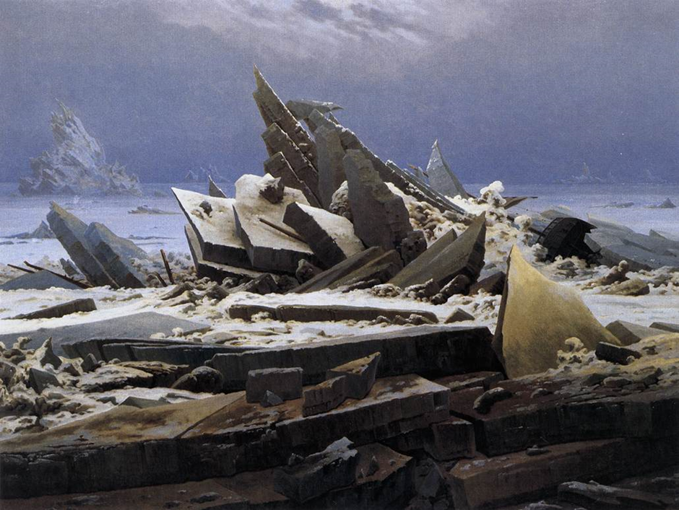
The sublime – see David Punter https://www.youtube.com/watch?v=pSdOYf0VBLM
The Sea of Ice by Caspar David Friedrich, 1824

Slide 9
Letter 2 - useful reference
Allusion to Samuel Taylor Coleridge’s ‘The Rime of the Ancient Mariner’ p21:
‘I am going to unexplored regions to ‘land of mist and snow’; but I shall kill no albatross, therefore do not be alarmed for my safety, or if I should come back to you as worn and woeful as the ‘Ancient Mariner’. You will smile at my allusion; but I will disclose a secret. I have often attributed my attachment to, my passionate enthusiasm for, the dangerous mysteries of the ocean, to that production of most imaginative of modern poets.’
‘a love for the marvellous’

Slide 10
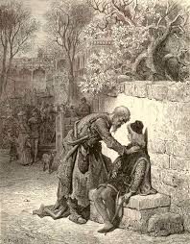
Letter 2 – significance of allusion
FUN FACT: Mary Shelley probably heard Coleridge reciting this poem in her own house, as he often visited her father.
Coleridge’s frame narrative poem is dominated by supernatural elements and begins with a wedding guest being interrupted by an ‘Ancient Mariner’, who proceeds to tell him the story of how, on a voyage, he killed an albatross despite it having led the sailors out of danger on Antarctic waters.
As a result, the ship is cursed, all the sailors die and the mariner is forced into a lonely and outcast state. As punishment for destruction of the creature and the subsequent death of his shipmates, he is exiled into a life of loneliness and isolation.
Notes:
Gothic connections – like Hamlet – ghost with a story to tell = revenge
Punishment for going against nature
Anticipates the end of the novel
Suggests however that Walton hasn’t fully understood the moral of the piece – he has just been captivated by the appeal of the wild – it is going to be up to Victor – the real mariner, to teach him. Walton is actually the bridal party guest!

Slide 11
Letters 3 and 4 - introduction to Victor
Focus points
Shift in form; use of diary entries within the letters
Characterisation of Victor Frankenstein
Presentation of setting
Framing as a cautionary tale
‘I see his thin hand raised in animation.’
Notes:
Up to letter 4

Slide 12
Extract from ‘Rime of the Ancient Mariner’
PART I
It is an ancient Mariner, And he stoppeth one of three. 'By thy long grey beard and glittering eye, Now wherefore stopp'st thou me?
The Bridegroom's doors are opened wide, And I am next of kin; The guests are met, the feast is set: May'st hear the merry din.'
He holds him with his skinny hand, 'There was a ship,' quoth he. 'Hold off! unhand me, grey-beard loon!' Eftsoons his hand dropt he.
He holds him with his glittering eye— The Wedding-Guest stood still, And listens like a three years' child: The Mariner hath his will.
The Wedding-Guest sat on a stone: He cannot choose but hear; And thus spake on that ancient man, The bright-eyed Mariner.
Notes:
Victor as mariner – framing story as morality tale?

Slide 13
Prep task - written
Why might Shelley have wanted to use Walton’s letters as the opening to the novel?
Aspects to consider:
Link to Rime of Ancient Mariner
Introduces themes e.g. journeys, dreams, madness, uncontrollable passions, breaking acceptable boundaries, friendship.
Introduces techniques - imagery, language of exploration, imagery, telling a tale
Deliberate parallels between Walton/ Frankenstein

