Slide 1
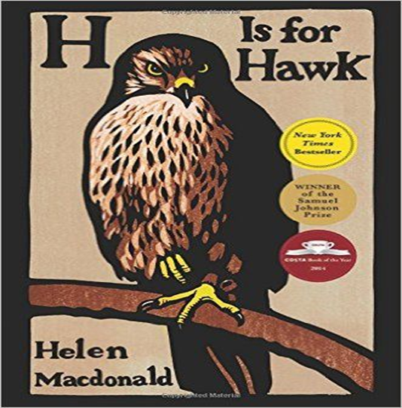
H is for Hawk

Slide 2
Understanding
This passage describes the first meeting between the author and her Hawk.
What instinctive decision does she make about the two Hawks?
How would you describe the way in which she writes about the two birds?

Slide 3
Helen Macdonald is an English writer, naturalist, and an Affiliated Research Scholar at the University of Cambridge Department of History and Philosophy of Science. She is best known as the author of H is for Hawk, which won the 2014 Samuel Johnson Prize and Costa Book Award.
This true story opens with the protagonist, Helen, talking about her love for birds. Helen has been a falconer for several years, and has recently become interested in a specific type of bird of prey, the Goshawk. Goshawks are notoriously hard to train because they are considered to be one of the most savage birds. Helen returns home one day after watching Goshawks in the woods to hear the shocking news that her father has passed away suddenly, of a heart attack. Helen was incredibly close to her father and considered him a legend, so the news devastates her.

Slide 4
Part of her grieving involves getting a Goshawk of her own and in this extract she meets the Goshawk for the very first time. It is a tense moment, a time when she is encountering a wild bird which is trained to hunt. When she meets with the breeder, he tells her that he brought two birds because he is selling another. She intends to get the older one, but after meeting the younger goshawk, she feels more of a connection with it. The older one is overwhelmingly big, male, and had a wild look, something that she doesn't think she can deal with. She pleads with the breeder to let her have the smaller, younger, female hawk instead.

Slide 5
Helen has been interviewed about her father passing away and training the bird in a number of YouTube clips. Here she is being interviewed by a news channel about her experiences:
https://www.youtube.com/watch?v=CV5ZK68OkEY

Slide 6
Techniques Used
Find and label any of the following techniques used by Macdonald to create an engaging piece of writing:
3 x similes
3x metaphors
3 x repetition of words/phrases for effect
Ellipsis (incomplete sentences) to build suspense

Slide 7
Structure: H is for Hawk (Page 20)
Decide which sections of H is for Hawk would fit with the following feelings/moods and write the line numbers down next to each mood.
E.g.
Tension – lines 1-5 + lines 22-26 etc
Anti Climax – lines…
Tension
Anti-Climax/disappointment
Calm
Chaos

Slide 8
Quotation | Comment
11: ‘another hinge untied. Concentration. Infinite caution.’ | Builds suspense through short stopped sentences. Suggests caution must be taken.
12: The air turned syrupy | Metaphor to imply time went very slowly as anticipation grows.
15: whirring, chaotic clatter of wings | Alliteration creates a sense of chaos and wildness. Contrasts to the slow build up of tension.

Slide 9
Quotation | Comment
16: enormous, enormous hawk | Repetition illustrates the sheer overwhelming size of the bird.
17: a great flood of sunlight drenches us and everything is brilliance and fury. | Personification conveys the mystical brilliance of the animal. It is almost a heavenly object.
20: A reptile. A fallen angel. A griffon from the pages of an illuminated bestiary. | A series of metaphors. Reptile suggests the potential for harm and evil. Angel suggests a spiritual aspect to the bird. Griffon suggests it belongs to another time.

Slide 10
Quotation | Comment
39: All at once I loved this man, and fiercely. | Could imply the void of her father is being filled. The adverb ‘fiercely’ suggests intense emotions.
52: and instead of twittering, she wailed… | Contrast to the normal, beautiful and peaceful sounds of the animal.
59: But this isn’t my hawk. | Repetition of inner thoughts show that intuitively she is repelled by the larger bird and cannot stomach it.

Slide 11
Exam Style Question 12 marks
How does the writer use language and structure to portray the birds?
You should support your answer with close reference to the passage, including BRIEF quotations.
The writer portrays the birds in different ways in this extract. Initially the first hawk is described as.../The write creates a sense of….
The writer uses a………..to describe the hawk when she writes ‘………………………………..’ which conveys…..

Slide 12
Starter: Write down what you think the words mean:
Dejected
Capricious
Taciturn
Belligerent
Effervescent

Slide 13
Starter: Write down what you think the words mean:
Dejected – feeling sad/disappointed or miserable
Capricious – Always changing
Taciturn – to be shy or quiet and distant
Belligerent - aggressive
Effervescent – lively and bubbly

Slide 14
H is for Hawk: Comparison Question
How do the writers convey their different feelings and experiences in these extracts? (22 marks)

Slide 15
Comparison Extract
In your exercise books pick 5 quotations from the extract with the person next to you.
You are going to write each quotation out in your book. You will then highlight key words and label what impression they give you. Bonus = identify if any techniques have been used e.g. rhetorical question, simile, interesting verbs and adverbs.
You will then tell the class what you have found at the end of the lesson.

Slide 16
Comparison
Find one quotation from both extracts that would fit with the feelings or experiences:
Feelings:
Awe/wonder/amazement
Potential threat of the birds
Disgust/Sadness

Slide 17
How do the writers convey their different feelings and experiences in these extracts? (22 marks)
Comparison words
Ambitious Vocabulary
Quotations
Both writers convey a sense of awe and wonder about the birds they describe in their extracts. Macdonald uses a series of metaphors to convey the first Hawk she meets when she describes it as ‘a conjuring trick…a fallen angel…a griffin from the pages of an illuminated bestiary’. This presents the bird as something mystical and spiritual and not from this earth. Macdonald is clearly mesmerised by the animal and feels a range of emotions from fear to bliss as she gazes at the hawk. Similarly, Bradley depicts the penguin he comes across as a source of amazement. He calls it ‘extraordinary’ and writes ‘One valiant bird was alive; a single surviving soul struggling amid all that death.’ The word ‘valiant’ suggests he has total respect for the penguin being able to survive and the harsh sibilance used conveys that the penguin has suffered greatly yet continues to stand, undefeated.
Zoom Down on a word
Writers’ Techniques identified

Slide 18
Potential threat of the bird (class paragraph)

Slide 19
Disgust/Sadness
Success:
( CP) Comparison phrases (similarly, likewise…)
(AV) Ambitious Vocabulary (dejected, belligerent, hostile, ominous….)
(Q) Quotations Used
(EQ) Explain how the quotations show feelings/experiences
(WT) Writers Techniques identified (metaphor/verb/simile/adverb/adjective/list of 3 etc)
(Z) Zoom down on a word.
Now you are going to write an independent comparison paragraph comparing how the writers convey their disgust or sadness with what they see and experience in the extracts.
Both writers convey….
Macdonald conveys her disappointment/dejection when she writes……
Bradley conveys his disgust/sadness/anger as he writes ‘…………………….’

