Slide 1
In this lesson, students will be mastering the following:
Mastery Content:
Jane is devastated by her punishment from Mr Brocklehurst
Helen Burns comforts Jane
Miss Temple asks Jane to acquit herself of the charge of being a liar
Miss Temple believes Jane and treats Helen and Jane well
Learning Objective:
To explore how Miss Temple is juxtaposed with Mr Brocklehurst.
Mastery Content

Slide 2
Do Now: Why did Mr Brocklehurst punish Jane? Why did Jane feel humiliated? List one event where Miss Temple treated the girls at Lowood kindly. What is Mr Brocklehurst’s attitude to childhood? Extension: What attitude towards children is the opposite of Brocklehurst’s attitude?
Reading: Helen comforts Jane Read from, ‘Ere the half hour ended… (page 81) Read to, ‘…recognised as Miss Temple.’ (page 83)
Helen comforts Jane In this passage, we see how Jane’s perception of what has happened varies drastically from the other children’s. Students need to explain how the two girls view what has happened as a check for understanding of the passage that has just been read. | This acts as a check for understanding as both Jane and Helen explain their feelings in relatively plain English. The exception is Helen’s description of God’s judgement, so you may wish to consider how to support re-reading of this part.
Reading: Miss Temple Recap the main points students already know about Miss Temple, then continue reading. Read from, ‘“I came on purpose to find you…”’ (page 83) Read to, ‘“… you are clear now.”’ (page 85) There are some true/false questions after the extract to assess students’ comprehension of the extract.
Reading Inform students that they will continue reading from where Miss Temple invites Jane and Helen to spend the evening with her. Read from, ‘She kissed me…’ (page 85) Read to, ‘…a tear from her cheek.’ (page 87)
Miss Temple and Mr Brocklehurst Recap what juxtaposition is. Often in Victorian literature, there is a juxtaposition between characters who have a similar relationship with the protagonist. Students independently write a paragraph answering this question: How does Bronte juxtapose Mr Brocklehurst and Miss Temple’s attitudes towards children? Extension: Which Victorian attitude towards children do you think Brontë agreed with? Why? | You may want to ask students to write down their initial ideas to this question. We are clearly meant to empathise much more with Miss Temple, suggesting that Brontë would advocate a more accepting and tolerant approach to raising and teaching children.
Mastery assessment plenary Students complete quiz.
Lesson Guide
NOTE: There is a lot of reading in this lesson, so think carefully how you will manage this.

Slide 3
Tuesday, 14 June 2022
Miss Temple
Do Now:
Mr Brocklehurst punished Jane because she dropped her chalkboard.
Jane felt humiliated because Mr Brocklehurst told everyone at Lowood that she is a liar.
Miss Temple gave the girls cheese and bread when their breakfast was burnt.
Brocklehurst believes that children are born evil, and they need to have the sin beaten out of them with strict discipline.
Do Now:
Why did Mr Brocklehurst punish Jane?
Why did Jane feel humiliated?
List one event where Miss Temple treated the girls at Lowood kindly.
What is Mr Brocklehurst’s attitude to childhood?
Do Now
Extension: A child is born completely innocent and pure. They are only contaminated by contact with corrupt forces.
Extension: What attitude towards children is the opposite of Brocklehurst’s attitude?

Slide 4
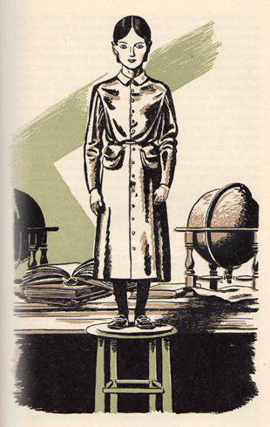
Last lesson Jane was ordered to stand on a stool.
Let’s find out what happens to Jane for the rest of the day.
Read from, ‘Ere the half hour ended…’ (page 81)
Read to, ‘…recognised as Miss Temple.’ (page 83)
Jane Eyre

Slide 5
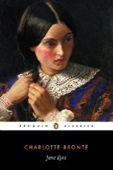
Ere the half-hour ended, five o’clock struck; school was dismissed, and all were gone into the refectory to tea. I now ventured to descend: it was deep dusk; I retired into a corner and sat down on the floor. The spell by which I had been so far supported began to dissolve; reaction took place, and soon, so overwhelming was the grief that seized me, I sank prostrate with my face to the ground. Now I wept: Helen Burns was not here; nothing sustained me; left to myself I abandoned myself, and my tears watered the boards. I had meant to be so good, and to do so much at Lowood: to make so many friends, to earn respect, win affection. Already I had made visible progress: that very morning I had reached the head of my class; Miss Miller had praised me warmly; Miss Temple had smiled approbation; she had promised to teach me drawing, and to let me learn French, if I continued to make similar improvement two months longer: and then I was well received by my fellow-pupils; treated as an equal by those my own age, and not molested by any; now, here I lay again crushed and trodden on; and could I ever rise more?
refectory – cafeteria
ventured – dared
descend – move down
dusk – nightfall
prostrate – stretched out
approbation – approval
molested – mistreated
Jane Eyre
p.81

Slide 6
‘Never,’ I thought; and ardently I wished to die. While sobbing out this wish in broken accents, someone approached: I started up – again Helen Burns was near me; the fading fires just showed her coming up the long, vacant room; she brought my coffee and bread.
‘Come, eat something,’ she said; but I put both away from me, feeling as if a drop or a crumb would have choked me in my present condition. Helen regarded me, probably, with surprise: I could not now abate my agitation, though I tried hard; I continued to weep aloud. She sat down on the ground near me, embraced her knees with her arms, and rested her head upon them; in that attitude she remained silent as an Indian. I was the first who spoke –
‘Helen, why do you stay with a girl whom everybody believes to be a liar?’
‘Everybody, Jane? Why, there are only eighty people who have heard you called so, and the world contains hundreds of millions.’
‘But what have I to do with millions? The eighty I know despise me.’
ardently – eagerly
vacant – empty
regarded – looked at
abate my agitation – lessen my worry
Jane Eyre
p.81-82

Slide 7
‘Jane, you are mistaken: probably not one in the school either despises or dislikes you; many, I am sure, pity you much.’
‘How can they pity me after what Mr Brocklehurst said?’
‘Mr Brocklehurst is not a god: nor is he even a great and admired man: he is little liked here; he never took steps to make himself liked. Had he treated you as an especial favourite, you would have found enemies, declared or covert, all around you; as it is, the greater number would offer you sympathy if they dared. Teachers and pupils may look coldly on you for a day or two, but friendly feelings are concealed in their hearts; and if you persevere in doing well, these feelings will ere long appear so much the more evidently for their temporary suppression. Besides, Jane – ‘ She paused.
‘Well, Helen?’ said I, putting my hand into hers. She chafed my fingers gently to warm them, and went on –
‘If all the world hated you, and believed you wicked, while your own conscience approved you, and absolved you from guilt, you would not be without friends.’
especial – special
covert – secret
concealed – hidden
persevere – continue
suppression – absence
absolved – forgave
Jane Eyre
p.82

Slide 8
‘No; I know I should think well of myself; but that is not enough: if others don’t love me, I would rather die than live – I cannot bear to be solitary and hated, Helen. Look here; to gain some real affection from you, or Miss Temple, or any other whom I truly love, I would willingly submit to have the bone of my arm broken, or to let a bull toss me, or to stand behind a kicking horse, and let it dash its hoof at my chest – ‘
‘Hush, Jane! you think too much of the love of human beings; you are too impulsive, too vehement: the sovereign Hand that created your frame, and put life into it, has provided you with other resources than your feeble self, or than creatures feeble as you. Besides this earth, and besides the race of men, there is an invisible world and a kingdom of spirits: that world is round us, for it is everywhere; and those spirits watch us, for they are commissioned to guard us; and if we were dying in pain and shame, if scorn smote us on all sides, and hatred crushed us, angels see our tortures, recognise our innocence (if innocent we be: as I know you are of this charge which Mr Brocklehurst has weakly and pompously repeated at second-hand from Mrs Reed; for I read a sincere nature in your ardent eyes and on your clear front), and God waits only the separation of spirit from flesh to crown us with a full reward.
solitary – alone
submit – allow
impulsive – hasty
vehement –intense
sovereign Hand – i.e. God
feeble – weak
commissioned – assigned
smote – hit
pompously – arrogantly
ardent – passionate
Jane Eyre
p.82-83

Slide 9
Why, then, should we ever sink overwhelmed with distress, when life is so soon over, and death is so certain an entrance to happiness – to glory?’
I was silent: Helen had calmed me; but in the tranquillity she imparted there was an alloy of inexpressible sadness. I felt the impression of woe as she spoke, but I could not tell whence it came; and when, having done speaking, she breathed a little fast and coughed a short cough, I momentarily forgot my own sorrows to yield to a vague concern for her.
Resting my head on Helen’s shoulder, I put my arms round her waist; she drew me to her, and we reposed in silence. We had not sat long thus, when another person came in. Some heavy clouds, swept from the sky by a rising wind, had left the moon bare; and her light, streaming in through a window near, shone full both on us and on the approaching figure, which we at once recognised as Miss Temple.
glory – magnificence
tranquillity – calmness
alloy – mixture
woe – sadness
reposed – rested
Jane Eyre
p.83

Slide 10
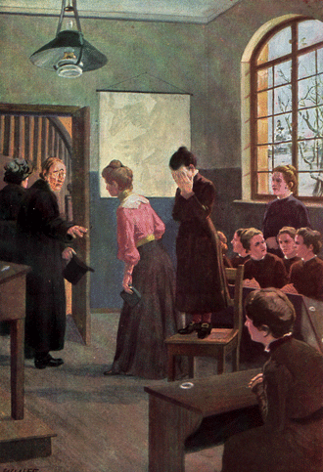
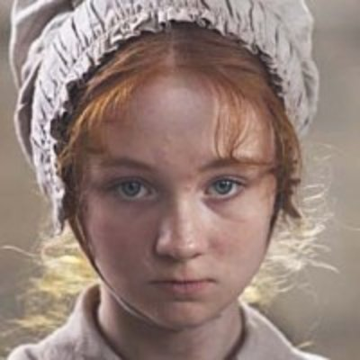
Jane and Helen have very different perspectives on what has just happened.
Jane and Helen
Jane
Helen Burns
In pairs, make a list of bullet points on these two questions:
What does Jane think about what has just happened to her?
What does Helen Burns think about what has happened to Jane?

Slide 11
Jane
Jane and Helen
Jane thinks that everyone is going to hate her now.
She is worried that no one will want to talk to her.
Jane has been working very hard at Lowood, and she is worried that all of her good work will now be undone.
Jane would gladly have her arm broken or be kicked by a horse if it meant that the students would like her again!

Slide 12
Helen Burns
Jane and Helen
Helen reassures Jane. She tells Jane that no one hates her.
Helen tells Jane that none of the girls like Mr Brocklehurst. It would have been worse for Jane if Mr Brocklehurst had liked her!
All the girls and the teachers will like Jane more because of the way Mr Brocklehurst treated her.
Helen reminds Jane that it doesn’t matter what people think of her. The only thing that matters is God’s judgement when we die.

Slide 13
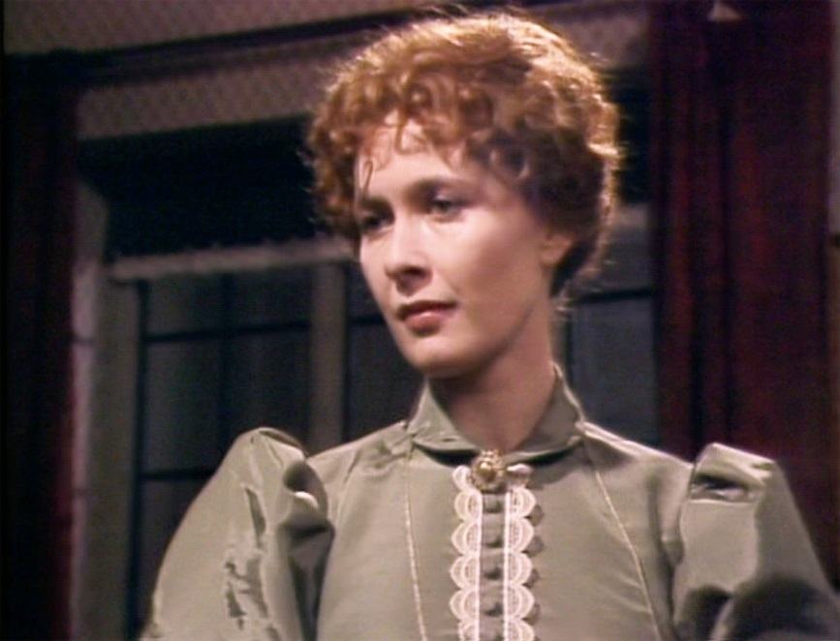
She gave the children bread and cheese when their breakfast was burnt.
Miss Temple is kind and generous.
Helen also loves Miss Temple.
Jane loves Miss Temple.
Miss Temple
When the girls walked to the church in the cold, she was the only teacher to encourage the girls.
She is the best-loved teacher at Lowood School.
Miss Temple
In the next passage, we see how Miss Temple treats Jane.
Before we continue reading, think about three things that you know about Miss Temple.

Slide 14
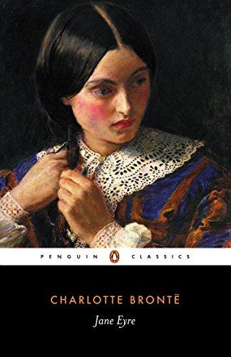
Let’s find out how Miss Temple reacts to what Mr Brocklehurst has said about Jane.
Let’s read.
Read from, ‘“I came on purpose to find you…”’ (page 83)
Read to, ‘“… you are clear now.”’ (page 85)
Jane Eyre

Slide 15
‘I came on purpose to find you, Jane Eyre,’ said she; ‘I want you in my room; and as Helen Burns is with you, she may come too.’
We went; following the superintendent’s guidance, we had to thread some intricate passages, and mount a staircase before we reached her apartment; it contained a good fire, and looked cheerful. Miss Temple told Helen Burns to be seated in a low arm-chair on one side of the hearth, and herself taking another, she called me to her side.
‘Is it all over?’ she asked, looking down at my face. ‘Have you cried your grief away?’
‘I am afraid I never shall do that.’
‘Why?’
‘Because I have been wrongly accused; and you, ma’am, and everybody else will now think me wicked.’
‘We shall think you what you prove yourself to be, my child. Continue to act as a good girl, and you will satisfy us.’
‘Shall I, Miss Temple?’
‘You will,’ said she, passing her arm around me. ‘And now tell me who is the lady whom Mr Brocklehurst called your benefactress?’
intricate – tricky
mount – climb
hearth – fireplace
benefactress – sponsor
Jane Eyre
p.83-84

Slide 16
‘Mrs Reed, my uncle’s wife. My uncle is dead, and he left me to her care.’
‘Did she not, then, adopt you of her own accord?’
‘No, ma’am; she was sorry to have to do it: but my uncle, as I have often heard the servants say, got her to promise before he died, that she would always keep me.’
‘Well now, Jane, you know, or at least I will tell you, that when a criminal is accused, he is always allowed to speak in his own defence. You have been charged with falsehood; defend yourself to me as well as you can. Say whatever your memory suggests as true; but add nothing and exaggerate nothing.’
I resolved in the depth of my heart, that I would be most moderate – most correct; and, having reflected a few minutes in order to arrange coherently what I had to say, I told her all the story of my sad childhood. Exhausted by emotion, my language was more subdued than it generally was when it developed that sad theme; and mindful of Helen’s warnings against the indulgence of resentment, I infused into the narrative far less of gall and wormwood than ordinary.
own accord – own choice
resolved – decided
moderate – reasonable
indulgence of resentment– excessive
hatred
infused – filled
gall – bitterness
wormwood –grief
Jane Eyre
p.84

Slide 17
Thus restrained and simplified, it sounded more credible: I felt as I went on that Miss Temple fully believed me.
In the course of the tale I had mentioned Mr Lloyd as having come to see me after the fit: for I never forgot the, to me, frightful episode of the red-room; in detailing which, my excitement was sure, in some degree, to break bounds; for nothing could soften in my recollection the spasm of agony which clutched my heart when Mrs Reed spurned my wild supplication for pardon, and locked me a second time in the dark and haunted chamber.
I had finished: Miss Temple regarded me a few minutes in silence; she then said –
‘I know something of Mr Lloyd; I shall write to him; if his reply agrees with your statement, you shall be publicly cleared from every imputation: to me, Jane, you are clear now.’
recollection – memory
supplication – request
imputation – accusation
Jane Eyre
p.84-85

Slide 18
Which statements about Jane’s discussion with Miss Temple are true?
Miss Temple treats Jane with respect.
Jane gets angry and upset when she tells Miss Temple what happened at Gateshead Hall, just like she did when she told Helen what happened.
Jane has not forgotten the terror of the red-room.
Miss Temple says that she will believe that Jane is a liar until Mr Lloyd has proved her innocence.
Jane Eyre

Slide 19
Which statements about Jane’s discussion with Miss Temple are true?
1. Miss Temple treats Jane with respect.
1. Miss Temple treats Jane with respect. TRUE
2. Jane gets angry and upset when she tells Miss Temple what happened at Gateshead Hall, just like she did when she told Helen what happened.
2. Jane gets angry and upset when she tells Miss Temple what happened at Gateshead Hall, just like she did when she told Helen what happened. FALSE Jane remembered that Helen told her to be calm, so she remains calm when she tells Miss Temple about her past.
Jane Eyre
3. Jane has not forgotten the terror of the red-room.
3. Jane has not forgotten the terror of the red-room. TRUE
4. Miss Temple says that she will believe that Jane is a liar until Mr Lloyd has proved her innocence.
4. Miss Temple says that she will believe that Jane is a liar until Mr Lloyd has proved her innocence. FALSE Miss Temple tells Jane that she already believes that Jane is not a liar.

Slide 20
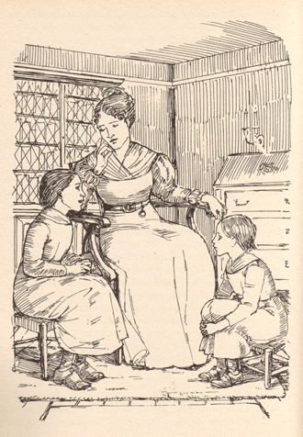
Miss Temple has invited Jane and Helen to spend the evening with her. We are going to continue to see why the girls at Lowood love Miss Temple.
Miss Temple
Let’s find out about their evening.
Read from, ‘She kissed me…’ (page 85)
Read to, ‘…a tear from her cheek.’ (page 87)
Jane Eyre
Helen Burns
Jane Eyre

Slide 21
She kissed me, and still keeping me at her side (where I was well contented to stand, for I derived a child’s pleasure from the contemplation of her face, her dress, her one or two ornaments, her white forehead, her clustered and shining curls, and beaming dark eyes), she proceeded to address Helen Burns.
‘How are you to-night, Helen? Have you coughed much to-day?’
‘Not quite so much, I think, ma’am.’
‘And the pain in your chest?’
‘It is a little better.’
Miss Temple got up, took her hand and examined her pulse; then she returned to her own seat; as she resumed it, I heard her sigh low. She was pensive for a few minutes, then rousing herself, she said cheerfully –
‘But you two are my visitors to-night; I must treat you as such.’ She rang her bell.
‘Barbara,’ she said to the servant who answered it, ‘I have not yet had tea; bring the tray, and place cups for these two young ladies.’
And a tray was soon brought. How pretty, to my eyes, did the china cups and bright teapot look, placed on the little round table near the fire!
pensive – lost in thought
pensive – lost in thought
discerned – noticed
Jane Eyre
p.85

Slide 22
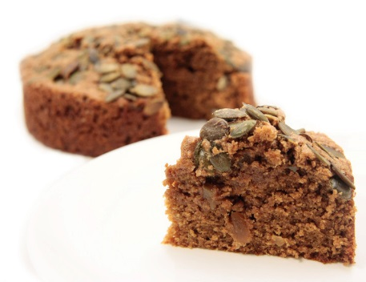
How fragrant was the steam of the beverage, and the scent of the toast! Of which, however, I, to my dismay (for I was beginning to be hungry), discerned only a very small portion: Miss Temple discerned it too.
‘Barbara,’ said she, ‘can you not bring a little more bread and butter? There is not enough for three.’
Barbara went out. She returned soon.
‘Madam, Mrs Harden says she has sent up the usual quantity.’
Mrs Harden, be it observed, was the housekeeper, a woman after Mr Brocklehurst’s own heart, made up of equal parts of whalebone and iron.
‘Oh, very well!’ returned Miss Temple; ‘we must make it do, Barbara, I suppose.’ And as the girl withdrew, she added, smiling, ‘Fortunately, I have it in my power to supply deficiencies for this once.’
Having invited Helen and me to approach the table, and placed before each of us a cup of tea with one delicious but thin morsel of toast, she got up, unlocked a drawer, and taking from it a parcel wrapped in paper, disclosed presently to our eyes a good-sized seed-cake.
discerned – noticed
i.e. ungenerous
deficiencies – shortages
morsel – piece
Jane Eyre
p.85-86

Slide 23
‘I meant to give each of you some of this to take with you,’ said she; ‘but as there is so little toast, you must have it now,’ and she proceeded to cut slices with a generous hand.
We feasted that evening as on nectar and ambrosia; and not the least delight of the entertainment was the smile of gratification with which our hostess regarded us, as we satisfied our famished appetites on the delicate fare she liberally supplied.
Tea over and the tray removed, she again summoned us to the fire; we sat one on each side of her, and now a conversation followed between her and Helen, which was indeed a privilege to be admitted to hear.
Miss Temple had always something of serenity in her air, of state in her mien, of refined propriety in her language, which precluded deviation into the ardent, the excited, the eager: something which chastened the pleasure of those who looked on her, and listened to her, by a controlling sense of awe; and such was my feeling now: but as to Helen Burns, I was struck with wonder.
nectar – syrup
ambrosia – food of the gods
famished – starving
liberally – generously
i.e. Miss Temple has a calming influence on people. Even if you feel like you should be overawed by her, she calms you. But Helen Burns fills Jane with wonder.
Jane Eyre
p.86

Slide 24
The refreshing meal, the brilliant fire, the presence and kindness of her beloved instructress, or, perhaps, more than all these, something in her own unique mind, had roused her powers within her. They woke, they kindled: first, they glowed in the bright tint of her cheek, which till this hour I had never seen but pale and bloodless; then they shone in the liquid lustre of her eyes, which had suddenly acquired a beauty more singular than that of Miss Temple’s – a beauty neither of fine colour nor long eyelash, nor pencilled brow, but of meaning, of movement, of radiance.
Then her soul sat on her lips, and language flowed, from what source I cannot tell; has a girl of fourteen a heart large enough, vigorous enough to hold the swelling spring of pure, full, fervid eloquence? Such was the characteristic of Helen’s discourse on that, to me, memorable evening; her spirit seemed hastening to live within a very brief span as much as many live during a protracted existence.
They conversed of things I had never heard of; of nations and times past; of countries far away; of secrets of nature discovered or guessed at: they spoke of books: how many they had read! What stores of knowledge they possessed!
lustre – shine
radiance – brilliance
vigorous – energetic
fervid eloquence – glowing
expression
discourse – speech
protracted – lengthy
Jane Eyre
p.86-87

Slide 25
Then they seemed so familiar with French names and French authors: but my amazement reached its climax when Miss Temple asked Helen if she sometimes snatched a moment to recall the Latin her father had taught her, and, taking a book from a shelf, bade her read and construe a page of Virgil; and Helen obeyed, my organ of veneration expanding at every sounding line. She had scarcely finished ere the bell announced bedtime; no delay could be admitted; Miss Temple embraced us both, saying, as she drew us to her heart –
‘God bless you, my children!’
Helen she held a little longer than me; she let her go more reluctantly. It was Helen her eye followed out the door; it was for her she a second time breathed a sad sigh; for her she wiped a tear from her cheek.
construe – interpret, translate
veneration – admiration
Jane Eyre
p.87

Slide 26
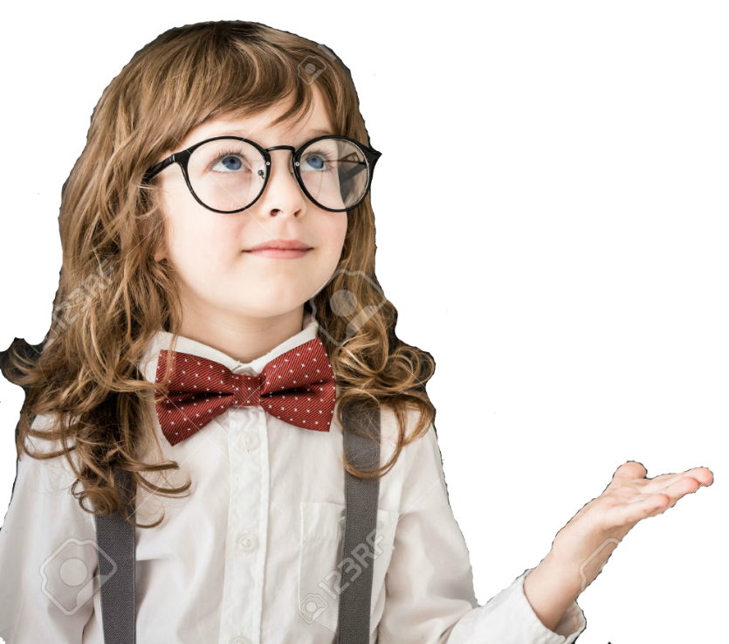
We feasted that evening as on nectar and ambrosia; and not the least delight of the entertainment was the smile of gratification with which our hostess regarded us, as we satisfied our famished appetites on the delicate fare she liberally supplied.
Helen and Jane are delighted to accept the food that Miss Temple gives them. They have been starved of food; they are famished.
Jane Eyre
In pairs, discuss how this passage is a metaphor.
Clue:
The girls are literally being given food. This is the tenor. What else is Miss Temple giving them?

Slide 27
We feasted that evening as on nectar and ambrosia; and not the least delight of the entertainment was the smile of gratification with which our hostess regarded us, as we satisfied our famished appetites on the delicate fare she liberally supplied.
Helen and Jane are delighted to accept the food that Miss Temple gives them. They have been starved of food; they are famished.
Jane Eyre
But the girls are not just nourished by the food. The food that Miss Temple offers Jane and Helen is a metaphor for the love and affection that Miss Temple offers, and which they gratefully receive. Jane has been ‘famished’ of love for her whole life. Now, Miss Temple ‘liberally supplied’ Jane with care and affection.

Slide 28
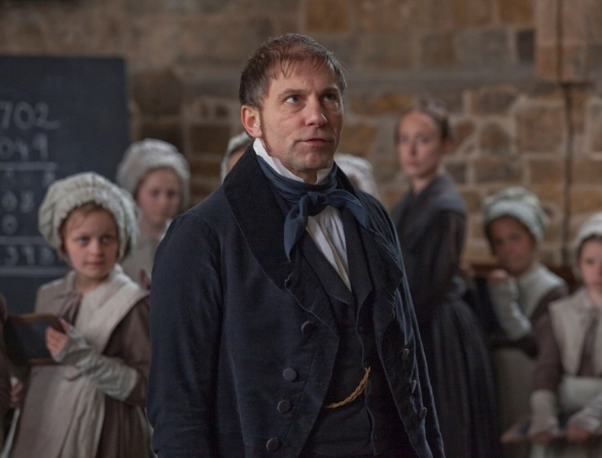
Juxtaposition is a literary technique where a writer places very different things or people close to each other. This helps to show how the things are similar or different.
A writer often juxtaposes characters on purpose.
They do this to show the contrast between two characters
Write a paragraph answering this question: Mr Brocklehurst and Miss Temple treat Jane very differently. What does this juxtaposition reveal about Brontë’s attitudes towards children?
Juxtaposition
Mr Brocklehurst
Miss Temple

Slide 29
What do we learn about Miss Temple in this chapter?
Miss Temple is scared of Mr Brocklehurst.
She is prepared to defend the children at Lowood School.
She is strict and harsh with the girls, just as Mr Brocklehurst tells her to be.
Miss Temple will trust Mr Brocklehurst’s opinion more than she will trust the girls’ because he is an adult.
Miss Temple will write to Mr Lloyd because she doesn’t think that Jane has been telling the truth about what happened at Gateshead Hall.
Mastery

Slide 30
What do we learn about Miss Temple in this chapter?
Miss Temple is scared of Mr Brocklehurst.
She is prepared to defend the children at Lowood School.
She is strict and harsh with the girls, just as Mr Brocklehurst tells her to be.
Miss Temple will trust Mr Brocklehurst’s opinion more than she will trust the girls’ because he is an adult.
Miss Temple will write to Mr Lloyd because she doesn’t think that Jane has been telling the truth about what happened at Gateshead Hall.
Review

Slide 31
Love this lesson?
Have suggestions for improvements?
Does something need fixing?
Feedback
Please let us know!
Fill in this feedback form so that we can keep improving.

