Slide 1
Watch documentary, making notes
https://www.youtube.com/watch?v=JofWsm2CJ68
https://www.youtube.com/watch?v=niuR45NDgEM
https://www.youtube.com/watch?v=JofWsm2CJ68&list=PL5MdabjsuL3ExUoqQC6I-gqGzo_6NzmiW

Slide 2
Introduction to Frankenstein

Slide 3
Key questions for today…
In what circumstances was Frankenstein composed?
In what ways were Mary Shelley and her companions influenced by contemporary ghost stories and Gothic horror stories?
In what ways did Mary Shelley draw upon contemporary developments in science?

Slide 4
First adaptation of Frankenstein 1910
Considering key themes and ideas…

Slide 5
Read Mary Shelley’s introduction to the 1831 edition…
What does Shelley say about the novel’s origins?
What parallels can be drawn between the ‘birth’ of a monster and the ‘birth’ of Shelley’s novel?

Slide 6
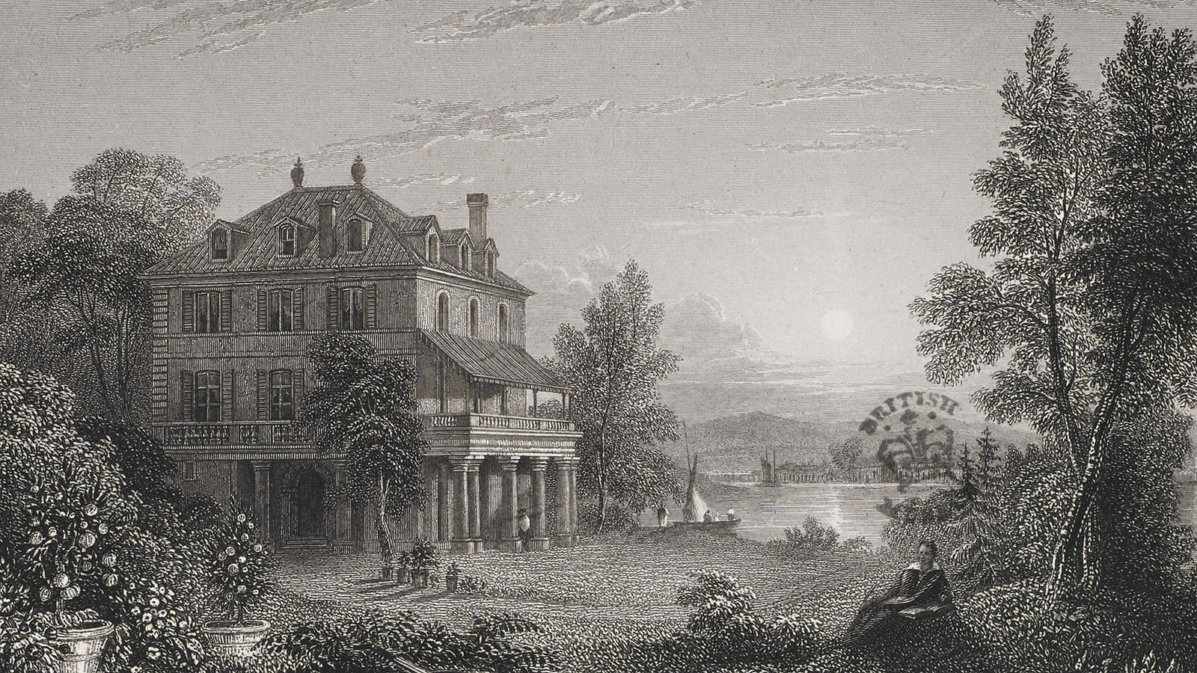
Villa Diodati

Slide 7
Explore contexts
Find out more about the concepts/ influences listed, considering in what ways they might be relevant to the story of Frankenstein…
Alchemy
Galvanism
Grave-robbing
Dissection
Fantasmagoria
The Vampyre, John Polidori
Villa Diodati and the ghost story challenge
Use the web links to help you, saved in student shared area

Slide 8
Produce…
A visual representation of the story of Frankenstein’s origins, including the events at the Villa Diodati and the scientific and literary ideas that influenced Mary Shelley.
You might aim to:
Storyboard, collage, comic strip…
Reflect some of the Gothic images and motifs you have already learned about
Draw upon the cartoon style adaptations of Frankenstein

