Slide 1
In this lesson, students will be mastering the following:
Mastery Content:
Life at Lowood continues to be harsh, as the water basins freeze over
Helen is punished for having dirty hands because she was unable to wash them in the frozen water
Helen accepts her unjust punishment without a word of complaint
Jane does not understand how Helen can accept her punishment so easily
Learning Objective
To analyse how Jane and Helen react to punishment differently.
Mastery Content

Slide 2
Do Now: Who is Helen Burns? List 2 adjectives to describe Helen. How are Jane and Helen Burns similar? How are Jane and Helen Burns different? Extension: _______________ is a literary technique where a writer places very different things or people close to each other. This helps to show how the things are similar or different.
Recap Recap the events of the previous chapter which show how life at Lowood is harsh and bleak.
Reading: Helen Read from, ‘The next day commenced as before’ (page 63) Read to, ‘…a tear glistened on her thin cheek’ (page 65) The passage shows Helen receiving a brutal flogging for having dirty hands, despite the fact that the water was frozen, which meant she was unable to. There are some check for understanding questions following the reading to allow you to check students’ comprehension of the passage.
Reading: Helen and Jane Read from, ‘The play-hour in the evening I thought the pleasantest fraction…’ (page 65) Read to, ‘… I put it off to a more convenient season’ (page 67)
Helen and Jane Ask students to re-read the conversation between Helen and Jane on page 66. The exchange shows Helen and Jane’s different attitudes to the way Helen received her punishment. In pairs, students, list down how Jane and Helen Burns react differently to receiving punishment. | Discuss answer slide on slide 22. You could extend this further by asking students whose views they with agree with the most and why.
Comparing Jane and Helen Students complete the close paragraph answering this question: Compare how Jane and Helen Burns react differently to receiving punishment. | There is a model provided, but you do not have to use it. Alternatively, you may wish to construct another paragraph together as a class before asking students to continue to write the rest of their answer independently.
Mastery assessment plenary Students complete quiz.
Lesson Guide

Slide 3
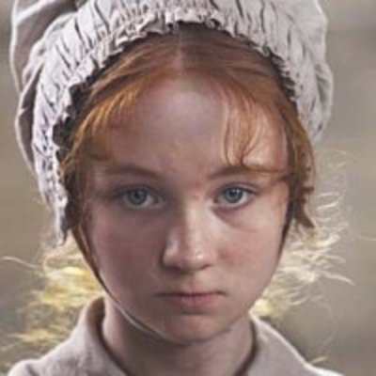
Tuesday, 14 June 2022
Helen Burns and Jane Eyre
Do Now:
Helen Burns is another student at Lowood school.
Helen is meek and obedient.
Both Helen and Jane are orphans.
Helen takes her punishment in a calm way, but Jane reacts to punishments passionately.
Do Now:
Who is Helen Burns?
List 2 adjectives to describe Helen.
How are Jane and Helen Burns similar?
How are Jane and Helen Burns different?
Do Now
Helen Burns
Extension: Juxtaposition is a literary technique where a writer places very different things or people close to each other. This helps to show how the things are similar or different.
Extension: _______________ is a literary technique where a writer places very different things or people close to each other. This helps to show how the things are similar or different.

Slide 4
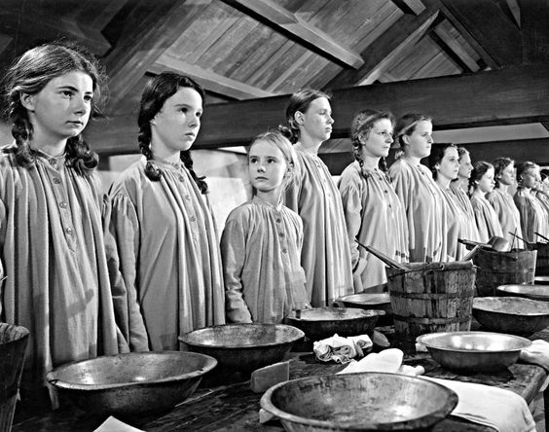
Jane has spent her first day at Lowood School.
The food is plain, and there is not much of it.
Much of the day is spent studying.
The Bible plays an important role in life at Lowood.
The girls regularly receive punishments.
Lowood School

Slide 5
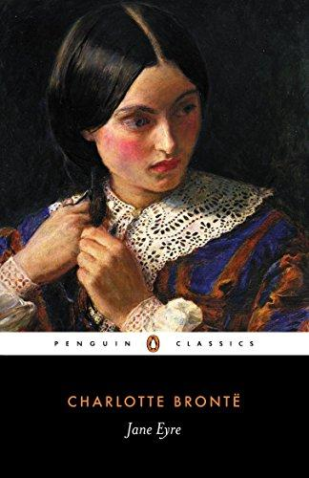
Lowood School is in the North of England, and Jane arrives in the middle of January.
We are about to see how the weather can make life even harder at Lowood!
Jane Eyre
Let’s read.
Read from, ‘The next day commenced as before’ (page 63)
Read to, ‘…a tear glistened on her thin cheek’ (page 65)

Slide 6
The next day commenced as before, getting up and dressing by rushlight; but this morning we were obliged to dispense with the ceremony of washing; the water in the pitchers was frozen. A change had taken place in the weather the preceding evening, and a keen north-east wind, whistling through the crevices of our bedroom windows all night long, had made us shiver in our beds, and turned the contents of the ewers to ice.
Before the long hour and a half of prayers and Bible-reading was over, I felt ready to perish with cold. Breakfast-time came at last, and this morning the porridge was not burnt; the quality was eatable, the quantity small. How small my portion seemed! I wished it had been doubled.
In the course of the day I was enrolled a member of the fourth class, and regular tasks and occupations were assigned me: hitherto, I had only been a spectator of the proceedings at Lowood; I was now to become an actor therein.
obliged –forced to
dispense - leave
ewers – water jug
perish – die
hitherto – before now
Jane Eyre
p.63

Slide 7
At first, being little accustomed to learn by heart, the lessons appeared to me both long and difficult; the frequent change from task to task, too, bewildered me; and I was glad when, about three o’clock in the afternoon, Miss Smith put into my hands a border of muslin two yards long, together with needle, thimble, &c., and sent me to sit in a quiet corner of the schoolroom, with directions to hem the same. At that hour most of the others were sewing likewise; but one class still stood round Miss Scatcherd’s chair reading, and as all was quiet, the subject of their lessons could be heard, together with the manner in which each girl acquitted herself, and the animadversions or commendations of Miss Scatcherd on the performance. It was English history: among the readers I observed my acquaintance of the verandah: at the commencement of the lesson, her place had been at the top of the class, but for some error of pronunciation, or some inattention to stops, she was suddenly sent to the very bottom. Even in that obscure position, Miss Scatcherd continued to make her an object of constant notice: she was continually addressing to her such phrases as the following:—
bewildered - confused
muslin – cloth
hem – sew an edge
acquitted – performed
animadversions – criticism
commendation – praise
Jane Eyre
p.63-64

Slide 8
“Burns” (such it seems was her name: the girls here were all called by their surnames, as boys are elsewhere), “Burns, you are standing on the side of your shoe; turn your toes out immediately.” “Burns, you poke your chin most unpleasantly; draw it in.” “Burns, I insist on your holding your head up; I will not have you before me in that attitude,” &c. &c.
A chapter having been read through twice, the books were closed and the girls examined. The lesson had comprised part of the reign of Charles I., and there were sundry questions about tonnage and poundage and ship-money, which most of them appeared unable to answer; still, every little difficulty was solved instantly when it reached Burns: her memory seemed to have retained the substance of the whole lesson, and she was ready with answers on every point. I kept expecting that Miss Scatcherd would praise her attention; but, instead of that, she suddenly cried out—
“You dirty, disagreeable girl! you have never cleaned your nails this morning!”
Burns made no answer: I wondered at her silence. “Why,” thought I, “does she not explain that she could neither clean her nails nor wash her face, as the water was frozen?”
sundry - many
tonnage and poundage – weight in tonnes and pounds
Jane Eyre
p.64

Slide 9
My attention was now called off by Miss Smith desiring me to hold a skein of thread: while she was winding it, she talked to me from time to time, asking whether I had ever been at school before, whether I
could mark, stitch, knit, &c.; till she dismissed me, I could not pursue my observations on Miss Scatcherd’s movements. When I returned to my seat, that lady was just delivering an order of which I did not catch the import; but Burns immediately left the class, and going into the small inner room where the books were kept, returned in half a minute, carrying in her hand a bundle of twigs tied together at one end. This ominous tool she presented to Miss Scatcherd with a respectful curtesy; then she quietly, and without being told, unloosed her pinafore, and the teacher instantly and sharply inflicted on her neck a dozen strokes with the bunch of twigs. Not a tear rose to Burns’ eye; and, while I paused from my sewing, because my fingers quivered at this spectacle with a sentiment of unavailing and impotent anger, not a feature of her pensive face altered its ordinary expression.
“Hardened girl!” exclaimed Miss Scatcherd; “nothing can correct you of your slatternly habits: carry the rod away.”
skein - length
strokes – hits
sentiment – feeling
unavailing – useless
slatternly – dirty
Jane Eyre
p.64-65

Slide 10
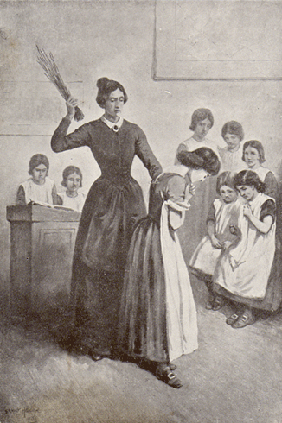
…carrying in her hand a bundle of twigs tied together at one end. This ominous tool she presented to Miss Scatcherd with a respectful curtesy; then she quietly, and without being told, unloosed her pinafore, and the teacher instantly and sharply inflicted on her neck a dozen strokes with the bunch of twigs.
Jane Eyre
p.64-65

Slide 11
Burns obeyed: I looked at her narrowly as she emerged from the book-closet; she was just putting back her handkerchief into her pocket, and the trace of a tear glistened on her thin cheek.
Jane Eyre
p.65

Slide 12
Quick Check
In pairs, discuss the answers to these questions:
How do we know that Helen Burns intelligent?
What did Miss Scatcherd punish Helen for?
How is Helen Burns punished?
How did Helen react to her punishment?
Helen Burns
Helen Burns

Slide 13
Quick Check
We know Helen Burns is intelligent as she was the only girl able to answer Miss Scatcherd’s questions about Charles I.
Miss Scatcherd punished Helen for having dirty fingernails, even though Helen was unable to wash her hands in the morning because the water was frozen!
Helen is beaten a dozen times with a bunch of twigs on her nexk.
Helen accepted her violent punishment without a word, and without flinching at all. She only shed a single tear after she put the sticks away.
Helen Burns

Slide 14
Let’s find out how Jane reacts to seeing Helen’s punishment.
Let’s read.
Read from, ‘The play-hour in the evening I thought the pleasantest fraction…’ (page 65)
Read to, ‘… I put it off to a more convenient season’ (page 67)
Jane Eyre

Slide 15
The play-hour in the evening I thought the pleasantest fraction of the day at Lowood: the bit of bread, the draught of coffee swallowed at five o’clock had revived vitality, if it had not satisfied hunger: the long restraint of the day was slackened; the schoolroom felt warmer than in the morning—its fires being allowed to burn a little more brightly, to supply, in some measure, the place of candles, not yet introduced: the ruddy gloaming, the licensed uproar, the confusion of many voices gave one a welcome sense of liberty.
On the evening of the day on which I had seen Miss Scatcherd flog her pupil, Burns, I wandered as usual among the forms and tables and laughing groups without a companion, yet not feeling lonely: when I passed the windows, I now and then lifted a blind, and looked out; it snowed fast, a drift was already forming against the lower panes; putting my ear close to the window, I could distinguish from the gleeful tumult within, the disconsolate moan of the wind outside.
revived vitality– re-energized
gleeful – joyful
tumult – disorder
disconsolate – unhappy
Jane Eyre
p.65

Slide 16
Probably, if I had lately left a good home and kind parents, this would have been the hour when I should most keenly have regretted the separation; that wind
would then have saddened my heart; this obscure chaos would have disturbed my peace! as it was, I derived from both a strange excitement, and reckless and feverish, I wished the wind to howl more wildly, the gloom to deepen to darkness, and the confusion to rise to clamour.
Jumping over forms, and creeping under tables, I made my way to one of the fire-places; there, kneeling by the high wire fender, I found Burns, absorbed, silent, abstracted from all round her by the companionship of a book, which she read by the dim glare of the embers.
“Is it still ‘Rasselas’?” I asked, coming behind her.
“Yes,” she said, “and I have just finished it.”
And in five minutes more she shut it up. I was glad of this. “Now,” thought I, “I can perhaps get her to talk.” I sat down by her on the floor.
“What is your name besides Burns?”
“Helen.”
“Do you come a long way from here?”
“I come from a place farther north, quite on the borders of Scotland.”
derived - took
forms - bodies
embers – burning bits of wood
Jane Eyre
p.65-66

Slide 17
“Will you ever go back?”
“I hope so; but nobody can be sure of the future.”
“You must wish to leave Lowood?”
“No! why should I? I was sent to Lowood to get an education; and it would be of no use going away until I have attained that object.”
“But that teacher, Miss Scatcherd, is so cruel to you?”
“Cruel? Not at all! She is severe: she dislikes my faults.”
“And if I were in your place I should dislike her; I should resist her. If she struck me with that rod, I should get it from her hand; I should break it under her nose.”
“Probably you would do nothing of the sort: but if you did, Mr. Brocklehurst would expel you from the school; that would be a great grief to your relations. It is far better to endure patiently a smart which nobody feels but yourself, than to commit a hasty action whose evil consequences will extend to all connected with you; and besides, the Bible bids us return good for evil.”
“But then it seems disgraceful to be flogged, and to be sent to stand in the middle of a room full of people; and you are such a great girl: I am far younger than you, and I could not bear it.”
attained – achieved
object – aim
endure – put up with
smart – pain
bids – asks
flogged – beaten
bear – stand
Jane Eyre
p.66

Slide 18
“Yet it would be your duty to bear it, if you could not avoid it: it is weak and silly to say you cannot bear what it is your fate to be required to bear.”
I heard her with wonder: I could not comprehend this doctrine of endurance; and still less could I understand or sympathise with the forbearance she expressed for her chastiser. Still I felt that Helen Burns considered things by a light invisible to my eyes. I suspected she might be right and I wrong; but I would not ponder the matter deeply; like Felix, I put it off to a more convenient season.
comprehend – understand
doctrine – lesson
endurance – acceptance
forbearance – self-control
chastiser – punisher
Jane Eyre
p.66-67

Slide 19
In pairs, read Jane and Helen’s discussion again.
Start from, ‘Is it still ‘Rasselas’? (page 66)
Read up to, ‘bear what it is your fate to be required to bear.’ (page 66)
Jane Eyre
Helen Burns
Jane

Slide 20
Jane: Is it still ‘Rasselas’?
Helen: Yes, and I have just finished it.
Jane: What is your name besides Burns?
Helen: Helen.
Jane: Do you come a long way from here?
Helen: I come from a place farther north, quite on the borders of Scotland.
Jane: Will you ever go back?
Helen: I hope so; but nobody can be sure of the future.
Jane: You must wish to leave Lowood?
Helen: No! why should I? I was sent to Lowood to get an education; and it would be of no use going away until I have attained that object.
Jane: But that teacher, Miss Scatcherd, is so cruel to you?
Helen: Cruel? Not at all! She is severe: she dislikes my faults.
Jane: And if I were in your place I should dislike her; I should resist her. If she struck me with that rod, I should get it from her hand; I should break it under her nose.
Helen: Probably you would do nothing of the sort: but if you did, Mr. Brocklehurst would expel you from the school; that would be a great grief to your relations. It is far better to endure patiently a smart which nobody feels but yourself, than to commit a hasty action whose evil consequences will extend to all connected with you; and besides, the Bible bids us return good for evil.
Jane: But then it seems disgraceful to be flogged, and to be sent to stand in the middle of a room full of people; and you are such a great girl: I am far younger than you, and I could not bear it.
Helen: Yet it would be your duty to bear it, if you could not avoid it: it is weak and silly to say you cannot bear what it is your fate to be required to bear.
Jane Eyre

Slide 21
Helen and Jane have very different reactions to the punishment Helen received earlier.
In pairs, list down how Jane and Helen Burns react differently to receiving punishment.
Jane Eyre
Helen Burns
Jane

Slide 22
In pairs, list down how Jane and Helen Burns react differently to receiving punishment.
Helen Burns
Jane
Jane Eyre
Helen does not think Miss Scatcherd is cruel. She thinks Miss Scatcherd is right to punish her for her faults.
Helen thinks it is better to endure pain and punishment than to act without thinking.
Helen it is a duty to bear a punishment, otherwise you are silly and weak.
Jane thinks Miss Scatcherd is cruel and is surprised that Helen does not want to leave Lowood.
Jane says she would resist Miss Scatcherd from hitting her by taking her rod and breaking it.
Jane thinks it is disgraceful to be flogged and says she could not bear such a punishment.

Slide 23
Complete the paragraph below to help you answer this question:
Compare how Jane and Helen Burns react differently to receiving punishment.
Helen Burns endures receiving a punishment and does not speak out against it. She is sent to stand in the middle of the schoolroom and secondly she is beaten with twigs. When Jane questions why Helen Burns doesn’t want to leave Lowood, she responds “It is far better to endure patiently….than to commit a hasty action”.
On the other hand, Jane reacts to receiving punishment in a different way, she …………………………………………………………
Helen Burns

Slide 24
Why does Helen accept the punishment from Miss Scatcherd?
Helen knows that she did wrong, which is why she knows that the punishment is appropriate.
Helen knows that it is her duty to receive the punishment, so she simply accepts it as her duty.
Helen knows that she would be expelled from the school if she was to rebel against receiving the punishment.
The Bible says that evil deeds should be returned with good ones, and Helen uses this to help her accept her punishment.
Helen knows that Miss Scatcherd will go to hell for her bad ways, so Helen does not mind accepting the punishment now.
Mastery

Slide 25
Why does Helen accept the punishment from Miss Scatcherd?
Helen knows that she did wrong, which is why she knows that the punishment is appropriate.
Helen knows that it is her duty to receive the punishment, so she simply accepts it as her duty.
Helen knows that she would be expelled from the school if she was to rebel against receiving the punishment.
The Bible says that evil deeds should be returned with good ones, and Helen uses this to help her accept her punishment.
Helen knows that Miss Scatcherd will go to hell for her bad ways, so Helen does not mind accepting the punishment now.
Review

Slide 26
Love this lesson?
Have suggestions for improvements?
Does something need fixing?
Feedback
Please let us know!
Fill in this feedback form so that we can keep improving.

