Slide 1
Act 1 Scene 5

Slide 2
How do I love thee?
My friend likes you!
Want to talk?

Slide 3
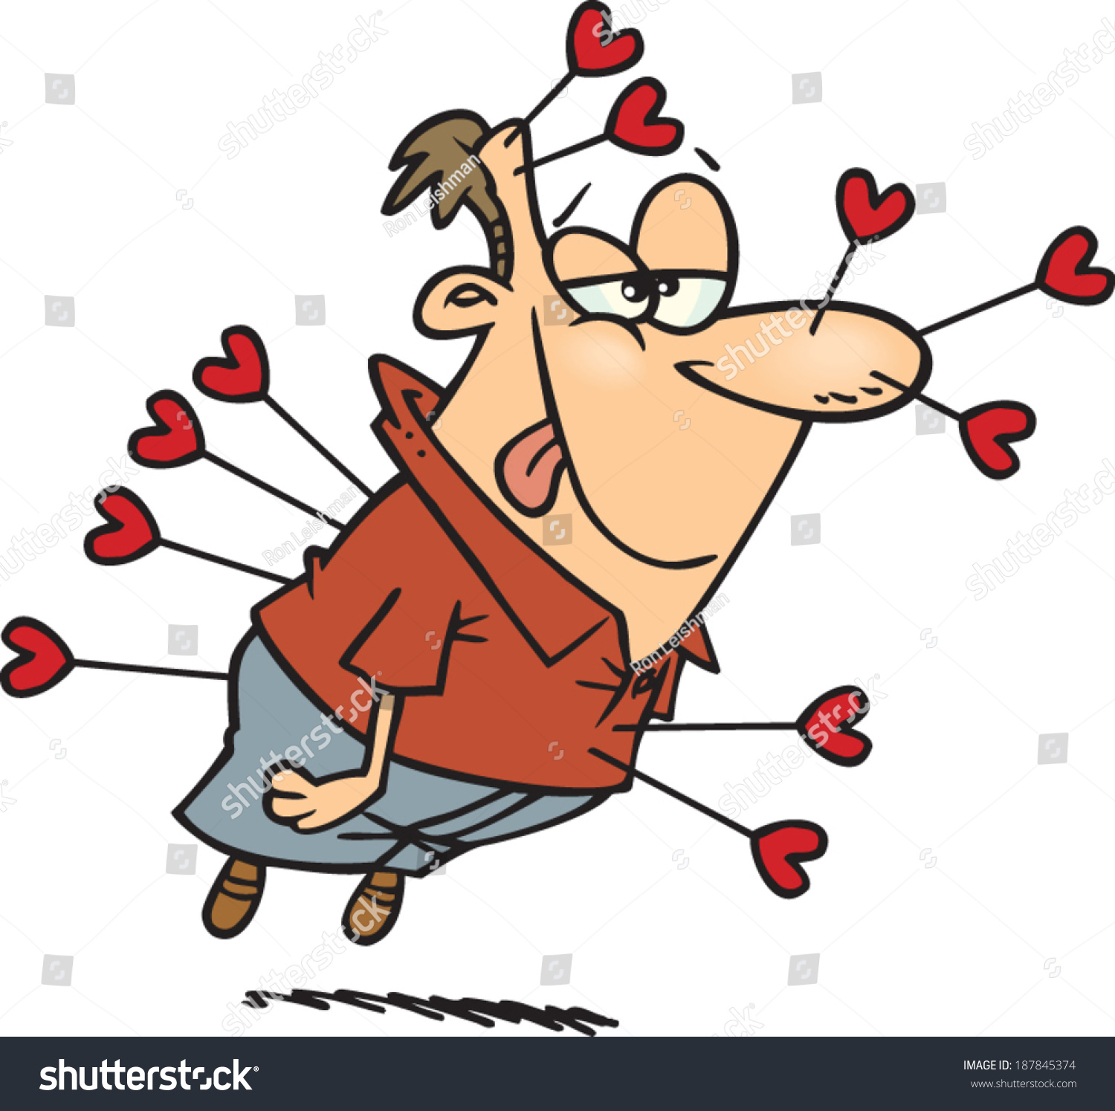
In Elizabethan Times…
Chaperones
Letters
Poems
Courtly Love
Cupid’s Bow

Slide 4
Remember in the previous scene Cesario (Viola dressed as a boy) started falling in love with Orsino – WHO DOESN’T REALISE SHE IS A BOY!

Slide 5
In Olivia's house, Maria is chiding Feste, the clown, for a recent unexplained absence. Feste responds by teasing Maria about her recent flirtations with Sir Toby Belch. Snapping that he should keep this to himself, she exits.
This scene once again presents the servants' separate, yet parallel world. Maria wants to keep her love for Toby secret, just as Viola does for Orsino.

Slide 6
Olivia enters, wearing mourning clothes and attended by her steward, Malvolio. Olivia first instructs her attendants to send Feste away, but he teases her into better spirits by saying that she is the fool of the two of them—for mourning her brother, who is in heaven. This pleases Olivia. But Malvolio disapproves and calls Feste a "barren rascal" (1.5.76). Olivia criticizes Malvolio for his "self-love" (1.5.83)—taking himself too seriously.
The fool (Feste) has official permission to cross boundaries of politeness between masters and servants. Malvolio's reaction to the fool's jokes establishes both his isolation from the other servants and his general humorlessness. In a play whose main focus is love, Malvolio primarily loves himself.

Slide 7
Maria returns to announce that a young man at the gate wishes to speak with Olivia. Olivia asks if he has been sent by Orsino. Maria doesn't know. Olivia sends Malvolio to send the man away. Passing through, Sir Toby exchanges a few drunken words with Olivia—also informing her about the gentleman at the gate. Olivia sends Feste to look after Sir Toby, who, Feste agrees, is drunk as a "mad man" (1.5.121).
Orsino's sending of messengers is so common that Olivia now expects them. Sir Toby's constant bad behavior provides a point of contrast to such courtly ceremonies. Feste's casual reference to Toby's drunken madness anticipates the antics to follow.

Slide 8
Malvolio returns and informs Olivia that the young man outside will not leave. Olivia asks what he is like. Malvolio replies that he is an androgynous adolescent, "between boy and man," (1.5.148) and speaks like a woman. Hearing this, Olivia gives in: she agrees to see the messenger. She quickly asks Maria to giver her a veil to hide her face.
This is the second account of Cesario's ambiguous gender. And it is precisely this ambiguity that seems to convince Olivia to see him. However, before meeting Cesario, Olivia covers her face—costuming herself for the courtship-game.

Slide 9
Cesario enters and recites ornate poetry about Olivia's "unmatchable beauty" (1.5.158). Olivia instructs him to get to the point. Cesario protests that he put a lot of effort into memorizing this speech and adds that, besides, it is beautiful poetry. But Olivia refuses to listen: it is "not the time of moon," she says, to try to make her crazy by carrying on like this (1.5.187). Maria asks Cesario to leave but he persists, insisting that he must speak with Olivia in private. Finally, Olivia agrees. She sends the others away. Now, she demands to know: who wrote Cesario's "text" (1.5.208)? Cesario confesses that it was indeed Orsino. Exasperated, Olivia says that she has already heard all he has to say. Cesario asks to see Olivia's face. Olivia consents, joking that they are "now out of text" (1.5.217), and unveils herself.
Orsino conducts his wooing through go-betweens, never actually meeting with Olivia. It's as if he wants to woo Olivia more than he actually wants to win her love. Olivia's references to "scripts" highlight how she is playing a role in the wooing ritual. Even when Olivia unveils her face and jokes that she is departing from scripted action, she is in fact creating a highly theatrical moment. In this way, Shakespeare uses traditional clichés for talking about love while also satirizing them at the same time. In effect, he is winking at the audience.

Slide 10
Cesario says it would be cruel for Olivia to go through life without producing an heir to keep such beauty alive after her death. Cesario adds that Orsino loves Olivia so deeply that she should yield to him. Olivia asks Cesario to describe Orsino's affections for her. Cesario reports: he adores her, weeps for her, groans, and sighs. Olivia replies that Orsino is a worthy man but knows perfectly well that she cannot return his affections. Cesario responds that, if he were Orsino, he would not accept this denial: he would build a makeshift hut at the gate of Olivia's house, and spend all his time calling, writing, and singing to her, until she was finally moved to pity.
In improvising a response to Olivia, Cesario demonstrates his cleverness and skill. He is a natural poet: the argument that beautiful people are obligated to love and produce heirs is a common theme of Shakespeare's own sonnets. Viola's poetry is new and interesting in comparison to Orsino's clichéd poetry, and her description of what she would do in Orsino's place is urgent and powerful. Orsino himself would never live in a makeshift hut.

Slide 11
Cutting Cesario off, Olivia asks what his own background is. Cesario replies that he is a gentleman by birth, although conditions have reduced him. Olivia replies that Cesario should return to Orsino, tell him that Olivia cannot love him and must not to send any further messengers—except, that is, for Cesario. Olivia offers Cesario money but he refuses, telling Olivia that he hopes that one day she will love as passionately as Orsino does, and find that the object of her affections has a heart of stone. With this, Cesario departs.
Saying that Orsino should send Cesario is a clue that Olivia is falling for Cesario. Cesario's witty refusal of Olivia's money shows his skill with verbal conventions of love and also hints at the resentment Viola must feel: she is in love with Orsino, and unable to act on it, while Olivia, who could have him instantly, is too proud to love him back.

Slide 12
Once she is alone, Olivia admits to herself that she is extremely attracted to Cesario. She lists his beautiful features—"Thy tongue, thy face, thy limbs" (1.5.269) —and describes them as a "blazon." Thinking fast, Olivia summons Malvolio and gives him a ring, which, she lies, Cesario left behind on Orsino's behalf. She commands Malvolio to chase down Cesario, return the ring, and instruct him to come back on the following day to hear her reasons for rejecting it. Malvolio takes the ring and hurries off to catch up with Cesario. Olivia remarks to herself that she does not know what she is doing: she is acting irrationally, purely on the basis of physical attraction. Yet, she says, she cannot resist fate.
A "blazon" is the term for a list of a beloved's features in a poem. Olivia here adopts the kind of ornate language mainly used by Orsino up to this point. She also starts playing lovers' mind-games: her lie to Malvolio, designed to get Cesario to come back, marks a big change from her nun-like behavior earlier. The fact that Olivia's love is pretty shallow—she describes Cesario only in terms of his looks—indicates the play's satirical attitude toward love and emphasizes the homoerotic dimension of her desire. She is specifically attracted to Cesario's female features.

