Slide 1
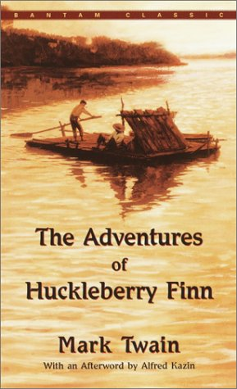
Huckleberry Finn Remote Learning Package
Week 15 May – 22 May

Slide 2
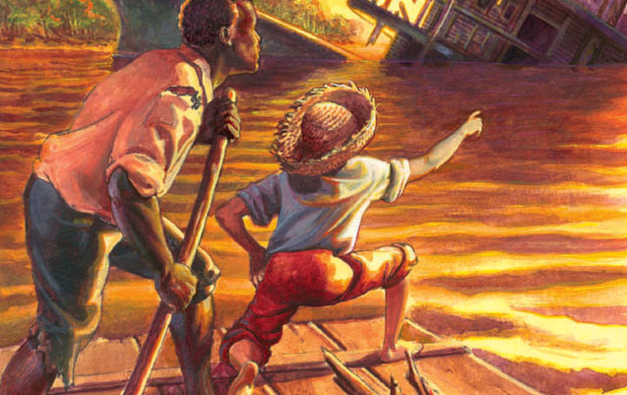
Tasks for the Week
Make sure last week’s tasks are sent to me. I have created an area for them all on FF which we can refer to as we start revising for exams
Read up to THE END OF THE NOVEL!!
Prepare for Assessments after half-term by looking at the mark scheme, researching the Lit Crit, collating quotes on theme.

Slide 3
Chapter 38 and 39 Summary
While Jim and Huck file pens out of candlesticks and a saw out of a case knife, Tom is busy working on the coat of arms for Jim. He comes up with one that is unintelligible, but it does not seem to matter as long as it comes from a book. Huck questions the meaning of such terms as “fess” and “bar sinister,” but Tom refuses to answer. Since dungeon walls were always made of stone, Tom suddenly strikes upon the idea that they could chisel both the coat of arms and the mournful inscriptions on one rock. He suggests they use the grindstone down at the mill. Huck and Tom find it too heavy to move to the cabin, however, so they decide to ask Jim to help them. He willingly takes the chain off the bedpost, wraps it around his neck, and slips out through the tunnel the boys have dug. He and Huck easily role the grindstone back to the cabin as Tom “superintends” the whole thing. With a nail for a chisel and an old iron bolt for a hammer, Jim starts to work on the grindstone.
Tom decides every authentic prisoner should have to contend with spiders, snakes, rats, and a flower to water with his tears. Although Tom feels a rattlesnake would mean more “glory” for Jim, he finally decides to “let it go” after Jim threatens to leave if he forces the issue. Reluctantly Jim agrees to garter snakes instead but complains about the “bother” and “trouble” it is to be a prisoner. Tom instructs him to play music to the rats and provides him with an onion to make tears to water his Pitchiola flower. When Jim complains, Tom loses his patience and reprimands him for not appreciating the fact that he had “more gaudier chances than a prisoner ever had in the world to make a name for himself.” Promising to behave, Jim finally apologizes.

Slide 4
The boys catch fifteen rats and decide to hide them under Aunt Sally’s bed, but a little Phelps boy unknowingly releases them from the cage. The boys find Aunt Sally on top of the bed screaming in fear. Busily catching spiders, bugs, frogs, and caterpillars, Huck and Tom even try for a hornet’s nest but decide to give it up. They catch several dozen garter snakes and hide them in a bag in their bedroom. When they go back upstairs all the snakes have mysteriously disappeared, only to show up later all over the house. Aunt Sally, incensed by the whole ordeal, gives Huck and Tom their just reward by spanking them each time she sees another snake.
Unable to get any rest, Jim complains that the rats and snakes do not all sleep at the same time, keeping him on guard day and night. Each time a rat bites Jim, he writes on his shirt or journal with the fresh blood.

Slide 5
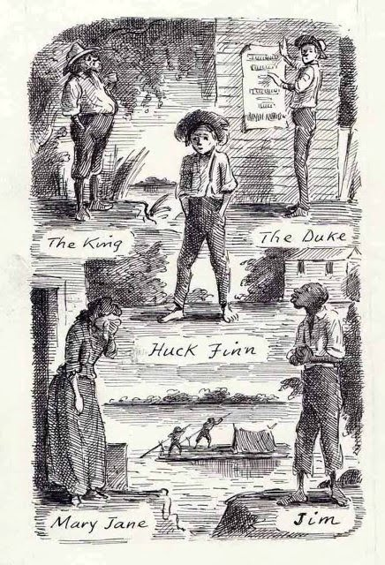
Since there has been no news from the plantation below New Orleans, Uncle Silas thinks he will advertise Jim in the New Orleans and St. Louis papers. The mention of St. Louis hits home to Huck, who realizes that Miss Watson will probably see the ad. Tom, however, must continue to do things by the book. The next item on his agenda is the distribution of anonymous letters warning people about Jim’s escape. Huck dresses up like a servant girl and shoves the first warning under the front door. The next night skull and crossbones are placed on the door, but the third night the note warns that “a desperate gang of cutthroats” will invade the property and steal Jim.

Slide 6
Discussion and Analysis
It is ironic that in Tom’s exaggerated plan to free Jim, he must call him out of prison to help role the heavy, oversized grindstone, and, thereby, carry out the plans for his own escape. Jim could, in fact, walk away anytime, but he obviously loves the boys and would not think of betraying their trust in him. This ludicrous incident is one of the most humorous in the novel.
Twain is ridiculing the romantic mind of Tom who “superintended” the whole project. In the eyes of Huck “he knowed how to do everything.” He does, of course, choose a grindstone that is too heavy for the boys to handle, and when the entrance into the cabin is not big enough for the stone, it is Jim, not Tom who quickly solves the problem. Jim also endures the tortures inflicted upon him by Tom because that is supposedly his role as a prisoner. Only in the case of the rattlesnakes does Jim refuse to cooperate with Tom’s fantastic schemes. Jim’s practical nature comes to the foreground when Tom, in wild abandonment, is willing to risk Jim’s life just for the sake of the glory. Tom puts Jim through an ordeal that leaves him with adverse feelings about the entire prisoner experience. “He said if he ever got out this time he wouldn’t ever be a prisoner again, not for a salary.” Since a salary is totally foreign to Jim, the last phrase might be interpreted to mean not for a million dollars.

Slide 7
Tom subjects Aunt Sally, as well as Jim, to undue cruelties in this section of the novel. She must endure his antics involving rats and snakes in the house, and anonymous notes designed to terrify her and other members of the household. The suffering of others is secondary to Tom’s passion to dramatize the romantic notions he has only read about in books. The incongruity of Tom’s treatment of Aunt Sally and Jim is especially apparent when we consider how kind and loving both of them have been toward Tom.
Tom’s knowledge of the terminology of the coat of arms is limited at best. The language is confused to the point of being unintelligible. When Tom refuses to explain the meaning of “fess” and “bar sinister” it is evident he does not know. It is obvious that Tom often covers his lack of understanding in this way. Huck, however, attributes Tom’s refusal to his personailty. “If it didn’t suit him to explain a thing to you, he wouldn’t do it.” Tom is covering his ignorance and, thereby, saving face with Huck who looks up to him.

Slide 8
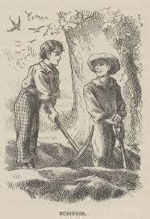
Chapter 40 and 41 Summary
After the last warning note has been sent, Huck and Tom take a picnic lunch and go fishing in the river. They check out the raft to make sure everything is in order. When they arrive home for supper that night, everyone in the house is in a state of frenzy. Worried about the threatening letter, Aunt Sally hustles them up to bed after supper without a word.
At half past eleven the boys get up and begin eating the lunch they had stolen from the cellar cupboard. Noticing the butter is missing, Tom sends Huck back to the cellar to get it while he goes to Jim’s cabin to prepare the scene for the escape. Huck finds the butter and stealthily climbs up the stairs, when suddenly he runs into Aunt Sally. He quickly shoves the bread and butter under his hat. Aunt Sally questions him about his mysterious activities in the cellar, but getting nowhere she sends him into the “setting-room” until she has time to get to the bottom of it. In the room he sees fifteen farmers with guns ready to attack
the cutthroats who are coming to steal Jim. The room is hot, and the butter under
his hat melts and trickles down his forehead. He lifts his hat, revealing the stolen
bread and butter. Relieved that his brain is not “oozing out” from brain fever, Aunt Sally
hugs him and lets him go.

Slide 9
He runs to Jim’s cabin and frantically tries to explain that the men are coming, and there is no time to lose. The men fill the dark cabin just as Huck, Tom, and Jim slip out the hole and into the lean-to. Tom finally gives the all clear signal, and the three make a run for it. Tom’s britches catch on a splinter on the top rail of the fence, however, and when he pulls loose, the splinter snaps and makes a noise. Soon gunfire is heard, dogs are released, and the chase is on. The dogs are friendly, however, and the runaways make it to the raft safely. Everyone is happy, but Huck and Jim suddenly notice Tom has been shot in the leg. Tom insists they go on, but Jim refuses to leave before they get a doctor for Tom. Huck goes for the doctor, instructing Jim to hide in the woods when the doctor arrives.
Huck gets the doctor out of bed and tells him a story about Tom kicking his gun in his dreams and shooting himself in the leg. The doctor is a kind old man who agrees to help, but insists on going alone because he feels the canoe is safe for one person only. He becomes suspicious when Huck blurts out that it easily held three. Waiting for the doctor’s return, Huck sleeps on a lumber pile all night. The doctor has not returned by morning, and Huck runs into Uncle Silas in town. Under pressure to explain their absence, he tells Uncle Silas that he and Sid (Tom) were all over the river last night looking for the runaway slave. Huck claims Sid is at the post office so they wait awhile, but when he does not show up, they go home to Aunt Sally who is overjoyed to see Huck.

Slide 10
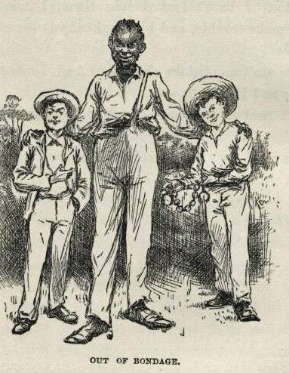
The house is still full of people who are eager to overstate the truth about what happened the night before. Mrs. Hotchkiss is worse than the others, claiming the runaway was not in his right mind.
That night Aunt Sally tucks Huck in and asks him not to leave. Seeing her caring nature, he finds it impossible to sneak out this time, but his mind is on Tom and he sleeps restlessly. He slides down the lightning rod several times during the night, but when he sees Aunt Sally waiting up for Tom, he goes back upstairs.

Slide 11
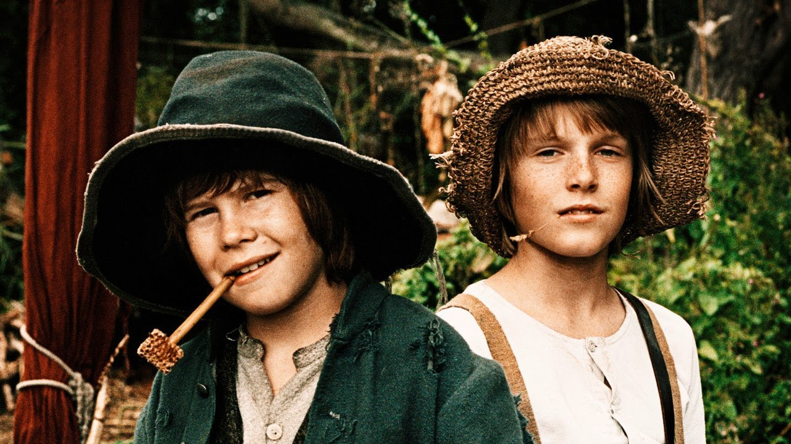
Discussion and Analysis
Tom’s plan of escape takes on an air of sensationalism as the three runaways battle the suspense of gunfire, tracking dogs, screaming voices, pounding footsteps, and a breath-taking slide through the tunnel with the gunmen breathing down their necks. What tops off the whole romantic episode for Tom, however, is the bullet wound in his leg. They are all glad to get to the raft, “but Tom was the gladdest of all because he had a bullet in the calf of his leg.” He does not want to stop now when everything is going so well. He attempts to bandage his own wound and challenges them to set the raft loose and continue the escape down the river. When Tom realizes Jim will not budge before they get a doctor for him, he instructs Huck to blindfold the doctor, put a purse full of gold in his hand, and make him swear to silence. Tom is, of course, continuing his escape plan in style according to the book. The next step is to confuse the doctor by taking him to the raft in a roundabout way so he will not chalk the raft and find it again. Ironically, if Huck had followed Tom’s instructions, it would probably have caused Tom’s death.

Slide 12
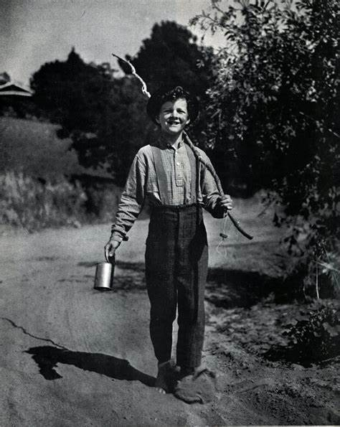
When Huck is on his own, he ignores Tom’s fanciful instructions and does what Huck does best—invents a story. His fantastic story is not as believable, however, as the ones he has conjured up in the past. When he tells the doctor Tom kicked his gun in his dreams, the doctor replies, “Singular dream.” Interpreted to mean “peculiar dream,” we sense a hint of the doctor’s suspicion about the whole story. To ease his concern about what he might find there, the doctor decides to go to the raft alone, using the excuse that the canoe will not safely hold two people. Huck’s slight slip of the tongue adds to further suspicion when he tells the doctor the canoe carried “the three of us easy enough.” The doctor leaves Huck on the shore with instructions to go home and prepare the Phelps family for the surprise that Huck had talked about.
When Tom insists on continuing down the river with the bullet still lodged in his leg, Jim’s response is an expected one for it is consistent with his character throughout the novel. Jim’s unselfishness in giving up his freedom for the sake of Tom is no surprise to Huck. “I reckoned he’d say what he did say.” When we consider the fact that Jim could have executed his own escape from the Phelps Plantation
at any time, we realize his love for Huck and Tom, his friends, was worth more to him than
his long-sought freedom. He could not seek his own freedom at the expense of his friend’s
life. Ironically, he feels Tom would do the same for him, but Tom is more concerned with
completing his escape with style.

Slide 13
Chapters 42 and 43
The next morning Uncle Silas looks for Tom in town but comes back discouraged. He hands Aunt Sally a letter from her sister that he had picked up at the post office the day before. She starts to open the letter, but glances out of the window and drops it as she sees Tom being brought in on a mattress. He is followed by the doctor and Jim, who has his hands tied behind his back. Thinking Tom is dead, Aunt Sally runs up to him, but he is delirious and can only mutter something unintelligible. Aunt Sally is happy just to see him alive.
While the others go into the house with Tom, Huck follows the men who take Jim back to his cabin. He hears them cursing Jim and giving him an occasional blow on the head for running away. They threaten to hang him as an example to other runaway slaves. They chain both his legs and hands to a big staple driven into the bottom log of the cabin. He is put on a diet of bread and water, and farmers with guns plan to guard his door at night while bulldogs will be on the watch during the day. In a little while the doctor comes to check on Jim. When he sees his deplorable situation, he asks them not to punish him too severely since Jim demonstrated exemplary behaviour while he was with the doctor. He explains that Jim stepped out of hiding when Tom became seriously ill and incoherent, threatening to kill the doctor. Jim offered to help and he did it well. He tells them Jim is worth one thousand dollars and kind treatment too. At this the men soften their approach slightly. Huck hopes they will remove some of the chains and alter his diet but doesn’t dare suggest it.

Slide 14
The first chance Huck gets, he slips into the sick room. Bewildered and a bit confused, Tom soon wakes up, asking about the raft and Jim. Huck tells him all is well. Aunt Sally listens in shock as he suddenly blurts out the whole story about their fantastic scheme to free Jim, the runaway slave. Aunt Sally calls him a rapscallion, threatening to punish him if she catches him meddling with Jim again. Surprised to learn Jim did not escape, Tom orders them to release him immediately because he is not a slave. He tells them that Miss Watson, who died two months ago, “set him free in her will.” Puzzled, Huck asks Tom about his motives for planning the escape. Tom tells him he did it for the adventure.
Aunt Polly appears in the doorway and the game of mistaken identities is over. She has come eleven hundred miles to see why Aunt Sally has not answered her letters. Knowing the letters would spell trouble for him, Tom admits intercepting them.
Aunt Polly confirms Jim’s freedom and Jim is released. Uncle Silas, Aunt Sally, and Aunt Polly make a fuss over Jim for helping the doctor nurse Tom. Tom gives him forty dollars for being a patient prisoner. Pleased and excited, Jim tells Huck it is his hairy breast that has made him rich again just as he had predicted on Jackson’s Island.

Slide 15
Tom suggests that the three of them go for “howling adventures” in Indian territory. When Huck complains that he has no money for such adventures, Tom tells him the six thousand dollars is still there since his father has never been back for it. Jim then reveals the secret about Huck’s pap. Hesitantly, he tells him Pap was the dead man in the floating house they were exploring on the river. With no show of emotion, Huck announces his plan to “light out for the territory ahead of the rest.” Aunt Sally wants to adopt him and “sivilize” him and “he can’t stand it.” He has been through that before.

Slide 16
Discussion and Analysis
Twain portrays Jim as a noble character when he bravely steps out of hiding to help the doctor save Tom’s life, knowing full well it will cost him his freedom and possibly his life. The doctor attests to the fact that he never saw anyone who was more faithful “and yet he was risking his freedom to do it.” Jim is a profoundly sensitive human being whose feeling and sacrifice for Tom comes as no surprise. We have seen him sacrifice his sleep by taking Huck’s watch on the raft. We have seen his joy when Huck returns after their separation in the fog and his deep hurt when Huck plays a trick on him. We also see him as a caring family man whose dream is to, someday, buy his wife and children out of slavery. Jim’s nobility lies in his sensitive nature and is consistent throughout the novel. In the case of Tom, we would not have expected Jim to behave any other way.
The men who take Jim back to his cabin in chains get “very huffy” and want to hang him as an example to the other slaves. Their scandalous values are clear when they decide not to do it since they do not own Jim, and if the owner ever showed up, he would certainly make them pay for his loss of property. When the doctor appears on the scene to tell them of Jim’s actions in nursing Tom back to health, they should, ironically, be saluting him for his heroism, but they only “soften up a little.”

Slide 17
When Huck realizes Tom knew all along that Jim had been set free, he understands why a boy with a respectable upbringing like Tom would get mixed up in the messy business of helping a slave escape. Tom tells him he did it strictly for adventure. He was planning to prolong the adventure all the way to the “mouth of the river,” and then take Jim home on a steamboat in style and bring him into town as a hero with a “torchlight procession” and a “brass band.”
The novel has come full circle as we see Huck “light out for the territory,” afraid Aunt Sally will “sivilize” him again as the Widow Douglas tried to do in the first chapter. Taught through his many difficult decisions to follow his instinctive, natural morality, Huck has grown into a more mature, sensitive human being. He belongs in the wilds of the “territory” where he can again be free from the hypocrisy inherent in society’s constraints.

Slide 18
Tasks for the Week
Read, research, understand, revise

