Slide 1
The Glory of War in Shakespeare's Henry V
Introduction to 'Once More Unto the Breach'

Slide 2
‘How is war presented as glorious?’

Slide 3
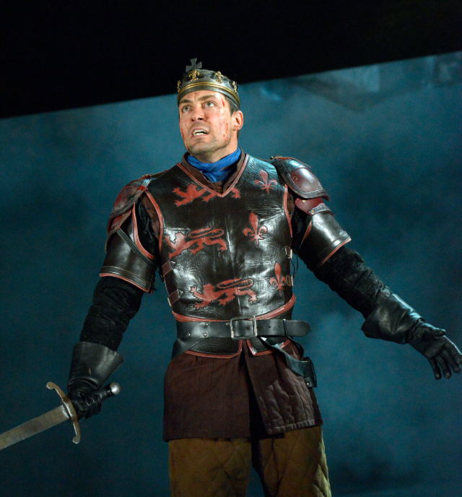
Introduction to 'Once More Unto the Breach'
Famous speech from Shakespeare's play "Henry V"
Delivered by King Henry V to motivate his troops
Set during the Siege of Harfleur in 1415
Part of the Hundred Years' War between England and France
Explores themes of courage, patriotism, and the nature of war
This speech occurs at the peak of action in act three where King Henry’s army weakens the walls of the French city, Harfleur, and the king asks them to make a little more effort to be victorious.

Slide 4
Kit Harrington (Game of Thrones) - Let’s critique this version - What do we notice?

Slide 5
Now let’s look at HOW King Henry uses persuasive techniques to mobilise his war weary troops…
HIGHLIGHT AND ANNOTATE AS WE GO…

Slide 6
Only 1 more - anyone can do 1 more of anything…
Once more unto the breach, dear friends, once more;
Or close the wall up with our English dead.
In peace there's nothing so becomes a man
As modest stillness and humility:
But when the blast of war blows in our ears,
Then imitate the action of the tiger;
Stiffen the sinews, summon up the blood,
Disguise fair nature with hard-favour'd rage;
Then lend the eye a terrible aspect;
Let pry through the portage of the head
Like the brass cannon; let the brow o'erwhelm it
As fearfully as doth a galled rock
O'erhang and jutty his confounded base,
Swill'd with the wild and wasteful ocean.
Term of endearment and they’re his friends! He’s a KING!!!
Lays out the consequences of NOT doing anything in v graphic detail
How does he want his men to look and why? (see Haka on next slide)
Metaphors in this section - why are they good?

Slide 7
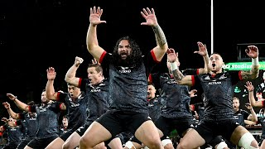
Is this how Henry V wanted his soldiers to look? Why and how is this intimidating? (Haka: Wiki https://en.wikipedia.org/wiki/Haka)

Slide 8
How will this make the men appear to the enemy?
Now set the teeth and stretch the nostril wide,
Hold hard the breath and bend up every spirit
To his full height. On, on, you noblest English.
Whose blood is fet from fathers of war-proof!
Fathers that, like so many Alexanders,
Have in these parts from morn till even fought
And sheathed their swords for lack of argument:
Dishonour not your mothers; now attest
That those whom you call'd fathers did beget you.
Ultimate flattery - they’re now being referred to as noble - suffix ‘est’ adds to it why?

Slide 9
Thick, good quality breeding
Be copy now to men of grosser blood,
And teach them how to war. And you, good yeoman,
Whose limbs were made in England, show us here
The mettle of your pasture; let us swear
That you are worth your breeding; which I doubt not;
For there is none of you so mean and base,
That hath not noble lustre in your eyes.
I see you stand like greyhounds in the slips,
Straining upon the start. The game's afoot:
Follow your spirit, and upon this charge
Cry 'God for Harry, England, and Saint George!'
Patriotism appeals to
A challenge…
He believes in them
Simile - explore!
Rule of 3 explore specific words!

Slide 10
WRITTEN RESPONSE:
How does Shakespeare make war seem glorious in this speech and what rhetorical techniques does King Henry use to motivate his soldiers?

