Slide 1
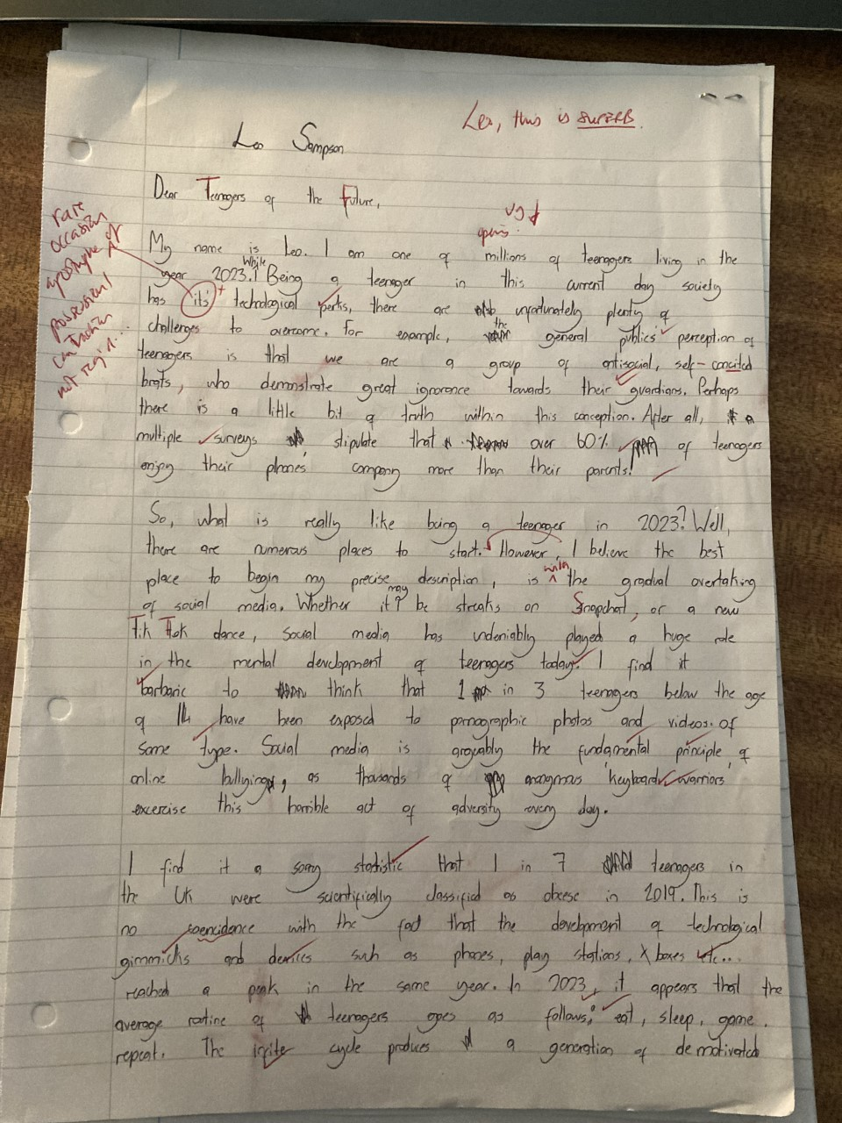
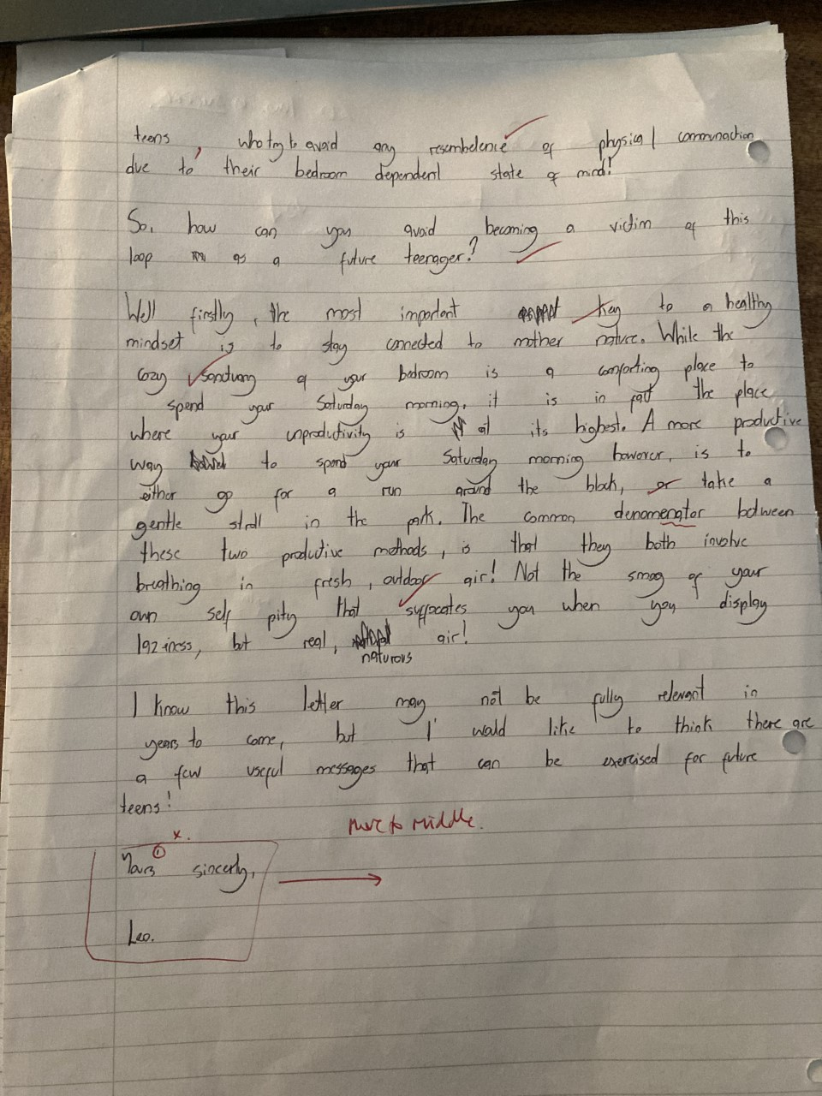
EXEMPLAR ENGLISH LANGUAGE PAPER 1 TRANSACTIONAL WRITING LETTER ‘Teenagers of the Future’
MY NOTES

