Slide 10
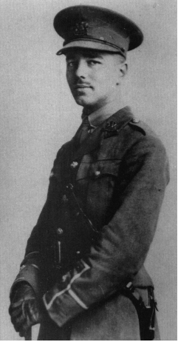
Disabled by Wilfred Owen

Slide 11
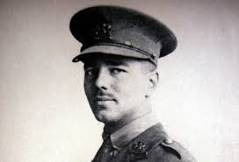
Wilfred Owen aimed to convey ‘the pity of war’ in his poetry. How does he try to do this in “Disabled”?
“This book is not about heroes. English poetry is not yet fit to speak of them. Nor is it about deeds, or lands, nor anything about glory, honour, might, majesty, dominion, or power, except War. Above all I am not concerned with Poetry. My subject is War, and the pity of War. The Poetry is in the pity.”

Slide 12
First draft

Slide 13
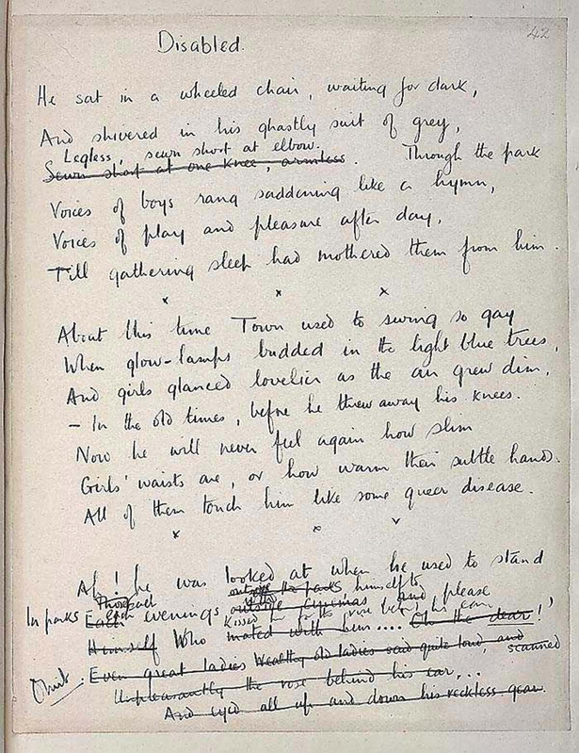
Second Draft

Slide 14
Wilfred Owen aimed to convey ‘the pity of war’ in his poetry. How does he try to do this in “Disabled”?
Wilfred Owen conveys ‘the pity of war’ in “Disabled” by exploring its effects on a young soldier. Owen himself had fought in the First World War and he is regarded by historians as a leading poet during this time, known for his realistic portrayals of war.
A lot of his poetry was heavily influenced by his friend - Siegfried Sassoon. Owen aims to convey ‘the pity of war’ in his poetry rather than glorify it.
In “Disabled”, a young man goes to war as a victim of its glorification. His recurring thoughts of women make us wonder: do we feel sorry for him because the war has stripped him of his legs, or not because he joined the war to illicit female attention?

Slide 15
Structure
“Disabled” is written in six stanzas, divided into two main sections: a view of his life before the war began and the reality of his life after the war. It is also written in iambic pentameter, which represents the slow beating of his heart and shows his life slipping away from him as a victim of the glorification of war.

Slide 16
From the beginning of the poem, the pity of war is conveyed through a personal pronoun: “he”. The persona is being vague and the use of the word “he” demonstrates that the war affected everyone, not just one specific man, as well as emphasising the idea of a Total War.
In the same line, the words “wheeled” and “waiting” further the concept of the pity of war by use of alliteration. It emphasises the man’s disability - he is “Legless”. “Waiting” is a passive verb which indicates that the man doesn’t have a choice; doesn’t have freedom. His only option is to wait.
‘dark’ is ambiguous. Is he waiting fro nighttime or is a metaphor for death.
The alliterative phrase “ghastly suit of grey.” This implies that he’s been dressed and didn’t have a choice in what to wear. The simple routines we take for granted - such as being able to choose our own attire - have been taken from him.
Alternatively, it is a metaphor for his pallour and suggests that all his colour and life is gone, leaving just a skeleton of the man he once was.
He sat in a wheeled chair, waiting for dark, And shivered in his ghastly suit of grey, Legless, sewn short at elbow. Through the park Voices of boys rang saddening like a hymn, Voices of play and pleasure after day, Till gathering sleep had mothered them from him.
Are these the echoes of war, the cries of his friends dying in battle. Is that all he has left to think about?
‘Sleep’ is ambiguous. Is it a metaphor for the deaths of his friends. Or does he long for sleep as that is the only way he will find any peace from his terrible thoughts.
The use of sibilance here makes reference to the temperature, which occurs a lot throughout the poem. The repeated “S” noises suggest a cold temperature and could be the sounds of shivering.
‘Mothered’ infantilises him. He is like a child, he needs to be cared for as he cannot look after himself.

Slide 17
Throughout the poem, Owen constantly jumps between the past and present, making comparisons between the “youth[ful]” young man and the “old” disabled one. The setting in the first and last stanza of the poem is the present, with the stanzas in between them jumping back and forth in time. The juxtaposition of these different ideas contribute to Owen’s conveyance of ‘the pity of war’ by demonstrating how the war affected the man and stripped him of his freedom of choice.

Slide 18
The alliteration on ‘g’ emphasises hoe romantic the town seems at night. Something that he is now excluded from as he is disabled and considered like a ‘queer disease’
Disabled and decrepit, the soldier imagines the sound and warmth that once rang through its walls. It also has connotations of homosexuality as he is no longer attractive to women. Link this to the words ‘queer disease’ on the last line.
Now that he is disabled, he realises how rash he was to rush to go to war just to make girls find him more attractive. The implication that this was a needless loss (sacrifice) is reinforced by where the wounded soldier fails to remember why he joined up, pointing only to a distant sense of duty, and euphoria after the football match
About this time Town used to swing so gay
When glow-lamps budded in the light blue trees, And girls glanced lovelier as the air grew dim –
In the old times, before he threw away his knees. Now he will never feel again how slim Girls' waists are, or how warm their subtle hands;
All of them touch him like some queer disease.
The soldier has a sudden realisation that he went to war to attract women, but due to his injuries he will never feel a woman again.
Having lost his leg there is probably chance that he is now impotent and unable to have sexual relations with a woman.

Slide 19
Ambiguous:
The soldier was such a handsome teenager an artist wanted to desperately paint him. This emphasised with the alliteration on ‘younger’ and ‘youth’.
Or is ‘artist’ a metaphor for a young girl who fancied him and was ‘silly’ for him.
The caesura after ‘last year’ emphasises how one year at war has changed him. ‘Now he is old’ Think about how this relates to the pity of war? What does war do to young men?
There was an artist silly for his face, For it was younger than his youth, last year. Now, he is old; his back will never brace;
He's lost his colour very far from here,
Poured it down shell-holes till the veins ran dry,
And half his lifetime lapsed in the hot race,
And leap of purple spurted from his thigh.
Metaphor for losing his youth but also could be interpreted as his face draining of colour as he loses blood while he is left on the battlefield waiting to be rescued.
Like an old man bent double, he will never be able to stand up right. This is emphasised by the alliteration ‘back and ‘brace’
The thought of foreign travel was one of the many attractions that drew men to go to war, thinking it would all be over by Christmas.
The use of the verb ‘poured’ indicates that the young man wasted his life by simply ‘pouring’ it away.
The alliteration on ‘h’ and ‘l’ emphasises the excitement that war initially brought to him. This extends the idea that war is pitiful as it fools the young in to believing it is something it is not.
A shocking image of a him left bleeding out on the battle field.
A graphic image of his injury. The artery severed sprayed blood out where his leg had been blown off.

Slide 20
Owen’s portrayal of the man in his youth helps convey the ‘pity of war’. He “liked a blood-smear down his leg”. Owen uses irony effectively here. We are already aware that the soldier has lost an arm and his legs, yet here we are told that before the War he felt proud to have an injury (albeit obtained on the football field), and to be carried shoulder-high (for reasons of celebration as opposed to helplessness). The concept of reversal is again used: sporting hero to cripple, handsome to 'queer disease' , colour to dark, warmth to cold.
An indication that the soldier was a member of one of the Scottish regiments. This also implies that the soldier joined up for reasons of vanity.
One time he liked a blood-smear down his leg, After the matches, carried shoulder-high. It was after football, when he'd drunk a peg, He thought he'd better join. - He wonders why. Someone had said he'd look a god in kilts, That's why; and maybe, too, to please his Meg; Aye, that was it, to please the giddy jilts He asked to join. He didn't have to beg;
A Scottish term for a young woman.

Slide 21
The sadness of the soldier's plight is heightened. Clearly he was under-aged when he enlisted and therefore is still young.
Chances are he had no real understanding of the politics of the war. Just that it would be good to sign up after having had ‘drunk a peg’.
Smiling they wrote his lie: aged nineteen years. Germans he scarcely thought of; all their guilt, And Austria's, did not move him. And no fears Of Fear came yet. He drought of jewelled hilts For daggers in plaid socks; of smart salutes; And care of arms; and leave; and pay arrears; Esprit de corps; and hints for young recruits. And soon, he was drafted out with drums and cheers.
To a working class boy the draw of a new uniform, and comradery with your friends (Esprit de corps) sounds like an adventure from the ordinary and mundane life they would normally lead. A life in the army was clearly romanticized in his head. . The glorification of war sucks young men into thinking that they are truly doing an amazing and honourable thing for themselves and for their country.
Repetition of the word ‘fear’ suggests the feeling of invincibility of the young. No real idea of the consequences of injury or death.
Think carefully about this last line. Compare how he is treated when he leaves for war and when he returns from war. This is the pity of war how shallow people were to the returning heroes. How quickly their attitudes changed.

Slide 22
Recalls the image of the football match earlier. Implies that he was carried from the field shoulder-high, possibly as the result of scoring the winning goal. Here, despite having achieved far more, for far greater a loss than a 'blood- smeared leg', the crowd's reception is more hollow.
As the persona’s narrative returns to the present, we start to question our thoughts of the young man. At the beginning, we tend to feel sorry for him because he’s been portrayed as an old, sad man who has been stripped of his freedom and left disabled after the war, though as the poem travels to the past we discover that he had no real conviction to join the war. He wanted the glory. As he returns from the war, he didn’t get the greeting he expected. “Only” one man “Thanked him; and then inquired about his soul”. The use of the word “soul” emphasises both a physical and mental disability. It gives us the idea that his experiences at war had imprinted such horror into his mind that it would scar him mentally, while consequently resulting in his disability
Some cheered him home, but not as crowds cheer Goal. Only a solemn man who brought him fruits Thanked him; and then enquired about his soul. Now, he will spend a few sick years in institutes, And do what things the rules consider wise, And take whatever pity they may dole. Tonight he noticed how the women's eyes Passed from him to the strong men that were whole. How cold and late it is! Why don't they come And put him into bed? Why don't they come?
Repeating again the loss of the soldier, this time in his attractiveness to the opposite sex. 'Whole' implying that he is incomplete, less than a man. Ironically he is now dependent on young women to put him to bed, in contrast with his prewar virile manhood when he could expect to take women to bed.
The soldier's passivity is complete. The fine young athlete has been reduced to a state of dependency on others and helplessness (heightened by the pitiful closing repetition of 'Why don't they come?'). The stanza has him waiting for others to do things for him, he 'spends a few sick years', 'takes whatever pity' others choose to offer him; he is passed over by the women's attentions, as he bemoans the cold and hopes that someone will put him to bed.
An anaphora: Who is he talking about? The nurses or the young women.

Slide 23
Conclusion
The ‘pity of war’ comes from the idea that the man, once a young and foolish teenager, made a mistake and paid a price. Now, society is rejecting him. This contributes to an overall underlying sadness provided by the poem.
The present society is judging him for a decision he made when he was young and didn’t know any better: he thought that his decision would benefit both himself and his country in the sense that he would be more attractive to women and he would be helping his country fight. In reality, he has been shunned and that is the pity of war.

Slide 24
Plenary
Review whether you have learnt the learning objectives – if not, get a partner to teach you!
Teach the poem to the person sitting next to you;
Summarise the poem in ONE sentence.
If the poem was an object/person/animal, what it be and why?

