Slide 1
Icon guide
Students should complete this task on their own.
Students should complete this task in pairs. Pair talk would work well with this activity.
This task may be completed in small groups.
This task should be modelled by the teacher. A model is provided, but teachers may want to complete an addition class model ’live’ with the group.
The answers to this task should be written. Teachers may decide that some tasks without this icon should also be written down – this is down to a teacher’s discretion.
This icon is a reminder that students will sit a fortnightly mastery quiz at the end of this lesson.

Slide 2
In this lesson, students will be mastering the following:
Mastery Content:
Jane is locked in the red-room
Jane feels increasingly conflicted about her treatment
Mrs Reed made a promise to Mr Reed before he died
Jane thinks that the red-room is haunted
Jane is traumatised by the experience of being locked in the red-room
Learning Objective:
To explore how Bronte presents the lasting impression the red room has on Jane
Mastery Content

Slide 3
Do Now: Where does Jane Eyre live? What is Jane’s punishment for fighting back against John Reed? Why do the Reed family treat Jane unkindly? Complete this sentence: Jane is vulnerable because Extension: List 3 reasons why a reader feels sympathetic towards Jane at the start of the novel
Reading: description of the red-room Students read the description of the red-room. Read from page 16: ‘The red-room …’ Read to, ‘I will not say how many years, I see it clearly.’ (page 19) Students complete the check for understanding questions in pairs. | Do you want this to be a discussion or for the answers to be written down
Reading: Jane the revolted slave Look at the given quotation. Discuss the meaning of ‘revolted’. Students answer the following question in pairs: Why is Jane feeling ‘revolted’ and why is she a ‘slave’?
Reading Chapter 2 Read from, ‘Daylight began to forsake…’ p.19 Read to, ‘… Bessie and Abbot entered.’ p.21
Emotions Here are four phrases from the passage we have read. Match these to the emotions that Jane is feeling.
Jane’s state of mind Students read the given quotations and then use them to help answering the following question: How does Brontë present Jane’s feelings after being locked in the red-room?
Fortnightly Quiz Ask students to complete fortnightly quiz | You may choose to complete the quiz next lesson if you need more time to manage the reading in this lesson.
Lesson Guide
NOTE: There is a lot of reading in this lesson, so think carefully how you will manage this.

Slide 4
Tuesday, 14 June 2022
The Red Room
Do Now:
Jane lives at Gateshead Hall.
Jane is sent to the red room by Bessie and Miss Abbot.
The Reed family do not see Jane as an equal because she is an orphan.
Jane is vulnerable because she is dependent on her aunt for food and shelter, but it does not seem like she is being well looked after.
Do Now:
Where does Jane Eyre live?
What is Jane’s punishment for fighting back against John Reed?
Why do the Reed family treat Jane unkindly?
Complete this sentence: Jane is vulnerable because__________________________________
Do Now
Extension:
She has no friends at Gateshead Hall. Jane is not allowed to play or interact with the Reed children.
John Reed bullies Jane every day.
The adults threaten her with terrible punishments, even though a reader might have sympathy for how Jane has behaved.
Extension: List three reasons why a reader feels sympathetic towards Jane at the start of the novel.

Slide 5
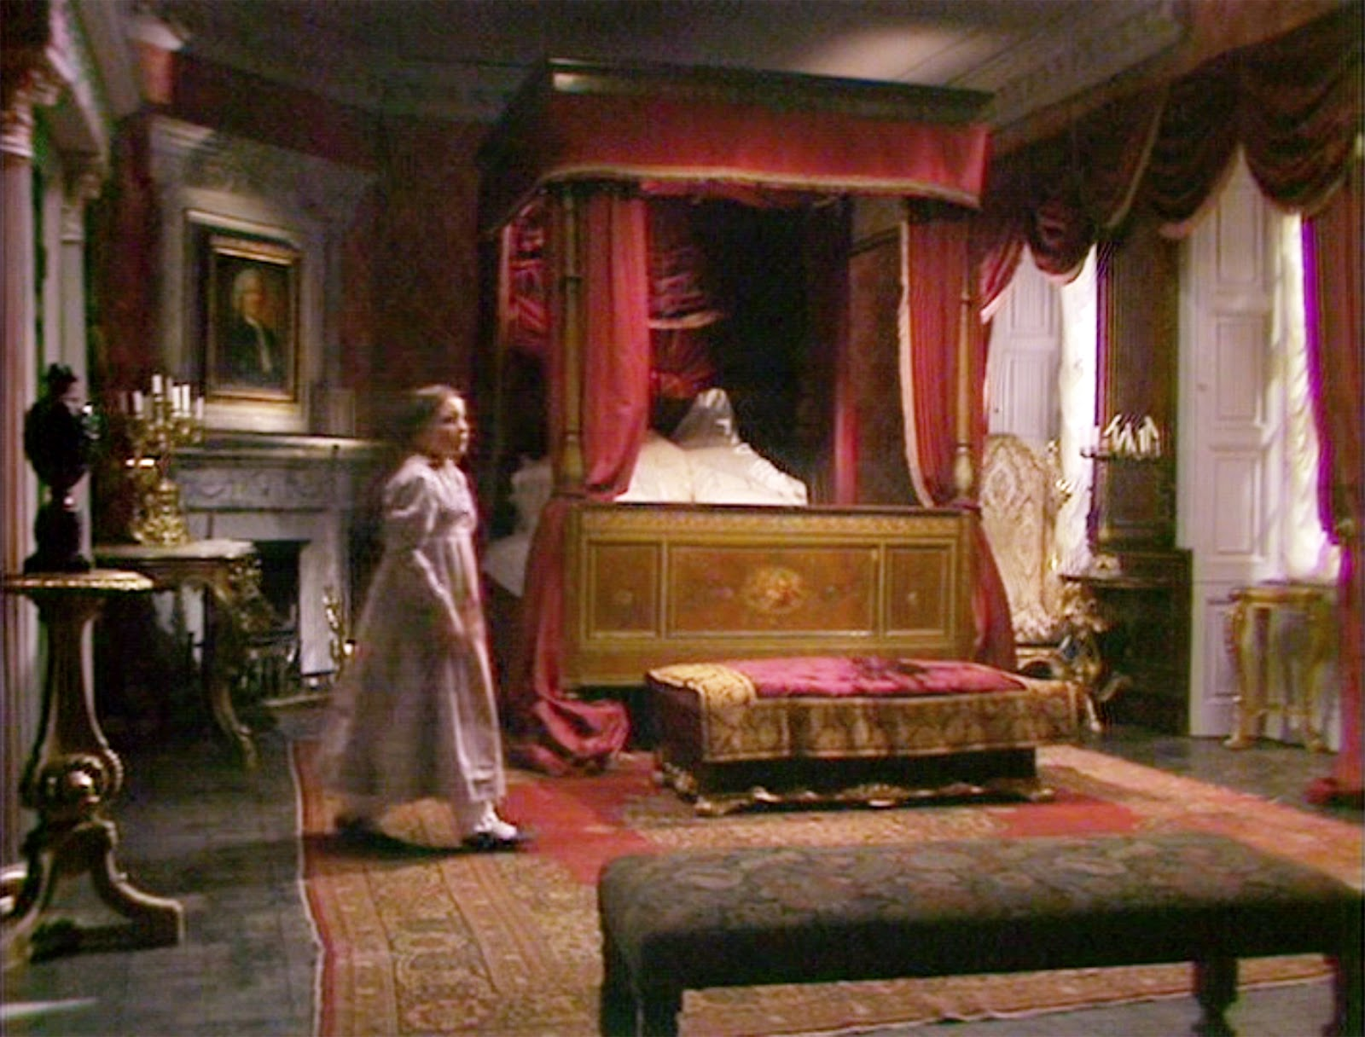
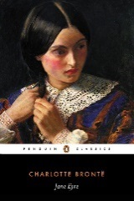
Jane has been taken to the red-room by Bessie and Miss Abbot. She has been locked in alone.
Let’s read Jane’s description of the red-room.
Chapter 2
Read from, ‘The red-room was…’ p.16
Read to, ‘I will not say how many years, I see it clearly.’ (page 19)
Jane Eyre
p. 16

Slide 6
The red-room was a square chamber, very seldom slept in, I might say never, indeed, unless when a chance influx of visitors at Gateshead Hall rendered it necessary to turn to account all the accommodation it contained: yet it was one of the largest and stateliest chambers in the mansion. A bed supported on massive pillars of mahogany, hung with curtains of deep red damask, stood out like a tabernacle in the centre; the two large windows, with their blinds always drawn down, were half shrouded in festoons and falls of similar drapery; the carpet was red; the table at the foot of the bed was covered with a crimson cloth; the walls were a soft fawn colour with a blush of pink in it; the wardrobe, the toilet-table, the chairs were of darkly polished old mahogany. Out of these deep surrounding shades rose high, and glared white, the piled-up mattresses and pillows of the bed, spread with a snowy Marseilles counterpane. Scarcely less prominent was an ample cushioned easy-chair near the head of the bed, also white, with a footstool before it; and looking, as I thought, like a pale throne.
seldom – not often
influx – lots of people arriving
stateliest - impressive in size
mahogany – a type of dark wood
damask – a thick cloth
tabernacle – a place of worship
shrouded - covered
Marseilles counterpane – stiff fabric bedcover
Jane Eyre
p. 16

Slide 7
This room was chill, because it seldom had a fire; it was silent, because remote from the nursery and kitchen; solemn, because it was known to be so seldom entered.
The house-maid alone came here on Saturdays, to wipe from the mirrors and the furniture a week’s quiet dust: and Mrs. Reed herself, at far intervals, visited it to review the contents of a certain secret drawer in the wardrobe, where were stored divers parchments, her jewel-casket, and a miniature of her deceased husband; and in those last words lies the secret of the red-room—the spell which kept it so lonely in spite of its grandeur.
Mr. Reed had been dead nine years: it was in this chamber he breathed his last; here he lay in state; hence his coffin was borne by the undertaker’s men; and, since that day, a sense of dreary consecration had guarded it from frequent intrusion.
divers parchments – different papers /documents
miniature – a small portrait
hence – from there
consecration – made holy / religious
Jane Eyre
p. 17

Slide 8
My seat, to which Bessie and the bitter Miss Abbot had left me riveted, was a low ottoman near the marble chimney-piece; the bed rose before me; to my right hand there was the high, dark wardrobe, with subdued, broken reflections varying the gloss of its panels; to my left were the muffled windows; a great looking-glass between them repeated the vacant majesty of the bed and room.
riveted – fastened to
vacant majesty – empty grandness
Jane Eyre
p. 17

Slide 9
I was not quite sure whether they had locked the door; and when I dared move, I got up and went to see. Alas! yes: no jail was ever more secure. Returning, I had to cross before the looking-glass; my fascinated glance involuntarily explored the depth it revealed. All looked colder and darker in that visionary hollow than in reality: and the strange little figure there gazing at me, with a white face and arms specking the gloom, and glittering eyes of fear moving where all else was still, had the effect of a real spirit: I thought it like one of the tiny phantoms, half fairy, half imp, Bessie’s evening stories represented as coming out of lone, ferny dells in moors, and appearing before the eyes of belated travellers. I returned to my stool.
Superstition was with me at that moment; but it was not yet her hour for complete victory: my blood was still warm; the mood of the revolted slave was still bracing me with its bitter vigour; I had to stem a rapid rush of retrospective thought before I quailed to the dismal present.
Alas – an exclamation of sadness
Looking-glass / visionary hollow – referring to the mirror
dells – small valleys
Superstition – belief in the supernatural causing events
vigour - energy
retrospective – thinking about the past
quailed – felt frightened
Jane Eyre
p. 17-8

Slide 10
All John Reed’s violent tyrannies, all his sisters’ proud indifference, all his mother’s aversion, all the servants’ partiality, turned up in my disturbed mind like a dark deposit in a turbid well. Why was I always suffering, always browbeaten, always accused, for ever condemned? Why could I never please? Why was it useless to try to win any one’s favour? Eliza, who was headstrong and selfish, was respected. Georgiana, who had a spoiled temper, a very acrid spite, a captious and insolent carriage, was universally indulged. Her beauty, her pink cheeks and golden curls, seemed to give delight to all who looked at her, and to purchase indemnity for every fault. John no one thwarted, much less punished; though he twisted the necks of the pigeons, killed the little pea-chicks, set the dogs at the sheep, stripped the hothouse vines of their fruit, and broke the buds off the choicest plants in the conservatory: he called his mother “old girl,” too; sometimes reviled her for her dark skin, similar to his own; bluntly disregarded her wishes; not unfrequently tore and spoiled her silk attire; and he was still “her own darling.”
aversion – strong feeling of dislike
partiality – the unfair support of one person
turbid – full of mud
acrid – strong
captious and insolent carriage – nasty, picky character
indemnity – protection from
thwarted - preventing someone from doing what they want
reviled – to criticise someone in a way that shows dislike
Jane Eyre
p. 18

Slide 11
I dared commit no fault: I strove to fulfil every duty; and I was termed naughty and tiresome, sullen and sneaking, from morning to noon, and from noon to night.
My head still ached and bled with the blow and fall I had received: no one had reproved John for wantonly striking me; and because I had turned against him to avert farther irrational violence, I was loaded with general opprobrium.
reproved – told off
wantonly – doing something with no reason
opprobrium – severe blame
Jane Eyre
p. 18

Slide 12
“Unjust!—unjust!” said my reason, forced by the agonising stimulus into precocious though transitory power: and Resolve, equally wrought up, instigated some strange expedient to achieve escape from insupportable oppression—as running away, or, if that could not be effected, never eating or drinking more, and letting myself die.
What a consternation of soul was mine that dreary afternoon! How all my brain was in tumult, and all my heart in insurrection! Yet in what darkness, what dense ignorance, was the mental battle fought! I could not answer the ceaseless inward question—why I thus suffered; now, at the distance of—I will not say how many years, I see it clearly.
Jane Eyre
‘Unjust...-…clearly.’ – Jane feels that she has been unfairly treated and these agonising thoughts of injustice are swirling around her head. She briefly thinks that she could escape it all by running away or letting herself die. She does not understand why she is being punished and her troubling thoughts, along with the rebellion (‘insurrection’) that she feels, overwhelm her.
p.19

Slide 13
Quick check
Discuss the answers to these questions in pairs:
Why do you think this room is known as the ‘red-room’?
Why does Mrs Reed sometimes visit the red-room?
According to Jane, what is the ‘secret of the red-room’?
Jane Eyre

Slide 14
Quick check
The room is probably known as the ‘red-room’ because it has large red curtains on the bed and windows as well as a red rug (‘carpet’) and tablecloth.
Mrs Reed sometimes went into the room to check the contents of the secret drawer in the wardrobe.
The ‘secret of the red-room’, according to Jane, is that the room is rarely used as it has a feeling of odd sacredness or holiness. This is because Mr Reed died there and then his body was taken from there in a coffin.
Jane Eyre

Slide 15
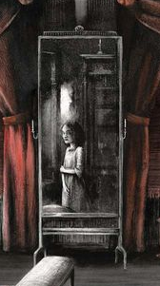
Jane is still feeling angry and frustrated at her fight with John. She says:
‘the mood of the revolted slave was still bracing me with its bitter vigour.’
In the context of this quotation, the word ‘revolted’ is a synonym of ‘rebel’. It means to take action against a government or ruler. It does not mean revolted as in disgusted.
We looked at a rebellion in ‘Animal Farm’ where the animals threw Farmer Jones from the farm because he was a tyrant and treated them cruelly. Jane feels like a revolted (rebellious) slave against the ‘tyrants’ at Gateshead Hall.
Jane Eyre
Discuss this question with a partner.
Why is Jane feeling ‘revolted’ and why is she a ‘slave’?

Slide 16
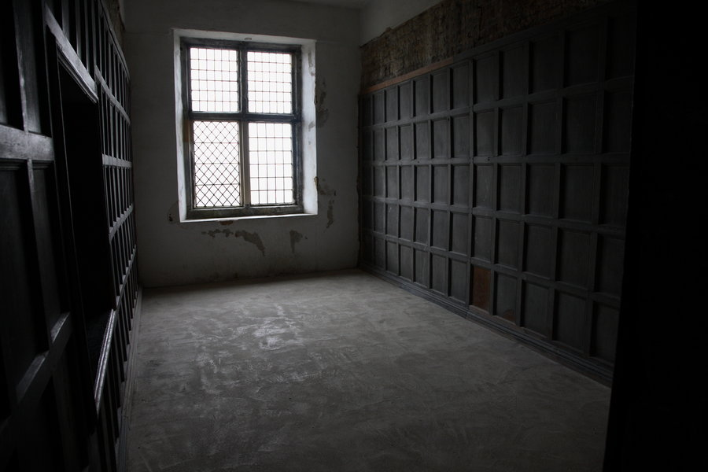
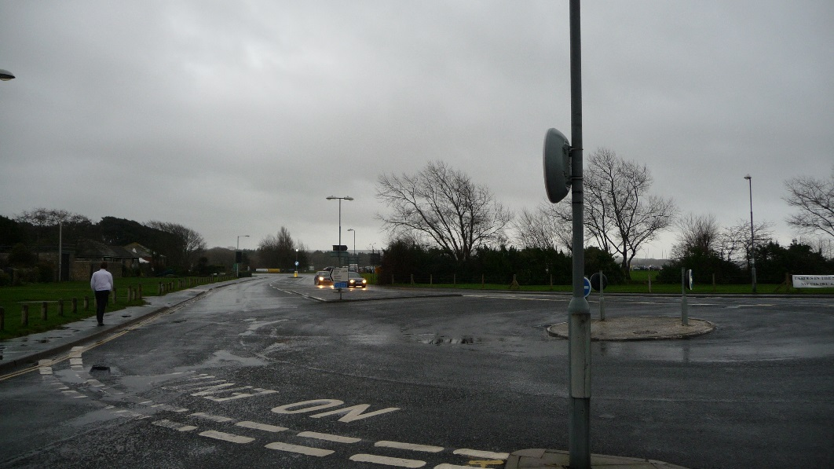
In the final passage, Jane will describe herself as ‘oppressed’.
oppress – verb
If something oppresses you, it makes you feel depressed, anxious, and uncomfortable.
The place oppressed Aubrey even before his eyes adjusted to the dark.
It was not just the weather which oppressed her.
Close Reading
Which places do you find oppressive?

Slide 17
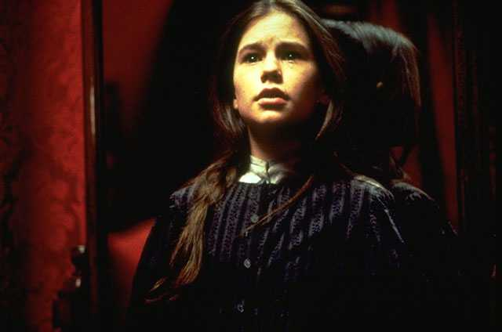
The sun is beginning to set whilst Jane still sits in the red-room.
Let’s find out what happens next.
Chapter 2
Read from, ‘Daylight began to forsake…’ p.19
Read to, ‘… Bessie and Abbot entered.’ p.21
Jane Eyre
p. 19

Slide 18
Daylight began to forsake the red-room; it was past four o’clock, and the beclouded afternoon was tending to drear twilight. I heard the rain still beating continuously on the staircase window, and the wind howling in the grove behind the hall; I grew by degrees cold as a stone, and then my courage sank. My habitual mood of humiliation, self-doubt, forlorn depression, fell damp on the embers of my decaying ire. All said I was wicked, and perhaps I might be so; what thought had I been but just conceiving of starving myself to death? That certainly was a crime: and was I fit to die? Or was the vault under the chancel of Gateshead Church an inviting bourne? In such vault I had been told did Mr. Reed lie buried; and led by this thought to recall his idea, I dwelt on it with gathering dread. I could not remember him; but I knew that he was my own uncle—my mother’s brother—that he had taken me when a parentless infant to his house; and that in his last moments he had required a promise of Mrs. Reed that she would rear and maintain me as one of her own children.
forsake – leave
drear – dreary
habitual – usual
ire – anger
chancel – the main part of the church with the altar
Jane Eyre
p.19-20

Slide 19
Mrs. Reed probably considered she had kept this promise; and so she had, I dare say, as well as her nature would permit her; but how could she really like an interloper not of her race, and unconnected with her, after her husband’s death, by any tie? It must have been most irksome to find herself bound by a hard-wrung pledge to stand in the stead of a parent to a strange child she could not love, and to see an uncongenial alien permanently intruded on her own family group.
A singular notion dawned upon me. I doubted not—never doubted—that if Mr. Reed had been alive he would have treated me kindly; and now, as I sat looking at the white bed and overshadowed walls—occasionally also turning a fascinated eye towards the dimly gleaning mirror—I began to recall what I had heard of dead men, troubled in their graves by the violation of their last wishes, revisiting the earth to punish the perjured and avenge the oppressed; and I thought Mr. Reed’s spirit, harassed by the wrongs of his sister’s child, might quit its abode—whether in the church vault or in the unknown world of the departed—and rise before me in this chamber.
interloper – entering without permission
race – family
irksome – annoying
uncongenial – unpleasant
notion – idea
violation – to not obey the promise
perjured – to lie after promising the truth
oppressed – downtrodden
abode - home
Jane Eyre
p. 20

Slide 20
I wiped my tears and hushed my sobs, fearful lest any sign of violent grief might waken a preternatural voice to comfort me, or elicit from the gloom some haloed face, bending over me with strange pity. This idea, consolatory in theory, I felt would be terrible if realised: with all my might I endeavoured to stifle it—I endeavoured to be firm. Shaking my hair from my eyes, I lifted my head and tried to look boldly round the dark room; at this moment a light gleamed on the wall. Was it, I asked myself, a ray from the moon penetrating some aperture in the blind? No; moonlight was still, and this stirred; while I gazed, it glided up to the ceiling and quivered over my head. I can now conjecture readily that this streak of light was, in all likelihood, a gleam from a lantern carried by some one across the lawn: but then, prepared as my mind was for horror, shaken as my nerves were by agitation, I thought the swift darting beam was a herald of some coming vision from another world.
preternatural – unnatural
consolatory – something that makes you feel better
endeavoured – try hard
penetrating… aperture – getting through a hole/gap
conjecture – guess without evidence
Jane Eyre
p.20-1

Slide 21
My heart beat thick, my head grew hot; a sound filled my ears, which I deemed the rushing of wings; something seemed near me; I was oppressed, suffocated: endurance broke down; I uttered a wild, involuntary cry; I rushed to the door and shook the lock in desperate effort. Steps came running along the outer passage; the key turned, Bessie and Abbot entered.
endurance – doing something difficult for a long time
involuntary - uncontrolled
Jane Eyre
p. 21

Slide 22
“Miss Eyre, are you ill?” said Bessie.
“What a dreadful noise! it went quite through me!” exclaimed Abbot.
“Take me out! Let me go into the nursery!” was my cry.
“What for? Are you hurt? Have you seen something?” again demanded Bessie.
“Oh! I saw a light, and I thought a ghost would come.” I had now got hold of Bessie’s hand, and she did not snatch it from me.
“She has screamed out on purpose,” declared Abbot, in some disgust. “And what a scream! If she had been in great pain one would have excused it, but she only wanted to bring us all here: I know her naughty tricks.”
“What is all this?” demanded another voice peremptorily; and Mrs. Reed came along the corridor, her cap flying wide, her gown rustling stormily. “Abbot and Bessie, I believe I gave orders that Jane Eyre should be left in the red-room till I came to her myself.”
“Miss Jane screamed so loud, ma’am,” pleaded Bessie.
peremptorily
– expecting to be obeyed
Jane Eyre
p. 21

Slide 23
“Let her go,” was the only answer. “Loose Bessie’s hand, child: you cannot succeed in getting out by these means, be assured. I abhor artifice, particularly in children; it is my duty to show you that tricks will not answer: you will now stay here an hour longer, and it is only on condition of perfect submission and stillness that I shall liberate you then.”
“O aunt! have pity! Forgive me! I cannot endure it—let me be punished some other way! I shall be killed if—”
“Silence! This violence is all most repulsive:” and so, no doubt, she felt it. I was a precocious actress in her eyes; she sincerely looked on me as a compound of virulent passions, mean spirit, and dangerous duplicity.
Bessie and Abbot having retreated, Mrs. Reed, impatient of my now frantic anguish and wild sobs, abruptly thrust me back and locked me in, without farther parley. I heard her sweeping away; and soon after she was gone, I suppose I had a species of fit: unconsciousness closed the scene.
abhor –hate
artifice – making up stories / lies
submission – allowing someone to have power over you
virulent – hateful
duplicity – dishonest talk and behaviour
parley – discussion
Jane Eyre
p.21-2

Slide 24
Here are four phrases from the passage we have read. Match these to the emotions that Jane is feeling.
1) My habitual mood of humiliation, self-doubt, forlorn depression, fell damp on the embers of my decaying ire.
Vulnerable
2) I wiped my tears and hushed my sobs, fearful lest any sign of violent grief might waken a preternatural voice to comfort me
Alone
The red-room
Scared
3) Mrs. Reed, impatient of my now frantic anguish and wild sobs, abruptly thrust me back and locked me in
Depressed
4) I grew by degrees cold as a stone, and then my courage sank.
Notes:
5 True or False questions
Here are 5 phrases from the passage we have read. Match these to the emotions that Jane feels.: vulnerable, alone, scared, angry

Slide 25
Here are four phrases from the passage we have read. Match these to the emotions that Jane is feeling.
1) My habitual mood of humiliation, self-doubt, forlorn depression, fell damp on the embers of my decaying ire.
Depressed
2) I wiped my tears and hushed my sobs, fearful lest any sign of violent grief might waken a preternatural voice to comfort me
Alone
The red-room
3) Mrs. Reed, impatient of my now frantic anguish and wild sobs, abruptly thrust me back and locked me in
Vulnerable
4) I grew by degrees cold as a stone, and then my courage sank.
Scared
Notes:
5 True or False questions
Here are 5 phrases from the passage we have read. Match these to the emotions that Jane feels.: vulnerable, alone, scared, angry

Slide 26
Below are some quotations from chapter 2.
Use them to help you write a paragraph answering the following question:
How does Brontë present Jane’s feelings after being locked in the red-room?
I was oppressed, suffocated: endurance broke down; I uttered a wild, involuntary cry; I rushed to the door and shook the lock in desperate effort
‘Why was I always suffering, always browbeaten, always accused, for ever condemned?’
Jane Eyre
“O aunt! have pity! Forgive me! I cannot endure it—let me be punished some other way! I shall be killed if—”
‘the mood of the revolted slave was still bracing me with its bitter vigour.’

Slide 27
Quiz time!
Circle the correct answers for quiz 1.
Fortnightly quiz

Slide 28
Quiz answers
b d
a b c
d
e
b c e
c e
c
b d
a e
a d e
Answers

Slide 29
Love this lesson?
Have suggestions for improvements?
Does something need fixing?
Feedback
Please let us know!
Fill in this feedback form so that we can keep improving.

