Slide 1
The Creature’s narrative
Volume 2

Slide 2
Aims
Explore the extent to which nature is presented as sublime and Victor as a Romantic, rather than Gothic
Analyse the creature’s first speech and draw comparisons with Victor’s language style

Slide 3
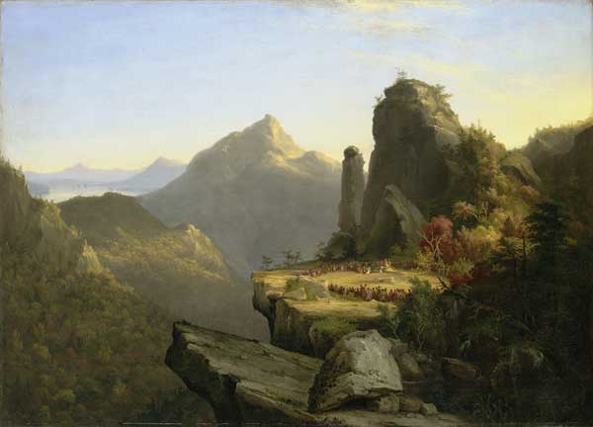
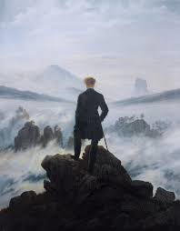
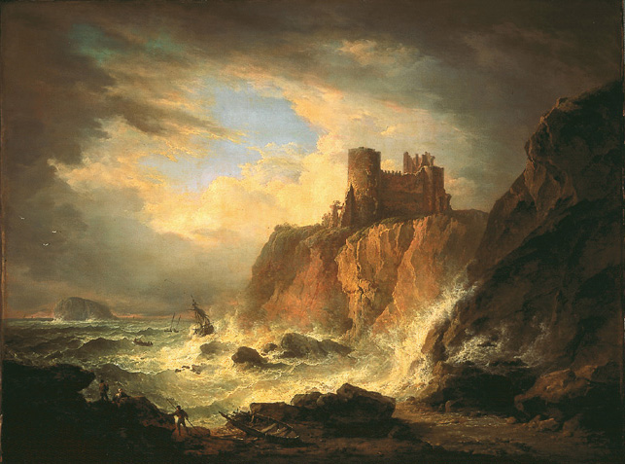
Introduction and re-cap of sublime and the ‘Romantic man’

Slide 4
Sublime Romantic man
Lack of harmony and proportion
Terror, awe, obscure, irregular landscapes
Man’s surrender to nature/god’s omnipotence
Sense of the Gothic; the unknown/ psychological blankness
Solitary/ isolated
Imposing his meanings/ imagination onto nature; visionary
Socially progressive
Concern with inner nature
Delight in natural environment
EXPLAIN TO THE PERSON SITTING NEXT TO YOU WHAT THE TYPICAL FEATURES OF THESE ARE…

Slide 5
Volume one, chapter 1
How does the characterization and development of Victor and Caroline change/develop? Consider ‘monstrosity’ as a key Gothic concept.
How (and why) does Shelley draw parallels between the creature and Victor?
Consider Shelley’s depiction of nature (specific focus on p97 beginning ‘The weight upon my spirit was sensibly lightened…’
What effect does it have on Victor?
What is the relationship between God and nature?
Connections to the sublime and relationship between creator/created?

Slide 6
Volume two, chapter 2 up to page 101
When and why does the shift from Romantic to Gothic occur?
Allusion to Mutability

Slide 7
AO3 – allusion to ‘Mutability’
A series of symbols, clouds, wind harps, describe the permanence in impermanence
The first two stanzas concern the bustle and hurry of life which only conceals its inherent transience. susceptible to every passing wind gust.
The last two stanzas concern the theme of the lack of freedom. In sleep, the mind cannot control the unconscious which poisons sleep. Human life and actions are subject to uncontrollable internal or autonomic reactions and to external forces.. The conclusion is that the only constant is change.
There is also a prose version of the themes of the poem before the appearance of the poem: "Alas! Why does man boast of sensibilities superior to those apparent in the brute; it only renders them more necessary beings. If our impulses were confined to hunger, thirst, and desire, we might be nearly free; but now we are moved by every wind that blows and a chance word or scene that that word may convey to us."
The prose version enunciates the identical themes of the poem, that man cannot control his thoughts because man has a subconscious that he cannot completely control.

Slide 8
Enter creature…
In what ways does the interruption of the creature contrast the previous chapter/ paragraphs exploring Victor’s apparent Romanticism? Think about change in language, style and genre.
What is particularly Gothic about this encounter?

Slide 9
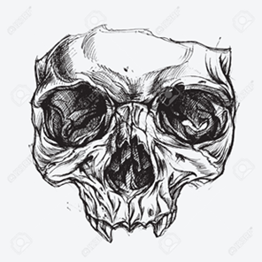
Gothic doubles – reflections and oppositions
Like many Gothic novels, Frankenstein generates much of its dramatic doubling by splitting its protagonist in parts; the secondary being, usually a ghost or a doppelganger, is an symbolic figure and a projection of the protagonist’s inner life on the outer world. This makes the Gothic novel as strongly solipsistic form.
Frankenstein notes how the creature is always physically near to him, but this exists as a metaphor also: ‘I do not doubt that he (creature) hovers near the spot which I inhabit.’
The clearest indication that Victor recognises the creature as a double comes when he observes: ‘my own spirit let loose from the grave, forced to destroy all that was dear to me’.
The creature is often spotted framed by windows, which can be seen as mirrors. Similarly, Victor catches sight of him in flashes of lightning, as though he has caught sight of a ghostly reflection.

Slide 10
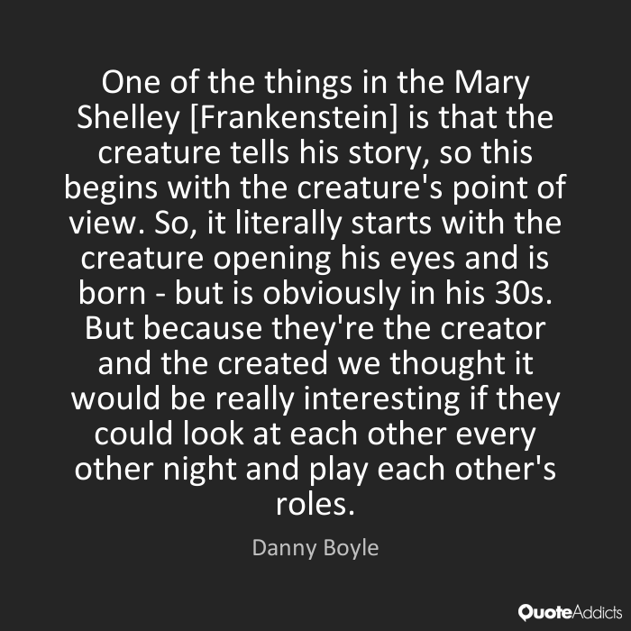
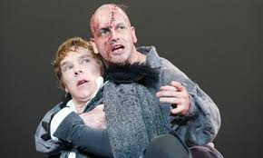
Danny Boyle, 2011 National Theatre production of Frankenstein

Slide 11
Gothic doubles – reflections and oppositions
The moment in Chapter 10 when Victor catches sight of the creature on the mountains, is often read as a reference to the ‘Brocken’ moment.
The ‘spectre of the brocken’, a gigantic shadow of the observer projected on the cloudbank opposite the sun was a favourite subject for Romantic writers like Shelley and Coleridge, who saw it as a symbol of the viewer’s ego or personal obsession. The shadow or ghost is created by our own personal obsessions, yet often, we do not realise that the shadow or ghost we pursue is ultimately created by our own imagination.

Slide 12
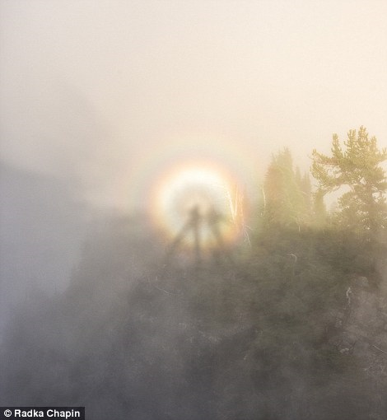
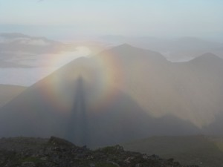
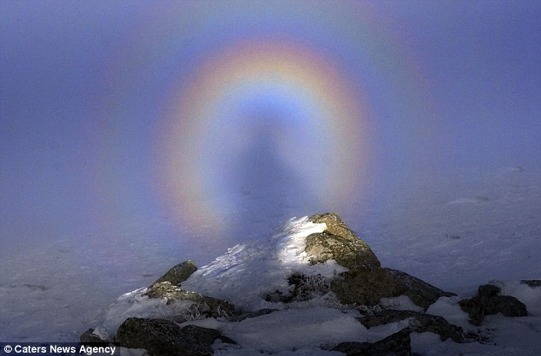
The double/ shadow haunts Victor; he is both pursued by it and pursues it, blurring the boundaries between the observer and the observed; it is perhaps no surprise then that both Victor and his creature are known indiscriminately as ‘Frankenstein’.

Slide 13
Gothic doubles – reflections and oppositions
The novel is full of doubles; for instance, the resemblance between Margaret Saville and Mary Shelley (they even share the same initial); between Mary Shelley and Walton; Walton and Victor; Victor and the monster; the monster and Safie; Safie and Mary Shelley and so on.
Modern productions like Danny Boyle’s 2011 stager version take this even further, casting similar looking actors in the roles of Frankenstein and the creature, and alternating their roles; the audience is continually reminded of their affinity.

Slide 14
Key quotation page 102
a miserable or dejected state, as well as an abject and outcast or destitute state
‘All men hate the wretched: how, then, must I be hated, who am miserable beyond all living things!’
Symbolic of any outcast or ostracised groups (e.g. the poor, the deformed, the ugly, the other) because they present a threat to others’ sense of self. Possible link to French Revolution where uprising peasant seen as monstrous.
What might the creature be symbolic of?
Notes:
Symbolic of any outcast or ostracised groups (e.g. the poor, the deformed, the ugly, the other) because they present a threat to others’ sense of self. Possible link to French Revolution where uprising peasant seen as monstrous

Slide 15
The ‘abject’ and its meaning
In psychoanalytic theory, the ‘abject’ represents a taboo part of the self that we wish to separate off from ourselves, and when we are confronted with something or someone we perceive as abject, we reject, expel or even attack it.
Julia Kristeva suggests the corpse is an extreme example of abjection – for it was once a human person, or subject, but has become in death, an object, outside of the cultural order.
Our disgust stems from the fact it poses a threat to our identity and sense of self.

Slide 16
Task 2 – analysis of creature’s speech
What are the creature’s arguments?
How does he use language effectively to communicate his point?
How does his language contrast with Victor’s?
Support – features list for the two characters…

Slide 17
Aesthetic prejudice
Often called ‘monster’, the term ‘monstrous’ in Gothic fiction is etymologically something that serves to demonstrate or warn (Latin, monstrare: to demonstrate/ monere: to warn).
The ill assorted parts of a monster allow a visible demonstration of the follies of vice.

Slide 18
However…
Aesthetic ‘otherness’ also defines the normal; in this sense, a binary opposition is formed…
However, in Shelley’s novel, this is problematic because the creature is only a reflection of his creator, and in fact is arguably more natural and humane than others in the novel (the father who shoots at him, the rejection of the De Lacey’s, the court’s dealings with Justine)
In Gothic fiction, the ‘double’ is often associated with ugliness, signifying the depravity of its more upright twin (see Jekyll and Hyde/ Dorian Grey)

Slide 19
AO5: Peter Brooks ‘What is a Monster?’
‘the opposition of sight and speech’
‘monster clearly understands that it is not visual relation that favours him’
‘as a verbal creation he is the very opposite of monstrous’

Slide 20
Task 3- creature v Victor - extra
Complete the comparison chart, looking at pages 101-104, exploring the differences between the creature and Victor’s language style.
Each pair allocated one row each, ready for whole class feedback

Slide 21
Summing up…
At this stage, who do you feel more sympathy for and why? Whose side might Shelley have been on? Is it different to your viewpoint?

