Slide 1
Act 4 – Ophelia and Laertes

Slide 2
Aims
To explore Ophelia’s madness and the treatment of it in 4.5
To consider Laertes as the third avenger of the play in 4.5, 4.6, 4.7
To consider gender roles

Slide 3
Starter activity- consider these ‘ideas’ about women… why might people have believed/ believe them?
Women, by nature, are sexually deviant – they need to be controlled by men. If their sexual desires are allowed to run free, they will go mad.
Women are mutilated men who have to live with the deformity of not having a penis.
Female madness is a result of a disturbance of the womb.
A diagnosis of ‘moral insanity’ was common for women in the Victorian era and included being loud or sexually promiscuous; women outnumbered men two to one in asylums, leading doctors to believe that women were more vulnerable to insanity than women.

Slide 4
Gender in the Elizabethan period
Elizabethan Men
Elizabethan Women
Powerful and privileged
Common for men to visit brothels without much damage to reputation
Syphilis a widespread disease – Laertes warns Ophelia of ‘contagious blastments’ that might affect reckless lovers.
Might refer to symptoms of disease or corruption of her innocence by men’s sexual desires
Socially, intellectually and physically inferior
Accepted idea since Eve that women are responsible for man’s fall into evil
Must be virgins before marriage
Not socially acceptable for women to have affairs – if a woman was unfaithful she made a ‘cuckold’ of her husband, represented by a man with horns – Hamlet refers to this when he says, ‘marry a fool. For wise men know well enough what monsters you make of them.’

Slide 5
In ‘Hamlet’, gender restricts….
Women and men thought to have gender-specific weaknesses
Manly maladies
Hamlet’s melancholia (or depression) was fashionable for young men at the time – it was seen as coming from the part of the brain that produces artistic and intellectual creativity.
Feminine flaws
Women either chaste or promiscuous – once they’d had sex, women were thought to develop an uncontrollable appetite for sex and a tendency to become hysterical.
Ophelia’s madness in 4.5 is has often been associated by feminist critics (like Elaine Showalter) with sexual hysteria.
However…
Hamlet’s overthinking is often criticised as being too feminine – Claudius criticises his ‘unmanly grief’. A popular idea at the time was that women talk and men act – hence Hamlet attacks himself and tendency to overthink as being womanly: ‘must like a whore unpack my heart with words.’

Slide 6
Hysteria
Hysteria, more commonly observed in women than in men, was once supposed to be an exclusively feminine disorder and was blamed on a disturbance of the womb.
This belief is reflected in the Greek hysterikos, meaning 'hysterica' or 'of the womb' (from hysteria, 'womb'), a standard term for the womb, and rising of the mother, fits of the mother, and even simply mother were hysterical fits brought on by disturbance of the womb.

Slide 7
Stage directions – explore symbolism
First quarto:
‘Enter Ophelia, playing on a lute, and her hair down singing.’
Second quarto:
‘Enter Ophelia, distracted.’

Slide 8
‘reason in madness’?
Before this point, Ophelia says little, able to play the role of the obedient daughter with skill…it’s ironic that when she goes mad, Shakespeare gives her a voice and freedom she once lacked…
Question: What might be the sense or truth of Ophelia’s madness? Select at least two of her lines that suggest some truth – either about the situation or her true self…

Slide 9
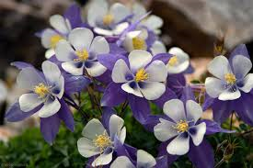
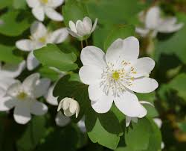
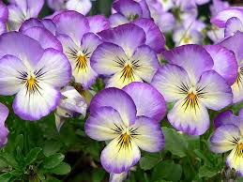
FLOWER SYMBOLISM: WHO SHOULD GET WHAT?
Fennel for flatterers
Columbines for unfaithfulness
Rosemary for remembrance
Daisies for deception in love
Rue for regret and repentance
Violets for faithfulness

Slide 10
Recap: ‘My brother shall know of it’ (p378)
Political/ outside is intruding on the domestic/inside
Imagery of disorder: ‘the people muddied/ Thick and unwholesome in thoughts and whispers’ (4.5.81-82)
Laertes as a symbol of disorder: ‘young Laertes in a riotous head/o’erbears your officers. The rabble call him lord.’ (4.5.101-102)

Slide 11
LAERTES AS REVENGER
‘That drop of blood that’s calm proclaims me bastard’ (4.5,118)
‘I’ll not be juggled with./ To hell allegiance, vows to the blackest devil,/ Conscience and grace to the profoundest pit.’ (4.5, 129-131)
‘By heaven, thy madness shall be paid with weight’ (4.5, 155)
‘And so I have a noble father lost,/ A sister driven to desperate terms’ (4.7, 26-27)
DISCUSSION QUESTIONS:
Which of these lines best conveys Laertes’ reasons for and desire for revenge?
Is Laertes a more powerful avenger than Hamlet/Fortinbras? Why? Why not?

Slide 12
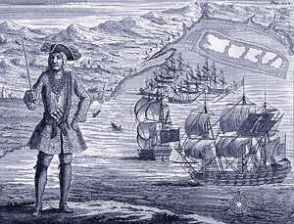
4.6 – Hamlet and the pirates
‘I boarded them’
‘I am to do a turn for them’
Plot device?
Signifies a change in Hamlet?

Slide 13
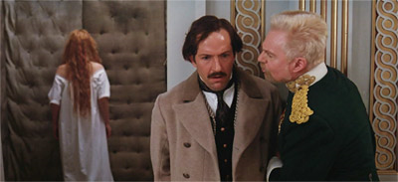
4.7 Claudius and Laertes
Claudius manipulates Laertes
Emerges as a cunning, Machiavellian villain here
Appeals to Laertes’ ego with flattery of his swordsmanship
Questions his loyalty to his father and his masculinity

Slide 14
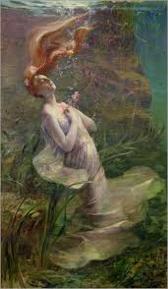
Ophelia’s drowning 161- end
Feminist critic, Elaine Showalter suggests Ophelia is a ‘potent and obsessive figure in our cultural mythology’ – female madness is associated with bodies and erotic desires..
Ophelia most famously captured the attention of the Pre-Raphaelite Brotherhood. Inspired by the theories of John Ruskin, who urged artists to ‘go to nature’, they believed in an art of serious subjects treated with maximum realism. Their principal themes were initially religious, but they also used subjects from literature and poetry, particularly those dealing with love and death. They also explored modern social problems.

Slide 15
OPHELIA, JOHN EVERETT MILLAIS, 1852 Pre-Raphaelite
Notes:
INSPIRATION FOR OLIVIER FILM

Slide 16
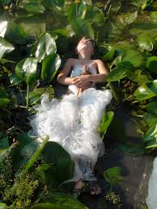
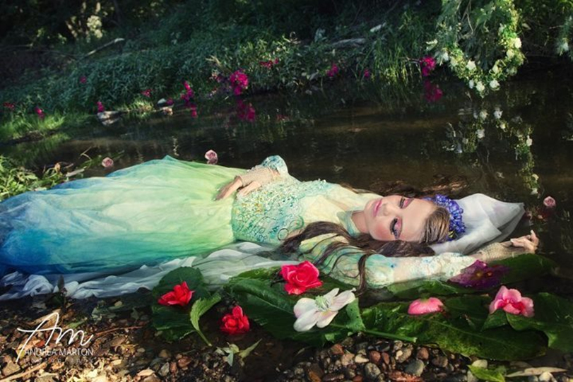
THINKING QUESTIONS – 3 MINUTES TO DISCUSS:
In what other genre do we see the image of the beautiful dead woman?
Why do you think this moment in ‘Hamlet’ so captured the popular imagination?

Slide 17
Symbolism – critics
‘Of all the characters in Hamlet, Ophelia is the most persistently presented in terms of symbolic meanings.’ (Bridget Lyons)
‘Ophelia’s symbolic meanings, moreover are specifically feminine. Whereas for Hamlet, madness is metaphysical, linked with culture, for Ophelia, it is a product of the female body and female nature…On the Elizabethan stage, the conventions of female insanity were sharply defined. Ophelia dresses herself in white, decks herself with ‘fantastical garlands’ of wild flowers…her speeches are marked by extravagant metaphors, lyrical free associations and explosive sexual imagery.’ (Elaine Showalter)
Drowning was associated with the feminine – female fluidity rather than masculine aridity – Gaston Bachelard traced the connections between women, water and death, suggesting drowning is the truly ‘feminine death’ in literature. Females immersed in water suggest a return to the organic symbol of liquid woman; her body consists of blood, amniotic fluid and milk.
TASK – LOOK AT THE IMAGES USED BY GERTRUDE IN THE SPEECH WHICH DESCRIBES THE DROWNING AND CONSIDER THEIR SYMBOLIC VALUE.

Slide 18
PREP – Read Elaine Showalter’s article on Ophelia http://www.houseofideas.com/mscornelius/resources/hamlet/hamlet_vol_59__elaine_showalter_essay_date_1985_276850-.pdf
What does Showalter suggest Lacan’s view of Ophelia involves?
How often does Ophelia appear in the text? What does this imply about her personal ‘story’?
How is Ophelia viewed by French Feminist theory?
How might Ophelia represent Hamlet’s effeminate side?
What role do visual illustrations of Ophelia have?
What, according to Lyons, is Ophelia’s ‘symbolic meaning’, encapsulated in her appearance and her suicide method?
What is erotomania?
What stage representations of Ophelia are discussed?

