Slide 1
A Game of Polo with a Headless Goat

Slide 2
What can you remember?

Slide 3
Why is it called A Game of Polo with a Headless Goat?
The title of the piece is extremely unusual in order to pull the readers in. A reader wouldn't usually imagine polo (a less well-known sport played by posh upper classes) as having anything to do with a 'headless goat', an image which is extremely grotesque and slightly barbaric. It thus juxtaposes the civilised and the savage.

Slide 4
Context
Levine chose to travel on a one-year trip around Asia. This resulted in her writing ‘A Game of Polo with a Headless Goat’, which was then developed into a documentary.
Author’s Purpose
This text is a travelogue; a non-fiction book describing a foreign country. The writer is aiming to engage both people who are interested in foreign travel and people who are interested in culture and sport with this particular story. She wants to inform readers about the traditions and culture of the exotic places she is visiting, and also to entertain readers with humorous and surprising stories which sum up the quirky and unexpected events she witnesses.

Slide 5
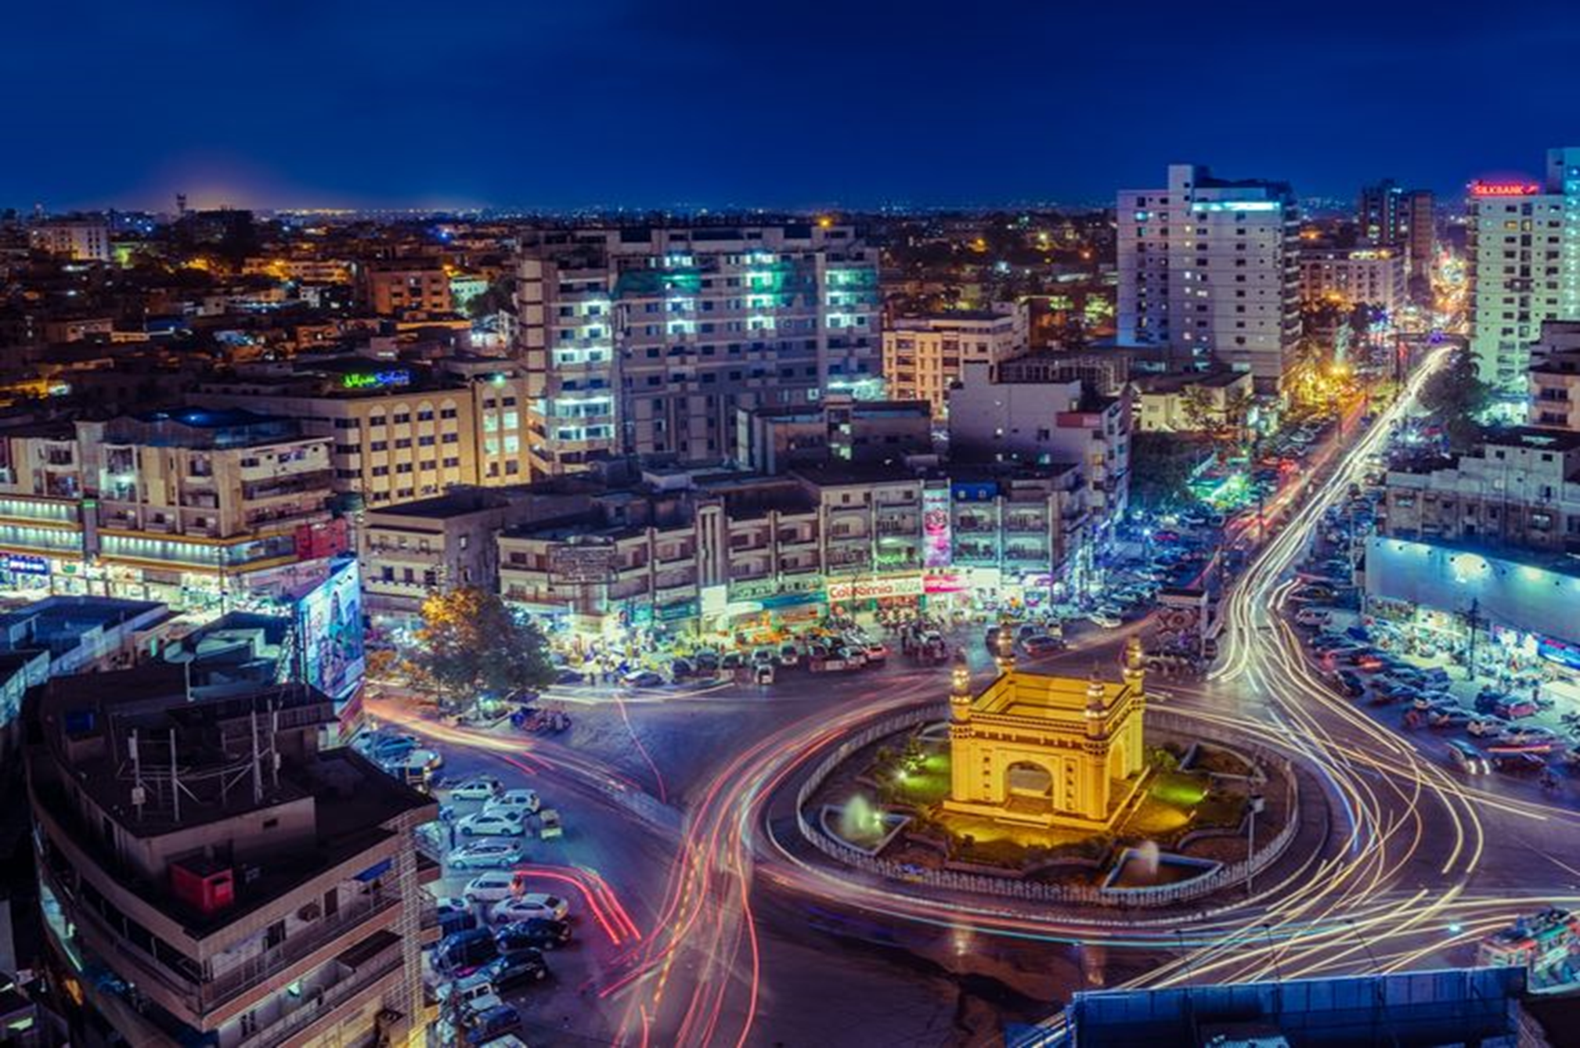
Karachi, Pakistan What do you already know about the city? Watch the following video and make a note of any important information you find out about the city.

Slide 6
AO1: Read and understand a variety of texts, selecting and interpreting information, ideas and perspectives.

Slide 7
Key Questions…
Lines 1-14
What word/phrase suggests the race would be chaotic? Why is it effective?
What word/phrase suggests the boys were excited about the race? Why is it effective?
What phrase suggests Levine thought the race was not going to happen?
Why did she not think the race was going to happen?
Lines 14-30
From Lines 14-20, list THREE details about the race
From Lines 21-25, list THREE details that show the race was exciting
How does line 28 effectively descibe the traffic of the race?

Slide 8
Key Questions…
Lines 30-40
What do we learn about Yaqoob in this part of the extract?
Lines 43- END
Why were people upset about the end of the race?
Why did people have such ‘strong opinions’ about the end of the race?
Which line suggest that there was a chance of violence? Why is it effective?
What is humorous about the end of the extract?

Slide 9
Let’s Check…

Slide 10
Remind yourself of the extract from A Game of Polo with a Headless Goat
How does the writer, Emma Levine, use language and structure in the text to present Yaqoob and Iqbal?
You should support your answer with close reference to the extract including brief quotations.

Slide 11
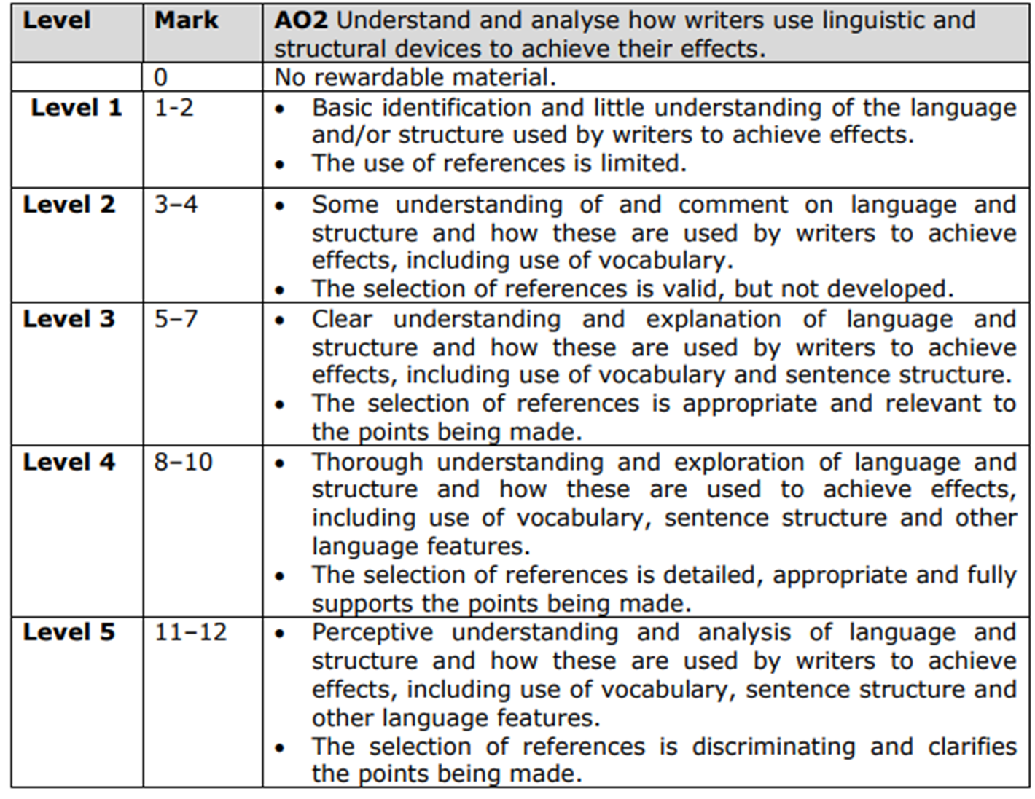

Slide 12
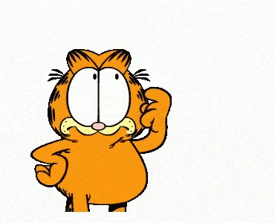
Zoom in…
“The two lads who had never been interested in this Karachi sport were suddenly fired up with enthusiasm”
1. What does ‘lads’ suggest?
2. Which words and phrases stand out for you?
3. What does the metaphor suggest about their feelings?

Slide 13
Emma Levine presents 'the lads' as immature as they prepare to drive through the donkey race in Karachi. Levine uses the colloquial 'the lads' to describe Yaqoob and Iqbal, the term implies that Yaqoob and Iqbal are not fully fledged men but are instead inexperienced and possibly mischievous in their pursuits to help the writer secure her prize photo of 'the wacky races'. The term could also be used to foreshadow the dramatic ending of the race. As readers we question the safety of Levine as she places herself in the hands of 'the lads', however, her hindsight makes this interaction with 'the lads' humorous as although she is in danger, she does survive. Furthermore, the use of 'the lads' pre-empts the ending of the tale...

Slide 14
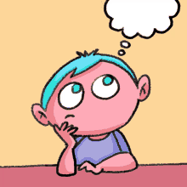
Zoom in…
“Our young driver relished this unusual test of driving skills. It was survival of the fittest”
1. What does the verb ‘relished’ suggest?
2. What does this suggest about his situation?
3. What technique does the writer use and why is it effective?

Slide 15
Zoom in…
1. What do we learn about the young men?
‘I really enjoyed that,’ he said as we drove off at a more sedate pace. ‘But I don't even have my licence yet because I'm underage!’
2. What is the effect of the dialogue?
3. What is the impact of the punctuation?

Slide 17
Remind yourself of the extract from A Game of Polo with a Headless Goat
How does the writer, Emma Levine, use language and structure in the text to present Yaqoob and Iqbal?
You should support your answer with close reference to the extract including brief quotations.

Slide 18
You could try…
Point – referring to the question
In the text, the writer presents Yaqoob and Iqbal as…
Evidence linked to the writer The writer desribes…
What is the writer doing?
The writer’s use of (add a technique) may indicate…
How does the writer want the reader to respond?
This is effctive as it conveys how the two young men are…

Slide 19
Over to you…

