Slide 1
AIC Essay
11.10.18

Slide 2
AO2 discussion varied more across answers with some candidates limiting themselves to a peripheral approach such as identifying a technique without placing it in context or using it to respond to the question. A number of Level 4 responses were seen with thorough application of analytical detail and a convincing critical style. At Level 5, some very impressive responses were seen that used deep understanding of analytical approaches to perceptively respond to the question. Sophisticated exploration of AO2 led to some poised and lucid work with many achieving full marks.

Slide 3
An Inspector Calls
Q3 This was another very popular question with candidates working at all levels of achievement responding to the play’s themes and ideas. Candidates proved well able to explore how the Inspector is used by Priestley to explore the mystery behind Eva Smith’s demise. Some fell into a trap of narrating without analysing language, structure or form. The question led to some perceptive and focused answered at the top end with imaginative interpretations applied in many cases. Examiners reported seeing a significant number of high level responses to this question. Some elements of context were applied unnecessarily but others highlighted aspects of the Inspector’s role and use with some interesting reflections on his ghostly presence and connotations of the name, Goole. Some very lucid and successful answers remarked on the dramatic use of the telephone at the end of the play.
Q4 This was also a popular question with candidates confidently able to discuss the changes to Sheila’s character as the play progresses. Stronger candidates were able to view Sheila as a construct used by Priestley to promote his themes and ideas. Most answers were well supported by relevant and judiciously selected reference. Less able candidates found the level of challenge of this question more accessible than Q3 as they were able to work sequentially through the play. Sheila’s growth and maturity were well documented with good use of textual reference applied in support of arguments. Sheila’s use of exclamatory language and her relationships with others were key features of many answers.

Slide 4
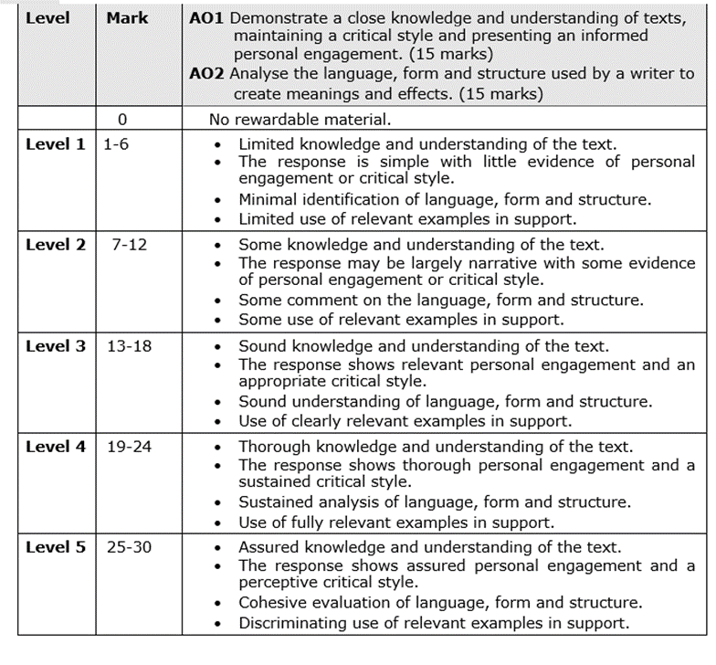

Slide 5
Top marks exemplar from June 2018 cohort
(J Hodgson)

