Slide 1
In this lesson, students will be mastering the following:
Mastery Content:
Jane meets Helen Burns
Lowood School is an institute for orphans
Helen is a complete contrast to Jane – she is quiet, thoughtful and meek
Learning Objective
To explore the similarities and differences between Jane and Helen
Mastery Content

Slide 2
Do Now: How does Jane react to being punished by Mrs Reed at Gateshead? What time does Jane have to wake up on her first day at Lowood? How do we know that the girls are raised in a Christian way at Lowood? What are the girls given for breakfast? Extension: How are the orphans treated in ‘Oliver Twist’? How does this compare to the way the girls are treated at Lowood?
Recap Recap some of the ways life at Lowood is tough. The girls are orphans, and have no one to stad up for them. Relate this information to the Do Now task.
Reading Read from, ‘As yet I had spoken to no one’ (page 58). Read to, ‘“Now I want to read”’ (page 61). In this passage, Helen Burns in introduced. We don’t learn her name, but it is useful to introduce it here in order to help make the later discussion easier to write about. Helen tells Jane a lot of information about Lowood Institute. There is a Q&A matching activity following the passage to help assess students; comprehension of the passage. | Note that the pronouns have been obscured in order to make the answers less obvious!
He is a clergyman, and is said to do a great deal of good. This is a fascinating exchange that should be unpicked by students as it begins reveals Brocklehurst’s true nature. Note the difference between what Helen says and what she doesn’t say. Other people say Mr Brocklehurst is good; she does not. This reveals that Mr Brocklehurst is probably not a good man, and Helen is very polite and tactful. If Jane doesn’t like someone (eg Mrs Reed), she has no reticence in letting her true feelings be known!
Reading Read from, ‘But at that moment the summons sounded for dinner’ (page 61) Read to the end of the chapter. There are some check for understanding questions at the end of the chapter to help assess students’ comprehension of the passage.
Helen and Jane differences Students discuss the differences between Jane and Helen at this part of the novel. The differences will become more and more explicit later in the book, but at this point we already can see how meek and gentle Helen is compared to Jane.
Similarities Jane and Helen Burns react differently to punishment. Students write a paragraph answering this question: What are the similarities are there between Jane Eyre and Helen Burns?
Fortnightly quiz Students complete quiz.
Lesson Guide

Slide 3
Tuesday, 14 June 2022
Helen Burns
Do Now:
Jane reacts by passionately telling Mrs Reed how much she dislikes her for being so cruel and unfair.
Jane has to wake up at dawn.
The girls start their day by reading the bible for an hour.
The girls are given brunt porridge for breakfast.
Do Now:
How does Jane react to being punished by Mrs Reed at Gateshead?
What time does Jane have to wake up on her first day at Lowood?
How do we know that the girls are raised in a Christian way at Lowood?
What are the girls given for breakfast?
Do Now
Extension: The orphans are treated harshly and are given very little food such as gruel. This is similar to the way the girls are treated at Lowood as they are given burnt porridge.
Extension: How are the orphans treated in ‘Oliver Twist’? How does this compare to the way the girls are treated at Lowood?

Slide 4
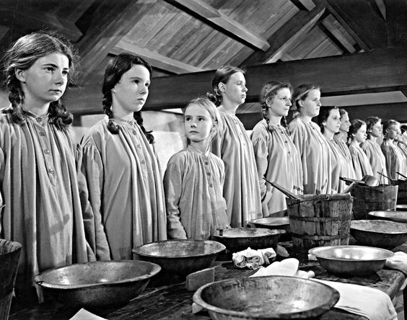
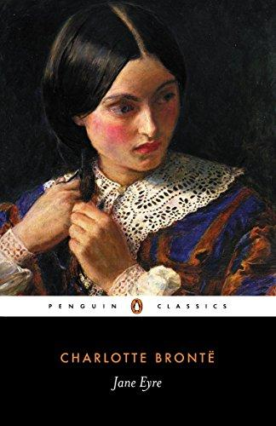
Last lesson, we looked at Jane’s morning routine at Lowood School. It was harsh and tough.
In the passage you are about to read, Jane meets a new character called Helen Burns.
Jane asks Helen about Lowood School.
Lowood School
Let’s read.
Read from, ‘As yet I had spoken to no one’ (page 58)
Read to, ‘“Now I want to read”’ (page 61)

Slide 5
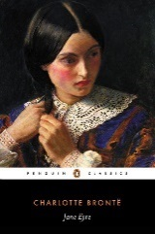
As yet I had spoken to no one, nor did anybody seem to take notice of me; I stood lonely enough: but to that feeling of isolation I was accustomed; it did not oppress me much. I leant against a pillar of the verandah, drew my grey mantle close about me, and, trying to forget the cold which nipped me without, and the unsatisfied hunger which gnawed me within, delivered myself up to the employment of watching and thinking. My reflections were too undefined and fragmentary to merit record: I hardly yet knew where I was; Gateshead and my past life seemed floated away to an immeasurable distance; the present was vague and strange, and of the future I could form no conjecture. I looked round the convent-like garden, and then up at the house—a large building, half of which seemed grey and old, the other half quite new. The new part, containing the schoolroom and dormitory, was lit by mullioned and latticed windows, which gave it a church-like aspect; a stone tablet over the door bore this inscription:—
“Lowood Institution.—This portion was rebuilt A.D. ---, by Naomi Brocklehurst, of Brocklehurst Hall, in this county.” “Let your light so shine before men, that they may see your good works, and glorify your Father which is in heaven.”—St. Matt. v. 16.
accustomed – used to
conjecture – guess
mullioned – divided
latticed - squared
Jane Eyre
p.58-59

Slide 6
I read these words over and over again: I felt that an explanation belonged to them, and was unable fully to penetrate their import. I was still pondering the signification of “Institution,” and endeavouring to make out a connection between the first words and the verse of Scripture, when the sound of a cough close behind me made me turn my head. I saw a girl sitting on a stone bench near; she was bent over a book, on the perusal of which she seemed intent: from where I stood I could see the title—it was “Rasselas;” a name that struck me as strange, and consequently attractive. In turning a leaf she happened to look up, and I said to her directly—
“Is your book interesting?” I had already formed the intention of asking her to lend it to me some day.
“I like it,” she answered, after a pause of a second or two, during which she examined me.
“What is it about?” I continued. I hardly know where I found the hardihood thus to open a conversation with a stranger; the step was contrary to my nature and habits: but I think her occupation touched a chord of sympathy somewhere; for I too liked reading, though of a frivolous and childish kind; I could not digest or comprehend the serious or substantial.
penetrate – understand
import - importance
hardihood –bravery
occupation –hobby
Jane Eyre
p.59

Slide 7
“You may look at it,” replied the girl, offering me the book.
I did so; a brief examination convinced me that the contents were less taking than the title: “Rasselas” looked dull to my trifling taste; I saw nothing about fairies, nothing about genii; no bright variety seemed spread over the closely-printed pages. I returned it to her; she received it quietly, and without saying anything she was about to relapse into her former studious mood: again I ventured to disturb her—
“Can you tell me what the writing on that stone over the door means? What is Lowood Institution?”
“This house where you are come to live.”
“And why do they call it Institution? Is it in any way different from other schools?”
“It is partly a charity-school: you and I, and all the rest of us, are charity-children. I suppose you are an orphan: are not either your father or your mother dead?”
“Both died before I can remember.”
“Well, all the girls here have lost either one or both parents, and this is called an institution for educating orphans.”
“Do we pay no money? Do they keep us for nothing?”
Jane Eyre
p.59-60

Slide 8
“We pay, or our friends pay, fifteen pounds a year for each.”
“Then why do they call us charity-children?”
“Because fifteen pounds is not enough for board and teaching, and the deficiency is supplied by subscription.”
“Who subscribes?”
“Different benevolent-minded ladies and gentlemen in this neighbourhood and in London.”
“Who was Naomi Brocklehurst?”
“The lady who built the new part of this house as that tablet records, and whose son overlooks and directs everything here.”
“Why?”
“Because he is treasurer and manager of the establishment.”
“Then this house does not belong to that tall lady who wears a watch, and who said we were to have some bread and cheese?”
“To Miss Temple? Oh, no! I wish it did: she has to answer to Mr. Brocklehurst for all she does. Mr. Brocklehurst buys all our food and all our clothes.”
“Does he live here?”
“No—two miles off, at a large hall.”
“Is he a good man?”
board – food and a bed
deficiency – lack
subscription –regular payments
benevolent – kind
treasurer – manager of money
Jane Eyre
p.60

Slide 9
“He is a clergyman, and is said to do a great deal of good.”
“Did you say that tall lady was called Miss Temple?”
“Yes.”
“And what are the other teachers called?”
“The one with red cheeks is called Miss Smith; she attends to the work, and cuts out—for we make our own clothes, our frocks, and pelisses, and everything; the little one with black hair is Miss Scatcherd; she teaches history and grammar, and hears the second class repetitions; and the one who wears a shawl, and has a pocket-handkerchief tied to her side with a yellow ribband, is Madame Pierrot: she comes from Lisle, in France, and teaches French.”
“Do you like the teachers?”
“Well enough.”
“Do you like the little black one, and the Madame ---?—I cannot pronounce her name as you do.”
“Miss Scatcherd is hasty—you must take care not to offend her; Madame Pierrot is not a bad sort of person.”
“But Miss Temple is the best—isn’t she?”
clergyman – vicar
pelisse – coat
Jane Eyre
p.60-61

Slide 10
“Miss Temple is very good and very clever; she is above the rest, because she knows far more than they do.”
“Have you been long here?”
“Two years.”
“Are you an orphan?”
“My mother is dead.”
“Are you happy here?”
“You ask rather too many questions. I have given you answers enough for the present: now I want to read.”
Jane Eyre
p.61

Slide 11
Match the question to the correct answer. The pronouns have been edited so the answers are not too obvious.
1. Why is it called Lowood Institution?
A. He/she is very good.
2. Do the pupils have to pay to attend?
B. Miss Temple.
3. Who was the person that gave us bread and cheese?
C. Friends or family members pay some money. The rest of the money is given by other kind people in the area and in London.
Helen Burns
4. Who runs the school?
D. Mr Brocklehurst.
5. Is Mr Brocklehurst a good person?
E. Naomi Brocklehurst.
6. What is Miss Temple like?
F. It is a charity school for orphans.
7. Who established Lowood School?
G. Some people say that he/she has done good things.

Slide 12
1. Why is it called Lowood Institution?
F. It is a charity school for orphans.
2. Do the pupils have to pay to attend?
C. Friends or family members pay some money. The rest of the money is given by other kind people in the area and in London.
3. Who was the person that gave us bread and cheese?
B. Miss Temple.
Helen Burns
4. Who runs the school?
D. Mr Brocklehurst.
5. Is Mr Brocklehurst a good person?
G. Some people say that he/she has done good things.
6. What is Miss Temple like?
A. He/she is very good.
7. Who established Lowood School?
E. Naomi Brocklehurst.

Slide 13
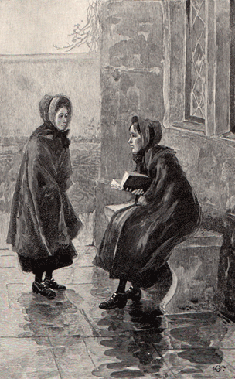
Jane: Is Mr Brocklehurst a good person?
Helen: He is a clergyman, and is said to do a great deal of good.
Helen Burns
This is an interesting response!
Think about the answers to these questions:
What does Helen’s answer tell you about Mr Brocklehurst?
What does it reveal about Helen?

Slide 14
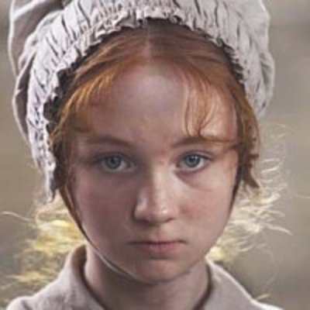
We have begun to find out more information about Lowood School and Helen Burns.
Let’s see how different Helen is to Jane by the way she handles being given a punishment.
Helen Burns
Lowood School
Let’s read.
Read from, ‘But at that moment the summons sounded for dinner’ (page 61)
Read to the end of the chapter.

Slide 15
But at that moment the summons sounded for dinner; all re-entered the house. The odour which now filled the refectory was scarcely more appetising than that which had regaled our nostrils at breakfast: the dinner was served in two huge tin-plated vessels, whence rose a strong steam redolent of rancid fat. I found the mess to consist of indifferent potatoes and strange shreds of rusty meat, mixed and cooked together. Of this preparation a tolerably abundant plateful was apportioned to each pupil. I ate what I could, and wondered within myself whether every day’s fare would be like this.
summons – bell
refectory – dining hall
regaled - supplied
tolerably abundant – fairly large
fare - food
Jane Eyre
p.61

Slide 16
After dinner, we immediately adjourned to the schoolroom: lessons recommenced, and were continued till five o’clock.
The only marked event of the afternoon was, that I saw the girl with whom I had conversed in the verandah dismissed in disgrace by Miss Scatcherd from a history class, and sent to stand in the middle of the large schoolroom. The punishment seemed to me in a high degree ignominious, especially for so great a girl—she looked thirteen or upwards. I expected she would show signs of great distress and shame; but to my surprise she neither wept nor blushed: composed, though grave, she stood, the central mark of all eyes. “How can she bear it so quietly—so firmly?” I asked of myself. “Were I in her place, it seems to me I should wish the earth to open and swallow me up. She looks as if she were thinking of something beyond her punishment—beyond her situation: of something not round her nor before her. I have heard of day-dreams—is she in a day-dream now? Her eyes are fixed on the floor, but I am sure they do not see it—her sight seems turned in, gone down into her heart: she is looking at what she can remember, I believe; not at what is really present. I wonder what sort of a girl she is—whether good or naughty.”
adjourned – went
recommenced – restarted
marked - notable
ignominious – humiliating
Jane Eyre
p.61-62

Slide 17
Soon after five p.m. we had another meal, consisting of a small mug of coffee, and half-a-slice of brown bread. I devoured my bread and drank my coffee with relish; but I should have been glad of as much more—I was still hungry. Half-an-hour’s recreation succeeded, then study; then the glass of water and the piece of oat-cake, prayers, and bed. Such was my first day at Lowood.
relish – enjoyment
Jane Eyre
p.62

Slide 18
In pairs, discuss the answers to these questions:
How is Helen Burns punished?
How does Helen Burns react to her punishment?
How does Jane react to Helen’s punishment?
Helen Burns
Helen Burns

Slide 19
In pairs, discuss the answers to these questions:
Helen Burns is sent to stand in thee middle of the schoolroom.
Helen Burns stands quietly and does not cry or get embarrassed.
Jane is amazed at how composed Helen Burns is. She says she would feel embarrassed if she were in Helen Burns’ position.
Helen Burns
Helen Burns

Slide 20
Jane and Helen Burns react differently to punishment.
Write a paragraph answering this question:
What are the similarities are there between Jane Eyre and Helen Burns?
Helen Burns
Helen Burns
Jane

Slide 21
Quiz time!
Circle the correct answers for quiz 3.
Fortnightly quiz

Slide 22
Quiz answers
a b c
c e
e g f c h d a b
b c d
a e
d e
c
b d
b e
d e
Answers

Slide 23
Love this lesson?
Have suggestions for improvements?
Does something need fixing?
Feedback
Please let us know!
Fill in this feedback form so that we can keep improving.

