Slide 1
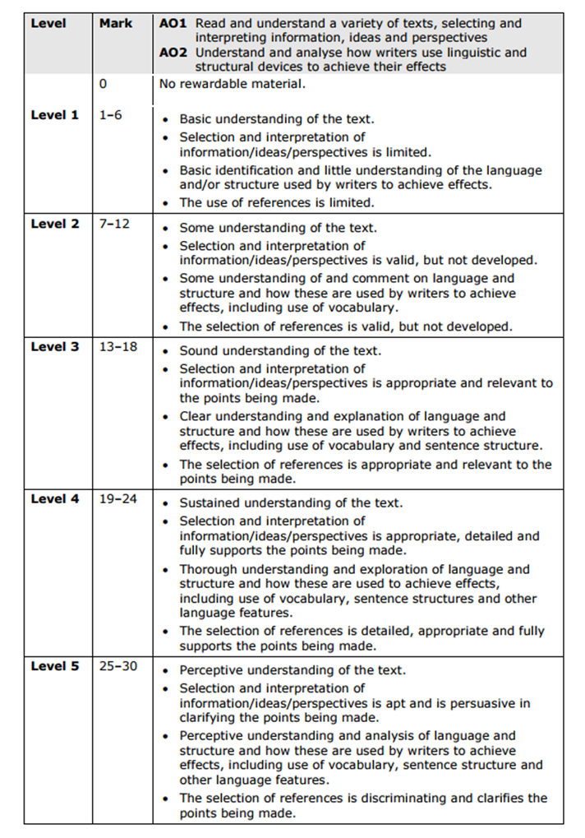
Bright Lights Plan

Slide 2
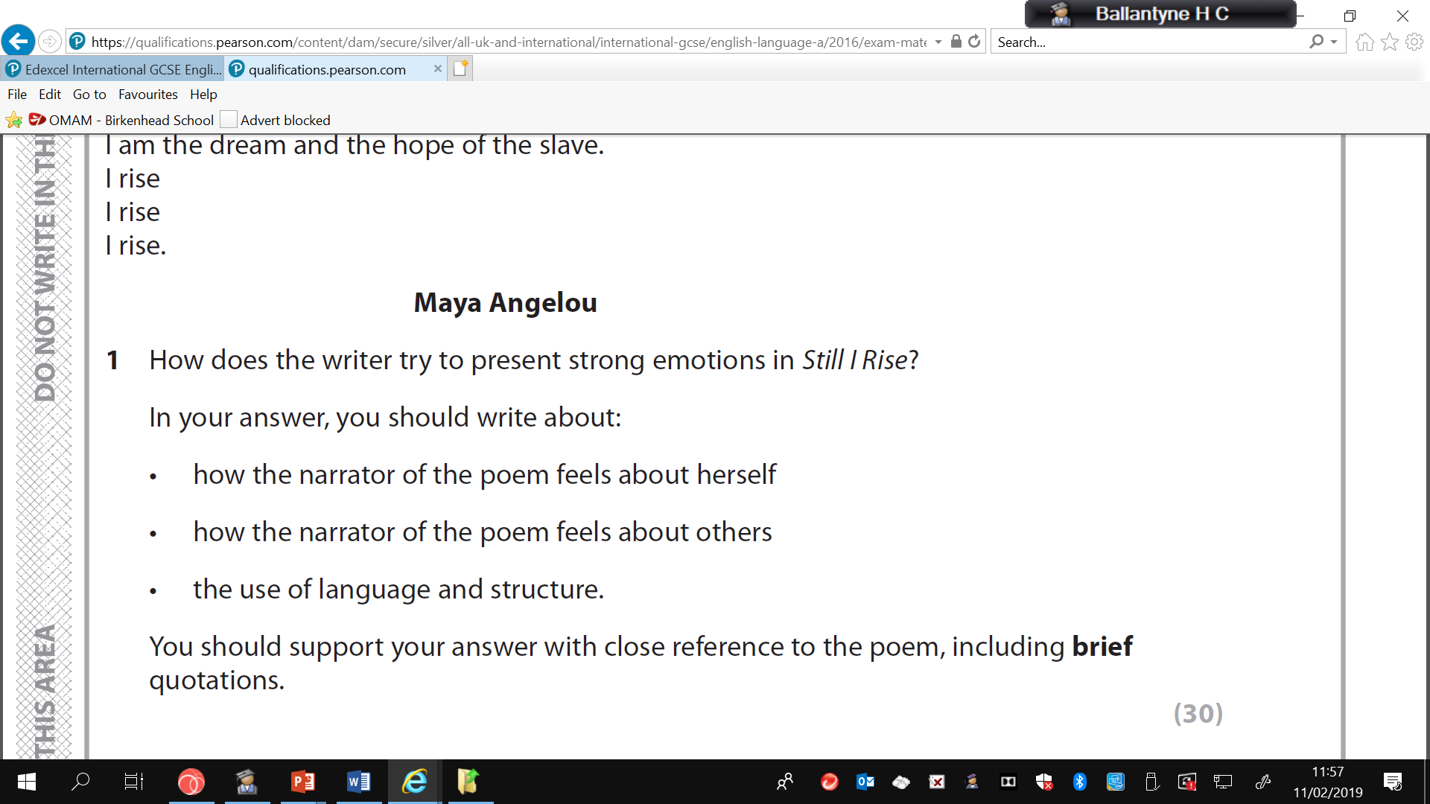
How does the writer present war in the poem?
In your answer you SHOULD write about:
-The setting
-Relationships
- Use of language and structure

Slide 3
Intro: Harrison presents war as…. Struggle through which the human spirit endures
Reality, horrors, hardship, pessimistic, optimistic, relationships, environment, conditions
P1 Title – ‘bright lights’ = dual meaning – alluring nature of cities, life, glamour etc. juxtaposed with reality of war – bombs highlighting destruction of city, siege, Bosnian War
P1-2 Stanza – Talk about how many, their form etc link to Q
Deal with tone established in opening lines and lang. to support i.e. slow, drudgery of life, relentless pessimistic outlook,’queuing’, ‘meagre’ ‘struggling’. Comment on listing and use of enjambement to support this one. Verbs used highlight the hardship – slow and fast paced ‘dodging’ next to ‘struggling’. Lexicon of strife, human survival – water, shelter etc. WAR is presented as – apply to environment, apply to people and families – e.g. pram isn’t used for babies but to survive….
P2 Volta ‘But’ also first person direct address ‘you’d’ – personal, gives impression of omniscient third person, god-like? Observing whole picture, and minutiae of human experience. Universality of human experience – life goes on etc. Irrespective of one’s cultural/religious group, the human experience is universal. Use of colour – monochromatic representation of humans – paradoxical idea that even when in darkness, relationships can shine. One’s identity is irrelevant, eg. Use of native tongue to describe bread. Bread is bread, we all need it. Ref alliterative reinforcement of these ideas – sibilance and assonance.
P3 Focus on specific relationship = love. Shows how humans adapt, assimilate and not only survive but thrive despite the war. A typical fairy tale romance is going on between ‘dark shape’ girl and boy (universal) – link to idealistic ideas hinted in title. Words for war used to describe their courtship – ‘radar’ to show how they have adapted to their circumstances.

Slide 4
P4
Harrison uses imagery connected with light and darkness throughout. Darkness typically connected with war – in terms of bleakness and depressing impact of. Also the way in which cities are plunged into darkness due to war cutting off services and also for self-protection – blackout. Harrison however presents darkness as a good thing – an exciting, clandestine meeting between a boy and girl. Romantic environment in which two people fall in love. Whether the light comes from a candle, cigarette or sniper – the details aren’t important. In this less than ideal environment, love prevails.
P5
Second stanza – Harrison continues this theme using the same images as the closing lines of the first stanza – match-flare test. Tone reverts back to highlighting daily horrors of war – the nonchalant way in which the hyphenated ‘blood-dunked’
is seemingly dropped into the poem. These broken words, awkwardly connected, seem not right, the every day mundane next two the graphic results of war – ‘broken dead’. This feeling of doom gives way to an optimistic feeling towards the end of Stanza 2 – reinforced by the longer line depicting clouds clearing, the pathetic fallacy used to present hope for the future. Harrison is not so naïve to suggest a ‘happily ever after’ conclusion to this unlikely fairy tale. He reminds us that this hope may well be short lived thanks to the window of opportunity it gives to a bomber.
P6 Ref wells, water, wells as good and bad.
P7 Shorter last stanza, not as full of images of war – ends on an optimistic scene, the grain bags doubling as sand bags – the resilience and prevailing nature of life and love over war.

