Slide 1
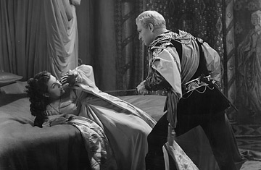
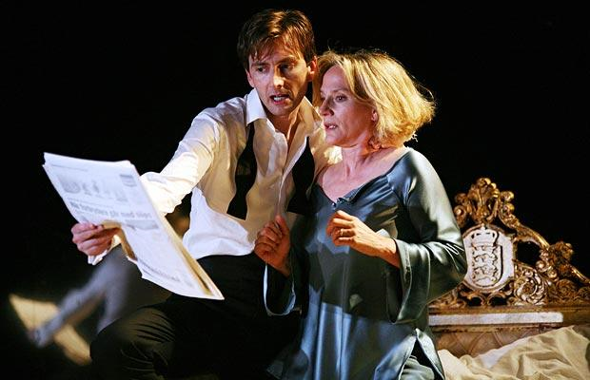
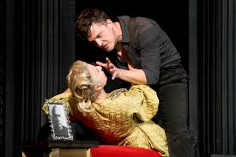
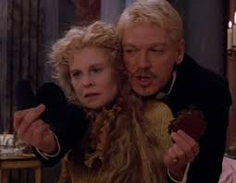
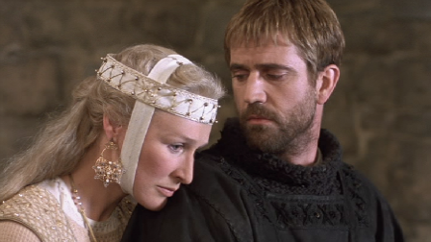
Act 3, scene 4

Slide 2
Aims
To analyse closely the effects of language, form and structure
To explore character development in Act 3 Scene 4
To consider an psychoanalytic interpretation of ‘Hamlet’

Slide 3
Overview – first reading
Polonius tells Gertrude what to say to Hamlet then hides behind an arras
Hamlet confronts his mother and hears Polonius calls for help. He seems to assume it’s Claudius (although how can it be?) and kills him.
Hamlet continues to criticise his mother about the betrayal of his father
The ghost re-appears and reminds Hamlet of his purpose; he tells him to be kind to Gertrude (nb Gertrude cannot see the ghost)
Hamlet reveals to Gertrude she is only pretending to be mad and she agrees to keep it secret

Slide 4
Psychoanalytic criticism
20TH century – major influence on the understanding and interpretation of human behaviour
Sigmund Freud, seen as founder of movement, explained personality as a result of unconscious and irrational desires, repressed memories or wishes, sexuality, fantasy, anxiety and conflict.
Freud’s theories, together with his stress on early childhood experiences, have strongly influenced criticism and stagings of Hamlet.

Slide 5
Ernest Jones Oedipus and Hamlet
“Hamlet had, in years gone by, as a child, bitterly resented having had to share his mother’s affection, even with his own father, had regarded him as a rival, and had secretly wished him out of the way so that he might enjoy undisputed and undisturbed the monopoly of that affection.”
Jones interprets Hamlet’s strongly expressed disgust for his mother’s behaviour and his delay as due to repression of sexual desire for his mother; he cannot bring himself to kill Claudius because Claudius has done exactly what he wanted to do – kill his father and marry his mother. He is repressing an unconscious desire to have killed his father himself.

Slide 6
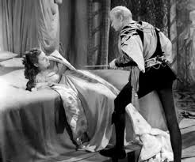
Influence on interpretations
Olivier (1948) – bed a powerful symbolic presence – Hamlet behaves more like a lover than a son. In the first court scene they kiss passionately and in the closet scene, Hamlet seems close to raping his mother. It also includes lots of phallic sword pointing action!
https://www.youtube.com/watch?v=VhW7bOoTxxQ

Slide 7
Read overview of Oedipus Complex…
Individually - Read and highlight key points
In pairs - Come up with some ideas (specific examples please) that this way of thinking about the play could be used to inform your interpretation (from this scene but also elsewhere in the play). Where else do we see evidence of:
Unconscious and irrational desires
Repressed memories or wishes
Sexuality
Fantasy
Anxiety
Conflict

Slide 8
Act 3 Scene 4 – Critical debate
‘Her son had been forced to see in her action not only an outstanding shallowness of feeling, but an eruption of coarse sensuality, “rank and gross”, speeding post-haste to its horrible delight…… Hamlet’s chief desire… is to save Gertrude’s soul. And while the rough work of vengeance is repugnant, to him, he is at home in this higher work… No father-confessor could be more selflessly set upon his end of redeeming a fellow creature from degradation, more stern of pitiless in denouncing the sin, or more eager to welcome the first token of repentance.’ (AC Bradley)
1. THE ‘HAMLETITES’ – FIND LINES THAT DIRECTLY SUPPORT/DEVELOP THIS ASSERTION
‘Hamlet’s long ‘repressed’ desire to take his father’s place in his mother’s affection is stimulated to the unconscious activity by the sight of Claudius usurping this place exactly as himself had once longed to do. More, Claudius is a member of the same family, so that actual usurpation resembles the imaginary one in being incestuous. Towards the end of Hamlet’s interview with his mother the thought of her misconduct expresses itself in that most physical disgust which is so characteristic of intensely ‘repressed’ sexual feeling.’ (Joes)
2. THE ‘PSYCHOANALYSTS’ - FIND LINES THAT DIRECTLY SUPPORT/DEVELOP THIS ASSERTION

