Slide 1
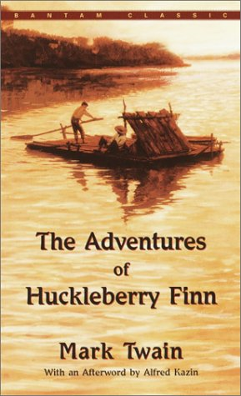
Huckleberry Finn Remote Learning Package
Week 24 April – 1 May

Slide 2
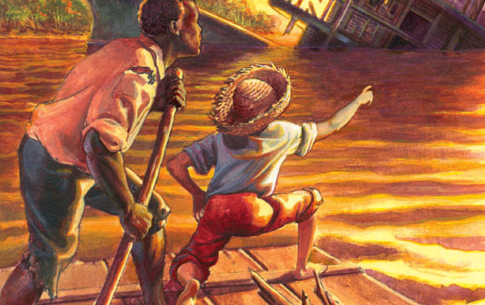
Tasks for the Week
Complete coursework drafts – it’ll take me a couple of weeks to mark them properly so it gives us time to get back to core work.
Read up to Chapter 29
Answer the questions and prepare thoughts on the points for discussion to be submitted in Wednesday’s lesson.

Slide 3
Chapter 26 + 27 Summary
After Dr. Robinson leaves, Mary Jane takes the visitors up to their rooms. The duke is assigned the spare room, Huck will sleep in the garret or attic, and the king is given Mary Jane’s room.
At supper that night, Huck is expected to stand behind the king and the duke and wait on them since he is posing as their servant. The women make degrading comments about their own cooking in order to draw compliments from their guests. Huck and Joanna eat later in the kitchen. The charade is nearly exposed as she questions him about England. His information is sketchy at best, and he often contradicts himself. While Joanna is accusing him of lying, Mary Jane and Susan step into the room and immediately jump to his defence. Mary Jane reprimands Joanna for making Huck feel ashamed and forces her to apologize. Huck is so impressed with her kindness that he asks himself, “this is a girl that I’m letting that old reptile rob her of her money?” He feels “ornery” and “low down” for not telling them about the king’s fraudulent intent. Finally he can stand it no longer, so he makes up his mind to get their money back from the king and the duke, no matter what. He thinks of several ways to get the money, but for the sake of the girls and for his own safety as well as Jim’s, he does not dare take chances. He finally realises that he will need to steal the money in such a way that they will not suspect him.
He hides among Mary Jane’s gowns in the king’s room. After the king and duke enter the room he eavesdrops while they are discussing their plans. Nervous about Dr. Robinson’s suspicions, the duke wants to take the money and run, but the king has other ideas. He plans to stay long enough to sell the property. The duke finally agrees to stay. He inadvertently reveals the hiding place of the bag of gold. To keep it safe from the servants they decide to move it from the closet to the featherbed. Huck grabs it immediately after they leave the room and takes it up to his garret. That night, after everyone is in bed, he tries to sneak outside to hide the money in the yard but finds the front door locked. When he hears someone coming, he quickly hides the money under the lid of the coffin, hoping to retrieve it later. Desperately, he tries to see whether the money is still in the coffin the next day, but someone is always around. Uncertainty about the money plagues him as they bury Mr. Wilks.
The king and the duke promise that they will take the girls to England to live with them. They are in a hurry to return so they convince them to sell the property immediately. The day after the funeral the king sells the slaves and splits the family in two. Both the Wilks girls and their servants are grief-stricken, not realizing that the whole thing is a sham. Since the sale is not legal the slaves will soon be back.

Slide 4
He hides among Mary Jane’s gowns in the king’s room. After the king and duke enter the room he eavesdrops while they are discussing their plans. Nervous about Dr. Robinson’s suspicions, the duke wants to take the money and run, but the king has other ideas. He plans to stay long enough to sell the property. The duke finally agrees to stay. He inadvertently reveals the hiding place of the bag of gold. To keep it safe from the servants they decide to move it from the closet to the featherbed. Huck grabs it immediately after they leave the room and takes it up to his garret. That night, after everyone is in bed, he tries to sneak outside to hide the money in the yard but finds the front door locked. When he hears someone coming, he quickly hides the money under the lid of the coffin, hoping to retrieve it later. Desperately, he tries to see whether the money is still in the coffin the next day, but someone is always around. Uncertainty about the money plagues him as they bury Mr. Wilks.
The king and the duke promise that they will take the girls to England to live with them. They are in a hurry to return so they convince them to sell the property immediately. The day after the funeral the king sells the slaves and splits the family in two. Both the Wilks girls and their servants are grief-stricken, not realizing that the whole thing is a sham. Since the sale is not legal the slaves will soon be back.

Slide 5
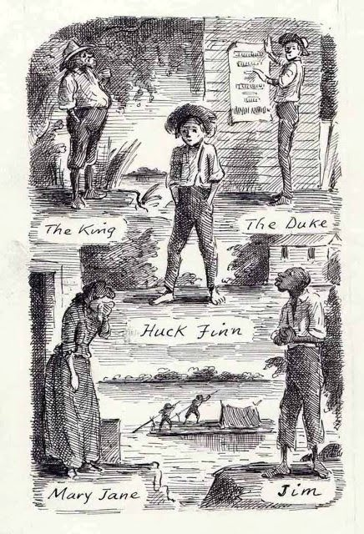
On the day of the auction the king and duke
suddenly discover that the bag of gold, worth
six thousand dollars, is missing. Huck pushes
the blame onto the servants since he knows
they are already gone and will not be harmed
by the accusation.

Slide 6
Discussion and Analysis
In these chapters Huck’s humanitarian effort to help the Wilks girls is significant in his human development. He is extremely fond of Mary Jane and her sisters and feels morally obligated to recover their money since they will need it later on for their livelihood. As we have seen in his relationship to Jim, Huck’s morality is based on his natural instincts and shows a responsiveness to human need rather than an adherance to the rules of society. It is when he feels “ornery and low down and mean” for allowing the king to defraud the Wilks girls that he makes his moral decision to help them. Since his decision could bring danger to himself and to the girls, he weighs his strategy carefully before he decides that stealing the money would, in fact, be the safest course to take.
In his rush to accumulate as much money as possible before they are found out, the king overrides the duke’s fears about selling the slaves to a slaveholder. Later, when Huck convinces them that the slaves have stolen the six thousand dollars, the king and the duke feel tricked. Ironically, the slaves have supposedly beat them at their own game by pretending to be sorry they were leaving, then snatching the bag of money as they left. It was, of course, Huck who had taken the money, but the duke wishes he would have kept the slaves around for their “histrionic talent.” He feels he could have used them in his con games but regrets that the king had “sold ‘em for a song.”

Slide 7
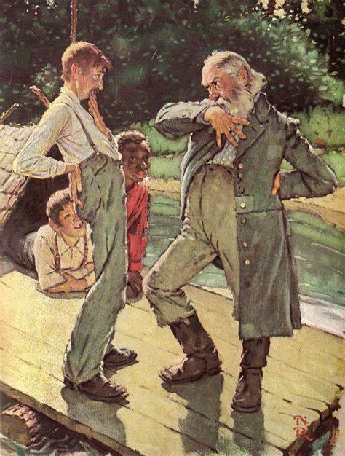
In this episode of the novel, Twain repeats the theme of the separation of families through the buying and selling of slaves. This is reminiscent of Miss Watson’s intention of selling Jim down the river and separating him from his family. This incident reveals not only the pain of separation of mother and sons, demonstrating the humanity of the slaves, but also the caring response of the Wilks girls. It is at this point that Huck almost breaks down and exposes the king and the duke, but he knows the sales are fake, and the slaves will be home soon. His human sympathy for the injustice in this incident
foreshadows his ultimate commitment to Jim as
Huck struggles with his conscience in subsequent chapters.

Slide 8
Chapter 28 + 29 Summary
In the morning, Huck passes Mary Jane’s room and sees her crying through the open door. Heartbroken about the separation of the slaves’ families, she tells Huck that her beautiful trip to England is spoiled. Uneasy about her crying, Huck quickly replies that the slaves will be back in less than two weeks. He has spoken too soon, but since he is in a “tight place,” he decides to tell the truth even though it is risky. He asks Mary Jane to promise to leave town for four days if he tells her why the slaves will soon be back. If she leaves she will not be tempted to reveal to the king and the duke that she knows the truth. She gives her word, and Huck blurts out the whole story about the two rogues who have posed as her uncles and duped her out of her inheritance. Shocked, she immediately wants to tar and feather them and throw them in the river, but Huck gently reminds her of her promise. She calms down, telling him she will do whatever he asks.

Slide 9
After some deliberation he thinks he can get the two frauds jailed in town so he and Jim can be rid of them. He shortens Mary Jane’s stay to one day, asking her to place a candle in the window by eleven as a signal to Huck that she is at home. If he does not respond, she will know he is gone, and she can have the king and duke arrested and jailed. Huck advises her to check with the Bricksville townspeople where The Royal Nonesuch was played if she needs evidence of their fraudulent activities. She agrees to stand by Huck and attest to the fact that he is not involved with them in case he gets caught. Since he will not be seeing her again, he writes her a note telling her where the bag of money is hidden and asks her not to read it until he is gone. After she leaves, Huck explains to her sisters that Mary Jane has gone to see a sick friend. He asks them to tell their uncles it is a rich friend, however, who is interested in buying the house. The sick friend has a communicable disease, and it will delay their trip to England. Neither story is true, of course, but Huck wants to allay the suspicions the king and the duke might have about Mary Jane’s absence by telling them that she is working for the auction. Since the girls are eager to start on their trip, Huck knows they will cover for Mary Jane. During the auction two more men arrive on the steamboat claiming to be Wilks’ brothers, Harvey and William.
Surprised by their rude reception, Harvey Wilks is not prepared for the other claimants of Peter Wilks’ inheritance. William and Harvey have been down on their luck lately. William has broken his arm, and their baggage has been misplaced in another town. William speaks only sign language, and the arm he normally uses for signing is broken. Besides, he usually writes for both brothers, but now he cannot sign his name for proof of identification. All other identification is with their lost luggage. Huck is convinced of Harvey Wilks’ identity from the beginning because of his true English accent. “I see straight off he pronounced like an Englishman—not the king’s way.”

Slide 10
he majority of the townspeople still rally around the king and the duke, but a few people begin to question the king. Hines, a man in the crowd, claims to have seen him in a canoe the day before the funeral. After a long debate about identities, the new Harvey Wilks suggests that the true brother would know what was tattooed on Peter Wilks’ chest. To settle the argument they must exhume the body. When they open the coffin, they are shocked to find the bag of gold. In the excitement Huck escapes in the dark and runs until he finds a boat to take to the raft. He sees Mary Jane’s candle in the window but has no time to stop. He and Jim escape down the river thinking they are free of the king and the duke at last. Their happiness is short-lived, however, for soon they hear them coming over the water in a skiff.

Slide 11
Discussion and Analysis
Throughout the novel Huck has been telling lies or concocting stories to get himself out of tight situations. It has, in fact, been necessary for his survival on the river and particularly in the towns along the river. In Chapter 28, however, we finally hear him telling Mary Jane the truth. After thinking it over, he decides that “the truth is better and actuly safer than a lie.” He has, in fact, already blurted out part of the truth about the slaves who will be back in two weeks. In a sense he has reached a point of no return and must tell her the whole story. He undoubtedly respects Mary Jane enough to trust her with the truth. “She was the best girl I ever see, and had the most sand.” He feels a moral obligation to expose the king and the duke and keep them from exploiting her. When she leaves town, however, he must tell another one of his stories to protect her from the two frauds.

Slide 12
Ironically, when the men question Huck about being English, he cannot convince them. Levi Bell, the lawyer, tells him to quit trying. “I reckon you ain’t used to lying, it don’t seem to come handy...You do it pretty awkward.” Perhaps he is awkward because the story is not his own creation. He is lying for the king and the duke and simply does not have his heart in it.
Twain’s plot falls into place when the body of Peter Wilks is exhumed to solve the identification problem. The whereabouts of the bag of gold has not been ascertained. Twain uses a believable chain of events as an angry crowd rushes to the cemetery on a dark, blustery night. Not only do they find the money, but it also affords an opportunity for yet another escape for the king and the duke, and, in this case, for Huck.

Slide 13
Tasks for the Week
Sonny/ Cerys Compile a list of quotes from the 4 chapters on racism/slavery.
Nick/Katie Compile a list of quotes from the fours chapters on Huck’s character development.
Amelia/Annie Find other examples from Chapter 1 – 29 where Twain explores the concept of ‘truth’.
Tom/Natasha Discuss Twain’s use of satire in these four chapters.
Sophie Explore the development of ‘sivilisation’ in these chapters.
Izza Consider the continued use of stereotypes in these chapters.
Grace/Maddie Respond to the question ‘Society corrupts the individual, who is born innocent’. Write a one-page response looking at Huck Finn as well as wider reading.

