Slide 1
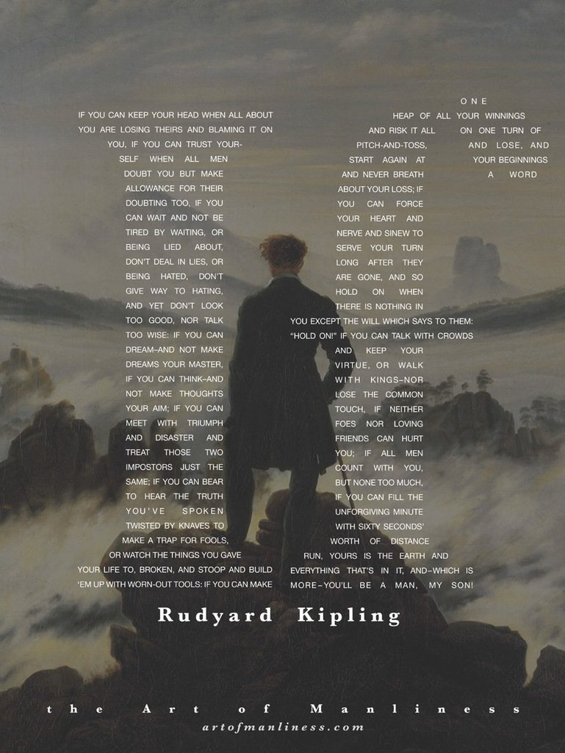
Date: Sunday 24th September 2017
Title: If by Rudyard Kipling
Learning Intention:
To understand what influenced Kipling to write his poem
Analyse a poem for linguistic technique and structural features
Starter: Read the article on your table. Summarise the context of the poem based on what you learn from the article.

Slide 2
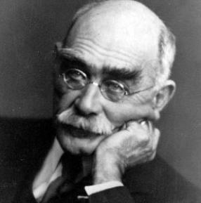
Rudyard Kipling
Born in 1865 in Bombay, India
Awarded the Nobel Prize for literature
Offered a knighthood, but refused it
Much of his work is based on his knowledge of India and the East, especially the stories in his most well known novel ‘The Jungle Book’
He was known as a very patriotic person but his attitudes were changed deeply by the loss of his son in the first world war.
This poem is a dedication to his son

Slide 3
If by Rudyard Kipling
IF you can keep your head when all about you Are losing theirs and blaming it on you, If you can trust yourself when all men doubt you, But make allowance for their doubting too; If you can wait and not be tired by waiting, Or being lied about, don't deal in lies, Or being hated, don't give way to hating, And yet don't look too good, nor talk too wise: If you can dream - and not make dreams your master; If you can think - and not make thoughts your aim; If you can meet with Triumph and Disaster And treat those two impostors just the same; If you can bear to hear the truth you've spoken Twisted by knaves to make a trap for fools, Or watch the things you gave your life to, broken, And stoop and build 'em up with worn-out tools: If you can make one heap of all your winnings And risk it on one turn of pitch-and-toss, And lose, and start again at your beginnings And never breathe a word about your loss; If you can force your heart and nerve and sinew To serve your turn long after they are gone, And so hold on when there is nothing in you Except the Will which says to them: 'Hold on!' If you can talk with crowds and keep your virtue, ' Or walk with Kings - nor lose the common touch, if neither foes nor loving friends can hurt you, If all men count with you, but none too much; If you can fill the unforgiving minute With sixty seconds' worth of distance run, Yours is the Earth and everything that's in it, And - which is more - you'll be a Man, my son!
Pitch and toss: an old gambling game in which players throw coins as close to a wall as possible.
Imposter: a person who pretends to be someone else in order to deceive others
Knave: a dishonest man or a man who lacks morals
Sinew: A piece of tough tissue that attaches muscle to bone or tendon to ligament.
Stoop: Bend your head or body downwards
Virtue: behavior showing high moral standards.
Notes:
Click title for a reading of the poem

Slide 4
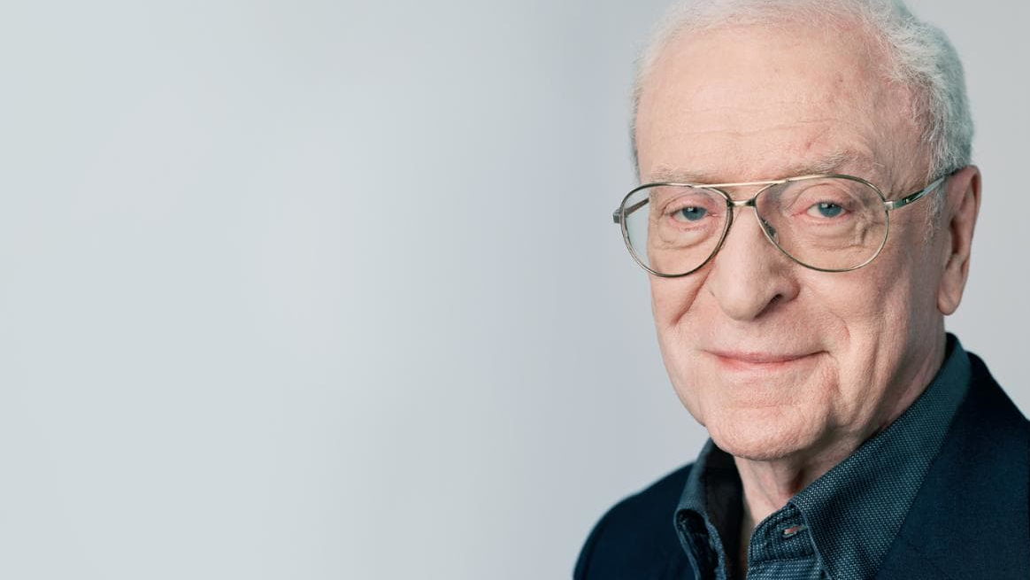
Michael Caine on If (click for the link)
In the video, Michael Caine talks about his interpretation of the poem ‘If.’
Task:
What do you learn about the poem based on what he says?
What is your own view on war? Do you agree with Mr Caine?

Slide 5
Analysing Language
Work with a partner and select some key phrases from the poem, adding them to the table. These may:
Show the qualities that Kipling admires
Focus on features of Kipling’s language and its effect, such as repetition, personification and metaphor
Be words that seem striking or unusual to you and that convey Kipling’s powerful ideas.
Language | What is it saying?
‘keep your head…’ | He should not panic under pressure
‘talk with crowds and keep your virtue…’ | He should be able to relate to all people, hoigh or low
‘If you…’ | Repetition plays an important part – could suggest uncertainty or difficulty
‘Triumph and disaster’
‘Or being lied about, don’t deal in lies,/Or being hated, don’t give way to hating.’

Slide 6
Form and Structure
Challenge:
How many stanzas does the poem have and what is the rhyme scheme?
What is the focus of each stanza?
Comment on the use of punctuation
Using the iPads find out what the following terms mean:
Iambic
Pentameter
Dramatic Monologue
Narrator
Question: How can you relate these terms to the poem?

Slide 7
Content
The poem features a long list of virtues that the writer believes his son must possess and for each aim, there is a potential obstacle.
Task: List the virtues you think Kipling is suggesting for his son based on the content of the stanzas.
Quote | Virtue
‘If you can wait and not grow tired of waiting’ | Patience
‘don’t deal in lies’
Challenge: Comment on the final line of the poem. ‘Yours is the earth and everything that’s in it,/And – which is more – you’ll be a Man, my son.’
What is Kipling’s final piece of advice to his son?

Slide 8
Some Questions to Consider
How do you think a teenager would react to being given the advice in this poem?
How do the form and structure of the poem help to present the ideas?
Why might the attitudes in this poem be described as stoical? Do you think this is a good word to use?
Why are some of the ideas in the poem linked to sport?
Key word; Stoical
Not complaining when bad things happen to you.

Slide 9
Links with other poems
‘If’ is often referred to as an inspiration or motivational poem, with the writer giving encouragement to a young person and advice about how to live. If you think of the qualities that Kipling admires, such as courage, self-belief, perseverance, staying calm under pressure, then you may find links to other poems.
Task: Make a list of poems you could compare ‘If’ to based on the qualities listed above.

Slide 10
Exam-Style Questions
Re-read ‘If-’.
Discuss how the idea of success is presented in ‘If-’ and one other poem in the anthology.
You should make reference to language, form and structure.
Support your answer with examples from the poems. (30 marks)

