Slide 1
Icon guide
Students should complete this task on their own.
Students should complete this task in pairs. Pair talk would work well with this activity.
This task may be completed in small groups.
This task should be modelled by the teacher. A model is provided, but teachers may want to complete an addition class model ’live’ with the group.
The answers to this task should be written. Teachers may decide that some tasks without this icon should also be written down – this is down to a teacher’s discretion.
This icon is a reminder that students will sit a fortnightly mastery quiz at the end of this lesson.

Slide 2
In this lesson, students will be mastering the following:
Mastery Content:
Jane Eyre lives at Gateshead Hall
She lives with her aunt (Mrs Reed) and cousins (John, Georgiana and Eliza)
John Reed is an unpleasant and unlikeable bully
Lesson Objective:
To explore how Bronte presents John Reed.
Mastery Content

Slide 3
Do Now When and where was Charlotte Brontë born? Where did she go to school? What did this inspire? Brontë sets her novel ‘Jane Eyre’ in Yorkshire because of the __________ landscape. The protagonist Jane is an orphan who is _________ and _________ Extension: Why was it unusual to have a protagonist like Jane Eyre in the Victorian era?
Introduction to Jane Eyre Read summary of the ‘'Jane Eyre' story with students. Explain to students that over this term they will be reading about Jane’s childhood in chapters 1-10. | Spoiler alert: teachers may wish to not share the rest of the novel’s plot with students.
Reading Introduce the characters in chapter 1. Explain that the location of this chapter is Gateshead Hall - a large house with many occupants. Read the summary of this part of the chapter as a class. Ask students to read from the start of chapter 1 until ‘retired back a step or two from his chair’ on p.13.
Check for understanding Ask students to complete the 5 comprehension questions in pairs. Do you want students to write down the answer?
John Reed the bully Explain that John Reed is an unlikable bully. Remind students of Noah Claypole from ‘Oliver Twist’ who was also a bully. Ask students to read the given extract from page 12 again and, in pairs, write a list of four things that make John Reed an unlikable and unpleasant character. Take feedback. Students write a paragraph answering the question: How does Brontë present John Reed?
Mastery assessment plenary Students complete quiz.
Extension/Homework Pupils compare the John Reed extract from Page 12 to an extract about Dudley Dursley from the Harry Potter series. They identify the similarities between the characters.
Lesson Guide
Please note that there is a recommended section of text to omit at your discretion. The ‘check for understanding’ questions will not cover this part of the text. This is indicated on the PowerPoint slide by one red star (*) at the beginning of the section and two (**) at the end.

Slide 4
Tuesday, 14 June 2022
Character Focus: John Reed
Let’s re-cap your knowledge of Charlotte Brontë
Do Now:
Charlotte Brontë was born in Yorkshire in 1816.
She went to the Clergy Daughter’s School which inspired the fictional school of Lowood in ‘Jane Eyre’.
Brontë sets her novel ‘Jane Eyre’ in Yorkshire because of the bleak landscape.
The protagonist Jane is an orphan who is independent and tough.
Let’s re-cap your knowledge of Charlotte Brontë
Do Now:
When and where was Charlotte Brontë born?
Where did she go to school? What did this inspire?
Brontë sets her novel ‘Jane Eyre’ in Yorkshire because of the __________ landscape.
The protagonist Jane is an orphan who is _________ and _________
Do Now
Extension: It was unusual for a female character in the Victorian era to be strong and independent.
Extension: Why was it unusual to have a protagonist like Jane Eyre in the Victorian era?

Slide 5
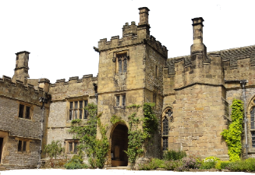
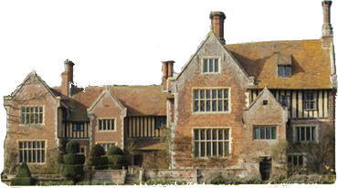
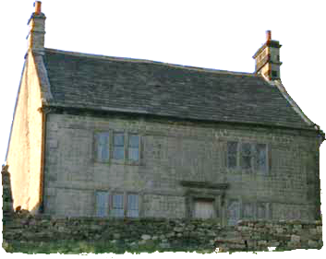
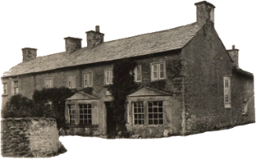
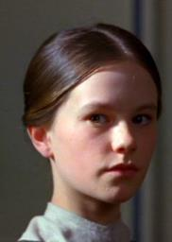
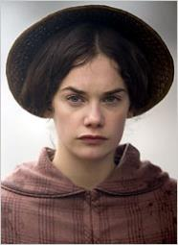
The novel 'Jane Eyre’ follows the life of Jane as she grows from a vulnerable but spirited child into a strong woman. As she grows up, she moves to different locations across the north of England.
Let’s read a summary of the story of ‘Jane Eyre’.
Jane Eyre
Young Jane
Adult Jane

Slide 6
1. Jane, the orphan, lives with her aunt and cousins at Gateshead Hall.
2. She is sent away to the harsh Lowood School where she spends six years as a pupil and two as a teacher.
Gateshead Hall
3. Jane gets a job as a Governess at Thornfield Hall where she falls in love with her employer, Mr Rochester.
Lowood School
Young Jane
Jane Eyre
4. After finding out that Mr Rochester already has wife who is locked up in the attic, Jane runs away and stays with a family at Moor House.
Thornfield Hall
5. Jane hears Mr Rochester’s voice calling her on the moors. She goes to find him and finds out that Thornfield Hall has burnt down and his first wife has killed herself. She marries him. Ferndean Manor becomes their home.
Moor House
Adult Jane
Ferndean

Slide 7
1. Jane, the orphan, lives with her aunt and cousins at Gateshead Hall.
2. She is sent away to the harsh Lowood School where she spends six years as a pupil and two as a teacher.
Gateshead Hall
3. Jane gets a job as a Governess at Thornfield Hall where she falls in love with her employer, Mr Rochester.
Lowood School
Young Jane
Jane Eyre
4. After finding out that Mr Rochester already has wife who is locked up in the attic, Jane runs away and stays with a family at Moor House.
Thornfield Hall
Over the next term, we will be reading about Jane’s childhood at Gateshead Hall and Lowood School. This is in chapters 1-10 of ‘Jane Eyre’.
5. Jane hears Mr Rochester’s voice calling her on the moors. She goes to find him and finds out that Thornfield Hall has burnt down and his first wife has killed herself. She marries him. Ferndean Manor becomes their home.
Moor House
Adult Jane
Ferndean

Slide 8
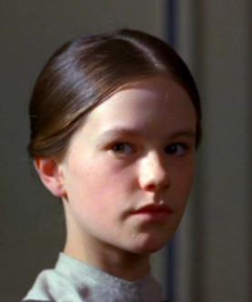
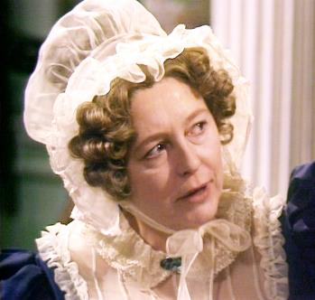
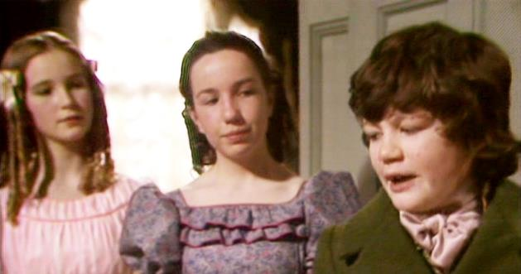
Today, we are going to start reading ‘Jane Eyre’.
Jane
Mrs Reed
Georgiana
Eliza
John
Jane Eyre
Jane, the orphan, lives in a large house called Gateshead Hall with her aunt, Mrs Reed, and her cousins, Eliza, John and Georgiana.
Gateshead Hall
Gateshead Hall is a large manor house with many rooms. Some of the rooms are used every day and some are used only occasionally when there are guests in the house.

Slide 9
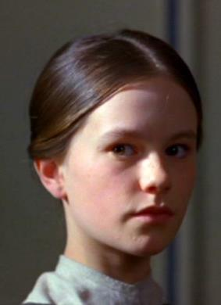
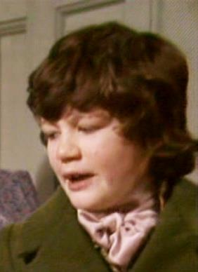
Here is what happens in the part of the story we are about to read.
It is a bitter, rainy day at Gateshead Hall. Jane is not allowed to sit with the Reed family until she behaves in a more pleasing way. She goes to sit on the window seat to read a book quietly. Her large cousin, John Reed, goes looking for her. Jane is scared of John because he is a bully and he is older than her. John hits Jane.
Jane Eyre
Jane
John
Gateshead Hall

Slide 10
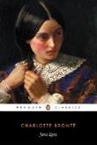
Let’s start reading about Jane’s life at Gateshead Hall.
Chapter 1
Read from, ‘There was no possibility…’ (page 9)
Read to, ‘retired back a step or two from his chair.’ (page 13)
Jane Eyre
p. 9

Slide 11
Chapter 1
There was no possibility of taking a walk that day. We had been wandering, indeed, in the leafless shrubbery an hour in the morning; but since dinner (Mrs. Reed, when there was no company, dined early) the cold winter wind had brought with it clouds so sombre, and a rain so penetrating, that further out-door exercise was now out of the question.
I was glad of it: I never liked long walks, especially on chilly afternoons: dreadful to me was the coming home in the raw twilight, with nipped fingers and toes, and a heart saddened by the chidings of Bessie, the nurse, and humbled by the consciousness of my physical inferiority to Eliza, John, and Georgiana Reed.
The said Eliza, John, and Georgiana were now clustered round their mama in the drawing-room: she lay reclined on a sofa by the fireside, and with her darlings about her (for the time neither quarrelling nor crying) looked perfectly happy.
shrubbery – a garden with small bushes
sombre – gloomy
penetrating –strong
twilight – the time just before it gets completely dark
chidings – telling offs
Jane Eyre
p. 9

Slide 12
Me, she had dispensed from joining the group; saying, “She regretted to be under the necessity of keeping me at a distance; but that until she heard from Bessie, and could discover by her own observation, that I was endeavouring in good earnest to acquire a more sociable and childlike disposition, a more attractive and sprightly manner—something lighter, franker, more natural, as it were—she really must exclude me from privileges intended only for contented, happy, little children.”
“What does Bessie say I have done?” I asked.
“Jane, I don’t like cavillers or questioners; besides, there is something truly forbidding in a child taking up her elders in that manner. Be seated somewhere; and until you can speak pleasantly, remain silent.”
A breakfast-room adjoined the drawing-room, I slipped in there. It contained a bookcase: I soon possessed myself of a volume, taking care that it should be one stored with pictures. I mounted into the window-seat: gathering up my feet, I sat cross-legged, like a Turk; and, having drawn the red moreen curtain nearly close, I was shrined in double retirement.
dispensed – let go
cavillers - people who raise petty arguments
moreen – a thick fabric
Jane Eyre
p.9-10

Slide 13
Folds of scarlet drapery shut in my view to the right hand; to the left were the clear panes of glass, protecting, but not separating me from the drear November day. At intervals, while turning over the leaves of my book, I studied the aspect of that winter afternoon. Afar, it offered a pale blank of mist and cloud; near a scene of wet lawn and storm-beat shrub, with ceaseless rain sweeping away wildly before a long and lamentable blast.
I returned to my book—Bewick’s History of British Birds: the letterpress thereof I cared little for, generally speaking; and yet there were certain introductory pages that, child as I was, I could not pass quite as a blank. *They were those which treat of the haunts of sea-fowl; of “the solitary rocks and promontories” by them only inhabited; of the coast of Norway, studded with isles from its southern extremity, the Lindeness, or Naze, to the North Cape—
“Where the Northern Ocean, in vast whirls,
Boils round the naked, melancholy isles
Of farthest Thule; and the Atlantic surge
Pours in among the stormy Hebrides.”
drapery - curtains
lamentable blast – extremely strong wind
sea-fowl – a bird that lives and flies around the sea
promontories – a piece of land that sticks out from the sea
Jane Eyre
p. 10

Slide 14
Nor could I pass unnoticed the suggestion of the bleak shores of Lapland, Siberia, Spitzbergen, Nova Zembla, Iceland, Greenland, with “the vast sweep of the Arctic Zone, and those forlorn regions of dreary space,—that reservoir of frost and snow, where firm fields of ice, the accumulation of centuries of winters, glazed in Alpine heights above heights, surround the pole, and concentre the multiplied rigours of extreme cold.” Of these death-white realms I formed an idea of my own: shadowy, like all the half-comprehended notions that float dim through children’s brains, but strangely impressive. The words in these introductory pages connected themselves with the succeeding vignettes, and gave significance to the rock standing up alone in a sea of billow and spray; to the broken boat stranded on a desolate coast; to the cold and ghastly moon glancing through bars of cloud at a wreck just sinking.
I cannot tell what sentiment haunted the quite solitary churchyard, with its inscribed headstone; its gate, its two trees, its low horizon, girdled by a broken wall, and its newly-risen crescent, attesting the hour of eventide.
forlorn – lonely and not cared for
accumulation – gradually increasing
comprehended – to understand something fully
notions – ideas
vignettes – short pieces of explanatory writing
sentiment – feeling/emotion
eventide - evening
Jane Eyre
p.10-1

Slide 15
The two ships becalmed on a torpid sea, I believed to be marine phantoms.
The fiend pinning down the thief’s pack behind him, I passed over quickly: it was an object of terror.
So was the black horned thing seated aloof on a rock, surveying a distant crowd surrounding a gallows. **
Each picture told a story; mysterious often to my undeveloped understanding and imperfect feelings, yet ever profoundly interesting: as interesting as the tales Bessie sometimes narrated on winter evenings, when she chanced to be in good humour; and when, having brought her ironing-table to the nursery hearth, she allowed us to sit about it, and while she got up Mrs. Reed’s lace frills, and crimped her nightcap borders, fed our eager attention with passages of love and adventure taken from old fairy tales and other ballads; or (as at a later period I discovered) from the pages of Pamela, and Henry, Earl of Moreland.
With Bewick on my knee, I was then happy: happy at least in my way. I feared nothing but interruption, and that came too soon. The breakfast-room door opened.
becalmed – unable to move
torpid – sleepy
fiend - a cruel or unpleasant person
profoundly - deeply
hearth – the bottom of a fireplace
crimped – ironed into neat folds
ballads – a song or poem that tells a story
Jane Eyre
p. 11

Slide 16
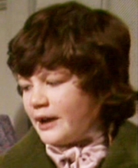
“Boh! Madam Mope!” cried the voice of John Reed; then he paused: he found the room apparently empty.
“Where the dickens is she!” he continued. “Lizzy! Georgy! (calling to his sisters) Joan is not here: tell mama she is run out into the rain—bad animal!”
“It is well I drew the curtain,” thought I; and I wished fervently he might not discover my hiding-place: nor would John Reed have found it out himself; he was not quick either of vision or conception; but Eliza just put her head in at the door, and said at once—
“She is in the window-seat, to be sure, Jack.”
And I came out immediately, for I trembled at the idea of being dragged forth by the said Jack.
“What do you want?” I asked, with awkward diffidence.
“Say, ‘What do you want, Master Reed?’” was the answer. “I want you to come here;” and seating himself in an arm-chair, he intimated by a gesture that I was to approach and stand before him.
Mope – to feel sorry for yourself and sulk
vision – the ability to see
conception – the ability to form an idea or plan
forth – away from a place
intimated – letting someone know what you mean
John
Jane Eyre
p. 11-2

Slide 17
John Reed was a schoolboy of fourteen years old; four years older than I, for I was but ten: large and stout for his age, with a dingy and unwholesome skin; thick lineaments in a spacious visage, heavy limbs and large extremities. He gorged himself habitually at table, which made him bilious, and gave him a dim and bleared eye and flabby cheeks. He ought now to have been at school; but his mama had taken him home for a month or two, “on account of his delicate health.” Mr. Miles, the master, affirmed that he would do very well if he had fewer cakes and sweetmeats sent him from home; but the mother’s heart turned from an opinion so harsh, and inclined rather to the more refined idea that John’s sallowness was owing to over-application and, perhaps, to pining after home.
John had not much affection for his mother and sisters, and an antipathy to me. He bullied and punished me; not two or three times in the week, nor once or twice in the day, but continually: every nerve I had feared him, and every morsel of flesh in my bones shrank when he came near.
unwholesome – not looking healthy
lineaments – features
visage - face
extremities – hands and feet
bilious – feeling sick, looking green
sallowness – unhealthy looking, yellow coloured skin
antipathy – strong feeling of dislike
Jane Eyre
p. 12

Slide 18
There were moments when I was bewildered by the terror he inspired, because I had no appeal whatever against either his menaces or his inflictions; the servants did not like to offend their young master by taking my part against him, and Mrs. Reed was blind and deaf on the subject: she never saw him strike or heard him abuse me, though he did both now and then in her very presence, more frequently, however, behind her back.
Habitually obedient to John, I came up to his chair: he spent some three minutes in thrusting out his tongue at me as far as he could without damaging the roots: I knew he would soon strike, and while dreading the blow, I mused on the disgusting and ugly appearance of him who would presently deal it. I wonder if he read that notion in my face; for, all at once, without speaking, he struck suddenly and strongly. I tottered, and on regaining my equilibrium retired back a step or two from his chair.
mused – to think carefully about something
Jane Eyre
p. 12-3

Slide 19
Quick check
Discuss the answers to these questions in pairs:
Who is the narrator?
Why was there ‘no possibility of taking a walk’?
What reason does Mrs. Reed give Jane about why she cannot join the rest of the family in the drawing-room?
What activity does Jane do in the breakfast-room?
Which character is ‘large and stout for his age’?
How does Jane feel about John and why?
Jane Eyre

Slide 20
Quick check
Jane Eyre is the narrator.
There was ‘no possibility of taking a walk’ because it was too rainy and cold outside.
Mrs Reed says that Jane cannot join the rest of the family until she has heard and seen Jane behaving more pleasantly and like a child.
Jane sits reading cross-legged in the window seat of the breakfast-room.
John Reed, Jane’s cousin, is ‘large and stout for his age’.
Jane is scared of John because he bullies her and no one else in the household is willing to defend her.
Jane Eyre

Slide 21
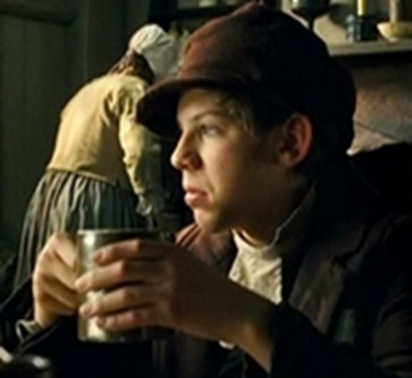
Let’s look more closely at the character of John Reed.
Jane tells the reader that John Reed is a bully. We are going to think about what makes John Reed such an unpleasant character.
When we studied ‘Oliver Twist’ in Year 7 we met the character Noah Claypole.
Like John Reed, Noah is a bully who is an unpleasant character. Charles Dickens described Noah as being malicious, facetious and cowardly.
Dickens is guiding the reader to feel sorry for Oliver by making Noah Claypole unlikable and unpleasant.
In 'Jane Eyre', Charlotte Brontë guides the reader to feel sorry for Jane by making the character of John Reed unlikable and unpleasant.
Noah Claypole from ‘Oliver Twist’
John Reed
John Reed from ‘Jane Eyre’

Slide 22
Read this extract from page 12 again.
How does Brontë present John Reed?
In pairs, write a list of four things that make him an unlikable and unpleasant character. Support your ideas with quotations.
John Reed was a schoolboy of fourteen years old; four years older than I, for I was but ten: large and stout for his age, with a dingy and unwholesome skin; thick lineaments in a spacious visage, heavy limbs and large extremities. He gorged himself habitually at table, which made him bilious, and gave him a dim and bleared eye and flabby cheeks. He ought now to have been at school; but his mama had taken him home for a month or two, “on account of his delicate health.” Mr. Miles, the master, affirmed that he would do very well if he had fewer cakes and sweetmeats sent him from home; but the mother’s heart turned from an opinion so harsh, and inclined rather to the more refined idea that John’s sallowness was owing to over-application and, perhaps, to pining after home.
John had not much affection for his mother and sisters, and an antipathy to me. He bullied and punished me; not two or three times in the week, nor once or twice in the day, but continually: every nerve I had feared him, and every morsel of flesh in my bones shrank when he came near.
unwholesome – not looking healthy
lineaments – features
visage - face
extremities – hands and feet
bilious – feeling sick, looking green
sallowness – unhealthy looking, yellow coloured skin
antipathy – strong feeling of dislike
John Reed
p. 12

Slide 23
Here are some ideas that you may have come up with:
John Reed is unpleasant to look at:
He is ‘large and stout for his age’
He has ‘dingy and unwholesome skin’
He has ‘heavy limbs and large extremities’
He has ‘flabby cheeks’
John Reed is greedy:
He often gorges himself when eating
He is bilious – he is sickly from eating too much
John Reed is deceptive:
His mother makes excuses for his weight
He allows his mother to think that his unhealthy appearance is due to him missing his home
John Reed is nasty:
He does not like his mother or sisters much
He bullies and punishes Jane every day
John Reed

Slide 24
Write one paragraph on this question:
How does Brontë present John Reed?
You may wish to use these words in your answer:
John Reed
malicious
greedy
facetious
deceptive
cowardly
cruel

Slide 25
Which of these statements are true?
John Reed and Jane Eyre do not get on because they are so similar.
John Reed is sickly looking because he does not eat much food.
John hits Jane Eyre because she makes fun of him for being so large.
The character of John Reed shows how cruel Jane can be.
John Reed makes a reader feel sorry for the way Jane is treated.
Mastery

Slide 26
Which of these statements are true?
John Reed and Jane Eyre do not get on because they are so similar.
John Reed is sickly looking because he does not eat much food.
John hits Jane Eyre because she makes fun of him for being so large.
The character of John Reed shows how cruel Jane can be.
John Reed makes a reader feel sorry for the way Jane is treated.
Review

Slide 27
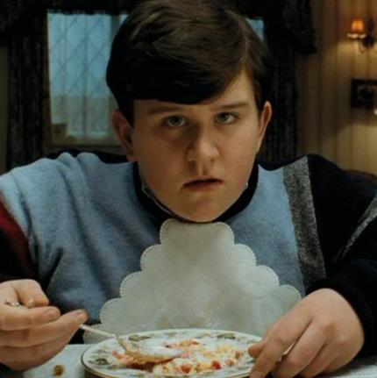
Another famous fictional bully is Dudley Dursley from the Harry Potter series.
Dudley is nasty to Harry Potter just like John Reed is nasty to Jane Eyre.
Dudley Dursley from the Harry Potter series
Homework
Compare the following extract about Dudley Dursley to the extract from page 12 of 'Jane Eyre' that you have just read.
What are the similarities between the descriptions of John Reed and Dudley Dursley?

Slide 28
Extract 1 – Dudley Dursley from ‘Harry Potter and the Goblet of Fire’
Dudley’s life had taken a most unpleasant turn since he came home for the summer with his end-of-year report.
Uncle Vernon and Aunt Petunia had managed to find excuses for his bad marks as usual; Aunt Petunia always insisted that Dudley was a very gifted boy whose teachers didn’t understand him, while Uncle Vernon maintained that ‘he didn’t want some swotty little nancy boy for a son anyway’. They skated over accusations of bullying in the report – ‘He’s a boisterous little boy, but he wouldn’t hurt a fly!’ said Aunt Petunia tearfully.
However, at the bottom of the report there were a few well chosen comments from the school nurse which not even Uncle Vernon and Aunt Petunia could explain away. No matter how much Aunt Petunia wailed that Dudley was big-boned, and that his poundage was really puppy-fat, and that he was a growing boy who needed plenty of food, the fact remained that the school outfitters didn’t stock knickerbockers big enough for him any more. The school nurse had seen what Aunt Petunia’s eyes simply refused to see: that, far from needing extra nourishment, Dudley had reached roughly the size and weight of a young killer whale.
Homework

Slide 29
Extract 2 – John Reed from ‘Jane Eyre’
John Reed was a schoolboy of fourteen years old; four years older than I, for I was but ten: large and stout for his age, with a dingy and unwholesome skin; thick lineaments in a spacious visage, heavy limbs and large extremities. He gorged himself habitually at table, which made him bilious, and gave him a dim and bleared eye and flabby cheeks. He ought now to have been at school; but his mama had taken him home for a month or two, “on account of his delicate health.” Mr. Miles, the master, affirmed that he would do very well if he had fewer cakes and sweetmeats sent him from home; but the mother’s heart turned from an opinion so harsh, and inclined rather to the more refined idea that John’s sallowness was owing to over-application and, perhaps, to pining after home.
John had not much affection for his mother and sisters, and an antipathy to me. He bullied and punished me; not two or three times in the week, nor once or twice in the day, but continually: every nerve I had feared him, and every morsel of flesh in my bones shrank when he came near.
Homework
p. 12

Slide 30
Love this lesson?
Have suggestions for improvements?
Does something need fixing?
Feedback
Please let us know!
Fill in this feedback form so that we can keep improving.

