Slide 1
OMAM – Aiming for 8/9
28th January 2019

Slide 2
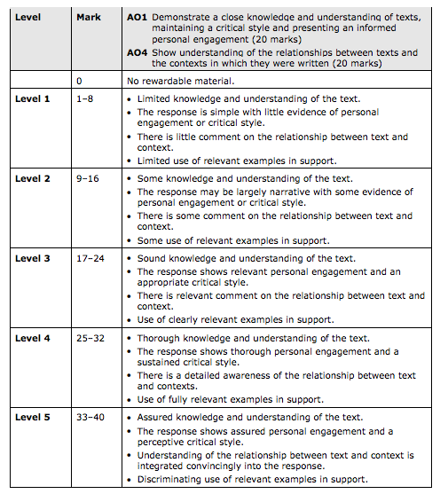
Criteria
A01 CLOSE knowledge/understanding
i.e. specific refs to egs. using specific Qs
A04 RELATIONSHIP between context and text
i.e. LINK the two, don’t bolt it on

Slide 3
Steinbeck’s Craft – How he does it?
Really unpick your examples and quotes in DETAIL and link to the overall question
Use of adjectives in your analysis: Related to character
Look at Will’s OMAM ON FF 38/40
9=32
8=27
7=24

Slide 4
Conclusion: End with a quote Link to Steinbeck’s craft Include relevant contextual link Address the question

Slide 5
Predictions = Character
Not Crookes
SAM – Candy and Curley
Possibly: CW/L/G/L&G

Slide 6
Predictions = Theme
Not : Loneliness
Possibly = Dreams/Settings/Friendship

Slide 7
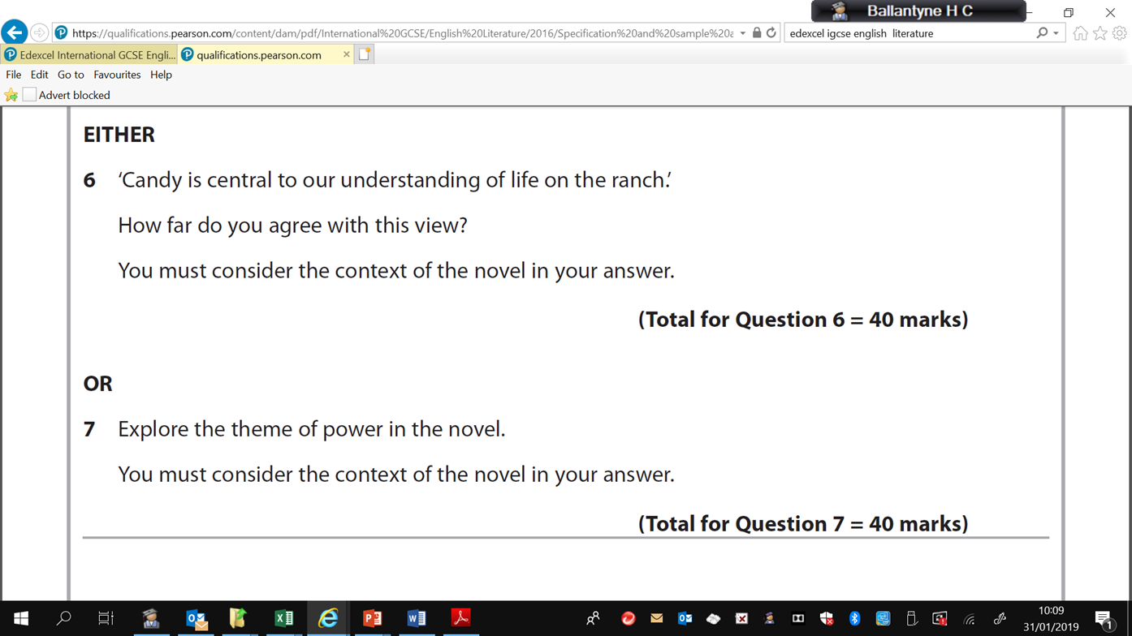
Revision: Prepare for timed essay Monday 4th February (closed book)
1. Explore Steinbeck’s presentation of Curley’s wife and one other character who does not fit in on the ranch.
2. Discuss the theme of friendship in Of Mice and Men
How does Steinbeck present Lennie as an innocent victim in this novel?
How does Steinbeck present different settings?
Discuss Steinbeck’s presentation of George in the novel.

Slide 8
GEORGE– QUOTES, KEY IDEAS, STEINBECK’S INTENTIONS/CONTEXT, CWA?
George – MILTON – First time we meet him? ‘small and quick with restless eyes’
Steinbeck – Defined by his relationship with Lennie, paternal figure,
Exception rather than the rule
Lennie allows George to DREAM and HOPE
Allows George to ESCAPE the grim reality of his existence
‘If I didn’t have you…..I’d go and blow…..’
Intelligent, quick, sharp, wrath towards Curley, astute, perceptive, wiry, lean
Mean – short-tempered

Slide 9
George – contd. Protective, cynical, pragmatist, realist, Meeting the boss Meal the night before they arrive at ranch – beans Meeting Curley’s wife Conversation with Slim Killing Lennie Taming the animalistic instincts of Lennie Lennie = pure, instinctive, child-like Steinbeck’s intentions – life = hope/child-like/dream-like consciousness.

Slide 10
CANDY QUOTES, KEY IDEAS, STEINBECK’S CRAFT/CONTEXT, CWA Central to understanding? First meet him Steinbeck’s intentions for the character – what is the point? Highlight the disadvantaged Human nature – survival of the fittest Parallel with G&L – he has the dog ‘whiskers’ ‘shuffling’ Example to George HOPE DREAM buys in – literally Bit like Crookes? Isn’t helpless – retains a type of power – in gossip Survival – is an example of it but

Slide 11
CENTRAL? G&L Characters exemplify different aspects of the novella’s central theme – ‘of mice and men etc.’

Slide 12
CW QUOTES, KEY IDEAS, STEINBECK’S CRAFT/CONTEXT, CWA What’s her purpose fm S’s POV? Within the social hierarchy still strict boundaries/limitations First meet her? Imagery refs. Doll – ‘made up’, no name (possession), only woman, Sadness – pathos. S’s comment on women at time Dream – movie star (context) Retains power – entertainment/self-esteem? Vulnerability. Only power is her sexuality. Façade – not ‘real’

Slide 13
Refs made about her: ‘jailbait’ Doll Lulu Purty – honest – nice to look at –purity, not stained with experience, cynicism of adulthood etc. Description – looks almost angelic? ‘ache for attention’ – struggle is over. Life is a struggle – release – pathos….cathartic, tragic ‘simple’ Physical description being diff at start to end – talk about being not quite good enough, reality v diff to the dream etc. ‘Cotton house coat’ not the Hollywood glamour that she aspired to.

Slide 14
Curley What was S’s intention? 1 of 3 characters that are higher on the social ladder – The Boss, Curley & Slim Exemplifies institutionalised misogyny at the time: ‘small man syndrome’ – Power due to position – not the only one. Contrast with The Boss. Symbols of authority – hats, shoes, Motivates his troops via threat of pain. Physical description – ‘angry little man’, unpredictable, boxer etc… lightweight, ‘handy’….

Slide 15
Curley Despite position still not satisfied – has a wife, has a father – only eg of a family in the book. But not happy, or content ‘ants in his pants’. Dissatisfied with life. Why – because he sees life as the acquisition of possession and power – AMERICAN DREAM? CAPITALISM? S’S COMMENT ON WHAT HAPPENS TO US WHEN WE ‘HAVE IT ALL’? Ranch owner – this is the ultimate dream surely? But it has made him entitled, insecure & mean. KEY POINTS: 1. First meeting – hear about him before we see him 2. Fight with Lennie – hand 3. Wife death/revenge – no emotion or love shown towards his wife. Damaged property – she was ‘Curley’s wife’ after all.

Slide 16
Last time we see him – ‘I’m gonna get him’ Words of anger, revenge etc. Cyclical – Contextually – lawlessness, law into his own hands – literally survival of fittest. Hunting each other down like animals Heron ate the snake

Slide 17
Lennie SMALL Innocence of a child – also mental disability. To know Lennie we need to explore in rel to George ‘I got you and you got me’ S’s is showing possibility/hope lies in the purest form of love – relationships, human dependency, trust, friendship, honourable behaviour. What human experience can do to this purity. NATURE – is complete, perfect, pure. Lennie appears from nature – as if he is a part of it. L exists to teach us something, not just George. Man’s efforts to control nature and the repurcussions/consequences of meddling with nature. Link in to Dust Bowl. Also societal repercussion – that broke up families, destroyed the already perfect existence. The American Dream was a nightmare – ‘Eden’ was damaged by man – George Milton. S’s social critique – consequences of man’s attempt to tame nature.

Slide 18
Friendship, power and dreams, setting – theme planning and preparation (timed essay Friday 15th)

Slide 19
Friendship = relationships = loneliness Friendship = companionship = dependence = weakness? Self sufficient, survival Friendship for friendship’s sake = suspicious? E.g. ‘what stake have you got in this guy?’ ‘what are you trying to put over/selling’…. All to do with gaining power/’one-upmanship’ Steinbeck’s view – G&L an anomaly? George & Lennie ‘I got you and you got me’ pure unadulterated friendship. Lennie is a burden! Candy & Dog – dog is weak, but companion nevertheless… ‘I shoulda shot him myself’ – parallel storyline…..? Carlson – pragmatic, selfish attitude borne out of their environment. Have to have a use – when you are no longer contributing you are dispatched – Candy – inevitability of his destiny. Context – disability, old age…. Slim in general? Closeness – Curley’s wife and Lennie? She craves it – no healthy example of friendship. Her life characterised by predatory relationship, victim or perpetrator. POWER. Crookes/Lennie Candy – buying into the Dream? Ending line ‘ what d’ya suppose is eatin’ them two guys?’ cannot empathise – context – harsh reality of life at the time. Survival of fittest – Q ‘Of mice and men’. At the end it shows that lack of sensitivity – inured to their predicament/environment. Nature wins etc. refer to heron eating the snake.

Slide 20
Setting- Steinbeck’s motivations? Cyclical – circle of life/from nature to nature Contextually – Dust Bowl/Golden State/Man’s impact on environment 1. Start and end of novel ‘fresh and green’, ‘the water slipped twinkling over the yellow sand’, ‘for a moment the place was lifeless’, 2. Beginning of sections – description, time of day, 3. Nature vs. manmade 4. Bunkhouse – men’s bunks. ‘whitewashed’ ‘small square windows’ ‘apple box’ ‘just ‘two shelves for personal belongings’ 5. Crookes’ room 6. Inside/outside 7. Description/auditory – foreshadowing ‘rattling of chains’/light&dark 8. Animals – instinctive awareness of impending doom, liken to Lennie (part of nature - ) Bear-like refs. ‘paws’ 9. DREAM description – animals essentially description, ‘Fatt o the land’, pastoral paradise, simple, self sufficiency – opposite of what caused the Dust Bowl. Intensive farming etc… MILTON – EDEN - PARADISE

Slide 21
LIGHT VS DARK Setting – sunrise and setting. Pathetic fallacy – esp. description of CW’s body Light = hope/heaven Dark = bunkhouse – windows small and square ‘rectangle of sunshine in the doorway was cut off’ when CW appears for the 1st time, literally obscuring their dream…. Fight is at night Fire – red light dimmed on the coals – man made, image of comfort, simple living….

