Slide 1
Quick quiz… 1.1
How do we know the officers have seen the ghost before?
Which of these words are NOT used to describe the ghost?
Thing Ghost Apparition Fantasy Devil Sight
3. Which character suggests the ghost ‘bodes some strange interruption to our state’?
What happened between Old Hamlet and Old Fortinbras?
What is the ghost said to be wearing?
Who is Horatio going to tell about the ghost and why?

Slide 2
Quick quiz… 1.1
How do we know the officers have seen the ghost before? Because they are frightened/ scared/ Marcellus says they have seen it twice
Which of these words are NOT used to describe the ghost?
Thing Ghost Apparition Fantasy Devil Sight
3. Which character suggests the ghost ‘bodes some strange interruption to our state’? Horatio
What happened between Old Hamlet and Old Fortinbras? A duel where the winner (O.H.) was given a portion of Norway
What is the ghost said to be wearing? Armour – what he was wearing when he fought Fortinbras
Who is Horatio going to tell about the ghost and why? Hamlet because if it is his father, he is more likely to speak to him/ they love him and feel a sense of duty towards him

Slide 3
Act 1, scene 2

Slide 4
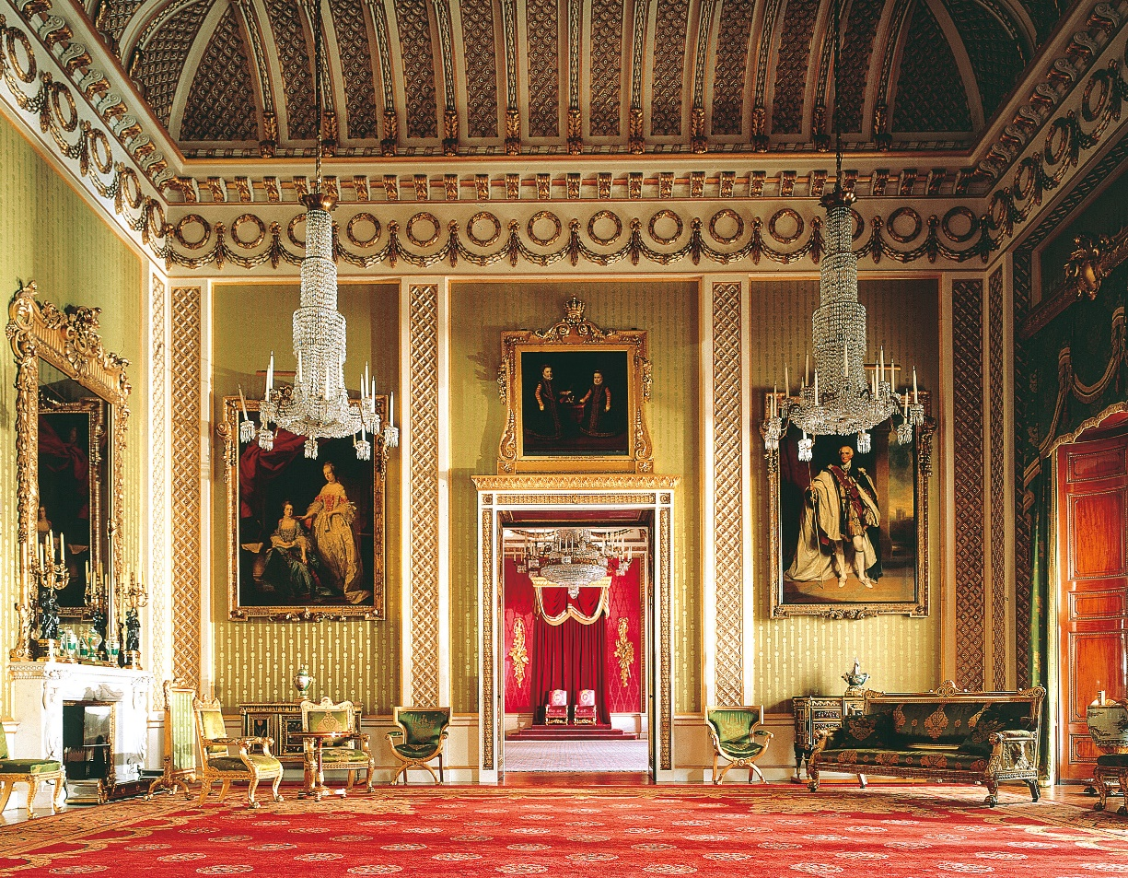
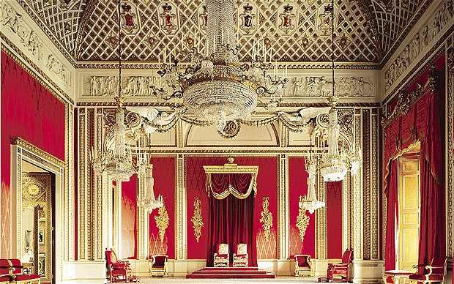
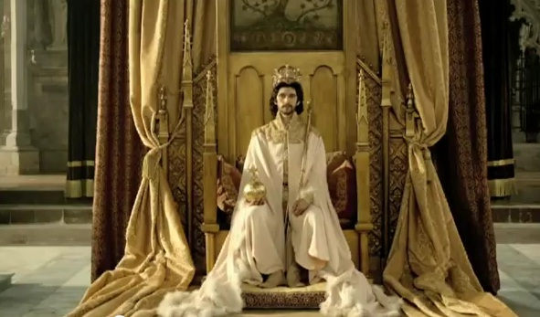
State rooms… what kind of setting is this? What do you think the purpose of rooms like this might be?

Slide 5
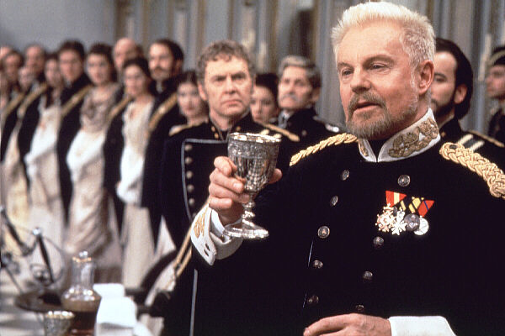
Act 1, lines 1-40, Claudius’ opening speech
Lines 1-16: death of the King/ marriage to Gertrude
Lines 17-25: Discusses young Fortinbras’ attack
Lines 26-39: Proposed response
What is your first impression of Claudius, as a man and as a King?
What do you think the style of the King’s speech reveals about state of his mind e.g. uneasy conscience, majesty, dignity, eloquence?
How does Claudius establish his identity and relationship with the court/ subjects here?

Slide 6
Act 1, lines 41-63 Claudius and Laertes
Notice, the public compliment to Polonius
What is the tone of Claudius’s speech? Notice the repetition.
What is the effect of having Laertes request and Claudius respond?
What do you think Hamlet might be doing at this point?
Notes:
12.4

Slide 7
Act 1, lines 63-117 Hamlet, Claudius and Gertrude
Note, Hamlet’s first words are a rejection of any kinship with Claudius.
Is Gertrude consoling or insensitive to the depth of Hamlet’ grief?
Is Hamlet angry here? Miserable? Resentful? Upset?
What reasons does Claudius give for suggesting Hamlet should stop grieving?
Do you agree with Claudius’ criticism of Hamlet’s grief?
In what ways do Hamlet and Claudius differ?

Slide 8
Act 1, lines 118-128
Note, Gertrude using the informal, loving pronoun ‘thou’, whereas Hamlet uses the more formal ‘you’.
Why does Gertrude seem to interrupt Claudius at the beginning of this section?
What do you notice about the interaction between these three characters?

Slide 9
Register – Professor Martin Joos
Frozen – fixed, prescribed, official language (e.g. Lord’s Prayer/ police arrest)
Formal – formal speech, specialised, often to address large groups, frequently in blank verse in drama (e.g. education, business, court)
Consultative – a mix of formal and casual, sometimes verse, sometimes prose (e.g. teaching, peer-to-peer)
Casual – chatty or casual language, used in close friendship groups, usually in prose (e.g. friends, close colleagues)
Intimate – between two people, lovers or twins, tight, close knit, can be in verse or prose, can be lyrical/poetic (e.g. Romeo and Juliet, coded text messages/pet names)

Slide 10
Hamlet – clever use of language
A little more than kin and less than kind.
I am too much in the ‘son’
‘Seems’, Madam – nay it is. I know not ‘seems’.
But I have that within which passes show

Slide 11
Critical interpretation – AO5
Ambiguous/ open to interpretation
‘The equivocal features in Claudius’ language suggest inner anxieties.’
(Stanley Wells)
Examples
Over-frequent reference the royal: ‘we’ ‘us’ ‘our’
Overly careful structuring of the speech; it’s insincere and over-rehearsed
Flattery of the court: ‘your better wisdom’
The contrasts used when he talks of his marriage to Gertrude (‘delight and dole’
2. Do you agree? How else could you interpret Claudius?

Slide 12
Critical interpretation – A05
Hamlet’s appearance and behaviour should strikingly contrast the rest of the court. His alienation and melancholy should be emphasised by the director.
Examples?
Do you agree? How else might you interpret Hamlet if you were directing the play?

Slide 13
Comparing language styles/ metre activity - prep
Complete the sheet with examples from the text and brief explanation.
Come up with some similarities and differences between the characters on the back of the sheet and/or anything else you notice.
Complete activity on metre
Work with each other if you are struggling.

