Slide 2
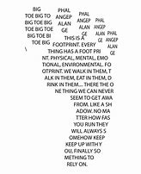
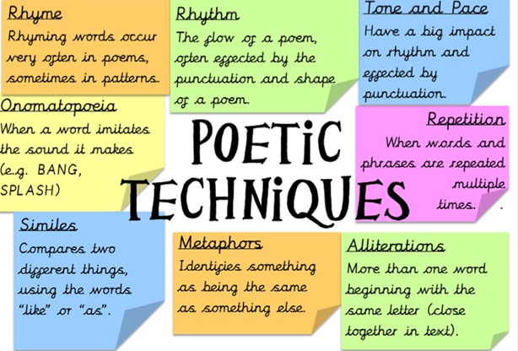
1)What is the poem about?
Explode the title
Look at the first line
Who or what is the subject of the poem?
Who is the speaker?
What is it exploring?
2)Explore the emotions, mood and feelings
3a) Zoom and explode powerful words
4. Identify the purpose, theme or message.
How does it impact you?
Unseen Poetry
3b) Explode literary techniques
3c) Can you say anything about structure?
Is there a shift in feeling?
Where are the pauses?
Is there a rhyme scheme?
Is the pace fast or slow?
How does the poem begin?
How does the poem end?

